Slide 1
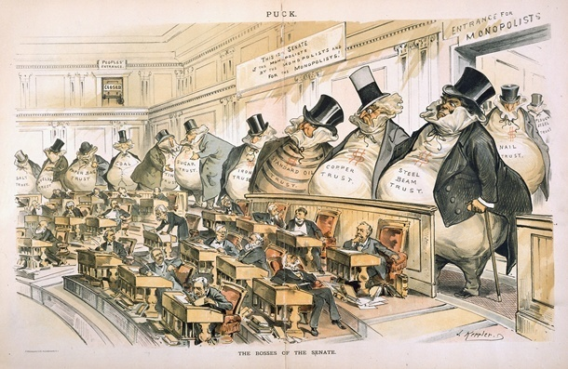
AP US History Unit VI: The Gilded Age
1865 to 1898

Slide 2
Unit Periodization & Major Questions
Periodization => Why 1865? Why 1898?
In 1865__________________________________________________
-- Fundamental shift in US economy & demography
In 1898 ______________________________inaugurates a new era in US Expansionism & Social Reform
Unit Essential Questions . . .
How did the 2nd Industrial revolution represent both changes and continuities from the patterns est. in the Market Revolution?
Were the industrialists of the late 1800’s better categorized as “Robber Barons” or “Captains of Industry”?
What effects did the transformation of the US into an urban, industrial nation have on the country socially, politically & economically?
How did workers, farmers, blacks and social reformers respond to the challenges of industrialization & the growth of corporate power?
How did the settlement of the West effect Natives, blacks and other minorities?

Slide 3
Unit Intro Activity – Cartoons & Pictures
Start w/ Textbook picture Activity (pgs 512-562)
-- What can you tell about this era?
-- Which picture(s) symbolize or capture the essence of the period “best”?
Era in US history is VERY Dynamic and features a lot of connections to modern day US => ** HOW?? **
-- Concentration of wealth => large Corporations & uber wealthy
-- Corruption in politics => scandals, lack of concern for lower classes
-- Anti-Immigration attitudes => anti-Chinese, Italian, etc…
-- Large number of changes happening rapidly => railroads, cars, telegraph, urbanization, etc…
-- “Entertainment Culture” => Vaudeville, ‘conspicuous consumption’
The consequences of this period were felt for decades and are still even felt today in attitudes concerning women, immigrants, governmental role in society, politics, rich, poor, etc….

Slide 4
The 2nd US Industrial Revolution
Post 1865 the US shifts from an agricultural nation to an Industrial Power (1865: US #4 industrial economy in world 1865; 1894: UD #1) => HOW????
#1: _____________=> 1865 US has 35,000 miles of track; by 1900 ~200,000!!
5 TC RR’s (i.e. Union Pacific, Northern Pacific, Southern Pacific) were laid w/ government subsidies of land, $$ (200 M acres via Pacific Railway Act)
Led to . . .
Growth and dominance of US steel industry (US Steel)
Massive need for other products (i.e. air brake, steel, oil)
Consolidation of firms due to mergers and bankruptcy
Shipment of other products nationwide, urbanization, immigration (RR companies offered bounties to immigrants for construction jobs)
#2: ________________________(440,000 _______issued from 1860 to 1890)
New Inventions facilitated products that made Industrial boom possible
A)___________________________– a fast/efficient way of making steel
B) Kodak Film and Cameras – George Eastman created the world’s first flexible roll film and revolutionary new cameras and video recorders
C) Alexander Graham Bell – invented _____________and perfected it’s use
D)___________________________– invented lightbulb, DC current, phonograph, stock ticker, and ~1000 others!!
E)_______________– invented modern oil drilling machinery in 1859 in PA

Slide 5
US Steel Production & General Industrial Production

Slide 6
The Second US Industrial Revolution (Cont)
F) George Westinghouse – created AC current (needed for long lines)
G) Others => Typewriter, cash register, Pullman Railway Car
#3: Abundance of semi-skilled and unskilled labor
New sources of Immigration => __________________(Italy), _____(Chinese)
_______________________migration => former slaves move to N factories
#4: Abundant capital via government development and loans
#5: Class of skilled & ruthless entrepreneurs & Industrialists
“Robber Barons” or “Captains of Industry” =>_________________________
#6: Abundant Natural Resources
American continent rich in resources needed for Industrialization (i.e. ______ ____________________________etc…) => leads to exploitation of West
American foreign policy also focused on acquiring additional resources & markets => i.e.____________________________ in China, Pacific islands
-- #1 export item = Standard Oil 5 gallon drum
#7: Favorable Government Policies =>_____________________________
US Government adopted a “hands off” policy => lack of enforcement of government acts (i.e. Sherman Antitrust Act)

Slide 7
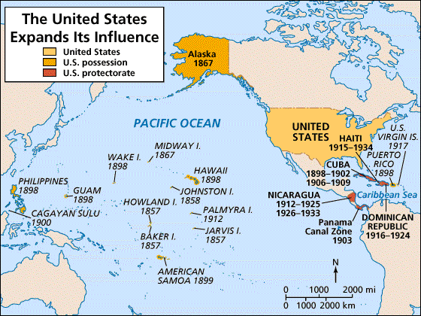
US Imperialist Actions (1890-1920)

Slide 8
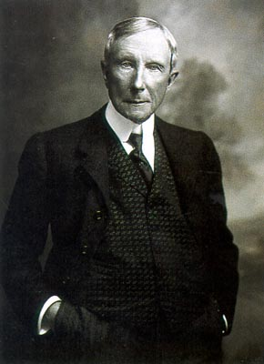
The “Robber Barons” or “Captains of Industry”
Who were they? => uber wealthy industrialists & entrepreneurs who owned the country’s largest corporations (trusts)
By 1900 10% of population controlled 90% of wealth (top 1% controlled 50%)
“Trusts” existed in many different Industries => Oil, Sugar, Tobacco, Meat, Copper, Steel, Coal, Banking etc…..
Economic framework is called Oligopoly => small number of large powerful companies control industries/economy
Famous Examples (People became the Symbol of the Era):
#1: __________________(Standard Oil) => pioneered “Trust” by combining stock of various rivals; controlled 95% oil market
Reputation as a ruthless businessman

Slide 9
Wealth Concentration in US History

Slide 10
The “Robber Barons” or “Captains of Industry”
#2: ________________(Banker & Financier; Northern Securities) => financed the reorganization of RR & other companies, bought out Carnegie for over $400 M in 1900 to dominate Steel
#3: ________________(US Steel) => poor immigrant who came to America & became one of richest men in US by “hard work”; steel industry
#4: _______________________________(RR companies) => financed and built Transcontinental RR and exacted brutal rates and terms from farmers and other shippers to monopolize commerce & trade

Slide 11
Source: George Rice, “How I Was Ruined by Rockefeller,” New York World, October 16, 1898.
“I am but one of many victims of Rockefeller’s colossal combination,” said Mr. [George] Rice, “and my story is not essentially different from the rest. . . . I established what was known as the Ohio Oil Works. . . . I found to my surprise at first, though I afterward understood it perfectly, that the Standard Oil Company was offering the same quality of oil at much lower prices than I could do—from one to three cents a gallon less than I could possibly sell it for.”
“I sought for the reason and found that the railroads were in league with the Standard Oil concern at every point, giving it discriminating rates and privileges of all kinds as against myself and all outside competitors.”

Slide 12
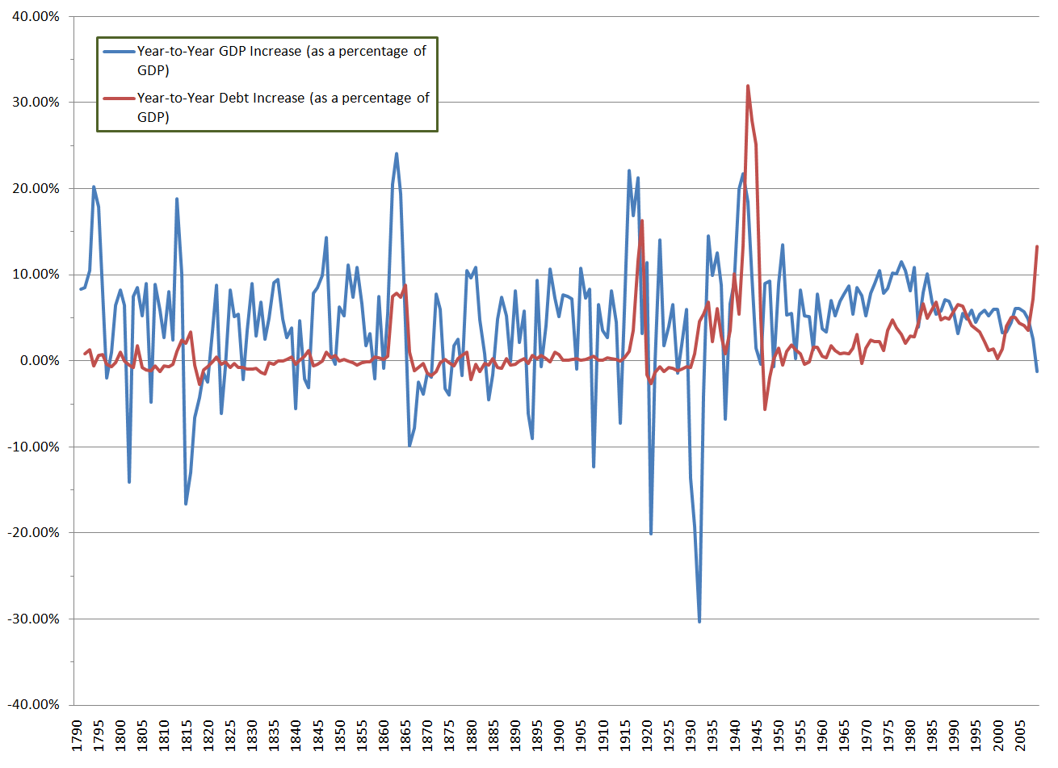
Economic Activity of the Late 19th Century
Despite the success of the uber-wealthy during the period economic prosperity overall was not quite as consistent
Period from 1865 to 1917 was characterized by periods of great prosperity followed by deep depressions

Slide 13
The Mind of the Robber Barons – RB Philosophy
Philosophies of the Robber Barons
#1: ____________Economics – “Let it Be” (Adam Smith, Wealth of Nations)
Govt. should _________________________b/c there are “natural laws” (i.e. gravity, etc…) which coordinate things for the best interest of all
Dominant idea of the US at the time was “competition is healthy” and “small Govt. is best” (Jefferson)
Industrialists made sure that the US government followed this maxim by donations to political campaigns and control of regulatory agencies
Ex: __________________________forbade “pooling” by RR companies and fair treatment of all by RR companies
-- Not enforced equally & ICC controlled by corps and wealthy
__________________________(1886)case also forbade states from regulating rates charged by RR (Interstate Commerce Clause)
=> Supreme Court decisions of the 1880’s & 90’s alone did away with over 500 laws that regulated corporations
Sherman Antitrust Act (1890) also was rarely enforced => only to be used to break up “unreasonable monopolies”

Slide 14
The Mind of the Robber Barons (Cont)
#2: ________________(H. Spencer) => based on Darwin’s Theory of Evolution
* “Millionaires are a product of natural selection” – William Sumner *
Argues that wealthy are simply harder working and men of superior intelligence and ability => reason for wealth
Charity for poor simply dilutes society and works against nature
Source of Wealth for US Millionaires (1900)

Slide 15
The Mind of the Robber Barons (Cont)
#3: “_______________________” or “Rags to Riches” – Andrew Carnegie
Argues that that “Godliness is in league w/ riches” (Carnegie) & said that a sign of God’s blessing was material wealth
Carnegie also said that the wealth of the “Robber Barons” was a ______ _____________________________________ => donated his entire fortune to Universities, libraries, est. Carnegie Institute
Reinforced Rev. Conwell’s “_______________” sermon which forwarded the idea that all people in the US could attain wealth is they tried
#4: Incorporation Laws => used 14th amendment and Constitution to thwart attempts to limit the power of corporations
Supreme Court case ____________________________est. precedent that corporations were “people” ($$ & rights protected from seizure)
From 1865 to 1900, 14th amendment was used 300 times to defend the rights of corporations; 19 for blacks

Slide 16
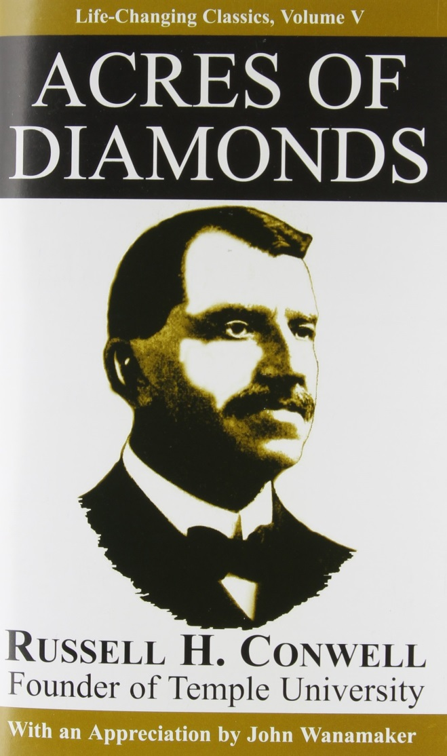
Rev. Conwell – Acres of Diamonds
“I say that you ought to get rich, and it is your duty to get rich . . . The men who get rich may be the most honest men you find in the community. Let me say here clearly . . . Ninety eight out of one hundred of the rich men of America are honest. That is why they are rich. That is why they are trusted with money by God. That is why they carry on great enterprises and find plenty of people to work with them. It is because they are honest men . . .
“ I sympathize with the poor, but the number of poor who are not to be sympathized with is very small. To sympathize with a man that God has punished for his sins is to do wrong, . . . let us remember there is not a poor person in the United States who was not made poor by his own shortcomings.” -- Rev Conwell
**Rev Conwell gave his Acres of Diamonds sermon over 5000 times **

Slide 17
Expansion of the Industrial Workforce
The new world of industry changed the American workplace like never before => transformation to a Hamiltonian industrial America complete
Americans concept of time was revolutionized => farmers lived by the clock of nature, now Americans were controlled by factory time
-- US adopted 4 “time zones” in order to better fit into RR schedules which spanned the nation
Industrial work schedule ___________________(_______a day, 6 days a week) and often necessitated women and children working
-- Women and children paid ½ of male wages
Real standard of living for average American increased during late 1800’s => new inventions led to textiles, better homes, better food
-- Wages for Am. workers higher than anywhere in world ($1/day) => jobs often very dangerous though (__________________________)
Wage work often meant insecurity for families => dependent on male laborer => sickness meant hunger, fear of unemployment

Slide 18
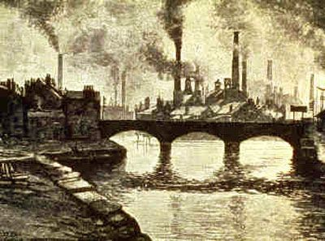
Expansion of Industrial Workforce
New industrial factories need workers => Q: Where do they get them?
#1: New Immigration => _________________(Italy), Eastern Europe (Polish Jews) & ___________(China) were new sources
From 1880 to 1920 over __________new immigrants entered the US
#2: ____________________________=> eager to escape Southern segregation many blacks migrated to northern factories
#3: ________=> children were desired in some industries due to their size & skills
#4: Women => lower and some middle class women were employed in factories but also in new types of jobs (i.e._____________________________)

Slide 19
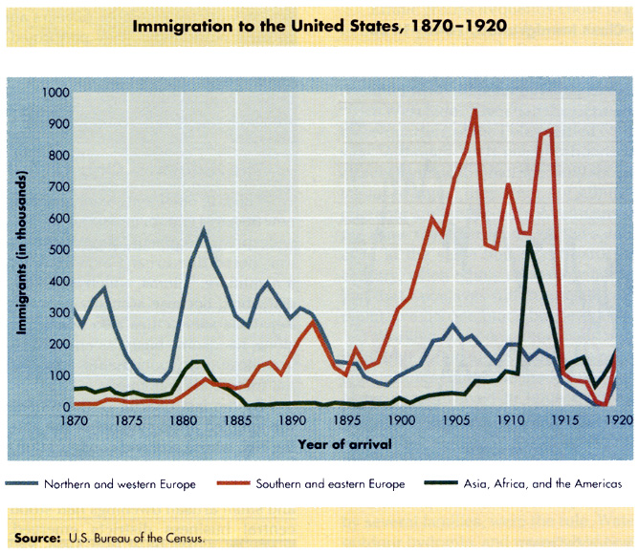
US Immigration during late 19th & Early 20th centuries

Slide 20
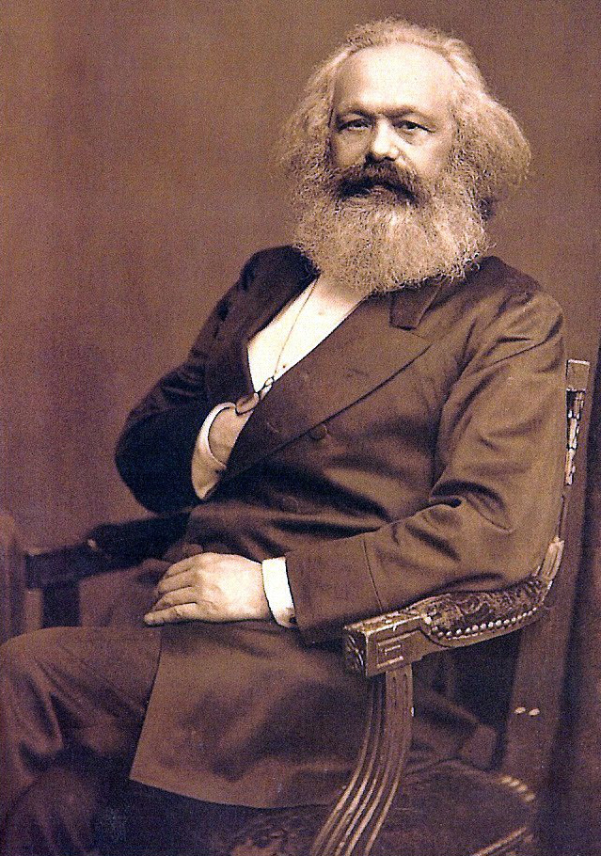
The Revolt of the Working Class (1880-1900)
The latter half of the nineteenth century was a very volatile time for working class
Class conflict was erupting all over Europe
As a result of the Industrial Revolution a poor working class (proletariat) developed and their struggle was blamed on capitalism itself =>
Socialism and Communism gained popularity => promised more equal distribution of wealth
In the ___________________Marx predicted that a Capitalist economy, even a democracy, would look after the interests of the wealthy at the expense of the poor
US socialists like _________________wrote Looking Backward which described a socialist future for US (sold 1M copies)
** Had the United States up until 1890 followed this pattern of behavior??? **

Slide 21
Rise of US Labor Movement
By 1890 the situation for many working class citizens was bleak . . .
Much industrial work had been “de-skilled” => men = machines
-- Immigration glutted labor market and depressed wages
Company directors and owners isolated from workers => mis-treatment more acceptable (Corporations answer to shareholders)
Many workers lived in “__________________” (mining and steel industry) => homes owned by company which had “stores” where workers purchased food, clothes, etc…. (excessive prices common)
Response of workers? => formation of new industrial Unions
Union =_______________________________________________ ______________________________________________________
-- Strategies??? => ______________________________
Workers believed if companies could form collective groups (i.e. trusts, pools, etc…) they could form collective groups of laborers
-- Idea = increase power of workers to bargain with large corporation

Slide 22
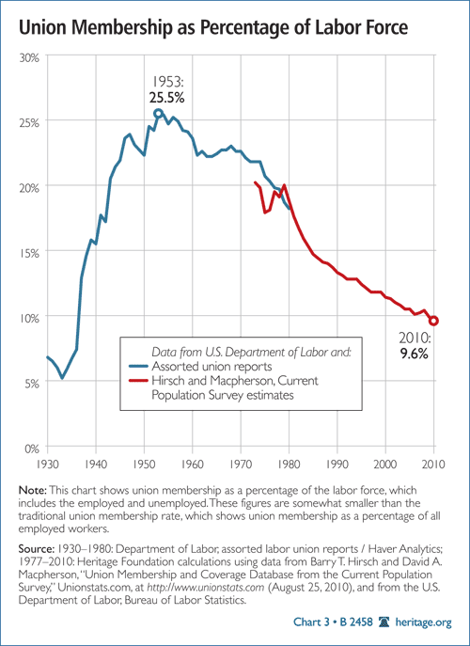
Union Membership & US Labor Force

Slide 23
Rise of US Labor Movement
#1: National Labor Union (1866) => formed after the Civil War
Membership = 600,000 w/ members in farming, skilled, unskilled (excluded Chinese and blacks, who formed their own Unions)
Major contributions = Great Railway Strike of 1877 (after RR companies cut pay 10%); Failed due to ethnic divisions among strikers
Depression in 1873 caused a decline in power & never recovered
#2: _________________________________(1869)
Membership ~ 750,000 in skilled & unskilled work
Fought for 8 hr. workday and end to child labor
Most radical of all Unions => desired socialist reform of US
____________________________=> series of strikes at the McCormick Reaper plant
Turned violent as pipe bombs were thrown at police (7 killed)
Knights became associated with anarchists and violence
#3: _______________________________________(AFL)
Led by _____________________=> cigar maker who shunned socialism
AFL was a federation of different trade unions => AFL was a skilled worker union only (rejected unskilled workers, Catholics)
Focused on “____________” issues => better pay, 8 hour workday, etc….

Slide 24
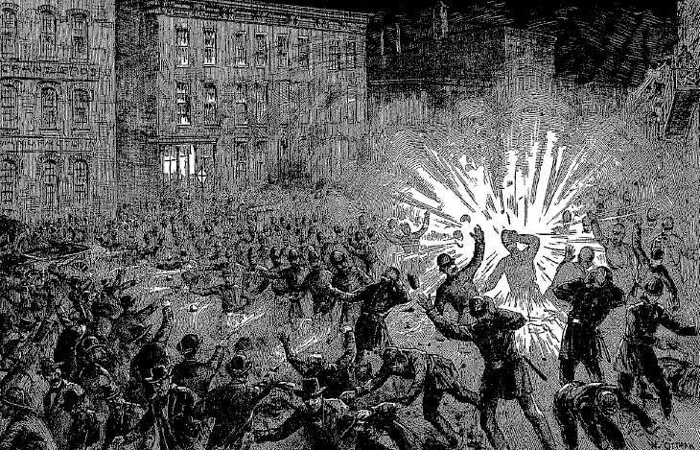
Chicago Haymarket Affair -- 1886
In 1886 in retaliation for the killing of three protestors by police some supposed anarchists threw molotov cocktails that killed 7 policemen

Slide 25
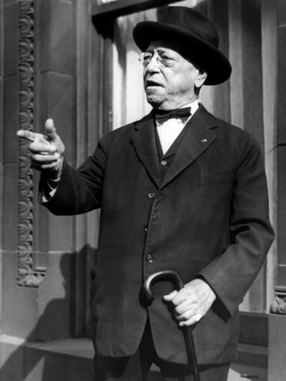
Response of Corporate America
1881-1900 saw 23,000 strikes w/ over 660,000 workers
“Loss” of $450 M for employers (50% win ratio for Unions)
Middle Class grows weary of constant striking => erodes support
American corporations responded to Unions with a variety of tactics
#1: Destruction of Unions => Yellow Dog contracts, “scabs”, lockouts, and __________
#2: US Government Support => Federal courts sided with employers over Unions
-- Ex: ____________________=> federal troops break strike to deliver mail
Overall Union movement brought attention to WC issues but did not achieve goals
No 8 hour workday, no right to unionize, no end to child labor
Labor Day begun in 1894
Samuel Gompers – Prez of AFL from 1884 to 1925

Slide 26
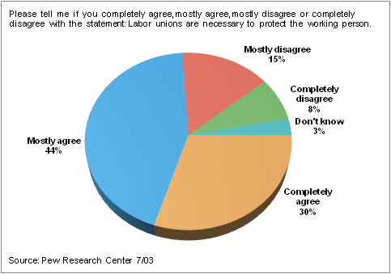
Union Journal
Q: Are Labor Unions good for the country? Were they necessary in 1900? Are they necessary today?

Slide 27
The “New South” in the late 1800’s
After the Civil War, the Southern economy was in ruins and the “old South” could not continue => Q: What was the Old South????
Socially? Politically? Economically?
William Grady (Atlanta Constitution) & others championed a “New Southern” vision of industrialization, urbanization & white supremacy
Grady believed that the South should diversify farming and through Northern investment, become like the North in its industrial focus
South did have some industrial successes . . .
#1: __________________=> cigarette industry provided an opportunity for S. agriculture to diversify (new strand of tobacco => cigarettes)
-- Am. Tobacco Co was founded by cigarette czar James Duke => consolidated tobacco industry (Duke University)
#2: _____________________=> 1880 and beyond northern capital investments erected southern cotton textile factories (Piedmont region)
-- Used Southern cotton & paid southerners lower wages than northerners (non-union) => ½ of northern wages
-- Dominated by women and children

Slide 28
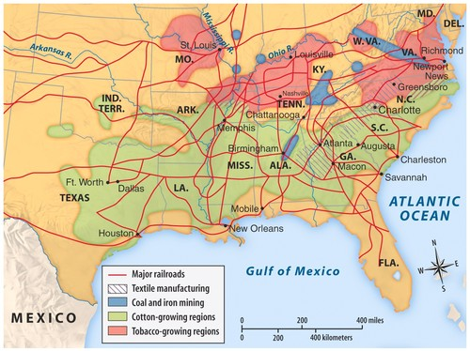
Southern Industry in Late 1800’s

Slide 29
The “New South” in the late 1800’s
#3: ________________________=> Birmingham AL challenged Pittsburgh as a steel making city & coal mining developed in South
#4: ______________________doubled in South from 1880-1890 => connected rural areas of south and led to economic trade
#5: _________________________________developed on interior and became centers of trade and industry => i.e. Atlanta (Coca-Cola industry)
However, the real South was more like the Old South than a New South
South remained a rural society dominated by sharecropping agriculture
-- Southern share of manufacturing dropped from 1865-1900
-- “Made in South” became synonymous w/ cheap goods
Southern wages were so low that it impeded economic dev., tax funded programs, education and immigration (wages too low)
Southern society was also segregated socially along racial lines
-- ______________________(1896) decision institutionalized segregation
Southern political system dominated by Democrats => _____________ voted Democratic in EVERY election from 1880 to 1950
-- Blacks disenfranchised by poll taxes, literacy tests & lynching

Slide 30
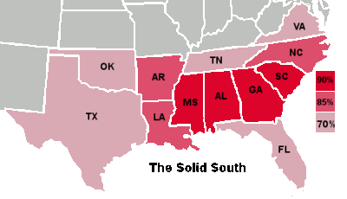
The Solid South – 1880 to 1950
Between 1880 and 1950 the Southern states highlighted cast nearly every electoral vote for President for the Democratic candidate

Slide 31
The Transformation of Agriculture
After the Civil War new technology, government policy & economic conditions revolutionized American agriculture from 1865 to 1900
Three main western industries => farming, mining and ranching
Farming & Ranching
During the Civil War the US Govt passed the _____________=> Western migrants get 160 acres if they settle on land (5 years) & improve it
Sod houses favored due to lack of trees, but much land was claimed by corporations => “fake homesteaders”, 12x14 inch houses
Combined w/ TC Railroad encouraged by __________________this led to rapid expansion of farming and ranching in the West
Many discovered Homestead Act was a mirage => 160 acres too little & Western conditions (drought, pestilence => _________) too tough
-- West of 100 mediran little rain fell => led to sod farming & irrigation projects (2/3 Homesteaders failed)
Farmers and ranchers could now easily ship products to eastern markets (meat shipped in _________________________to Chicago stockyards)
Led to rise of Cowboys and “Wild West” => cattle trails from Texas to TC RR’s led to yearly drives (Cowboys = whites, blacks & Mexicans)

Slide 32
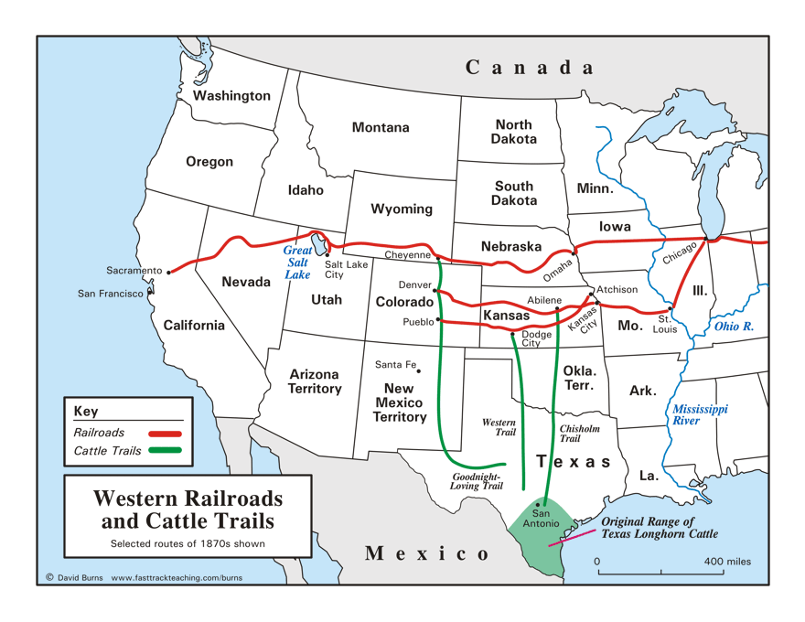
Cattle Rails of late 1800’s

Slide 33
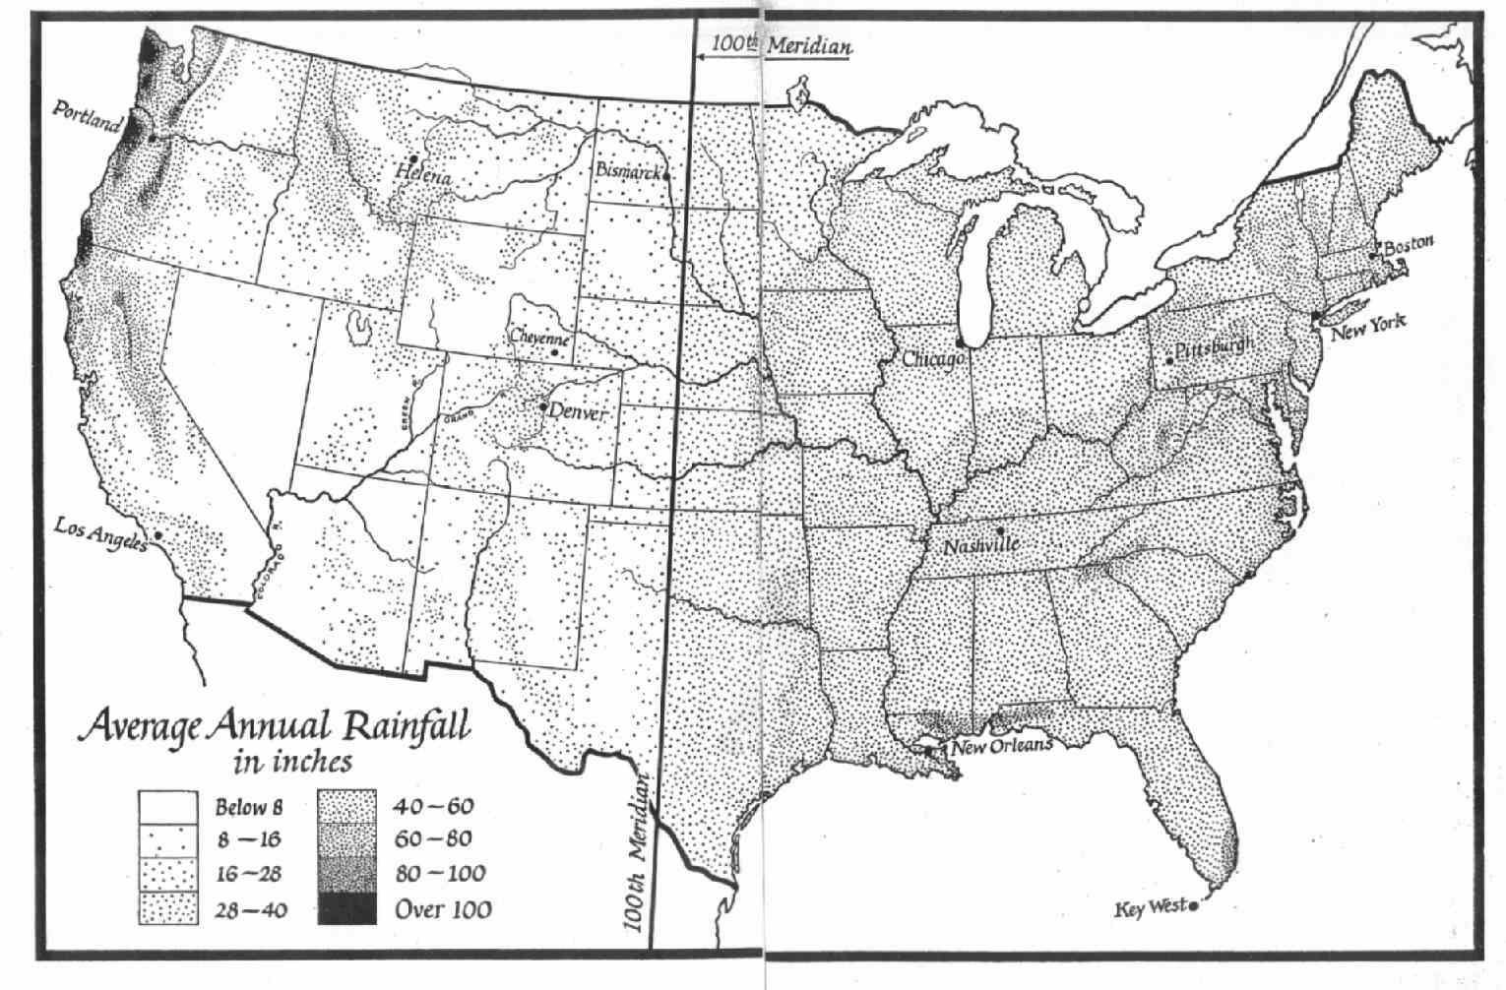
Average Rainfall in US

Slide 34
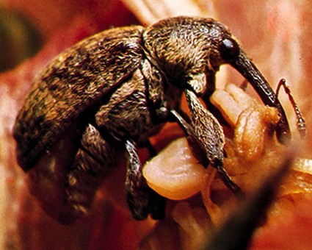
Bollweivels

Slide 35
The Transformation of Agriculture
RR took advantage of farmers as they became dependent on RR to ship products to Eastern markets (changed rates, pooled, etc…)
-- Complaining farmers were “dealt” with by RR companies => late train cars, grain left out in rain
Increasing use of technology also revolutionized farming & ranching
___________________ (reaper & thresher) pulled by 20-40 horses & steam engines pulling plows and seeders sped up pace of agriculture
Led to specialization of agriculture to one crop => wheat or corn
-- Prices dependent on foreign production => fluctuated wildly from year to year depending on harvests
-- Many farmers went bankrupt and sold farms in times of drought or low prices (overproduction) => ____________________by 1880
Also led to an increase in the size of farms => more land needed to pay for equipment ( also led farmers to go into massive debt)
-- _______________=> corporate farms (15,000 acres +) in ND/MN
Ranches were also consolidated by invention of __________=> led to massive fencing of land (no more free pastures)
-- Led to growth of large stockhouses & decline of small rancher

Slide 36
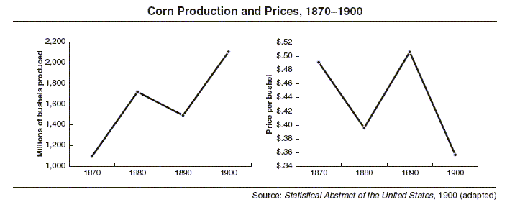
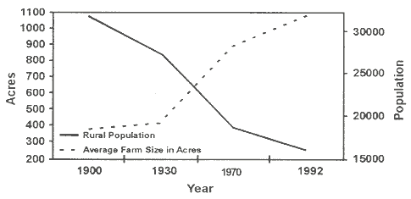
The Price of Corn in late 1800’s

Slide 37
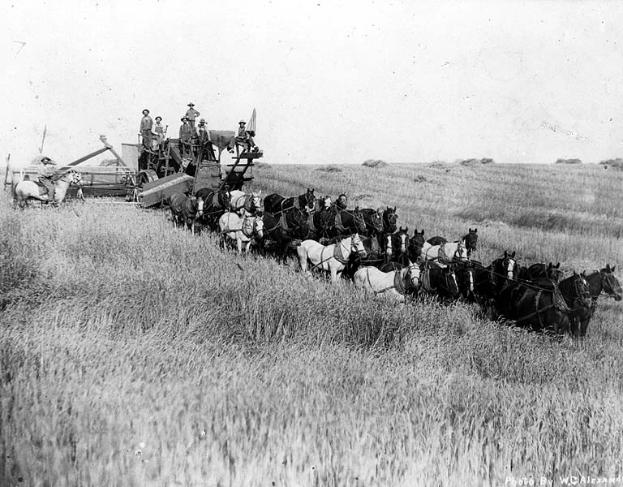
Late 1800’s Combine
Late 1800’s combines were pulled by 20-40 horses & simultaneously reaped and bagged the grain

Slide 38
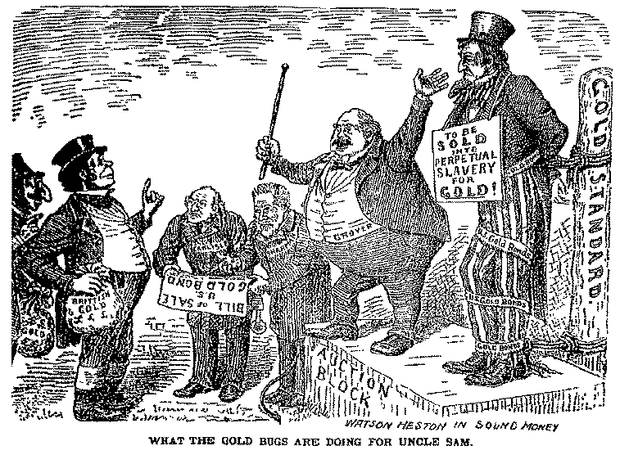
The Transformation of Agriculture
US monetary policy also led to deflation => hurt American farmer
Gold standard made printing $$ more difficult => rising population and expanding economy requires more $$ (actual $$ contracted)
Republicans also favored “hard $$ policies” (Goldbugs) Q: WHY??
-- Stopped printing of silver $$ in 1873, Greenbacks withdrawn from circulation after CW (Resumption Act of 1875)

Slide 39
Response of the American Farmer
By 1880s and 90’s many American farmers were suffering => droughts, overproduction and high tariffs all led to starvation and economic ruin
Farmers responded by a mixture of collectivism & political agitation
Collectivism
Ranchers in the West organized the __________________________=> standardized practices, prevented theft and wielded political power
Farmers in the West & South started___________________________
Provided farmers with social opportunities (picnics, etc…)
Organized farmers who collectively sold grain => increased power and began to organize politically
Advocated for passage of laws at state and national level
-- Illinois passed state law limiting freight rates (upheld by SCOTUS)
-- US government passed _______________________=> set up the ICC to investigate pooling & fraud; regulated interstate commerce
Collectivism was crippled by racial divisions & lack of organization => separate________________________________

Slide 40
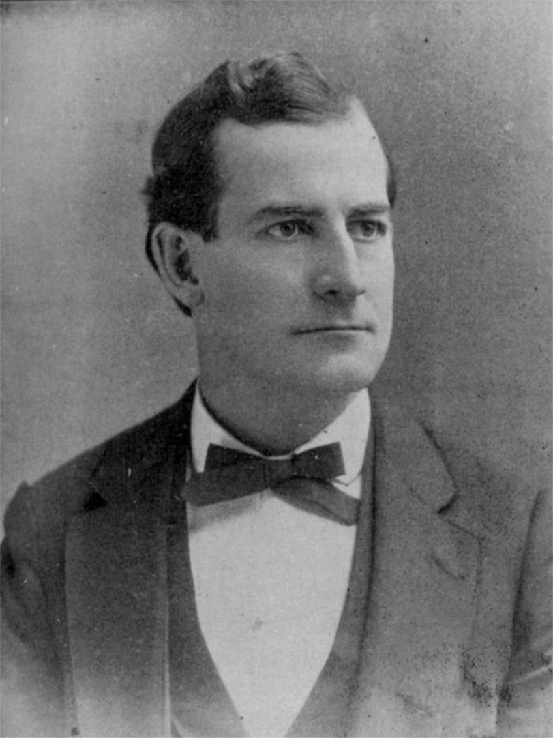
Response of the American Farmer
Populism
By the 1890’s farmers were increasingly upset by the lack of political attention to their needs by either political party (still 50% of US farmers)
Formed their own _____________=> party which was designed to support interests of “common man” (became a farmer’s party)
Platform in 1892 was made up of progressive demands => coinage of silver at 16:1; graduated income tax; govt ownership of telephone, telegraphs and railroads; direct election of US Senators; term limit of President; use of initiative and referendum to stop government abuses
Leader =________________________
William Jennings Bryan

Slide 41
The “popularity” of Populism in the West
From 1892 to 1896 Populists racked up victories in the West and alarmed many Northern Goldbugs

Slide 42
Election of 1896 – Zenith of Populism
From 1892 to 1896 Populism racked up electoral victories in the West and acquired a charismatic leader – William Jennings Bryan
Populists elected governors, state legislatures and congressmen => eastern bankers, industrialist started to fear power of Populists
Republicans continued to take measures to anger the farmers and Populists => passage of McKinley Tariff of 1890 (~ 50%)
Nomination of William McKinley on a Gold standard platform => financied by Marc Hanna => wealthy industrialist
Republicans supported a “trickle down” economics approach
Republicans supported by urban workers, wealthy, industrialists
Democratic Convention in Chicago was overtaken by William Jennings Bryan’s ______________________=> Populism co-opted by Democrats
Main issue = free coinage of silver at 16:1 (50% inflation) => became almost a religious crusade as Bryan gave 100’s of speeches
Democrats were supported by rural America, farmers and debtors
Election became a clash for the future of America at the end of the 19th century => Urban or Rural? Farmer or Industry? Gold or Silver?
Example of Class conflict => Rich vs Poor

Slide 43
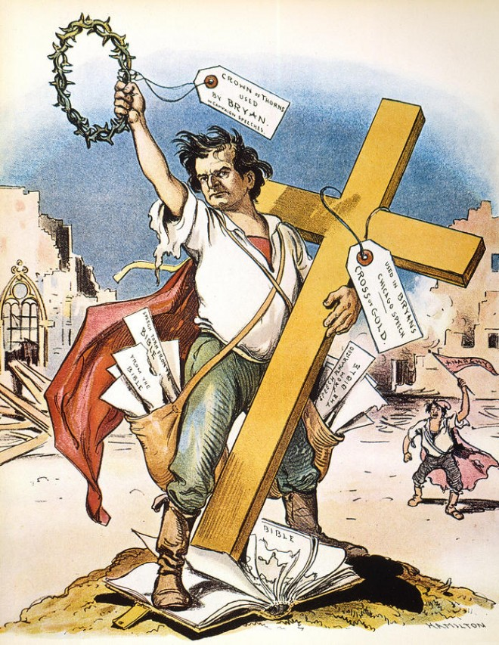
William Jennings Bryan – Cross of Gold Speech
“You come to us and tell us that the great cities are in favor of the gold standard. I tell you that the great cities rest upon these broad and fertile prairies. Burn down your cities and leave our farms, and your cities will spirng up again as if by magic. But destroy our farms and the grass will grow in the streets of every city in the country.
If they dare to come out in the open field and defend the gold standard as a good thing, we shall fight them to the uttermost, having behind us the producing masses of the nation and the world. We shall answer their demands for a gold standard by saying to them, you shall not press down upon the brow of labor this crown of thorns. You shall not crucify mankind upon a Cross of Gold.”
-- William Jennings Bryan, 1896

Slide 44
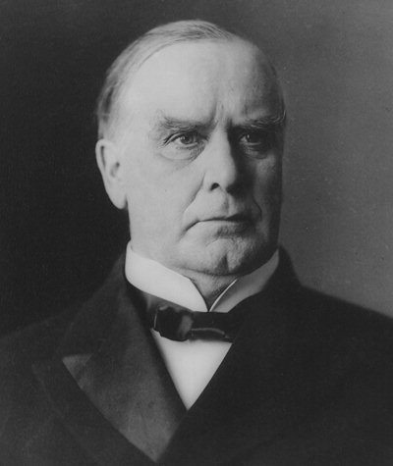
Results of Election of 1896
McKinley crushed Bryan in the campaign
Much better financed than Bryan
Blacks refuse to support Democrats in North due to legacy of CW
Northern factory workers interest don’t align with farmers (i.e. inflation)
Marked the start of a new political era in US
Party system had weakened, voter participation down & issues changed
Republicans dominated Presidency for next 36 years (won all but 8 years)
Loss weakened Farmer’s movement which petered out => co-opted by Progressives
Achieved many of their goals
US went to Gold Standard in 1900 but inflation did occur => Yukon Gold Rush & new chemical processes increased gold & $$

Slide 45
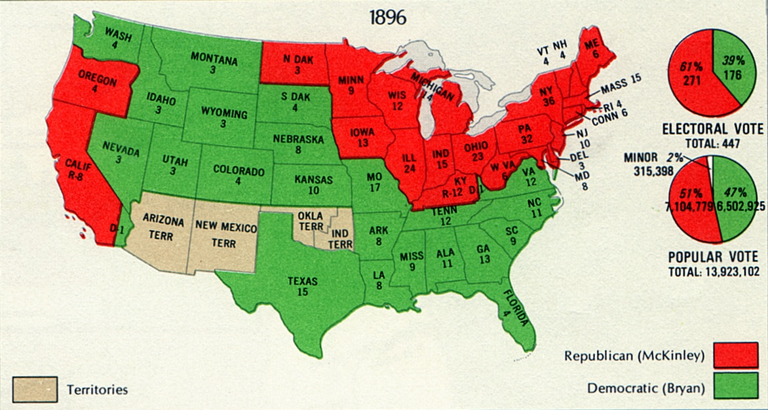
Election of 1896

Slide 46
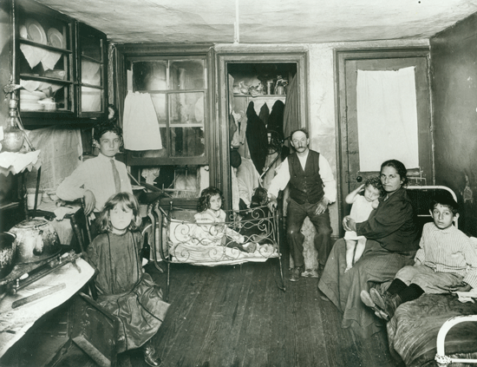
I Room Apartment in Tenement Flat -- 1901

Slide 47
American Urban Revolution of late 1800’s
By 1900 almost 40% of Americans lived in cities => number of city dwellers in 1900 had tripled from only 1870 census
Growth of American metropolises spectacular => in 1860 no Am city had more than 1M; by 1890 NYC, Philadelphia & Chicago did
-- NYC w/ 3.5M by 1900 was 2nd largest city in world
Cities during period grew up & out => electric trolley cars, suspension bridges (Brooklyn Bridge) & skyscrapers (Louis Sullivan) changed city life
Larger metropolises became divided by social class & ethnicity => ethnic neighborhoods (i.e. Little Italy, Chinatown, Harlem) flourished
New amenities and inventions also attracted many to cities => indoor plumbing, electricity and telephones were all major attractions
-- New job opportunities were also abundant
New cities also had many problems
New disposable items (bottles, bags, cans) created huge trash issues
Overwhelmed city infastructure led to rise in crime & prostitution
Overcrowding led to poorly ventilated __________________
Many middle & upper class residents fled to suburbs

Slide 48
America’s Urban Population (1790 to 1990)

Slide 49
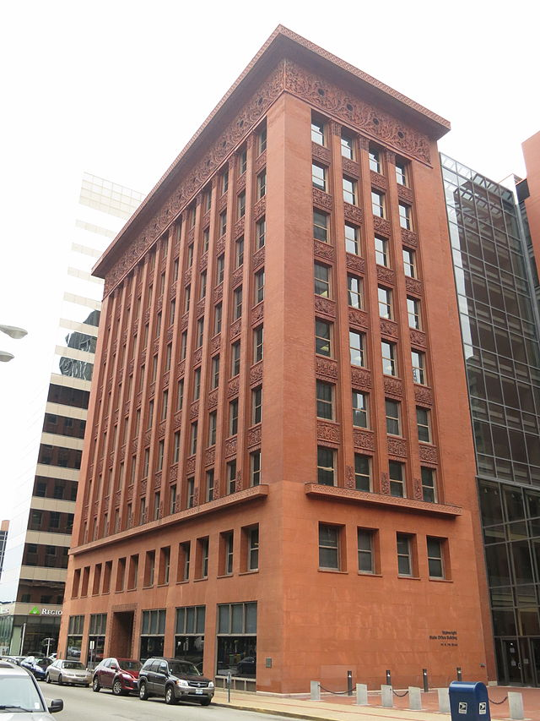
Chicago’s Wainwright building – 1890
Louis Sullivan’s 10 story Wainwright building in St Louis was called the world’s 1st “skyscraper”

Slide 50
America’s New Immigration
In the late 1800’s conditions in Europe promoted an unparalleled rise in immigration to the US
Reasons? => Overcrowding & “Am. fever” (i.e. land of opportunity)
Statue of Liberty given to US (1886)=>“Give me your huddled masses”
Prior to 1880’s most immigrants had come from N. Europe (Q: Where?)
New Immigrants came increasingly from ________________________(i.e. Italy, Slovakia, Greece, Poland, Jews, China)
Problems??? => Language, religion, lack of education & democracy
Expectations = _______________________(Melting Pot ideology)
-- New immigrants strived to preserve heritage (i.e. parochial school, Yiddish theater, Greek restaurants) but children shunned native cultures
Reaction to New Immigration => renewed Nativism
Many Americans feared the new foreigners => culturally “inferior” and not “Anglo Saxon”; believed them to be the rejects of their nations
-- Organized labor also decried willingness to work for low wages

Slide 51
US Immigration during late 19th & Early 20th centuries

Slide 52
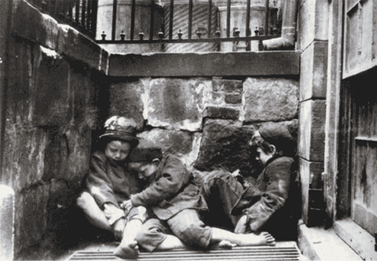
Jacob Riis – How the Other Half Lives
Newsboys in NYC

Slide 53
Reaction to New Immigration
New orgs. begun in cities to try & depress power of immigrants => ____ (Am Protective Association) lobbied against Catholic candidates
New restrictive laws were passed for 1st time in 1880’s
-- _____________________(1882) => banned Chinese immigration
-- __________________________prohibited immigrants who were paupers, criminals or convicts
New Reform movements tried to address the problems of cities & poor
Walter Rasuchenbasuch => pioneered____________________; church should be an agent of social reform
-- Hell’s Kitchen => soup kitchen which provided gospel lessons
_______________=> opened by ___________(1st settlement house)
-- Offered instruction in English, childcare & activities
-- Florence Kelley also began
_____________begun in 1879 to offer financial assistance to poor => YMCA/YWCA also exploded in popularity in crowded Am cities

Slide 54
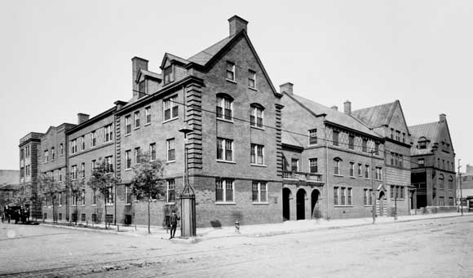
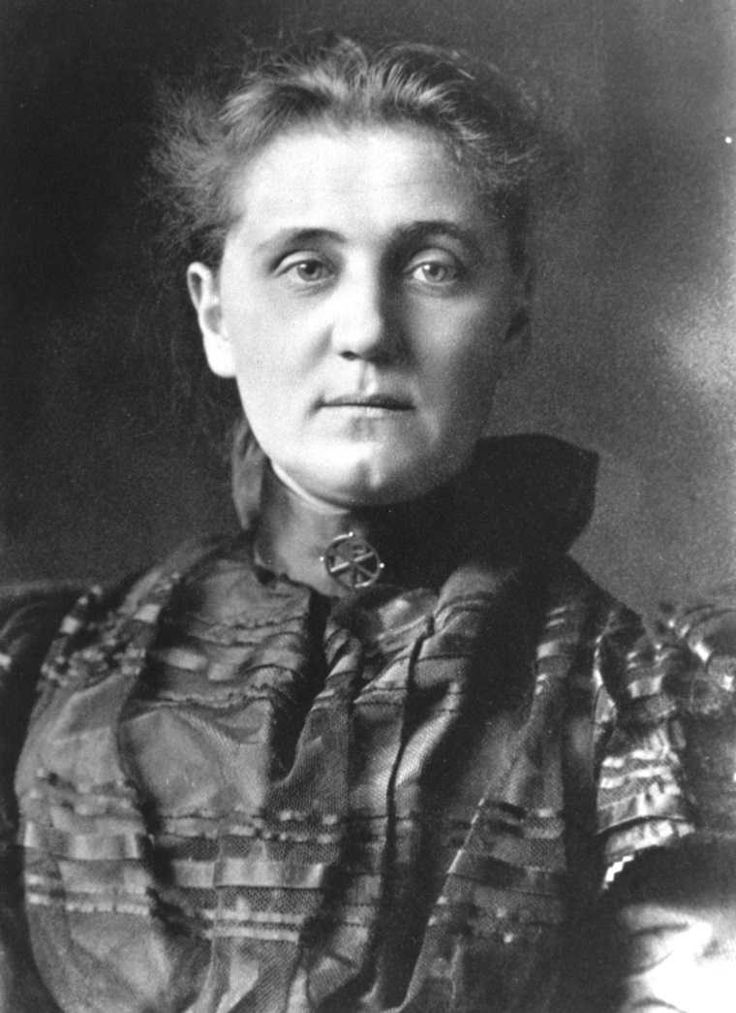
Jane Addams – Hull House
Hull House was one the first prominent settlement houses in American cities => it once covered a city block on Chicago’s South side and provided services for the city’s poor
Addams was a wealthy women who pioneered the US social services and social work movement of the late 1800’s

Slide 55
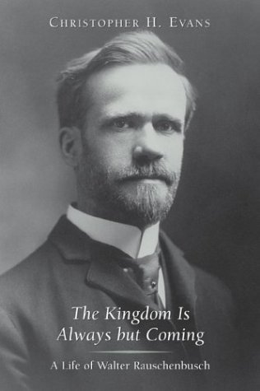
Walter Rauschenbausch – Hell’s Kitchen

Slide 56
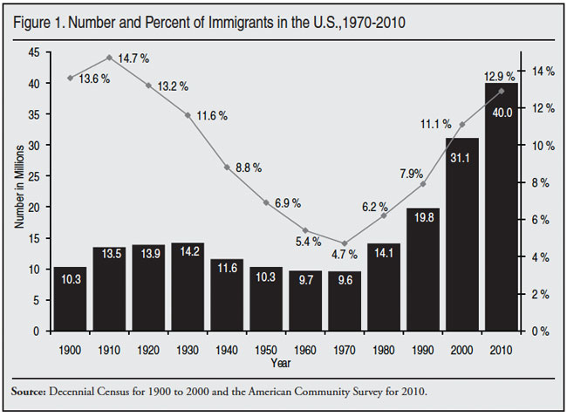
Foreign Born Immigrant Population

Slide 57
The Urban Revolution & Rise of Urban Middle Class
The new urban economy and shift to factory production created a new urban middle class increasingly focused on consumption
Stores like __________________________________promoted consumption in cities & mail order catalogs did the same in rural America
New urban middle class had high level of disposable income => spend $$ on clothing, luxuries and entertainment (Vaudeville, circus & baseball)
Industrial Revolution also significantly impacted the role of women
Ideal of Age = ___________________(assertive, independent and athletic)
-- Feminist author _________________________encouraged women to become more independent and contribute positively to public culture
Urban environment provided single women with job opportunities => _____ ___________________________________________________________
-- Job opportunities dependent upon race and class & marriage => lower class women worked in garment industry
Upper class urban lifestyle and increased job opportunities led to increased power for women in marriage =>__________________________
-- Women married later due to careers and had less children; also divorce rate increased with greater economic opportunities for women
Reformer Anthony Comstock tried to instill greater morality into urban society by passage of ____________________________(1873)
-- Forbid publishing of “indecent materials and practice of birth control

Slide 58
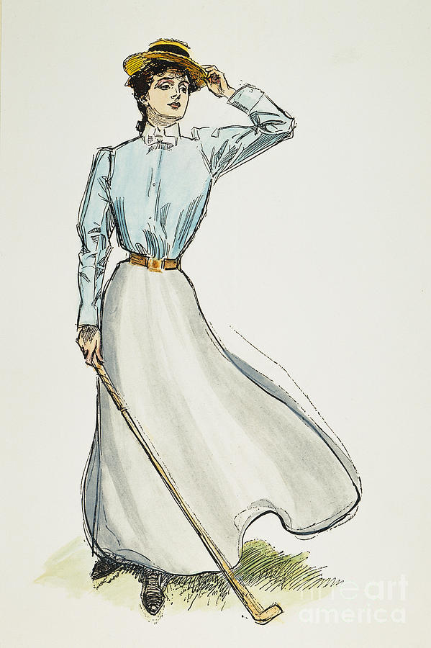
Gibson Girl
Illustrator Dana Gibson popularized the image of the Gibson girl in the late 1800’s => Q: How does this image of American womenhood differ from the Cult of Domesticity in the early 1800’s?

Slide 59
Marriages and Divorces in US History
Year | Marriages | Divorces | Ratio of Divorces to Marriages
1890 | 570,000 | 33,461 | 1:17
1900 | 709,000 | 55,751 | 1:12
1910 | 948,166 | 83,045 | 1:11
1920 | 1,274,476 | 170,505 | 1:7
1930 | 1,126,856 | 195,961 | 1:5
1940 | 1,595,879 | 264,000 | 1:6
1950 | 1,667,231 | 385,144 | 1:4.3
1960 | 1,523,381 | 393,000 | 1:3.8
1970 | 2,159,000 | 708,000 | 1:3
1980 | 2,390,000 | 1,189,000 | 1:2
1990 | 2,443,000 | 1,182,000 | 1:2

Slide 60
Women During Industrial Revolution
Many urban middle class women were involved in reform movements of various kinds
Settlement Houses (Jane Addams & Florence Kelley) => provided social services for poor immigrant populations
1890 ____________________________________(NWSA) was founded by Susan B. Anthony & Elizabeth Cady Stanton
-- Advocated for women’s right to vote => received right in western states first (Wyoming 1869); then nationally by 1919
-- Carrie Chapman & others advocated for vote by arguing it was an extension of women’s role as social agent in society
The ___________________________(WCTU) formed in 1874 to advocate for prohibition of alcohol (1/2 of country dry by 1900)
-- Alcohol use increased after CW, especially in Urban areas
-- WCTU was very militant => led by_________________

Slide 61
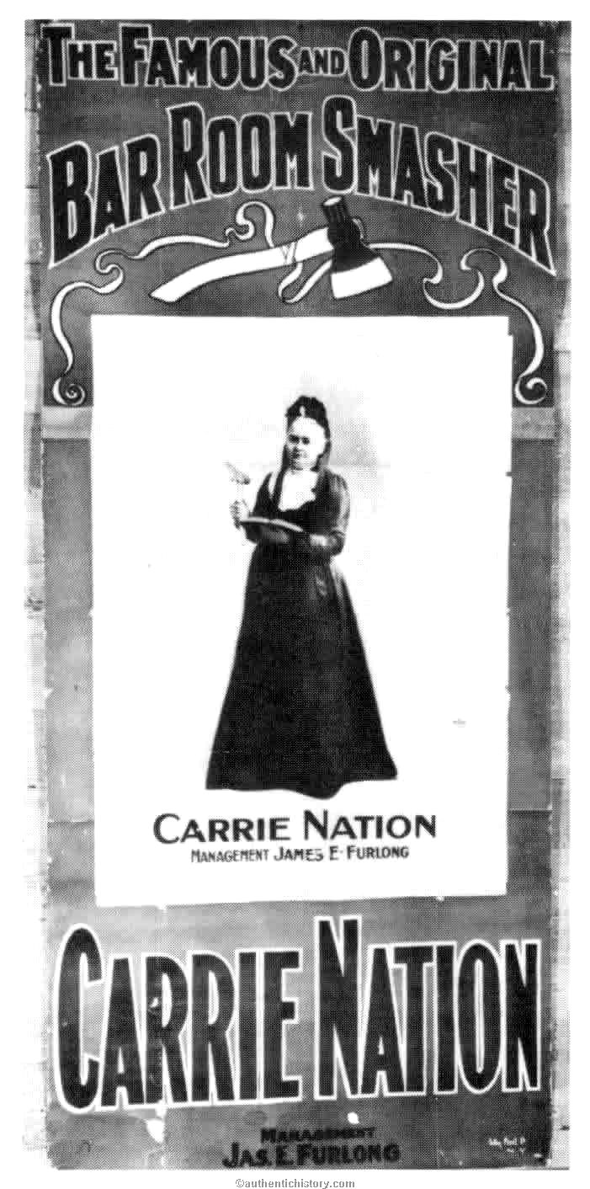
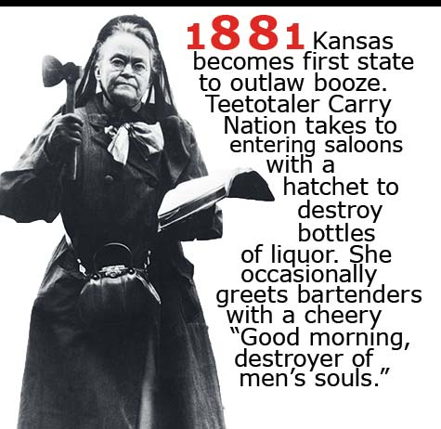
Carrie Nation & WCTU

Slide 62
Politics During the Gilded Age
Politics during the Gilded Age reached new low points & was dominated by Corruption & machines, strong party organizations & weak Presidents
Corruption & Political Machines (local control of politics)
During the late 1800’s the Spoils system pioneered by Jackson reached its heyday in the development of powerful Political Machines
Political Machine =______________________________________ _____________________________________________________
-- Exs: __________________________________________=> stole over $200 M from city during the 1870’s and 80’s
-- Examples of Machine abuses => $138,000 to a plasterer for 2 dayslabor, $500,000 toilets in city hall, etc…
-- Machines often pandered to immigrants to gain election => provided services and jobs in exchange for votes (___________)
-- Machines also used fraud => “________________________”
-- Machines used power to force silence (i.e. tax assessments)
Eventually Boss Tweed was arrested and put into jail based on cartoons of Thomas Nast

Slide 63
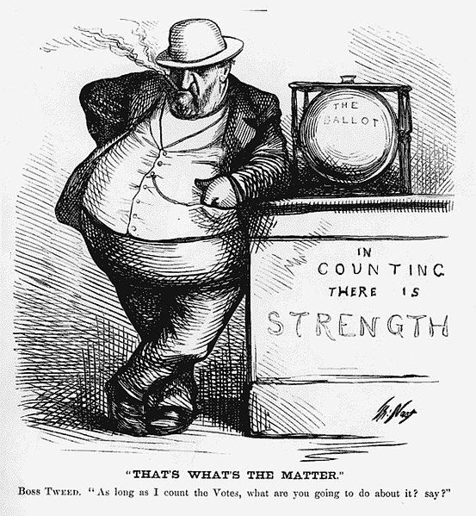
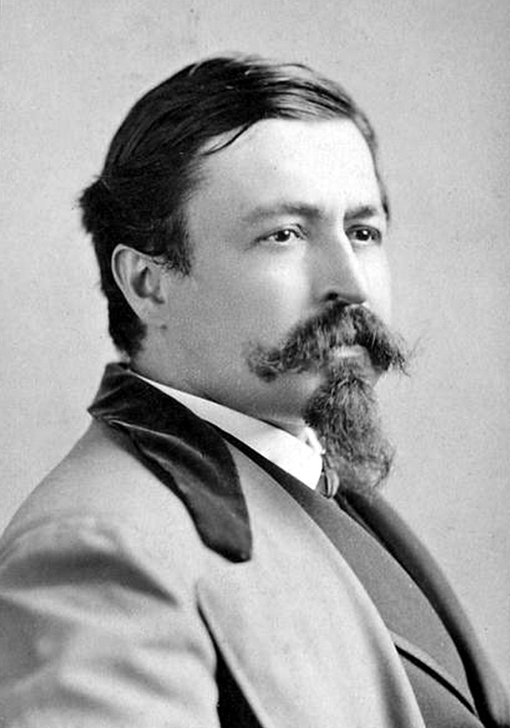
Boss Tweed and Thomas Nast

Slide 64
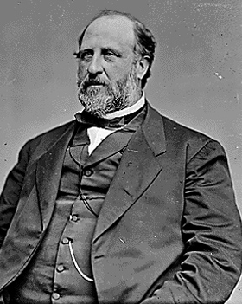
Examples of Tammany Hall abuses
$138,000 to a plasterer for 2 days labor
$500,000 toilets in city hall
Eventually due to cartoons of Thomas Nast and investigations of NY Times, Boss Tweed was charged with numerous counts of corruption, bribery, extortion, etc….
He fled to Spain, but due to Nast’s cartoons was arrested and extradited back to the US and placed in prison in 1872
-- Later died in prison

Slide 65
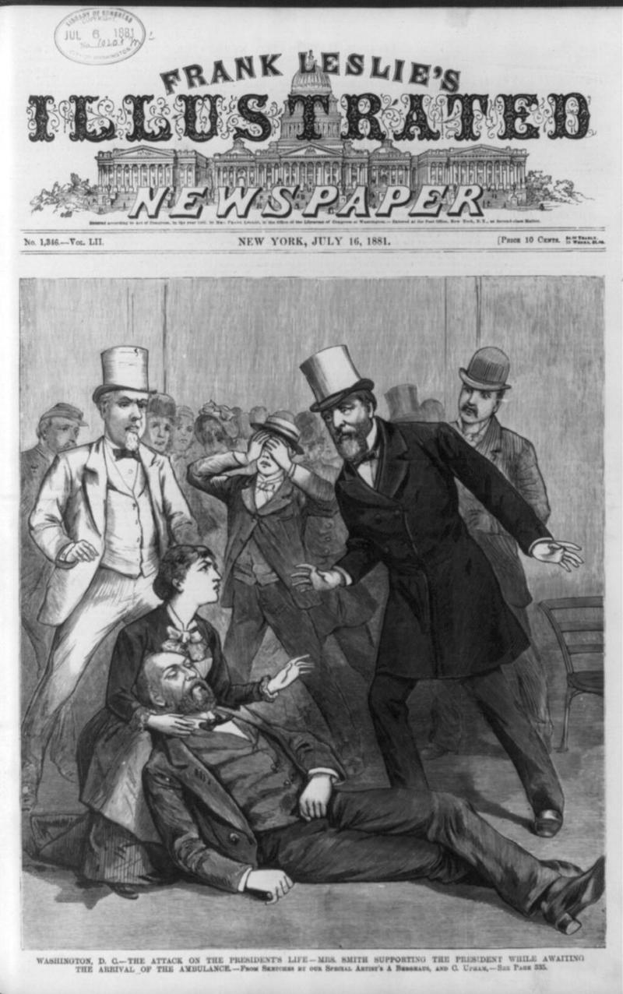
Political Patronage & Assassination of James Garfield
The issue of political patronage came to a head in 1880 when Garfield was shot by assassin Charles Guiteau
Democrats were divided internally between Stalwarts (Roscoe Conkling) & Half Breeds (Blaine)
-- Stalwarts were obsessed w/ political patronage
Guiteau believed he was owed job => Garfield thought him crazy
-- Garfield tried to downplay patronage by appointing Blaine as Sec of State
Guiteau shot Garfield in back screaming “I am a stalwart, long live Arthur!” (Garfield’s VP)

Slide 66
Politics During the Gilded Age
However, corruption also extended to elected officials => Grant administration one of most corrupt in US History
____________________scandal => RR construction scandal where company charged government $50,000/mile for RR construction
-- Distributed stock to congress members & VP for silence
___________scandal => ring of officials stole whiskey tax revenue from federal government (including Grant’s personal Secretary)
Fierce Party Organizations
Democrats and Republicans of Gilded Age were evenly matched parties with strong structures and support among public (80% + voter turnout)
House and Senate usually deadlocked due to close elections => control of Congress changed hands 6 times in 11 elections; one party dominated government for only 6 years out of 35
This despite the fact that they were not separated very far on the major issues of the period =>________________________________
-- Parties ignored the major issues of the day => minority rights (black, immigrant, women), corruption, big business, urban reform

Slide 67
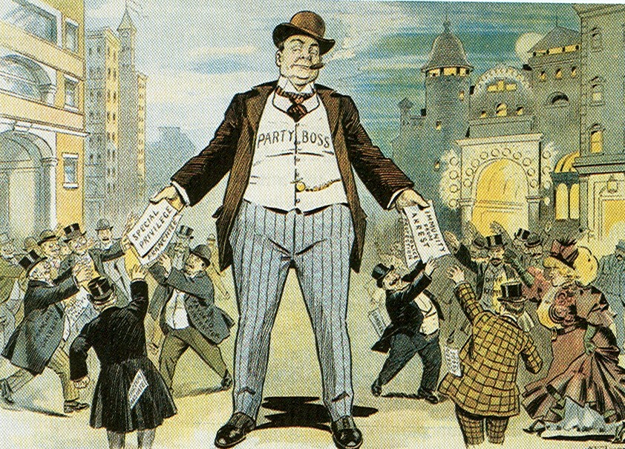
Parties of the Gilded Age
Republican Party of late 1800’s = tended to stress moral codes & believe that the govt should regulate the economy, not tolerant of immigrants
Strongest in NE & Midwest & among GAR & blacks
Democratic Party was less focused on morals and more accepting of immigrants; strongest in South and northern cities

Slide 68
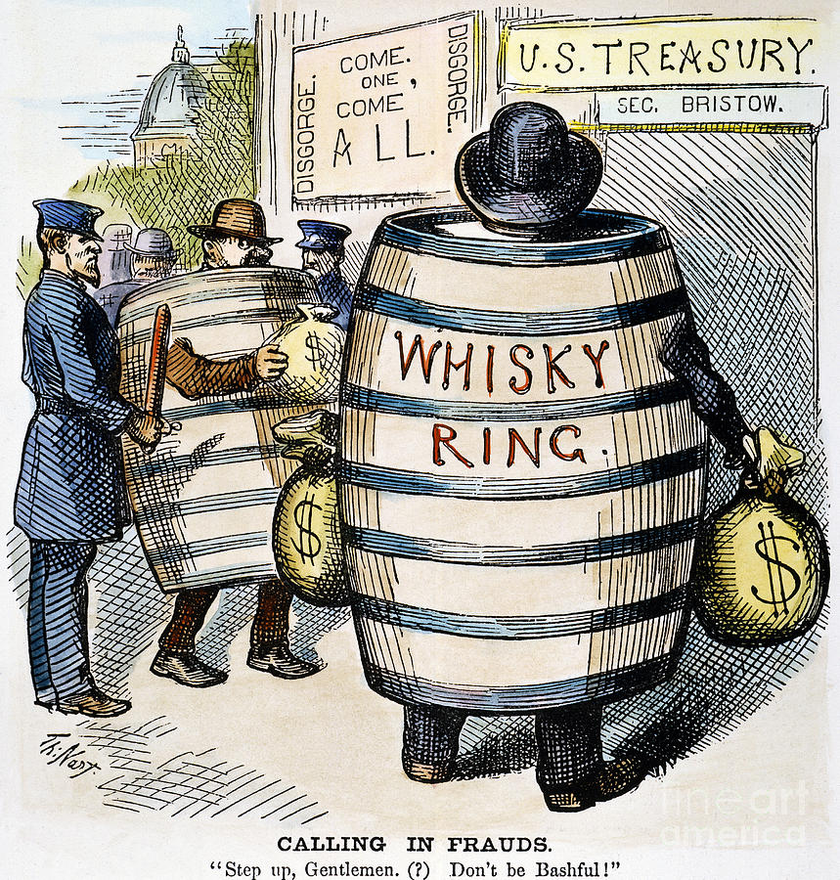
Whiskey Ring Scandal
The Whiskey Ring scandal and Credit Mobilier episode implicated many prominent politicians and gave people the impression that corruption was rampant in the post CW political system

Slide 69
Politics During the Gilded Age
Weak Presidential Leaders => country dominated by local govt & Congress
Exs: Garfield, Arthur, Harrison, Hayes, Cleveland => 1 accomplishment?
The late 1800’s was dominated by a string of Presidents dubbed the “____________________________” => Q: Why leadership so weak???
Power of corporations & small size of federal government => trusts dominated economic environment & federal govt still very small
Income tax voted unconstitutional in 1895 = revenue very small
Smartest and most ambitious men more attracted to business => corrupt image & practices also deter many from running for office
Some positive feats accomplished . . .
Passage of the Interstate Commerce Act (ICC) and Sherman Antitrust Act helped to regulate practices of trusts & RR
Chester Arthur passed ___________________=> created Civil Service Commission to assign federal jobs based on merit (exams)
-- Result? => Politicians start lobbying big business leaders
“Billion dollar Congress” of 1890 gave pensions to CW veterans
-- Congress in general thrifty during time period (huge surpluses)

Slide 70
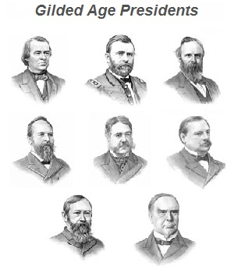
The “Forgettable Presidents”
From left to right, top to bottom:
Andrew Johnson (D) => 1865-1869
Ulysses Grant (R) => 1869-1877
Rutherford Hayes (R) => 1877- 1881
James Garfield (R) => 1881
Chester Arthur (R) => 1881-1885
Grover Cleveland (D) => 1885-1889; 1893-1897
Benjamin Harrison (R) => 1889-1893
William McKinley (R) => 1897-1901

Slide 71
The Closing of the American Frontier
On April 22nd 1889 the Federal Government made Oklahoma land available to settlers => 50,000 “Sooners” lined up to lay claim to land
“89’ers” moved the population of Oklahoma from 10,000 to over 60,000 in 8 months
-- In 1890 census the superintendent declared that the American frontier line was no longer discernable => West had been settled
** In 1827 the Secretary of War declared that full settlement of West would take over 500 years => How did it happen in 60 years??? **
Q: What role did technology, government policy and economic opportunity play in the quick settlement of the West?
In 1893 Frederick Jackson Turner presented his Turner Thesis of Am. development to the American historical society of the World’s Fair
Said that American history, economic development & values/beliefs were all primarily influenced by the “American Frontier”
Turner was concerned that with the frontier now “closed” that a new historical model and unifying factor would need to emerge

Slide 72
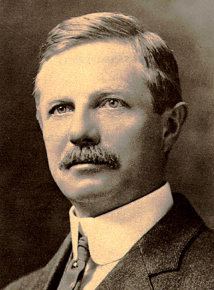
The Turner Thesis
Turner believed that the American frontier had built distinct “American” traits like individualism, independence and desire for freedom
Frontier made Americans less “European” and presented a challenge to each successive generation of Americans
Also believed that the frontier served as a release valve for social tension and social misfits
Few historians accepted his thesis => little historical evidence

Slide 73
Settlement of West
The rapid settlement of West was greatly accelerated by a trinity of factors => economic opportunity, technology & government policy . . .
Ec. Opportunity & technology => W. industries = farming, mining & ranching
Farming => many migrants . . . Exodusters, immigrants & corporations
Large amt of land available encouraged migration => own 160 acres due to Homestead Act (encouraged settlement and improvement)
-- New technologies like John Deere steel plow, combine and tractor made farming large amount of land feasible (Bonanza farms)
Govt irrigation projects also made land west of 100th parralel productive
Ranching => Homestead Act &free range land made ranching feasible
New technologies also led to spread of western ranching => i.e. refrigerated RR cars, barb wire for fencing herds
Mining
“__________________” sprung up around mining strikes at Pikes Peak and Comstock NV => many sprang up & disappeared (i.e. VA City NV)
-- “Helldorados” gave rise to Wild West frontier image => vigilante justice, sheriffs and lawlessness
Mining also aided by technology => new mining machinery & techniques (Washoe Process & Square set mining)
** All activities in West aided by growth of 5 Transcontinental RR’s => provided avenue to ship goods back to markets in East (Pacific Railway Act)**

Slide 74
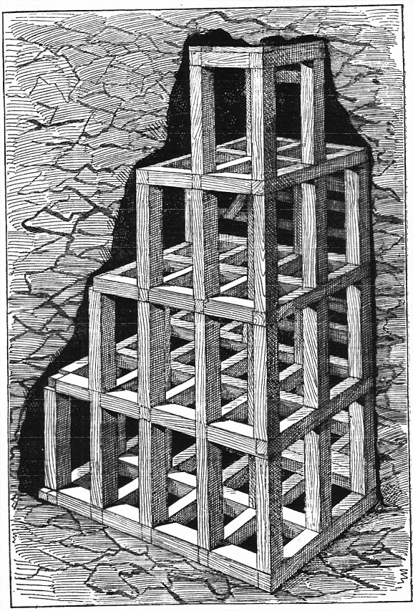
Square Set mining techniques
Square set mining allows miners to open up veins of ore in many directions simultaneously and greatly increases the productive capacity of mines

Slide 75
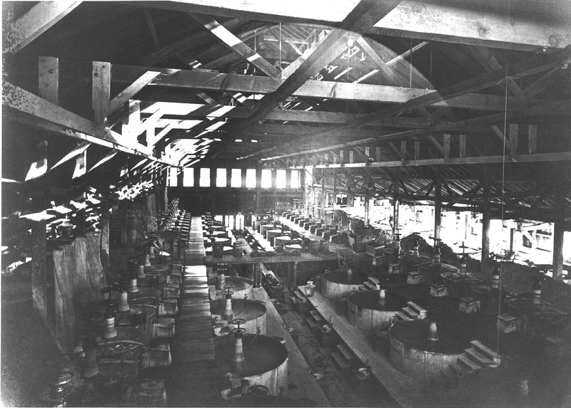
Washoe Process – silver refining
The Washoe process was a variant of pan amalgamation that used mercury and copper sulfate to extract silver from ore => involved the mass application of silver refining in large bins

Slide 76
Indian Removal – The Final Chapter
In 1865 there were over 400,000 Natives living west of the Mississippi => some on Oklahoma reservation but most lived on the W. frontier
Natives lived a semi-nomadic lifestyle hunting buffalo & riding horses => due to intense buffalo hunting by settlers and RR companies, warfare and conflict over diminishing resources plagued tribes
Lifestyle misunderstood by whites (property communally owned) & tribes were often locally led => Chiefs had little power & authority
In the 1850’s federal agents signed treaties with the “chiefs” of various “tribes” at Fort Laramie & Atkinson => beginning of________________
Natives were herded onto ever smaller plots of land => i.e. Great Sioux reservation in Dakotas & Oklahoma territory
-- Tribes gave up ownership of land for promises of food, blankets & peace => redefined relationship to land
Govt. Indian agents & settlers often abused promises => gave Indians moth eaten blankets, spoiled meat & ignored treaties in settlements
By 1870 Federal government repeatedly violated & modified treaties => i.e. discovery of gold in Dakotas shrunk Sioux reservation by 90%

Slide 77
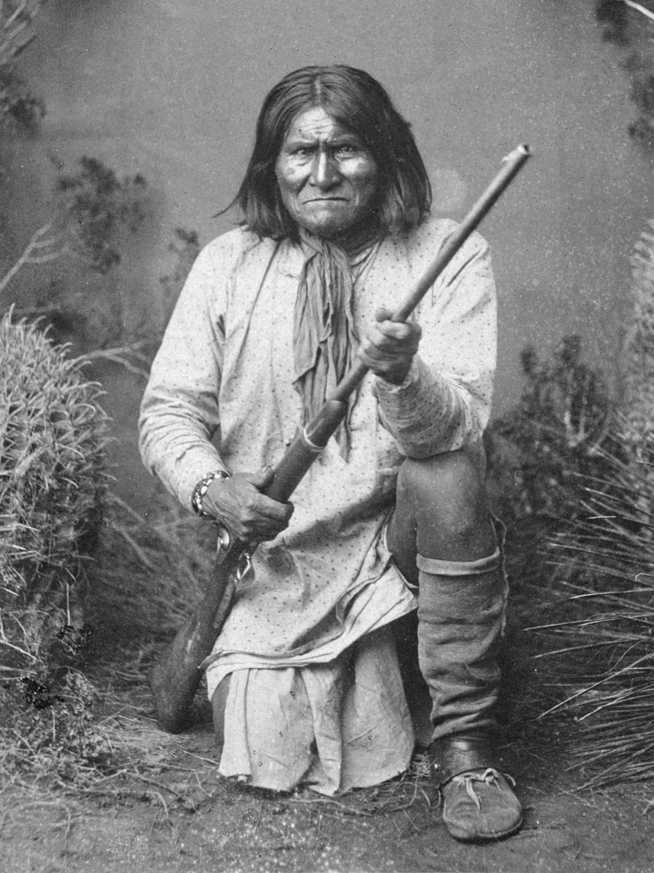
The Native Question – Individualism or Tribal lifestyles?
“Many of the country’s most profound students of the Indian question – men and women who have made the race and its relation to the nation a life study – have become converts of the policy of individualism and severality. The citizenship question aside, the folly and injustice of reserving many millions of acres of arable land as a wilderness used only as a camping ground for a few thousand lazy, squalid governmental paupers is palpable. If the Indians must be fed and herded like dumb brute, it should be done with smaller enclosures and not so senselessly at the expense of the American homesteader”
-- RW McAdams, Oklahoma Magazine, 1894
Geronimo – the most militant of Western Natives

Slide 78
Indian Removal – The Final Chapter
From 1868 to 1890 government engaged in Plain Indians Wars to rid plains of rouge Native tribes => list of battles in excess of 100 pages
Many of soldiers were black “_______________________” => attracted by good pay and ability to escape Southern discrimination
Atrocities committed by both sides => escalating violence
-- Massacre of 100 white settlers at Big Horn Mountain in 1868
-- Sand Creek Massacre of 400 natives in 1864
Major Battles = Little Big Horn (1876) & Bear Paw Mountain
-- Little Big Horn => expedition led by Gen Custer found gold in Wyoming and moved to evict Natives (massacred by Sitting Bull)
-- Bear Paw Mountain => Chief Joseph forced to surrender
By 1880’s, the Federal Government adopted the policy of “_______________ _________________________” => assimilation led by Christian missionaries
______________(1887) => dissolved Native tribes & split up tribal holdings into individual plots (160 acres), gave rest of land to RR and corporations
-- Gave citizenship to Natives who were peaceful for 25 yrs
-- Resulted in loss of 50% of tribal lands within 20 years
Led to foundation of Indian schools => i.e. Carlisle Indian School to forcibly assimilate Natives into white culture

Slide 79
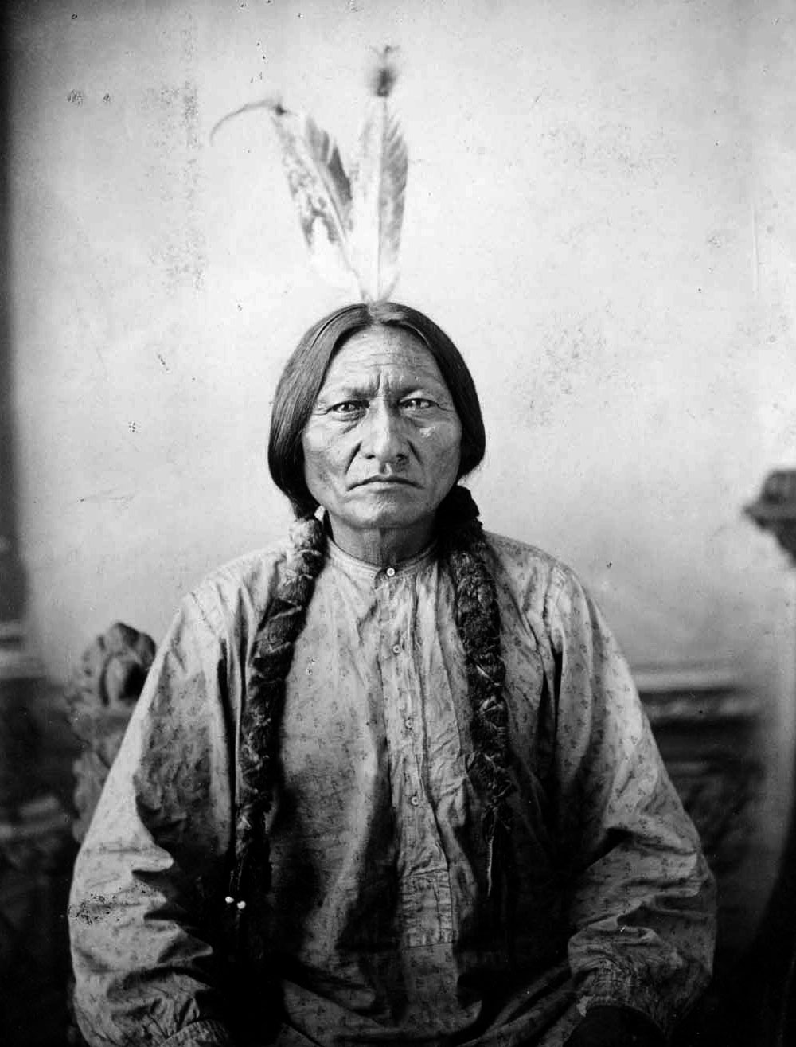
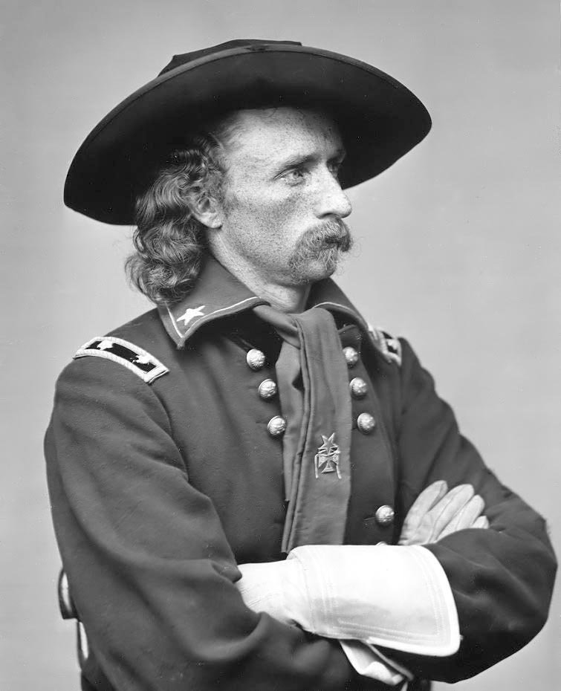
Sitting Bull & Geronimo
Sitting Bull Geronimo General Custer

Slide 80
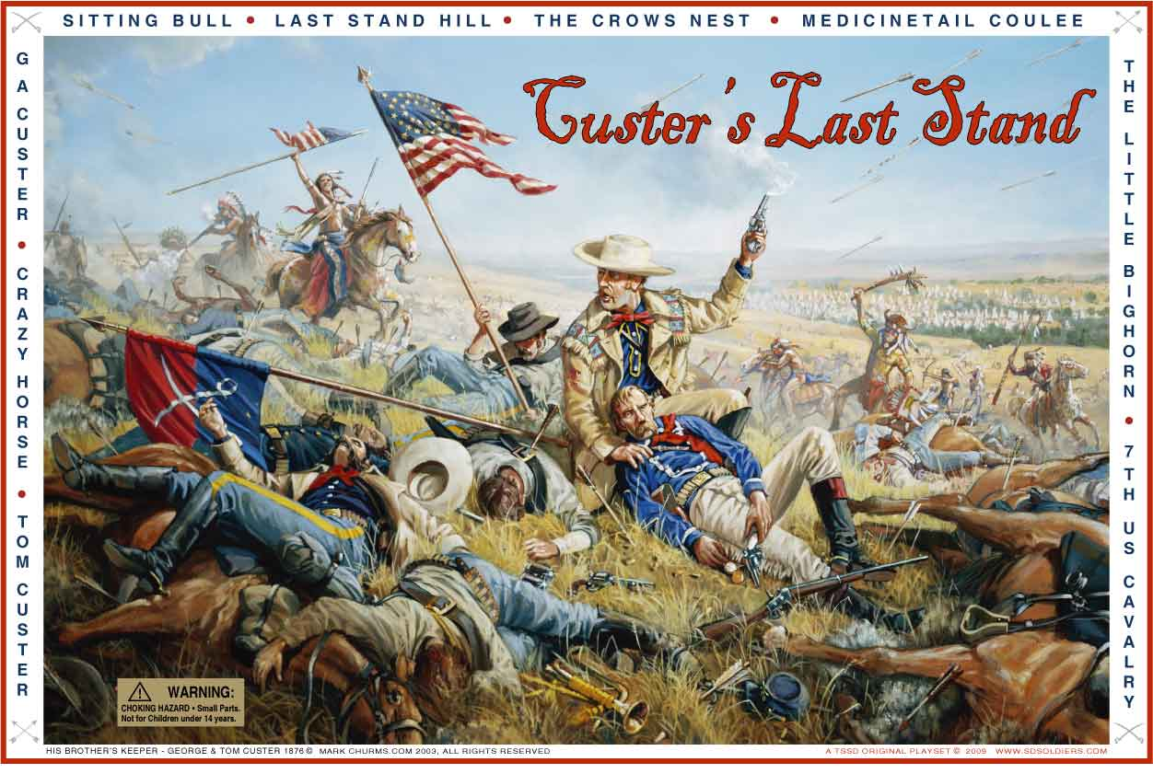
Custer’s Last Stand
Q: How are whites and Natives depicted in images of Custer’s Last Stand? How did popular depictions of Plains battles help to define federal government policy?

Slide 81
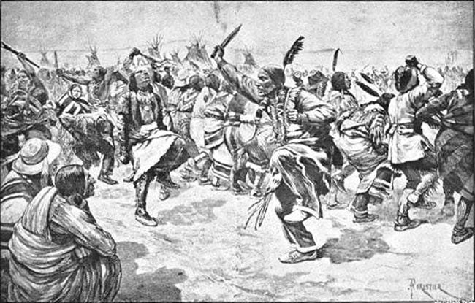
“Battle of Wounded Knee”
______________was basically set off by the Ghost Dance’s (Indian spiritual dance that would preserve Native culture & lead to victory over whites) spread in Sioux reservation => whites believed dance to be sign of rebellion
Massacre left over 200 Native women and children dead

Slide 82
Carlisle Indian School
Q: How are Indians dressed at the Carlisle Indian school? How old are students? What effect would this have on Native culture & beliefs?

Slide 83
Environmental Impact of Western Migration
The rapid US settlement of West had a massive environmental impact => Ex: US Plains buffalo population (1865 = 15M; 1885 = 1000)
Buffalo were hunted by settlers & RR companies with abandon
Spurred by conservationists like _________& orgs. like the ________the US govt started to engage in efforts to conserve Western resources
#1: Founding of the ________________in 1871 => commission organized to investigate causes for decline in aquatic populations in western lands
Commission engaged in practices of operating hatcheries like the seal fur hatchery in Alaska and also investigated fishing practices
#2: Founding of the ______________________(1849) => set up in 1849 to manage public lands and minerals, as well as handle Indian issues
In late 1800’s the department set up the first National Parks in Yellowstone (1872), Yosemite (1890) & Sequoia (1890)
-- New Idea =___________________________________________
#3: Founding of the __________=> conservationist John Muir founded this organization in 1890 to promote conservation of public lands & resources
Fought the federal government in early 1900’s over the proposal to build the Hetch Hetchy Dam to supply San Francisco w/ water

Slide 84
Plains buffalo extermination
In 1868 a Kansas Pacific locomotive had to wait 8 hours for a large herd of buffalo to cross a track => RR policy becomes to destroy buffalo

Slide 85
Bison skulls after an expedition in the 1880’s – “Buffalo” Bill Cody was rumored to have killed over 4,000 buffalo in the employ of the Northern Pacific RR

Slide 86
Hetch Hetchy Valley (before)

Slide 87
Hetch Hetchy Valley (after)

Slide 88
Gilded Age Culture & Society
During the Gilded Age cultural and social developments were impacted both by increasing opportunities & a desire for increased entertainment
Increasing Opportunities
#1: Education => at the local level tax supported schools increased in number after the Civil War
Majority of states required compulsory grade school education; 6,000 public high school existed & textbooks were tax supported
Problem = laws not always supported
___________________________for teacher training also began => opportunity for women to teach and gain economic independence
Number of colleges in the US also expanded greatly => many founded by industrialists w/ huge endowments
Cornell, U of Chicago (Rockefeller), Vanderbilt, Carnegie Mellon
Number of technical schools and graduate schools also expanded => i.e. John Hopkins (medical college an graduate school in sciences)
Universities during time period also founded for women’s education (Vassar) and other colleges allowed women to attend
-- ¼ of all college graduates in 1900 were women

Slide 89
Shippensburg State Normal School – Founded in 1871

Slide 90
Gilded Age Culture & Society
#2: Literature => literacy jumped from 80% in 1870 to over 92% by 1900
As a result of increased literacy, increased leisure time, greater access to public libraries & greater amount of $$ literature increased in popularity
Carnegie gave over $60M to establish thousands of libraries in US
New authors rose to popularity in America . . .
Popular authors like Mark Twain & Jack London wrote stories that captured pieces of American West and American character
Social novelists like Theodore Dreiser, Kate Chopin and Henry James wrote of feminism and the impact of modern society
______________________________& Harlan Halsey wrote stories that emphasized virtue and industry in their central characters
Invention of linotype in 1885 greatly expanded the profitability of newspapers => new movement was sensationalistic _______________
Sex, scandal and human interest stories were emphasized by William Randolph Hearst and________________________

Slide 91
Yellow Journalism in late 1800’s
In 1898 yellow journalism reached its zenith when it contributed to the outbreak of war between the US and Spain over the explosion of the USS Main in Havana harbor

Slide 92
Gilded Age Culture & Society
#3: Religion => by 1890 there were 150+ religious denominations in the US
New ideas include the Church of Christ Scientist (true Christianity heals sickness); Moody Bible Institute (adapted Christianity to urban cities)
Moody focused on Jesus as loving and forgiving
Immigration greatly strengthened Catholicism & Judaism in US
Darwin’s theory of Evolution greatly shocked the religious world => led to battles between Conservatives & Modernists
Fundamentalists = reject Darwin and science
Modernists = believed Bible a cultural document (accept science)
#4: Public Health
New scientific advances greatly improved public health in the late 1800’s
Louis Pasteur & Joseph Lister discovered germ theory of disease and antiseptics/anesthesia => led to easier surgeries and germ concerns
-- Heavy mustaches became unfashionable b/c they were seen as “germ magnets”

Slide 93
Gilded Age Culture & Society
Entertainment => due to increases in wealth among the urban middle class popular entertainment greatly increased in popularity
__________________= #1 form of entertainment => mixture of many different types of acts all performing in succession
____________________________________________________
Popular from 1880’s to 1930’s => present day examples????
Circus => late 1800’s was heyday of traveling circus; Barnum & Bailey’s
_________________________________________=> popular at professional and collegiate levels; signals move to spectator sports
College football dominated w/ rivalries like Yale & Princeton
Professional baseball league formed in 1870’s (National League)
Basketball was invented by James Naismith in 1891 (YMCA)
___________________________show also very popular (see next slide)

Slide 94
Buffalo Bill’s Wild West Show
As a form of entertainment Buffalo Bill, Annie Oakley and others put on “Wild West” show w/ famous Indians (forced to be in the show) like Geronimo, live Buffalo and sharpshooting
Created and fostered an obsession w/ the “Lawless” West that lives until the present day

Slide 95
Late 1800’s Vaudeville

Slide 96
African American in the Gilded Age
During the Gilded Age, African Americans had increased opportunities for additional social and economic rights and roles
African American men moved West under Homestead Act and became free farmers (Exodusters)
Others enlisted in the Army & fought in the Plains Indian Wars => Buffalo soldiers (25% of federal army during period)
Many men and women moved to northern cities to participate in factory labor => paid wages that were 25%-50% of whites
Despite increased opportunities, though, whites of the time period used many strategies to continue the oppression of blacks . . .
#1: _________________=> passage of ______________laws in the South created a system of legal segregation (i.e. separate schools, public facilities)
System supported by _______________________(1896) Supreme Court decision => “Separate but Equal” (not factual situation)
#2: ___________________________________________=> growth of KKK and mob violence used in South to keep blacks “in their place”
Blacks who challenged system were killed as examples to community

Slide 97
Lynchings in the South during the Gilded Age

Slide 98
Lynching – Black vs White

Slide 99
African American Activism
African American Activists –
Black social reformers like ___________________________attempted to call attention to issues like African American lynching in the South
She was successful in drawing attention to the issue, but ultimately not successful in gaining an end to the practice in the short term
Main focus of African American activism was to formulate a response to the racism practiced by whites in the South post Reconstruction
#1: _________________: est the _____________________in 1881 to provide trade education to blacks so they could better their economic standing
Accommodation => accepted segregation & racism until blacks could develop themselves and thus call for true equality and liberty
Led to education of many blacks, i.e. George W. Carver => chemist who pioneered use of peanut & soybean in paint, shampoo & grease
#2: __________________________: called Washington an “Uncle Tom” and called for total social and economic equality for blacks immediately
Founded the ______________to help achieve this goal => used legal challenges to fight against racist laws in the South and elsewhere
-- Called for the “Talented Tenth” `of blacks to rise up and lead the movement and gain immediate freedom and equality
Legal challenges culminated in the Brown v Board of Education decision in 1954 => ended school segregation

Slide 100
African American Reformers
WEB DuBois Booker T. Washington

