Slide 1
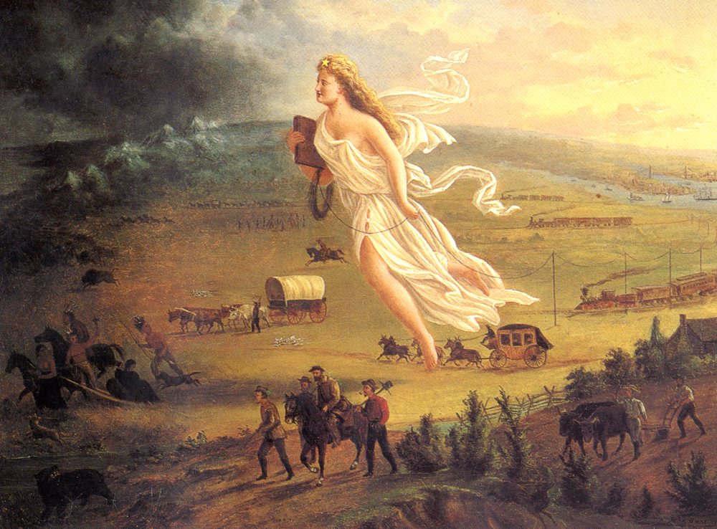
AP US History Unit IV – Expansionism, Jeffersonian Democracy & National Culture
Time period: 1800-1848

Slide 2
Unit Big Questions and Periodization
Periodization => Why 1800? Why 1848?
In ________________________________was elected President
-- From Democratic Republican party => would there be a peaceful transition of power? How would power transition?
In ___________________________________________________after the Mexican war ended
-- Manifest Destiny, American cultural identity was achieved and democratic participation had been changed forever
Unit Essential Questions . . .
In what ways and for what reasons did voter participation in political campaigns and elections change from 1800 to 1840? Analyze the forces that changed American politics during that time.
What methods and events did the US use to expand territorially from 1800 to 1850? What problems did territorial expansion cause?
How did American social movements in the early 1800’s impact government policy & lead to divergent American cultural identities? Who were the different founders and supporters of these social movements?
How did events & movements spark a dominant national cultural identity of Nationalism and expansion during the time period 1800 to 1830?
What were Jeffersonian and Jacksonian Democracy? How did each expand the power of the Presidency and lead to disagreements over the extent of Federal power?

Slide 3
The “Revolution” of 1800
In the election of 1800 the Federalists lost the election for the Presidency & never won again
Bailey says that “it is good that the Federalists had the reigns of US Government first” => Do you agree?
Campaign of 1800 full of “Mud-Slinging” (1st of it’s kind in U.S.)
Jefferson (DR) = Atheist, Father of mulatto children, “French lover”
Adams (F) = Hamilton against him, “Free Spender”, “Tyrant” (i.e. larger Army and Navy, A&S Acts, Debt up $10 M
Election is victory for Dem. Republicans in Congress and Presidency
** 250 votes separated Adams from Jefferson in NY!! **
Constitution gives each Elector 2 votes and 2nd place becomes VP
Burr and Jefferson tie at 72 EV and election thrown into House
After days of debate Jefferson is picked by House
12th Amendment created to stop this from occurring again!!
Was Election a “Revolution”?? What is a “Revolution”??
** ___________________________________________________**

Slide 4
Could Civil War have broken out here?
No precedent for Compromise of this magnitude
2 Men “tied” for the Presidency!!
What would have happened if Burr challenged the vote in House?
Q: What did Burr do 4 years later when he felt slighted by Alexander Hamilton?
What would have happened if House had not reached decision when Adam’s term expired?
Established precedent for “gracious” loser and transfer of power in peace

Slide 5
Jefferson’s Political Theories
Political Theories And Personality
Very educated – “Renaissance” Man
Wrote Declaration of Independence
Believed in “Decentralized” authority (Government is best at a local level)
-- “State’s Rights”; Small Natl. Govt.
Power corrupts people => “Power corrupts, absolute power corrupts absolutely” (Acton)
-- Strict Interpretation of Constitution
Fear of Urban Growth – AGRARIAN society of small farms (lends to democracy and less corruption)
Common Man educable and basis for democracy
-- Viewed w/ ________________________ ** Jefferson = “_______________________” **
Thought Blacks/Indians inferior to whites, little belief in women in politics
Goals as President => wanted to return government to common man, expand US to make yeoman farming possible (still need property to vote); improve education system

Slide 6
Thomas Jefferson Quotes
Jefferson on the Military
“Every citizen should be a soldier. This was the case with the Greeks and Romans, and must be the case with every free state.”
“The spirit of this country is totally averse to a large military force.”
Jefferson on the Constitution
“In matters of style, swim with the current; in matter of principle stand like a rock.”
“Some men look at Constitutions with sanctimonious reverence, and deem them like the ark of the covenant, too sacred to be touched.”
Jefferson on the Common Man
“There is a natural aristocracy among men. The grounds of this are virtue and talents.”
Jefferson on spending $$
“Never spend your $$ before you have it.” (Jefferson borrowed $15 to make the LA Purchase)

Slide 7
Jeffersonian and Jacksonian Democracy
Thomas Jefferson initiated a new era of American politics called Jeffersonian Democracy => imitated by nearly all leaders afterwards
Jackson most vigorous proponent => saw himself as the “heir of Jefferson”
#1: _________________________________ => common man (yeoman farmer) praised as the epitome of American spirit, initiative and freedom
Jefferson and Jackson believed common man should have a more active role in government and sought ways to initiate this
-- Jefferson still believed that government should be ruled by elite and educated => Jackson did not
Jefferson & Jackson also believed that government policies should be crafted to support the common man (not wealthy & elite)
#2: ____________________________=> principles should be followed but leaders should always do what is best for America
Jefferson kept many Federalist programs that were good (i.e. National Bank, tariff) and retained 85% of Federalist officials
#3: ________________________________________________________
Although originally a state’s right proponent, Jefferson endorsed a loose interpretation of the Constitution & federal supremacy
Jackson sought to expand Presidential power vastly => believed President was the “protector of the common man”

Slide 8
Jeffersonian & Jacksonian Democracy in Action
Who were the Jeffersonian and Jacksonian Democrats?
Jeffersonians => rural farmers, southerners, working class Americans
Jacksonians => western and southern farmers; westerners, artisans, southerners; debtors
Examples of Jeffersonian/Jacksonian Application
** Case Study => Jackson’s Inauguration Party**
#1: Loosening and Dropping of _______________________________
Jefferson supported lowering the property requirements to vote and thus more yeoman farmers became eligible to vote
Jackson took this a step further and eliminated property requirements => thus achieving _________________________________
Jacksonians also worked to allow individuals to choose Presidential electors, rather than having parties choose electors (Q: Why???)
#2: Acquisition of land => _______________________________________
Jefferson, although its manner went against some of his principles (i.e. use of National Bank, acquisition of debt) purchased Louisiana
Believed that this would free industrial classes of East to go west and live as yeoman farmers
Jackson pursued policies of Native Removal (i.e. Cherokees) and freed up land for white yeoman farmers

Slide 9
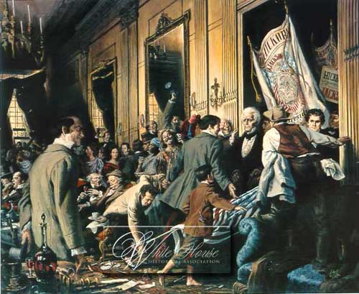
Jackson’s Inauguration -- 1829
Jackson’s supporters came from up to 500+ miles away
-- Jackson holds “people’s inauguration” w/ no formal invitations => WH open to all!!
WH reception becomes total chaos!!! => Activities include breaking Presidential china, breaking crystal, breaking WH windows, standing on WH furniture (Damascus chairs), destroying sofas, pulling down pictures and portraits, fighting, drinking in excess . . .
Jackson escapes out back & WH only clears when spiked punch is served on WH lawn!!
-- Earns Jackson nickname => “King Mob”

Slide 10
Voter Participation in Presidential Elections (1812 to 1840)
 | Percent of Eligible Voter Participation | Percent of States allowing voters to choose Presidential Electors
1812 | Unknown | 44.4
1816 | Unknown | 52.6
1820 | Unknown | 62.5
1824 | 26.9% | 75
1828 | 57.6% | 91.7
1832 | 55.4% | 95.8
1836 | 57.8% | 95.8
1840 | 80.2% | 95.8

Slide 11
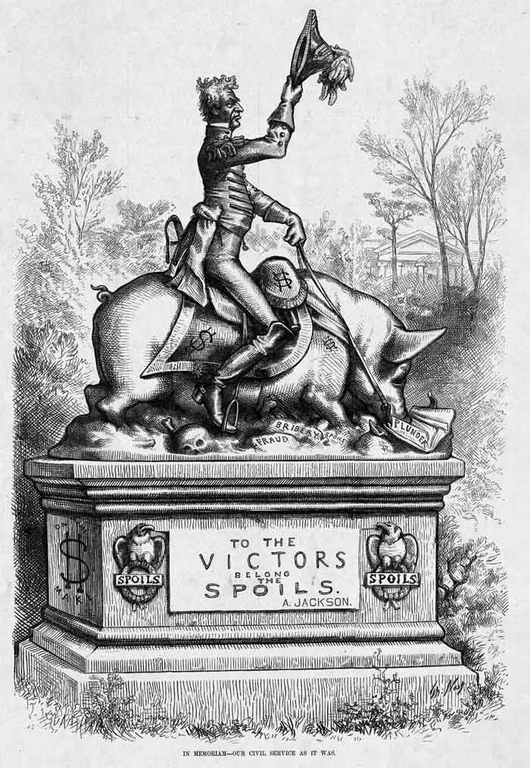
Jeffersonian & Jacksonian Democracy in Action
#3: Improving Opportunity of _____________________
Jefferson wanted to start a system of public education but could not gain support
Jackson applied the ______________________ system
“those who hold public office for a long time are apt to acquire a habit of looking with indifference upon the public interests and of tolerating misconduct from which an unpracticed man would revolt.”
Jackson removed up to 20% of officeholders and “rotated” them to supporters
-- Opponents called this “_________________”
Jackson believed “every man is as good as his neighbor. . . [or] equally better”
-- “Aristocratic” governing class not needed
Jackson used offices to reward those loyal to him and punish those “unloyal”
-- Some even “bought” offices (i.e. Samuel Swartwout, Customs collector for NY Port)

Slide 12
Jeffersonian & Jacksonian Democracy in Action
#4: Pragmatism => Jefferson applied Pragmatism in multiple ways
_________________=> use of National bank to fund, use of loose interpretation of Constitution to purchase w/o Congressional approval
____________________=> Federalists paid tribute to pirates in N Africa to protect shipping in Mediterranean (1801 =26 barrels of currency)
-- Jefferson refuses and builds small gunboat Navy to fight pirates => precedent of not negotiating w/ terrorists
#5: Charles River Bridge decision => Jackson appointed Roger Taney to Supreme Court (state’s right and common man proponent)
In _______________________________(1837) Supreme court decided that corporate contracts did not grant monopolies & that all could apply
Lowered prices for common man, speeded industrial progress and led to more equal economic opportunities to start business
Forwarded idea that _______________________________________=> not just connected elites

Slide 13
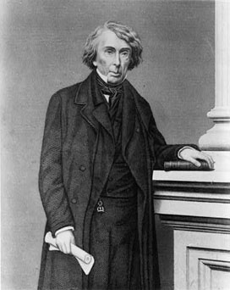
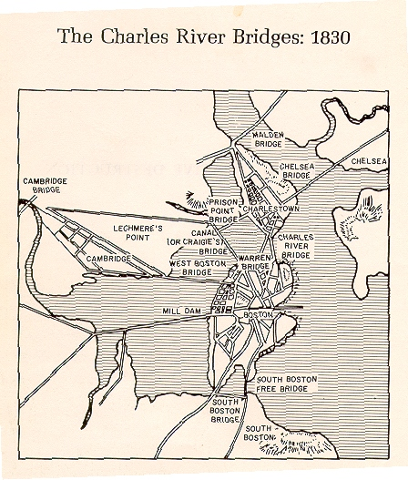
Roger Taney and Charles River Bridge
In 1785 the Charles River bridge was granted a charter and built a toll bridge => charged massive tolls but was only bridge to Boston
-- Warren River Bridge was granted charter in 1830 and was to be a toll free bridge after a period of toll to recoup costs and profit

Slide 14
John Marshall & Supreme Court
Supreme Court is the only court mentioned in the US Constitution
-- Had no home until 1930’s (Met in basement of Congress building)
Number of Justices started at 6, expanded to 7 in 1807, then to 9 in 1837
Current Members ?Current Chief Justices ?
Early US History huge debate about who or what institution should interpret Constitution
States? Courts? (VA & KY Resolutions, Hartford Convention)
_____________________(1800-1835) was most important Justice in the Court’s history!!!
Appointed by Adams at last minute (Midnight appointment)
Strong Federalist
-- Court decisions support strong Federal rights & supremacy (weaker states rights)

Slide 15
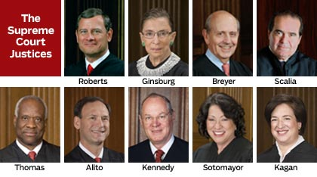
Current Supreme Court Justices

Slide 16
Major Cases of Marshall Court
Marshall Court known as a “Federalist Court in a Sectionalist country”
Major Cases
#1: ______________________(1803) – Marshall establishes precedent that Supreme Court (not the states) decide Constitutionality (not used again until 1857!!)
-- Dem. Republicans try to “impeach” Justice Chase after this which fails and establishes independence of Judiciary
#2: _______________________________(1819) – declares Natl. Bank constitutional using Hamiltonian “Loose” interpretation; enhances Federal Power!
#3: ______________________(1821) – Marshall rules on Constitutionality of Sate Supreme Court decision => furthers power of Federal Govt. & Supreme Court!
#4: ________________________________(1819) – Marshall court rules that even British King’s contract is legitimate; State’s rights diminished for corporate rights

Slide 17
The Era of Good Feelings
After the War of 1812 the Federalist Party died out => Q: WHY????
#1: _______________________Focus => Hamilton and others held onto idea of propertied elite that would rule country
Unpopular in time of Jeffersonian Democracy & rise of common man
#2: Death of ___________________=> Hamilton dies in a duel w/ Burr (1804); Washington dies of pnuemonia (bled 4 times)
#3: Opposition to ________________________=> Federalists opposed the LA Purchase and the expansion of voting rights
#4: ____________________________in War of 1812 => some NE Federalists warned British ships of American attacks and illegally traded w/ Britain
#5: Use of _______________________=> DR in Massachusetts redrew districts to favor their party and resulted in loss of more Federalist seats
As a result by 1814 Federalists cease to exist, run no candidates for office and the US is basically a One Party state (Dem-Republicans)
Many Federalists institutions are already est. (i.e. Natl Bank; Supreme Court) but power of Federal vs State governments was still being debated
Called the “Era of Good Feelings” => Q: Was Era of Good Feelings a Misnomer?????

Slide 18
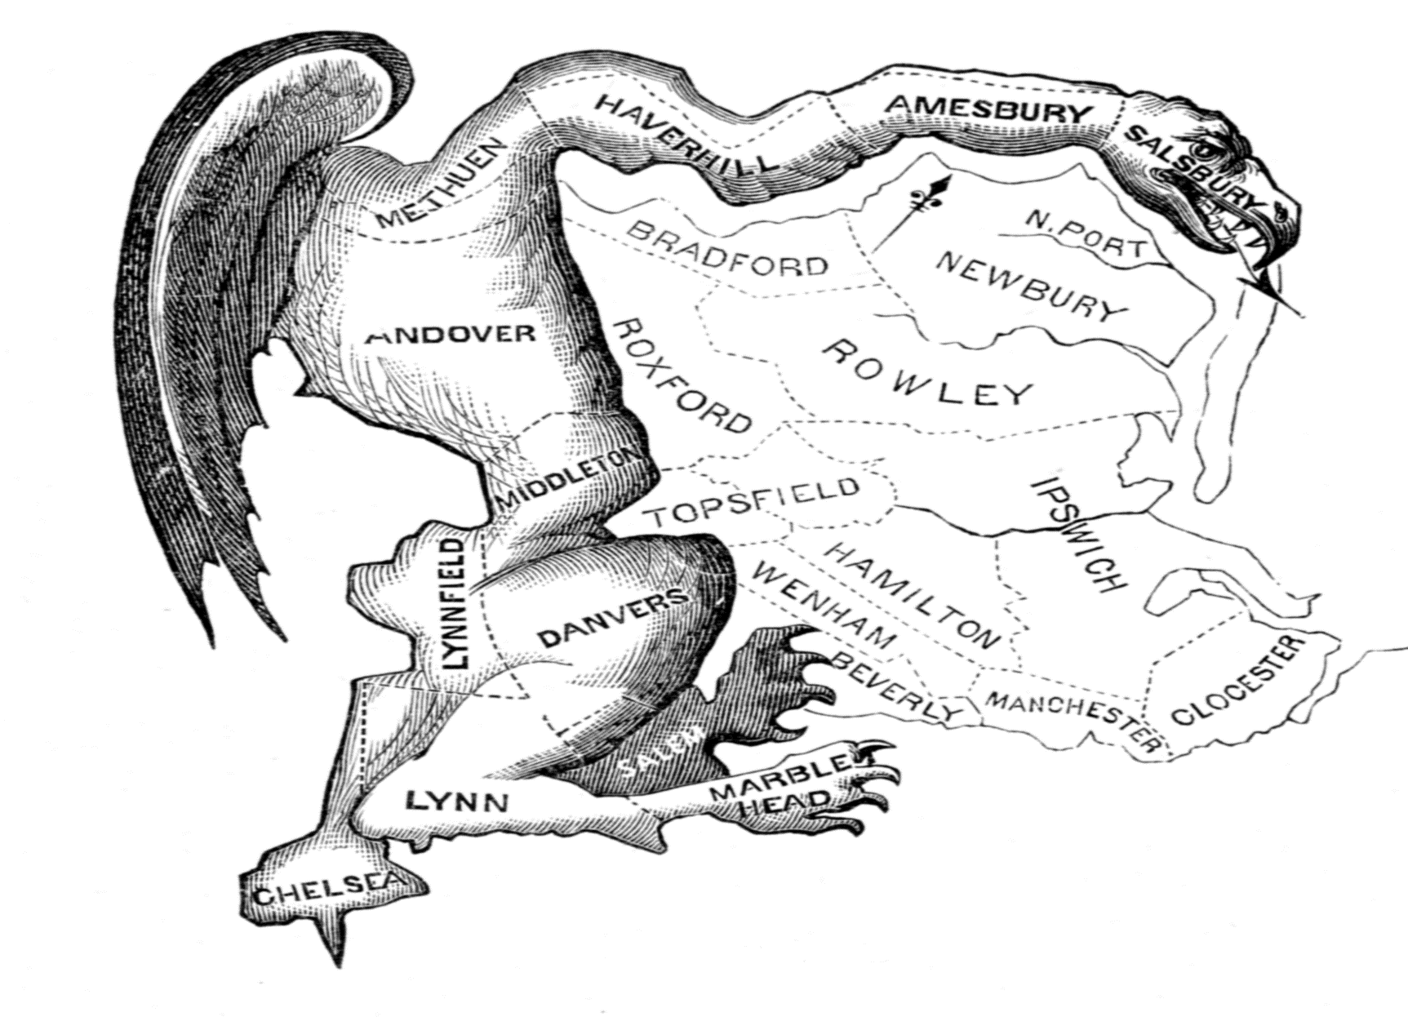
The Original “Gerrymander”
Gerrymandering got its name from this district drawn by then MA Governor Elbridge Gerry to favor Dem-Rep candidates

Slide 19
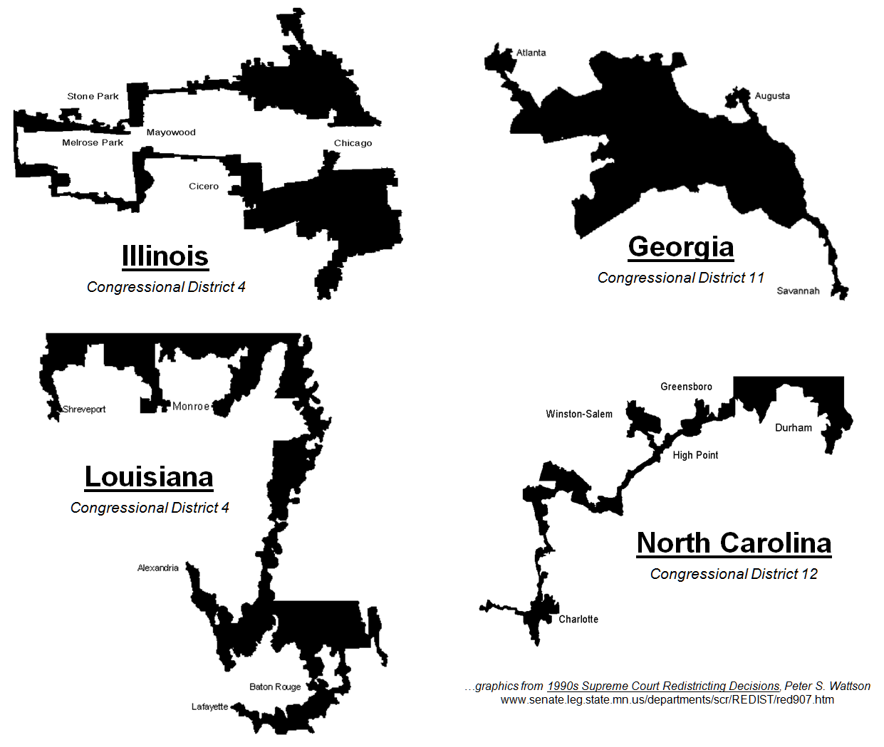
Gerrymandered Districts

Slide 20
Andrew Jackson – “Old Hickory”
Jackson was a War Hero – Battle of NO
Tall (6’1’’) and thin (140lbs) due to his bouts of dysentery, malaria, tuberculosis and lead poisoning
Jackson had a famous personality
-- Very strong ___________________________
______________________________
** Jefferson said of him “. . . He could never speak [in the senate] due to the rashness of his feelings. I have seen him attempt it repeatedly, and as often choke with rage . . . He is a dangerous man”
-- Jackson also had a manner of personifying conflicts and creating enemies
Jackson personified the West – ceaseless energy, rough nature, individualism, prejudice
He was a “_______________________” but was fantastically rich – “Frontier Aristocrat”
One of 9 Presidents never to attend college
As such did not value education

Slide 21
The Presidency of Andrew Jackson
Jackson saw himself as the heir of Jeffersonian Democracy but applied these principles in a different manner
Believed more strongly in ______________________=> use of Spoils System, universal white male suffrage
Did not support expansion of educational opportunities => believed education_________________________________
Also wanted to _______________________________=> believed that the President was only office truly elected by people
-- Could protect the common man and values of republicanism
#1: Expansion of Executive Power in Face of Cabinet – Petticoat Affair
#2: Expansion of Executive Power in Face of Legislative Branch – 2nd BUS
#3: Expansion of Executive Power in Face of Judicial – Indian Removal

Slide 22
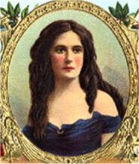
Episode #1: The Petticoat Affair
Background => Jackson’s wife had been called a “whore” by the Adams camp in 1828 for marrying Jackson “illegally”
Died before Jackson was inaugurated
Peggy Eaton, wife of Sec. of War John Eaton, was daughter of an innkeeper and was seen as “unsuitable” for company
As a result Mrs. Calhoun, an “aristocrat” refuses to invite her to parties
-- John C. Calhoun was Jackson’s running mate and Vice-President
Jackson attempted to force Calhoun to include her in social events, but failed (Van Buren does)
Jackson selected a weak cabinet of 6 men (Van Buren as Sec. of State)
-- Rarely consulted w/ them and instead gained advice from a group of 6-12 partisan supporters (i.e. Newspaper reporters, lawyers, etc…)
This group called “_____________________” b/c they meet informally

Slide 23
Episode #2: Jackson & The 2nd BUS
The BUS was the largest banking institution in the US => issued US currency, took deposits from State banks, loaned to US corporations and ensured sound $$ policies
Bank was extremely powerful & dominated by rich
-- Policies were Anti-Western => denied issuing of cheap currency by “____________________”
___________________(called “Czar Nicholas I” due to his extreme power) was head of the BUS during the 1830’s => rich, well educated, snobbish
-- Lent $$ to friends, business partners and the press yet “turned the screws” on W. Banks
Jackson was very distrustful of large, powerful banks or companies and hated the_________ _____________________________

Slide 24
Episode #2: Jackson & The 2nd BUS
In 1830’s he voiced his desire to “destroy the bank” before leaving office
Clay & Webster try to re-charter the BUS early to defeat Jackson in 1832
-- Jackson vetoed the BUS and vowed, “The Bank is trying to kill me, but I will kill it”
Jackson’s veto message was historic =>accused the BUS of being “___________________________________” and played on Western and poor’s fears of foreign ownership and rich domination
Veto __________________________over both Legislative and Judicial branches b/c Jackson reversed a Supreme Court decision (McCulloch v. Maryland) and the will of Congress (__________________________!!)
After the election Jackson feels he has a “mandate” to destroy the BUS
Withdraws all Govt. deposits from BUS (after firing 3 Secretaries of Treasury who refused to do so) and “strangles” bank
W/O Bank to tighten currency and keep an eye on State Banks, currency printing in West runs wild and Jackson issues “____________________”
Specie mandates all Federal land purchases must be made in Gold

Slide 25
The Second BUS
After the destruction of the 2nd BUS in 1836 when its charter expired, the US entered a period of financial instability which led to among other things the Panic of 1837 and a prolonged depression

Slide 26
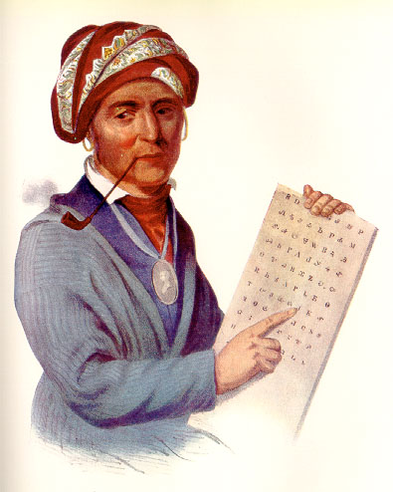
Episode #3: Native Removal
There were ~ 125,000 Indians living on land East of Mississippi in 1830
-- Washington Govt. recognized them as separate “Nations” and agreed to acquire land from them only through treaties
-- Americans also tried to “Civilize” or “Americanize” the Indians by teaching them Christianity, literacy, English, farming
By 1830 5 “Civilized” tribes were recognized –_________________________________ ____________________________
-- Most notable among these was the Cherokees who had developed a written language, a system of agriculture, public schooling system, a written constitution w/ 3 branches, and owned slaves

Slide 27
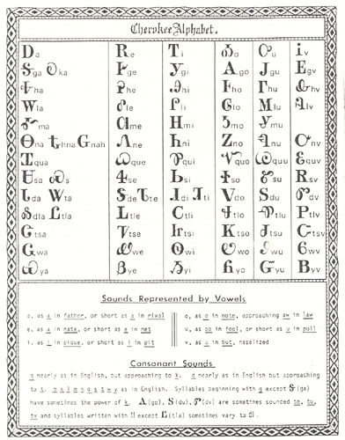
Cherokee Alphabet

Slide 28
Indian Removal and the Trail of Tears
US population was doubling every 20 years!! (13 M by 1830)
Most states left Indian lands intact but by 1830 yeoman farmers wanted land
1828 Gold was discovered on Cherokee land -- Georgia legislature declared Cherokee tribal council illegal and seized land
Cherokees appealed to the Supreme Court and in ____________________ Marshall decided that seizure & removal was illegal
Jackson says, “Mr. Marshall has made his decision; now let him enforce it”
Jackson saw himself as the “protector of Indians” and devised a scheme to “save” their cultures (_________________________________)
Indians were to give up land & in exchange receive plots in __________ where they would be safe from white encroachment “forever”
Emigration was supposed to be voluntary but was often at gunpoint
Over 100,000 Indians were removed
Worst experience was the Cherokee Nation => “_________________”
15,000 Cherokees removed in cold weather w/ poor food supplies and over 4,000 die as a result

Slide 29
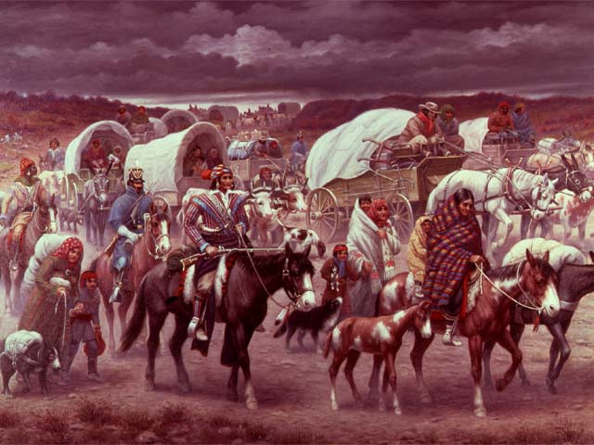
Trail of Tears – Robert Lindneux

Slide 30
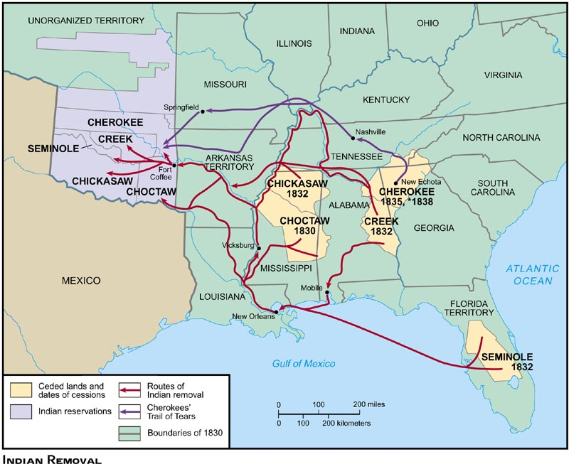
Trail of Tears -- 1838

Slide 31
The Second Party System & End of Good Feelings
After the War of 1812 the Federalist Party was destroyed and the democratic Republican party was in total control
1818 Congressional elections left Dem-Reps w/ 85% of seats => Federalists don’t run a candidate for President in 1820
By 1824, though Dem-Republicans had started to splinter into different factions => influence of sectionalism & ideology
-- ________________________(JQ Adams) => Pro Business, high tariffs, federally funded internal improvements
-- __________________(Jackson) => small federal government (low tariff, no federal funding for improvements, pro-agriculture)
Election of 1824 became a referendum on these ideas and growing sectional loyalties (influence of sectionalism HIGH)
#1: William Crawford – Southerner (Sec of Treasury)
#2: Henry Clay – Westerner (Speaker of House)
#3: JQ Adams – Northerner (Sec of State)
#4: Andrew Jackson – Westerner (War Hero)

Slide 32
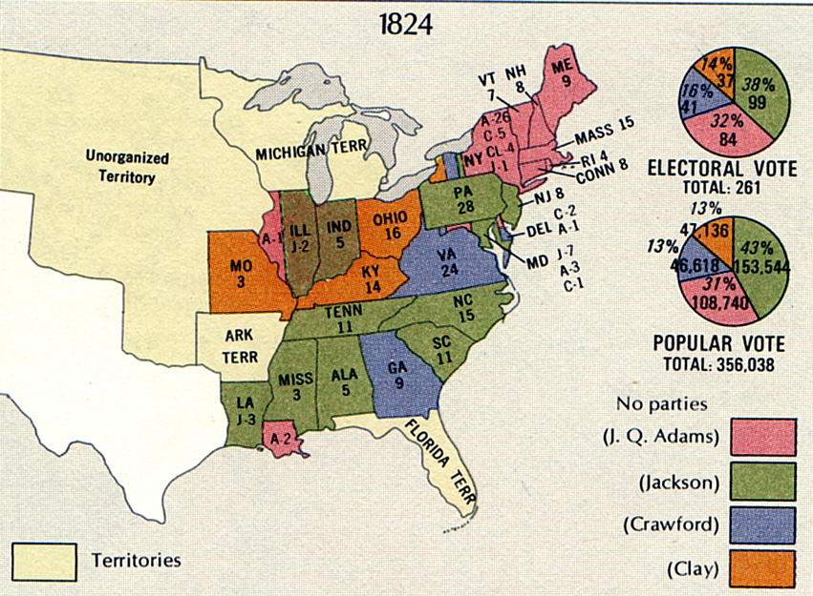
Election of 1824

Slide 33
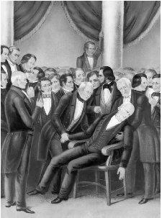
The Corrupt Bargain
Result in Election of 1824 => Who wins????
Jackson wins Popular and Electoral Vote => doesn’t get majority
** What does this show you about a multiparty system in the US??**
Election decided by ___________________
=> Speaker of House Clay supports JQ Adams to get appointed Sec of State
-- Sec of State = Road to White House
Jackson says this amounts to a “___________” => Is it????
-- Jackson’s character? Illegal? Unethical?
Although Adams is President the image of corruption stays with him and he can get none of his nationalistic programs passed as President
Incident creates animosity between Adams and Jackson and leads to formation of Second Party System in US => Whigs vs Democrats

Slide 34
2nd Party System
Democrats become party to forward the agenda of Andrew Jackson
Whigs are created by Henry Clay, Daniel Webster and JC Calhoun to oppose Jackson => haters (Anti-Masonic Party also formed to oppose Jackson earlier)
Second Party System was different than the first in many key ways . . .
#1: _______________________and Issues => 2nd Party system aimed to create broad and lasting coalitions among many different groups in society
Federalists & Dem-Rep were more reactions against the Constitution & then represented views of upper class in different ways
#2: Cultivation of political loyalties through __________________=> Jacksonian Democrats utilized Spoils System to build powerful party organizations
Party organizations aggressively campaigned for candidates using all kinds of tactics => vote fixing, double voting, immigrant voting
-- Use of newspapers (1835 = 1200 newspapers) as a tool to promote party agenda (ads, songs, rallies)
Jobs were promised to some supporters and donors
#3: Appeals to __________________=> common man seen as key to winning and aggressively sought after (ex: __________________________________of 1840)
William Henry Harrison uses popular images (log cabin and hard cider) to get elected President (none are true about him)
Start of growing democratization of politics

Slide 35
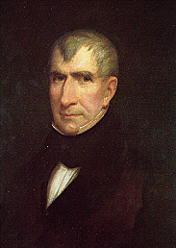
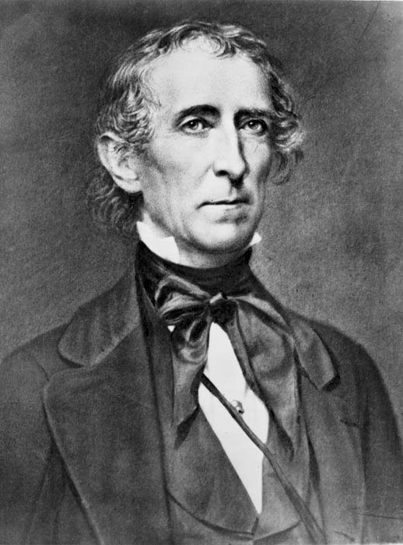
William Henry Harrison & Presidential Succession
After Election in 1840 Harrison gives 2 hour inaugural address w/o coat (prove he is smart and hardy/tough) => dies of pneumonia in 30 days
Q: What to do? Who is president? => Webster and cabinet believes there should be new election in fall
John Tyler insists on serving out term => sets precedent for Presidential succession of VP (Q: Exs of prominent VP’s?)
Tyler blocks all Whigs nationalistic programs (i.e. roads, canals, National Bank) and is expelled from Whig party

Slide 36
Intro to Sectionalism
From the 1820’s onwards Sectionalism became a powerful and divisive force in American politics and society => Q: WHY
#1: Agendas and perspective of different areas of the US diverged => economies needed different things
#2: Founding Fathers dead => new leaders less nationalistic
#3: Slavery intensifies as political issue => British abolish slave trade in 1808 & worldwide abolition movement starts
Sections in America
* North => very industrialized and more urban area; #1 priority = ________
* West => growing section w/ large amounts of frontier; #1 priority = ____ ____________________________________________
* South => agricultural economy w/ large plantations, very rural and dependent on export trade; #1 priority (and defining institution) = ______
During time period different leaders emerged for each section to advocate for sectional goals and agendas
However leaders during time always remained more Nationalistic => able to Compromise when needed

Slide 37
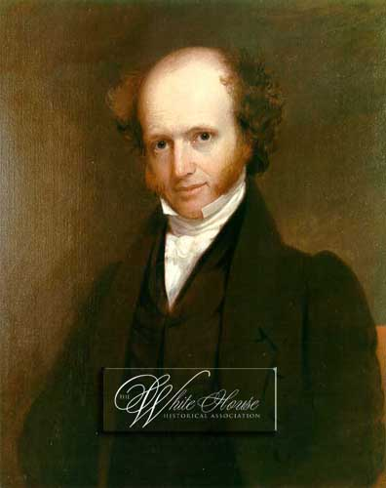
Sectionalism -- North
Leaders
_________________– Mass., Puritanical personality, hard working, not very likeable
___________________ – NY, “Red Fox”, skilled at straddling the fence
______________________– Mass, great orator, “burning personality”, “wishy-washy”
Viewpoints – See Handout

Slide 38
Sectionalism -- South
Leaders
____________________________– Georgia, state’s rights advocate, poor health
__________________________ – SC, lacked personable nature, extremely intellegent, started out a nationalist but became a real Southern advocate
Viewpoints – see handout

Slide 39
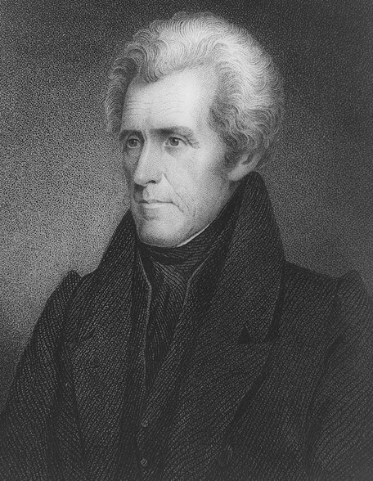
Sectionalism -- West
Leaders
_____________ – Kentucky, “Great Compromiser, charismatic, gambler, drinker
___________________ – Missouri, sectional leader only, champion of W. farmer
_______________________– Ohio, anti-Indian, “War hero” not a real politician
________________________ – “War Hero”, knew politics well, violent temper, anti-Indian, hero of common man (anti-establishment, bank, tariffs, etc….)
Viewpoints – see handout

Slide 40
The Nullification Crisis
Sectional Conflict between leaders reached very fevered points during the 1820’s and 30’s => Ex: Nullification Crisis & Theory of Nullification
During the Adams Presidency a high tariff bill was passed as a ruse to attempt and discredit Adams => rates of 45% on 100’s of items
Southerners rebelled against “Tariff of Abominations” & threatened not to pay it => leads JC Calhoun to publish _____________________________
Theory of Nullification
States are sovereign entities & created the Federal Government => gave it limited powers
Supreme Court not empowered to rule on constitutionality since it is merely a branch of the Federal Govt.
States being Sovereign can call special conventions where States can declare Federal actions “null and void”
Appeal then made to remaining states who hold conventions
If ¾ of states agree with nullification, the federal law is null and they effectively amend the compact (partnership)
** Is this a good idea? What are the potential consequences of this idea””

Slide 41
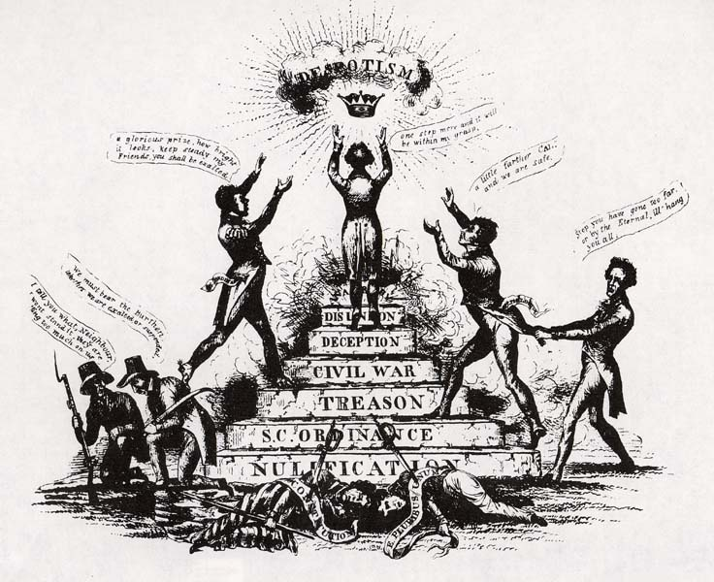
The Nullification Crisis
In 1833 South Carolina took up Calhoun’s idea and nullified the new Tariff passed by Congress in 1832 (reduced rates by 10%)
Jackson threatened to personally hang SC secessionists himself (his former VP & SC senator Calhoun being one)
Henry Clay negotiates a compromise tariff (reducing rates 10% within 10 years) => SC and Jackson both save face and agree to compromise
Political cartoon from 1833 showing the result of Nullification

Slide 42
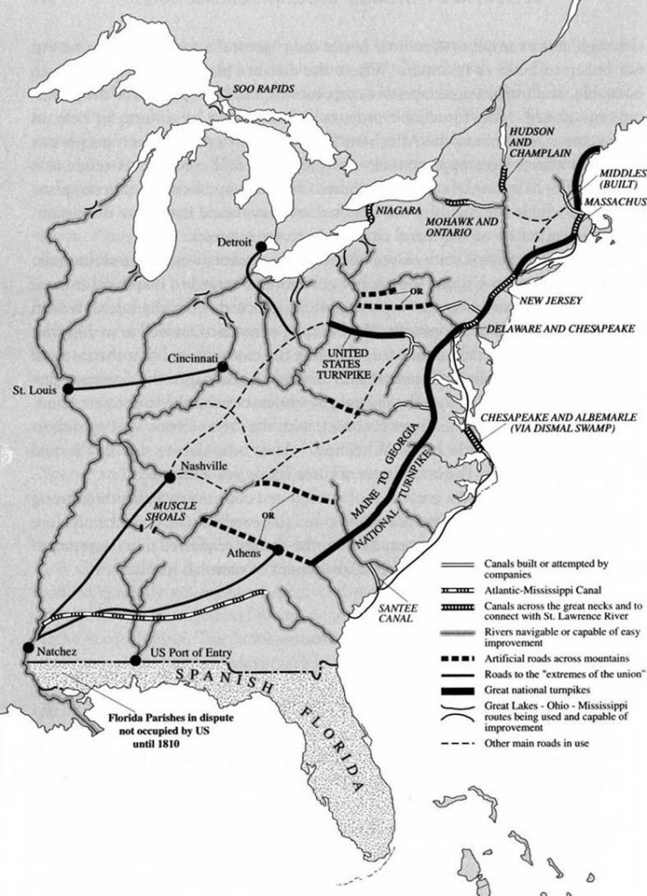
The American System
At other times, leaders (usually Western leaders) attempted to craft compromises that would please all sections
At times they succeeded, other times they did not
One such attempt was Henry Clay’s ________ _______________________
Am. System was a plan designed to promote the economic growth and modernization of the Am. Economy
#1: Strong National Bank – keeps economy going, provides loans, etc…
#2: Protective Tariff – helps US industry develop (British manufacturing too strong)
#3: Federally funded roads and canals => link regions for trade & communication
Program vetoed by Monroe (not proper role of Federal Government) & could not be passed by JQ Adams in 1825

Slide 43
Social & religious Reforms of the early 1800’s
In the early 1800’s America was swept by a wave of reform movements inspired by a variety of sources . . .
#1: American Revolution => some Americans were struggling with how to match the new ideas about democratization with existing social realities
#2: European liberalism => French Revolution & Enlightenment philosophers also inspired greater focus on equality & social responsibility
#3: _____________________________________=> the Romantic movement believed that human society was perfectable and humans should strive to achieve this goal, “transcend human experience”
#4: _____________________________________=> focused on improving human society before the 2nd coming of Christ (reform focused)
2nd Great Awakening was a reaction against _______=> idea that there was a creator God, but that he was more of a watchmaker
-- Denies divinity of Jesus, focuses on science, rational thought and reason (embraced by T Paine, Jefferson & Franklin)
-- Focuses more on the positive side of GOD => portrays God as a loving God and humans as essentially good (Church = Unitarian)

Slide 44
2nd Great Awakening Figures
Peter Cartwright => Methodist ‘circuit rider” (rode town to town on frontier holding revival meetings)
Charles Finney => preacher and President of Oberlin College

Slide 45
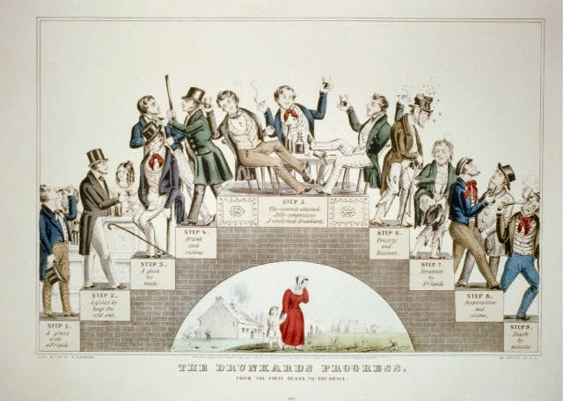
Social Reform Movements
Largely due to the 2nd Great Awakening, social reform movements gained much steam during the early 1800’s . . .
#1: ____________________ => movement was spurred by books such as Ten Nights in a Barroom and What I Saw There & efforts of reformers like Neal Dow
Many reformers stressed temperance, but Dow and others preached prohibition =>
-- Maine Law of 1851 (prohibited sale and manufacture of liquor)
Reformers (women) focused on effects on family and effect on laborers at work => called alcohol “Demon Rum”
American Temperance Society formed in 1826 => 12 states dry by 1860

Slide 46
Social Reform Movements
#2: ______________________ => supported increasingly from 1825-1860, mostly in North, by rich for means of social control and “Americanization”
Schools still local & ill controlled => “3R’s & Little Red School House Age”
Reformers such as _____________________ (MA Board of Ed.) and Noah Webster/McGuffey (textbook publisher) urged change
-- Mann implemented higher pay for teachers, longer school days & better schools; Webster/McGuffey improved instruction
-- McGuffey reader also taught patriotism
By 1860 only 100 public high schools existed and education was almost non-existent in W and S (especially for slaves)

Slide 47
Social Reform Movements
#3: _____________ => early Abolitionists like the Quakers inspired others to question slavery (most Northern states had abolished slavery by 1800)
Many early Abolitionists focused on transporting blacks back to Africa => ______________________________(Liberia w/ capital of Monrovia)
Problem????
Abolitionism really began to heat up in the 1830’s w/ publishing of ____ _________by __________________________(anti-slavery newspaper)
Uncompromising abolitionist (advocated Northern secession) => founded the __________________________________in 1833
Other abolitionists (i.e. Frederick Douglas) sought compromise and a political solution
-- Founded political parties like the Liberty Party and Free Soil Party => advocated against extending slavery further (territories)
Most northerners preferred the more moderate abolitionism
By 1840 Garrison & his extremism was decried in north as well as south as “inflammatory” and anti-union

Slide 48
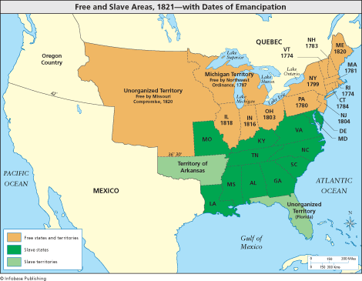
Emancipation Dates by State
Q: What was the status of slavery in the Northern states by 1800?

Slide 49
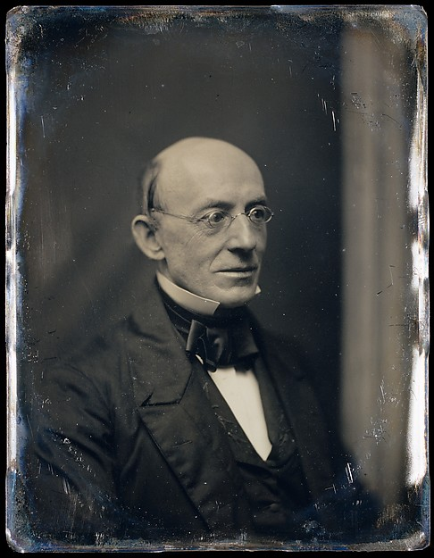
William Lloyd Garrison – The Liberator
“I will be as harsh as truth and as uncompromising as justice . . . I am in earnest and I will not equivocate, I will not excuse and I will not retreat a single inch.”
-- William Lloyd Garrison

Slide 50
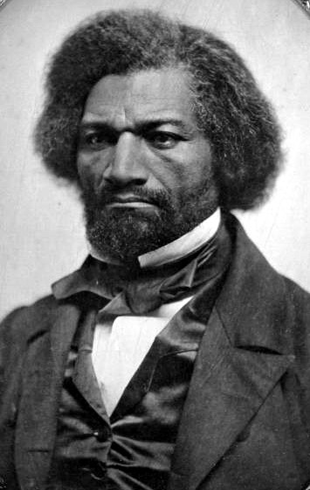
Frederick Douglas => escaped slave who learned to read and write and published a stirring account of slavery, The Autobiography of Frederick Douglas
Lectured extensively on abolition and suffered many beatings and death threats

Slide 51
Social Reform Movements
#4: Other movements
Prison Reform => prisons moved from punishment to “reform” & also eliminated “debtor’s” prisons by CW
-- Dorthea Dix also reformed and improved conditions at mental asylums for the insane
Higher Education => Women’s colleges like Troy Female Seminary and Oberlin College in Ohio offered education to women
Women’s Suffrage => _________________1848 called for women’s equality and right to vote
Women’s reformers like Lucretia Mott, Elizabeth Cady Stanton and Susan B Anthony started the ____________________________________
Suffrage often took a backseat for many reformers to abolitionism

Slide 52
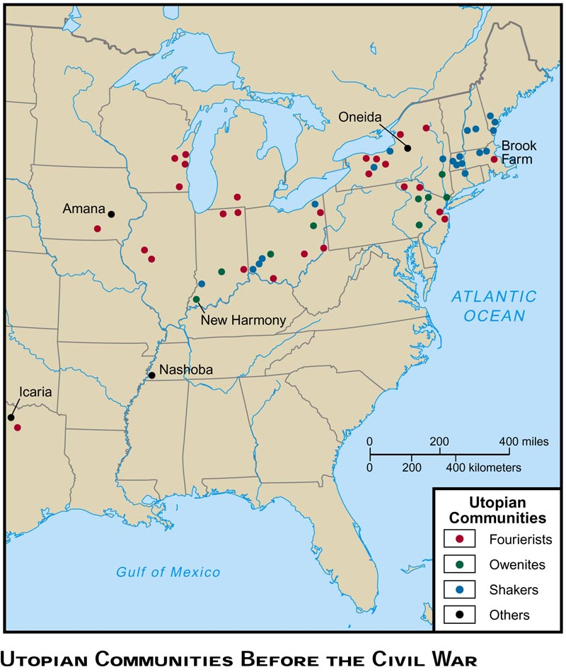
Social Reform Movements
Utopian Communities => inspired by democracy, “perfect” society & liberal ideas, 40 + utopian communities were est. in US
Brook Farm (1841) => transcendental community; farm building burnt and collapsed in debt
____________________(1848) => practiced complex marriage & eugenic selection to create “superior offspring”
-- Successful financially => silverware
_________________ (1770) => led by Mother Ann Lee
-- 6000 members by 1840 => practiced celibacy and supported themselves w/ furniture manufacture
-- Extinct by 1940 (6 Shakers today)

Slide 53
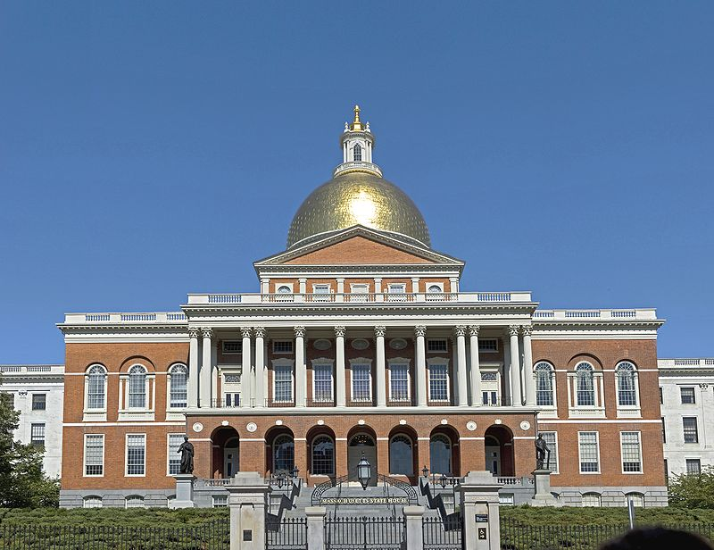
Federalist Architecture
The Massachusetts State House => an example of Federalist architecture w/ use of columns, symetry, white windows and rotunda

Slide 54
Opposition to Democratic Inclusion
Despite the trend towards democratization, many groups in America were not included (i.e. groups that were not white, protestant men) . . .
Natives
Washington Adm agreed to only acquire land via treaty => Natives routinely tricked an deceived by treaties
By the 1820’s 120,000 Natives lived east of Mississippi => Whites believed they could ‘civilize’ and ‘christianize’ Native tribes
____________________________________founded in 1787 & many tribes (Cherokees, Choctaws, etc..) adopted white practices
-- Cherokees created an alphabet, Cherokee tribal council adopted a Constitution w/ 3 Branches, owned slaves & raised cotton
After gold was discovered on Cherokee land in GA natives are forcibly removed and Bureau of Indian Affairs is founded to administer relations
Trail of Tears => forced Cherokee removal (thousands die)
Told they would be “safe” on frontier forever (lasted 15 years)

Slide 55
Cherokee Alphabet

Slide 56
Trail of Tears – Robert Lindneux

Slide 57
Trail of Tears -- 1838

Slide 58
Opposition to Democratic Inclusion
Blacks
Southerners continued to forward pro-slavery arguments in early 1800’s
#1: Slavery “good” for slaves => clothed them, fed them (better than Africa); gave them employment, social security
#2: Supported by Bible, Aristotle and ancient Romans
#3: Slaves were part of “family” on plantations
#4: Slaves treated better than Northern workers
Millions of slaves were obviously not accorded democratic rights => even freed blacks were not given equal treatment
By 1860, 500,000 free blacks lived in the US (1/2 in N & ½ in S)
-- In South they could be captured and sold back into slavery, could not vote, prohibited from certain jobs & could not testify in court
-- In North they were barred from communities, could not be educated in some states and could not vote in most states
** They were despised in both sections => in South as an example of “freedom”; in North by immigrants **

Slide 59
Opposition to Democratic Inclusion
Women
Women were not allowed to vote in any state during the early 1800’s and only about 10% of women were working outside the home
Women, upon marriage were expected to conform to the ________ ________________________=> separate spheres for women
-- Women = stay home, raise kids, wash, clean (Domestic Sphere)
-- Man = work, run country, interact in Public sphere
Women, though did exercise some level of control in family size => “_____________________________”; women had fewer children
Immigrants
Pre Civil War a new wave of immigration hit America => ____________ ___________________ were predominant immigrants of 1840s and 50s
Q: Why? => Irish potato famine, Political persecution in Germany
Need for immigrants to fill industrial jobs
By 1850 Catholicism is #1 religion in US => establish own school system to teach Catholic values

Slide 60
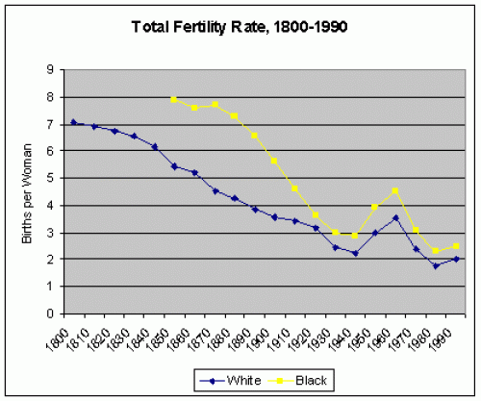
Women’s Fertility Rate during 1800’s
Q: Why is the fertility rate of women declining in the 1800’s?

Slide 61
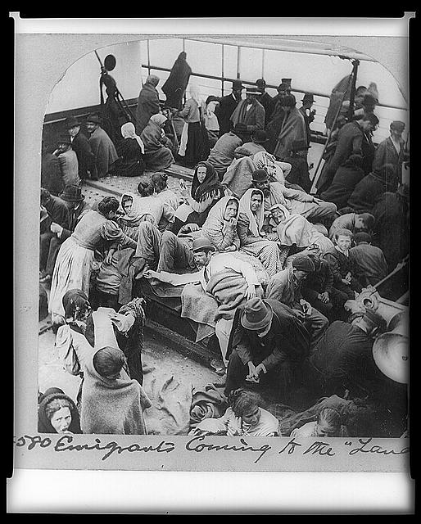
Irish Immigrants (~1860)

Slide 62
Anti-Irish and German Cartoon (~1850)
Q: How does the cartoon portray Irish & German immigrants?

Slide 63
Opposition to Democratic Inclusion
Result? => rise of Nativism in US (______________; fear of immigrants)
Nativists blamed immigrants for urban crime, political corruption, alcoholism, lower wages
NINA posters => No Irish Need Apply (discrimination)
Order of Star Spangled Banner (1849) => anti immigrant society that formed the __________________________
-- Advocated for strict limitations on immigration and deportation of poor Irish and Germans
Violence => Philadelphia riots in 1840’s =2 Catholic churches burned
“Americanization” expected of Immigrants
Irish & Germans did utilize the right to vote => formed and used patronage system effectively (Political machines like Tammany Hall)
New wave of immigrants also led to demographic shifts in America => increased Urbanization (43 cities w/ 20,000 +; NYC the largest)
New immigrants also led to a more________________________

Slide 64
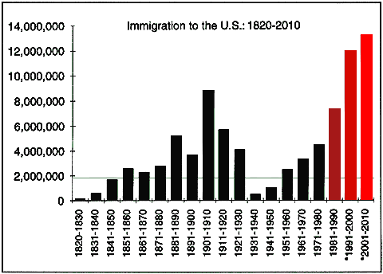
US Immigration in the 1800’s

Slide 65
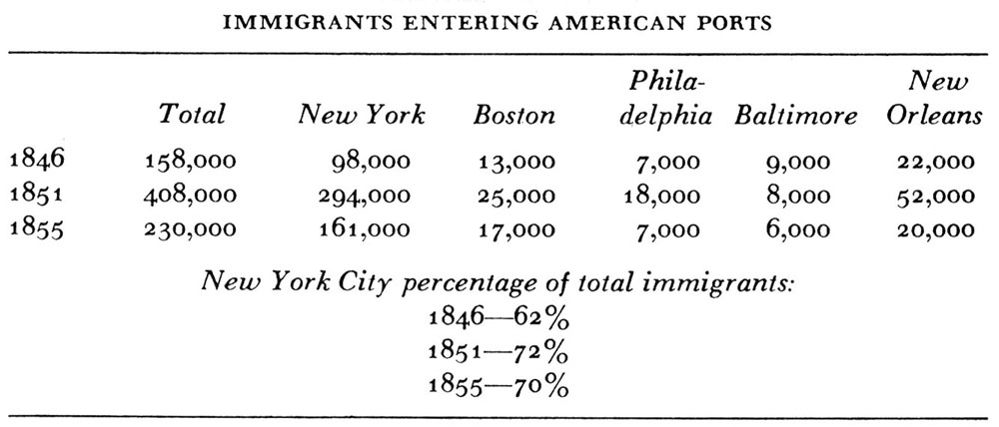
US Immigration Destinations (Early 1800’s)

Slide 66
Creation of a Nationalistic Culture in US
In the early 1800’s American artists focused on creating a distinct “American” culture in various ways . . .
Painting
Artists such as Cole, Bierstadt and Rembrandt Peale painted sweeping American landscapes => _____________________________
Romaticized view of America’s natural beauty => encouraged migration and westward movement
Enviroment
James Audubon became America’s 1st naturalist and ornithologist => recorded new species in American wilderness (Birds of America)
Helped lead to formation of National Parks (Yellowstone 1st) by George Caitlin & other painters
Literature
Nationalist Literature was promoted after the War of 1812 by James F. Cooper (Last of Mohicans) & Washington Irving (Legend of Sleepy Hollow)
“American” themes such as Revolution, nature and immortality

Slide 67
Creation of a Nationalistic Culture in US
NE also exploded with a new American literary movement => __________________________(idea that truth transcends the senses)
Truth cannot be found by observation alone => each person has an inner light that speaks to him/her
Focus on individual, rejection of authority & conventional wisdom
Famous artists =>
-- Ralph Waldo Emerson (American Scholar)
-- Henry David Thoreau (Walden; Civil Disobedience)
-- Walt Whitman (Leaves of Grass)
Religion
Mormonism founded by Joseph Smith in 1840’s => received golden plates from an Angel (_________________________)
After he was killed, Brigham Young led movement to Utah => set up cooperative agriculture, practiced polygamy and defied govt
Eventually became a state after outlawing polygamy in 1898

Slide 68
African American Cultural identity in early 1800’s
African American
African Americans relied on various methods to survive the horrors of slavery => stable families were the #1 method
Slave auctions separated families, but majority of blacks were raised in two parent households => evidence of continuity in family names
-- Separation more common on smaller plantations, Upper South
-- By mid 1800’s slaves were traded within South => from Upper (i.e. VA) to lower South
Religion also became a powerful force in African American lives => 1794 Richard Allen founded ________________________________________(AME)
Designed for freedmen and black slaves to have a place to worship
Tried to improve status of black community (Sabbath schools to teach literacy, political organizations)
Music => slave spirituals were sung at campfires and talked mostly of struggle and religious connections (i.e. suffering of Israelites)
Ring shout dances also popular (call and response)
** Ex: http://www.youtube.com/watch?v=7oFcFzJT7Tw (Roll Jordan Roll)

Slide 69
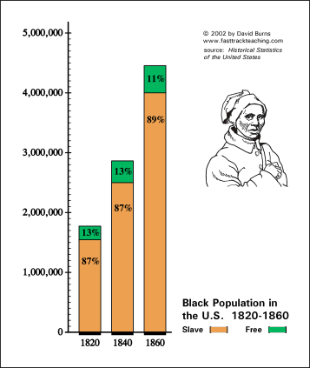
US Slave Population during Early 1800’s

Slide 70
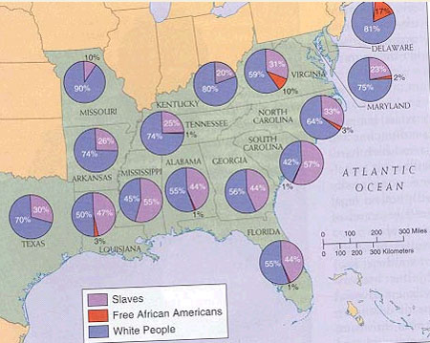
Slave Population by State

Slide 71
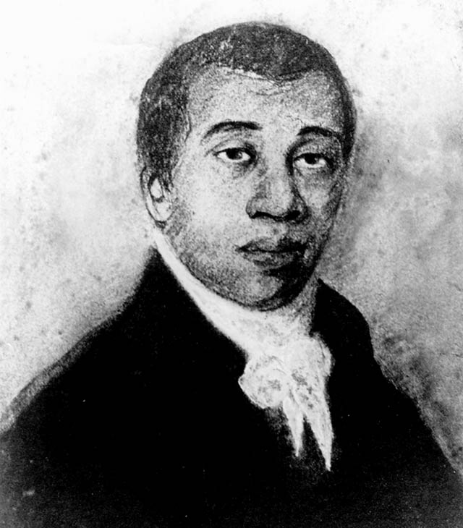
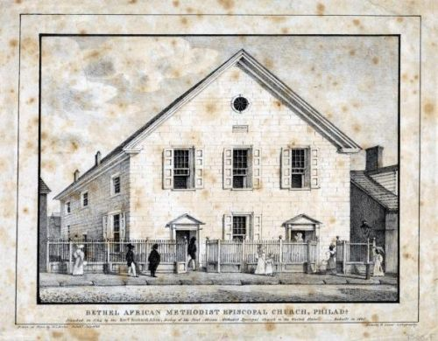
Allen’s church started at the 5am service of white churches, but eventually he tired of segregation and founded his own church
Richard Allen – founder of AME church

Slide 72
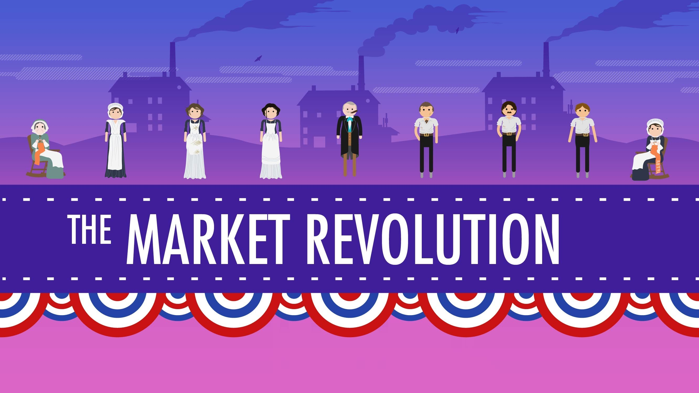
http://www.youtube.com/watch?v=RNftCCwAol0

Slide 73
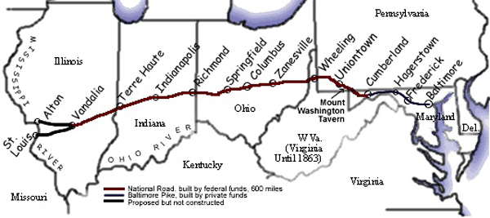
Intro to Market Revolution
By 1860 developments in the US had created a truly national economy, where 50 years earlier there stood only regional economies at best . . .
The #1 reason for this was the creation of vast network of “internal improvements” => roads, canals and railroads
Roads
Roads of the era were often private “_______________” => 1st turnpike was built from Lancaster to Philadelphia (hard surface & broad)
_____________was started in 1811 to link the East to West => road projects had difficulties securing federal funding due to state’s rights advocates
The National Road was started in 1811 and took 40 years to complete due to wars and debates over federal funding by state’s rights advocates

Slide 74
Intro to Market Revolution
Canals
Erie canal started construction in 1817 and was finished by 1825 => Led to huge boom in NY & cities along Great Lakes (Chicago, Cleveland)
Decreased cost of shipping 1 ton of grain from $100 to $5 from Buffalo to NYC => ½ price of potatoes in NYC
Thousands of miles of canals dug after Erie canal’s success
Steamboat’s introduction made water transport vastly more useful as well => Mississippi became vast trading artery
** Q: Why did RR defeat the canal by 1860? **
Railroads
First RR appeared in the US in 1828 => By 1860 US had 32,000 miles of track (75% in the North)
RR were all weather enterprises, cheaper to construct and universally usable (not need to be near water)
Early RR had many problems => poor brakes, lack of standard gauge track, fires
-- Many fixed by 1860; Laws standardized gauges of tracks

Slide 75
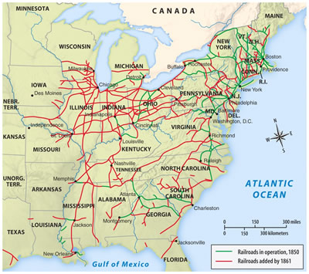
Pre-Civil War Railroads

Slide 76
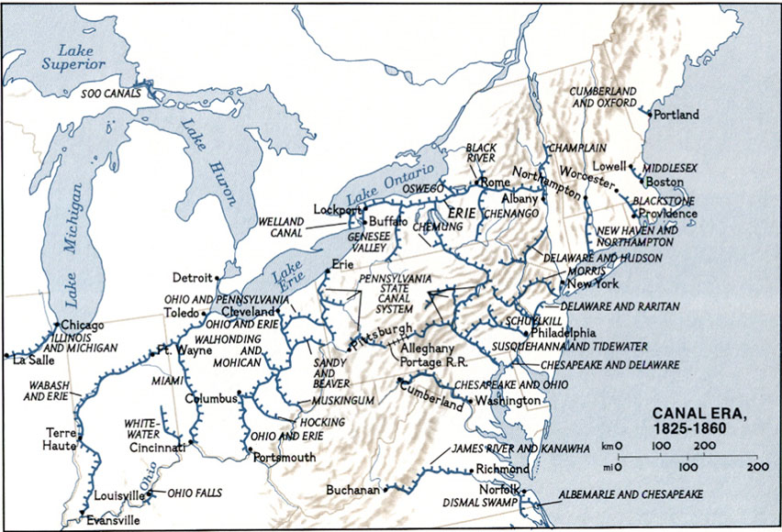
American Canals – 1825 to 1860

Slide 77
Intro to Market Revolution
Via new transportation methods US, by 1850 had become one inter-connected web of a nation & had begun to take on economic specialties
North = __________________________=> Made machines and textiles for the South and West (also for export to other nations)
South = ________________________=> raise cotton, tobacco, sugar and other cash crops for use by North and export
West = ________________________of America => raise grain and livestock to feed factory workers and Southern farmers
Regions of US were closely economically tied together & dependent
Families were now also interdependent => American families used to be quasi self sufficient (raise own food, produce own clothes)
-- Now people worked in factories or common areas specializing in one skill and traded or bought other needs (i.e. food, clothes, etc..)
Prices were also out of people’s control => set by competition & “markets”
The Market Revolution was also about how people worked => fundamental ____________________________________________
* Q: By 1850 has America become a Jeffersonian or Hamiltonian nation? WHY? *

Slide 78
Impact of Market Revolution
The Market Revolution had large and long lasting impacts on American life socially, politically and economically . . .
#1: Regional Connections => nation now interconnected by an impressive series of RR’s, canals, rivers and roads
Economy is national for the 1st time w/ regional specialization
Travel between regions easier and faster
#2: Southern isolation => Market Revolution transportation systems and economic ties more closely linked North and West than South
South socially isolated on plantations, little RR coverage, no canals
South also politically isolated by reliance on slavery => political system centered around system
#3: Migrations => Market Revolution also led to many migrations, voluntary & forced
Immigration => between 5-6 million immigrants entered America from 1830-1860 (mostly German and Irish)
-- Leads to a more pluralistic American society

Slide 79
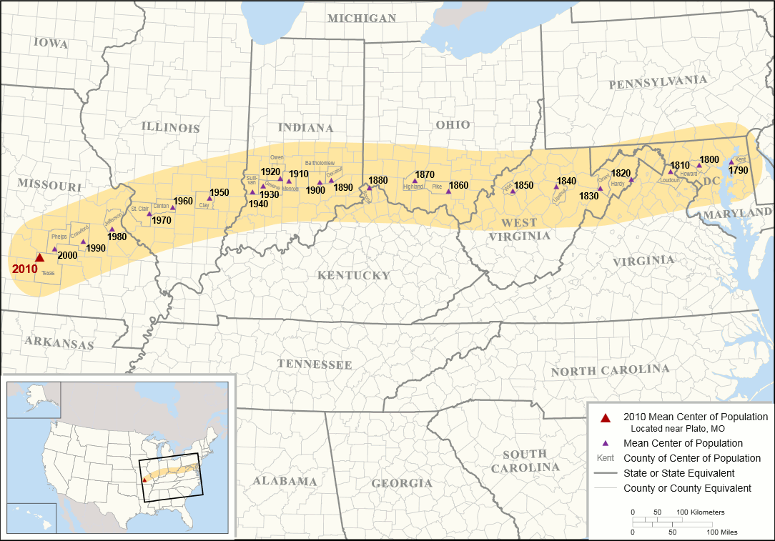
Mean Center of American Population Map

Slide 80
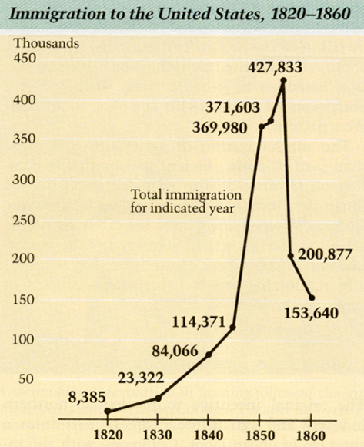
US Immigration per Year

Slide 81
Impact of Market Revolution
Western migration also occurs rapidly => millions of Americans flood western US due to economic opportunity and safety
Natives were removed from land necessary for “American” production => Trail of Tears and Reservations in Oklahoma
_____________________________developed in South to move slaves to more productive “Cotton Kingdom”
-- From 1800-1860 over 1 million slaves moved from Upper to Lower South => growing cotton and sugar
#4: Workplace changes => American workplace becomes increasingly dominated by factory labor for women and unskilled
Decline of skilled artisan => use of interchangeable parts and standardized production reduces skill of laborers
__________________________________were employed in NE textile mills => discriminated against w/ lower wages and benefits
_______________________________become ideal for women => separation of spheres with women as guardian of virtue in home
-- Males interact in “corrupt public sphere”
Market Revolution produced a new Urban Middle Class => factory owners and managers => wealth gap widens between poor and rich

Slide 82
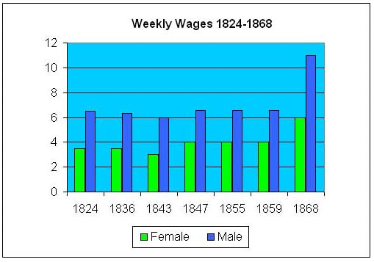
Weekly Wages for Textile workers
Q: What discreptancy exists between wages for male and female workers? Why?

Slide 83
Henry Evans, Workingmans Declaration of Independence
"We hold these truths to be self evident that all men are created equal; that they are endowed by their creator with certain unalienable rights; that among these are life, liberty, and the pursuit of happiness; that to secure these rights" against the undue influence of other classes of society, prudence, as well as the claims of self defence, dictates the necessity of the organization of a party, who shall, by their representatives, prevent dangerous combinations to subvert these indefeasible and fundamental privileges. "All experience hath shown, that mankind" in general, and we as a class in particular, "are more disposed to suffer, while evils are sufferable, than to right themselves," by an opposition which the pride and self interest of unprincipled political aspirants, with more unprincipled zeal or religious bigotry, will willfully misrepresent. "But when a long train of abuses and usurpations" take place, all invariably tending to the oppression and degradation of one class of society , and to the unnatural and iniquitous exaltation of another by political leaders, "it is their right it is their due ' to use every constitutional means to reform the abuses of such a government and to provide new guards for their future security. The his tory of the political parties in this state, is a history of political iniquities, all tending to the enacting and enforcing oppressive and unequal laws.”

Slide 84
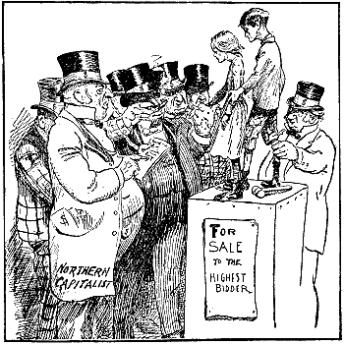
Impact of Market Revolution
Early labor movements starts out of factories => ___________________ (Philadelphia in 1828; Mechanics)
-- Wrote a Workingman’s Declaration of Independence
-- Supreme Court decision in ____________________________ allowed labor unions in US
First strikes occur in 1820’s & 30’s => 1834 Lowell Textile mill strikes
-- Most were not successful as govt sided w/ employers
Many women and children of 1820’s and 30’s complain of Northern “wage slavery”
-- Wages not enough to live on

Slide 85
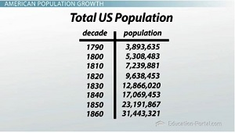
Total US Population By Decade
Q: What is the Growth Rate for American population every twenty years?

Slide 86
US Expansionism & Manifest Destiny
Post Washington, US foreign Policy continued to be dominated by isolation from European affairs => focus on American expansionism
During the Early 1800’s it became US policy to establish dominion over the entire North American continent => our “____________________”
Manifest Destiny related to idea of “American Exceptionalism” => “GOD” had ordained US to expand and carry democracy to continent
Term 1st coined by John O’Sullivan in 1845 => endorsed by most Americans and connected to feelings of patriotism & nationalism
Why expansionism needed?
#1: US pop. doubling every 20 years
#2: Fear of foreign powers dominating continent (i.e. Russia, Britain, Spanish, French)
#3: West = rich in resources & access to Pacific for trade with China/Japan
Expansionism pursued by series of Presidents from both parties over a period of decades (Jefferson, Madison, Monroe, Jackson, Polk)

Slide 87
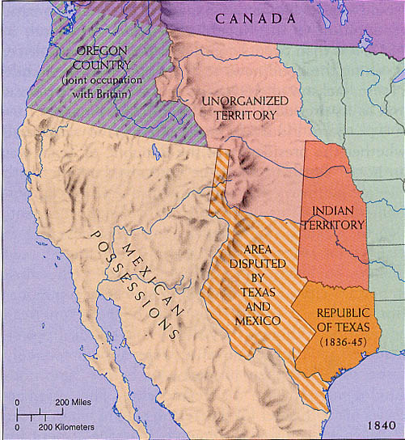
Tactics for Expansionism
From 1800 to 1852 the US utilized a variety of methods to acquire, survey and open lands to expansion & commerce
Diplomacy => i.e. treaties, negotiation, purchases, initiatives
War and aggression
Annexation => declaration that a piece of property is yours

Slide 88
Method #1: Diplomacy
Louisiana Purchase (1803)
Napoleon annexes LA Territory from Spain in 1800 => Jefferson says that “the day that France takes possession of New Orleans we must marry ourselves to the British Fleet and nation.” *Q: Why?*
US becomes concerned about French expansion, loss of right of deposit on Mississippi for trade, French block on US expansion
Jefferson sends Madison to France to negotiate for port of NO ($10M)
Napoleon offers all of LA for $15M ($.03/acre) => needs cash for wars, doesn’t really own land, can’t defend it
Jefferson uses a loose interpretation of Constitution to purchase the land w/ $$ from National Bank (takes a loan)
Solidifies loose interpretation of Constitution & National Bank
Doubles size of US & sets whets Americas appetite for more land
Sets a precedent for land acquisition => purchase via treaty
____________________sent to explore territory => came back w/ glowing review and greatly encouraged settlement of new land
** LA Purchase Cartoons**

Slide 89
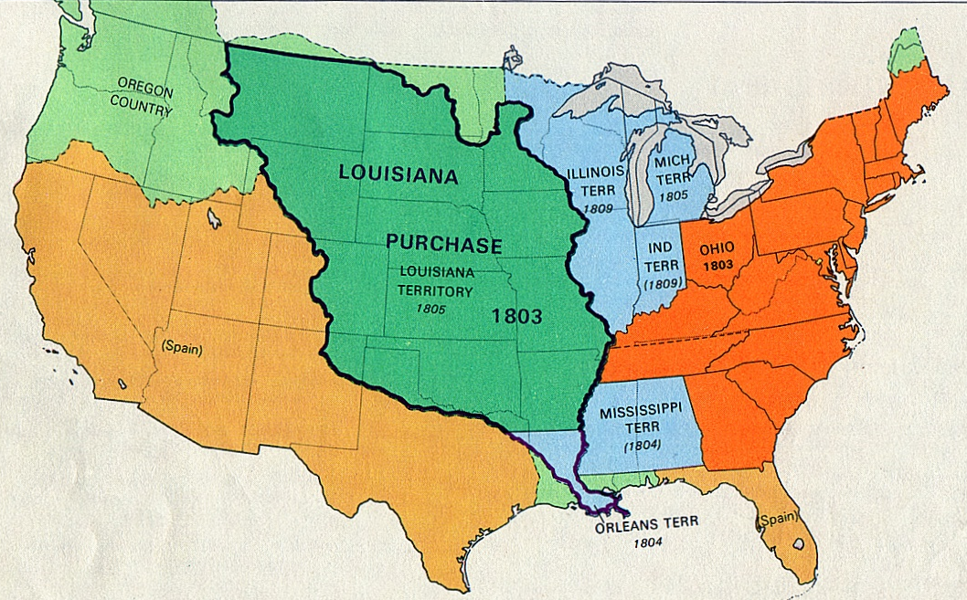
THE LOUISIANA TERRITORY
INCLUDED PARTS OF LOUISIANA, ARKANSAS, MISSOURI, IOWA, MINNESOTA, NORTH DAKOTA, SOUTH DAKOTA, NEBRASKA, KANSAS, OKLAHOMA, COLORADO, WYOMING, TEXAS, NEW MEXICO, AND MONTANA – 13 STATES CREATED OUT OF THE TERRITORY WHICH DOUBLES SIZE OF U.S.

Slide 90
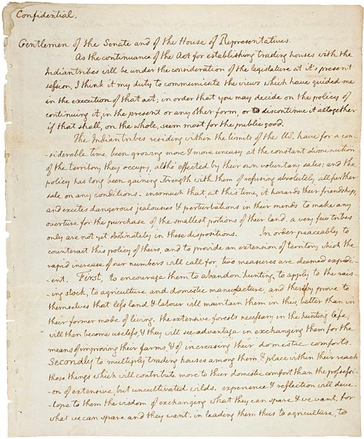
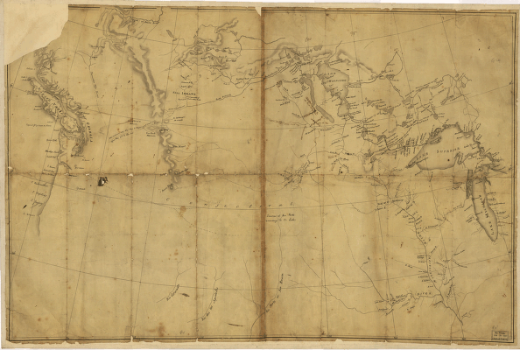
EXPLORING THE NEW LANDS
PRESIDENT JEFFERSON SENT MERIWETHER LEWIS (PERSONAL SECRETARY) AND WILLIAM CLARK ON A JOURNEY OF DISCOVERY TO MAP AND INVESTIGATE ON THE NEW WESTERN LANDS – AIDED BY NATIVES (ESPECIALLY SACAJAWEA)
CONFIDENTIAL LETTER FROM PRESIDENT JEFFERSON TO LEWIS AND CLARK ON THE PURPOSE OF THEIR EXPLORATORY JOURNEY
MAP THEY TOOK WITH THEM

Slide 91
Method #1: Diplomacy
Acquisition of Florida (1819)
Florida, under the Spanish, was a den of outlaws & Natives (Anarchy)
Monroe dispatches Jackson to guard border and prevent raids => Jackson marches into Florida and kills Spanish settlers
______________________________(JQ Adams) => Spain ceded Florida to Us but gives up all claims to Texas
Canadian Border lands (1818; 1842)
Rush-Bagot agreement (1818) => Post War of 1812 the British wanted to clear up border disputes with the Great Lakes (divides lakes evenly)
Creates world’s largest unprotected border & gives US rights to Newfoundland fisheries
______________________(1842) => settles tension of “Aroostook” war
Border dispute in Maine where Canadian and American lumberjacks were logging same areas and fighting almost broke out
Border lands settled and peace maintained

Slide 92
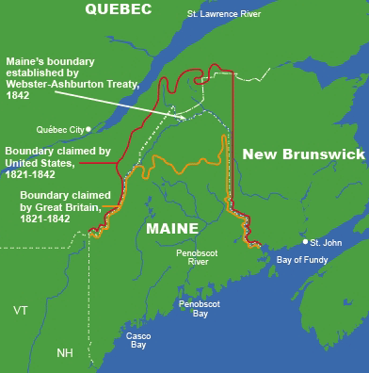
Webster-Ashburton Treaty (1842)

Slide 93
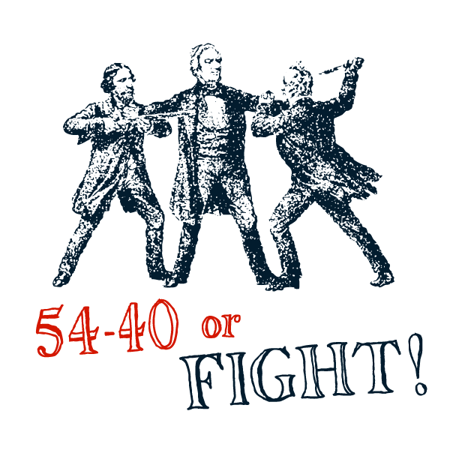
Method #1: Diplomacy
Oregon Territory (1844)
Britain and US had disagreements over Oregon boundary => both sides claimed competing extremist positions
James K Polk was elected in 1844 on a slogan of “_______ ___________”=> most Manifest Destiny driven President
Polk accepts a compromise of 49th parallel => avoids war w/ Britain

Slide 94
Oregon Territory Dispute

Slide 95
Method #1: Diplomacy
Monroe Doctrine
The Monroe Doctrine was issued by President Madison in 1822 (written by JQ Adams) => statement of US foreign policy, not a treaty
Context => Monroe makes declaration in midst of European powers expressing interest in Americas
Russia = Oregon and Cali; France = expansion in Carribbean;
Spanish = re-establish Latin American empire
Terms of Doctrine => “_____________________________________”
Forbids any further European colonization in the Americas (already established colonies okay)
Q: Can US support this doctrine? Why issue it?
Effect? => effective in stopping colonization
Britain helps US enforce (power balance in Europe)
Increases US International prestige
** Doctrine becomes a cornerstone of US Foreign policy**

Slide 96
Method #2: Annexation
Texas Annexation (1842)
Mexico gained independence from Spain in 1823 & wants to settle Texas quickly => gives land grant to Stephen Austin to bring 300 Roman Catholic families to live in Texas & become Mexican
30,000 settlers come to Austin’s land (Texicans) and ignore Mexican restrictions => Santa Anna raises an army to force compliance
Texas war for independence ends with Texas becoming an independent republic in 1836 (Battle of Alamo & San Jacinto)
-- Key figures = Sam Houston, Davy Crockett, etc….
Texas appeals to US for annexation => ignored by Jackson, Van Buren
Q: Why??? => Mexican feelings??????
Tyler annexes Texas by Joint Resolution (technically illegal) in 1843

Slide 97
Texas War for Independence

Slide 98
Method #3: War and Aggression
In 1844 Manifest Destiny reached a fevered pitch => central idea in Presidential Election
James K Polk wins on a 4 Point platform
#1: Lowered Tariff => Achieved this in 1846 with a bill that reduced rates to 25%
#2: Restore independent Treasury => established Treasury Dept. in 1846
#3: Acquisition of all of Oregon Territory
-- Disputed with Britain but settled w/ a compromise at 49th parralel in 1846
#4: Acquisition of California
Wants to open trade with China and east
** Problem?? => owned by Mexico**

Slide 99
Mexican War (1846-48)
Polk sends John Slidell in 1845 w/ $25M to negotiate purchase of California => Mexicans refuse to even meet w/ him
Mexicans still upset by Texas annexation & other incidents
Polk orders Gen Zachary Taylor into disputed territory near the Rio Grande and tells him to “wait for an attack”
Two US soldiers are killed while getting water => Polk says “despite all of our efforts to avoid it, American blood has been shed on American soil . . . Such actions cannot be ignored.”
** Analysis? => who is at fault? ( see Grant quote)
Some Whigs protest outbreak of war => Abraham Lincoln introduces ________________________(identify the spot where American blood spilt)
US never loses a battle and captures huge swaths of Mexican territory
Negotiates the Treaty of Gaudalupe-Hidalgo => Mexico recognizes annexation of Texas, cedes to US a vast territory (1/2 of Mexico), pays Mexico $15M and assumes $3.5 M in Mexican claims
Outcome? => US fulfills Manifest destiny, gains international respect, acquires Pacific port and opens trade with China and Japan
Alienates Mexico & Central American countries (US = “collossus of north”)

Slide 100
The Battles of Monterrey and Mexico City
Ulysses S Grant said of the Mexican War => “This war was the most unjust war ever fought by a stronger nation against a weaker one.”

Slide 101
Gadsden Purchase
Last piece of land to be acquired was Gadsden Purchase which was only acquired so US could build a Southern Transcontinental RR
Pierce, pro-southern w/ a southern cabinet, sent team of negotiators to meet w/ Mexican leader Santa Anna and paid $10 million for land to build a Southern transcontinental RR

Slide 102
Expansionism & Manifest Destiny case study -- War of 1812
War of 1812 is tied up in European Napoleonic Wars
US attempted many efforts to stay out of Napoleonic War
Jefferson Embargo of 1807 (no trade w/ belligerent nations)
Macon’s Bill #2 => trade resumes w/ French (angers Britain)
War of 1812 was 2nd war fought w/ British in a generation => what caused the war????
#1: Indian problems and issues on frontier => frontier settlers and exposed to many Native raids (believe the British are supplying Natives)
Indian Chief Tecumseh organizes last Native Confederacy => defeated by WH Harrison at Battle of Tippecanoe
#2: Land Hunger => Dem-Republicans want to expand farming in West; still hungry from LA Purchase (want Canadian land)
#3: Freedom of Seas => British practice of impressment angers Americans (6000+ sailors from 1800 to 1812)
#4: War Hawks => leaders like Henry Clay (westerners) who want to “prove” themselves in battle vs British

Slide 103
War of 1812 – Major Campaigns

Slide 104
Expansionism & Manifest Destiny case study -- War of 1812
War Hawks negotiate a deal w/ Madison => they aid his re-election campaign and he declares war against British
War causes internal division in America => Q: Who would be opposed to war w/ Britain? Why?
NE Federalists oppose war due to trade impact => Blue Light Federalists (shine lights to warn British of US attacks at night)
Author the _______________________=> discuss secession and nullification and vote for 4 new amendments (i.e. 2/3 vote to institute an embargo, declare war or admit new states)
War outcome => war is essentially a stalemate after failed US invasion of Canada; Britain does burn WH in 1814
War increases nationalism, provides war heroes (i.e. Jackson) and eliminates Federalists as a national party
Treaty of Ghent does not address any issues war fought for

Slide 105
Impact of Manifest Destiny
Manifest Destiny had many impacts on American history (both + & -)
#1: Increase in Nationalism => success in expansion brought people together in a common goal and buoyed US pride (i.e. MX War)
#2: Increasing western migration => west populated quickly as settlers rushed into claim new lands (_______________=> purchase up to 80 acres for $1.25/acre)
#3: Cultivation of new regional cultures => frontiersmen and mountain men dominated western scene and created an enduring image
Key to exploration, trade and US land claims => frontiersmen lived a tough life (trapping, hunting) and reinforced American individualism
Exs: Davy Crockett, Daniel Boone
#4: Created or reignited many controversial issues => i.e. expansion of slavery, federal supremacy and Native Removal
Federal Supremacy was challenged on numerous occasions => Nullification Crisis, Hartford Convention, Theory of Nullification
-- Northern view => Federal Government was ultimate authority in US and could overrule state power and interests
-- Southern view => state supremacy and right of states to disagree and impose will on federal government

Slide 106
Resistance to Expansionism & Federal Authority
Largest disagreement by far, though centered around the expansion of slavery into the newly acquired territories . . .
Northerners wanted to limit the expansion of slavery
-- US follows European lead and abolishes Intl. slave trade in 1807
-- 2nd Great Awakening and abolition movement also influenced many Americans => Frederick Douglas and many slave accounts
-- _______________________and other political movements focused on limiting the expansion of slavery into new territories
Southerners want to expand slavery and ensure its survival
-- Intensive farming had depleted soil of Upper South (i.e. VA) => lower south & lands of SW needed to expand cotton production
-- South also concerned about Northern attempts to outlaw slavery => want to maintain sectional balance in Congress (i.e. Senate)
-- Forced Congress to pass a law in 1835 banning abolitionist materials in Southern mail (postmasters were to destroy in South

Slide 107
The MO Compromise or Compromise of 1820
The most critical Sectional concern was the admittance of new States * WHY?*
Balance in Congress was maintained between “Free” and “Slave” states up until 1820 at ~ 10 of each
In 1819 Missouri, having reached 60,000 in population petitioned for statehood
Problem:
#1: Tip balance of slave/free states
#2: Majority of Missouri owned slaves – wanted slavery extended
Tallmadge Amendment proposed which would allow slavery in MO but free all slaves born there when they reached age of 25 and then ban slavery
-- Passes House (North = higher pop) but not Senate
** South sees that they must keep balance in Senate or face end of slavery!! **
Compromise prevails after months of deadlock – Clay orchestrated
Terms: #1: Missouri admitted as a slave state
#2: Maine admitted as a free state
#3: Slavery banned North of 36’ 30’’
Henry Clay – The “Great Compromiser”

Slide 108
Problems w/ Compromise??? Who “wins”?
-- See quotes

Slide 109
Presidents on MO Compromise
T. Jefferson “ The Missouri Question … is the most portentious one that has ever yet threatened our Union. In the gloomiest moment of the Revolutionary War I never had any of the apprehensions equal to what I feel from this source … [the] question, like a fireball in the night, awakened and filled me with terror . . . With slavery we have a wolf by the ears and we can neither safely hold him or safely let him go. I consider this question to be the knell of the Union.”
JQ Adams “I take it for granted that the present question is a mere preamble – a title page to a great tragic volume.”

Slide 110
Expansionism – the Native Question
As the US expanded in all directions, they also came across another source of tension and opposition, Natives . . .
Although some groups favored integrating Natives into American culture (i.e. Society for Propagating the Gospel Among Indians) US policy was best characterized by Jackson’s Native Removal policy
-- Series of encounters in the early 1800’s cleared Natives out of the way so that whites could expand safely into Am continent
#1: Native Removal in SE => due to Native Removal Act in 1832 Cherokees & other tribes were removed to Oklahoma (Native Reservation)
Some tribes went peacefully and relied on Bureau of Indian Affairs
-- Gave Natives poor quality provisions & settled them on low quality land (removed them if land value changed; SD example)
#2: _________________=> Series of 3 wars fought from 1816 to 1842 in Florida
Natives in Florida resisted removal and attacked frontier settlements
US sent in army & brutal fighting in swamps led to many casualties; US utilized tactics such as killing chiefs who came into negotiate truces
Native chiefs (i.e. Osceola) eventually bribed & starved into submission => shipped west after their defeat

Slide 111
Native Removals due to Indian Removal Act (1832)

Slide 112
Oklahoma => Indian Reservation

