Slide 1
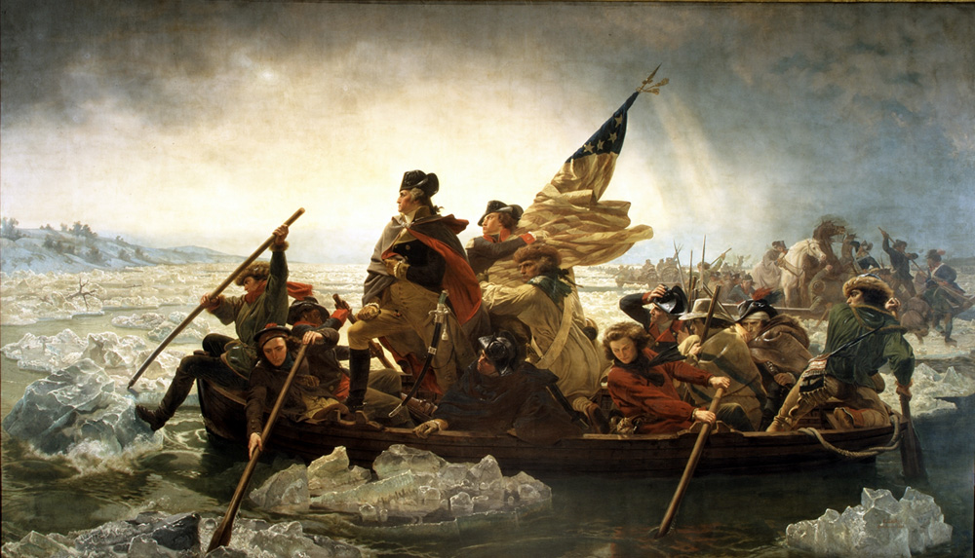
Unit III: American Revolution and Early Republic
Q: What is wrong with this picture? Why is it drawn this way?
Washington Crossing the Delaware

Slide 2
Unit Big Questions and Periodization
Periodization => Why 1754? Why 1800?
In 1754 the ___________________started => France and Britain battle for N. American colonial supremacy
-- Voltaire: “A cannon shot fired in America set Europe ablaze”
1800 => end of John Adams term as President and election of Thomas Jefferson (“_______________________________”)
Unit Essential Questions . . .
What political, social and economic events and ideas led to the outbreak of fighting in the American Revolution?
What forces and events led to American victory in the American Revolution?
When did a distinct American identity first form? What are some examples and evidence of that formation?
Evaluate the effectiveness of the AOC as a form of government.
How did the Constitution fix the social, political and economic problems of the AOC?
What led tot creation of the first American political parties? How did they contribute to national unity? Sectionalism?

Slide 3
The Seven Years War or The French and Indian War (1754 – 1763)
In 1754 France & Britain fought THE war that determined North American colonial domination => last in a series of wars (see handout)
Previous wars start in Europe and spread to N America => F & I War starts in North America (border dispute in Ohio Valley)
Britain starts to see N American colonies as an asset => wants to expand to Canada (French) and Florida (Spain)
-- Sends Col. Washington to survey disputed territory near Ft . Duquesne => shots are fired at Ft Necessity
Native tactic prior to F&I war was to renegotiate alliances w/ Europeans
Ex => Iroquois used English aid to defeat the Huron & French during the Beaver Wars, then signed Great Peace of Montreal w/ French
-- Treaty expanded fur trading w/ French and allowed Natives to repopulate Ohio Valley (feared English expansion)
-- Treaty jumping allowed Natives to pursue their own policies => settle grudges w/other tribes, trade, expand territory, etc….

Slide 4
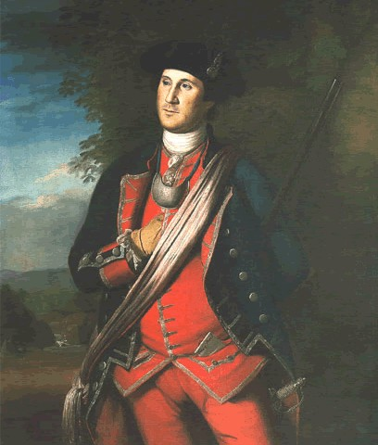
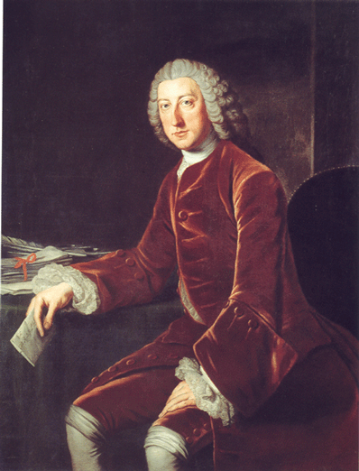
Major Figures of the French & Indian War
23 year old Colonel Washington and William Pitt (British PM)

Slide 5
The Seven Years War or The French and Indian War (1754 – 1763)
Sides in French and Indian War were . . .
#1: ____________________________(+2 Iroquois tribes) vs.
#2: __________________________________(+ all Natives in N. America)
Native tribes (Huron, Shawnee, Delaware) allied with French due to fear of English settler expansion (even split Iroquois Confederacy)
Early war goes disasterously for British => Braddock defeated at Ft. Duquesne (Guerilla vs Traditional warfare misunderstandings)
** Last of the Mohicans video clip**
Prussian troops under Frederick the Great defeat Spanish, Russians and French in Europe => frees British up in N. America
William Pitt sends additional troops, increases supplies and spends large amount of $$ to win war (pays colonials in gold)
After British invasions of Canada and victories in Montreal and Quebec Britain signs ____________(1763) to end war => no Natives present
British debt at wars end was over $122 million pounds!!

Slide 6
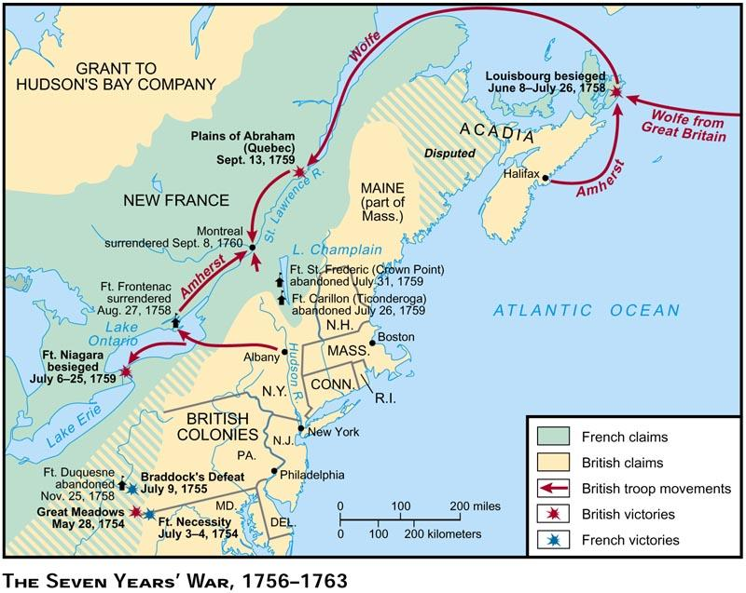
Major Campaigns and Battles of the F&I War
The British overcame early losses by investing troops and $$ in N America => went into debt

Slide 7
Aftermath of the F&I War
Treaty of Paris (1763) ends French presence in N America
France must give up all land in N America => Canada and land East of MS river goes to Britain and land west of MS goes to Spain
-- France is humiliated and wants revenge on Britain
-- British claim Native land even though none are at negotiations
Britain also gets Florida from Spain
Ottawa chief Pontiac considers treaty illegitimate=> rebels on frontier to drive British settlers back out of Ohio Valley (__________________)
British destroy Ottawa tribe and King issues___________________
-- Forbids all British settlement West of Appalachians => ignored by thousands of settlers and land speculators
Paxton Boys (Scot-Irish settlers in PA)& other settlers formed vigilante groups to protect frontier settlements from Indian raids
Paxton Boys raided Conestoga tribes’ lands (granted by Penn) and killed 20+ (Conestogas = Christian Natives who were peaceful)
** Constant encroachment and attacks lead to poor relations between frontier settlers and Natives after F&I War**

Slide 8
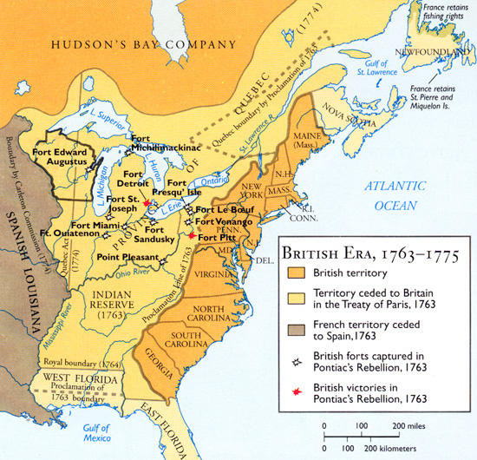
Proclamation of 1763
British believed that this line would settle Native/settler disputes and avoid violent confrontation => it seemed to colonials to be siding with Natives vs colonists

Slide 9
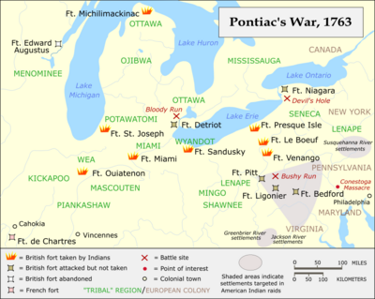
Pontiacs Rebellion – Ottawa tribe
Ottawa chief Pontiac believed that this was the last chance for Native to repel English settlers => attacked settlements and forts along the Ohio Valley

Slide 10
Effect and Impact of F&I War
Colonies => self identity and nationalism
1. Gain self-confidence & military experience
-- 20,000 Colonials in arms; Washington and other military leaders
2. Realize that Colonies must be united to be powerful (I.e.___________________)
-- Colonists see how ‘alike” they are while serving as soldiers
3. Want to expand into newly opened lands to the west
4. Begin to see the British as not “invincible” and “conquerable” => Braddock’s defeat & misunderstanding of New World warfare
British => debt and mercantilism
1. Want to clamp down on colonies and exploit riches
2. Want strict political and economic control of colonies => have been very loose since 1700 (“________________________________”)
3. Believe Colonists did not help w/ war effort enough
-- Laugh at Colonial Militia (allow no Americans w/ rank of Major or above)
-- Colonials need to be “reimbursed” & illicitly trade w/ French and Spanish
4. Believe colonials should help pay for War Debt ($122 M pounds)
-- War “started” in America; War helped to “protect” colonies
-- British troops must remain in New World to protect colonies against Natives

Slide 11
Motivations for Colonial Independence
After the F&I War many events, ideas and trends led an emerging colonial independence movement . . .
#1: Colonial population explosion => from 1700 to 1776 population in the British colonies increased from 250,000 to 2.5 M (10x)
Majority of increase was homegrown => new inhabitants thought of themselves as “American” in identity
#2: Self Government => all colonies had some form of elected legislature which instilled a desire for self rule and republicanism
Many colonials felt that British taxation passed by Parliament (no colonial reps) trampled this idea => “Taxation w/o Representation”
-- British rationale of ____________________(every member of Parliament represents all subjects) was not accepted by many
Colonials also did not like the idea of Royal veto (King could veto any colonial law) => only used 469 times in 8,563 laws
Colonials also believed that British authorities were violating English rights as expressed in the English Bill of Rights & Magna Carta

Slide 12
British N. American Colonial Population

Slide 13
Motivations for Colonial Independence
#3: Protestant Evangelism => Puritan idea of Massachusetts colony as a “City on a Hill” had morphed into “__________________________”
Am. Exceptionalism => idea that republicanism, pure Christianity & clean environment made America “different” from Europe
Lent itself to nationalism and deeper American identity
#4: Salutory Neglect => Britain’s “hands off” enforcement policy for majority of 18th century had created a lack of respect for British law
Molasses smuggling, colonial iron furnaces, trade with French& Spanish during F&I War contributed to ideas of Free Market
-- Embraced Adam Smith’s Wealth of Nations (capitalism) vs British mercantilist practices
#5: Enlightenment ideas => writers like Rousseau, Locke and Adam Smith argued for new models of government and economics
Locke and Rousseau argued for republican govt based on a social contract between ruler and people (ruler elected based on merit)
-- Argued for inalienable rights for all man (“Life Liberty & pursuit of happiness”) => reflected in Declaration of Ind & Bill of Rights

Slide 14
Motivations for Colonial Independence
Adam Smith’s Wealth of Nations advocated free market capitalism and free trade (instead of restrictions of mercantilism)
There were two groups that embraced the new independence movement => colonial elites and grassroots groups
Colonial elites were those in power or with wealth/land that believed the British were squelching opportunity, abusing power
-- Exs: George Washington, John Adams, Thomas Jefferson
-- Wanted freedom so they could pursue economic policies & self rule w/o British interference (sometimes co-opted grassroots)
-- Formed groups such as the ______________________to coordinate efforts and formulate strategies
Grassroots groups were artisans, laborers, women etc.. that believed in the idea of republicanism or were swept up in nationalistic fervor
-- Exs: Sam Adams, Paul Revere, Crispus Attucks, Mercy Otis Warren
-- Formed groups such as the __________________to protest and agitate against British actions that impeded liberty

Slide 15
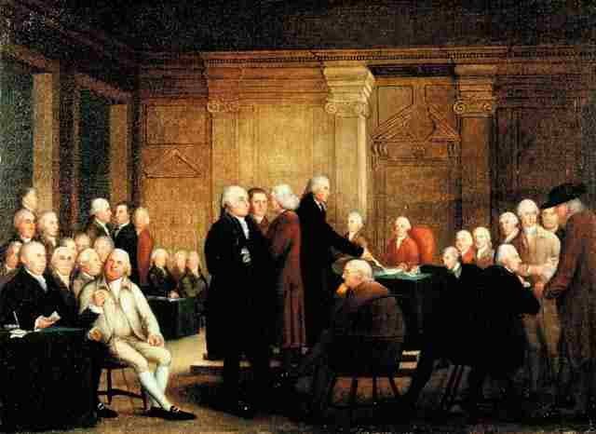
Committees of Correspondence
Committees of Correspondence were quasi governmental organizations in 11 of the 13 colonies run by Patriots that coordinated colonial response to British actions and eventually organized colonial government at the local and state level
-- They would meet regularly and write letters to other local committees as well as committees in other colonies

Slide 16
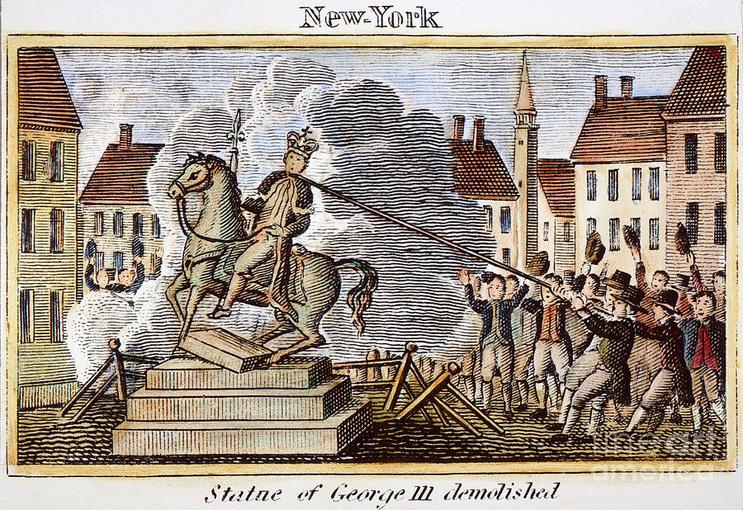
Sons of Liberty
The Sons of Liberty was a group of mainly middle to lower class members (artisans, printers, lawyers, politicians) who organized opposition to British actions based on the “rights of Englishmen”
-- They conducted actions such as the Boston Tea Party, were present at the Boston Massacre and organized Stamp Act protests which led to the act’s repeal

Slide 17
Outbreak of Revolutionary War
As the British cracked down on their American colonies administratively & economically, events also led to war between Britain and the colonies
Repeal of ______________________
In 1766 due to colonial protests, economic boycotts and the difficulty of enforcing the tax Parliament repealed the Stamp Act
Later added the Declaratory Act (right of Parliament to tax colonies) and Townshend Acts (tax on paper, paint, lead, glass and tea)
-- TA were import taxes (colonists forced to import all items)
Repeal set precedent that colonists could influence British
_______________________________
In 1770 during protests about the Townshend Acts (England would pay salaries of governors and officials) 5 colonists were killed by troops
British troops were acquitted of killings in British court
Paul Revere engraving popularized event to colonists => led to increased unity and distrust of British

Slide 18
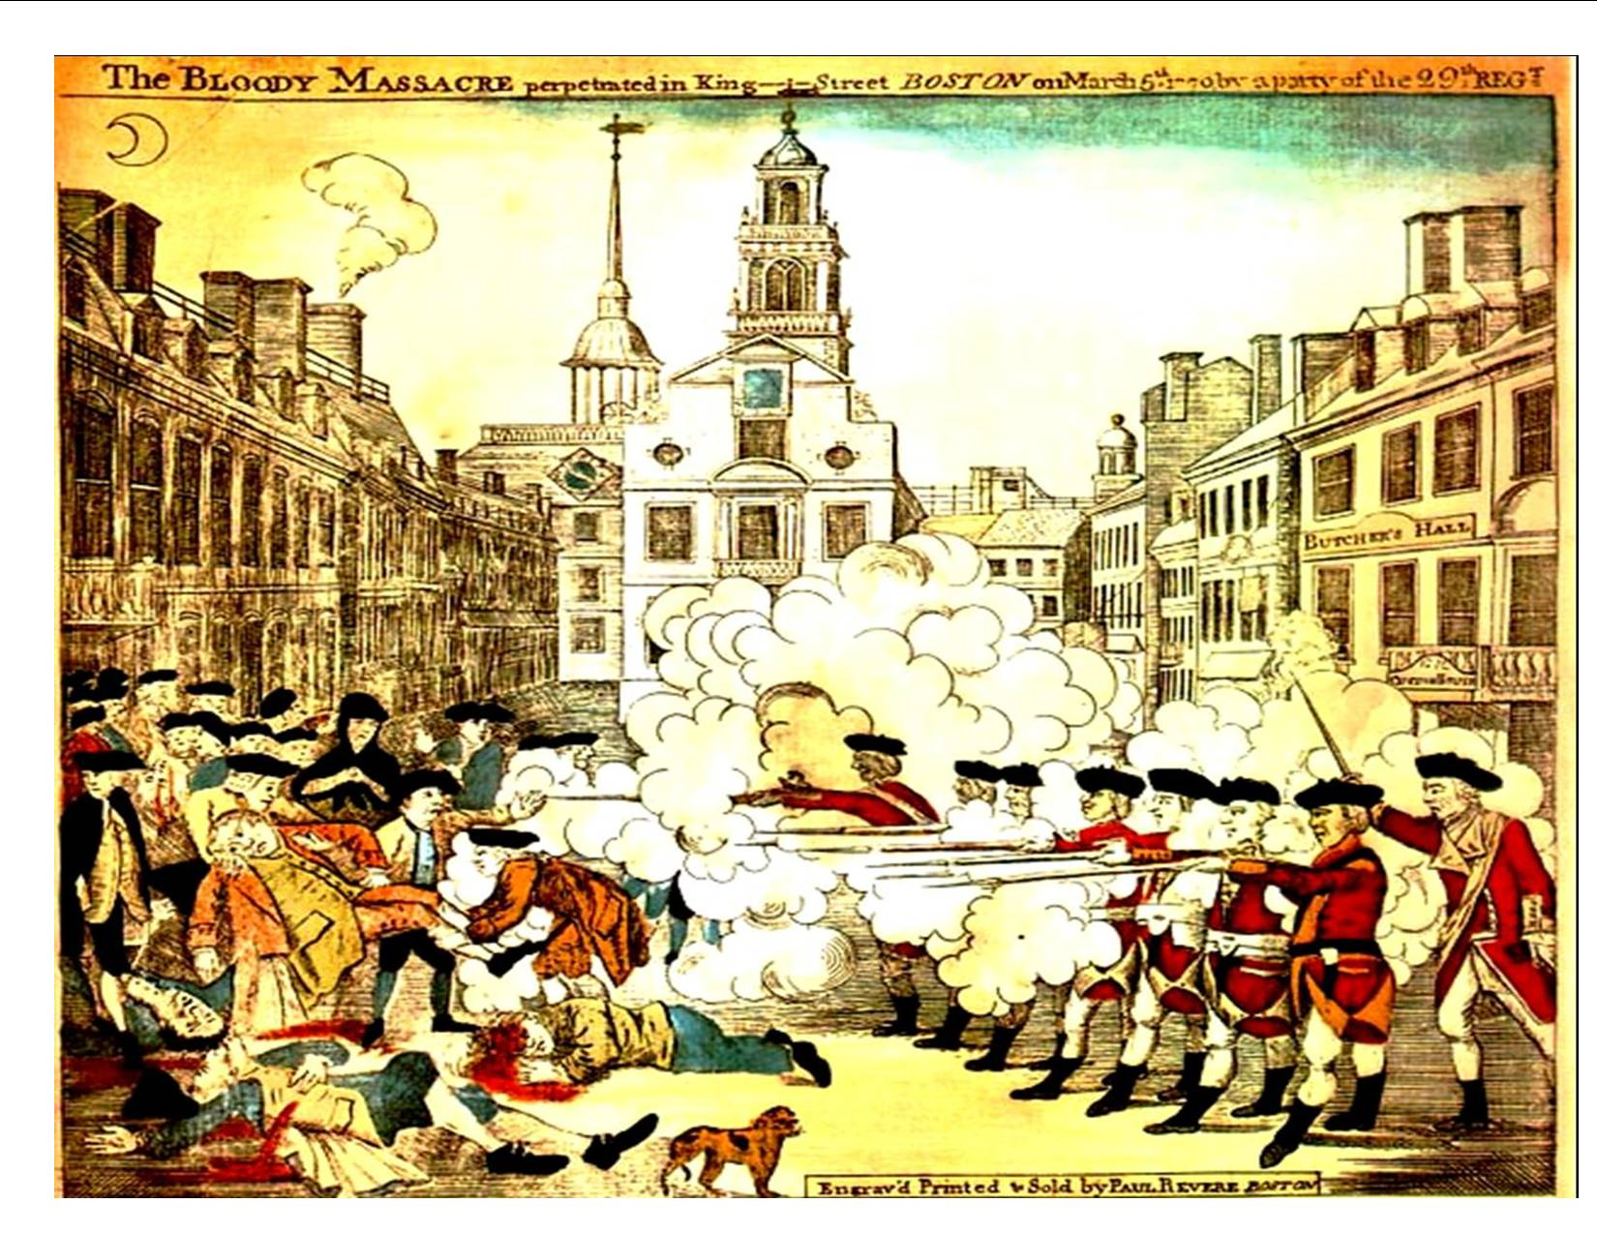
Boston Massacre -- 1770
Q: How does Revere depict the event? Do you believe he is accurate?

Slide 19
Outbreak of Revolutionary War
_____________________________
In 1773, after imposition of Tea Tax, Sons of Liberty boarded British ships and dumped 342 chests of tea ($1M) into Boston Harbor
British responded w/ Coercive Acts or Intolerable Acts=> shut down Boston Harbor until tea was paid for ($968,000 pounds)
Colonists responded by calling 1st Continental Congress => called for repeal of Act, opening of Boston Harbor
56 delegates from 12 colonies (Georgia) => set up _______________ , organized boycott of all British goods
-- Group divided between reconciliation and war
__________________________
In April 1775 British troops were sent from Boston to arrest “rebel” leaders Sam Adams and John Hancock and take a store of weapons
Met militia resistence and shots were fired in Lexington => 73 British killed (174 wounded); 39 Americans killed (49 wounded)
Led to the colonial siege of Boston and Battle of Bunker Hill

Slide 20
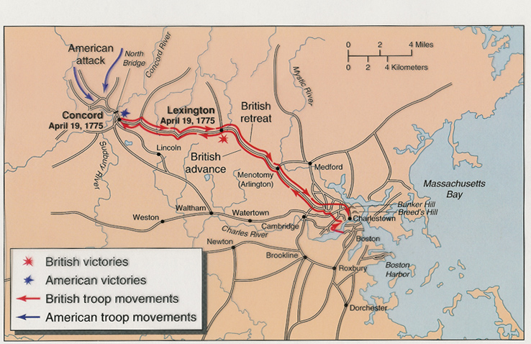
Lexington and Concord
Although an impromptu battle, colonial militias had been organizing and practicing for months prior to April 1775 => the British were outnumbered and rattled, they retreated to Boston and colonials lined up along the road to shoot at them during their entire retreat

Slide 21
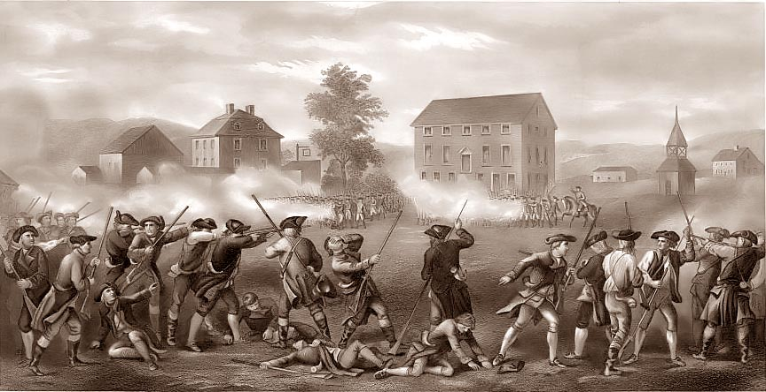
Outbreak of Revolutionary War
2nd Continental Congress
After the Battle of Bunker Hill, colonial assembly sent the Olive Branch Petition to the King => asked for home rule and reconciliation
King threw away w/o reading => start of formal Revolutionary War

Slide 22
Revolutionary War Advs and Disadvs
As the Revolutionary War started it looked grim for the Am. colonies. . .
British Advantages (7.5 M population)
Military superiority => large standing army (50,000) that was professionally organized; large navy (78 ships, 170,000 sailors)
British also had Native American aid and Loyalist support (30%)
Economic superiority => largest economy in world, colonial empire, industrial production #1 in world
Ability to hire troops (30,000 Hessian mercenaries)
American weaknesses (2.5 M population)
Disorganized politically => capital constantly shifting (York?) and CC provided weak leadership
Lack of unity => states act independently at times (militias)
Army enlistments difficult to enforce, desertion common
Lack of $$ and supplies => print Continental Currency (worth $.02/dollar within a year)
Soldiers often go hungry, shoeless, lack of horses, guns, etc….

Slide 23
BOTH SIDES HAD STRENGTHS AND WEAKNESSES
COLONISTS (2.5 M) | BRITISH (7.5M)
STRENGTHS | STRENGTHS
STRONG MILITARY LEADERS – Washington and Lafayette | LARGE NUMBER OF TROOPS
FOREIGN AID (I.E. France) | PROFESSIONAL ARMY
MORAL ADVANTAGE | WEALTHY
AGRICULTURALLY SELF-SUFFICIENT | ABILITY TO HIRE MORE TROOPS
LARGE AREA – No “real” capital (i.e. hard to conquer) | WEAKNESSES
WEAKNESSES | UNORGANIZED GOVT. – WHIGS SUPPORT COLONISTS
DISORGANIZED – C.C. WEAK DURING WAR | 3,000 M AWAY: DIFFICULT TO GET SUPPLIES, ORDERS
LACK OF UNITY – States act independently | WEAK GENERALS AND BRUTAL TREATMENT OF SOLDIERS
ECONOMIC PROBLEMS -- $$ and supplies | FRANCE WANTED REVENGE

Slide 24
Views on the American Revolution:
“A salient feature of our Revolution was that it’s animating purpose was deeply conservative. The colonials revolted against British rule in order to keep things the way they were, not to initiate a new era.”
-- Carl N. Degler
VS.

Slide 25
“The American Revolution was more than a war on England. It was in truth an economic, social and intellectual transformation of prime significance – the first of those modern world-shaking reconstructions in which mankind has sought to cut and fashion the tough and stubborn web of fact to fit the pattern of its dreams.”
-- Charles A. Beard & Mary Beard

Slide 26
Revolutionary War
In 1776 the Continental Congress met again in 1776 and directed Thomas Jefferson to draft a Declaration of Independence
The document is debated & revised in June/July of 1776 and signed formally on July 4th => read throughout colonies in later weeks
-- Significant sections were revised => i.e. section condemning the slave trade and slavery was deleted (offensive to south)
The Declaration of Independence is a document that contains a clear expression of the American beliefs in __________________& the natural_________________________
-- “All men are created equal” => Meaning?
-- “[All men] are endowed by their Creator with certain unalienable Rights, that among these are Life, Liberty, and the pursuit of Happiness.” => Meaning?
-- “To secure those rights, governments are instituted among men, deriving their powers from the consent of the governed”
=> Meaning???

Slide 27
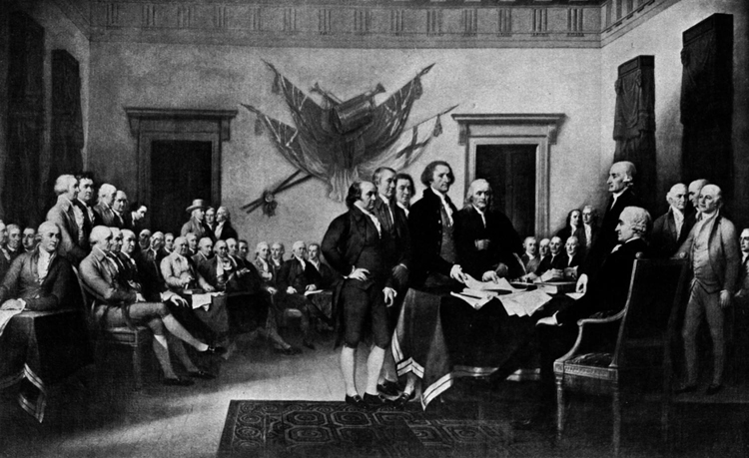
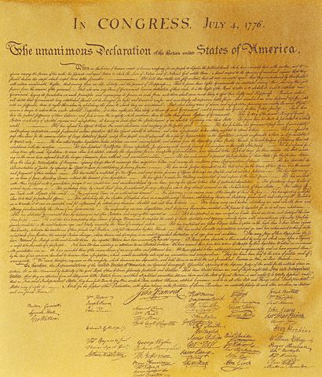
The Declaration of Independence
Although the Declaration was adopted on July 4th, it was actually voted upon on July 2nd and most people signed it in August

Slide 28
Revolutionary War
The Revolutionary War was fought between the British and Colonials, but support for independence and liberty in America was not universal
Majority of American colonists tried to remain neutral => 20% Loyalist (Tories) and 30% Patriots (Rebels)
** Q: More courage to be a Loyalist or a Patriot? Why??**
Loyalists
Typically _______________________connected and ________ * WHY?*
Loyalists stronger in______________________________________
Many blacks fought for both sides but more were Loyalists => British promised freedom after war’s end
Loyalists fought for British (50,000+) served as spies, incited Natives and sold food and goods to them (British underused Loyalists)
Loyalists were treated poorly during & after war by Patriots (property confiscated, hung) => many moved to Canada in 1783 or before

Slide 29
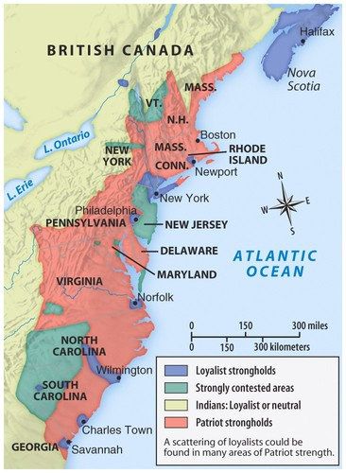
Loyalist vs Patriot Areas
Patriots
Typically___________________ _________________________
-- Many families split (Ben Franklin and son)
Patriots stronger in ________ ____________=> Presbyterian and Congregational churches
Very passionate recruiters of followers => passionate about ideological cause

Slide 30
Major Battles and Strategies
As the war started the British & Americans adopted different strategies
British = cut colonies in half (Hudson River Valley sweep)
Americans (after Manhattan) = fight a defensive, guerilla war and outlast British (no decisive defeat), gain foreign aid
British strategy floundered due to poor leadership and lack of knowledge of terrain => defeat of Burgoyne at _________(turning point)
General Howe wintered in Philadelphia while Burgoyne floundered in upstate NY => colonials used terrain to outmanuever him
-- Americans winter at _____________(25% of men die of exposure or starvation) => drill under German & French officers
After Saratoga B. Franklin is able to negotiate an alliance w/ France
British get drawn into a global conflict w/ Spain, France and Dutch
Contributes international respect and legitimacy
French supply 90% of gunpowder, large number of rifles and cannons, 25% of “American” army, 90% of American Navy
After many more years of fighting in the South and NY, Washington (w/ French naval aid) captures Cornwallis at _______________(end of war)

Slide 31
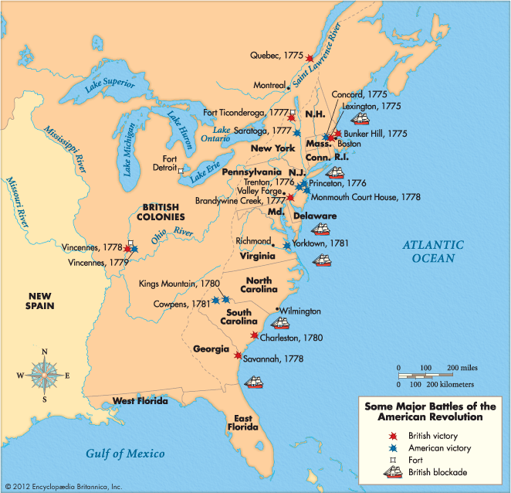
Major Battles of Revolutionary War
Total Casualties:
American – 25,000 dead (8000 in battle); 30000 wounded
*8000+ French and Spanish dead
British – 20,000 dead and wounded; 19,000 sailors dead
**42,000 deserted; 8000 Germans dead

Slide 32
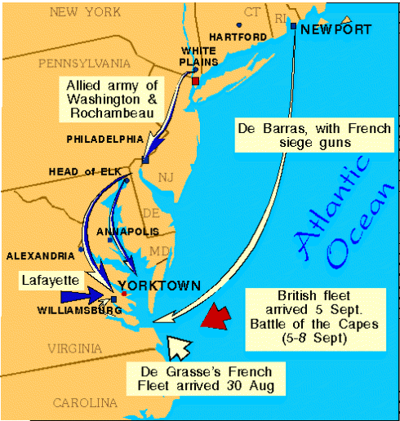
Battle of Yorktown
The American victory at Yorktown relied on British blunders, French naval support and Washington’s astute leadership

Slide 33
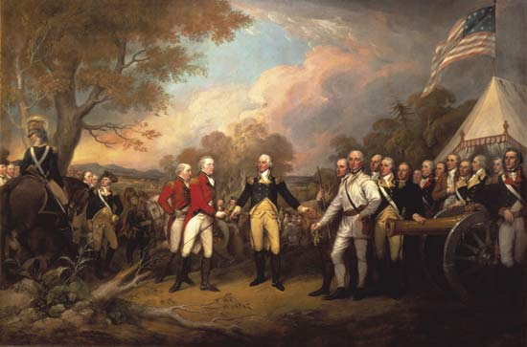
Q: Why American Victory?
#1: ___________________________=> Saratoga, guerilla manuevers in South
#2: __________________________=> Washington’s defensive strategy & willingness to suffer defeats, Franklin’s diplomatic skill, Jefferson’s rhetoric
#3: __________________________________=> fervor of patriots and republican cause (Common Sense, Declaration); Valley Forge
#4: ____________________________=> French Naval forces, gunpowder and $$; German and French officers (Lafayette, Von Steuben); European Warfare
#5: __________________________=> lack of loyalist usage; Howe and Saratoga

Slide 34
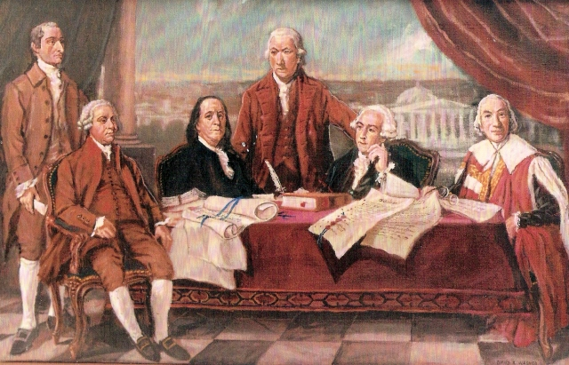
Treaty of Paris (1783)
Treaty Terms (negotiated w/o France; violation of alliance)
British recognize American independence => agree to remove forts and outposts from western lands
Boundaries = land West to Mississippi, south to Florida (Spanish), North to Great Lakes and Maine
Fishing rights in Gulf of St. Lawrence & Newfoundland
Tory War claims settled in American courts
** Q: Why so generous??**

Slide 35
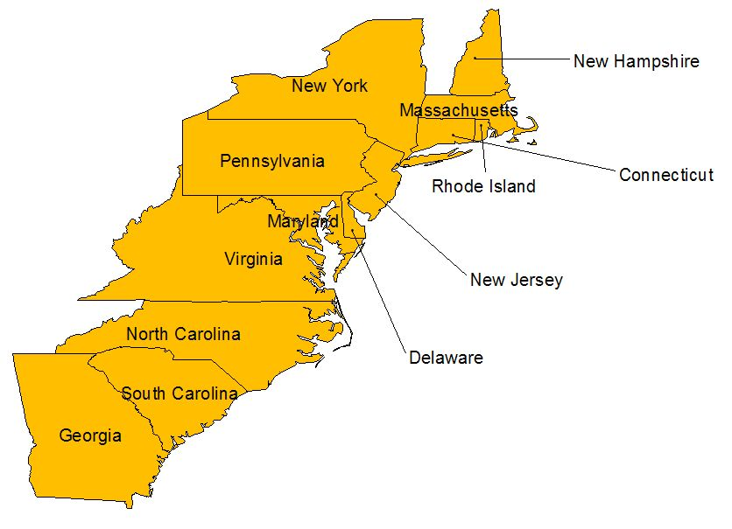
U.S. AFTER THE 1783 TREATY OF PARIS, WHICH ENDED THE AMERICAN REVOLUTION
Area given to the new U.S. by Great Britain in 1783

Slide 36
Articles of Confederation (AOC)
During the war the states and CC both worked to create new governments that represented the republican ideals they fought for
** Go over Confederation vs Federal vs Unitary Govts**
State Constitutions were very similar in their disdain for strong executives => established powerful legislative branches
-- Like Mass. many sought voter ratification (Social Contract)
-- Many also created Bills of Rights => secured individual liberties
** ALL created gender, racial & property requirements for voting => many states only allow elites to vote & hold office (20% of white males)
During the war the CC created the AOC to govern the country => no Executive and weak Judiciary (guard against abuses)
-- Called by Jefferson “the greatest government envisioned by man on this earth”; More like an alliance of firm friendship
-- Even Congress was weak; AOC favored strong state governments
The AOC as it existed had MANY problems => AOC problems activity

Slide 37
THE ARTICLES REFLECTED THE FEAR OF A STRONG EXECUTIVE BRANCH AND LACKED THE ABILITY TO FUNCTION IN SEVERAL IMPORTANT AREAS
WEAKNESSES OF
THE ARTICLES
OF CONFEDERATION

Slide 38
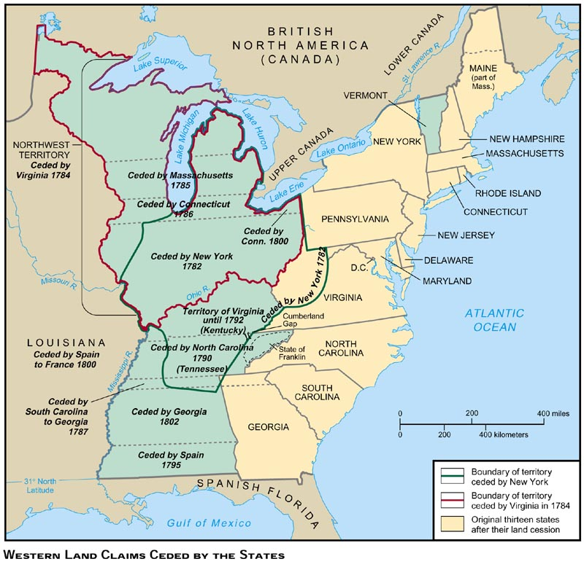
One Area where the AOC excelled was in dealing w/ Western land issues and encouraging migration => NW Ordinance sold western land for low prices
-- AOC also established path to statehood for western lands & school systems

Slide 39
AOC Problems and Solutions
#1: Commercial Problems
Britain refused to trade with the colonies (huge economic depression) => some states wanted severe restrictions and tariffs, others did not
Profiteering huge issue & pirates attack American shipping
Respect for private property low (loyalist land seizures encouraged)
#2: Currency Problems
States have separate currencies and no uniform exchange rate exists => trade between states and foreign nations difficult
#3: Intl Relations
Britain sought to undermine US at every turn => refuses to vacate forts on US soil due to fur trade (US cannot force them to leave)
Spain incites Indian violence on frontier => refuses to allow US access to MS river for trade (US unable to negotiate due to state conflict)
France demands debt repayment immediately (US cannot raise $$)
#4: Domestic Affairs
1783 -- PA soldiers demand back pay from Govt. (US cannot raise $$ w/ taxes)
MD & VA almost go to war over fishing rights in Chesapeake
________________(1786) veterans threaten to overthrow Mass. Govt due to seizure of farms due to debt => organizes mob & skirmishes w/ Mass militia

Slide 40
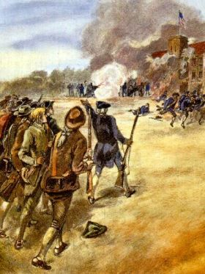
Shay’s Rebellion (1786)
Daniel Shay was a former Continental Captain who had his farm seized due to debts incurred while fighting in the war. He said that the purpose of his revolution was, “to march directly to Boston, plunder it, and then . . . Destroy the nest of devils, who by their influence, make the Court enact what they please, burn it and lay the town of Boston in ashes.”

Slide 41
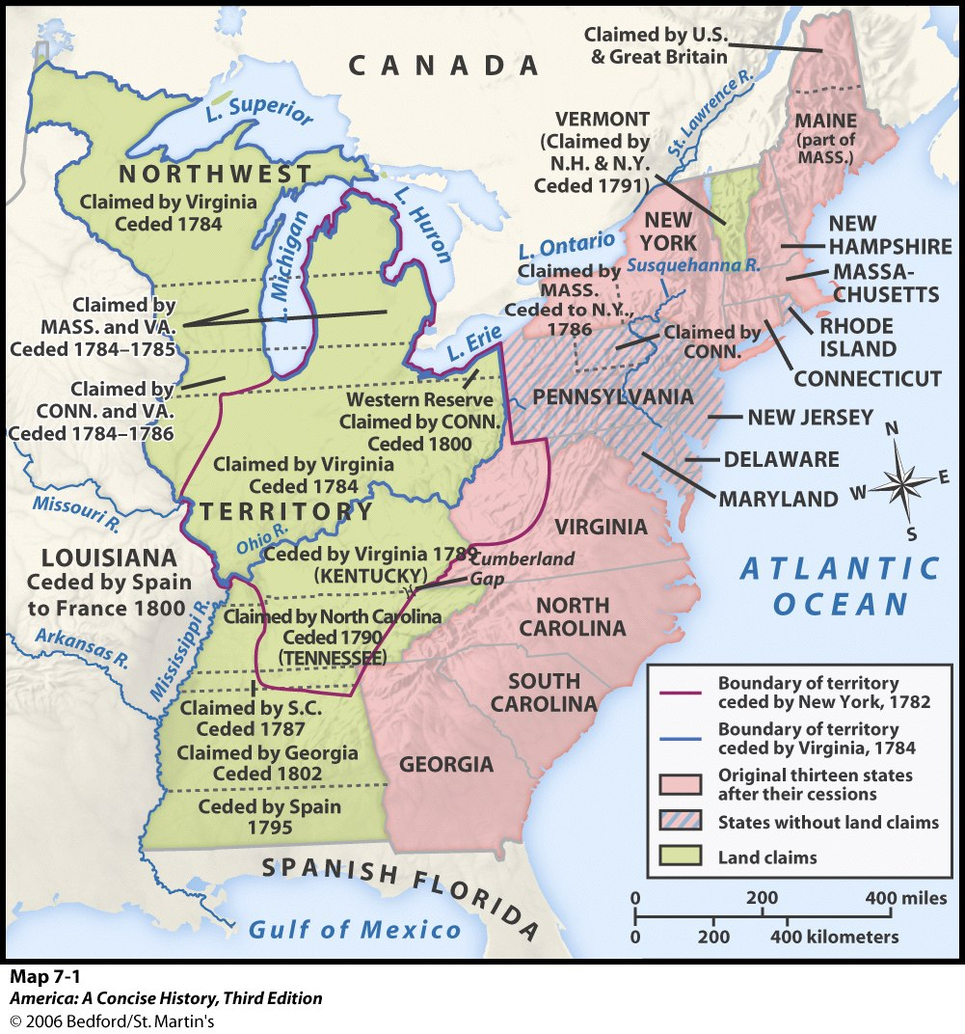
AOC Positives
AOC did have some success
#1: _____________________=> provided for orderly settlement of NW lands (schools funded)
=> $$ raised used to pay national debt; price of land set low to encourage migration
#2: ______________________ Provided for path to statehood for western lands; population reaches 60,000 area can apply for statehood
Promotes public education by taxing land for that purpose
Provides for surveying of land & securing of private property
=> Bans slavery in NW territory

Slide 42
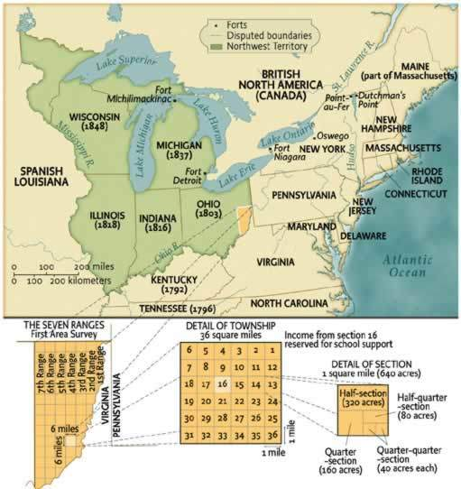
Northwest Ordinance MAP
The NW Ordinance was a huge success in banning slavery decisively, securing private property rights by surveying land (settlements much more secure than SW territory) and promoting public education

Slide 43
Constitutional Convention (1787)
After only 4 years the weaknesses and limitations of the AOC were apparent and a convention was called for its reform by Congress
55 delegates (12 states; no RI) met in Philadelphia and soon decided to scrap the AOC and form a new Constitution
Q: Who? => all were elite landowners with experience in govt (most at state level; many had written state Constitutions)
Meetings were held in secret & included many “demigods”
-- G. Washington => President of Convention
-- B. Franklin => elder statesmen
-- James Madison => architect of Constitution (studied enlightenment philosophers like Locke, Rousseau & Montesquieu)
-- Alexander Hamilton => proponent of strong federal government

Slide 44
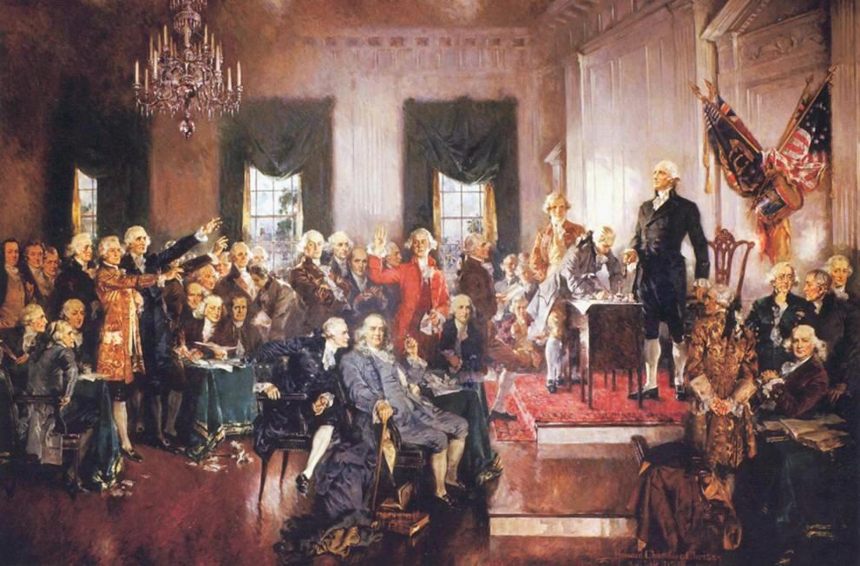
Factionalism at Constitutional Convention
During convention many arguments cropped up and different factions formed => Compromises needed between factions
Small states (DE, NJ) vs Large states (VA, NY, Mass)
Slave holders (South) Vs Antislavery advocates (Quakers)
Strong central government vs weak central government

Slide 45
COMPROMISE #1: DEBATE OVER REPRESENTATION IN CONGRESS
VIRGINIA PLAN
LARGE STATE
BICAMERAL
FAVORED NUMBER OF REPRESENTATIVES ALLOTTED BASED ON POPULATION
NEW JERSEY PLAN
SMALL STATE
UNICAMERAL
EQUAL NUMBER OF REPRESENTATIVES FOR EACH STATE (AOC)

Slide 46
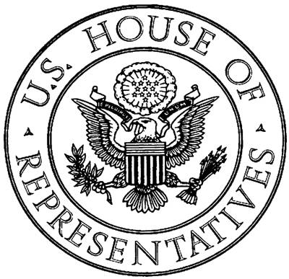
THE GREAT COMPROMISE
THE DELEGATES AGREED ON TWO HOUSES IN CONGRESS, THE SENATE AND THE HOUSE OF REPRESENTATIVES.
THE SENATE WOULD HAVE EQUAL REPRESENTATION, MEANING EVERY STATE WAS ALLOTTED 2 SENATORS.
THE HOUSE OF REPRESENTATIVES WOULD BE BASED ON POPULATION AND THEREFORE THE NUMBER WOULD VARY FROM STATE TO STATE.

Slide 47
COMPROMISE #2: SLAVERY=>
REPRESENTATION AND THE SLAVE TRADE
SOUTHERN DELEGATES INSISTED THAT SLAVES SHOULD COUNT AS PART OF A STATE’S POPULATION
THIS WOULD HAVE GIVEN THEM THE ADVANTAGE IN CONGRESS AS THEIR POPULATION WOULD HAVE BEEN GREATER AS A REGION
NORTHERN DELEGATES DISAGREED AND REFUSED TO COUNT SLAVES AS PART OF THE STATE’S POPULATION FOR PURPOSES OF REPRESENTATION
MOST STATES WANTED TO END THE AFRICAN SLAVE TRADE HOWEVER SOUTH CAROLINA AND GEORGIA LOBBIED HARD TO KEEP THE SLAVE TRADE INDUSTRY ACTIVE

Slide 48
_________________COMPROMISE, SLAVE TRADE, AND FUGITIVE SLAVES
THE SOUTHERN STATES WERE ALLOWED TO COUNT SLAVES AS 3/5 OF A PERSON FOR REPRESENTATION PURPOSES IN THE HOUSE. SLAVES WERE ALSO COUNTED TO DETERMINE THE AMOUNT OF FEDERAL TAXES OWED BY EACH OF THE SOUTHERN STATES.
THE SLAVE TRADE WAS ALLOWED TO CONTINUE UNTIL 1808, HOWEVER ALL OF THE NEW STATE CONSTITUTIONS EXCEPT GEORGIA’S BANNED OVERSEAS SLAVE TRADE.
Overall, though, the issue of slavery in the US was NOT resolved by compromises => led to recurring bouts of slavery related political conflict
ARTICLE I SECTION 2 Representatives and direct Taxes shall be apportioned among the several States which may be included within this Union, according to their respective Numbers, which shall be determined by adding to the whole Number of free Persons, including those bound to Service for a Term of Years, and excluding Indians not taxed, three fifths of all other Persons.
ARTICLE I Section 9. The Migration or Importation of such Persons as any of the States now existing shall think proper to admit, shall not be prohibited by the Congress prior to the Year one thousand eight hundred and eight, but a Tax or duty may be imposed on such Importation, not exceeding ten dollars for each Person.
ARTICLE IV SECTION 2 No Person held to Service or Labour in one State, under the Laws thereof, escaping into another, shall, in Consequence of any Law or Regulation therein, be discharged from such Service or Labour, but shall be delivered up on Claim of the Party to whom such Service or Labour may be due.
CLAUSE ON ESCAPED SLAVES

Slide 49
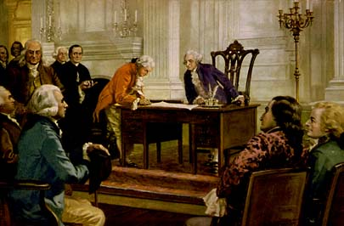
COMPROMISE #3: FEDERALISM
FEDERALISM = A FORM OF GOVERNMENT WHERE POWER IS SHARED BETWEEN STATE AND NATIONAL GOVERNMENT EQUALLY.
IN THE UNITED STATES THIS TRANSLATES TO A FEDERAL GOVERNMENT IN WASHINGTON D.C., STATE GOVERNMENTS, AND LOCAL GOVERNMENTS. IN THE U.S. THE FEDERAL GOVERNMENT IS MORE POWERFUL THAN THE STATE GOVERNMENTS, ALSO KNOWN AS NATIONAL SUPREMACY.

Slide 50
Federalism in Action
Federal Powers
Declare War
Coin $$
Regulate Interstate Commerce
Negotiate Treaties
Collect Taxes
Maintain Army & Navy
Borrow $$
Establish post offices and roads
Necessary & Proper Clause => establish all institutions needed to carry out powers (i.e. National Bank)
State Powers
Matters effecting family relations (marriage, divorce, etc..)
Police power and laws w/in state
Education
Regulating commerce w/in state boundaries
10th Amendment => all powers not granted to Federal Govt reserved for States

Slide 51
JUDICIAL
BRANCH
LEGISLATIVE
BRANCH
EXECUTIVE
BRANCH
ENFORCES THE LAWS
ELECTED BY ELECTORAL COLLEGE (FEAR OF “MOB” and COMMON MAN
HEADED BY THE PRESIDENT
THE DELEGATES AGREED ON SEPARATION OF POWERS & CHECKS & BALANCES
INTERPRETS THE LAWS
SUPREME COURT HIGHEST COURT
MAKES THE LAWS
CONGRESS DIVIDED INTO TWO HOUSES: SENATE AND HOUSE OF REPRESENTATIVES

Slide 52
Checks and Balances in Action
Executive Branch
Can Veto laws passed by Legislative
Appoints federal judges and justices
Can pardon convicted criminals
Legislative Branch
Senate ratifies treaties and appointments
Controls $$
May impeach President or judges
Can override veto w/ 2/3 approval
Senate confirms judges & justices
Can amend Constitution to override judicial decisions
Judicial Branch
Can declare laws and acts “unconstitional”
Appointment for life
Q: Which Branch is the most powerful? WHY????

Slide 53
The Constitution
“It grants powers to the government, limits the authority of the government, defines the structure of a government & explains the relationship between the government and its people.”
Requires majority vote to pass laws and 2/3 vote to amend
Institutionalized republicanism => rule by people, limits on power
“Living Document” – can be modified to changeable circumstances of society
It is the supreme law of the land!
Constitution can be seen as a “conservative” document => safeguards against the power of common man
No direct election of Senators or President (Electoral College)
Protects private property rights
Tight $$ policy
Judges appointed for life

Slide 54
Ratification of Constitution
The Constitution provided that 9/13 states needed to ratify it for it to take effect => states called special conventions for ratification
Only 20% of white males could vote (property requirements), so conventions were dominated by Conservatives & wealthy
Fierce debates ensued in many states (i.e. VA, NY, Mass) and the country’s 1st political parties were formed
-- Federalists = support ratification and strong federal govt
-- Antifederalists = against ratification (strong state govts)
Federalists conducted a campaign to ensure ratification
PA = forced 2 Antifederalists to sit to get quorum for vote
NY = Jay, Hamilton & Madison published a series of essays (Federalist Papers) arguing for benefits of Constitution
VA = Washington & Madison are “star power” behind ratification (argue against Patrick Henry & Jefferson)
** #1 item that secured ratification was promise of a Bill of Rights **

Slide 55
DEBATE OVER RATIFICATION
FEDERALISTS
ADVOCATED A STRONG CENTRAL GOVERNMENT
NATIONAL SUPREMACY
IN FAVOR OF RATIFICATION
BILL OF RIGHTS UNNECESSARY SINCE GOVERNMENT HAD LIMITED POWERS
MADISON, HAMILTON, JAY, WASHINGTON
STRONGEST ALONG THE COAST, AMONG UPPER CLASSES AND EDUCATED, FORMER LOYALISTS
ANTIFEDERALISTS
IN FAVOR OF STRONG STATE GOVERNMENTS
STATE SUPREMACY
AGAINST RATIFICATION
BILL OF RIGHTS ESSENTIAL TO GUARANTEE CITIZEN’S RIGHTS
MASON, CLINTON, HENRY, JEFFERSON
STRONGEST AMONG BACKCOUNTRY FARMERS, UNEDUCATED AND ILLITERATE, DEBTORS, POORER CLASSES

Slide 56
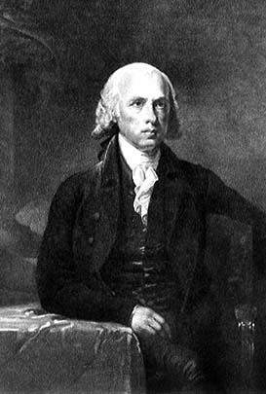
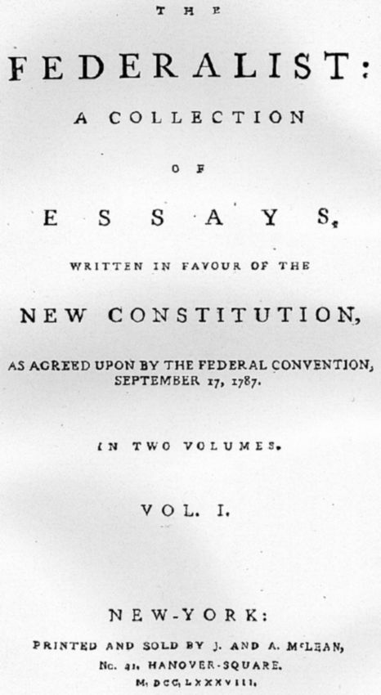
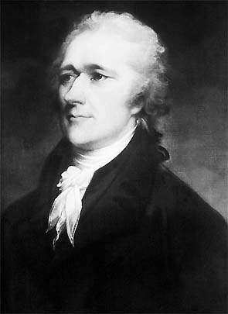
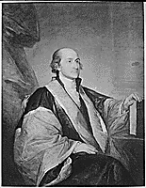
THE FEDERALIST PAPERS
A SERIES OF 85 ESSAYS ORIGINALLY PUBLISHED IN NEW YORK NEWSPAPERS FROM OCTOBER 1787 TO AUGUST 1788 AUTHORED BY PUBLIUS, THE PEN-NAME FOR JAMES MADISON, ALEXANDER HAMILTON, AND JOHN JAY. THE ESSAYS EXPLAINED THE NEW CONSTITUTION AND ARGUED FOR RATIFICATION CITING SUCH THEMES AS THE NEED FOR SEPARATION OF POWERS, STRONG CENTRAL GOVERNMENT, AND GOVERNMENT CONTROL OVER FACTIONS.
MADISON
HAMILTON
JAY

Slide 57
IN ORDER TO RATIFY THE CONSTITUTION TWO-THIRDS OF THE STATES, NINE, HAD TO APPROVE IT. THE PROCESS BEGAN IN DECEMBER OF 1787 WITH STATE CONVENTIONS SOME OF WHICH WERE HEATED DEBATES AND OTHERS WERE UNANIMOUSLY IN FAVOR.
STATE | DATE | VOTE IN CONVENTION
DELAWARE | DECEMBER 7, 1787 | UNANIMOUS
PENNSYLVANIA | DECEMBER 12, 1787 | 46 TO 23
NEW JERSEY | DECEMBER 18, 1787 | UNANIMOUS
GEORGIA | JANUARY 2, 1788 | UNANIMOUS
CONNECTICUT | JANUARY 9, 1788 | 128 TO 40
MASSACHUSETTS | FEBRUARY 7, 1788 | 187 TO 168
MARYLAND | APRIL 28, 1788 | 63 TO 11
SOUTH CAROLINA | MAY 23, 1788 | 149 TO 73
NEW HAMPSHIRE | JUNE 21, 1788 | 57 TO 46
VIRGINIA | JUNE 26, 1788 | 89 TO 79
NEW YORK | JULY 26, 1788 | 30 TO 27
NORTH CAROLINA | NOVEMBER 21, 1789 | 195 TO 77
RHODE ISLAND | MAY 29, 1790 | 34 TO 32

Slide 58
Challenges to the New Nation
A “Federalist” Agenda
1. Financial – Foreign Trade tied up in this also
“The nation’s debt was large; its credit shaky & its economic future uncertain.”
a. Domestic debt: $40 million owed to citizens
b. Foreign Debt: $11 m to Spain/France/Netherlands
c. Assumption of State Debts incurred by Revolution?
d. Economic depression due to lack of trade w/ Britain and pirate attacks on US shipping
2. Implementing New Government – after elections
a. Creation of Judiciary branch & appointment of judges
b. Establish Federal Power – Currency, Trade, State relations, Army
c. Creation of Cabinet
d. Overcome fears of strong Central Government & Executive
e. Guarantee individual rights
British, Spanish & Indian Problems on the frontier
-- Native raids; British Forts; Mississippi River mouth access?
Imposing Federal Taxes & Raising Revenue
-- Excise Tax and Whiskey Tax; providing back pay to soldiers

Slide 59
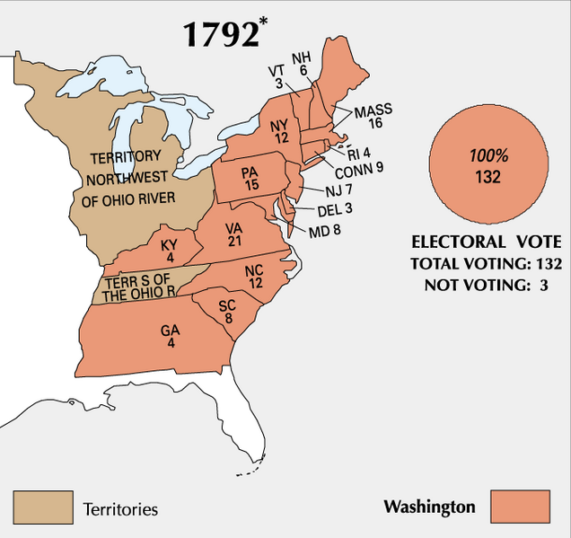
Election of 1792
Washington is the only President to win unanimous election to the Presidency (he did it twice)

Slide 60
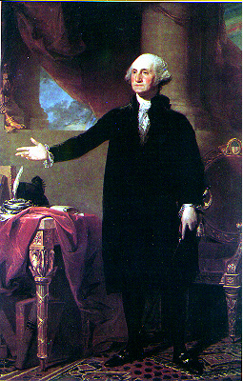
George Washington – Presidential precedents
Washington, as the 1st President had to set many precedents for Presidential behavior
Many were fearful that the President would become a “monarch”
#1: Address => insists on being called “Mr. President” (no bows, etc…)
#2: Shows no favor toward political party (despises political party)
#3: Does not advocate own election => others do this for him
#4: Serves only two terms => believes serving longer would be too much like a monarch
#5: Appoints a Cabinet => advisors to aid President in important areas

Slide 61
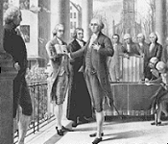
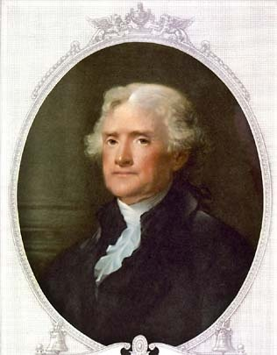
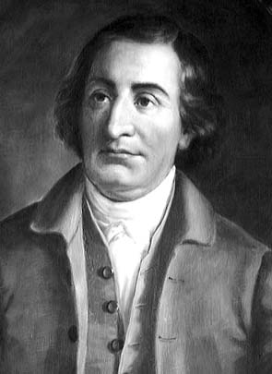
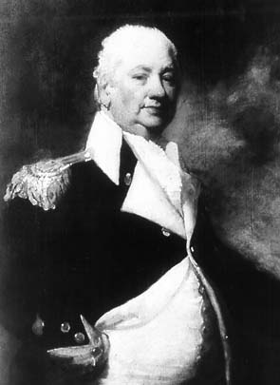
GEORGE WASHINGTON ELECTED FIRST PRESIDENT BY THE ELECTORAL COLLEGE IN 1789 AND HE APPOINTED A BALANCED CABINET (FEDERALISTS & DEM/REP) WITH FOUR MEMBERS.
WASHINGTON’S INAUGURATION
SECRETARY OF STATE, THOMAS JEFFERSON
SECRETARY OF TREASURY, ALEXANDER HAMILTON
LIBERALS
CONSERVATIVES
ATTORNEY GENERAL, EDMOND RANDOLPH
SECRETARY OF WAR HENRY KNOX

Slide 62
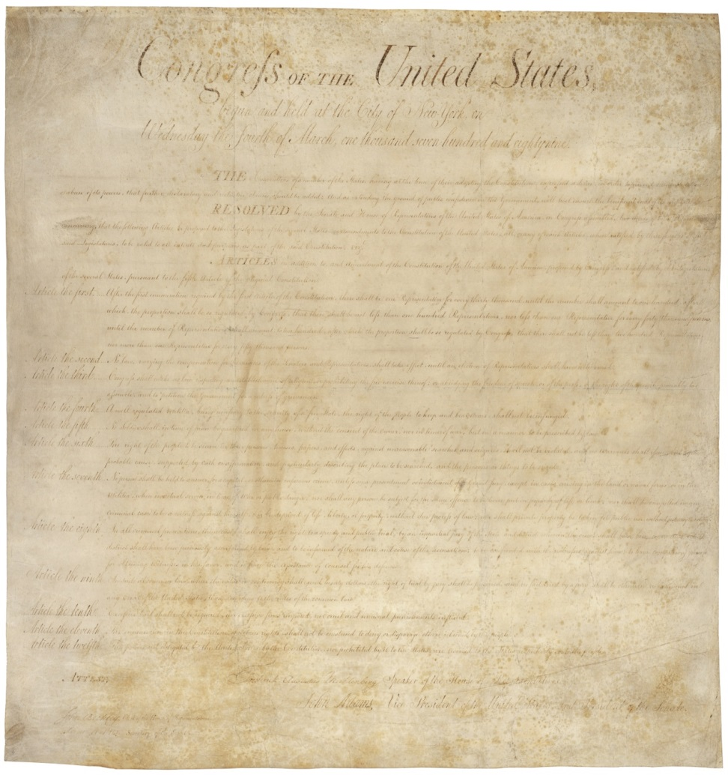
THE BILL OF RIGHTS
IN THE BATTLEGROUND STATE OF MASSACHUSETTS THERE WAS MUCH SKEPTICISM ABOUT THE CONSTITUTION. ANTI-FEDERALISTS LOBBIED HARD AT THE CONVENTION TO REQUIRE A BILL OF RIGHTS BE ADDED IN ORDER TO GUARANTEE RATIFICATION. THIS STARTED A MOMENTUM WHICH LED TO THE EVENTUAL ADDITION OF THE BILL OF RIGHTS, WRITTEN IN 1789 BY MADISON AND RATIFIED BY THE STATES OVER THE NEXT TWO YEARS.
Key provisions => freedom of speech, religion, press, assembly, right to bear arms, right to jury trail, prohibition against cruel and unusual punishments, right to privacy from searches and seizures, freedom from quartering troops

Slide 63
POLITICAL PARTIES EMERGED
FEDERALIST | DEMOCRATIC-REPUBLICAN
LED BY ALEXANDER HAMILTON | LED BY THOMAS JEFFERSON
STRONG NATIONAL GOVERNMENT | STRONG STATE GOVERNMENTS
LOOSE INTERPRETATION OF THE CONSTITUTION – “Elastic” Clause | STRICT INTERPRETATION OF THE CONSTITUTION
NATIONAL ECONOMIC POLICIES (HIGH TARIFFS & NATIONAL BANK FOR CURRENCY) | LIMITED INVOLVEMENT IN ECONOMICS BY FEDERAL GOVERNMENT (STATE BANKS & LOW TARIFFS)
SUPPORT BRITISH | SUPPORT FRENCH
MERCHANTS AND MANUFACTURERS ESPECIALLY FROM NEW ENGLAND; WEALTHY AND FORMER LOYALISTS | FARMERS, TRADERS, PLANTATION OWNERS FROM RURAL AND FRONTIER AREAS

Slide 64
Alexander Hamilton’s Financial Program
**Q: How does the Federal Government solve it’s “Debt Problem” and “Flex” it’s new financial muscles??? **
Hamilton created a Nationalized economic plan to favor wealthy & industry & help America develop (“Trickle Down Economics”)
#1: Protective Tariff – Builds American Industries and provides Revenue (#1 Financial tool of Federal Govt until 1900!!)
#2: Assumption Bill – Fed. Govt assumes all state debts
-- Opposed by the South (VA had paid off most of State Debt)
-- Compromise is worked out and Federal capital located in VA
#3: Whiskey Tax & other Excise Taxes – raise addtl Fed. revenue
#4: Creation of the National Bank of US -- Effective in creating “good” Federal Credit (Netherlands now loans US additional $$$)
-- National Bank prints federal $$
-- Creates further push for “loose” Interpretation of the Constitution based on “Elastic” Clause
** Hamilton’s Plan is source of much conflict and further embeds political ideologies and parties **

Slide 65
Challenges to the New Nation – Foreign Affairs
In 1789 the French Revolution breaks out => American reaction is at 1st very positive (republican principles, liberty, freedoms)
Revolution turns ugly quickly => guillotine & war
War breaks out between Britain, France, Netherlands, Spain => all sides lobby for American aid and alliance
Jefferson and Dem/Rep want to support France => 1778 treaty and fight for liberty and common man
Hamilton and Federalists want to support Britain => Revolution out of control, Britain = #1 trading partner
Washington issues _______________________(1793) => says America will remain neutral and not interfere in European affairs
Enshrines neutrality and non-intervention in US foreign policy for 150 years => US role in world affairs
-- Q: Why? => due to debt, lack of military power, “I want an American character that the powers of Europe may be convinced that we act for ourselves and not for others”

Slide 66
Challenges to the New Nation – Foreign Affairs
Washington also tried to negotiate with European powers to solve internal issues in the US => Britain and Spain
Britain => Jay’s Treaty
Britain agrees to vacate forts & respect US territory
Does not address inciting Native attacks, British practice of impressment (Napoleonic Wars)
Very unpopular in US => negotiations undermined by Hamilton
Spain => Pickney’s Treaty
Spain agrees to allow US to trade at mouth of Mississippi
Spain agrees to stop inciting Native attacks & allow US settlements in Florida
Trying to stop a British/American alliance => great treaty for US

Slide 67
British Forts and Spanish Right of Deposit
After the Revolutionary War the British refused to vacate their forts => fur trade & revenge
-- Spanish also refused to allow the US to trade at the mouth of Mississippi River

Slide 68
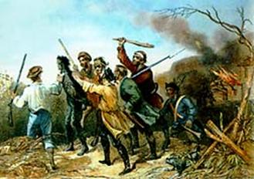
SECOND TEST OF THE NEW GOVERNMENT: DOMESTIC (WHISKEY REBELLION)
SECRETARY OF THE TREASURY HAMILTON PROPOSED A FEDERAL EXCISE TAX ON WHISKEY. HE WANTED TO RAISE MONEY FOR THE GOVERNMENT AS WELL AS TEST THE GOVERNMENT'S ABILITY TO TAX. IT ESPECIALLY EFFECTED FARMERS IN WESTERN PENNSYLVANIA WHO REFUSED TO PAY THE TAX AND EVENTUALLY THE SITUATION ESCALATED INTO VIOLENCE. IN 1794 A FEDERAL ARMY, HEADED BY WASHINGTON DEALT WITH THE PROTESTORS WHO DISPERSED IN THE FACE OF FEDERAL FORCE. THIS EVENT PROVED THAT THE NEW GOVERNMENT WOULD BE ABLE TO DEAL WITH CRISIS SITUATIONS IN A TIMELY AND ORDERLY FASHION.
Q: COMPARISON TO SHAY’S REBELLION?

Slide 69
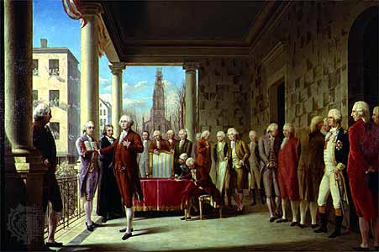
Washington’s Farewell Address
Hugely influential Speech => often quoted
Offers advice on two key items => political parties & foreign affairs
Says that the US must avoid “entangling foreign alliances” => becomes a precedent in US history (isolationism)
Also says that the US must avoid “the poisonous influence of political parties” => America doesn’t follow (many partisan debates in 1790’s; Natl Bank, French Rev, Alien & Sedition Acts)

Slide 70
Adams Presidency – Challenges to balance of power
The election of 1796 was hotly contested by the Federalist & Democratic Republicans => helped solidify parties in US
Federalists referred to Dem-Reps as “fire eating salamanders and poison sucking toads”
-- Many issues contribute to partisan fighting => Jays Treaty, Whiskey Rebellion, National Bank
Election became one of personalities => Adams (stuffy NE aristocrat) vs Jefferson (VA planter, friend of common man)
Adams was elected (partly due to Washington’s popularity) => Jefferson becomes VP, but not an ally
Adams presidency was dominated by partisan fighting and Federalist division over many issues . . .
#1: Alexander Hamilton => resigned as Secretary of Treasury due to hatred of Adams (weak minded)
Heads the “high Federalist” wing of party => wants war w/ France & seeks to undermine Adams (some of cabinet complicit)

Slide 71
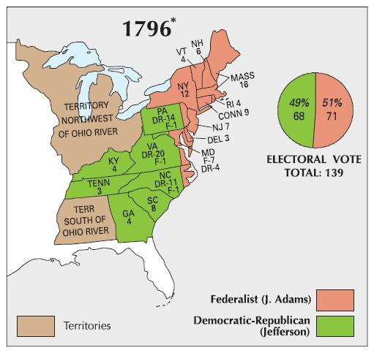
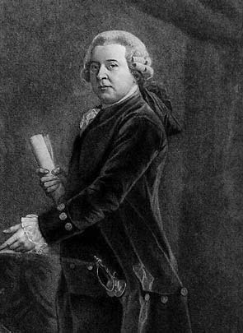
Election of 1796
John Adams -- 1796

Slide 72
Adams Presidency – Challenges to balance of power
#2: War w/ France => French start to seize American shipping (300+ ships) due to “violations” of 1778 treaty (Jay’s Treaty)
Hamilton & many Americans want war => Adams tries to negotiate w/ French
_________________=> American diplomats are told by French to pay $250,000 bribe to speak w/ French & loan French $32 M
Calls for war heat up => America commissions Marines and creates 10,000 man army and Navy
Adams resists war & negotiates end to French alliance
#3: ___________________________=> passed by Federalists & Adams to try and stem criticism of Dem-Reps & win elections
Alien Acts increase time for citizenship from 5 to 14 years (WHY?) & allows deportation/imprison foreigners in time of war
Sedition Act gives fine and imprisonment to people who impede policies of US or falsely criticize officials
Dem-Rep and Jefferson feared that this was a dangerous precedent => one party dictatorial politics (remained critical)

Slide 73
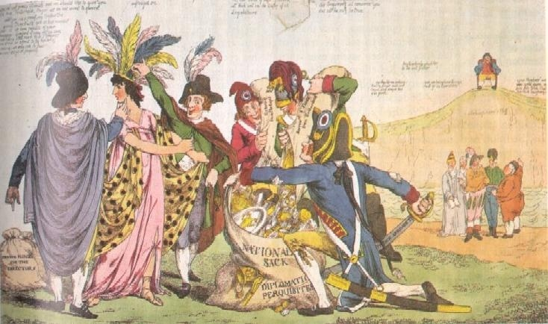
XYZ Affair
XYZ Affair was much reviled in the US (although it was standard practice in diplomacy during time to offer bribes for meetings or concessions)

Slide 74
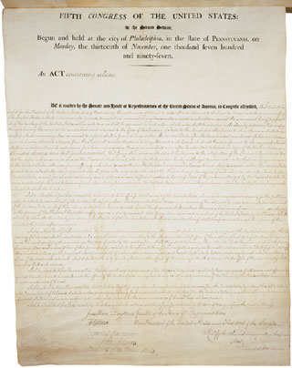
Alien and Sedition Acts
-- “No Stamp Act, No Sedition, No Alien Bills, No land tax; downfall to the tyrants of America, peace and retirement to the President. Long live the VP and the Minority; may moral virtue be the basis of civil government.”
-- One was convicted for violating Sedition Act received 6 hours in jail and a $5 fine. The other 18 months and a $400 fine (10 editors convicted overall)

Slide 75
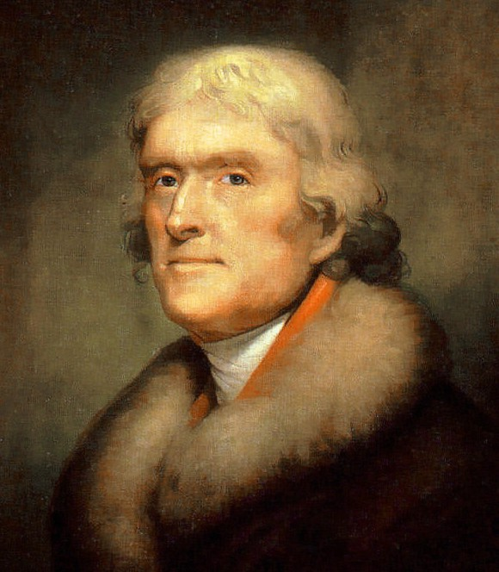
Adams Presidency – Challenges to balance of power
#4: VA & KY Resolutions => challenge to Sedition Act
Jefferson fears that Federalists will destroy Am democracy => wants addtl safeguards against federal abuse
Drafts KY Resolution under pen name (Madison does same in VA)
Argues for_______________________
-- States created Fed govt and were therefore judges of Fed govt actions
-- States can therefore declare actions of Fed. Govt “nullified” => refuse to obey
Other states refuse this logic => establishes a precedent for state supremacy/states rights & partisanship
Federalists argue Supreme Court judges actions of Federal govt

Slide 76
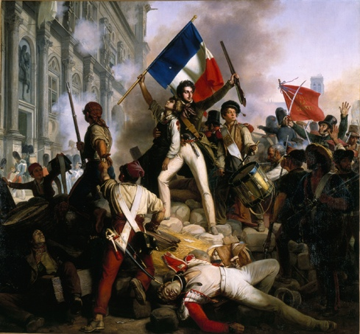
Impact of Constitution & American Revolution
#1: American Experiment in Democracy => emulated by other nations in world
American success was an endorsement of deomocracy
#2: Inspired other Revolutions
Latin American ind. movements of 1820’s (Simon Bolivar)
Haitian Revolution => Touissant L’Overture (1804)
French Revolution (1789)
#3: Constitution w/ its check an balances and 3 branches emulated by many govts
#4: Constitution established role of compromise in Am. Political system

Slide 77
Limitations of Constitution & Revolution
The American Revolution and Constitution were strikingly democratic for their time & contained many positive steps . .
Many states lowered property requirements for voting (expanded electorate; 20% to 25% of white males can vote)
Primogenture laws were ended in all states (1st born inherits all property)
However, there were many areas where Constitution and gains of the Revolution fell short if ideals (i.e. “All men created equal . . .”)
#1: Slavery and African Americans
Although in 1775 the Quakers began the 1st American anti-slavery society, slavery was not abolished in Constitution
Q: WHY? => FF did not want to upset national unity and protract issues to get Constitution passed
Many N. states abolish slavery or pass gradual abolition laws
Slave trade abolished in 1808

Slide 78
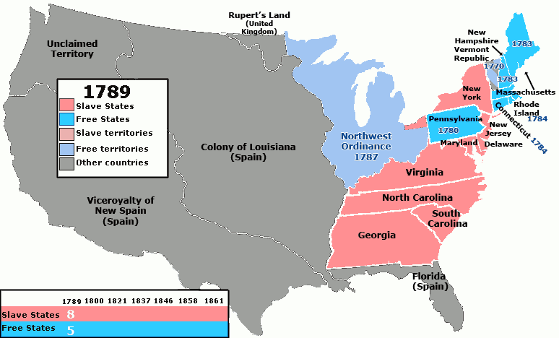
Free vs Slave States

Slide 79
Limitations of Constitution & Revolution
#2: Women’s Rights
Some women served in Revolutionary War (i.e. Molly Pitcher or as spies) but the ideals of Revolution did not extend to women
Abigail Adams became an early advocate of women’s rights behind the scenes => wrote letters to husband advocating for additional rights for women
Role of women did change => ideal role of women became _____________________________
Republican government rested on civic virtue (i.e. knowledge, commitment to public good, self sacrifice and service)
-- Women’s familial lives were depicted as republican ideal => supposed to pass on Republican virtues to children
Women’s roles were glorified in public life rather than ignored

Slide 80
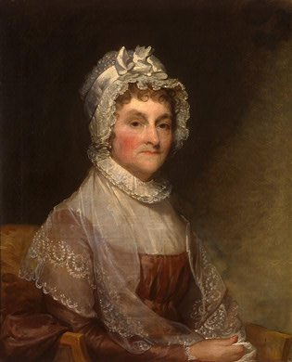
Abigail Adams
“If particular care and attention is not paid to the ladies, we are determined to foment a rebellion, and will not hold ourselves bound by any laws in which we have no voice or representation.”

Slide 81
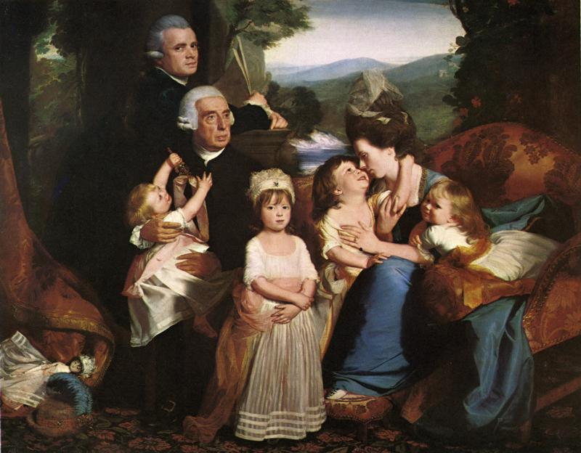
The Copley Family, John Singleton
Q: How does the composition of this family portrait reflect the importance of Republican Motherhood?

Slide 82
Limitations of Constitution & Revolution
#3: Native American relations
The Constitution did not set up a clear relationship between Indian nations and the Federal Government
Indian tribes were set up as semi-independent entities but their territorial claims & trading rights were loosely enforced
-- One could acquire land via purchase or “just war”
Federal government wanted to settle NW territory ($$ and settlers to enforce US land claims)
-- White settlers had conflicts w/ Native tribes (i.e. Miami tribe headed by Chief Turtle) => 1500 killed (1783-1790)
NW Indian War (1790-94) => Chief Turtle mounts war against US government; defeats 2 American armies
Defeated at _______________________(1794) => Natives forced to cede all lands west of Ohio River to US government

Slide 83
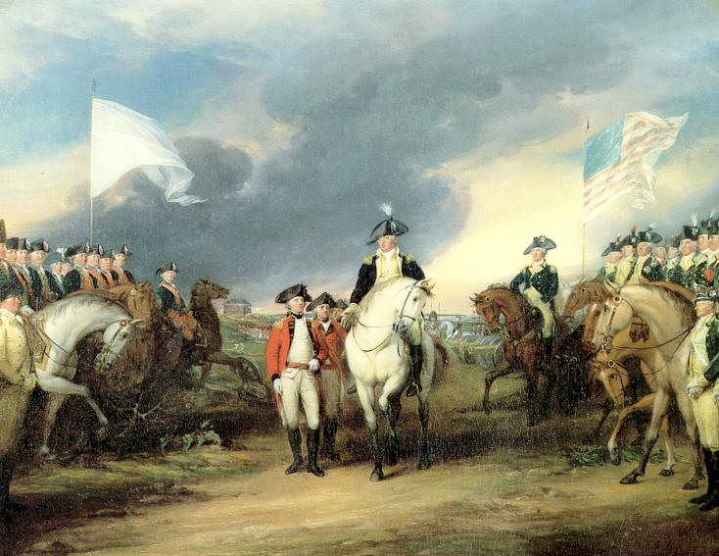
Q: Was the American Revolution really a Revolution?
The American Pageant pg 166, “The American Revolution was not a revolution in the sense of a radical or total change. It did not suddenly overturn the entire political & social framework, as later occurred in the French Revolution. What happened was accelerated evolution rather than outright revolution.”

Slide 84
Development of Am. Identity & Frontier Spirit
As British colonization intensified in the 18th century and the US gained its independence, a distinct American identity formed . . .
American identity rested on a few key characteristics in the early republic
#1: Cultural mixing and interactions => many different European nationalities migrated to America & brought distinct cultural practices
Religion was distinctively national =>
English = Anglican or Congregational
French/Spanish = Catholic
Scots-Irish = Presbyterian
** Contributed to an American identity that valued freedom of religion => 1st Amendment **
Spanish cultural practices were ingrained in SW/West settlements
Spanish mission architecture => incorporated key distinctive elements that became a part of SW design

Slide 85
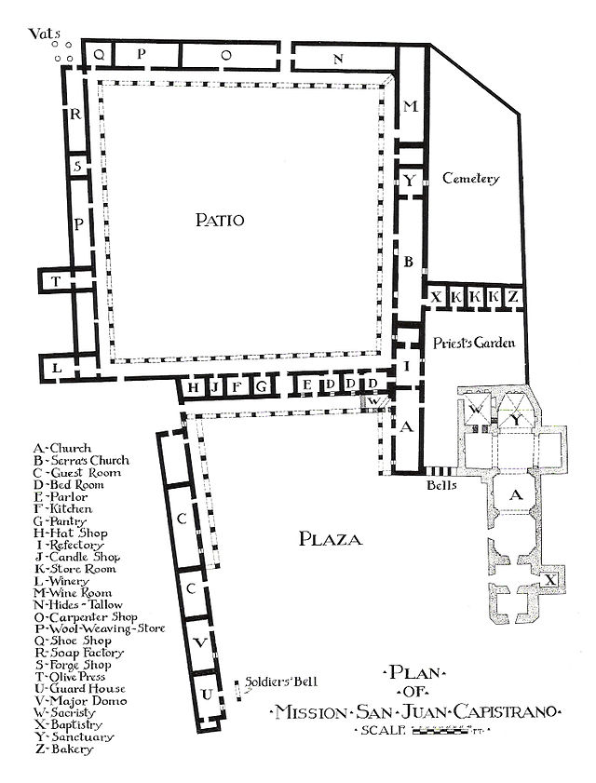
Spanish Mission Architecture
Mission San Luis Rey de Francia
Spanish missions had a distinctive architectural style that incorporated Spanish & Moorish cultural elements, as well as working within the limitations of building supplies

Slide 86
Present Day Santa Fe

Slide 87
Development of Am. Identity & Frontier Spirit
-- Patio & fountain; arched corridors; terra-cota roof; terraced bell towers w/ domes; undecorated wall surfaces
Corridos poetry & songs => ballad story style developed during the colonial period (remains popular today)
-- Corridos used waltz rhythms mixed w/ Spanish instruments to tell a story (love, news, etc…) to an audience
-- Corridos were an important way for illiterate peasants to communicate info prior to radio (Mex. Revolution in 1821)
Vaqueros => cattle herders who managed stock on wide swaths of dry land (distinct riding practice => “horse whisperers”)
-- Export of vacquero ranching (from Spain) provided social opportunities to lower classes in Spanish America
-- Vacquero culture merged with frontier culture in the 1800’s to create the American “cowboy” => use of short saddles, spurs, rope, brimmed hat & hackamore (scarf)

Slide 88
Corridos Lyrical style
http://en.wikipedia.org/wiki/Corrido
** Open file in Chrome **
Corridos song sheet about the battle of Ciudad Juarez

Slide 89
Vacquero Ranching
Vacquero ranchers were important in the settlement of the American SW and Great Plains => the vacquero culture was very influential on the development of the American “Cowboy”

Slide 90
Development of Am. Identity & Frontier Spirit
#2: Frontier settlements & western migration
Many European migrants came to America to acquire land in the 1700’s => frontier best place for that after initial settlement
Ingrained frontier mythos into American identity => created self-reliant, hard-working attitude that valued republicanism
-- Americans kept spreading further West (“Manifest Destiny”)
Scots-Irish were restless frontier settlers => built log cabins and hastily cleared fields (moved on after a few years)
-- Settled western frontier of PA, Ohio, Carolinas and MD
** 12 Presidents were of Scotch-Irish descent (incl. Andrew Jackson)**
Frontier settlements created tension w/ Natives => Paxton Boys March, Pontiac’s Rebellion, NW Indian Wars, etc….
Also led to tensions w/ tidewater elites => _______________________in NC/SC in 1760’s
Huge Scots-Irish population influx during the 1750’s & 60’s caused tension between old est. elites (coastal) & frontier settlers
-- Coastal Elites dominated government & used positions to increase taxes &abuse court system (corrupt officials fixing verdicts)
-- Backcountry vigilantes tried to break up power of courts w/ small acts of violence => elites & Gov. used militia to hang leaders & restore order
-- Regulators in SC (more elite than NC) were effective in gaining restrictions on hunting and calmed tensions w/ Natives

Slide 91
Regulator Movement
The Regulator movement in NC stemmed from the tension between the interests of tidewater elites (wealthy, estates) and frontier settlers => the tax code and courts favored the tidewater elites (5% of population) at the expense of the frontiersmen
-- Regulators took up arms to try and “fix” the situation => Royal Governor sent in the militia and at Alamance defeated 2000 Regulators (6 were hung afterwards)

Slide 92
Development of Am. Identity & Frontier Spirit
#3: Republicanism
Colonials during time embraced idea of republican government => preserved in Constitution
* Rallying cry of Am. Revolution => “No Taxation w/o representation”*
Although frontier settlements made satisfying property requirement, still only 20-25% could or did vote
Dem-Rep party made this a key part of their platform => tried to extend vote to immigrants, lower property requirements
-- Jefferson believed that universal education would precede universal suffrage
Republican Motherhood strengthened republicanism and encouraged its development in women and children
#4: Nationalism vs Regionalism
American Revolution had shown the benefits of a unified nation => Constitution greatly strengthened the federal govt also
However, Dem-Reps & Federalism preserved rights of the states and local govt=> regional attitudes & trends developed

Slide 93
Development of Am. Identity & Frontier Spirit
Examples of regional attitudes/beliefs
-- Slavery => Northerners (Puritan, Quaker religions, lack of economic usefulness) began to outlaw slavery
NW Territory ban on slavery extended attitude westward
-- Tariffs
Northern merchants wanted higher tariffs
Agricultural south wanted lower tariffs => need to import necessities and export cash crops
-- Foreign policy
Northerner & urbanites wanted closer alliance w/ Britain
Rural Middle & southerners wanted closer alliance w/ France
Regional differences helped lead to the development of national political parties => Federalist & Dem-Reps
Constitution also established National political institutions => National Bank, Congress, Army/Navy, Cabinet, President

