Slide 1
Social & Economic Dimensions of Empires -- Cities
Classical empires had a very important urban element => cities were centers of trade, public performances and rituals and political adm.
Over _______% of citizens were rural farmers/slaves; but urban focus benefitted urbanites and cities became centers of culture
Public Performances & Rituals
Rome => Colisseum and various temples to a pantheon of gods (Mars, Jupiter, Apollo) became the central focus of Roman culture
“______________________” became a way to control population & fame
Teotihuacan => religious shrines dominated the city; ________________were performed to worship Gods (Sun, Moon) and unite people
Pataliputra => Guptas were a “theater state” & relied on ________________ of Imperial court for political control (i.e. rituals, ceremonies, luxury goods)
Trade
Alexandria => its location and ____________________helped it to serve as a waypoint between Mediterranean and Indian Ocean
Pataliputra => Mauryan and Gupta capital, located at the branching of 5 tributaries, it was a central part of the Silk Road spice trade due to its location and Mauryan roads (trade taxed & had to pass through)

Slide 2
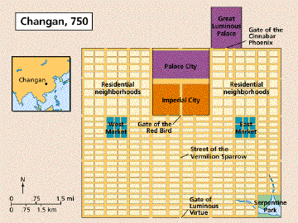
Social & Economic Dimensions of Empires -- Cities
Political Administration
Chang’an => Han capital contained the Forbidden city and imperial palaces which housed the _________________________and emperor
-- City divided into districts for control and powerful landed aristocrats were forced to move to city for control

Slide 3
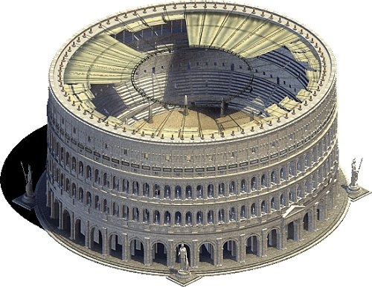
Roman Colisseum
Completed in 80CE by Vespasian, it was inaugurated with 80 straight days of games. The capacity was over 50,000 and it was sometimes flooded to be used in sea battles.

Slide 4
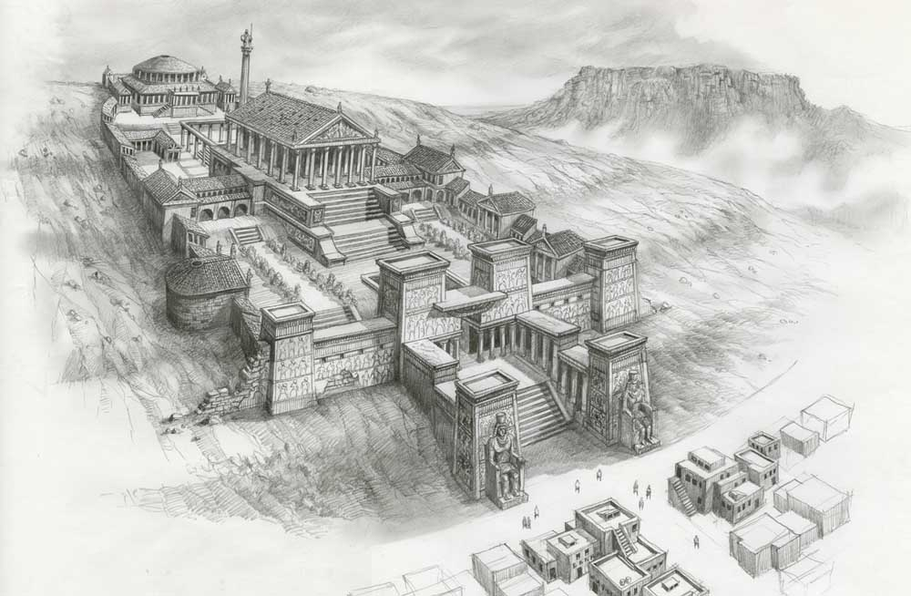
The Library of Alexandria
Established by Alexander the Great, the library employed professional librarians and scribes from Greece and other cultures, it is said to have housed over 1000,000 scrolls at its height

Slide 5
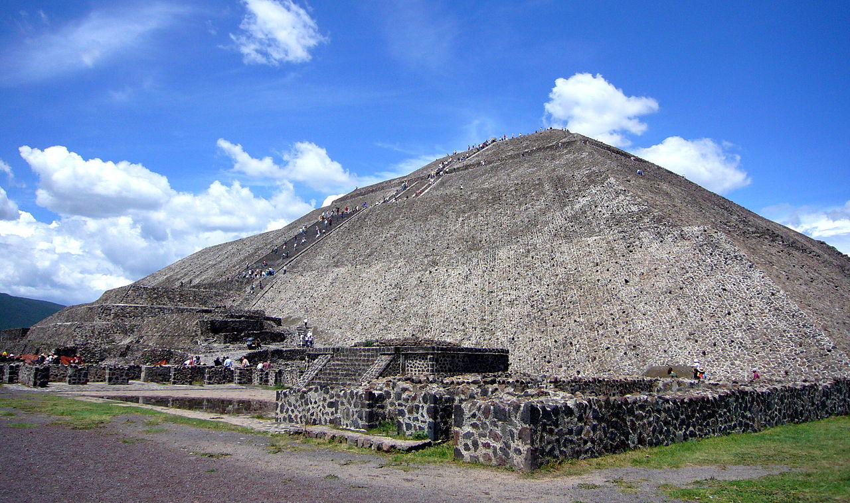
Teotihuacan -- Pyramid of the Sun
Pyramid of the Sun was the Teotihuacan site for astrological rituals and human sacrifice

Slide 6
Social & Economic Dimensions of Empires -- Hierarchies
Classical empires also had very strictly prescribed social hierarchies between classes and castes
Hierarchies also existed between gender w/ ______________________ dominating all classical empires (connection w/ agriculture)
Social Hierarchies
Mauryan/Gupta India => organized via ________________which assigned position based on job (very strict and no opportunity for advancement)
1st: Brahmins (priests); 2nd = Kshatriyas (warriors and rulers); 3rd = Vaisyas (traders, merchants, artisans); 4th =Sudras (farmer, workers)
Ideals of ceremonial purity limited interactions between groups
-- Gupta rulers gave extensive land grants to Brahmins (wealthy)
Roman Empire => divided into 2 large groups (_______________________) and merchants/artisans and slaves below
Wealthy landowners (patricians) controlled government during Republic and empire but Romans respected farmers (tax base)
Slaves = high percentage of Roman/Greek population (_____% +)
-- Used on ______________(commercial farms), public works, gladiators

Slide 7
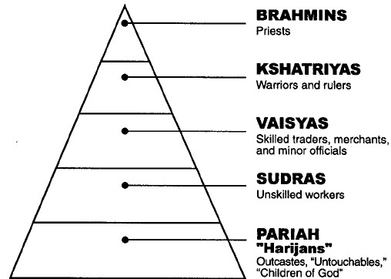
Indian Caste System
Indian Caste system provided social organization, economic justifications and political framework to India => formed a sort of identity far different from territorial sovereignty in Europe

Slide 8
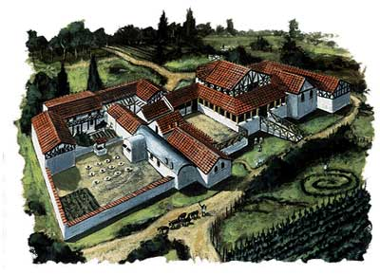
Social & Economic Dimensions of Empires -- Hierarchies
Han China => free peasant farmers were backbone of Chinese labor
Top = Bureaucrats and rulers; 2nd = free peasant farmers; 3rd = artisans and merchants (little to no slavery; 1% or less of pop)
Roman Latifundia – Romans engaged in commercial growing of wheat & olives

Slide 9
Social & Economic Dimensions of Empires – Food & loyalty
Classical empires had two important issues to deal with => producing enough food to supply the urban pops & maintaining loyalty of elites
Food Supply
Roman Empire => food supply depended on two things free peasant laborers and slaves
___________were Roman ideal -- provided tax base & military service
Large landowners used slaves to farm large estates (latifundia) for commercial purposes (wheat, olives, sheep)
-- Due to reliance huge fear of __________________(i.e. Spartacus)
Han China => food supply depended on free peasant labor
Qin dynasty (and later at times during Han) forcibly ______________ ____________________land to peasants (peasant communities)
Silk weaving supplemented income (“Man as tiller, woman as weaver”)
Teotihuacan => developed ____________________(floating islands) to permit year round agriculture
Mayans => developed ___________________farming to improve production of cotton, maize and cacao

Slide 10
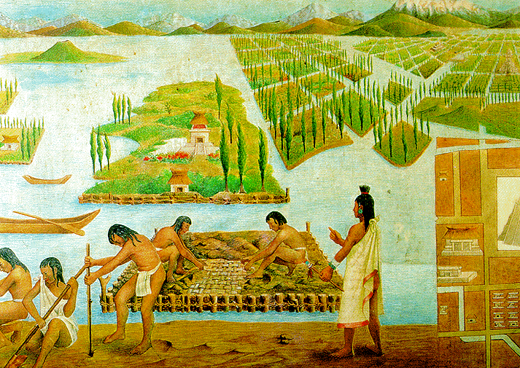
Teotihuacan Chinampas
Teotihuacan chinampas were made of reeds and anchored to the shore => underground irrigation and resistance to frost made them productive year round

Slide 11
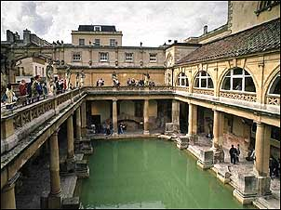
Social & Economic Dimensions of Empires – Food & loyalty
Elite Loyalty
Roman Empire => offered conquered elites ___________and emperors appointed elites to govt. posts & provided elaborate _________
By 356 CE Rome had 28 libraries, eleven thermae, 2 amphitheaters, two circuses and 19 aqueducts
Mauryan/Gupta Empires => Gupta rulers gave large land grants to ______________(used to secure legitimacy for Guptan kings)
Rulers like Ashoka also promoted arts and science (use of iron, herbal remedies, number zero)
Han China => Han rulers exempted
officials from taxation & military service
Exams often “rigged” and______
families had distinct advantages
Roman Thermae

Slide 12
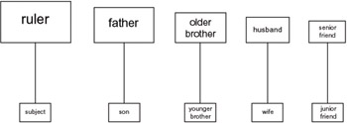
Social & Economic Dimensions of Empires – Patriarchy
All Classical Age empires preserved the patriarchal organization of society found in earlier times due to the prevalent farming lifestyle
Societies formally restricted women’s rights and actions
Importance of the family unit was still revered in empires
Patriarchy and Family
All classical empires had formals systems of patriarchy in place => limited women’s role in public sphere and right to inherit property
Qin and Han China => women were forbidden from owning property, no dowry (financial security) & divorce could result from no male heir
-- Nuclear family predominated and Confucianism prescribed a tight code of __________________(respect for parents and elders)
-- Filial piety prescribed 5 relationships which formalized patriarchy
5 Confucian Relationships

Slide 13
Social & Economic Dimensions of Empires – Patriarchy
Roman Empire => “_________________” exercised absolute control over extended household (arraigned marriage & protected women)
-- Upper class women did have some additional freedoms => i.e. education, limited property rights
Mauryan/Gupta India => Kama Sutra gave formal direction to Indian women; under Guptas women were forbidden to______________
-- Indian laws also strictly constricted the actions of women => barred from studying texts and participating in rituals
-- Guptas also encouraged _______________to increase population => girls married as young as ________(ensure purity also)
-- Rural women were also expected to participate in practice of ___ => women dives on husbands funeral pyre (preserves purity)
-- Women could escape lifestyle via religion (Jainism or Buddhism), training in poetry, sexual pleasure, music (wealthy families)

Slide 14
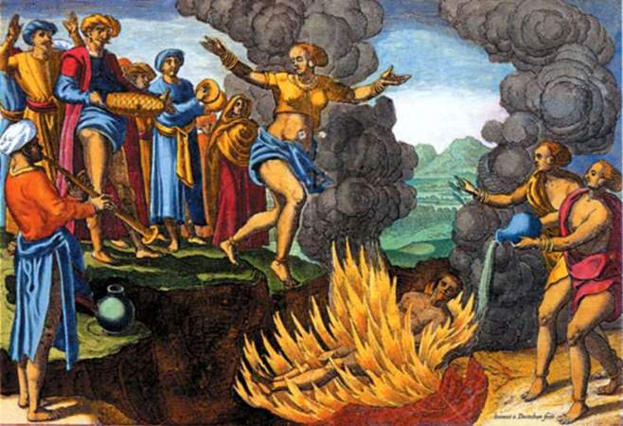
Indian Sati
The practice of Sati (“good wife”) was formalized in the Rig Veda and other Hindu texts => the practice was sometimes voluntary but often coerced by threats of communal ostracizing

Slide 15
The Decline and Fall of Classical Empires
By the 3rd to 5th centuires CE many classical empires (Persian, Roman, Han, Mayan and Gupta) experienced periods of decline and collapse
The fall of these empires had both internal and external dimensions
Internal
Roman Empire => series of weak emperors in the 3rd century (3rd century crisises) led to a weakening of Roman power and decline
Weak bureaucratic officials were unable to stem the ______________ ______________(land) => weakened tax base & military recruitment
-- Germanic mercenaries hired to defend borders (Roman commanded)
Environmental causes => __________________weakened Roman intellectual capacity (aqueducts)
-- Drought in N Africa led to a decline in wheat crops
_____________________led to inability for military to defend frontiers and displaced Germanic tribes (Augustus warned of this in 14 CE)
____________________by greedy emperors (i.e. less gold and copper %) led to inflation and lack of trade as barter economy returned

Slide 16
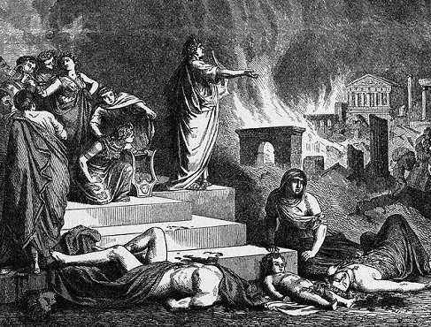
Nero and the Burning of Rome
Some accounts place the blame for the Great Fire of Rome (destroyed up to 20-25% of the city) at the hands of Nero who for insane or sane reasons (clearing room for his new building projects) set fire to the city and played his harp while it burned

Slide 17
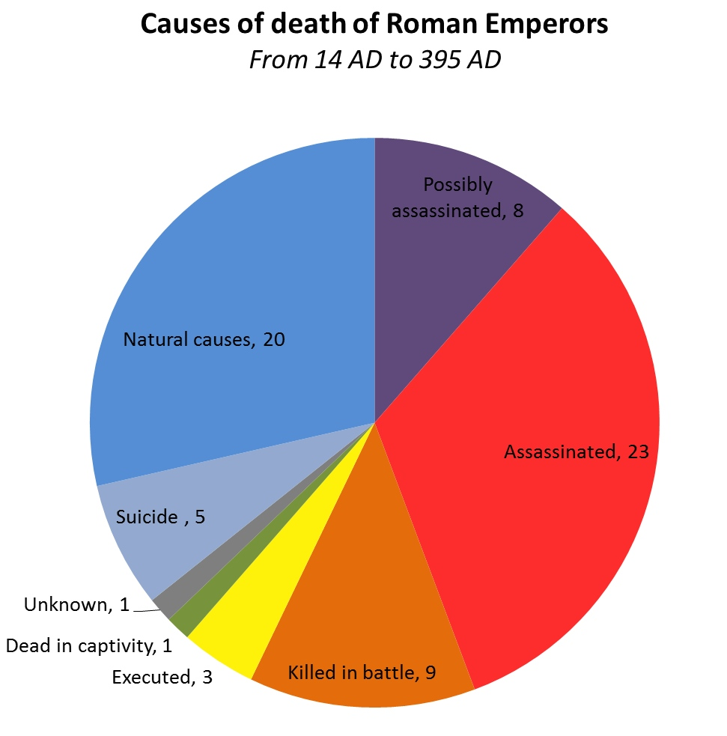
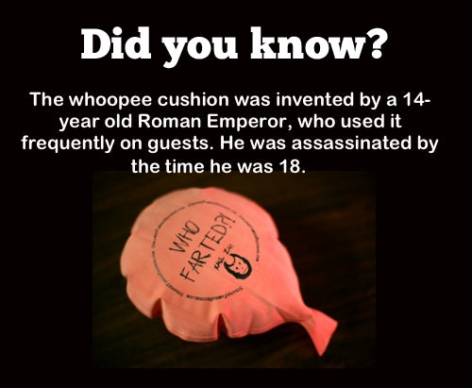
Roman Emperors & Fall of Rome
In the later empire (180 CE onwards) Roman emperors were often assassinated and rarely served out their terms naturally => this led to the Praetorian guard becoming more powerful and emperors becoming more isolated

Slide 18
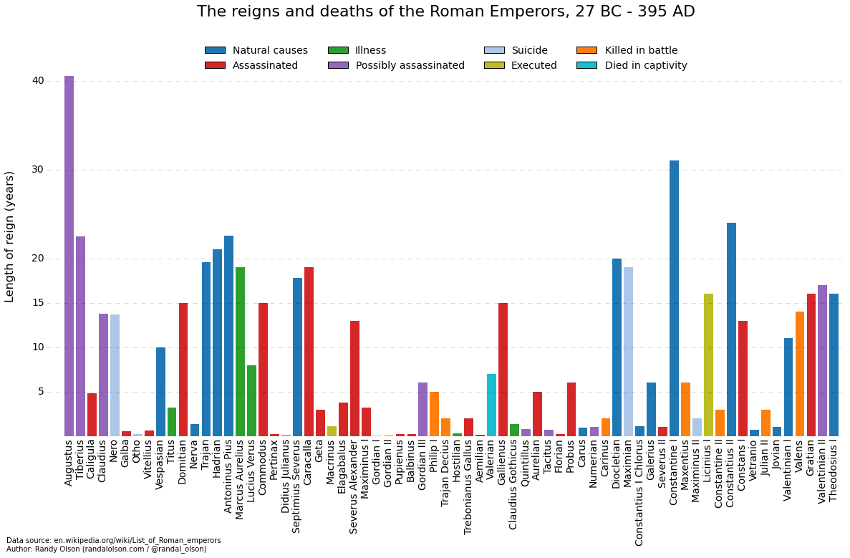
Roman Emperors Reigns

Slide 19
The Decline and Fall of Classical Empires
Han China => decades of weak rulers in the 1st and 2nd centuries CE led to a series of internal problems
____________________=> imperial taxes had to be paid in coins & in times of drought peasant farmers forced to sell land
-- Pop. growth also led to peasant farms reducing in size (___________)
Imperial corruption => wealthy and Imperial court were ___________and controlled by intrigue, eunuchs and concubines
-- Widespread peasant unrest and lack of military service => resorted to recruitment of SE asian mercenaries (unreliable)
-- Internal Rebellion by _________________________in 150 CE
Population decline => by 150 CE Chinese population was only 20 M
Guptian India
Guptan rulers practice of giving large land grants to Brahmins _________ ________________and led to peasant unrest and lack of revenue
Guptan empire was really a theater state => power rested on elaborate displays at capital were recruitment tool for association w/ empire (i.e. religious rituals, ceremonies, cultural performances)
-- Decline in revenue led to decline in ceremonial importance

Slide 20
The Decline and Fall of Classical Empires
Persian Empire
______________________led to a weakening of the empire’s ability to defend itself => esp in India and vs Greek city states
Persian kings hoarded massive amounts of _____________in palaces => excessive taxation weakened economy and led to unrest
Mayan Empire
_____________led to soil erosion and declining crop yields of maize => intensified conflict between _________and led to decline
Moche state
_____________and rain patterns caused the shifting of river beds and silting of existing irrigated fields => led to famine and decline

Slide 21
The Decline and Fall of Classical Empires
External Factors
Han China => Chinese expansion (especially Great Wall) had led to the formation of ______________________
Constantly attacked Chinese borders (breakthrough in 2nd century CE) and weakened Han through tribute for centuries
China devolved into anarchy and fractured states for over 400 years
Roman Empire => _______________displaced Germanic tribes (________ _____________) who invaded and overtook Rome by 5th century
Excessive Roman taxation and prejudice led to rebellion after Rome settled them in 2 provinces and gave them autonomy
German tribes established their own kingdoms and local autonomy prevailed for centuries (“Dark Age”)
Roman Empire gradually shifted resources and power to East => __________________became capital and __________________founded
Gupta Empire => invasions by the ________________weakened the Guptas & depleted the treasury (lack of ability to function as a theater state) => led to fall of Guptas by 550 CE (100’s of years of political division)
Mauryans fell to a similar fate => both were also weakened by social and political tensions created by the____________________

Slide 22
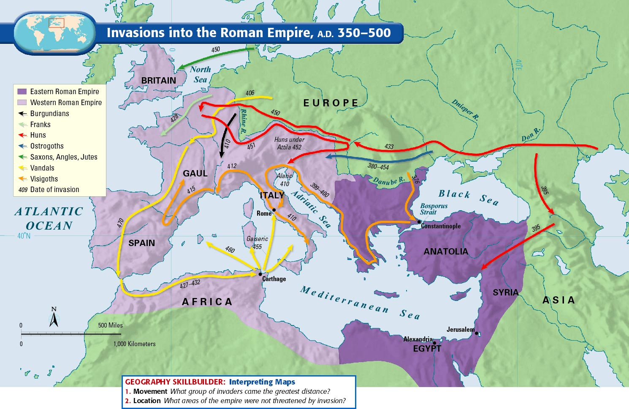
Invasions into Roman Empire

Slide 23
Hun migrations

Slide 24
Q: How is the sack of Rome portrayed? How are the Visigoths pictured compared to the Romans?

Slide 25
Social & Political Impacts of Fall of Empires
As three major Empires in India, China and the Mediterranean fell they had different impacts on the regions culturally and politically . . .
Roman Empire
Entered cultural “__________” where much of the _____________(aqueducts) & knowledge (i.e. Greek philosophy and__________________) was forgotten
_______________________remained a powerful force though in both Eastern & Western worlds (influence of Constantine & Catholic Church)
Less focus on luxuries and entertainment => more on Christian religion (i.e. churches and religious iconography)
Move to decentralized social and political control => ________________ -- Peasants became tied to land and lords offered protection
Politically the Western Empire entered a time of disunity, ruled by chieftains & isolated Germanic kingdoms (sought legitimacy via religion)
__________________________remained intact w/ Constantinople as Capital (same govt.) => ruled by series of good emperors (Justinian)
-- Better weathered invasions and many wealthy merchants moved to Constantinople due to its trade significance

Slide 26
Social & Political Impacts of Fall of Empires
China
Entered a_____________________________, anarchy and invasion => ruled by local elites and nomadic groups
Culturally the lack of centralized authority weakened Confucian ideology and popularity of ______________________________increased
Sui and Tang dynasties made them state religions => incorporated into Civil Service exams
Buddhist missionaries traveled on Silk Road and expanded religion
Confucian philosophy and tradition of filial piety did remain and were revived by Song and later dynasties
India
Entered a long period of disunity (500 yrs +) and local ruling clans/chieftains => _____________________still provided a sense of unity and identity
Caste system and karma remained unchanged and ordered society
Disunity _________________________________=> Indian epics (Ramayana and Mahabharata) were written during disunity and Indian mathematicians invented concept of zero as well

Slide 27
Classical Era Trade
During the Classical Era the volume of long distance trade increased dramatically in the Eurasian sphere
American civilizations (i.e. Teotihuacan, Maya, Moche) traded on a more local level due to city state organization & lack of overland/sea connections
Why & How?
Organization of _____________________=> empires united regions
Led to need for increasing amounts of raw materials
Brought regions into closer contact => i.e. Alexander the Great and Hellenistic influence in India
-- Less area to traverse to trade
_____________and Prosperity => empire formation led to building of roads, aqueducts, canals which facilitated easier interaction
Also led to accumulation of wealth by elites & desire for luxury items
Nomadic and __________________=> groups like the Scythians and Xiongnu provided protection to traders and navigated safer land routes
Benefitted from trade due to metal goods and crops
Emergence of Kushan kingdom & Parthian empire also filled in gaps between larger empires (led to safer travel)

Slide 28
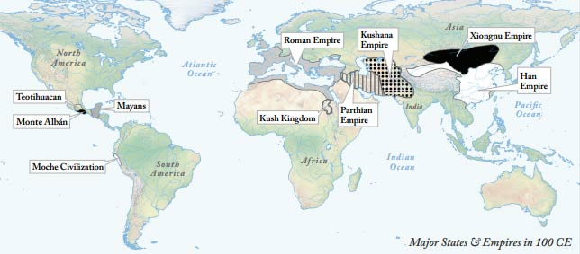
Major States and Empires in 100 CE
By 100 CE Eurasia is linked by major states and empires whereas the Americas are basically organized into small city states

Slide 29
Classical Era Trade Routes
4 Major trade networks existed => each different from others . . .
#1: Eurasian _____________________=> overland routes that linked Han China and Roman Empire (far ends of Eurasia)
Main item traded = high quality ________________
-- Romans imported ivory, indigo, silk textiles, pepper & spices
-- Han China imported silver, wine, olive oil, slaves, glass
Existed for centuries but trade increased in 1st century CE => due to_____ _____________________, rise of elites and emergence of linking empires
Trade conducted by merchants in towns across the route and nomadic trading caravans (horses and camels)
#2: __________________caravan routes => pioneered by Berbers nomads these routes carried trade from West African societies to Mediterranean & ME
Main items traded => __________________(Romans gave manufactured goods and crops like olives and wheat)
Most trade occurred with__________________, not interior
Caravan trading in large groups of camels (some times 5000 + camels w/ 1000’s of traders; travel at night)
Larger trading centers like Gao & Saleh established

Slide 30
Silk Road (ca 100 CE)
Silk Road goes through much challenging terrain => Gobi & Arabian deserts, Himalayian Mts => 4 months to travel by caravan from Chang’an to Samarkand

Slide 31
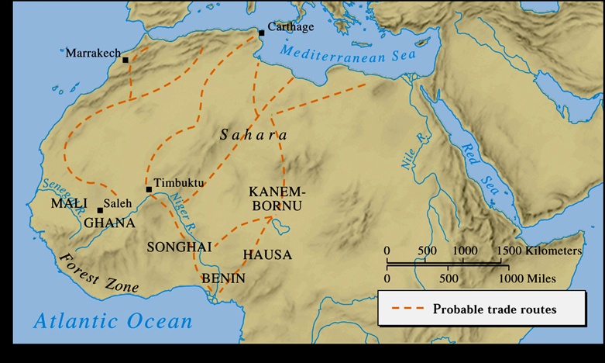
Trans Saharan Trade routes
Trans-Saharan routes originated among Berber traders prior to drying of Sahara => mostly done in large caravans of camels

Slide 32
Classical Era Trade Routes
#3: ______________Network => pioneered by Phoenicians, Greeks and Selucids who discovered ______________patterns (India to ME & E Africa)
Main trading items => Ivory, incenses, _____were traded by Indians for slaves, gold, woods and animals (elephants) from Africa
-- Spices important for medicinal, flavoring, perfumes (lack of baths), mystical potions
Dominated by Indian ___________=> used triangular __________ -- Sailed on Monsoon winds across open stretches of water
#4: _________________Networks => pioneered by Phoenicians and Greeks (established commercial colonies), perfected by Romans
Main trading items => glassware, olives, wheat, slaves, gold & silver
-- Lanes carried trade from other networks around_____________
Ships were mainly large __________________=> oared by slaves
-- Tight harbors and small spaces to manuever

Slide 33
Phoenician and Greek explorers discovered monsoon wind patterns in Indian Ocean => led to easier long distance voyages
Indian Ocean Trading Network

Slide 34
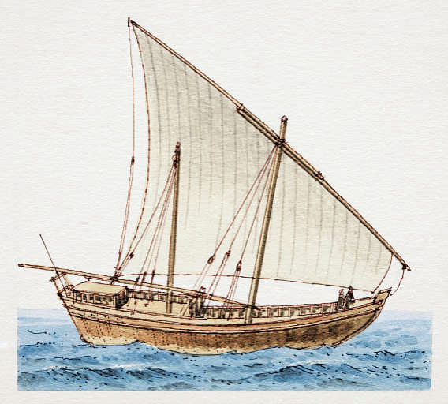
Indian Ocean Dhow ship
Dhow ships were likely invented by the Chinese and used lateen sails (1-2 masts) to effectively sail with and against monsoon winds

Slide 35
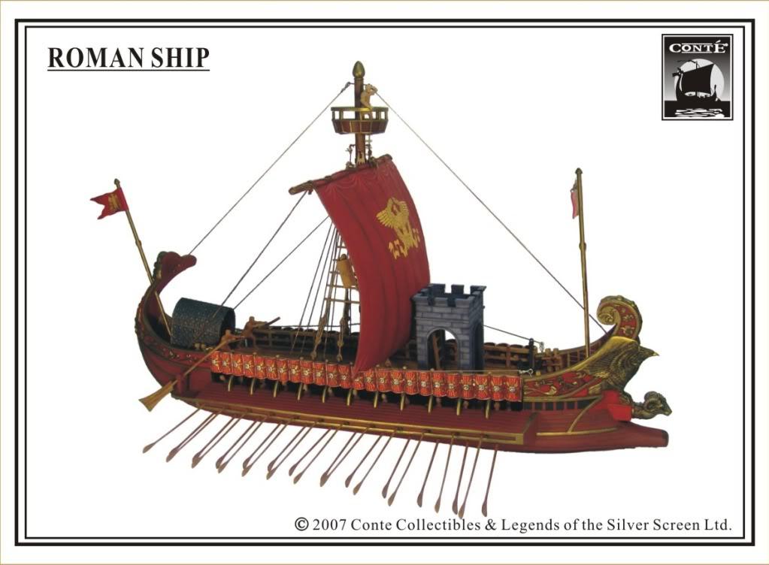
Roman Galleon
Roman galleons were based on Greek and Phoenician ships and used sails as well as oars to travel

Slide 36
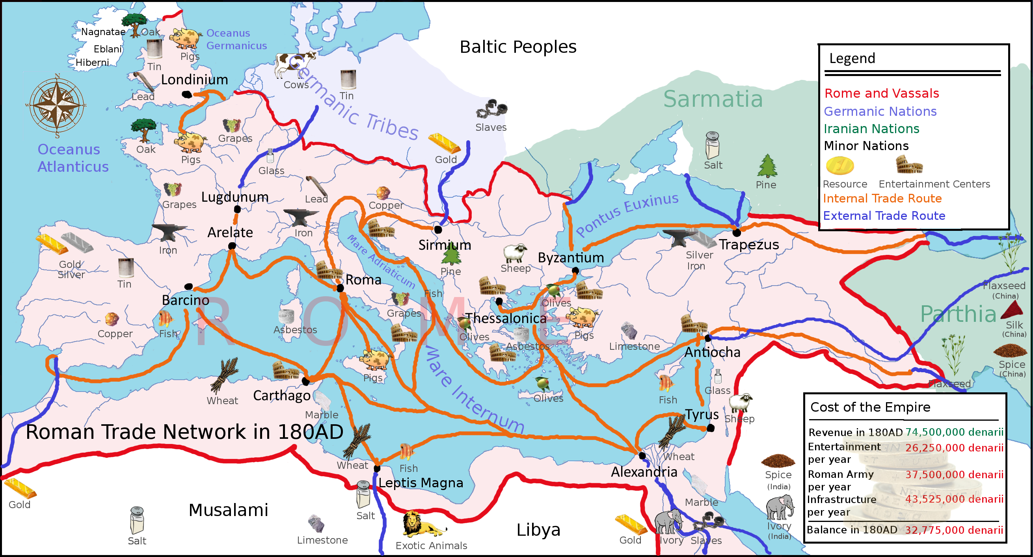
Roman Trade Network

Slide 37
Impact of Climate and Technology on Classical Trade
During the Classical Era, climate had significant impacts on trade routes => Climate/geography created barriers to trade in all regions
Indian Ocean => Greeks, Romans & Indian mapped monsoon wind patterns to sail ships across Indian Ocean (time sensitive)
Silk Road => deserts (Gobi), mountains (Himalayas) needed to be traversed (utilized oases and mountain passes)
Trans-Saharan => Berber traders mapped out oases paths and wind patterns to provide safe travel
Mediterranean => lack of reliable wind patterns led to rowed ships
Different technological improvements made the overcoming of climate and geography possible on a large scale
Land based technologies
____________________=> led to the use of domesticated animals (i.e. horses, oxen, llamas and camels) to be used effectively in trade
North Arabian _________________=> used for trade and defense (more stable and allowed riders to use bows and weapons)
-- Helped caravans defend themselves
-- Better for longer distance travel (rider doesn’t kneel)

Slide 38
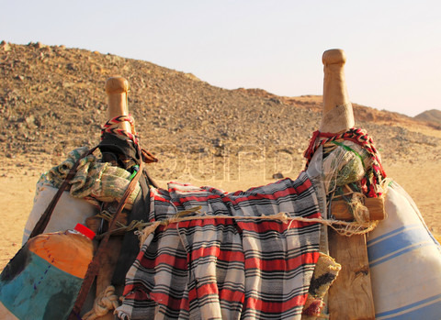
North Arabian camel saddles
North Arabian saddles were a large improvement due to the seating arrangement (not kneeling) and higher placement on top of camel’s hump => allowed a stable base to use weapons

Slide 39
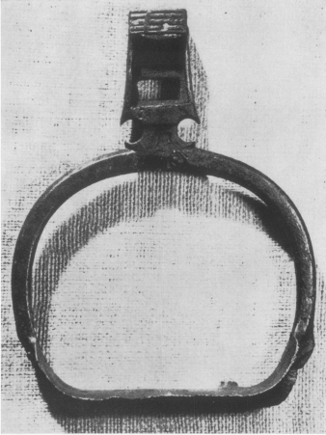
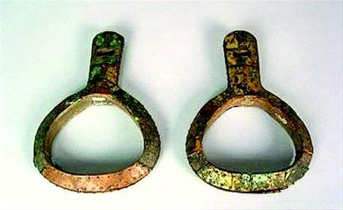
Early Kushan stirrups
The Kushan kingdom (and likely Scythian nomads) invented the stirrup in the 1st century CE => started as a loop for big toe and evolved from there to support the entire foot
Gave riders ability to fire bows or use lances to strike from horses

Slide 40
Impact of Climate and Technology on Classical Trade
____________________=> allowed riders to use bows and spears while riding horses (protect large caravans during travel)
Maritime Technologies
_______________and _______________
Lateen sails are triangular sails used by dhow ships (Indian Ocean) => can sail with or against wind (more effective use of wind)
-- Aided traders to sail in larger areas of open water and quickly manuever with monsoon winds
Indian Dhow ship

Slide 41
Nomadic Groups & Cross-Cultural Exchange
** Go over Stearns Essay on Nomads ** => What role did nomadic groups play in trade & cross-cultural exchange? Why are they well suited to do so?
Many different groups of ______played key roles in different trade routes => Q: What type of trade routes were nomads involved in?
_________________in the Sahara founded trade as they traveled through the desert => knew routes and showed to others
Scythian and Xiongnu peoples were essential in linking Silk Road network and providing protection to travelers
-- Also invented stirrups to make horses more useful in trade
-- Participated in network to obtain _______________and other luxury goods

Slide 42
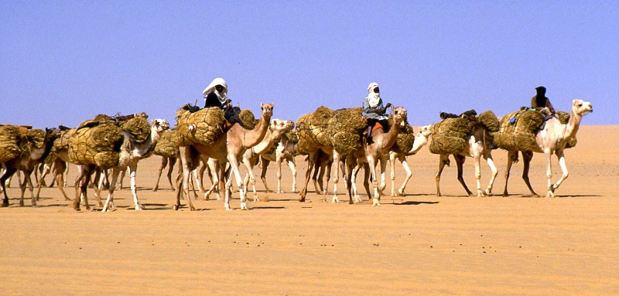
Camel Caravan in Sahara desert

Slide 43
Impact of Trade on Civilizations
Alongside economic trade (i.e. goods) many other items were transmitted through trade networks . . .
#1: Religion => Christianity, Buddhism and Hinduism were all spread
Christianity was spread from the Middle East to _____________(Ethiopia) &__________________________
Buddhism was spread around India and then to______________________
Hinduism was spread from Indus Valley to India
** Spread was carried by a mixture of missionaries and merchants **

Slide 44
Spread of Classical Era Religions (300 BCE to 400 CE)

Slide 45
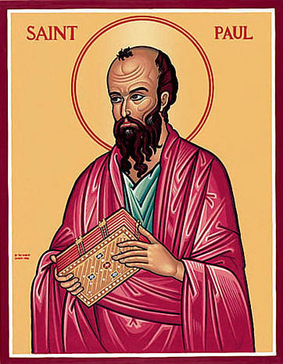
Religious Spread and Evolution
The three major religions of the Classical Age spread and evolved significantly during the time period
The universality of religions encouraged spread to acquire converts
As the religions spread they went through a variety of processes that resulted in change
-- Adapting to different regional practices and desires
-- Fitting into political structures and hierarchies
Spread typically involved trade routes and the activities of missionaries and merchants
-- i.e. Paul => traveled Mediterranean spreading Christianity

Slide 46
Spread and Evolution of Hinduism
Due to the challenges of Buddhism and Jainism, Hinduism was modified by the Brahmins (kept high status) to appeal to the masses
Rituals were de-emphasized and a _______________________was created to appeal to different peoples (______________________)
-- All gods though are manifestations of _______________(Brahman)
-- Most important are:
___________ (protector) => appears on earth in dire times in various forms (Rama, Buddha . . . Attempt to co-opt Buddhists)
________ (creation and destruction)
_______(fertility goddess) => both Shiva and Devi are co-opted gods from the Dravidian tradition in S. India
Hinduism offered many ways to achieve favor => ____________to deity, discipline (mental or physical =>_______) or ____________on truth
-- Shrines w/ statues of deities are places where followers gather => pilgrimages to shrines & Ganges to glimpse gods => provides Indian unity
Through changes that appealed to Dravidian S. Indians & absorption of Buddhist ideas, Hinduism spread throughout the Indian subcontinent

Slide 47
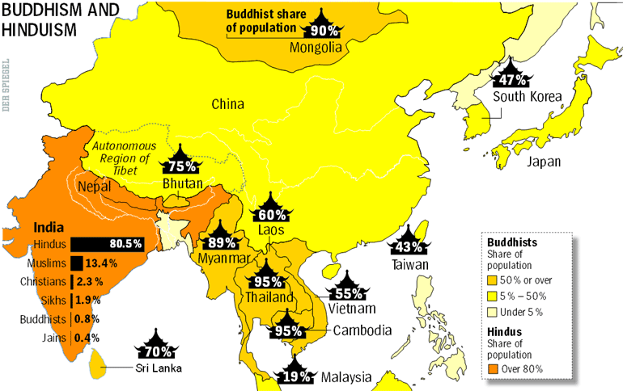
Buddhism and Hinduism in South, SE and East Asia

Slide 48
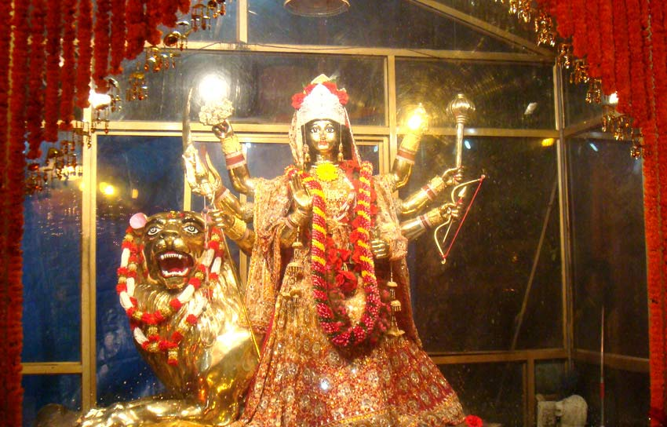
Devi Shrine
Hindus believe that gods take up temporary residence in beautiful statues => offer clothing, food, etc… to statue in hope to glimpse God form (special blessing)

Slide 49
Spread and Evolution of Buddhism
Buddhism was originally born in N. India but was spread throughout India by Mauryan Emperor _________=> pillar & rock edicts along roads
Ashoka also sent out missionaries and founded many monasteries => trained people in 8 Fold Path and 4 Noble Truths
Buddhism spread to other nations primarily through the Silk Road oasis towns (Bactria region) and merchant traders in Indian Ocean
-- Very popular in ______________________________(also China)
-- Chinese tried to co-opt Siddhartha Gautama => claimed he was Chinese or disciple of Lao Tzu (Daoism) to encourage conversion
As Buddhism traveled and time wore on, Buddhism split into two sects:
__________ (Teachings of Elders) => orthodox Buddhism that denied divinity of Siddhartha & kept focus on individual path to nirvana
________________ (Great Vehicle) => attempted to appeal to desire for gods mysticism and saints by modifying beliefs
-- Siddhartha was divine (Buddha image)
-- _______________put off enlightenment and were reborn to guide others to nirvana (i.e. Dhali Lama) => established monasteries
-- ____________were built to celebrate Buddha’s life and house relics

Slide 50
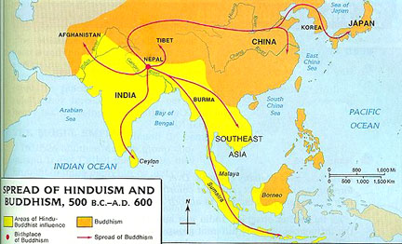
Spread of Buddhism & Hinduism

Slide 51
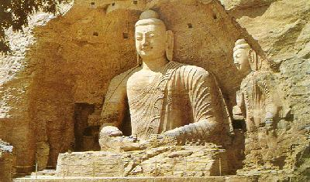
Buddhism in China
After the Fall of the Han Dynasty, Buddhism became very popular (along with Daoism) in the fractured states that survived. This is an account of the origins of Buddhism by a Chinese historian . . .
“What is recorded in the Buddhist scriptures is analogous to the teachings contained in the scripture of Lao Tzu (the founder of Daoism) in China. It is actually believed that Lao Tzu, after having gone to India, instructed the barbarians and became the Buddha.”
-- Yu Huan, Chinese historian ca 250 CE
Q: What is Yu Huan’s purpose? Is this story true?

Slide 52
Spread and Evolution of Christianity
When Christianity was 1st established Christians preached only to Jews => Jesus was savior promised in the Old Testament
Jews rejected the message and the practices of Christians => ____(1st ___________) started to preach to Romans and gentiles
-- Paul founded _______________=> appointed religious leaders (bishops) to coordinate activities and escape Roman persecution
Many believers embraced ______________=> founded Christian monasteries (monks and nuns)
-- Religion spread through Mediterranean, ME, Europe and Africa (Ethiopia)=> mainly along trade routes and in cities
-- Religion was codified into Old and New Testaments (Bible)
-- Christianity popular among Women, slaves, urban poor
After Constantine’s conversion and the______________, Christianity spread rapidly and underwent even further change

Slide 53
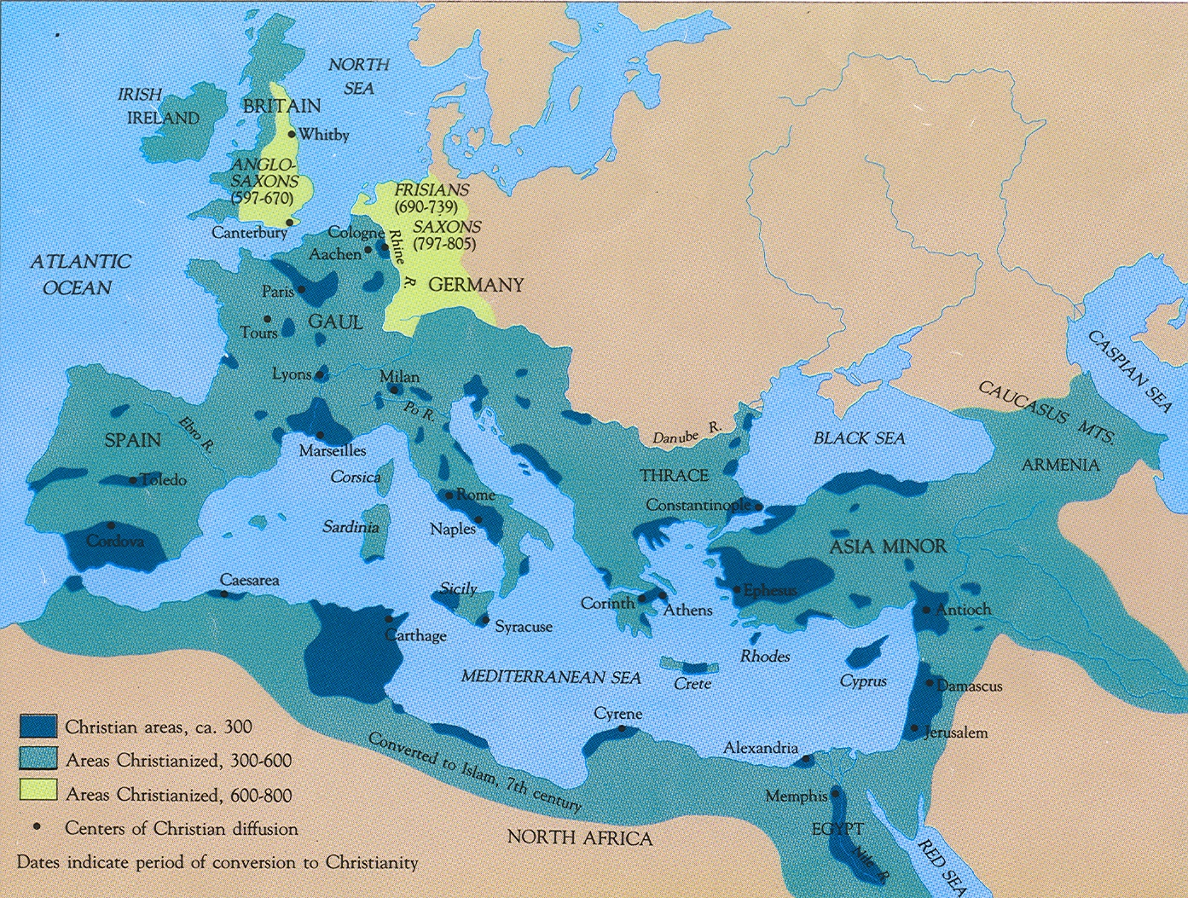
Spread of Christianity in Mediterranean and ME

Slide 54
Spread and Evolution of Christianity
Christian celebrations were moved to coincide with pagan festivals (winter solstice = Christmas; syncretism)
After the Fall of Roman Empire, the Bishop of Rome was redefined as the Pope (spiritual leader of church)
Church also accepted Roman and Greek influences
-- ___________becomes language of the Church
-- Christian theologians (St Augustus) formalized Christian doctrine in a rational sense (appeal to intellectuals)
-- __________________were adopted => baptism, communion
-- Preserved western learning in monasteries (monks copied texts)

Slide 55
Spread of Classical Era Religions (300 BCE to 400 CE)

Slide 56
Impact of Trade on Civilizations
#2: Crops => crops were carried both from and to East Asia
Western crops introduced in China: pistachios, walnuts, spinach & sesame
Chinese crops introduced in Europe: cinnamon, peaches, plums, ginger
South Asian crops to ME => ________________
Led to development of cotton plantations in Egypt and rice farming in ME => led to introduction of ________________in N Africa, China, India, etc..
______________= channel dug in a hill or mountainside used to irrigate crops
#3: Disease => diseases like ____________________________________spread across trade routes with merchants and missionaries
Urban areas were hardest hit => why???
Led to decline in ___________________centers and a drop in trade => economies contracted and were forced into self-sufficiency
Lack of sanitation and proper control measures on water supply; lack of immunity to diseases
Ex: ____________________(Roman Empire, 166 -180 CE) => measles or smallpox
Killed 2000+/day in Rome at its height => many areas lost 1/3 of their populations
Decimated the Roman Army where disease originated (40%+ killed)
Led to economic contraction, death of emperor and decline in power of military => one of causes of decline and fall of Rome
#4: Technology => examples already discussed such as lateen sails, saddles, stirrups, etc…

Slide 57
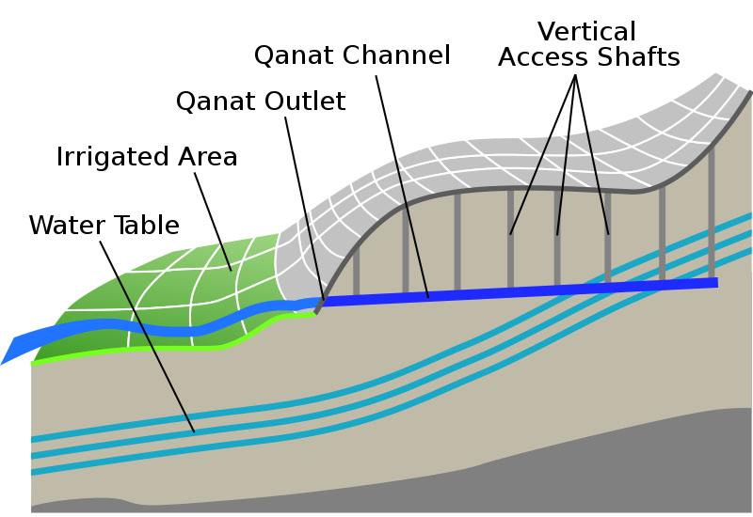
Qanat farming
The dry environment of the N Africa, combined with desire to produce new South Asian crops led to the development of qanats (expensive to construct) => qanats spread from Persia to China, India, N. Africa, etc…

Slide 58
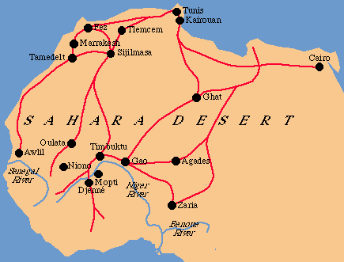

Slide 59
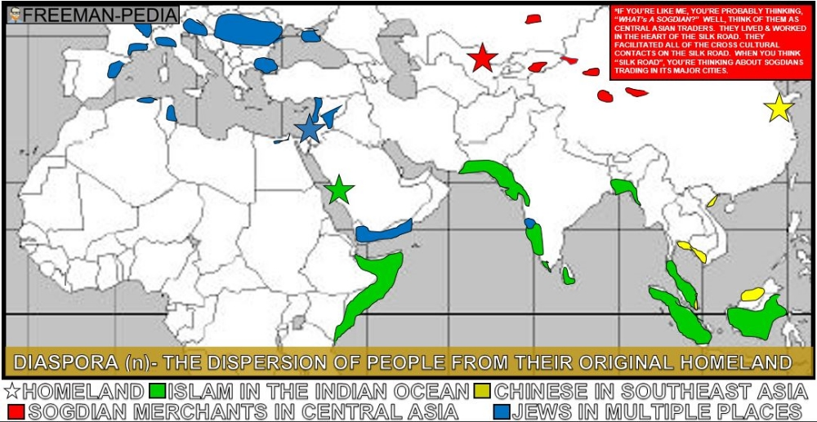

Slide 60
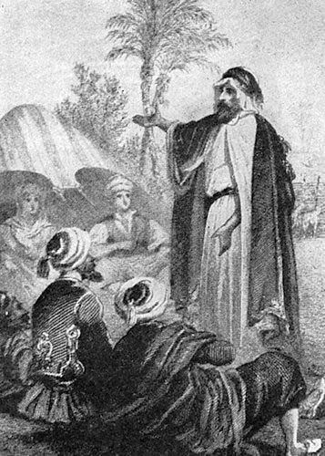
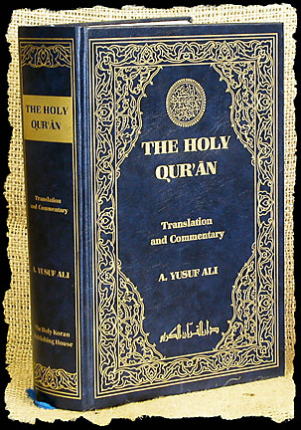
Islam
Muhammed

Slide 61
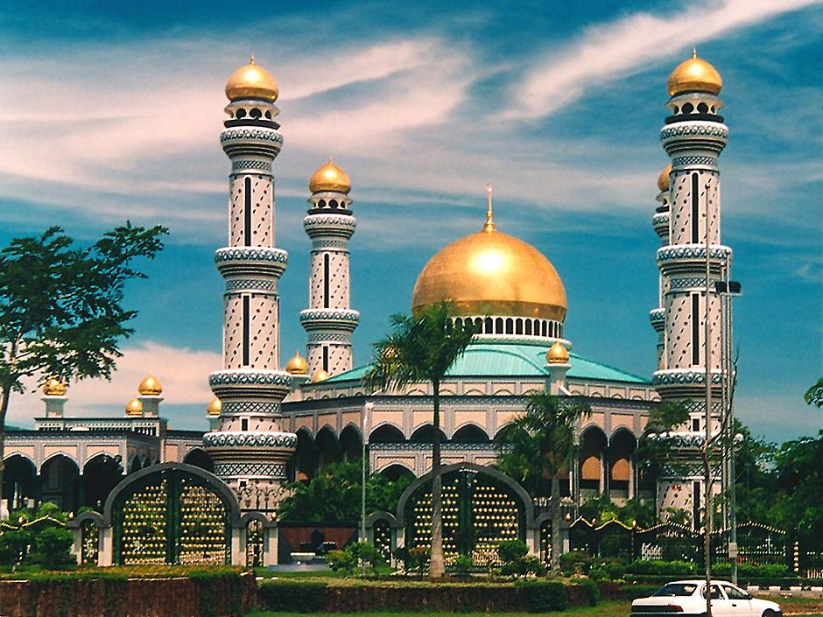

Slide 62
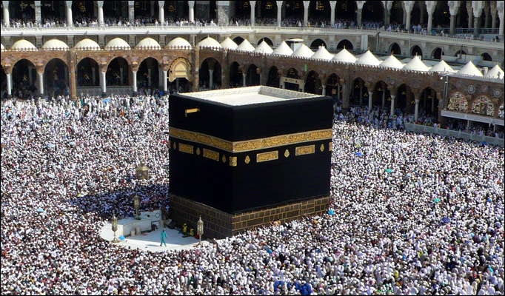
The Hajj to Mecca

Slide 63
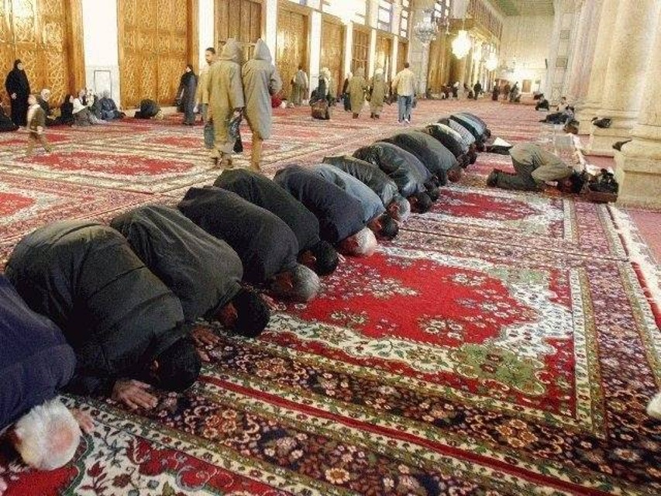
Muslim Prayer to Mecca

Slide 64
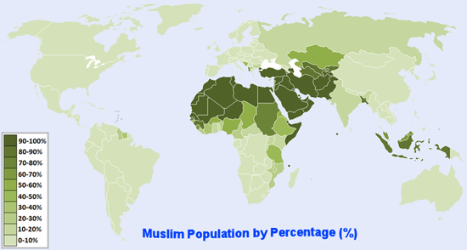
Islam adherents by country

Slide 65
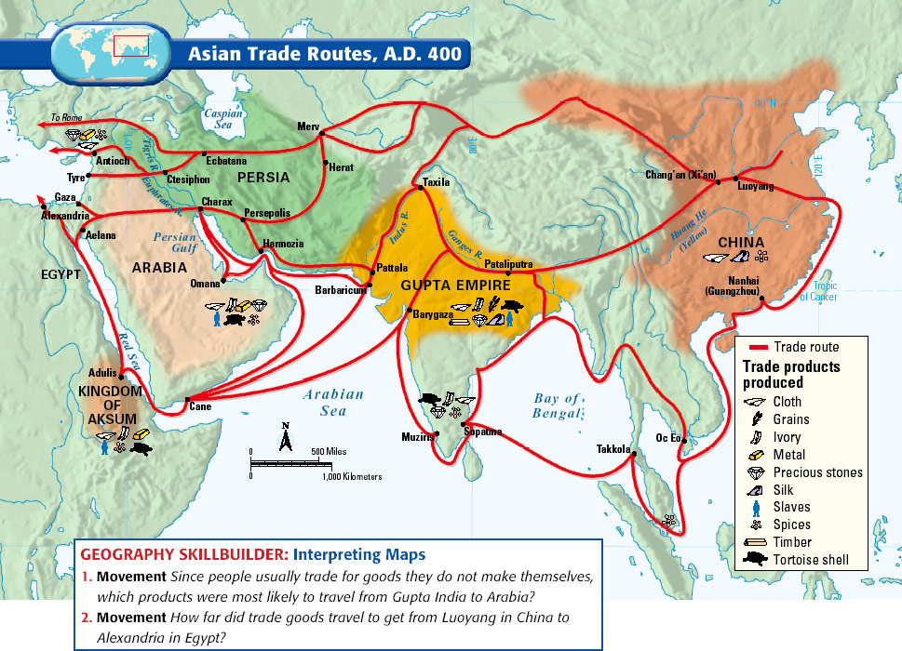

Slide 66
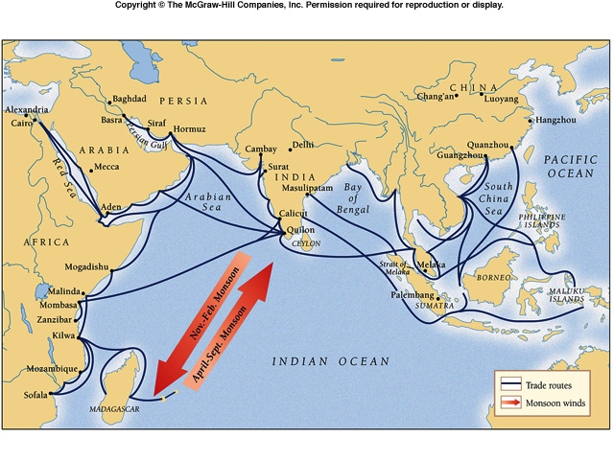
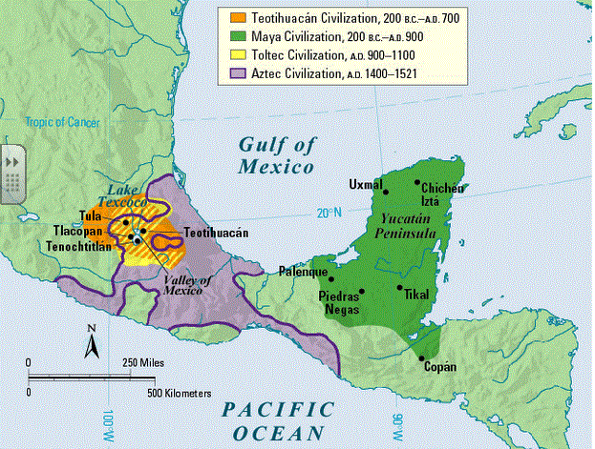

Slide 67
