Slide 1
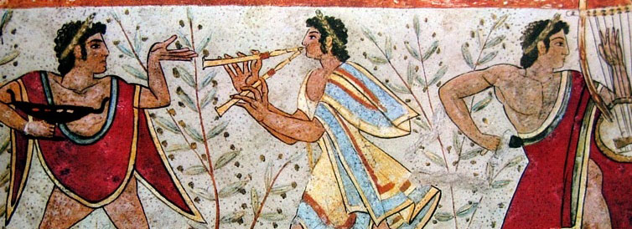
Unit II: Classical Civilizations and Interregional Contacts
Ca 600 BCE to 600 CE

Slide 2
World Population through History

Slide 3
Year | Est. World Population | Growth Rate
100,000 BCE | 10,000
30,000 BCE | 500,000 | 0.56%
8000 BCE | 6 Million | 1.25%
3000 BCE | 50 Million | 4.33%
1000 BCE | 120 Million | 4.47%
600 BCE | 120 Million | .06%
0 CE | 250 Million | .112%
600CE | 220 Million | -.033%
1000 CE | 250 Million | 0%
1200 CE | 400 Million | 26.49%
1400 CE | 375 Million | -3.18%
1600 CE | 578 Million | 24.15%
1700 CE | 680 Million | 17.65%
1800 CE | 954 Million | 40.29%
1900 CE | 1.6 Billion | 71.28%
1950 CE | 2.5 Billion | 139.74%
2000 CE | 6 Billion | 462.42%

Slide 4
The Classical Age – 600 BCE to 600 CE
After the Neolithic revolution & the rise of world civilizations, the classical age brought 3 changes in patterns of human interaction . . .
#1: Development of lasting ________________________________=> brought cultural unity and identity to many regions
Exs: Christianity, Hinduism, Buddhism, Daoism, Confucianism, Greek logic and empiricism
#2: The Increased ____________________________________brought unity to multiple geographic areas (i.e. China, India, Mediterranean)
Key Empires include:
-- SW Asia: Persian Empires (Achaemenid, Parthian, Sassanid)
-- East Asia: Qin & Han
-- Mediterranean: Phoenicia, Greek city states, Roman Empire, Hellenisitic Empires (i.e. Alexander the Great)
-- Mesoamerica: Teotichuacan & Maya city states
-- Andean S America: Moche
#3: Emergence of_____________________________________
Exs: Silk Road, Saharan caravan routes, Indian and Mediterranean sea trade
Overall, the effect of these developments was an intensification of regional unity and internal processes (i.e. artistic expression, social interaction and political development)
Civilizations pretty much developed independently & contacts were mostly regional

Slide 5
Universal Religions and the Axial Age
Historians call this period the Axial Age for its religious developments
From 600 BCE to 600 CE religious & philosophical thinkers formed the great majority of the world’s religious ideas (axes)
China: Rise of ______________ideology and _________
India: Creation of _________________and formalization of ____________
Mediterranean/Europe: Creation & codification of ____________________
-- Formalization of Greco/Roman philosophy also (rationalism & logic)
Christianity and Buddhism developed into the 1st Universal religions
_______________=> religion that attempts to ________________& appeal to people where they live (divided into sects & branches)
Different from a ethnic religion (i.e. Judaism) which appeals to only 1 group
The belief structures of this time period served many different functions
They provide a bond to tie people together => Common gods, common goals and cultural traditions
They set down moral codes (i.e. foundation of laws and civil order)
They also legitimize rule and reinforce political and social structures (i.e. Hindu caste system)
They can also create conflict between groups within & between societies
Satisfy a desire for people to have “mystical” connection with a deity

Slide 6
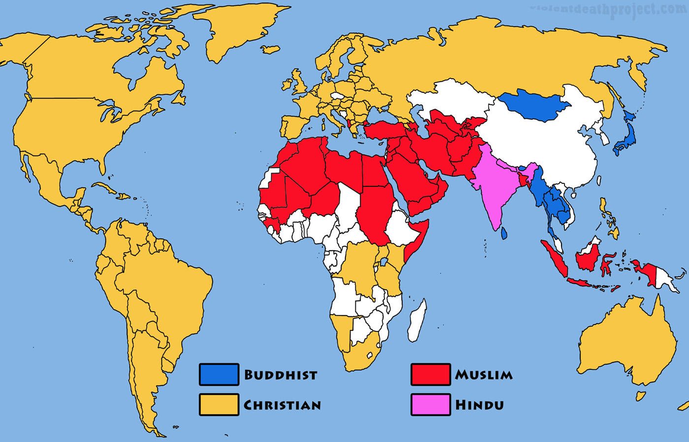
Universal Religions Map

Slide 7
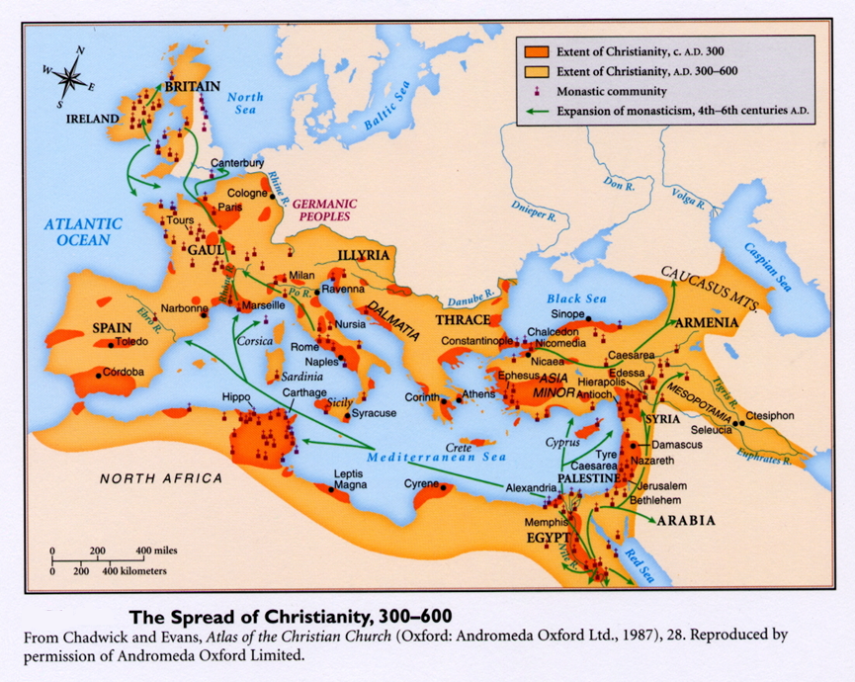
The Spread of Christian Monasteries

Slide 8
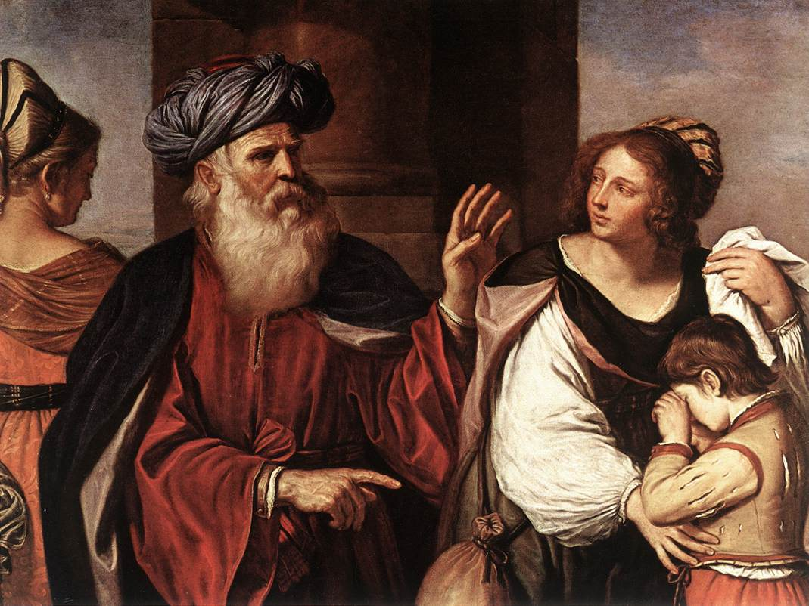
Judaism
Abraham – father of Judaism

Slide 9
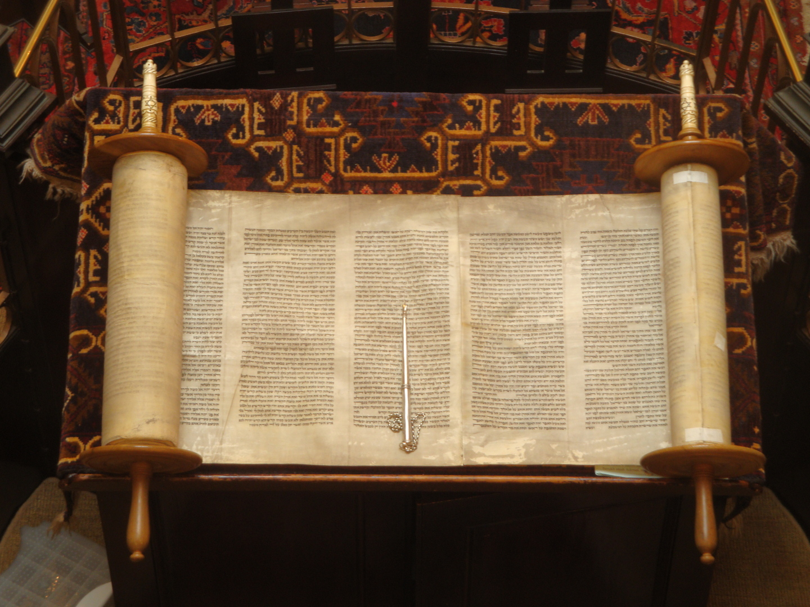
Torah

Slide 10
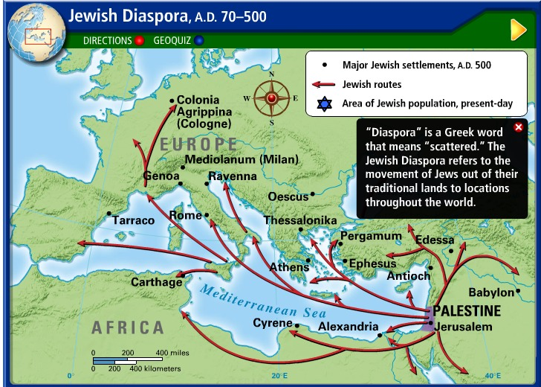
Jewish Diaspora in early years CE
Q: Why were the Jewish people persecuted by the Egyptians, Babylonians and Romans?

Slide 11
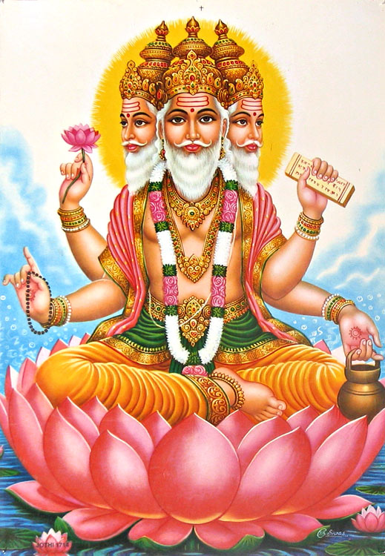
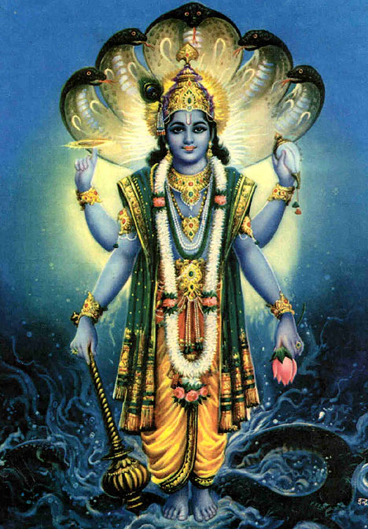
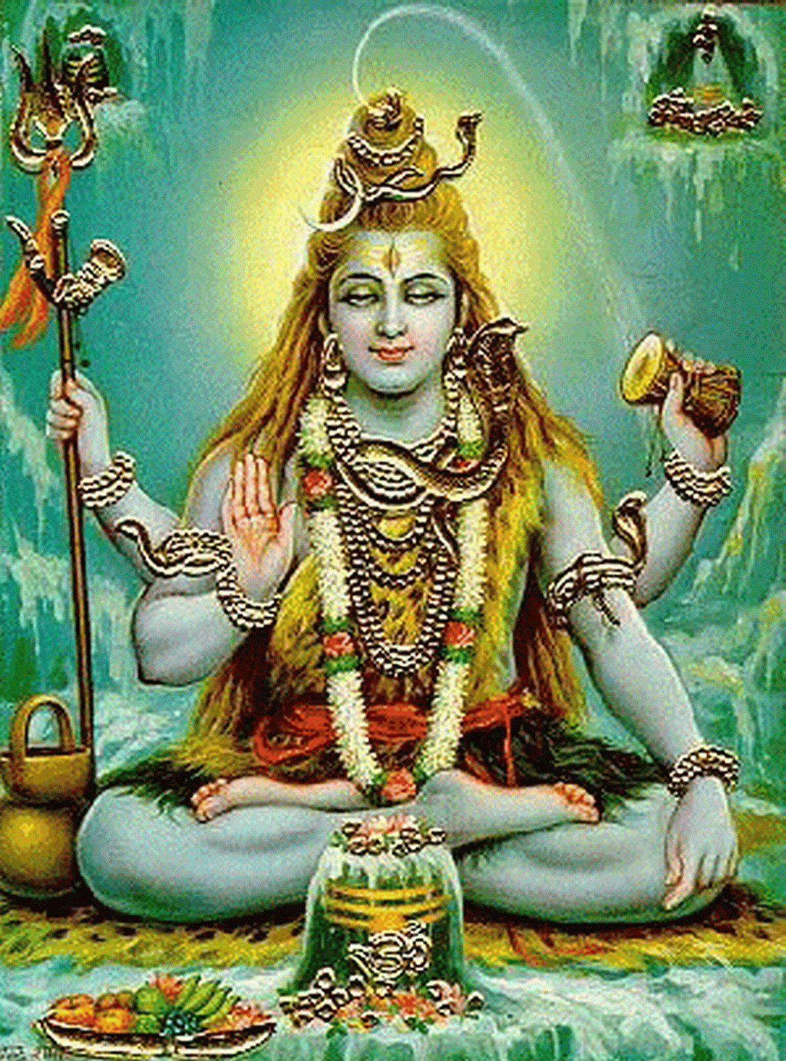
Brahma
Vishnu
Shiva

Slide 12
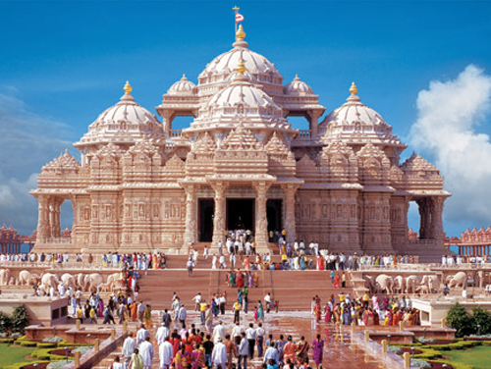
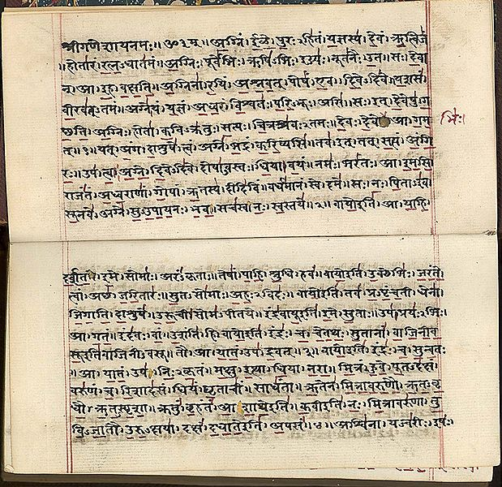
Hindu Mandir and Vedas

Slide 13
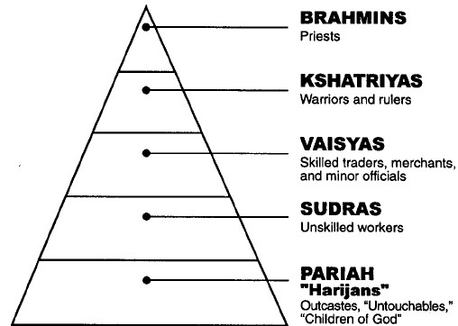
Indian Caste system -- Dharma

Slide 14
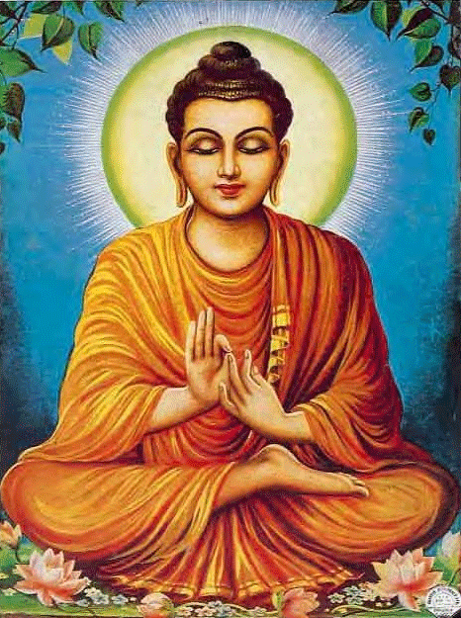
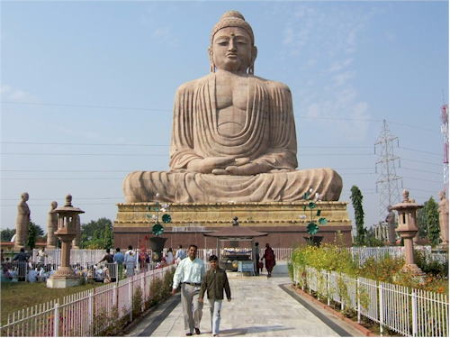
Buddhism
Siddharta Gautama

Slide 15
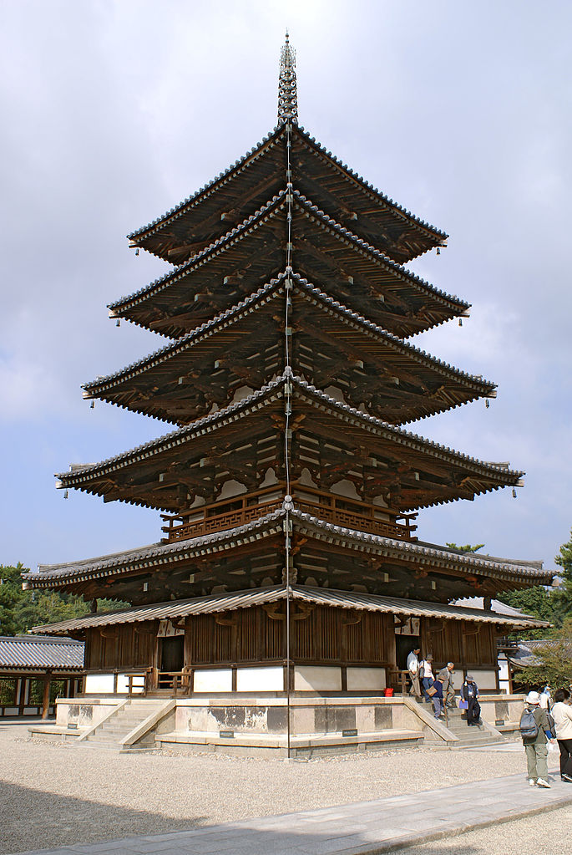
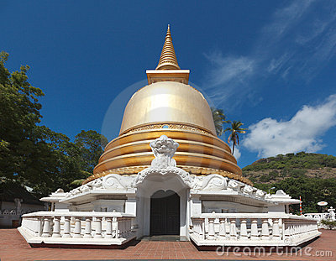
Buddhist Stupa
Japanese Pagoda

Slide 16
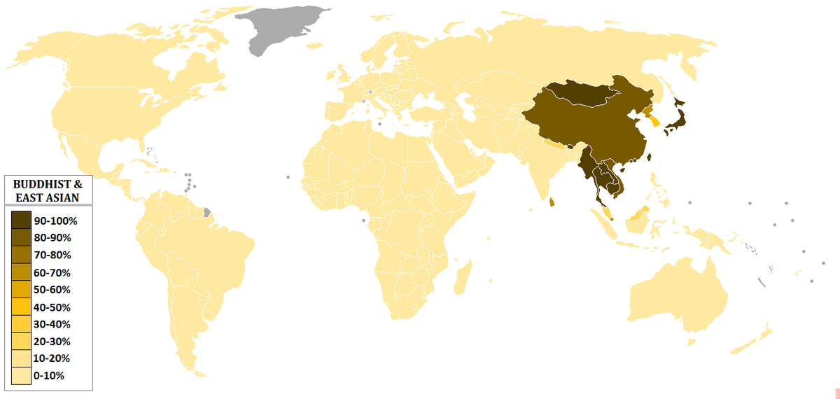
Buddhist Population by Country

Slide 17
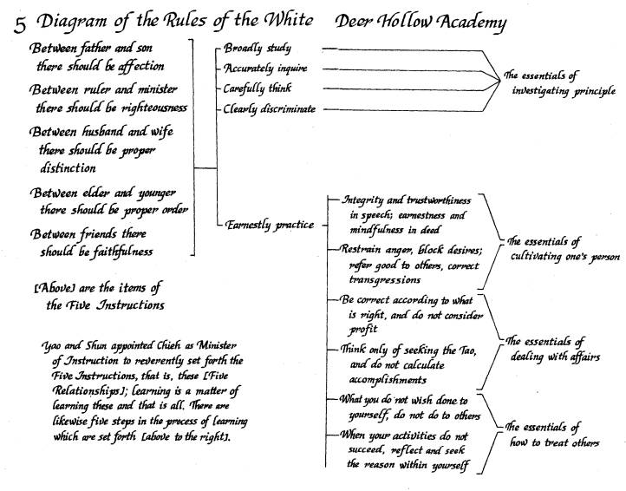
5 Confucian Relationships

Slide 18
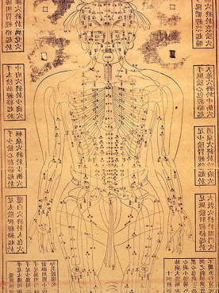
Ginseng – a herb believed to
aid longevity (does aid memory)
Traditional Chinese Daoist acupuncture chart
Daoist books like the Yellow Emperor’s Esoteric Classic led to a Chinese focus in medicine on natural remedies, herbs and acupuncture techniques

Slide 19
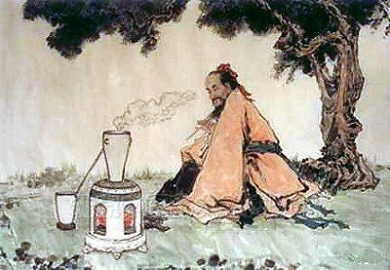
Daoism and Alchemy
Daoist alchemists elixirs included one made of a combination of saltpeper, sulfur and charcoal . . . If ingested this would likely kill you but it makes a great way to launch a rocket
The Daoist elixirs were initially concocted to provide a path to immortality but culminated in the invention of gunpowder in the ninth century CE

Slide 20
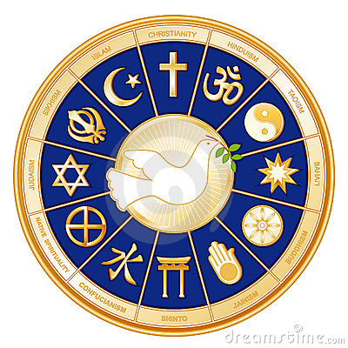
Classical Era Religion Questions
Our questions will include:
How did the codification of these different beliefs systems occur? How do they differ and what similarities do they share?
How did these belief structures impact gender roles? Political power? The shamanistic & ancestor veneration traditions of earlier societies?
How did religious belief structures impact architecture? Literature?
How did religions change as they migrated? (i.e. Hinduism, Christianity and Buddhism?)

Slide 21
Religious Beliefs adoption
The religious beliefs and changes in religious practices of the Axial age were motivated at times by political powers and systems, mystical desires, or interactions with other belief structures
The ______________________and varied acceptance of these belief structures were impacted by both societies and political institutions
-- Called resonance (do religious ideas mesh w/ cultural values)
Judaism
After the codification of Hebrew scriptures (Old Testament or________) the Assyrian, Babylonian and Roman Empires conquered Jewish states
All three empires forcibly removed Jews from Jerusalem region (i.e. Nebuchanezzar deportations) => Jews formed______________________
-- Did not intermix with local populations (i.e. intermarriage) and founded own communal organizations (i.e. synagogue)
Christianity
Christianity was 1st codified in the 1st and 2nd centuries CE by ________(series of epistles) and various gospels (life of Jesus)
Initial efforts only made to convert Jews => Jesus = Messiah of Jews
Missionaries, monks and nuns spread the faith through the ____________________________(Desert mothers and church saints)

Slide 22
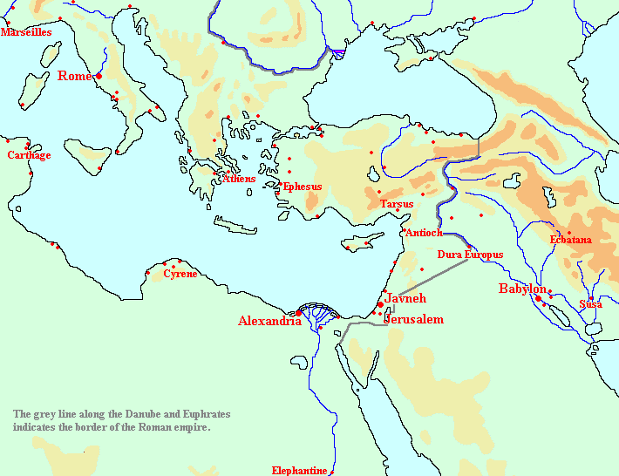
The Jewish Diaspora (ca 1st century CE)

Slide 23
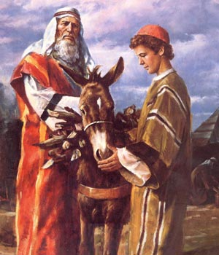
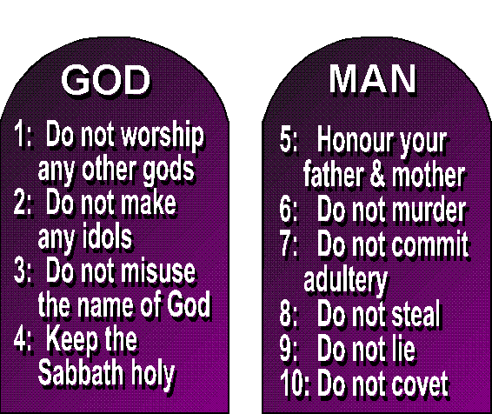
Abraham and Ten Commandments – code for moral living

Slide 24
Religious Beliefs adoption
Christianity was initially popular in the Roman Empire due to:
-- Its mystic qualities => Greek tradition was attracted to ideas of salvation and afterlife (Jesus is a more personal figure)
-- Decay of Roman world => as Rome weakened Christianity became a more popular idea (new? Salvation?)
-- Persecution => galvanized believers and created fiercely devoted missionaries (i.e. Paul); also led to more formal organization
In 312 Emperor Constantine converted to Christianity & issued the ____________=> promised religious toleration for Christians
-- Christianity became the state religion & became more formalized after the _____________________(doctrines, Bible, rituals, leaders)

Slide 25
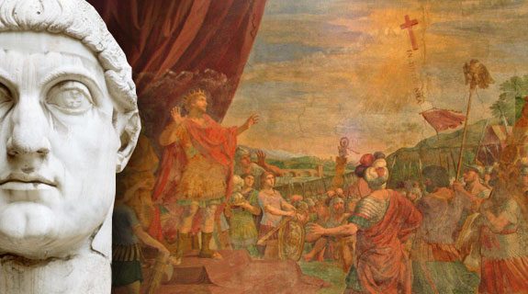
Constantine & the Battle of Milvian Bridge
At the Battle of Milvian Bridge, Constantine secured a huge military victory => attributed it to the image of a Cross he saw in the sun
-- Historians debate whether Constantine was spiritually motivated or wanted an ideology to unite Rome

Slide 26
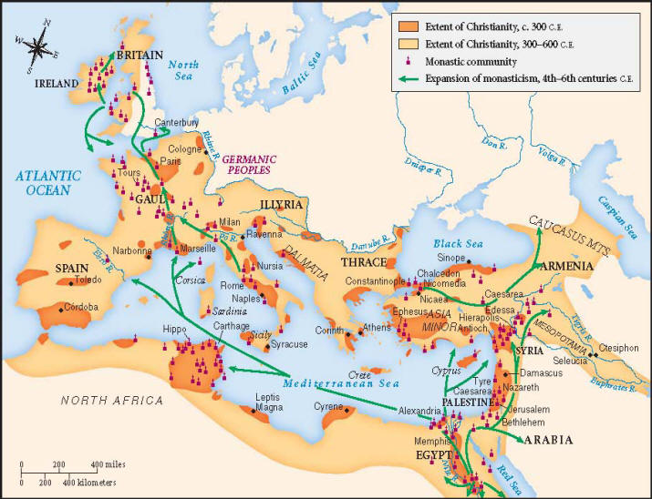
Spread of Christianity

Slide 27
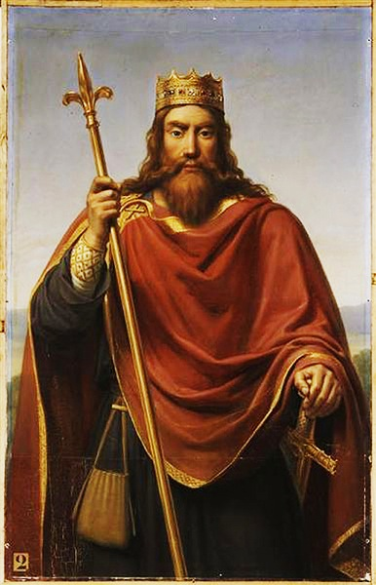
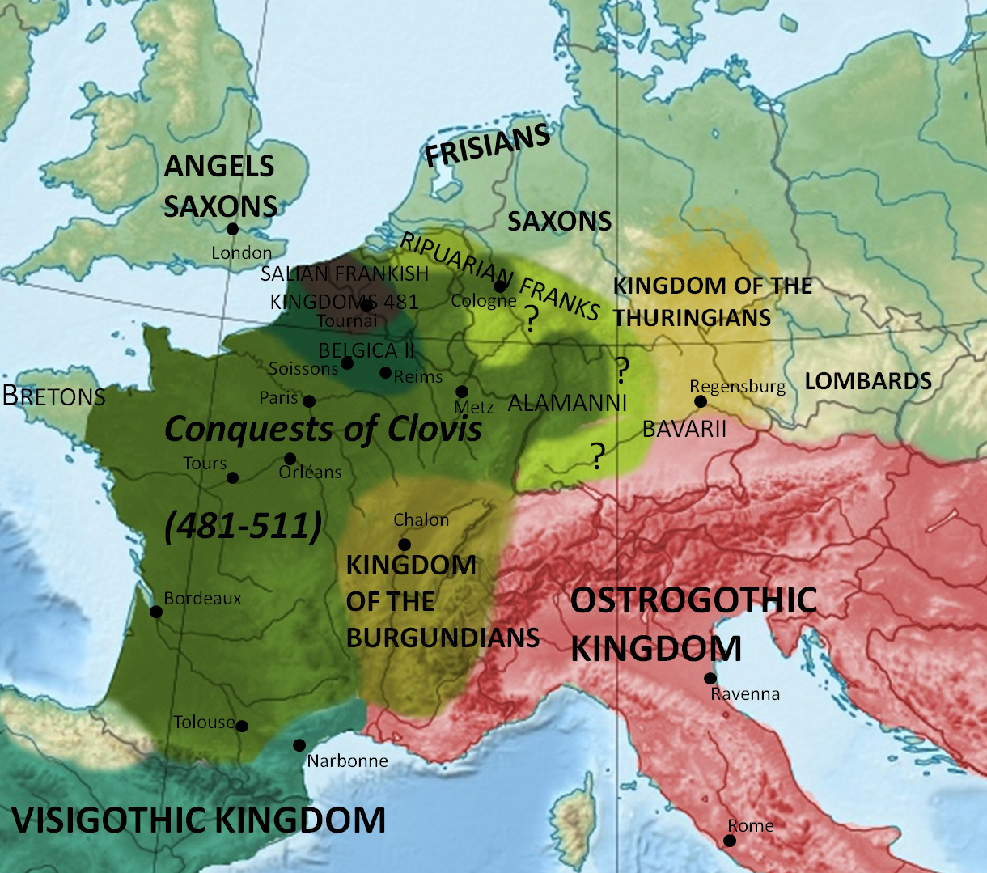
Clovis I and the Kingdom of the Franks
Q: How did adopting Christianity help Clovis’s political conquests??

Slide 28
Religious Beliefs adoption
Greco/Roman Philosophy
Ancient Greeks had religious structures and beliefs (i.e. Pantheon of humanistic Gods =>___________________) but were mostly philosophers
Gods took on _______________________(anthropomorphic => jealousy, hatred) and involved in human struggles directly (Home = Mt Olympus)
Gods were the ____________________________(patron Gods/Goddesses) and the Roman empire until the Republic
_______________________was the center of philosophy => philosophers were usually paid tutors to the wealthy
-- ___________________=> wrote little but employed “Socratic method” that encouraged people to use logic/reason to discover truth
-- ___________=> wrote The Republic, a treatise on government that emphasized the use of logic to govern justly
Created the Academy => school of philosophy
-- _________________=> use of empirical observation/senses (empirical methods) to discover laws of nature & humanity
Advocated a scientific approach to nature (systems of classification)
Wrote Politics, where he examined all forms of government and selected the 3 best => monarchy, aristocracy & democracy
Also wrote of women being inferior to men => “infertile and inadequecy define females” (very influential for centuries)
Greco/Roman thought (i.e. democracy, scientific inquiry, logic) all influence European/western culture to the present day

Slide 29
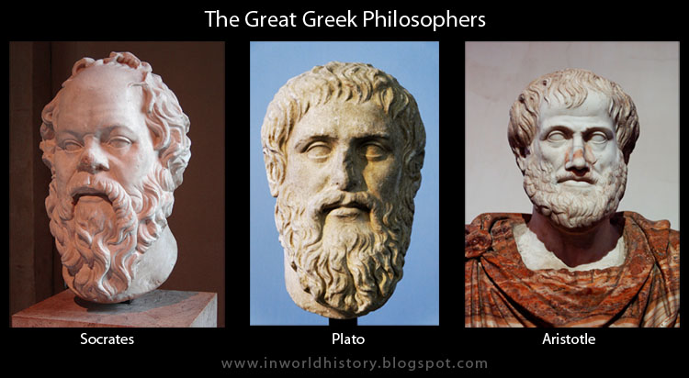
3 Greek Philosophers
The 3 great Greek philosophers impacted Western thought for centuries => European understandings of the cosmos, earth and medicine depended on their ideas for over 2000 years

Slide 30
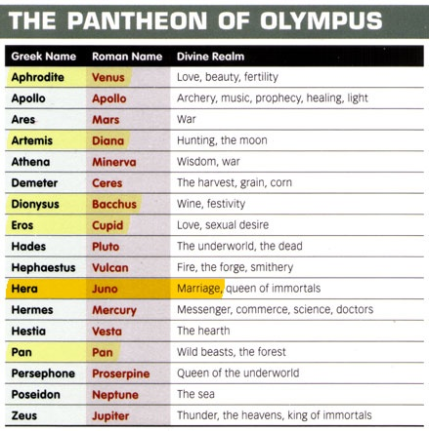
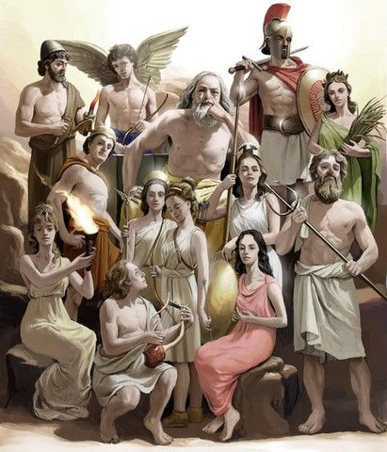
Greek and Roman Gods
Greek (later Roman) gods took on human forms and characteristics
Each was associated with various divine powers

Slide 31
Religious Beliefs adoption
Hinduism
Hinduism started in India as Brahmanism (Sanskrit Vedas) which emphasized caste and specific roles (_________) and groups in society (jati)
Brahmins, or ruling classes, were Aryans who created the system
-- Ordered Indian society based on __________________and jati groups (extended kinship groups, social network and safety net)
-- ___________________________justified the system
Mauryan & Gupta emperors formalized the caste system + ___________ (trade guilds) and assigned government posts to Hindus
Buddhism
After the codification of Buddhist beliefs (8 fold path & 4 Noble truths) Buddhism gained traction among lower classes & women in India
Mauryan _____________________conversion to Buddhism was a huge boost => sent missionaries out, created a series of ______________ reflecting Buddhist beliefs and practices and built _______________
Spread to _________and became very popular by 500 CE => especially after fall of Han in 200 CE (period of disunity where Confucian influence fell)
Buddhist monks were very organized and spread religion very successfully; early Tang dynasty emperors adopted Buddhist beliefs

Slide 32
Indian Caste System
Indian Caste system provided social organization, economic justifications and political framework to India => formed a sort of identity far different from territorial sovereignty in Europe

Slide 33
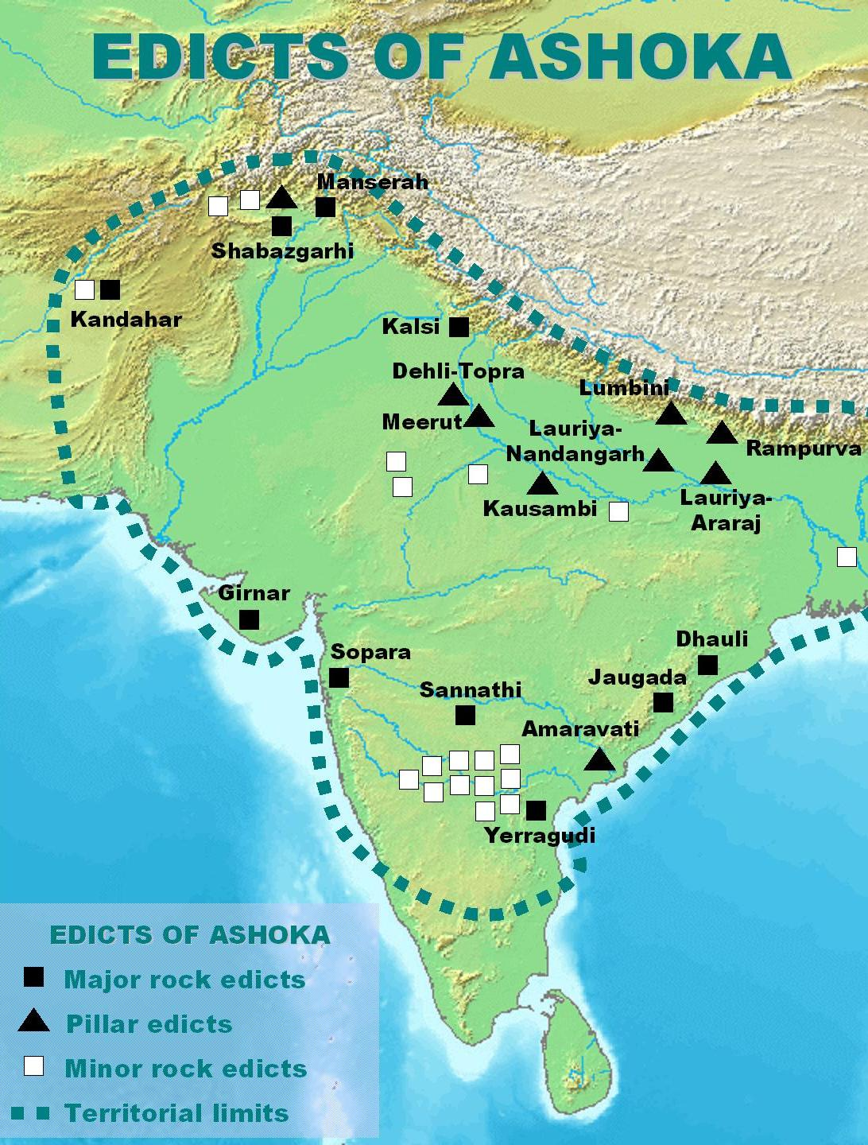
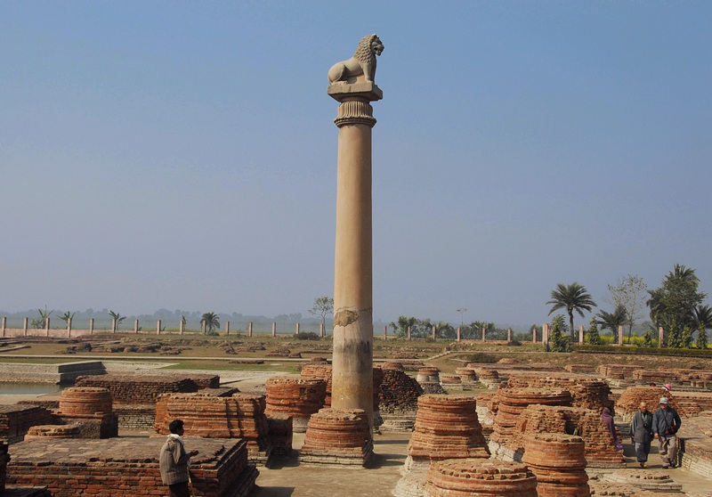
Rock and Pillar Edicts of Ashoka
Ashoka started out as a ruthless conqueror and reformed later – rejecting violence & becoming a Buddhist
-- Established edicts to promote teachings along roads, etc…
-- Died of starvation in a Jain temple

Slide 34
Religious Beliefs adoption
Confucianism
During the Warring States period of Chinese history (disunity & violence) Confucianism was codified by disciples in the________________
Called for order & social harmony that could be achieved through proper behavior & right relationships (respect for govt leaders)
-- Proper roles and code of behavior was called ____________=> respect for _____________________
Confucius also called for government leadership based on _________
Not concerned with spiritual side of existence (reflected times??)
Confucian principles were codified into Chinese government and code of ethical behavior by _________________of Han Dynasty (156-87 BCE)
Emperor Wu (Wudi) centralized the Chinese state govt and set up a series of schools to teach ______________________to administrators
-- Later became ___________________to train administrators (commoners and noblemen can take exam)
Wu also expanded Han China’s borders (doubled size), encouraged trade with Central Asia and funded cultural endeavors
-- Chinese poetry, landscape painting, music all funded by Imperial schools and bureaus

Slide 35
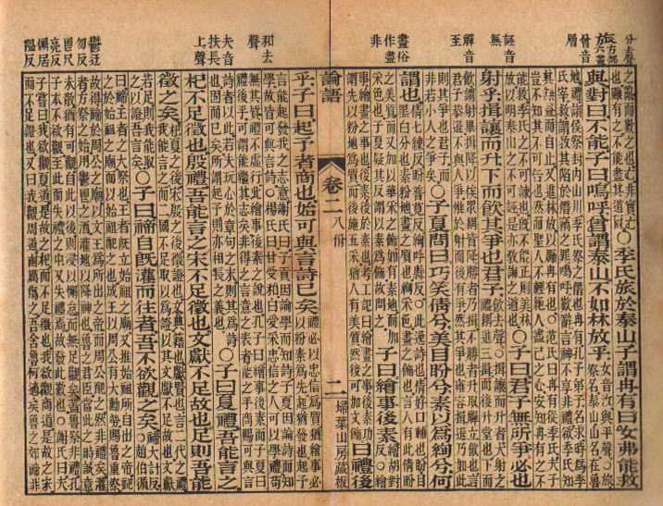
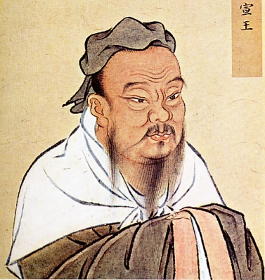
Confucius was a Chinese philosopher during the “Hundred Schools” period => his ideas led to a society that valued order and respect for hierarchal relationships

Slide 36
5 Confucian Relationships

Slide 37
Emperor Wu (Wudi) 156-87 BCE
Emperor Wu is recognized as one of the greatest Chinese emperors => his 57 year rule was not surpassed until 1800 years later
The cultural and political legacy of Wu, from Confucianism, Confucian exams, negotiation with nomadic tribes and his series of conquests, is also unparralled

Slide 38
Religious Beliefs adoption
Confucianism also adopted many ritual practices common in China
Most enduring is the practice of _____________________=> commemoration, communication and sacrifice to deceased ancestors
-- Ancestor veneration is said to cultivate filial piety and help ancestors separate ancestor souls (hun or light) from dark (po) soul
Daoism
Codified by __________________in The Way of the Dao => alternative philosophy to Confucianism
Concerned with proper behavior on earth, Daoism focuses on _______ __________________(allowing nature to control destiny)
Had a huge impact on Chinese culture => government officials were said to be “Confucian at court, Daoist in life” (_________________)
Daoist focus on natural processes also led to new ______________ _______________=> illness based on being out of alignment/w nature
Daoist healers use herbs, natural remedies, diet, meditation and acupuncture (stimulating bodily areas into realignment)
Daoism was also very interested in alchemy and created medicinal elixers (combinations of natural elements & minerals)=> Daoist alchemists in 9th century invented _________________

Slide 39
Ginseng – a herb believed to
aid longevity (does aid memory)
Traditional Chinese Daoist acupuncture chart
Daoist books like the Yellow Emperor’s Esoteric Classic led to a Chinese focus in medicine on natural remedies, herbs and acupuncture techniques

Slide 40
Daoism and Alchemy
Daoist alchemists elixirs included one made of a combination of saltpeper, sulfur and charcoal . . . If ingested this would likely kill you but it makes a great way to launch a rocket
The Daoist elixirs were initially concocted to provide a path to immortality but culminated in the invention of gunpowder in the ninth century CE

Slide 41
Belief Systems effects on gender roles & society
The new belief structures of the Classical Era had a deep effect on gender roles in Eurasia (Buddhism, Christianity & Confucianism)
Buddhism
Among Hindus in India Buddhism message to women was very appealing => _______________accepted women in inferior positions
Buddha himself was not kind to women, calling them “full of passion, . . . Stupid . . . And having no place in public life.”
Women are also shown as ______________(enlightened teachers)
Christianity
Christianity was also initially very popular among women => preached that all souls were equal and Jesus respected women greatly
Early church also encouraged the __________________for women
-- Exs: Desert Mothers (i.e. Melanie the Younger)
-- Gave women opportunities in public sphere to earn acclaim
Men and women were also encouraged to worship together

Slide 42
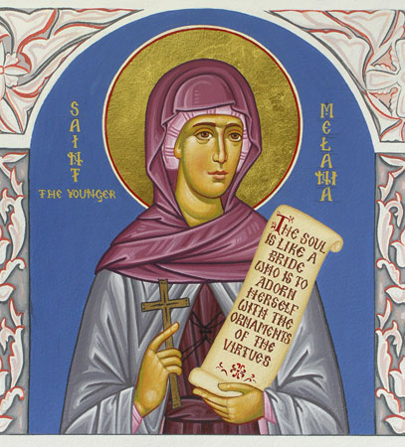
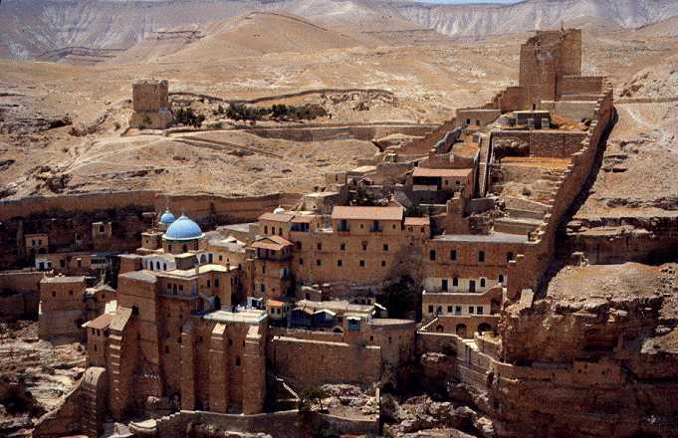
Saint Melanie the Younger
Monasteries of the “desert Fathers and Mothers”

Slide 43
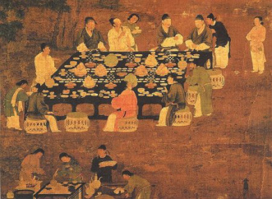
Belief Systems effects on gender roles & society
Confucianism
Set down a strict dual role in society => Men as food producers, rulers and actors in public sphere; women as homemakers and mothers
Confucian relationships _______________________in Chinese social relationships (reinforced patriarchy)
Women were also expected to act in accordance w/ requirements of filial piety => proper behavior and respect for family and role
Male children also preferred to carry on family name
“The relation between superiors and inferiors is like that between the wind and the grass. The grass must bend when the wind blows across it." – Confucius
** Confucianism believed that social harmony (goal of society) was the result of proper relationships between inferiors & superiors
-- Superiors do have obligation to act correctly (courtesy and respect) and inferiors to obey

Slide 44
Minor Belief Systems & Cultural Traditions
In addition to the major religious belief systems and universal religions, other new religions appeared and some traditional ideas persisted . . .
_________________
Founded by Mahavira around the same time as Buddhism => more _______________________________rejection of material world
Extreme asceticism => no possessions, rely on begging for a living
Few followers => Chandragupta Maurya (founder of Mauryan empire) converted to Jainism and died of starvation in monastery
Shamanism and ______________________
Continued to be important due to reliance on nature (inside and outside core civilizations)
Especially important among ________________=> settled in Northern Europe (France, Spain, Britain) and were organized in kinship groups
Religious leaders the _____________memorized prayers & performed rituals at sites (Stonehenge)
Animistic Gods (i.e. Lug, god of light) were worshipped wherever their presence was felt (i.e. by a river or at a hilltop)

Slide 45
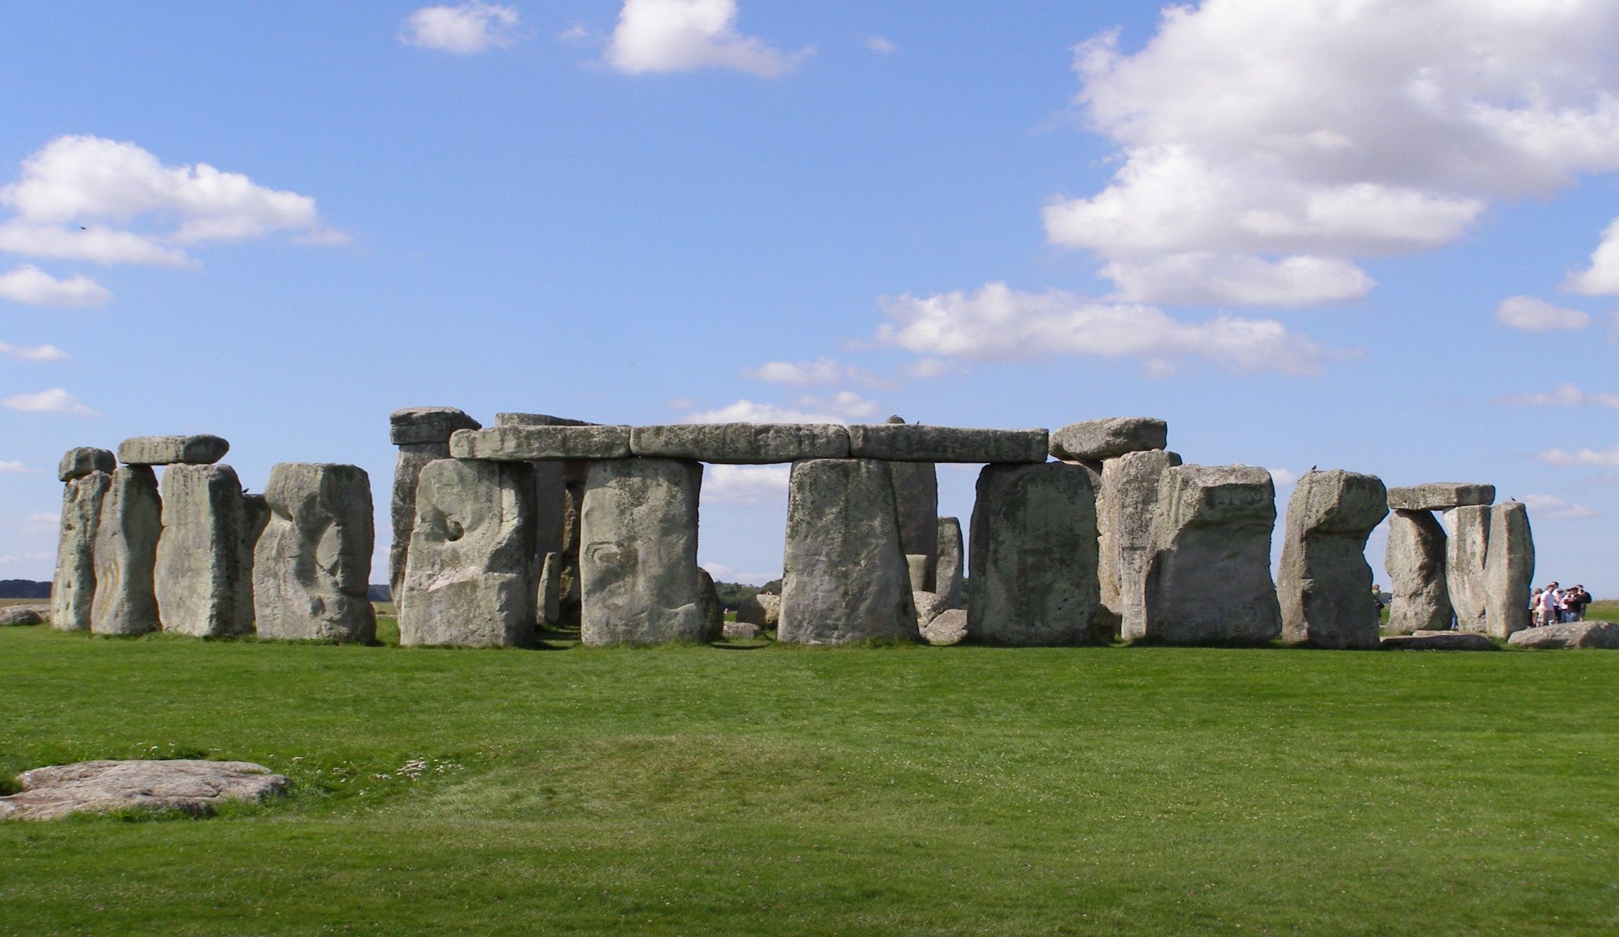
Celtic Stonehenge
Theories abound as far as the purpose of Stonehenge – a burial site, a site for sacrifice rituals, an astrological observatory?

Slide 46
Minor Belief Systems & Cultural Traditions
Rural Chinese beliefs were also very animistic => connection to various nature spirits was maintained by rituals and practices
Many cultures also practiced ______________=> use of oracle bones and or sacrifices to “predict” future (administered by “shamans”)
Chinese used oracle bones cracked by heat (interpret patterns); Celts used animal sacrifices (shape of organs), Roman and Greeks used oracles and astrological charts (zodiacs)
Ancestor Veneration
Ancestor veneration was still a very important practice in many regions => Africa (Meroe and Nubia), Mediterranean (Roman Empire), Andean civilizations and China
___________________in China => ancestors were said to influence daily life and should be consulted for major decisions (shrines)
-- Sometimes divination used to understand mood of ancestors
Romans had the ___________________=> dead emperors worshipped as Gods (increased power of emperors and loyalty)

Slide 47
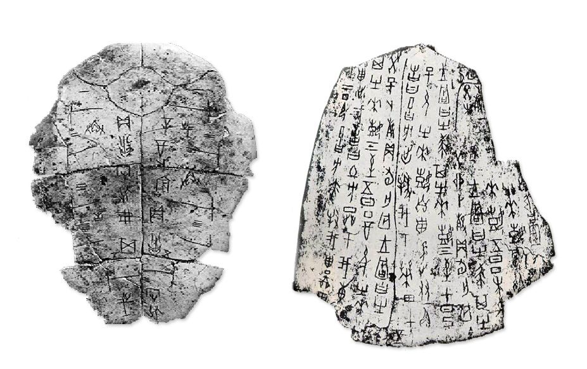
Chinese Oracle Bones
Chinese oracle bones => animal bones (or sometimes human bones) were heated and cracked . . . Predictions were then inscribed on the bones
** Some Celtic groups are even said to have killed humans and interpreted their death throes (evidence that they were barbarians to Romans) **

Slide 48
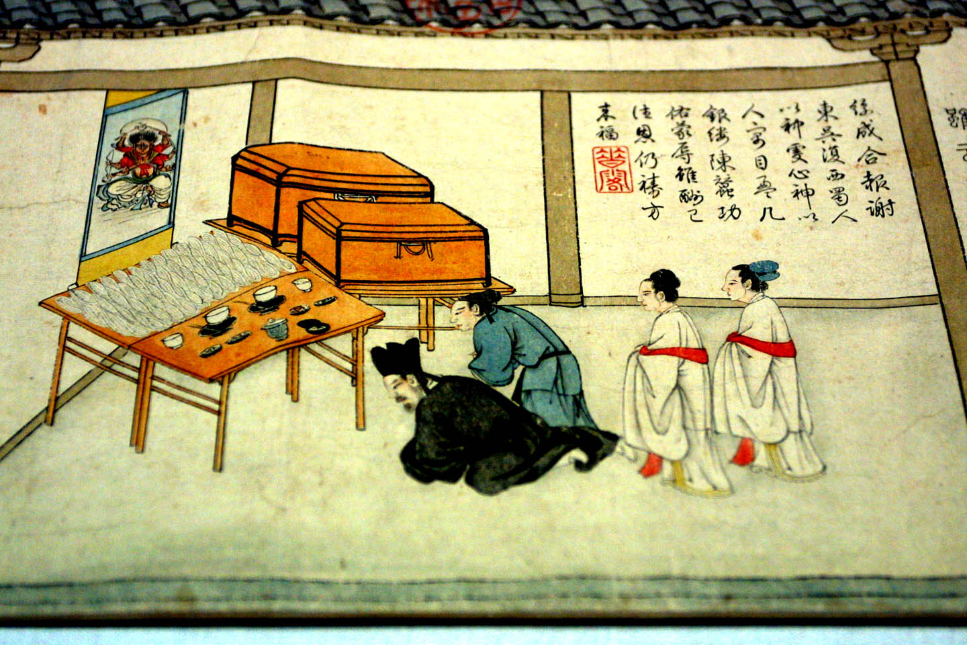
Chinese ancestor veneration
Chinese families would often have a shrine in their house to their dead ancestors and pray to it/offer sacrifices for guidance

Slide 49
Classical Age Literature
Classical Age developments in literature, especially in Indian and Greece, influenced neighboring areas and later times periods
Greece
Greek poetry, drama, historical writing and architecture all influenced later Roman developments & Western European culture for centuries
Greek plays were performed in public amphitheaters for citizens
-- Various forms were cultivated => tragedies (Oedipus Rex by Sophocles), comedies (Lysistrata by Aristophanes)
-- Plays not only _________________________________and some elements of Greek culture (i.e. satirizing the honor of war)
Greek culture (i.e. architecture, sculpture) was transmitted by Alexander to ME and India via conquest (______________________)
India
During the classical era Indian society produced epic literature that still impacts Indian and surrounding cultures to the present day

Slide 50
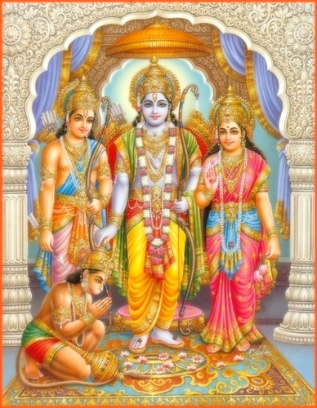
Classical Age Literature
Formal development of Sanskrit language by Panini led to the creation of epics ________ ______________ (Bhagavid Gita is a section)
Ramayana = story of King Rama & wife Sita => full of idealized portraits of men & women (teach Indians proper behavior)
Mahabhrata is a story exemplifying the concepts of dharma => moral duty & correct action of various groups
Epics are still performed today at religious festivals & are both a common religious link & instructional tool
Have inspired _____________that tell moral truths in other cultures => there are Sikh, Jain, Thai, Cambodian versions of Ramayana (national epics)
Oral storytelling of epics remains a cultural tradition in S and SE Asia
Rama, Sita and Lakshmana

Slide 51
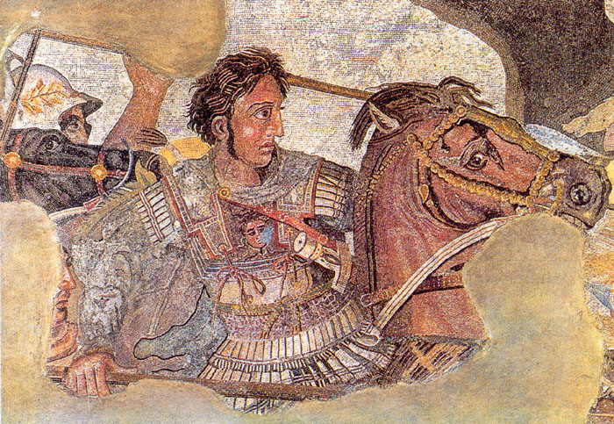
Empire Formation: Conrad- Demarest model
Q: What is an empire?
A:_______________________________________________________
Geoffrey Conrad & Arthur Demarest created a model for empire formation & decline (based on Aztec & Inca)
C-D Model argues that there are pre-conditions for empires to develop, but ultimately what fosters & sustains empire development is_________
Roman = idea of_____________; Chinese =_________________; Gupta =______________________
** C-D handout **
Mosaic of Alexander the Great fighting King Darius III of Persia

Slide 52
Persian Empire (ca 550 BCE to 330 BCE)
Persian Empire
Persian Empire was founded by the Achaemenids, led by_________
Cyrus married a Median chieftain’s daughter =>_______________
Satrap = __________________(connected by marriage to royal family); Persians respected local aristocracy & kept in power
-- Satrap collected tribute (gold/silver), kept order, raised military
Cyrus and Darius I expanded empire through warfare & alliances => maintained a ________________________and married judiciously
By 500 BCE it was largest world had seen => connected Mediterranean to East Asia (VP trade implications)
Persian society was based on a hierarchy => 3 classes were the warriors (land-owning aristocracy), priests & commoners (farmers and herders)
Warriors ruled and Kings were highest member of this class
Persian society was a __________=> royal women held some power

Slide 53
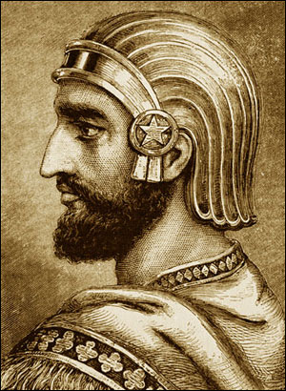
Persian Empire (cont)
Darius created a system of roads (_____ ____) to connect empire => provided for waystations & outposts to control areas
Built a grand capital at __________=> many palaces & grand shrines
-- Celebrations occurred here and foreigners were greeted
Uniting ideology was________________
Darius claimed that Ahuramazda created the world and was a God of justice and order (good) => Persian kings would bring order to empire and spread to all humanity (w/o Persia a source of “evil”)
-- Battle of __________(encouraged moral behavior by kings & people)
Cyrus the Great

Slide 54
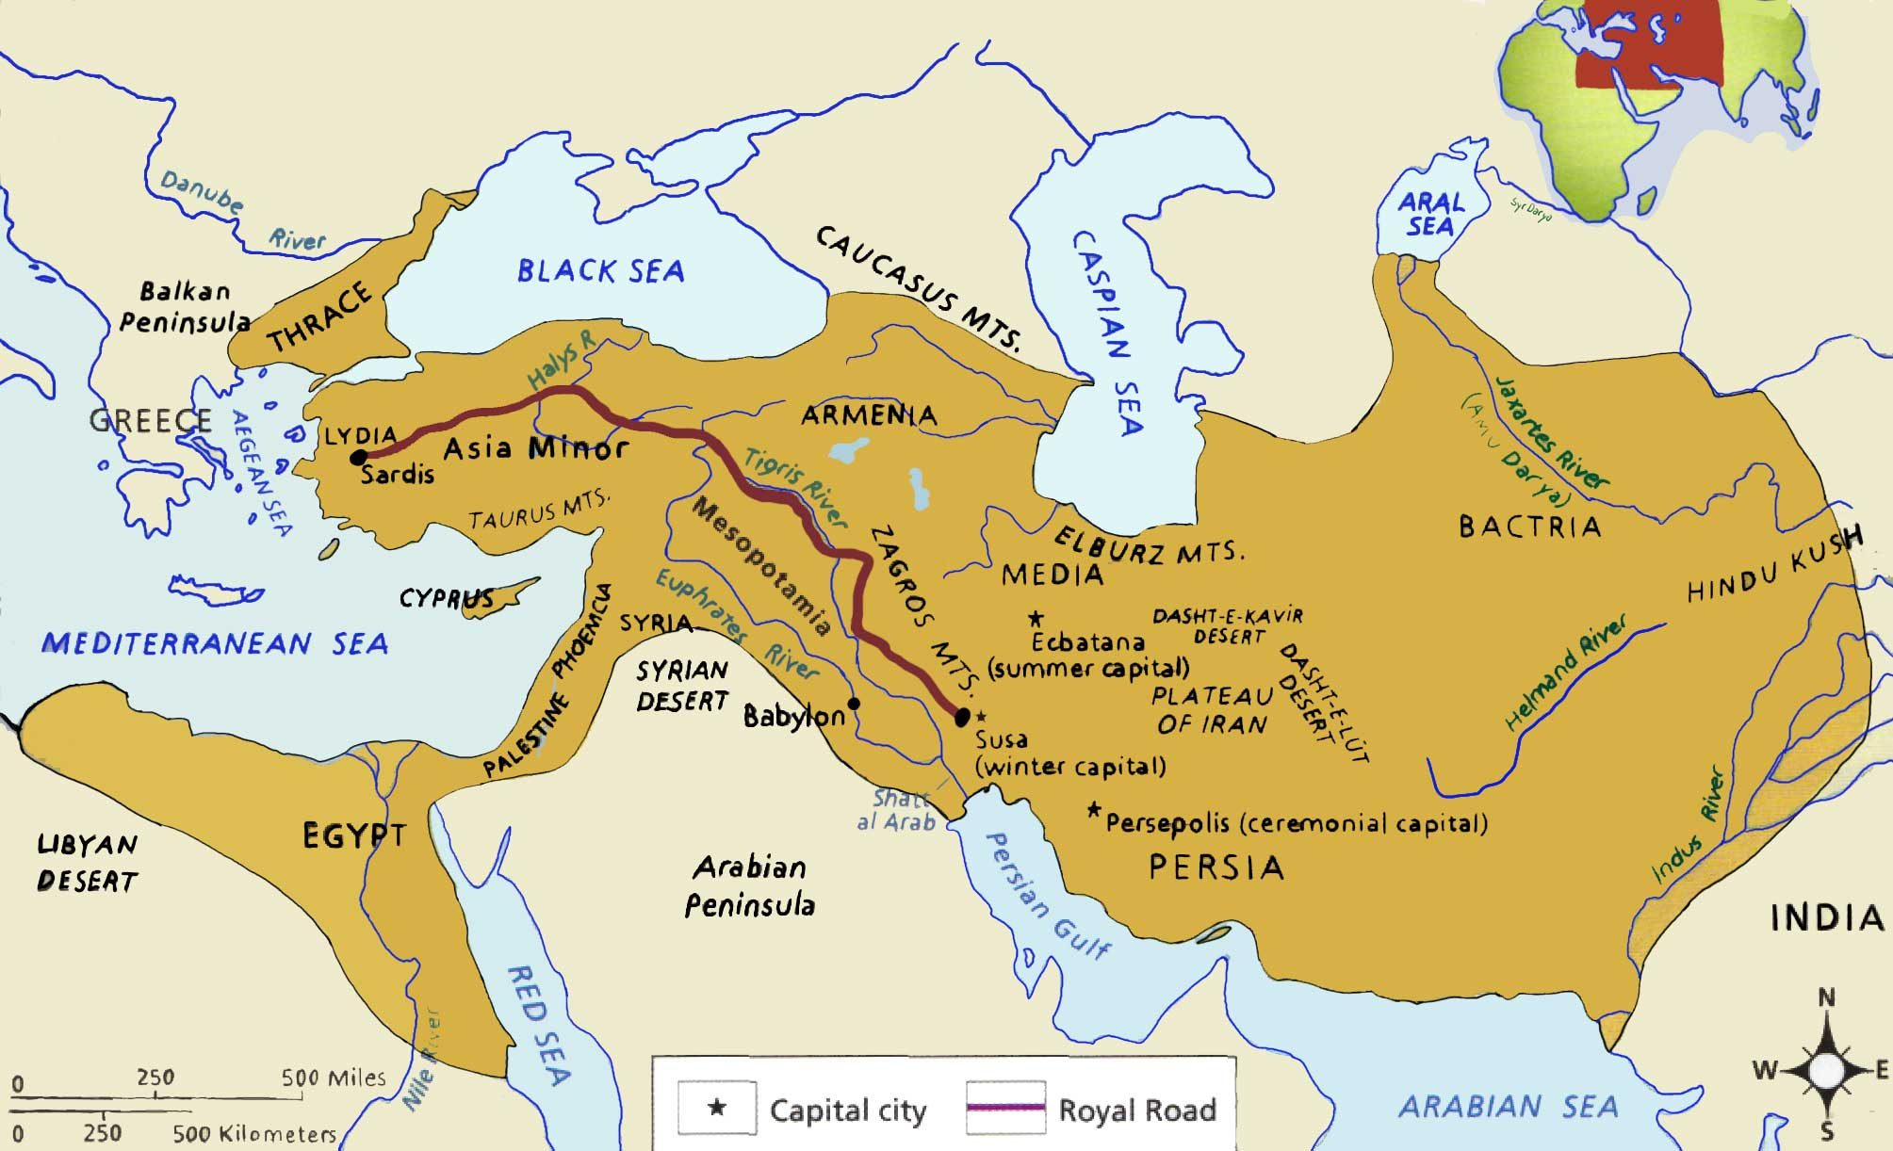
Persian Empire ca 500 BCE

Slide 55
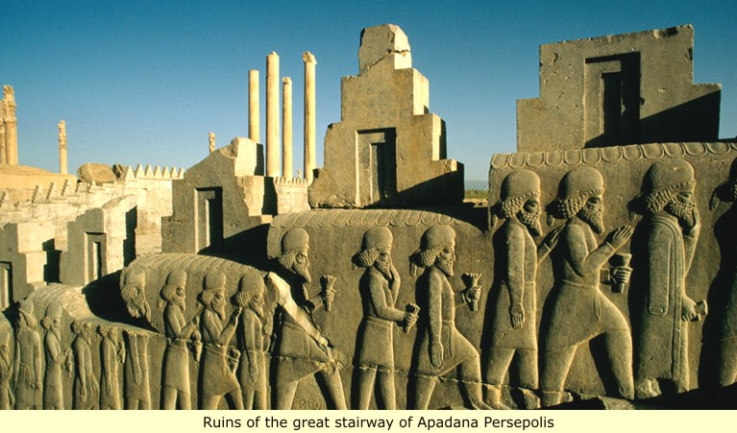
Grand Stairway at Persepolis

Slide 56
Ancient Greek City States
Greek City States
Greek Civilization flourished from ~ 800 BCE to 200 BCE
Greece was a Mediterranean power w/ ______________due to resource scarcity on Greek mainland => lack of iron, gold, timber, etc….
Organizing ideology of Greek culture was the _______=> political unit that organized all social, political and economic activities
Consisted of a town/city and its surrounding countryside (_______)
-- Most were ~ 1-2,000; Athens = 250,000 at its height
All had several features in common => hilltop acropolis (meeting point of safety), agora (marketplace and political meeting house)
Some degree of unity provided by belief in Olympian gods => _________________________(like men) and naturalistic
-- __________(god of thunder), ___________ (god of wisdom & war), Poseidon (god of_______________________)
-- Cities and towns had patron god(s) => i.e. Athens

Slide 57
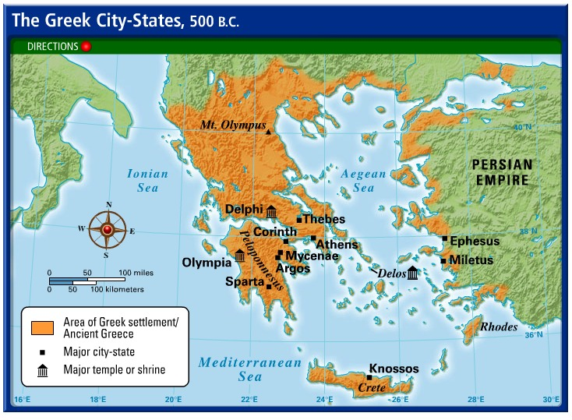
Greek City States – 500 BCE

Slide 58
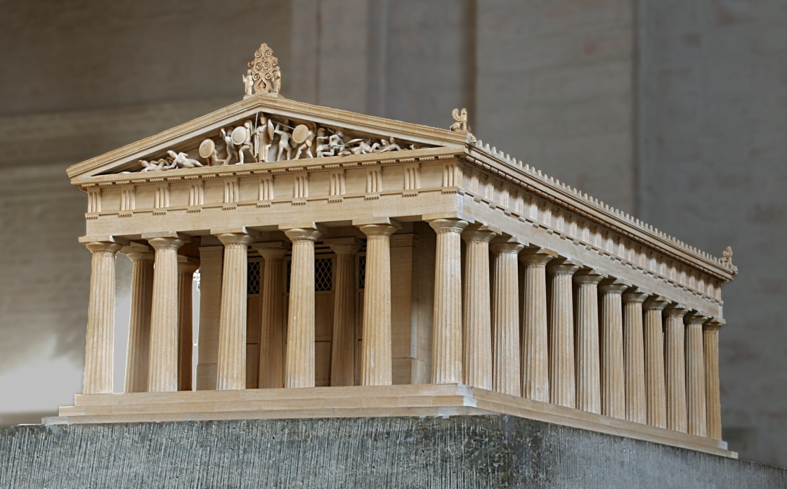
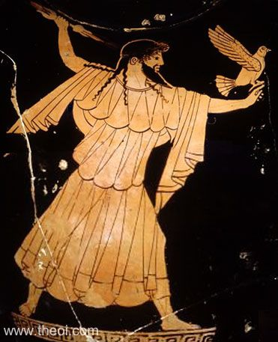
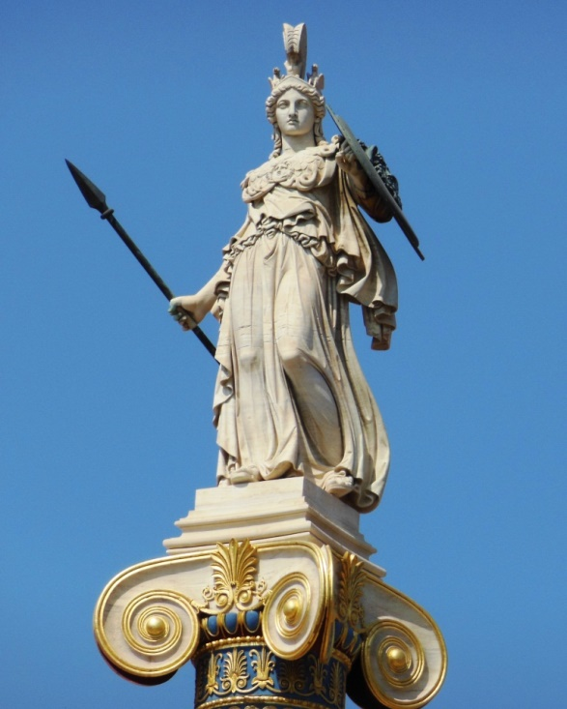
Greek Temple & Gods

Slide 59
Greek City States (cont)
Polis developed into democratic institutions due to ______________and slavery (landowning class had free time for direct democracy)
Hoplites were armored citizen foot soldiers => provided weapons and depended on unity (impetus for power of common man)
Athenian democracy reached its height under Pericles => created an Assembly (all landowning males) and Council of 500 to rule state
-- Elected generals and governors from among the population
__________________________________identity (Homerian epics) provided unifying ideology => sacrifice, courage & democratic state were idealized
Philosophers like Socrates, Plato and Aristotle solidified ideas => fostered belief in democracy, science, logic and reason
Leading city states = ____________(military oligarchy; all males serve in military from age 7) & ___________(cultural center & democracy)
United in the Delian & Peloponnesian Leagues to defeat the Persian invasions (Thermopylae & Marathon)
Fought ____________________(431-404 BCE) => depleted both states
Ultimately ________________conquered Greek city states and created a large regional empire => extended Greek culture across the ME & India
-- _____________________& kingdoms ensued (Antigonid, Ptolemaic & Selucid)

Slide 61
Greek Hoplite warfare
Greek Hoplite

Slide 62
Alexander the Great & Hellenistic Empire

Slide 63
Hellenistic Kingdoms
After Alexander’s death his kingdom disintegrated into Hellenistic states (monarhies)

Slide 64
Influence of Geography & Environment on Empires
Q: What impact did geography and the environment have on the formation of the Roman Empire?

Slide 65
Han Empire
Q: What impact did geography and the environment have on the formation of the Han Empire?

Slide 66
Gupta Empire
Q: What impact did geography and the environment have on the formation of the Gupta Empire?

Slide 67
Roman Empire

Slide 68
Major Chinese figures of antiquity
Han Emperor Wu
Confucius (ca 550 BCE)

Slide 69
Indian Mauryan Empire

Slide 70
Ashoka and Salt & Rock Edicts
Asoka erected a series of rocks and pillars around the country w/ edicts on right living

Slide 71
Emperor Chandragupta Maurya – founder of the Mauryan Empire
1st ruler to unite all of India into 1 empire

Slide 72
Teotihuacan and Mayan Civilizations

Slide 73
Mayan Civilization

Slide 74
Mayan Temple at Tikal
Religious temples formed the basis of Mayan cities => many are estimated to have taken over 40,000 man hours to complete
-- They were sites of human sacrifice (often by decapitation)

Slide 75
Teotihuacan Chinampas
Teotihuacan chinampas were made of reeds and anchored to the shore => underground irrigation and resistance to frost made them productive year round

Slide 76
Olmec Ball Games
The Olmecs started the tradition of a form of rubber ball game that was played ceremonially between groups => the Aztecs, Mayans and others adopted this game later
Aztecs & Mayans sacrificed the losing team to the gods

Slide 77
Classical Age Empire Commonalities
Many empires during the time period developed adm. institutions, utilized military control and promoted trade & economic integration
#1: Administrative Institutions
Roman Empire => Rome was 1st a _____________________governed by elected consuls, praetors & assemblies (Senate, Centuriate, Plebian)
Based originally on Greek _________(city state) run by citizens (demos)
-- Cincinnatus example (reading)
Later became an ___________________or “Principate” (emperor or Caesar = 1st citizen; link to past) under________________________
-- Augustus instituted reforms stripping Senate of power & giving it to Imperial Bureaucracy of equites (merchants & small landowners)
___________was the capital (1M people) & center of government
-- Empire was organized into _____________=> administered by a Governor who collected taxes, maintained army and judged disputes
Rome also developed a strong legal code =>____________________
-- Developed into natural laws based on reason => protected property rights & innocent until proven guilty (basis of Western law)

Slide 78
Julius and Augustus Caesar
Bust of Augustus Caesar
Roman provinces were originally governed by a Senator for 1 year at a time, but later were assigned to governors => many governors were selected based on connections and used province to enrich themselves

Slide 79
Roman Empire

Slide 80
Qin and Han Empires

Slide 81
Classical Age Empire Commonalities
Han China => The Qin state unified China after a period known as the __________________(Feudal kingdoms prior to Qin; disunity = violence)
China was ruled by a series of “_________________” – military dictatorships controlled by one ruling family & emperor (Qin Shi Huang)
Dynasties claimed the right to rule as the “____________________” => mandate is null if ruler abused power or could not rule effectively (natural disaster, famine, poverty = no mandate)
-- Han dynasty started by a commoner (Liu Bang)
Han government was based on _______________________philosophies
-- Prescribed respect for order, tradition, law and filial piety (knowing role in society and social order of patriarchy)
Han emperors created a massive administrative bureaucracy => tripartite govt (military, civilian and censorate)
-- Grand Council governed w/ reps from all segments; officials selected by ____________________________(still dominated by elite)
-- Emperor lived in Chang’an in a private palace (__________________)
-- Empire divided into provinces & districts (administered by locals)

Slide 83
Han Civil Service Examinations
Held every year at 3 levels => provincial, district & imperial
-- Farther you went higher your govt. position
Chinese academy at Chang’an had 30,000 students by 1st century BCE
Young boys would study Confucian classics, which were the subject of the exam, for years
-- Emphasized obeying parents, respecting elders, good morals, respect for tradition, respect for others and peace
Q: How would China benefit from basing government position and leadership on examinations? List three benefits.

Slide 84
Classical Age Empire Commonalities
Mauryan and Gupta Empires => India has a strong trend towards disunity & fragmentation (Both short compared to Rome & Han)
Mauryan Empire (324-184 BCE)
In 600 BCE India was fragmented into small kinship groups => ________________________used one to unite India for 1st time
Chandragupta used advice of Kautilya (advisor) => centralized the government w/ 6 branches (i.e. trade, manufacturing, military)
-- Capital = Pataliputra (pop ~ 250,000)
Used administration to implement heavy taxation system => ¼ of harvest, monopolies on mining, liquor, weapons and irrigation fee
Outlying districts were controlled by nobles related to king
Gupta Empire (320-550 CE)
After 500 years of disunity Chandra Gupta united India again
Not as centralized or effective in governing as Mauryans => relied on regional power centers administered by Governors & headmen
Characterized as a ________________=> relied on cultural splendor of capital/court and distribution of luxury goods for political control

Slide 85
Indian Mauryan Empire

Slide 86
Classical Age Empire Commonalities
#2: Application of military and diplomatic control
Roman Empire => relied on the ________________for military power (groups of 4000-5000 men); Roman ideal was the __________________
Military expansion supplied resources to Roman State =>
Roman army was designed like the Greek phalanx, but more flexible (javelin spears, gladius short swords, cavalry, artillery)
-- Romans recruited soldiers from _____________________=> forced service or promise of citizenship (late empire hired German mercenaries when manpower shortages occurred)
-- Gave Rome a manpower advantage (i.e. Punic Wars) and also lessened need for troops as conquered became part of empire
-- Typically tried to _____________________________=> burned Carthage to the ground after Punic War
Romans also used diplomacy very effectively => gave _____________ to conquered aristocrats and populations (buy in for expansion)
-- Also negotiated peace w/ Parthian Empire rather than conquering
On its borders Rome built defensive walls => i.e. _________________ in Britain (Scots) or the Walls of Constantinople (Parthians)
Rome also built large ______________to supply water to its urban culture (drinking, baths) => used concrete , lead & arches

Slide 87
Roman Legions and legionaries
Roman legions were based on the Greek phalanx but were more maneuverable, flexible and expandable => at its height Rome had over 25 legions (100,000 + soldiers)

Slide 88
Greek Hoplite warfare
Greek Hoplite

Slide 89
Roman Aqueducts
Romans used concrete, borrowed architecture from Greeks (arch) and applied slave labor to build extensive engineering feats => Rome had 17 aqueducts at its height

Slide 90
Classical Age Empire Commonalities
Han Empire => Han Empire lived under constant threat from _____________ (nomadic steppe people) and therefore military power was essential
Chinese had a complex & holistic view of warfare (Sun Tzu, Art of War)
Han had forced conscription laws that later faded into a ___________ _________ drawn from neighboring territories (SE & Central Asia)
-- Emperor WU imported horses via Silk Road => defeated Xiongnu
-- Qin ____________________gave Han and Qin advantage vs longbows
Han relied more on ______________________structures than Romans => did not expand outside of China (“barbarians”; didn’t speak Chinese)
-- Han used diplomacy with __________________Confederacy=> payed tribute in $$ (rice, silk) &maidens
-- Han and Qin also created the ___________________ to keep out “barbarians” and walled in their capital Chang’an (defensive moat)
Mauryan and Gupta Empires
Created a large standing army w/ chariot, cavalry and __________________ (learned horsemanship from nomadic Kushans)
Built earthen defensive walls and moats around Pataliputra

Slide 91
Han Great Wall and Mauryan Elephant brigades
Mauryan and Gupta War Elephants – used as much for intimidation as tactics
Han China Great Wall – built of rammed earth, it has survived for centuries

Slide 92
Classical Age Empire Commonalities
#3: Promotion of Trade via Roads and Currency
Romans => had over ___________________of roads and trade networks in the Mediterranean and overland linking to the Silk Road
Roman coins were minted from _________________(denarius) and facilitated easy exchange over the empire (only Rome minted coins)
_____________ (36 to 180 CE) => stability & peace brought by Roman power & secure borders => pop. 10 M (50 BCE) vs 60 M (150 CE)
Han Empire => built roads connecting Han to Central Asia (Silk Road)
Han dug more _________________than roads for internal movement => Yellow and Yangtze rivers
Han minted __________________coins (____________) for exchange & trade (Chang’an exclusive right)
Pax China (stability & peace of Han fostered trade along Silk Road & Indian Ocean networks) => Pop = 20 M (200 BCE) to 60 M (150 CE)
Mauryan & Gupta Empires => Silk Road & Indian Ocean trading networks
Built roads linking trade networks and established money system for commercial exchanges (copper and gold based)
Merchants used dhow ships to sail monsoon winds to ME and Africa

