Slide 1
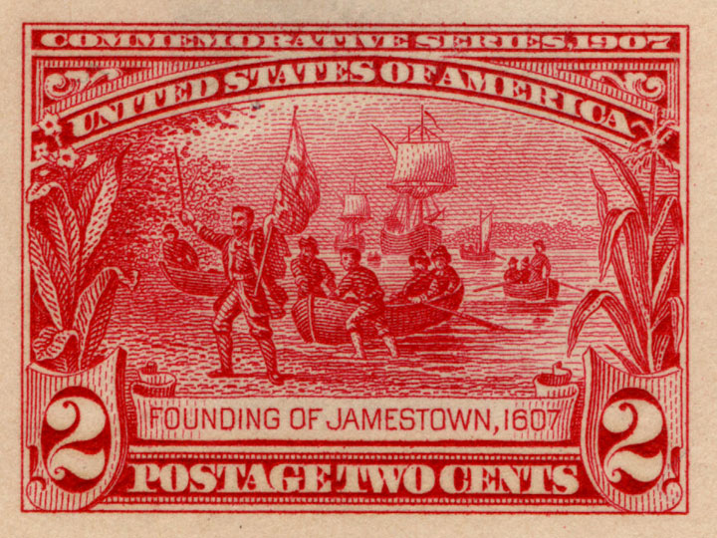
Unit II: The North American Colonial Period (1607 to 1754)

Slide 2
Unit Big Questions and Periodization
Periodization => Why 1607? Why 1754?
  In 1607_________________ was founded by the VA Company => first permanent English settlement in North America
  -- ______% of English settlers who set out for New World pre 1620 were dead w/in a year
  In 1754 the ________________________started => France and Britain battle for N. American colonial supremacy
Unit Essential Questions . . .
  By 1754 were the English colonies in North America better characterized as 1 nation or 3 separate and distinct regions? Why?
  In what ways did the ideas and values held by Puritans influence the social, political and economic development of the New England colonies from 1630 through the 1660’s?
  How did North America fit into the Triangular Trade system of the 17th and 18th centuries? What effect did European mercantilist attitudes have on colonial labor systems and colonial economies?
  How did the 3 distinct English colonial regions differ economically, socially and politically?

Slide 3
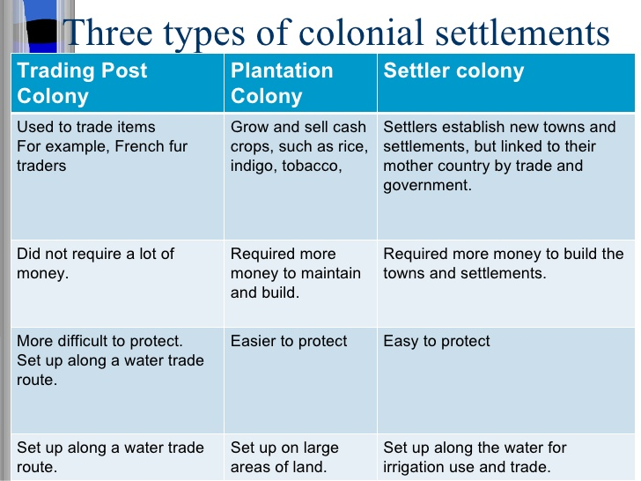
Types of North American Colonial Settlements

Slide 4
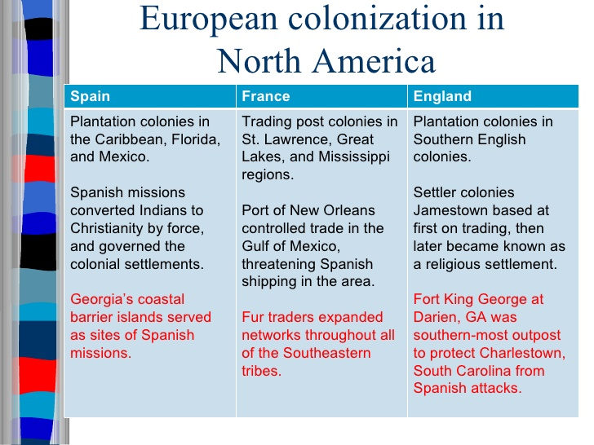
Types of North American Colonial Settlements

Slide 5
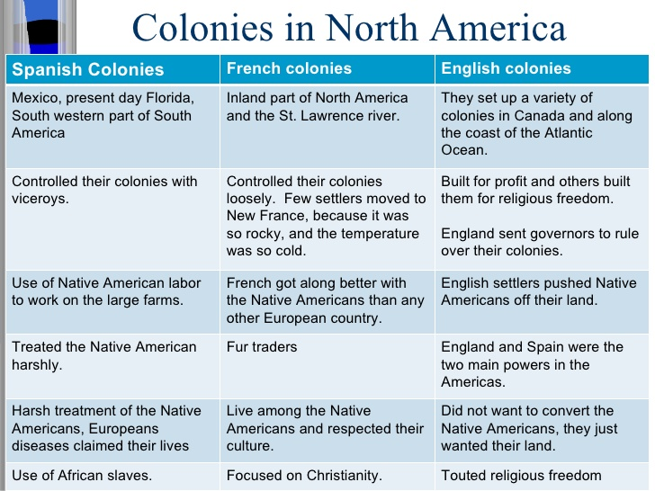
Spain vs English vs French Colonies

Slide 6
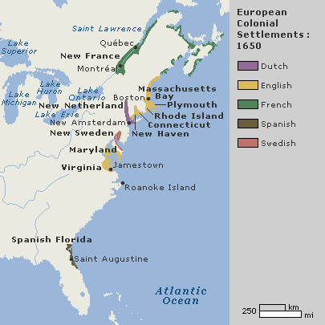
The Four North American Colonial Powers
In the 1600’s, 4 European powers established significant settlements and colonies in North America – the Dutch, English, French & Spanish
** GW: 4 Colonial Powers Charts **

Slide 7
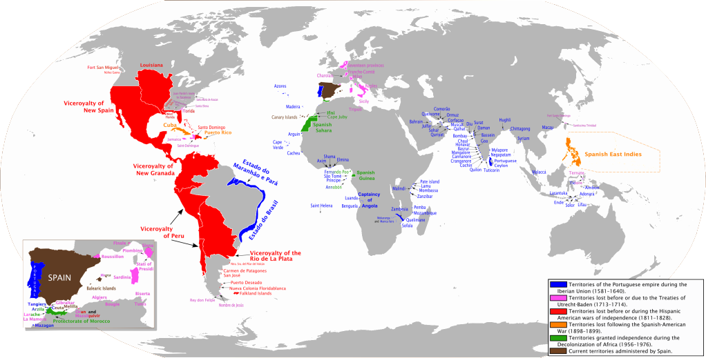
16th & 17th Century Spanish Empire

Slide 8
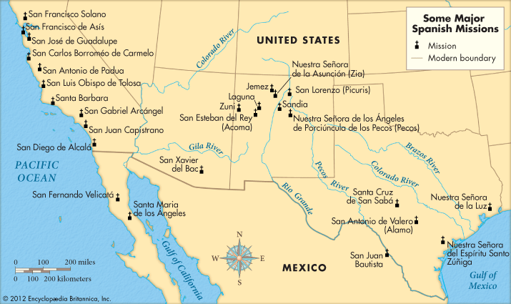
Spanish Missions in N. America

Slide 9
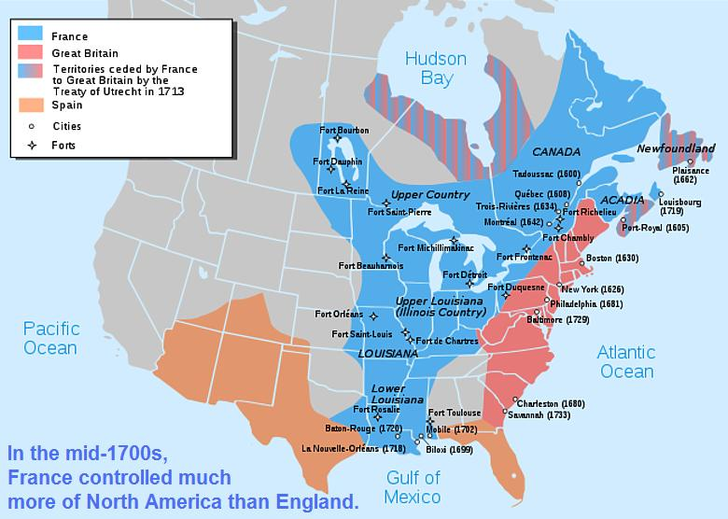
North American Colonial Powers 1754

Slide 10
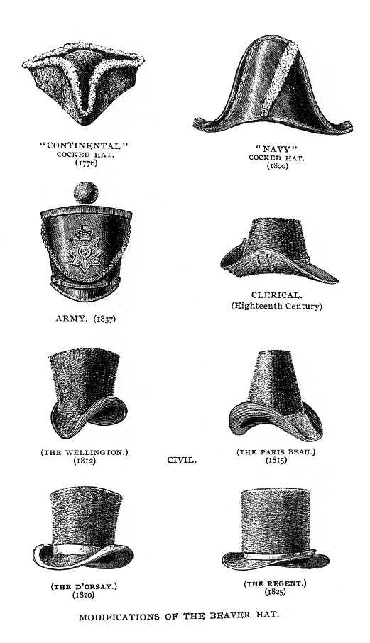
Beaver Fur hats – hats of the 1600 and 1700’s for both men and women were made of beaver furs (desired for warmth, style, softness and color)

Slide 11
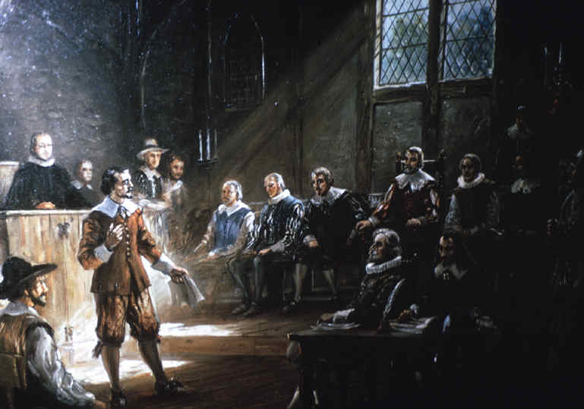
VA House of Burgesses
The VA House of Burgesses originally met once a year and could make laws and acts to govern the colony of VA. It was dominated by wealthy landowners, but did have representatives from all classes of society.

Slide 12
Approximate number of settlers in North American colonies (1700)

Slide 13
Labor Systems in British North America
In the 1600’s, as settlement in North America increased &Natives were pushed off of farmland, colonists needed a reliable labor force
  Option #1: _______________=> due to religion, death due to disease and lack of a system (i.e. encomienda) Native labor was not used
  Option #2: _________________=> originally _________________was used to encourage colonization in VA and other colonies
  Headright = grant of land (50 – 350 acres) given to individuals for migration to colonies (or if one paid for passage of a colonist)
  -- Headrights were given to heads of household for all who traveled (encouraged familial migration & indentured servitude)
  Indentured Servants = persons who promised to labor for 7 years in return for passage to New World (in 7 years get 50% of headright)
  By 1700 there were too many landless poor in VA & other colonies => disenfranchised by wealthy planters and became a threat
  ________________(1676) => 29 old former indentured servant kills frontier natives, takes over capital & burns wealthy planter homes
  -- Planters look for alternate labor source

Slide 14
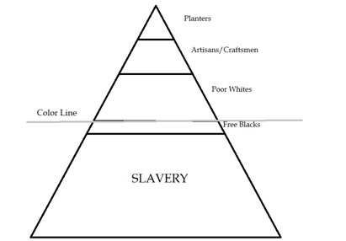
English Colonial Class System
Aristocrats (Landowners, Lawyers, Clergy, Officials)
White Indentured Servants
Yeoman Farmers (own small amt of land)
Class in British Colonial North America was based on wealth and Race

Slide 15
Labor Systems in British North America
In the 1600’s there were very African slaves in British North America => 20 Africans brought to Jamestown in 1619 (1670 only 2000 slaves in VA)
  Originally blacks were indentured servants who could earn their freedom => many free blacks in 1600’s
  In the mid 1680’s black slaves outnumbered indentured servants => wages in Europe increased and discouraged migration
  By 1750, blacks were 50% of population of VA and 66% in SC
African slaves were part of the ________________in 1700’s => linkage between African, European and American economies (*GW Activity*)
  West Africa supplied most slaves to North America => traded in markets upon arrival by merchants (Rhode Islanders = #1 colony)
In the early 1700’s many southern colonies established harsh slave codes modeled after the ____________________________
  Created absolute, chattel slavery (i.e. slaves are property) in perpetuity for Africans (Africans and children were slaves forever)
  -- Some colonies (i.e. SC) made it a crime to teach slaves to read; conversion to Christianity did not improve slave lifestyle

Slide 16
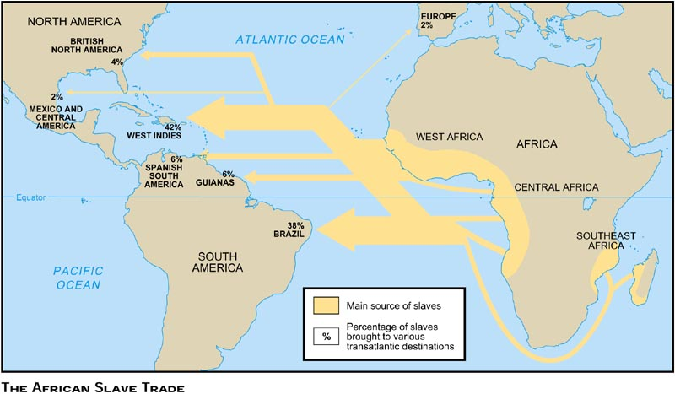

Slide 17
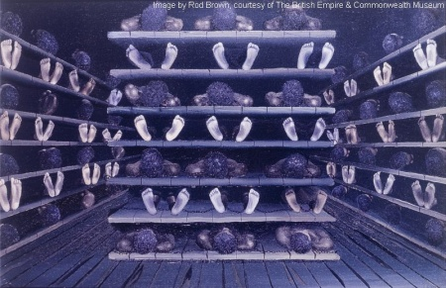
The “Middle Passage”

Slide 18
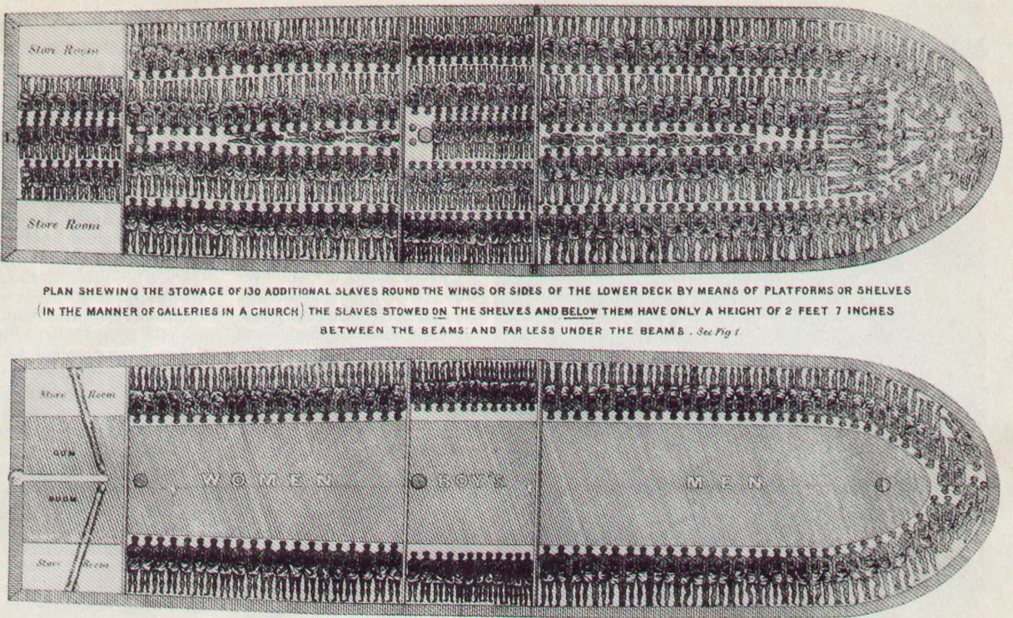

Slide 19
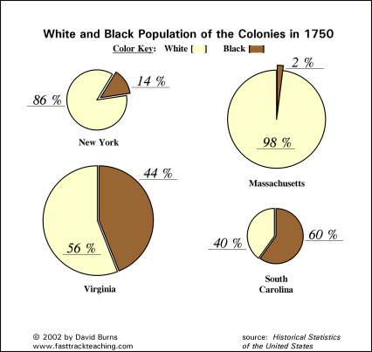
Chattel Slavery in British North America was very popular in the Chesapeake and Deep Southern colonies => not as useful in Middle and NE colonies *Q: WHY?*

Slide 20
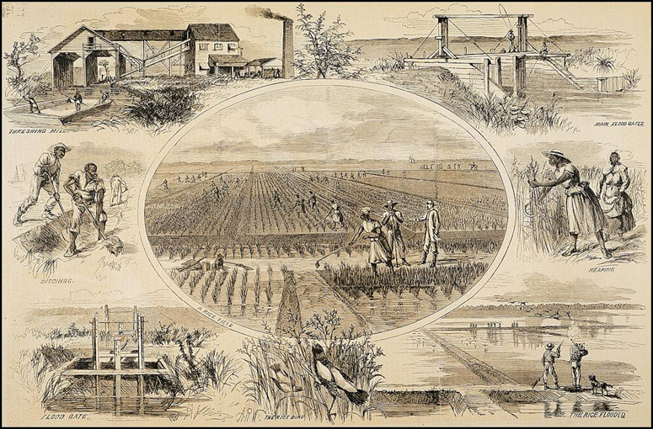
Rice Plantation in the Colonial South
Slave Labor in the South was used for two main crops => tobacco and sugar; tobacco was known as “the poor man’s crop” while sugar was known as “the rich man’s crop”) ** WHY?**

Slide 21
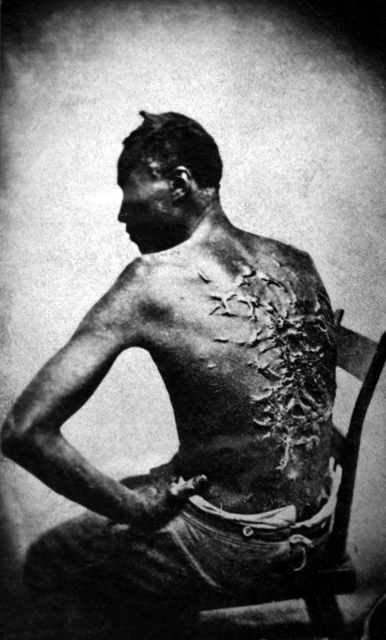
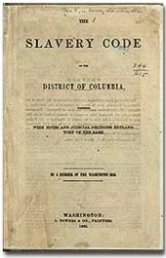
North American Slave Codes
Slave codes in many British colonies made slaves perpetual property of slaveowners and did not impose any restrictions on slave treatment

Slide 22
Impact of African Slave system on Blacks & culture
Life in British North American colonies was harsh for blacks compared to other colonial empires and thus had many impacts on life for blacks . . .
  Racial Relations & Hierarchy => Spanish and French believed in racial gradations (racial intermixing possible) and limited rights
    Spanish castas = mestizos, mullatos; French = met’is
    British were more disconnected from Natives and Blacks and thus preserved ideas of cultural superiority
      -- Based on diet, religion, color of skin, culture, etc….
      -- This led to a legacy of racism associated w/ skin color in US
  African American gender and kinship relations => gender and familial relations depended on the locations & conditions of slavery
    Southern ____________________plantations were extremely harsh and isolated => few women, short lifespans and no interactions
    Chesapeake __________plantations featured more women, more interactions (closer together) and encouraged family relationships
      -- VA plantations slave populations were self sustaining and actually grew (one of only instances in world history)
  * Slave families had no stability though => could be broken up & sold *

Slide 24
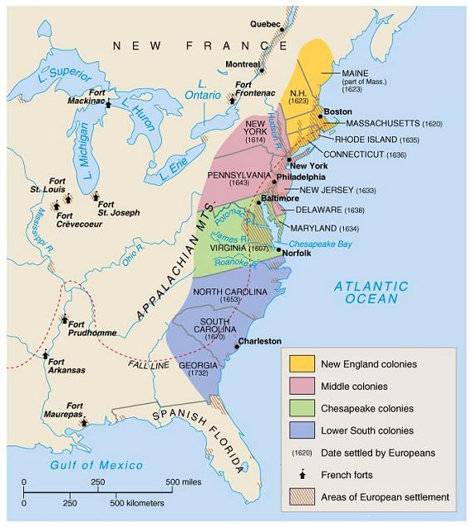
British Colonial America Regions

Slide 25
Impact of African Slave system on Blacks & culture
African Culture => native born Africans created their own unique culture
  Combination of diverse African elements (i.e. Ibo, Yoruba, Hausa) and European practices
  Language (________) => words goober (peanut) & voodoo (witchcraft)
  Religion => combo of tribal elements (circle dance) & Christianity
  Music => combo of African tribal elements & European (Jazz & Blues)
African slaves also rebelled various times against their masters unsuccessfully => led to stricter laws and codes
  ___________________=> 1739 SC rebellion where slaves killed masters and tried to march to Florida; intercepted and killed
    -- Resulted in a stricter slave code => punishments for cruel behavior by masters to slaves, restrictions on slave education/assembly/travel
  ____________________=> 1831 rebellion in VA, 55+ whites killed before it was suppressed (Nat Turner hid in swamp for 2+ months)
  -- Led to stricter laws regulating black education and religious services (i.e. white ministers must attend)

Slide 26
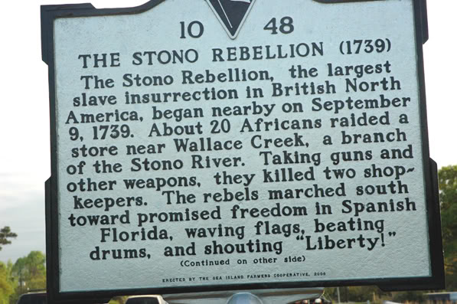
Stono Rebellion
The Stono Rebellion was led by an educated Kongolese slave named Jemmy => although initially successful, it ended in disaster when SC militia caught up with the rebels and massacred them

Slide 27
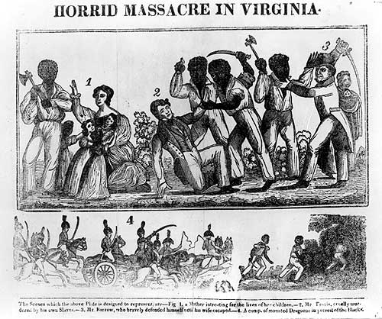
Nat Turner Rebellion advertisement
Q: Given the manner in which this was drawn, what perspective/POV does this represent as far as the Nat Turner rebellion is concerned? Why?

Slide 28
Anglicization of Colonial America
Over the 17th century, the English colonies became Anglicized in many different ways as they became integrated into the Atlantic World . . .
#1: Commercial Ties => English colonies became tied to the Triangular Trade network linking Africa, New World and England
  English colonies had a dual role => a market for English manufactured goods and a supplier of raw materials
    English colonies supplied timber, built ships, supplied tobacco, rum, rice, indigo and sugar
-- British encouraged naval production (i.e. pitch, tar, ships, etc..) by bounties & gave colonies a monopoly on tobacco production
    English colonies were expected to buy British manufactured goods (i.e. iron and metal products, beaver fur hats, textiles)
      -- English colonists disobeyed restrictive laws (Navigation Acts) & started their own industries (i.e. iron forges, hat companies)
#2: Trans-Atlantic Print culture => majority of Americans did not own books or but newspapers but a thriving print culture did exist
  By 1754 over 40 colonial newspapers were in print => source of local and foreign news

Slide 29
Triangular Trade – Detailed Map

Slide 30
Anglicization of Colonial America
    Newspapers were a unifying force => _______________decision
    -- Encouraged freedom of Press by allowing newspaper editor to criticize British governor
    Books led to the spread of Enlightenment ideas in the 18th century => i.e. Locke’s Social Contract theory & Montesquieu’s divided Govt
    Most news, though was obtained in local taverns (located along main roads) and thus tavern keepers were politically powerful
    -- Colonial America, like England, also had a postal system => delivery times were lengthy and secrecy was an issue
#3: Religious Toleration => many people came to America to escape persecution and most colonies tolerated different religions
  James I persecuted religious dissenters b/c he was afraid they would become political dissenters (Church of England led by King)
    Puritans, Quakers, Separatists all fled and established colonies
  _________was a model of religious toleration => founded by W Penn
    Secured by Penn from King to pay a debt, he advertised his colony in Europe to all nationalities and religions

Slide 31
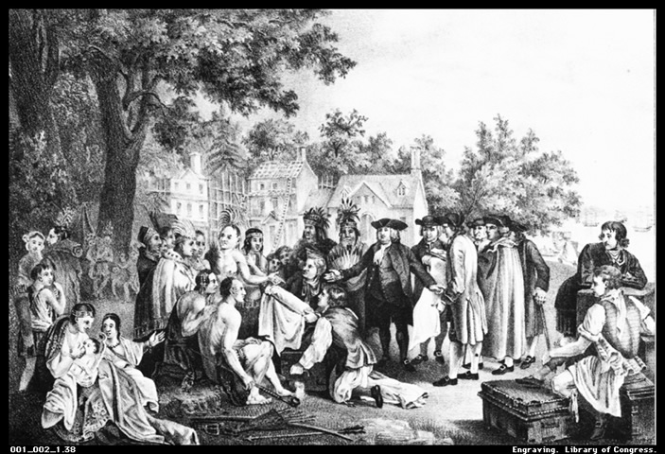
William Penn Walking Treaty
William Penn and Quakers did not believe in violence and negotiated treaties with Natives to buy land => led to peaceful relations in PA (until Scot-Irish immigrants broke the peace and started violent attacks)

Slide 32
Anglicization of Colonial America
      -- All religion tolerated (Catholics/Jews could not vote/hold office)
      -- PA had good native relations due to Quaker non-violence and Penn’s insistence on paid treaties for Native lands
  Lord Baltimore & MD also passed the __________________=> toleration to all Christians but death for those who denied divinity of Jesus
#4: Protestant Evangelism => begun in the 1730’s & 40’s in English “___________ __________”; exported to America by ________________(Trans-Atlantic exchange)
  Mainly focused on church members and sought to “revive” religious fervor by focusing on direct, spiritual contact w/ GOD
    Led to Half-Way Covenant => church membership not dependent on religious conversion experience
    Ministers like Whitefield and __________________held revival meetings in open fields and encouraged conversion experiences
    Caused divisions and challenged authority in American churches with “Old Light” preachers => stressed good works, ritual and education
    Led to evangelism among blacks & Natives and founding of new colleges => Brown, Rutgers, Princeton
    Also a major force for colonial unity => broke down sectional barriers and was a national movement that gave colonials a common belief set

Slide 33
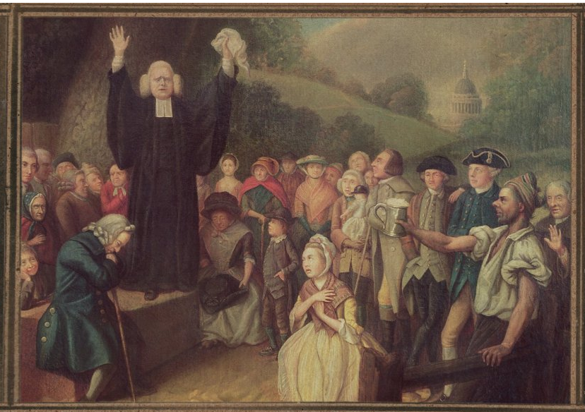
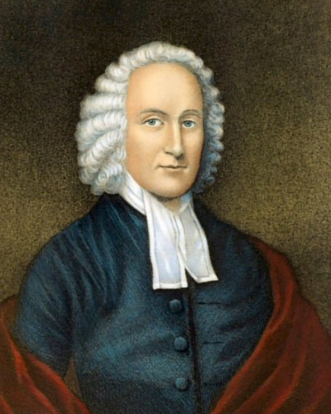
George Whitefield & Jonathan Edwards
Jonathan Edwards
George Whitefield preaching to a crowd – religious conversion experiences that Whitefield induced were said to have included rolling in snow, fainting, speaking in tongues, healing, etc…. Q: What do you notice about Whitefield’s crowd???

Slide 34
Anglicization of Colonial America
#5: English governmental styles and legal systems
  Legal systems => majority of British colonies were at some level autonomous politically but govts were based on British models
    Colonial governance was based on elected assemblies (i.e. Parliament) and governors (i.e. Kings)
      -- 8 Colonies were Royal Colonies: King selects Governor & Upper House; Voters elect Lower House (VA, MA, N/SA Carolina, GA, NJ, NY, NH)
      -- 3 Proprietary Colonies => Proprietor selected Governor; Voters elect Assembly (DE, MD, PA)
      -- 2 Self-Governing Colonies => Voters elect governor & Assemblies (RI, CT)
  Colonial society also had a burgeoning court system and large number of lawyers by 1754 (Patrick Henry, John Adams)
    Colonials adopted common law system => based law on legal precedents and set of interpreted rules/codes
      -- Local magistrates gave decisions after evidence presented
    Influenced by religion => Puritan legal code (lack of church attendance a crime) & PA ______________(no gambling, drinking, work on Sunday)
    Inherited a passion for English style oratory

Slide 35
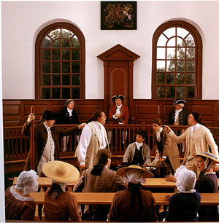
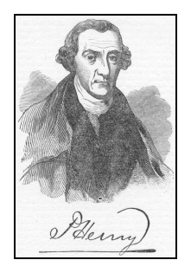
Colonial Courts and Orators/Lawyers
Colonial courts were based on the English model which uses adversarial lawyers to uncover the truth. Judgments were handed down by judge only (usually a religious or political authority). Confessions were sought to bring order back to society.

Slide 36
Socio-Economic Differences in the 3 Colonial Sections
Climate, geography and differences in natural resources contributed to widely varying socio-economic systems in the 3 colonial sections
New England Colonies (RI, MA, CT,
Geographically good natural harbors, rocky, uneven soil and shorter growing seasons led to a society with a mixed economy
  Trade fostered with English Atlantic system => exported timber, ships, whale oil, iron, rum, fishing
  Agriculture was based on self-sufficient food production
NE society deeply influenced by religion => Puritans & Separatists (Calvinists)
  Puritans form Massachusetts Bay Company to flee persecution by Charles I (John White = head; John Winthrop 1st Governor)
  Bible Commonwealth => only church members could vote & hold office; laws based on religion, religious authorities = civil authorities
  -- Blue Laws => laws based on religion (i.e. mandatory church attendence)
  Calvinist doctrines => believed in predestination and church of only elect members w/ conversion experience
  -- Stressed good works => “_______________________________”
  Massachusetts would be a “___________________” => pure civilization that would be special & an inspiration to world (Am. Exceptionalism)

Slide 37
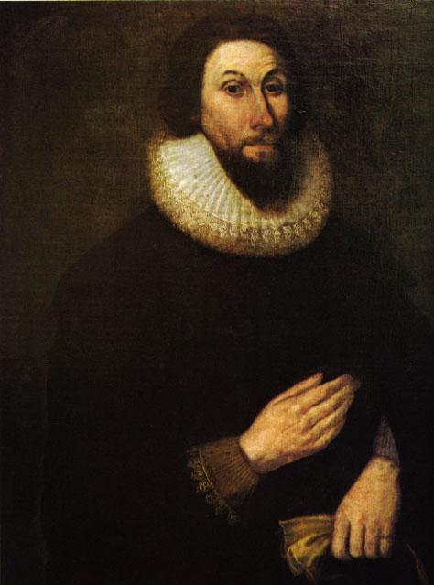
John Winthrop and Massachusetts Bay
The Lord will be our God and delight to dwell among us, as his owne people and will commaund a blessing upon us in all our wayes, soe that wee shall see much more of his wisdome power goodnes and truthe then formerly wee have beene acquainted with, wee shall finde that the God of Israell is among us, when tenn of us shall be able to resist a thousand of our enemies, when hee shall make us a prayse and glory, that men shall say of succeeding plantacions: the lord make it like that of New England: for wee must Consider that wee shall be as a Citty upon a Hill, the eies of all people are uppon us.
-- John Winthrop, City on a Hill Sermon (1630)

Slide 38
Socio-Economic Differences in the 3 Colonial Sections
  __________________are an ex of influence => 20 young women accused of witchcraft & executed as power of rural elites waned
  Dissenters like Roger Williams and Anne Hutchinson founded colony of Rhode Island for religious rebels
New England was less ethnically diverse (mostly English) and more urbanized => large professional class (lawyers, doctors, clergy)
NE organized into series of settled towns and villages
  Village commons = land for militia drilling and common area for town
  Mass School Laws (1647; “__________________”) => NE towns of 50 + had to provide public education (i.e. read bible); mainly males
  -- Led to est. of universities (_________=> education of ministers)
  -- Curriculum based around NE Primer => religious tracts & ideas
New England also very democratic => New England town hall style meetings for governance (direct democracy)
Middle Colonies (NY, NJ, PA, DE)
The Middle Colonies were blessed with excellent soil, deep harbors and good rivers => became the Breadbasket and largest cities of colonies

Slide 39
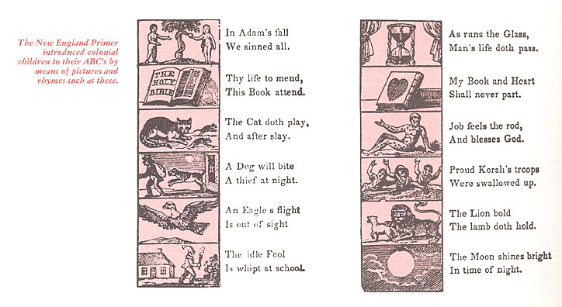
New England Primer page (ca1680)
The NE primer dominated education in colonial times => focused on a Puritan and religious worldview (respect for parents, sin, salvation)

Slide 40
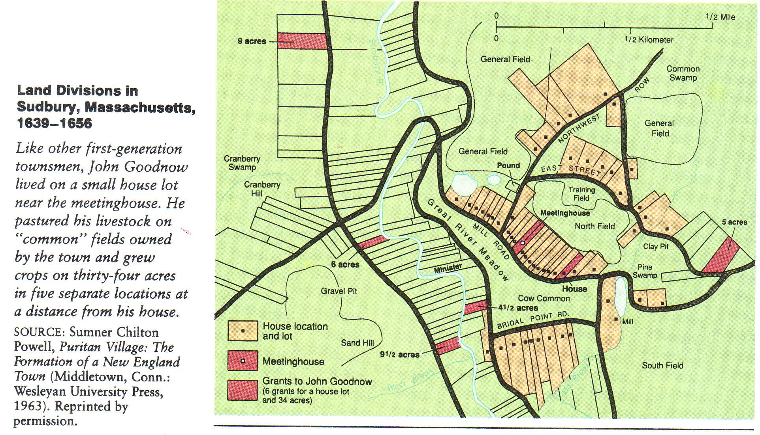
Organization of NE Town (ca 1650)
Q: What do you notice about the organization and structures within a NE colonial town?

Slide 41
3/4 English Colonial sections

Slide 42
Socio-Economic Differences in the 3 Colonial Sections
  New York and Philadelphia became largest cities in colonies => Philadelphia 1st planned city (25,000 pop)
Middle colonies were very ethnically (German, English, Dutch, Swedish, Scot-Irish) and religiously (Congregational, Presbyterian, Quaker) mixed
Middle Colonies had most democratic society => land ownership more evenly split and govt. more locally controlled
Southern Colonies (VA, MD, NC, SC, GA, Barbados)
Southern colonies were geographically flat, well watered and warm => led to an agricultural economy (tobacco, rice, indigo, sugar)
  Based on the cultivation of large plantations (land not equally distributed) by indentured and slave labor
  -- Encouraged by head-right system (50 acres for providing passage)
Southern society was very hierarchal => based on land, race and status
  Ex: VA ruled by ______(“_______________”) due to large coastal estates
  70 % of House of Burgesses were wealthy coastal planters (1-2% of pop)
Due to plantations South was very rural with high degree of social isolation and small professional class (i.e. lawyers, doctors, clergy)
  Very poor roads & waterways in South also

Slide 43
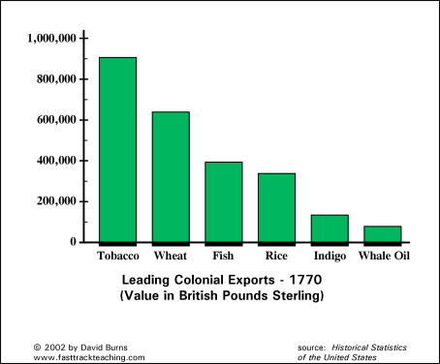

Slide 44
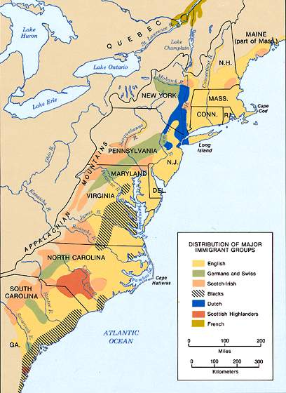
Ethnic Groups in Colonial America
Q: What patterns do you see in ethnicity in Colonial America?
Estimated Population elements (ca 1785)
English and Welsh: 66%
Scottish: 6%
German: 4.5%
Dutch: 2%
Irish: 1.5%
French: .5%
African: 20%

Slide 45
Competition and Conflict in Colonial America – Natives
As Natives and colonists came into increasing contact, clashes between the two groups caused changes in both Native and colonial societies
Spanish colonists adopted the accomodation model, allowing Natives to keep many aspects of their culture (especially after Pueblo revolt)
  Mission system converted Natives to Catholicism, but intermarriage led to intermixing of Native and European cultures
English colonists rejected this model & instead traded alcohol and firearms with Natives to secure land and furs => detrimental impact on Natives
#1: Population Decline
Wampanoag Natives in NE lost 75-80% of population after English arrival
  Could not defend themselves and formed alliances w/ English => aided them in 1st winter (Thanksgiving)
French followed a similar pattern with _____________________=> smallpox & measles epidemics killed 50-66% of population
  Led to Huron dispersal as they could no longer maintain fur rich lands through warfare w/ other Native tribes and Europeans

Slide 46
Competition and Conflict in Colonial America – Natives
#2: Cultural Loss
Spanish & English colonists embarked on programs to “civilize” Natives
  Spanish had missions system where they encouraged conversion of Natives to Catholicism and adoption of Spanish language
  Puritans had “_______________________” of Natives that were taught Christianity and English culture
Europeans also traded large quantities of alcohol (i.e. rum) with Natives for land and furs => led to alcoholism among Natives
#3: Warfare
European and Native styles of warfare were vastly different in 1630
  Natives saw warfare as “sport” => fought for dominance, resource rights, etc…. not domination and destruction
  -- Target warriors on battlefield & take captives as ST slaves
  Europeans saw warfare as a tool for domination => targeted entire population and goal was destruction and killing
European weapons (i.e. guns) and style of warfare made Native warfare (vs each other and Europeans) more destructive and deadly
  Europeans also sought alliances w/ Natives and encouraged warfare vs other Native tribes w/ rum & guns (_____________________)

Slide 47
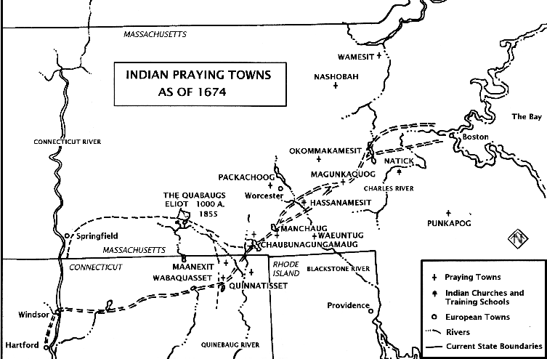
Puritan Praying Towns
Although never as extensive as Spanish mission system, Puritans did try to convert Natives on a small scale

Slide 48
Population Decline in Huron Confederacy
From 1634 to 1640 the Huron Confederacy was decimated by diseases such as smallpox and measles, to which they had no immunity => this led to the dispersal of the Huron, as they no longer had the strength to fight to maintain their position in fur rich lands

Slide 49
Competition and Conflict in Colonial America – Natives
Examples of Native/Colonial Warfare
  King Philips War (NE, 1640’s) => NE tribes organized alliance under Metacom to resist English territorial & cultural incursions
  -- Attacked 52 Puritan towns in European style
    -- War ended w/Native defeat (Philip beheaded & family sold into slavery) & assumptions by English of military and cultural superiority
  Powhatan Wars (VA & Chesapeake)
    1st Powhatan War (1614) – small skirmishes over land in VA
(Ends w/ Pocahontas/Rolfe marriage)
    2nd Powhatan War (1644) – Natives attempt to remove colonists
    -- Natives lose in bloody battles => 1646 peace treaty bans Natives form VA and creates 1st ‘reservation’ in West
  Beaver Wars (NW Territory; 1670’s) => Iroquois & Huron Confederacy
    Iroquois were armed by Dutch and English and encouraged to expand their land (furs) at expense of French allied Huron
    Led to defeat and dispersal of Huron, Shawnee & Susquehannock tribes => loss of tribal life and way of life

Slide 50
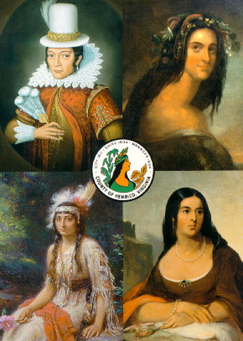
Competition and Conflict in Colonial America – Natives
  Chickasaw Wars (1730’s & 40’s; Tennessee)
    Choctaw & Illini tribes were encouraged/aided by French to attack Chickasaw tribe (French expand control of MS river)
    British organized Chickasaw into heavily fortified villages => repelled attacks but lost large #’s & disrupted culture
Different depictions of Pocahontas

Slide 51
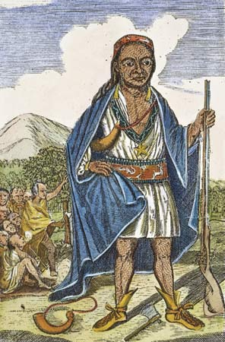
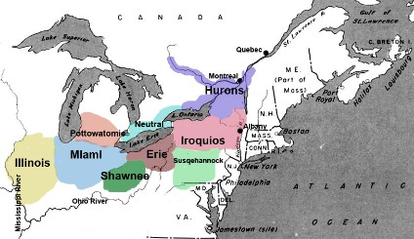
Beaver Wars & Native Tribal Alliances
Q: What do you notice about the # of Native tribes (even by 1670)? Why would the English deal so harshly w/ natives like Metacom who attempted native alliances?
King Philip (Metacom)

Slide 52
Competition & Conflict in Colonial America – Europeans
As the 17th and 18th centuries progressed in Colonial America English colonial resistance and resentment developed around 3 main issues
#1: Mercantilism => economic philosophy that colonies should benefit the mother country economically (dominant philosophy of time)
British government tried to institutionalize mercantilist philosophy
  ________________: all colonial trade must be carried on British ships
  ______________________: 6 pence tax on molasses imported from other nations (i.e. French and Dutch sugar colonies)
  _______________________: colonials forbidden to export wool, yarn or woolen products (lack of competition w/ Britain)
  _____________________: colonials forbidden to export beaver fur hats
Benefits => colonies enjoy protection of British navy and army; colonies have a monopoly on British tobacco market; England pays bounties for ship building products
Disadvs => lack of economic development; taxation; lack of free trade; higher prices for many goods
** Overall colonials enjoyed abundance & prosperity that was higher than England and most of world => were ____% wealthier & paid ____of taxes of Englishmen**

Slide 53
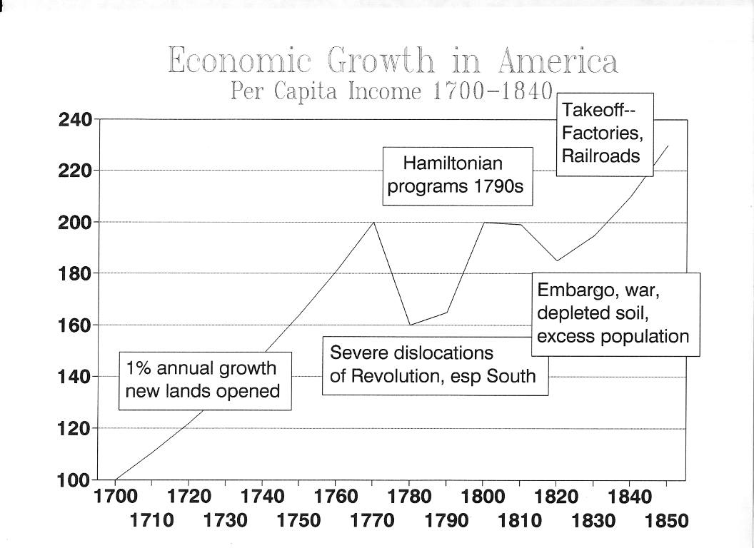

Slide 54
Competition & Conflict in Colonial America – Europeans
Reaction of colonials??
  Colonials responded by ignoring many of the laws =>
  -- Smuggled molasses from French Indies (80% of rum)
  -- Exported hats, wool and created iron forges (i.e. Valley Forge)
  Colonials bribed British collection officials => saw British as corrupt
#2: British Imperial Government control
At the end of 17th century Charles II & British wanted to reign in control of North American colonies => created _______________________
  Dominion was to provide Royal Govt, enforce Navigation Laws and collect taxes, & organize protection in case of Native attacks
  -- English colonists reacted harshly against Dominion due to enlightenment ideals of _______________(rule by elected officials)
  During the Glorious Revolution (James II deposed)in England Edmund Andros was deposed and Dominion of NE evaporated
  -- Subsequent British monarchs relaxed enforcement of Navigation Laws & taxes in a period of ______________________(1700-1763)

Slide 55
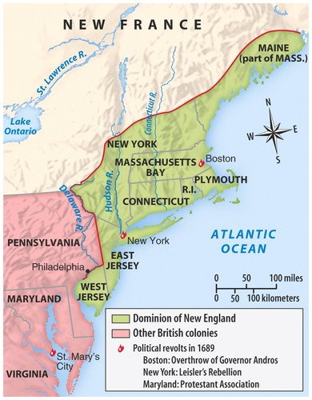
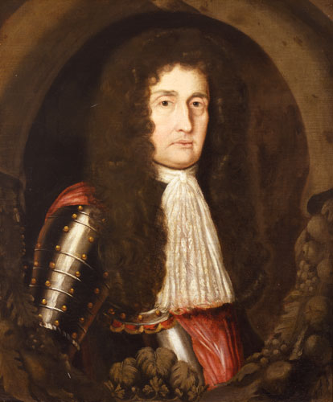
Dominion of New England
The dominion of NE was very unpopular due to the actions of Edmund Andros => restricted press, courts and town meetings, instituted new taxes and enforced Navigations Laws strictly

Slide 56
Competition & Conflict in Colonial America – Europeans
#3: Lack of Frontier Security
Colonials were constantly subject to attack on the frontier => believed that Britain did not do enough to protect settlers
  Bacon’s Rebellion (1680’s)=> partly due to complaints that the Royal Governor (Berkeley) sided with Natives vs settlers (fur trade advs)
  __________(1763) => group of Scotch-Irish settlers who massacred Susquehannock Natives after attacks & tried to march on Philadelphia
  -- Desired to expand land holdings of colonists
In general colonists resisted English Imperial attempts at control due to:
Experience w/ self government (i.e. House of Burgesses, NE town meetings, PA charter)
Evolving ideas of liberty => based on enlightenment writings of Locke (social contract and republicanism)
Religious independence and diversity => Great Awakening challenge to religious authority, diverse religions (Congregational, Presbyterian, Quaker, Methodist, Baptist, Lutheran)
Corruption of Imperial System => tax collectors accepted bribes, officials appointed (i.e.. Governors) based on connections

Slide 57
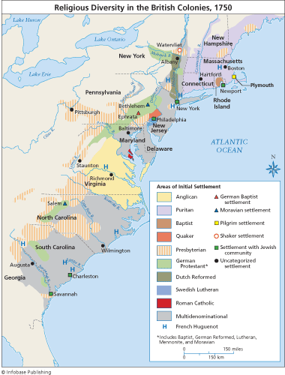
Religious Diversity in Colonial America
Est. number of Various religious adherents (1775)
Congregationalist: 575,000(NE)
Anglican: 500,000 (NY, South)
Presbyterian: 410,000 (frontier)
Lutheran: 200,000 (PA)
Dutch Reformed: 75,000 (NY/NJ)
Quakers: 40,000 (PA, DE)
Catholic: 25,000 (MD)

Slide 58
