Slide 1
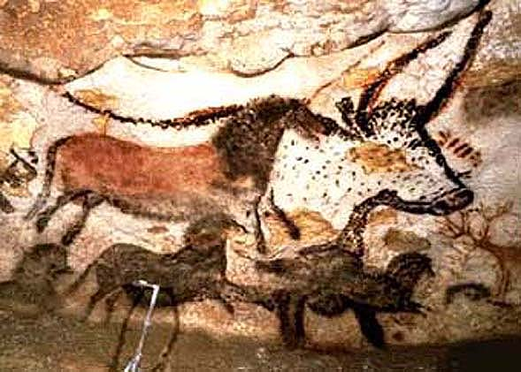
Unit I – Neolithic Revolution & the Birth of Civilization (8000 BCE to 600 BCE)
Lascaeux Cave Painting – Southern France (Paleolithic era)

Slide 2
What is World History?
Urban Dictionary Def => 1. An impossible class that results in sleepless nights, ruined GPAs, failing grades. Death. But it will teach you more about history, economics, culture, social hierarchy, politics and you guessed it ... history than any other class - if u make it out alive. Usually taken by sophomores who don't know how hard AP classes are, but honestly the first AP is always hell so it's usually better just to get it over with.
World History is NOT . . .
_____________________________________________=> -- “We don’t study the history of each separate state to understand American history . . . Rather we study national experiences & developments to understand the history of the United States.” (Heidi Roupp)
World History IS . . .
The study of ___________________________over time
The study of factors, events and processes that lead to _________ __________________________between states and regions
The comparison of _______________________________across cultural and geographic boundaries

Slide 3
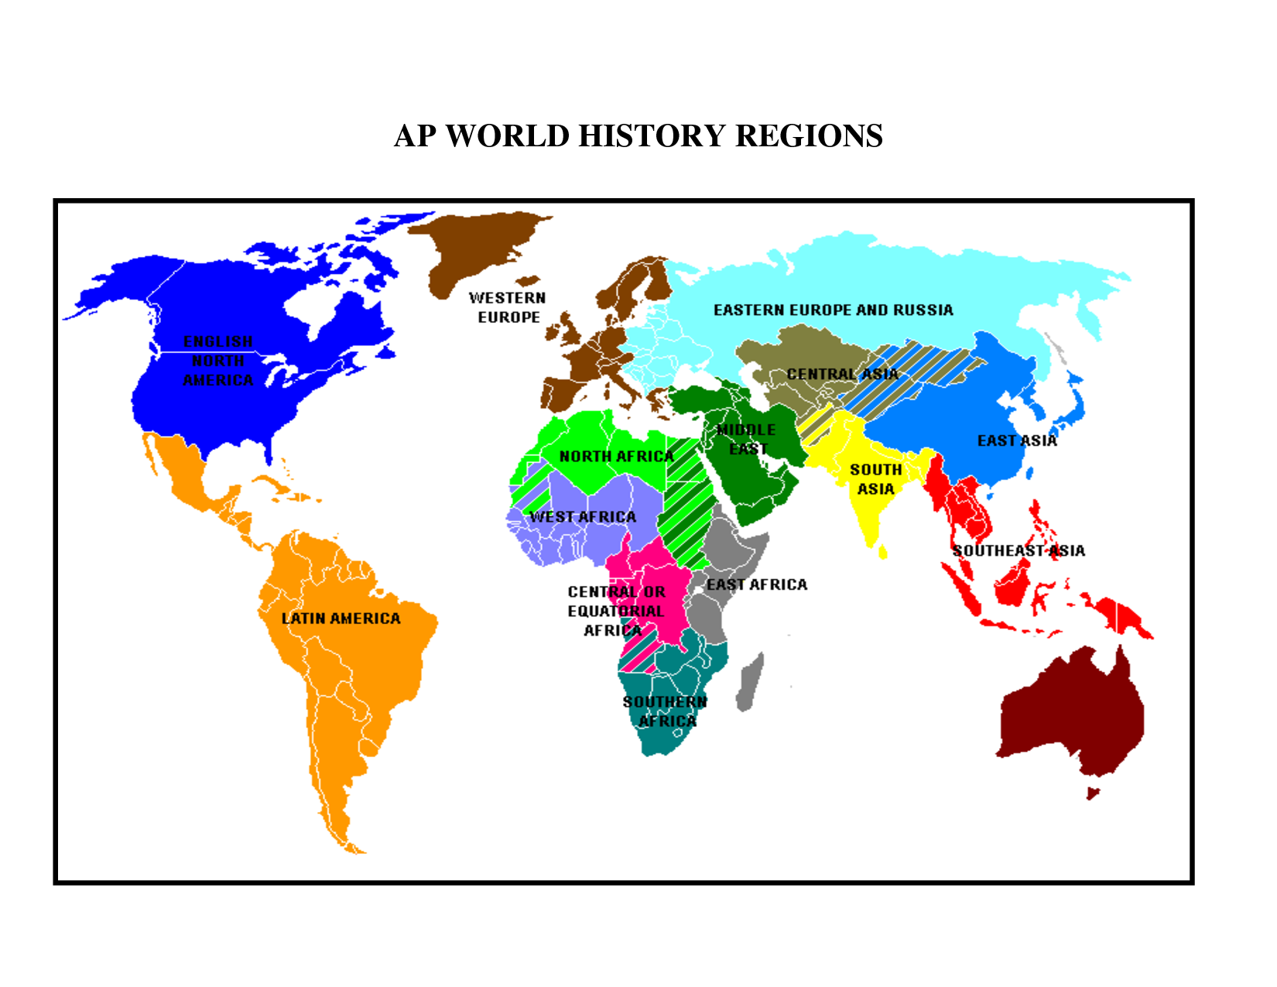
The Myth of Continents – a new regional framework

Slide 4
AP World History Major Themes
Social: Development and transformation of social structures
Gender roles and relations
Family and Kinship
Racial and ethnic constructions
Social and Economic classes
Political: State building, expansion and conflict
Political structures and forms of governance
Empires
Nations and Nationalism
Revolts and revolutions
Regional, trans-regional and global structures and organizations
Interaction between humans and the environment
Demography and disease
Migration
Patterns of settlement
Technology
Cultural: Development and interaction of cultures
Religions
Belief systems, philosophies and ideologies
Science and technology
The arts and architecture
Economic – Creation, expansion and interaction of economic systems
Agricultural and pastoral societies
Trade and commerce
Labor systems
Industrialization
Capitalism and Socialism

Slide 5
Intro to “Big History”
What is “Big History”?
A multidisciplinary approach to historical study that examines the whole of history from the Big Bang to the modern world
Big History seeks to understand the history of the universe and how humanity fits into this framework
-- Big History seeks to understand how humans developed within the world using common themes on multiple time scales
-- Big History sees the transition to civilization as gradual, occurring over a long time period, with many causes & effects
-- Big History also uses more types of historical evidence => geological data, archeological records, carbon dating, fossils, ecological records, etc….

Slide 6
Big History vs Traditional History
Conventional history | Big History
5000 BCE to present | Big Bang to present
7,000-10,000 years | 13.8 billion years
Compartmentalized fields of study | Interdisciplinary approach
Focus on human civilization | Focus on how humankind fits within the universe
Taught mostly with books | Interactive Internet
Microhistory | Macrohistory
Focus on trends, processes | Focus on analogy, metaphor
Based on a variety of documents, including written records and material artifacts | Based on current knowledge about phenomena such as fossils, ecological changes, genetic analysis, telescope data

Slide 7
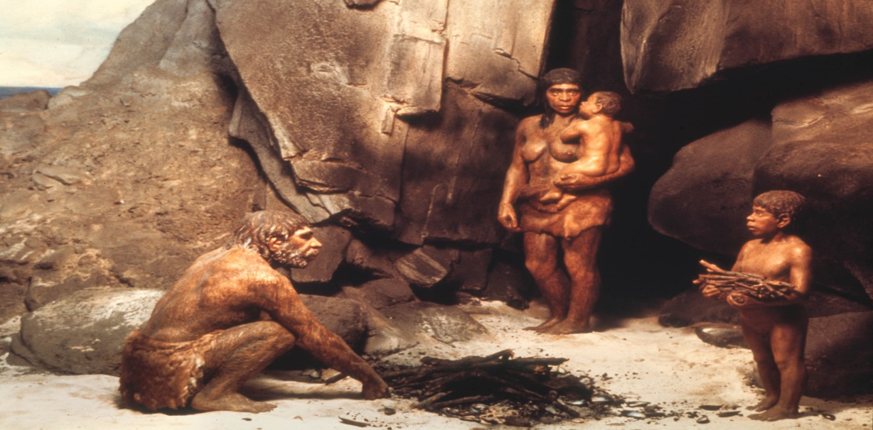
Early humans were slump-shouldered, slope-browed, hairy brutes. They hunkered over campfires and ate scorched meat. Sometimes they carried spears. Once in a while they scratched pictures of antelopes on the walls of their caves. That's what I learned during elementary school, anyway. History didn't start with the first humans - they were cavemen! The Stone Age wasn't history; the Stone Age was a preamble to history, a dystopian era of stasis before the happy onset of civilization, and the arrival of nifty developments like chariot wheels, gunpowder, and Google. History started with agriculture, nation-states, and written documents. History began in Mesopotamia's fertile crescent, somewhere around 4000 BC. It began when we finally overcame our savage legacy, and culture surpassed biology.
—Anthony Doerr reviewing On Deep History and the Brain

Slide 8
World Population through History

Slide 9
Year | Est. World Population | Growth Rate
100,000 BCE | 10,000
30,000 BCE | 500,000 | 0.56%
8000 BCE | 6 Million | 1.25%
3000 BCE | 50 Million | 4.33%
1000 BCE | 120 Million | 4.47%
0 CE | 250 Million | 7.62%
1000 CE | 250 Million | 0%
1200 CE | 400 Million | 26.49%
1400 CE | 375 Million | -3.18%
1600 CE | 578 Million | 24.15%
1700 CE | 680 Million | 17.65%
1800 CE | 954 Million | 40.29%
1900 CE | 1.6 Billion | 71.28%
1950 CE | 2.5 Billion | 139.74%
2000 CE | 6 Billion | 462.42%

Slide 10
Big Geography & Peopling of the Earth
Modern humans emerged in the ______________(2.5 M – 10,000 BCE)
BCE = Before the Common Era (similar to BC)
During this time humans evolved from a hominid ancestor => favored bipedal walking & larger brains (Natural Selection)
-- Other varieties of hominids including Homo Erectus
~ 200,000 years ago modern humans (Homo Sapiens) originated in W. Africa => _____________________________
These humans were organized into ________________________of approximately 20-30 individuals (____________ based)
They relied on hunting (buffalo, horses, bison, fish, reindeer) and foraging (nuts, berries, grains, green plants) for their diet
Foraging bands ___________________(2-3 miles/year) to maintain diet and variety of food => over 150,000 years populates the earth
-- Left Africa ~ 80,000 years ago
-- Humans were behaviorally modern before migration

Slide 11
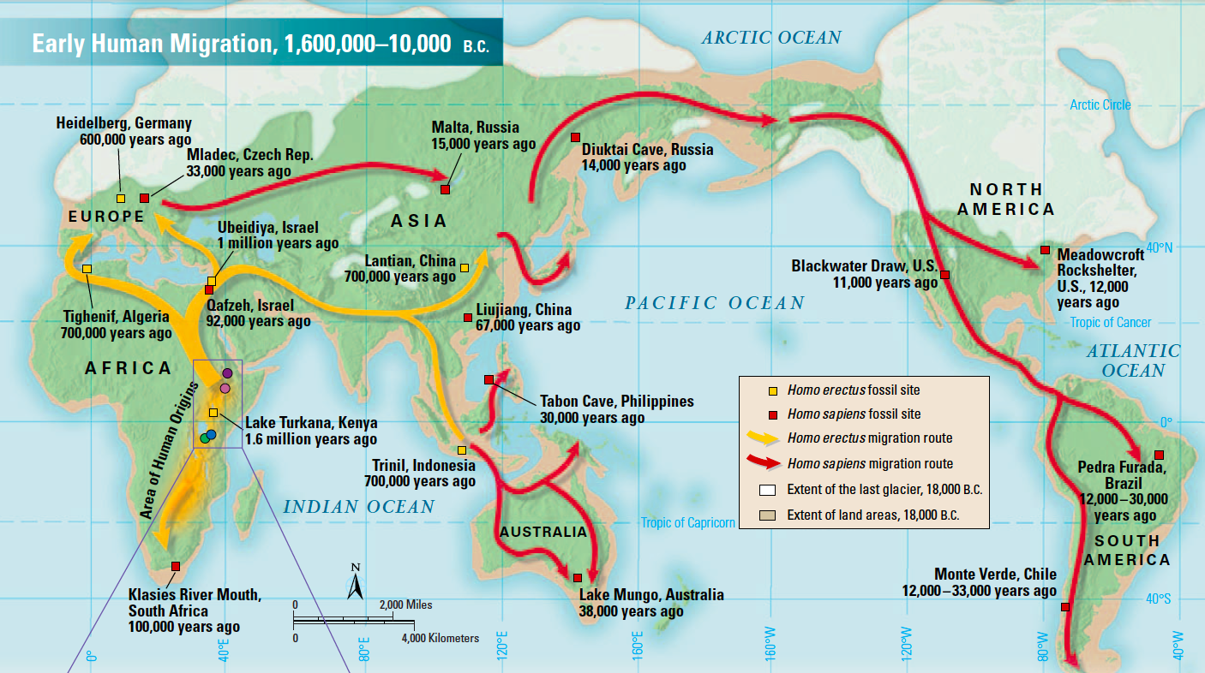
Paleolithic Age Human Migrations

Slide 12
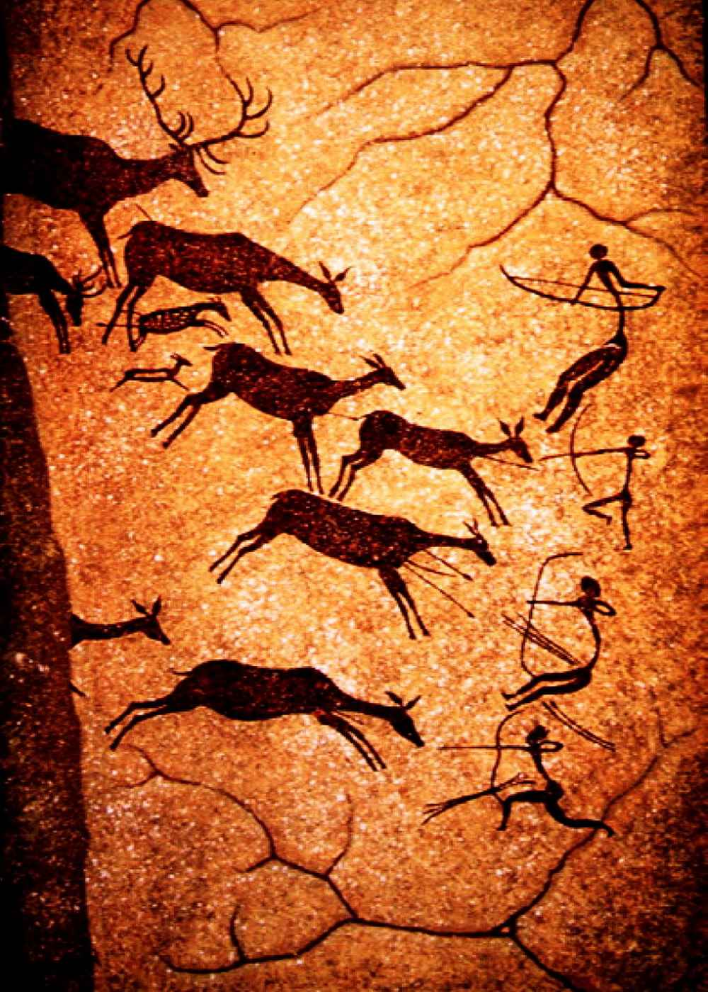
Paleolithic Adaptations
Foraging bands adapted to their environment (i.e. deserts, forests, tundra) in various ways . . .
#1: Use of __________ (#1 invention of Paleolithic Era)
Controlled use of fire dates vary (500,000 years ago to 1.7M)
-- Widespread use of fire ~ 125,000 years ago
-- Earliest site = Israel ~ 800,000 years ago
-- Fire sites have evidence of different ______(birds to rhinos) & _______ (oats to grapes) that humans used fire to cook
Fire use allowed humans to rapidly adapt to wide range of _____________________=> protection, warmth, hunting, food preparation
#2: Use of ______________
1st tool using hominids were Australopithecus Afarensis => used pieces of stone to carve meat off of carcasses and crack open bones for marrow
-- ___________evolved => spears, bows & arrows
-- _________ also developed => hooks, harpoons

Slide 13
Life during the Paleolithic Age
Life expectancy was very short => ~ 30-35 w/ 50% of children dying before the age of 10 (upper respiratory illnesses)
MYTH => Men hunt, women forage . . .
H/G society was _________=> men & women shared in hunting & foraging
Majority of time would be spent foraging for food => 6+ hours/day
-- All members of society needed for food production => _______ __________________________(no full time leaders, bureaucrats, artisans)
_________________________speculates that H/G lived much easier lives than we do today (i.e. more free time and less work in general)
Communication done via language (new development), cave paintings & smoke signals
Allows humans to pass down knowledge and thus adapt to environment
Dwellings were caves or small tents made of wood & animal hide
Religious beliefs were _____________________________
Belief that people & gods could embodied __________________(i.e. stubborn as a rock or graceful as a river)
No separation between spiritual and earthly spheres
Population growth rates ___________________=> doubling time ~ 9000 yrs!

Slide 14
The Neolithic Revolution
Partly due to climate change (i.e. end of the last Ice Age ~10,000 BCE) a revolution in human life occurred => the Agricultural Revolution
Humans developed ____________________slowly over a period of 1000’s of years independently in different geographic areas
Middle East/Fertile Crescent (8000 BCE) => wheat, barley; goats, sheep, pigs and cattle (spread to Europe)
Egypt & Nubia (6000 BCE) => wheat, barley
West Africa (4000 BCE) => yams, millet
India, SE Asia & China (6000 BCE) => rice, millet, bananas; dogs, pigs & horses
Mesoamerica (7000 BCE) => beans, squash, maize; dogs, fowl
Andes (5000 BCE) => beans, potatoes; llamas/alpacas
____________________________in World History => huge change that impacts multiple elements of social, economic and political life
Starts historical process of constant change and evolution => advance of technology and human “progress”
Communities had to work cooperatively to clear land for agriculture and create water control systems (i.e.______________________________)
Some communities relied on slash and burn agriculture

Slide 15
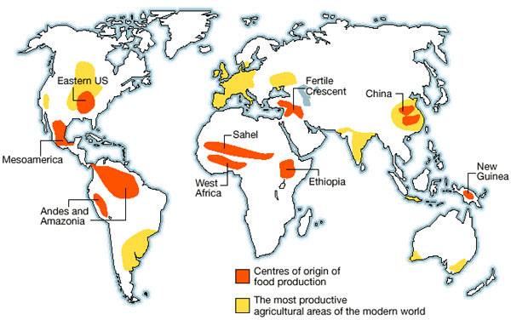
Neolithic Revolution – Centers of Food Production

Slide 16
Consequences of Neolithic Revolution
The Neolithic Revolution had huge impacts on human society . . .
#1: _________________________=> more reliable food supply & localized production led to stable societies (8000 BCE = 6M; 3000 BCE = 50 M)
Villages and pastoralism also led to disease (smallpox, measles, influenza)
#2: _________________________________=> surpluses of food led to new classes developing (i.e. warriors, artisans, elites and rulers)
Forced labor systems also develop (i.e. slavery)
#3: ________________________=> elite men developed hierarchal social structures that started with “big men” in villages and moved on to cities ruled by kings
Separation of spheres => women in home, men in fields
End of kinship based societies => replaced by villages and cities (largest = Catal Huyek ~ 6000 people)
#4: ___________________________=> agricultural & pastoral practices changed the environment through the selection of crops, grazing, land clearing & irrigation
Could lead to soil depletion & erosion
#5: ______________________=> due to technological innovations and stable locations trade ensued between agricultural and pastoral villages
Exs: shells, flint, semiprecious stones, weapons, tools

Slide 17
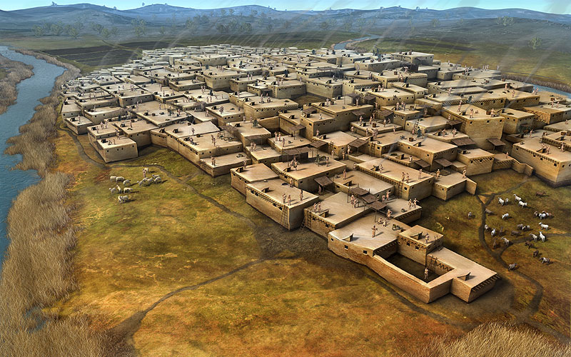
Catal Huyek ca 6000 BCE(i.e. Turkey)

Slide 18
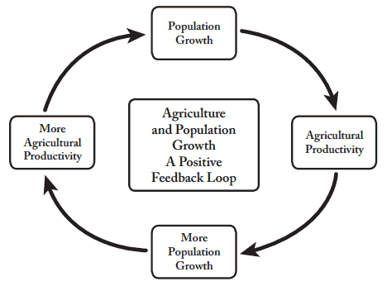
Growth of Agriculture and Pastoralism
Q: What happens when a society begins to use agriculture and pastoralism? Can the civilization “go back” to foraging? Why?

Slide 19
Neolithic Technological Improvements
Technological innovations during the early Neolithic age led to improvements in agriculture, trade and transportation
__________________ => used for storage of grain and beverages (i.e. beer) as well as trade (artisans)
_______________________=> made from stone, copper and bronze these tools increased farming capacity (artisans)
_________________________=> flax and cotton were used to weave textiles with more modern types of tools (artisans)
_____________________=> wheels made of stone & later iron enabled transportation of goods and war technologies (artisans)
__________________=> developed first in the Middle East and spread from there, use of metals in rocks to forge tools & weapons (artisans)
-- Improvements led to the Copper, Bronze and later Iron Ages
-- Assess to materials (i.e. iron) led to some civilizations becoming more advanced

Slide 20
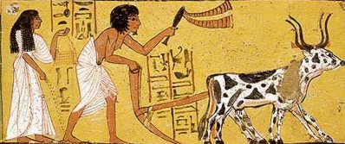
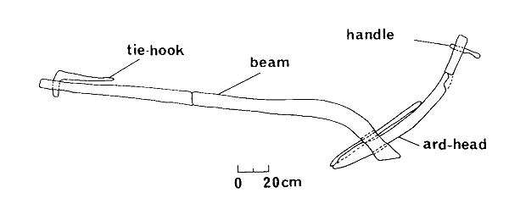
Early Neolithic Plows

Slide 21
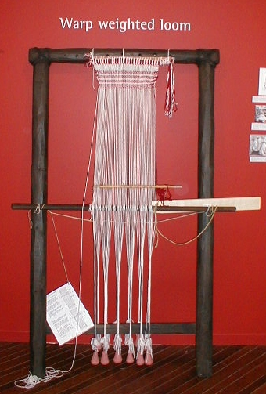
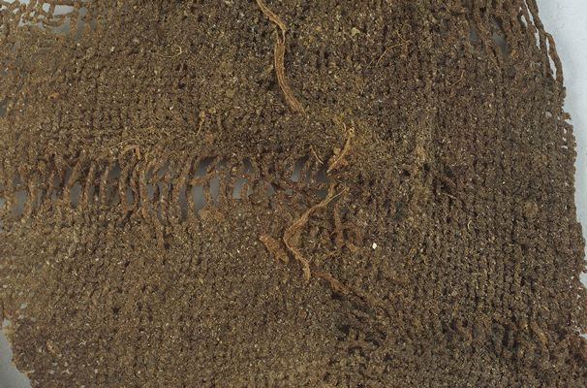
Neolithic Woven Textiles

Slide 22
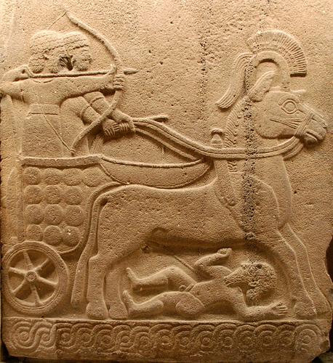
Hittite Chariot

Slide 23
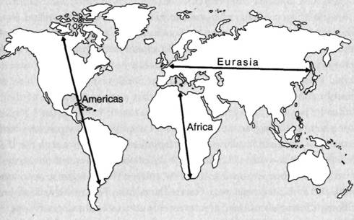
Jared Diamond’s Continental Axis theory

Slide 24
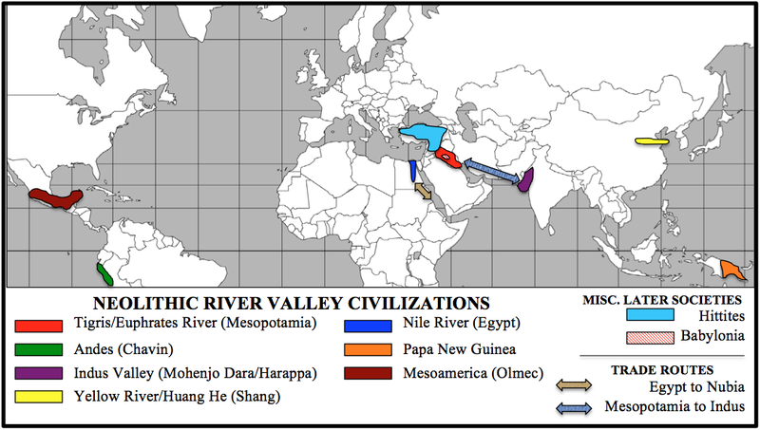
6 Foundational Civilizations

Slide 25
The founding of the 1st Civilizations
About 5000 years ago (~3000 BCE) the first urban societies developed which gave rise to the 1st civilizations
1st 6 foundational civilizations differed significantly, but shared some common features which define “civilizations”
#1: ___________________________ => allow specialization of labor and artistic expression and led to trade with other areas
#2: ______________ => urban centers gave rise to complex institutions
#3: ______________________ => social structures based on economic power (kings & elites at top, artisans in the middle & slaves at bottom)
#4: New _____________________________ => organized government bureaucracy grew & armies were created for expansion and defense
#5: __________structures => gods were deemed crucial for communal survival (priests and temples were created to worship them)
#6: _______________________________ => originally designed for record keeping it later served artistic functions

Slide 26
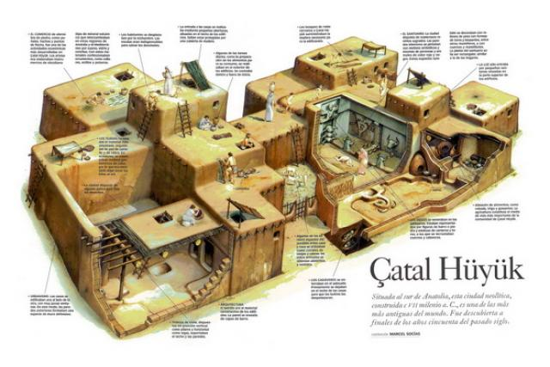
Why Civilization?
Historians are still debating what caused the rise of civilization
Challenge and response => civilization developed as a response to food problems and the need for defense(i.e. war leaders developed and needed paid in booty; only way to get booty = go to war; wars lead to development of large population centers)
Materialism => civilization developed out of agricultural food surpluses and led to other bureaucratic structures
Religion => provided the unity and purpose needed for civilization

Slide 27
Civilization – Mesopotamian Case study
Tigris & Euphrates civilization 1st emerged in ~3000 BCE by the ______________ who developed independent city states (Ur, Uruk, Babylon)
Civilization depended upon the yearly flooding of the rivers & the development of an elaborate irrigation system
Sumerian city states were ruled by Kings who claimed the divine right to rule => kingship was passed down based on heredity
Government structure was a mixture of absolute monarchy and _____________ due to the power and influence of priests
Sumerian king Hammurabi developed and codified a system of laws that gave state power over its subjects
-- Known as ___________________________(282 laws) => prescribed punishments and defined the social order (_____________)
Sumerian city were well organized and built of mud-bricks
Sumerians constructed defensive walls around their cities => Uruk had 6 miles of walls w/ defensive towers every 30 feet
Sumerian cities also had ___________ (monumental architecture) => massive steptowers used for worshipping the gods and housing priests
-- Also a sign of wealth, power and prosperity

Slide 28
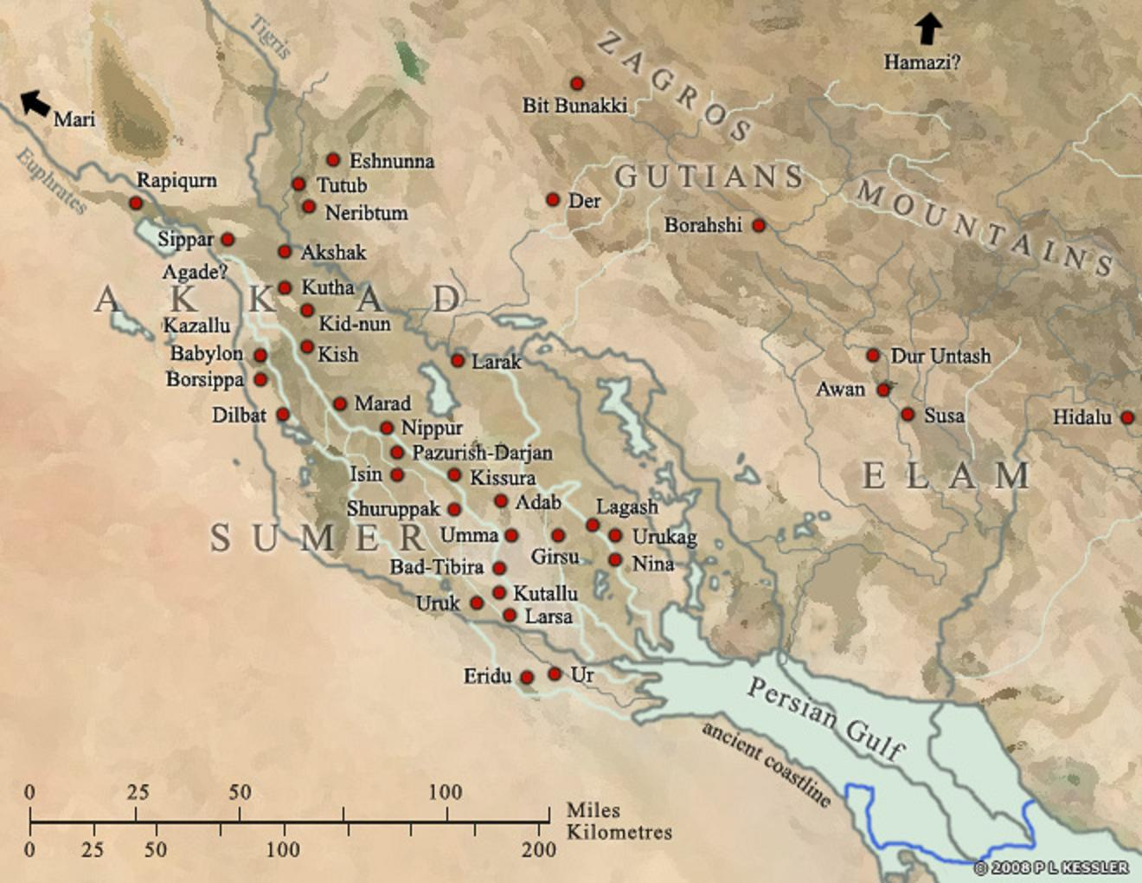
Sumerian City States

Slide 29
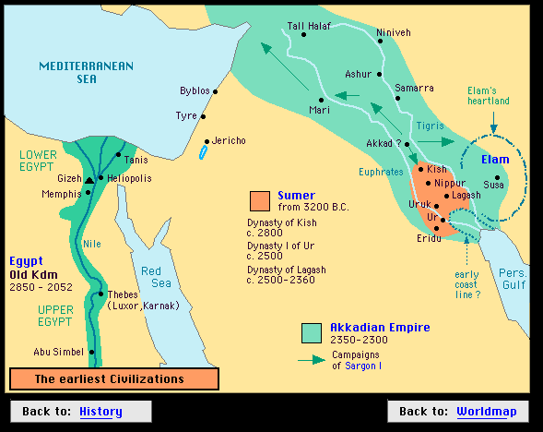
Sumer and the Akkadian Empire

Slide 30
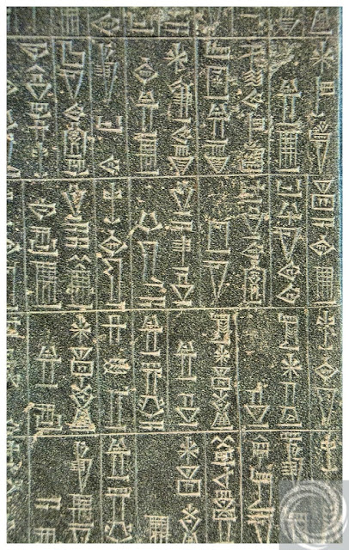
Code of Hammurabi
The Code of Hammurabi was 282 laws written in cuneiform on tablets
Code was designed to effectively administer a large population
Code also served to formalize the system of patriarchy that developed
Women possessed fewer rights & privileges; women were expected to be at home & maintain fidelity (men could have multiple sexual partners)
-- Men could divorce wife for not having children
Fathers ruled over children as well => could disinherit sons for offenses; cut off hands for striking

Slide 31
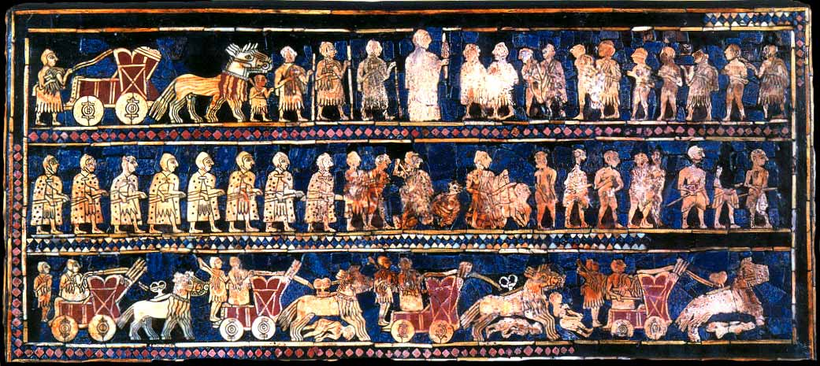
Royal Standard of Ur
Q: What does the Royal standard show about the power structure, technology and activities in Sumerian city states?

Slide 32
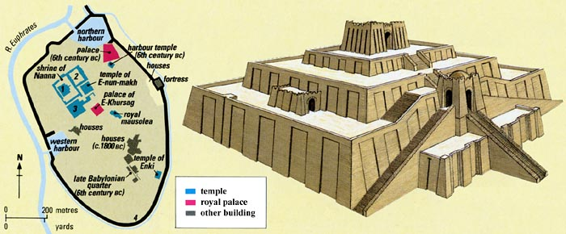
Sumerian Ziggurat
Q: What were ziggurats used for? What were they built of? What does their existence show about Sumerian civilization?

Slide 33
Mesopotamian economics
The Sumerian economy was primarily agricultural but also included industrial activity (i.e. wool textiles, pottery, metalwork)
Trade also occurred => wheeled carts (borrowed from Indo-Europeans) led to eastern Mediterranean trade & ships sailed to Indus valley and Egyptian coast
Exs: luxury items such as metals (silver), spices, textiles
Development of trade was also aided by migrations of peoples => i.e. Indo-Europeans or Bantus
Sumerian society was stratified based on economic pursuits
-- Elites: King and others (landowners, priests, royal officials)
-- Dependent commoners: elite clients (scribes and overseers)
-- Free commoners: farmers, merchants, fishermen, artisans
-- Slaves: workers (palace projects), weavers (temples), agricultural workers (elites)
_____% + of people were farmers, supporting the elites
Elites used wealth to promote arts => i.e. wall painting, sculpture, weaving (religious, prestige and artistic purposes)

Slide 34
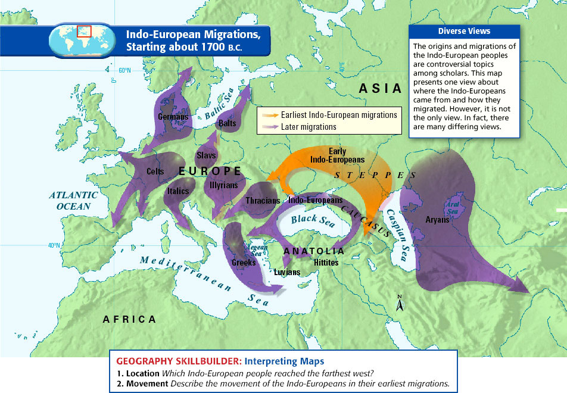
Indo European Migrations
Trade was aided by migrations due to new contacts established, knowledge of other groups and language similarities

Slide 35
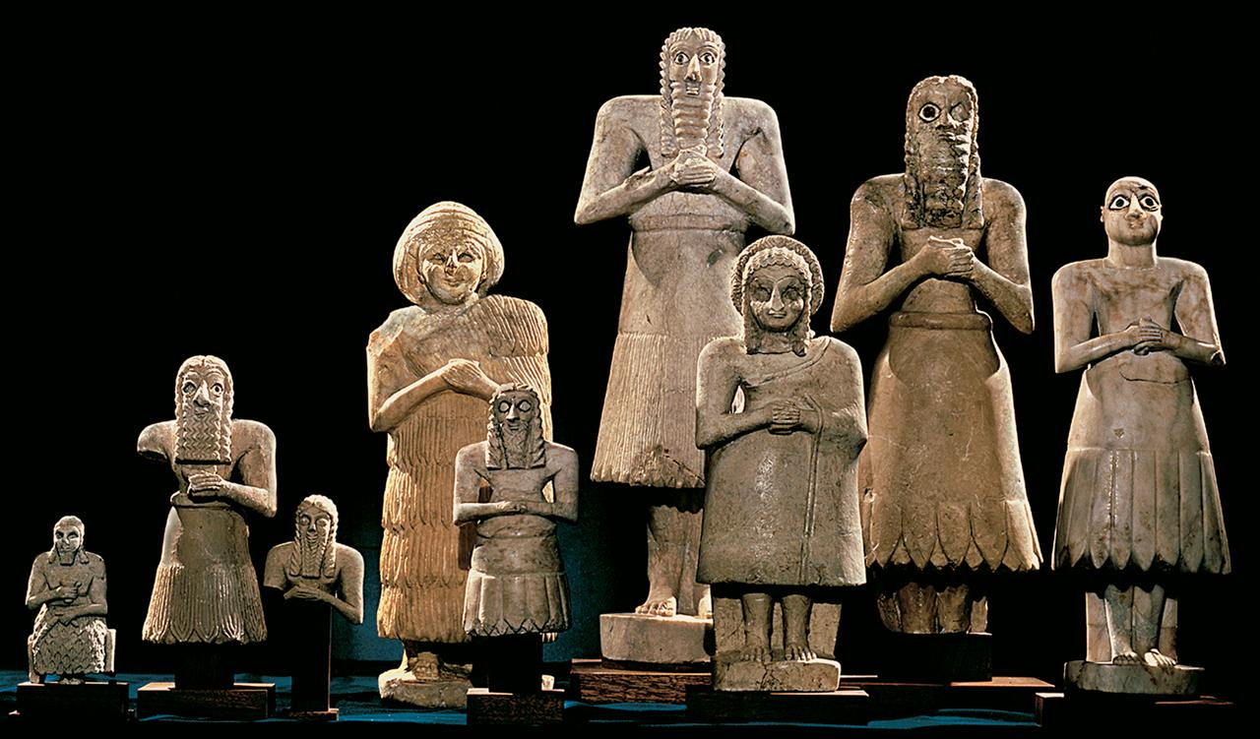
Sumerian Sculpture
Sumerian sculpture gives special prominence to the eyes (huge eyebrows and eyes) which reflects the importance of “seeing” in Sumerian culture

Slide 36
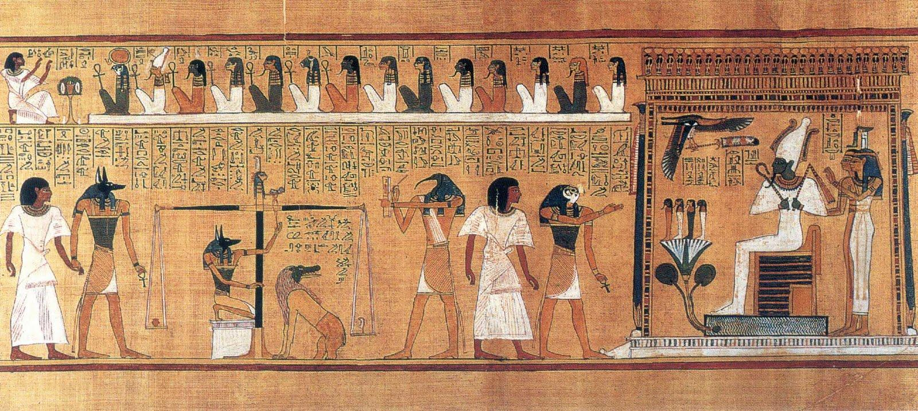
Ancient Egyptian Wall Art
Illustration from The Book of the Dead (weighing of the heart): Wall art often focused on religious ceremonies(rituals) or instructions to the dead for use in the afterlife

Slide 37
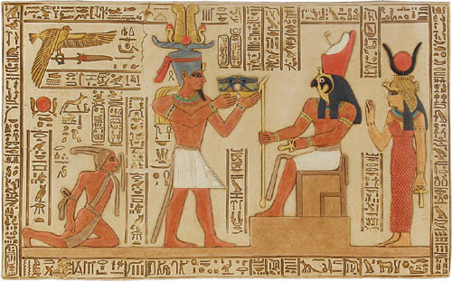
Ptolemy V offering to Horus: Egyptian art had specific “rules” concerning form (i.e. combine profile, semi-profile and frontal views) and presentation (i.e. physically accurate)

Slide 38
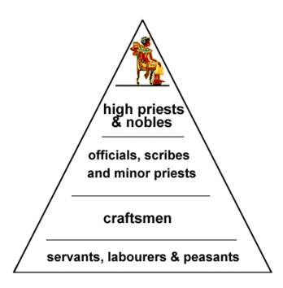
Sumerian social hierarchy

Slide 39
Mesopotamian society and culture
Religion was very important in Sumerian and other early societies
Religion was used by early societies to understand the natural world and place cosmic events within human context
Sumerian religion (like Egyptian) had a close connection to the physical environment and cosmic forces
Sumerian religion was ______________=> 4 main gods were An (sky and sun), Enlil (wind), Enki (rivers, canals, crafts, inventions) & Ninhursaga (goddess, soil, mountains, vegetation)
Sumerians believed that ______________________must be performed to appease the gods (i.e. control floods, etc…)
Sumerians also believed in _________________=> ceremonies performed to discern the will of the gods
-- Ex: kill oxen and look at the shape of organs => organ shaped in an X means successful military campaign, Y = failure

Slide 40
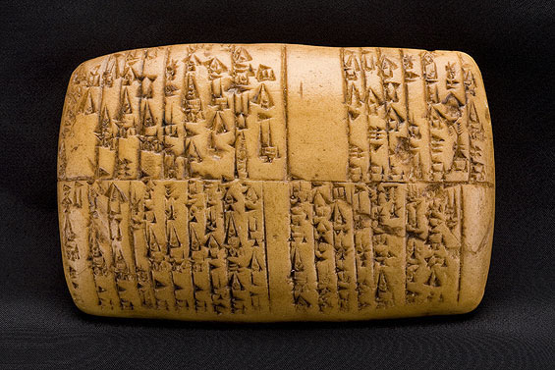
Development of writing
Early cuneiform (wedge shaped) writing was developed around 3000 BCE and primarily used for record keeping (i.e. taxes, population, etc…)
Cuneiform tablets were created from baked clay by scribes
Cuneiform eventually developed into a written alphabet (i.e. Phoenicians) => some writing did not, though (i.e. Egyptian hieroglyphs)
Written language led to the development of _______________ (i.e.____ ________________________________________) and cultural exchange
Literature reflected cultural practices => i.e. Epic of Gilgamesh deals with a king’s quest for immortality which he concludes is only for Gods
Sumerian cuneiform tablet – list of herders and cattle in goddess Inana’s fields

Slide 41
Sumerian Cuneiform alphabet

Slide 42
State Expansion and Empire building
The most powerful, well situated & resource rich civilizations employed powerful military machines to conquer and administer vast empires
Mesopotamia/Babylon
______________________Empire (Saragon; 2350 BCE) was the 1st Mesopotamian empire
Used powerful military (standing army of 5400) to establish a dynastic empire; used former rulers as governors
Hammurabi, Babylonians and others followed the example of Saragon and established empires in the Mesopotamian area
Empires culminated with the Hittites & Assyrians => pastoralists who used _________________________________________to change warfare
Hittites (ca 1750 BCE) were a group of pastoralists who introduced ___ ____________ (cheaper, easier to forge) & compound bows (shorter)
Assyrians (ca 700 BCE) were able to establish the largest empire due to their military tactics, use of horses to carry messages & brutality

Slide 43
Hittite Chariot

Slide 44
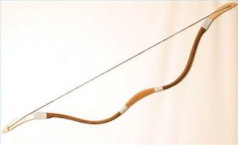
Assyrian Compound Bows & war tactics
Account of King Ashurnasipal’s treatment of Assyrian war prisoners =>
“3000 of their combat troops I felled with weapons . . . Many of the captives taken from them I burned in a fire. Many I took alive, from some of these I cut off their hands to the wrist, form others I cut off their noses, ears and fingers . . . I burned their young men and women to death”
** This type of treatment was reserved for those peoples that rebelled against Assyrian rule **
Q: How would these types of actions help the Assyrians rule a large geographic empire?

Slide 45
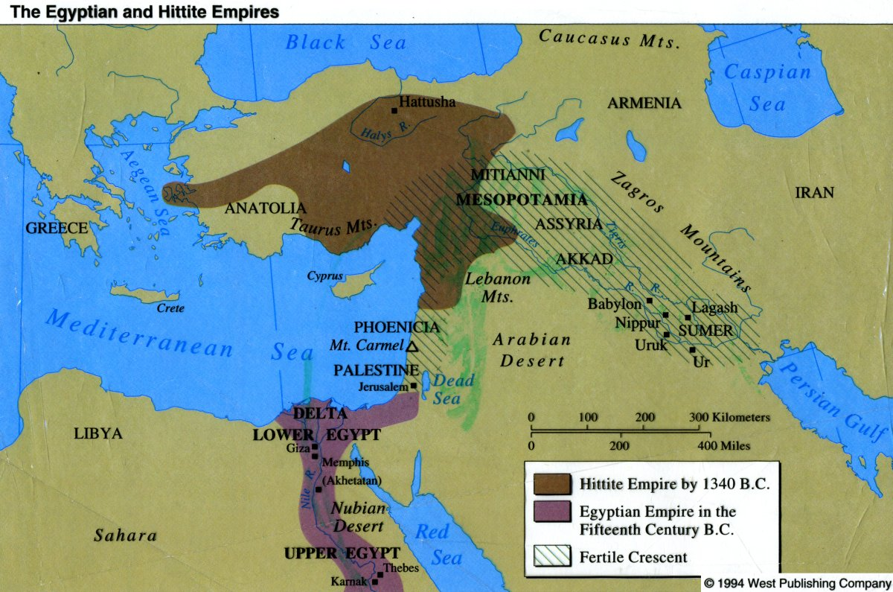
Hittite Empire (ca 1750)
The Hittites were the first group of nomadic pastoralists to establish an empire => afterwards there were many conflicts between these groups and agrarian societies (pastoralists/barbarians often developed more efficient military technologies and disseminated them to agrarian societies)

Slide 46
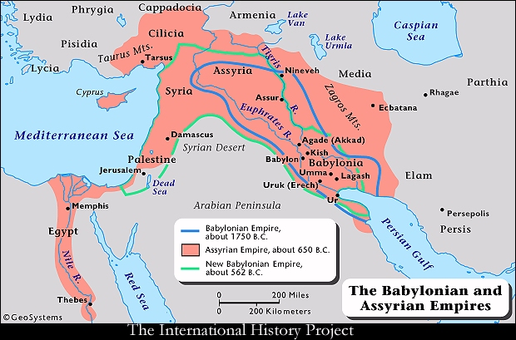
Assyrian Empire (ca 700 BCE)
Q: What would be the challenges of ruling such a large empire?

Slide 47
State Expansion and Empire building (Cont)
Egyptian Empire
Unlike the Fertile Crescent (i.e. flat land w/ no natural boundaries), Egypt’s geography made conquest difficult
Deserts to the East & West, Mediterranean Sea to North and Nile cataracts (rapids) to the South (security and continuity)
Egyptian civilization was divided into three periods
Old & Middle Kingdoms (ca 3100 BCE – 1650 BCE) => period of stability & domestic splendor (pyramids, Egyptian religion focused on Sun God RA, cultivation of wall art & hieroglyphics)
-- Brought to an end by the invasion of the Hyksos => pastoral people who brought bronze weapons & wheeled chariots
New Kingdom (ca 1550 – 1000 BCE) => after defeating the Hyksos, pharaohs used new military skills to establish a massive empire
-- Conquered Canaan, Phoenicia and parts of Babylonian empire
-- Cultivated trade with_____________, Fertile Crescent & Mediterranean => _________became a tributary state (ivory, leopard skins, ebony, gold) and adopted many Egyptian practices (i.e. art, religion, govt)

Slide 48
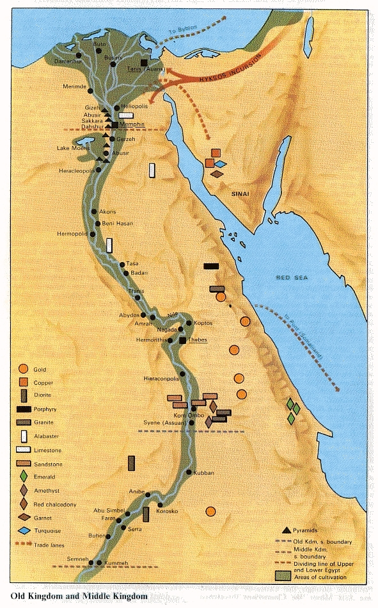
Egyptian Resources
Egypt was very rich in many resources that were valuable for trade and the development of civilization
Gold, Copper, granite, alabaster, emeralds, etc…
Nile River flooding (very predictable mostly) also provided Egypt with stable agricultural base

Slide 49
Ancient Religion
Early religious beliefs were primarily animistic and sought to make meaning of natural events (i.e. Egyptian and Sumerian)
3 new belief structures were fundamentally different & provided the basis for later religious ideas and religions
#1: Hebrew Monotheism
Semitic speaking people (i.e. Aramaic, Arabic, Hebrew) who originally worshipped nature spirits and many Gods
Post Babylonian exile (ca 600 BCE) Yahweh = only GOD
3 tenets of Hebrew tradition => covenant, law and prophets
-- __________________=> established between GOD and Moses, Hebrews were God’s chosen people & received promised land
-- ___________=> GOD gave Moses 10 commandments (moral code) which must be obeyed (if not evil and suffering follow)
-- _______________=> GOD sends teachers to serve as his voice to Israelites and they talk of universalism (all worship GOD)
Later leads to Judaism and influences other Monotheistic religions (i.e. Christianity and Islam)

Slide 50
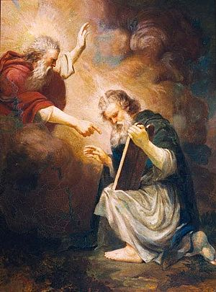
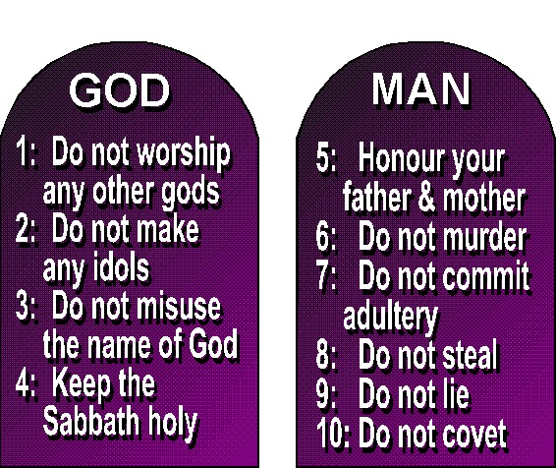
Hebrew Monotheism
Ten Commandments are written about in the Hebrew Bible (Old testament) in the books of Exodus and Deuteronomy

Slide 51
Ancient Religion (Cont)
#2: Zoroastrianism
Zoroastrianism was the main religion of the Persian Empire and was based on the teachings of Zoroaster in the book Zend Avesta
After wandering he experienced a series of revelations about what was the “true and only religion”
In the beginning there was one God, Ahuramazda => embodiment of good (wise, pious, kind, etc…)
-- He was opposed by Ahriman who was the embodiment of evil
Their battle played out among humans (free will) who must choose the path of good or evil
-- At the end of the world there would be a judgment and “good” go to paradise; “evil” thrown into abyss of torment
_________________________(good vs evil) and a last judgment later influences Christianity, Islam and other major religions

Slide 52
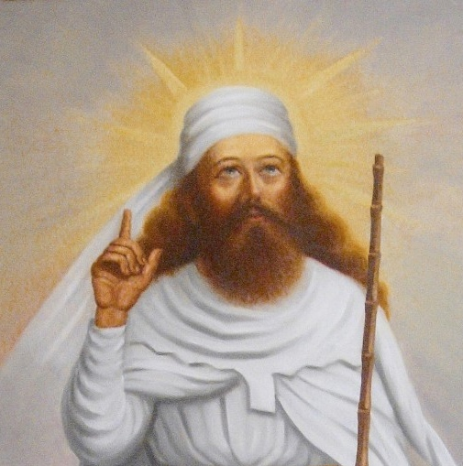
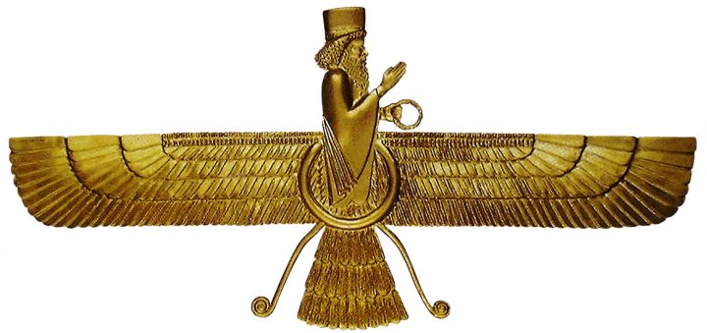
Zoroastrianism
Zoroaster, founder of Zoroastrianism & the main symbol of the religion, Faravahar (symbol of divine mandate that Persian kings had)

Slide 53
Ancient Religion (Cont)
#3: Vedic religion (Brahmanism)
The Vedic religion was a combination of Indo-Aryan religious beliefs and Indus Valley beliefs that coalesced from ~ 1500 – 500 BCE
Vedic religion was based on ________=> collection of hymns and rituals transmitted orally for 1000’s of years (written ca 1500 BCE)
Early Vedic beliefs were based on a pantheon of Gods (i.e. Greeks) that represented natural forces (i.e. fire, water, thunder, fertility)
-- The most powerful and important of these Gods was Indra (Thunder god or God of War)
Vedic religion was administered by the Brahmin class of priests
-- They performed ritual sacrifices to the Gods and chanted hymns
-- They were also practiced ___________=> denial of worldly pleasures to pursue spiritual goals (i.e. meditation, closeness to GOD)
Vedic religious practices influenced the later development of Hinduism (pantheon of Gods), Buddhism, Jainism, Sikhism, Christianity and Islam (asceticism)

