Slide 1
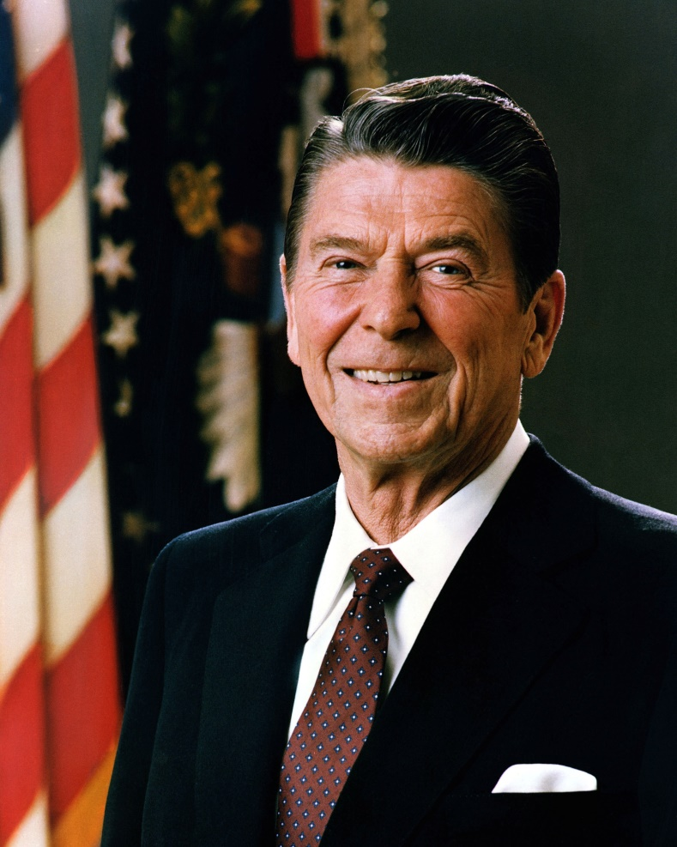
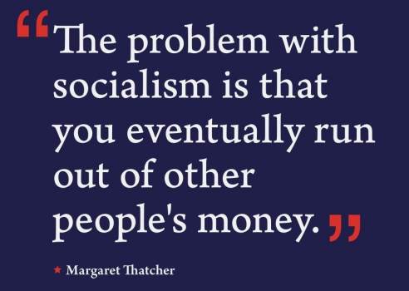
Unit IX: Rise of 1980’s Conservatism & the Modern Era
1980 to Present

Slide 2
Unit Questions and Periodization
Periodization => Why 1980? Why Present?
1980 =____________________________________
Present = No more history to study . . .
Unit Essential Questions . . .
Analyze the rise of the modern conservative movement in the 1980’s by evaluating the extent to which it was a reaction to liberalism in the 1960’s and 70.s.
How did US Cold War policies led to the fall of the Soviet Union in 1989? What role did Ronald Reagan play?
What social & cultural trends influenced the Am. public from 1980 to the present? How did these changes impact the US economy?
Evaluate the US government’s response the terrorist attacks on 9/11, did the US overreach in foreign policy or become too restictive domestically?
How did US immigration policy change post 1965 and what impacts did it have on migration in the post 1980 time period?

Slide 3
The Rise of the Conservative Movement
The election of Ronald Reagan in 1980 signaled the rise of the modern conservative movement => reaction to liberalism of 60’s and 70’s
Q: What issues were central to the 1980’s conservative platform???
#1: Belief in _______________________=> reaction against the liberal programs dating back to FDR & LBJ (i.e. welfare, food stamps, Medicare, etc…)
_________________________________economic philosophy => return to prosperity by cutting taxes and de-regulation (Laissez Faire)
Reagan fashioned “big government” as the foe of the common man, much as FDR had fashioned “big business” as enemy of common man in 1930’s
#2: Reassertion of “________________________________________=> reaction against abortion, pornography, television culture, homosexuality, feminism
Values such as hard work, respect for authority & sanctity of Am family
Advocated by Fundamentalist leaders such as ________________(Liberty U) => founded the _____________________to advance religious goals in govt.
-- Support conservative candidates w/ $$ and voter outreach
-- Agenda included things like prayer in schools, restricted access to abortion
#3: Promotion of American democracy in foreign policy => reaction against détente and perceived weakness of Carter (Iran hostage crisis; Vietnam)
Desired _______________________________=> confront USSR directly

Slide 4
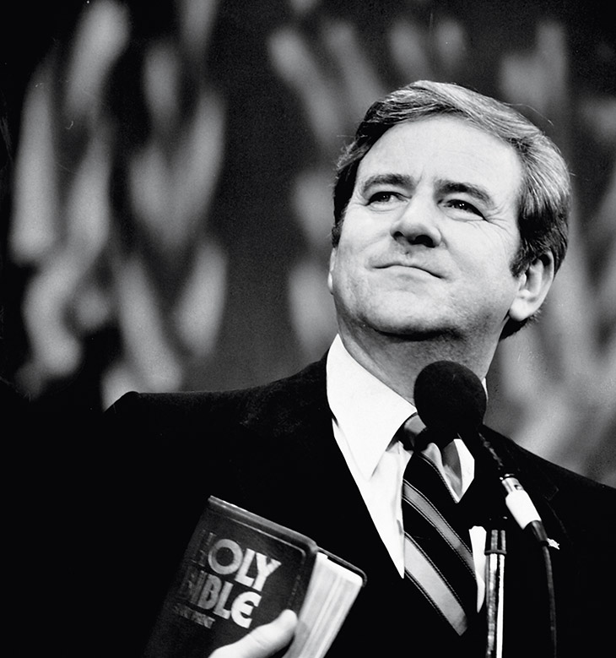
The New Right – The Moral Majority
Jerry Falwell – Founder of Moral Majority

Slide 5
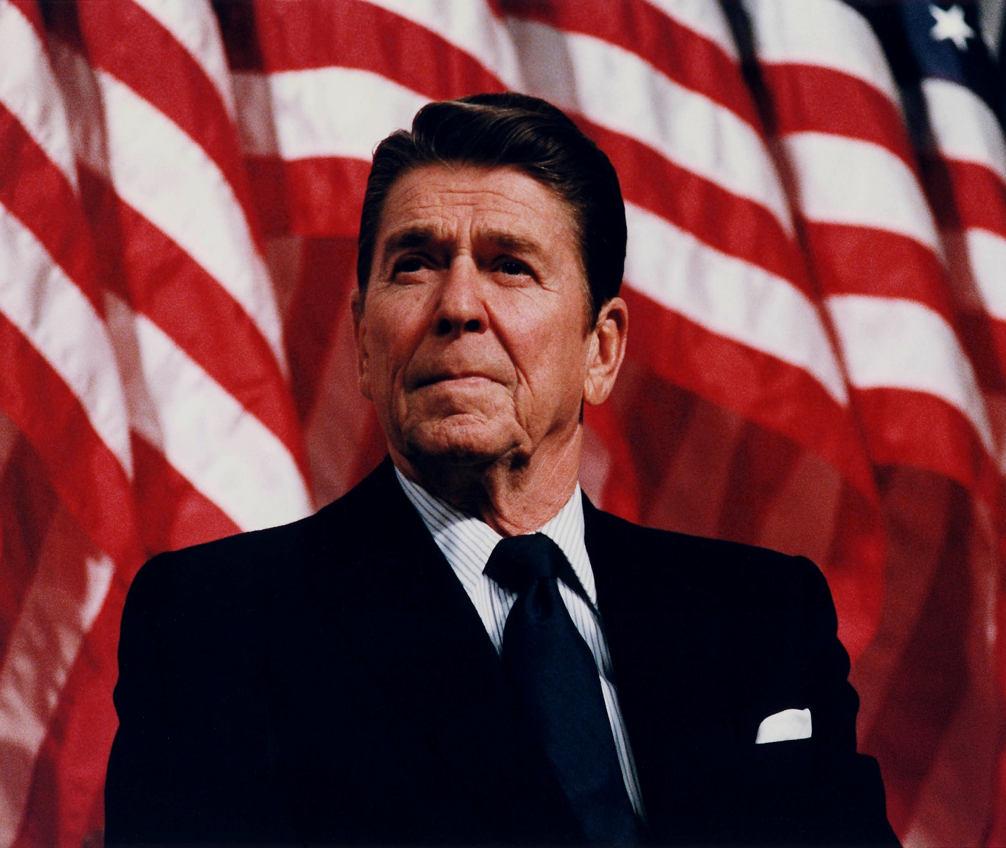
“Government is not the solution to your problems, government is the problem.”
-- Ronald Reagan

Slide 6
Election of Ronald Reagan -- 1980
Regan was a former actor from California and 69 when elected => very charismatic and well liked among public (esp. common man)
Reagan courted the support of the New Right => defeated Carter due to high inflation, Iranian hostage crisis, OPEC embargo & lack of charisma
Once elected Reagan & Republicans pursued Conservative policies on the Natl level
#1: ______________________in 1981 by almost 25% and business taxes by 40% => belief that economic growth would make up lost revenue (“Reaganomics”)
Led to massive budget deficits by the mid 80’s => Reagan responded by raising taxes at least 6 times (still decreased taxes though)
#2: “__________________________” => Reagan (w/ aid of First Lady Nancy), increased penalties for drug dealers, use of CIA to pursue intl dealers
Drug arrests increased over 125% from 1980 to 1990
#3: ______________________=> regulations in transportation (increase competition & promote entry), energy (price competition between suppliers), communications (decrease rules on mergers) and finance (allow banks more investment alternatives)
Many efforts led to economic growth, but some led to economic problems => i.e. Credit default swaps, ARM mortgages (Recession of 2008)
#4: Cuts to ______________Programs => Reagan argued that the social welfare programs of the 60’s and 70’s were ineffective at reducing poverty & cost $$$$

Slide 7
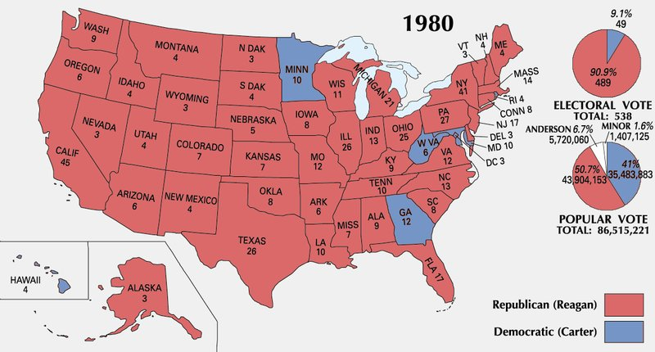
Election of 1980

Slide 8
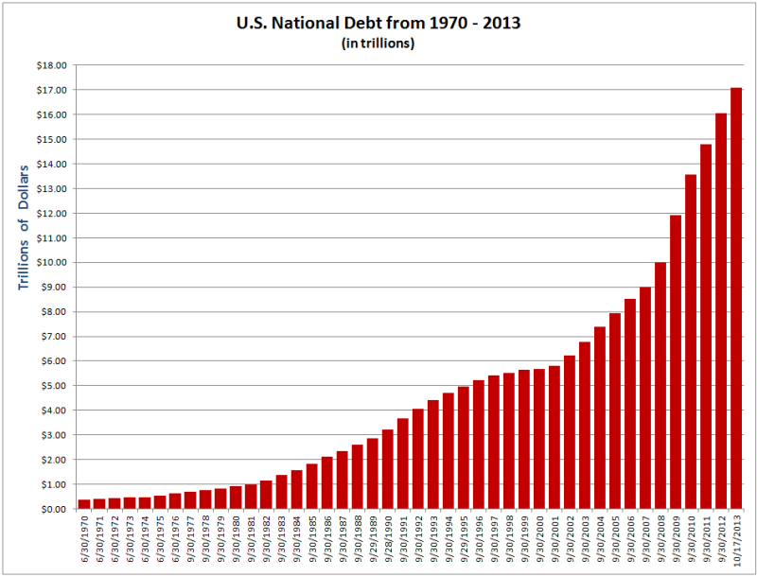
US National Debt – 1970 to Present

Slide 9
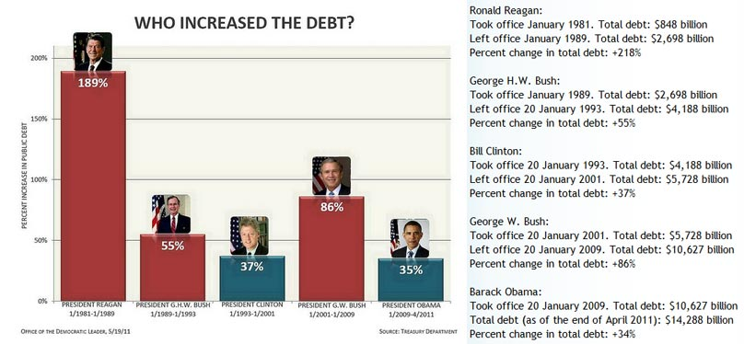
Presidents & Federal Debt

Slide 11
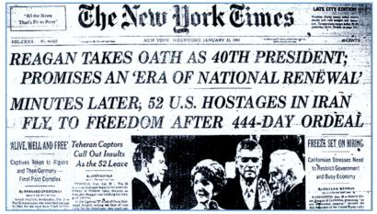
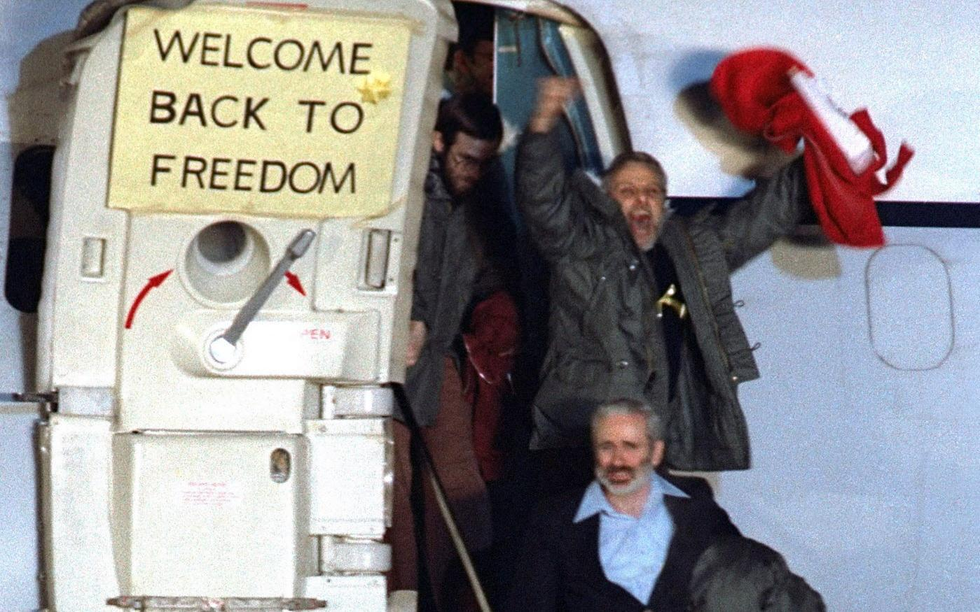
Iranian Hostage Release – Day of Reagan’s Inauguration

Slide 12
Domestic Policy Debates of Modern Era
During the nineties and early 21st century Conservatives continued to push their new agenda & liberals continued to promote theirs . . .
The result was a continuing disagreement over many issues between the two parties => increasing amounts of “partisanship”
#1: Promotion of _______________________=> Bush & Clinton passed _________ N. American Free Trade Agreement eliminated Mexican & Canadian tariffs
Conservatives tout this as economic progress, many liberals believe it has promoted cos moving overseas (esp. manufacturing)
Current disagreement over the CAFTA deal (expansion of NAFTA to C. America) & TPP (Trans Pacific Partnership)
#2: Size & Scope of government safety net => Reagan and conservatives during the 80’s attempted to slash $35B from welfare programs in 1981
Cut Welfare benefits in 80’s, Welfare reform in 1996 led to “______________” => look for work, limit years on benefits, restrict immigrant access
However, despite rapidly increasing spending welfare programs remained popular & were impossible to eliminate => reform efforts difficult
-- GW Bush added prescriptions drugs to Medicare in 2006
Costs skyrocket with “_____________________” => leads to need for reform but lack of political compromise needed to ensure it

Slide 13
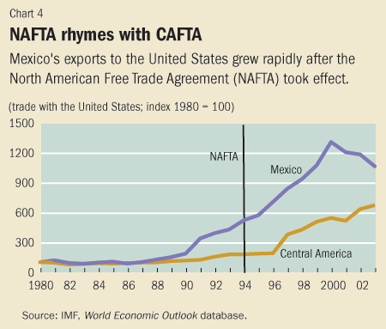
NAFTA’s Impact on Mexican Exports

Slide 14
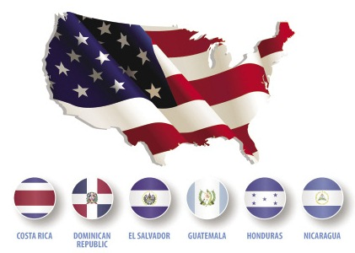
CAFTA nations

Slide 15
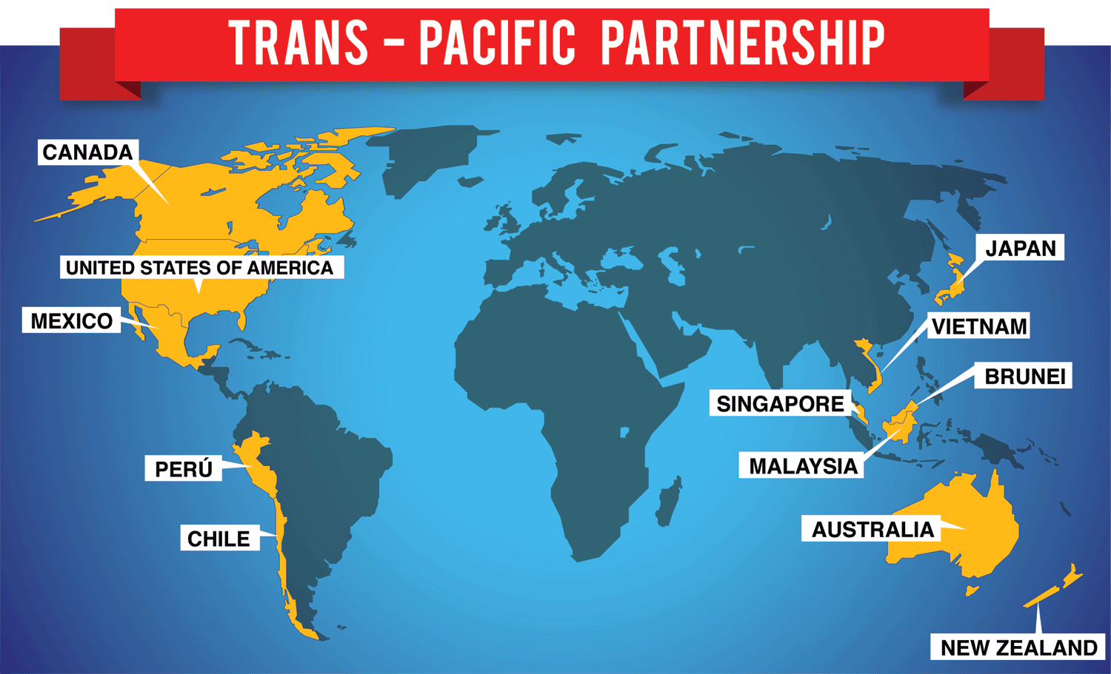
Trans-Pacific Partnership

Slide 16
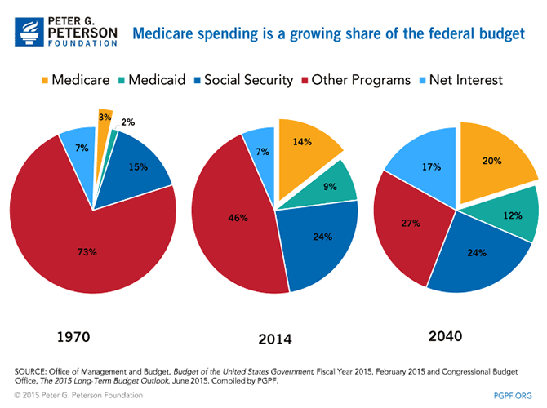
Growing Entitlement Spending

Slide 17
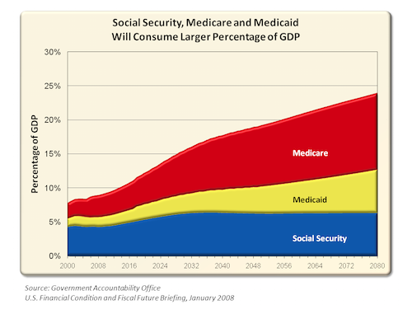
Rising Costs of Entitlement Programs

Slide 18
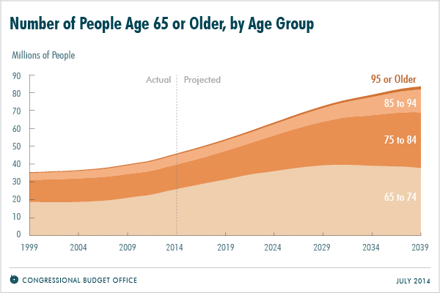
Demographic Trend in the 21st Century – “Graying of America”

Slide 19
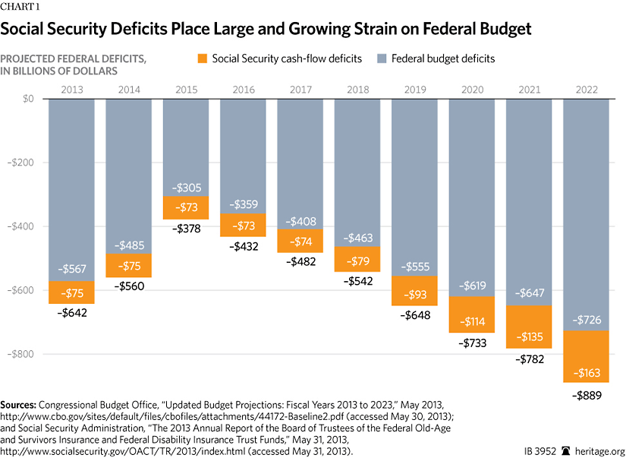
Social Security Deficits – 2013 to 2023

Slide 20
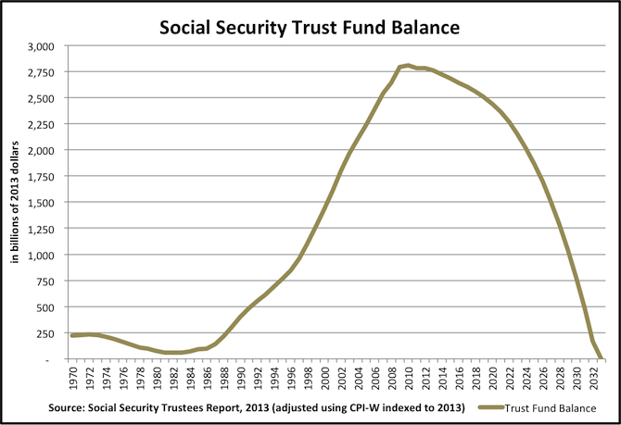
Social Security Trust Fund Balance

Slide 21
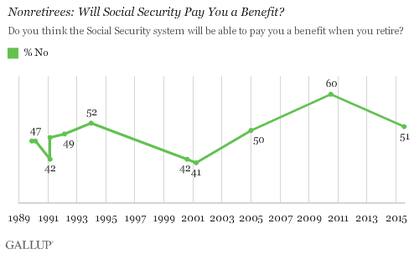
Eroding Popular Trust in Social Security

Slide 22
Domestic Policy Debates of Modern Era
#3: ___________________=> regulatory framework set up in 1930’s (Glass Steagall) was torn up by 1980’s deregulation . . . Banks invest in riskier items
Size of banks grows very large (i.e. Chase, Citi, WF, Bank of America, Bancorp control 50% of all assets; $15T) => “too big to fail”
-- Huge bank bailouts in 2008 mortgage crisis leads to calls for reform
#4: Issues involving __________________=> political parties tended to develop different constituencies and therefore attitudes about minority issues
Republicans = middle aged and elderly, white, Christian
Democrats = younger, black & Latino, more secular
Affirmative action became a hot button issue => __________________ ___________case ruled racial quotas in college admissions unconstitutional
Policing of black neighborhoods also became controversial at various points => “War on Drugs” = war on black neighborhoods?
_______________(LA) led many to question the racial makeup of police forces & other cases reinforced this (____________________________)
Calls for greater gun control also met mixed results => __________banned assault weapons, but rejected in recent years after school shootings
Columbine, Sandy Hook, etc……

Slide 24
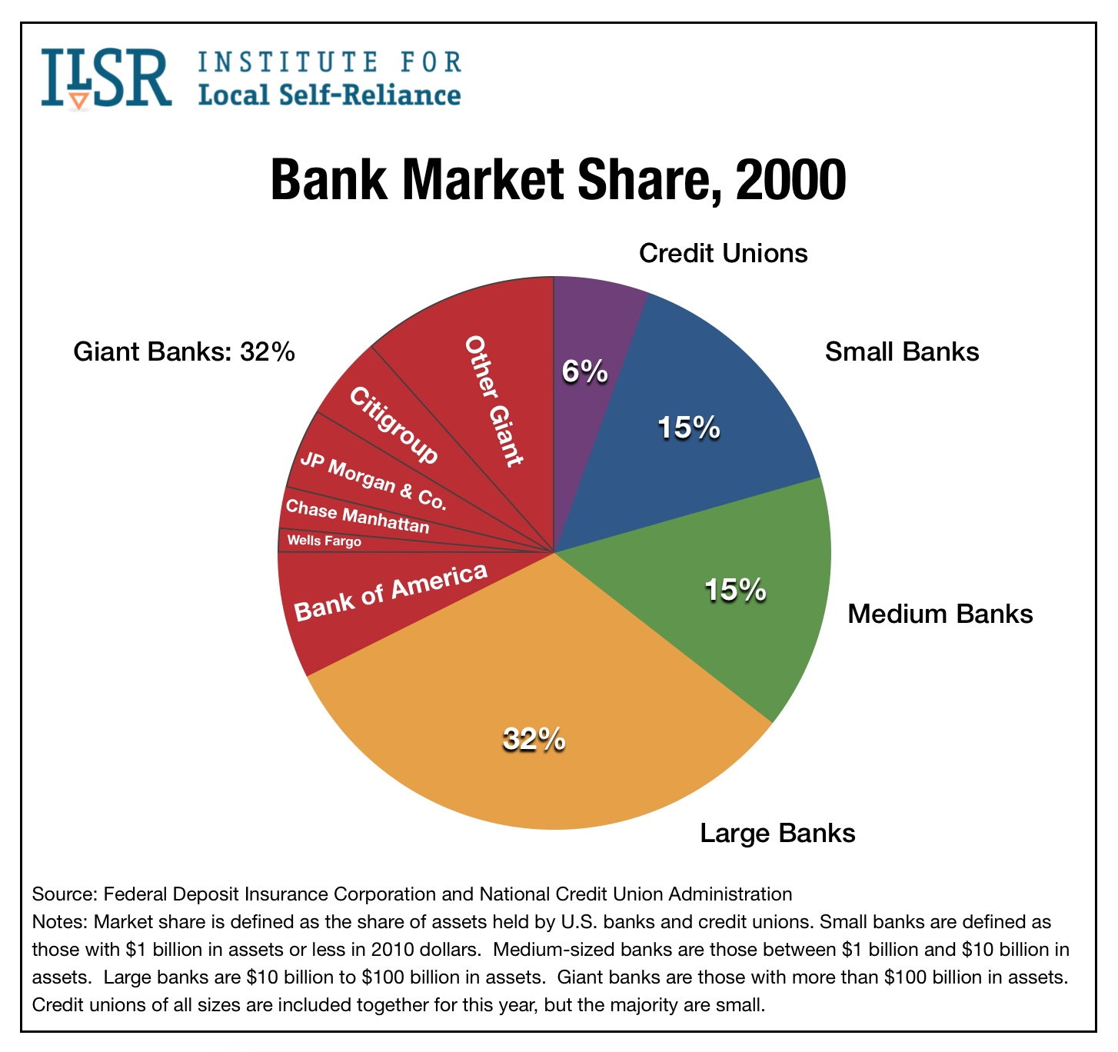

Slide 25
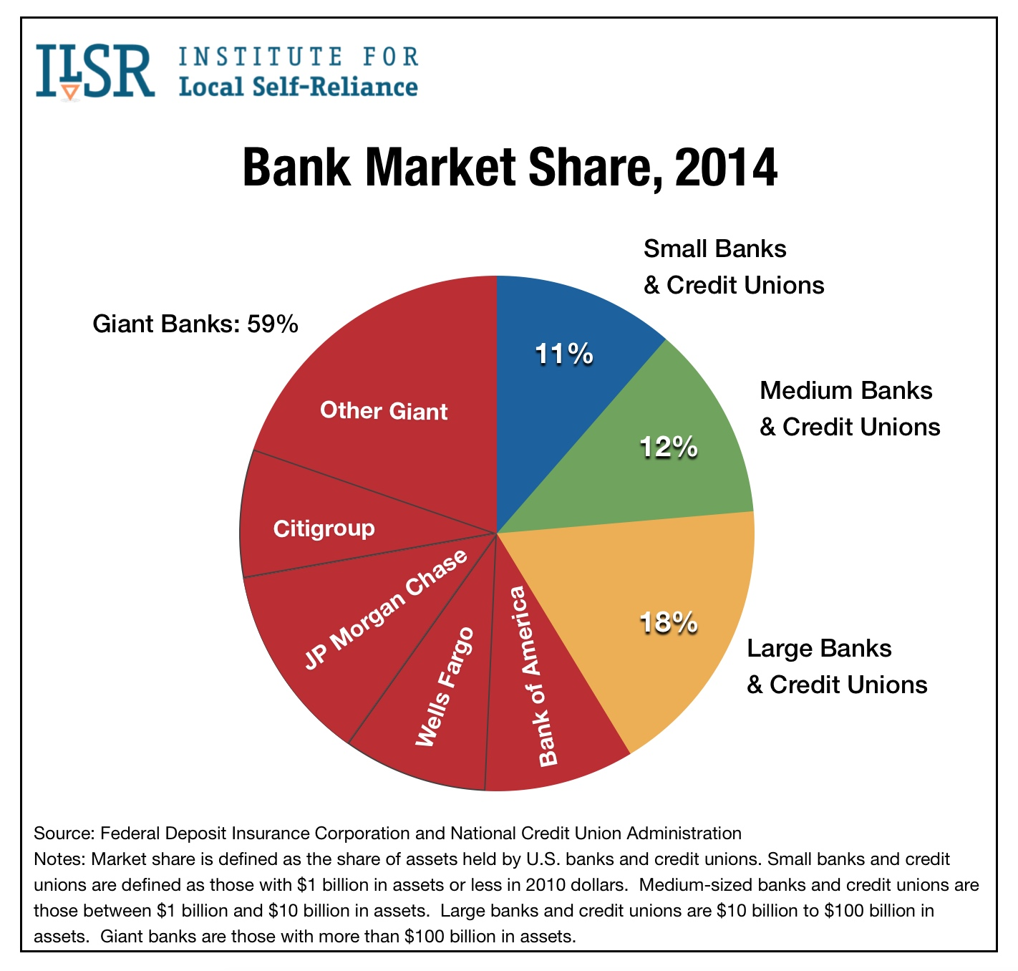

Slide 26
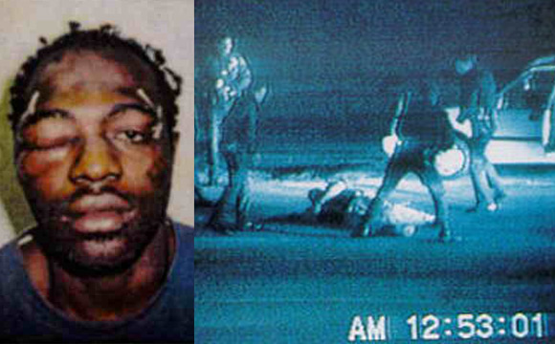
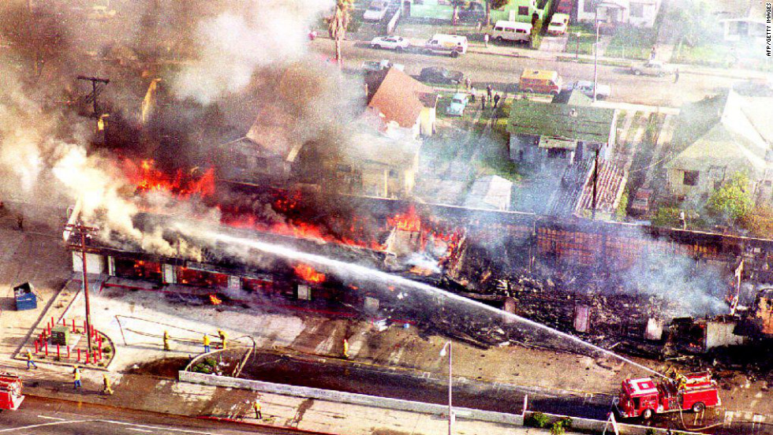
Rodney King Case (1991)
The acquittal of four white LAPD officers in the beating of Rodney King in 1992 caused rioting throughout LA that left 25 dead & over 1000 properties burned

Slide 27
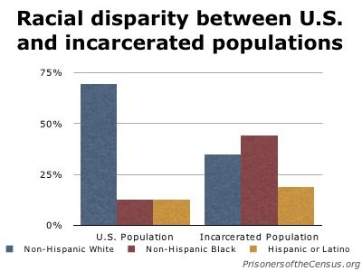
Racial Disparities in crime statistics

Slide 28
Domestic Policy Debates of Modern Era
#5: Gender Roles, Gender Issues and Family structures
Access to abortion services continued to be a controversial issue => Democrats desired a right to choose, Republicans pro-life
Since Roe v Wade conservatives have fought to restrict abortion rights
-- _________________________decision said states could restrict access to abortion if it did not “unduly burden women”
Post 1980 the ideology of the Cult of Domesticity significantly weakened => more egalitarian familial roles promoted (“Stay at home dads”)
Many Christian groups lamented the decline of family values as divorce rates increased => _______________________(James Dobson)
The issue of same sex marriage also became increasingly controversial
Same sex couples claimed they had the right to marry => equal rights, access to medical benefits, raising families
Christian groups generally opposed same sex marriage => biblical definition of marriage, domestic partnerships option . . .
1990’s “Don’t Ask, Don’t Tell Policy” left federal position very ambigious
______________________legalized same sex marriage in US

Slide 29
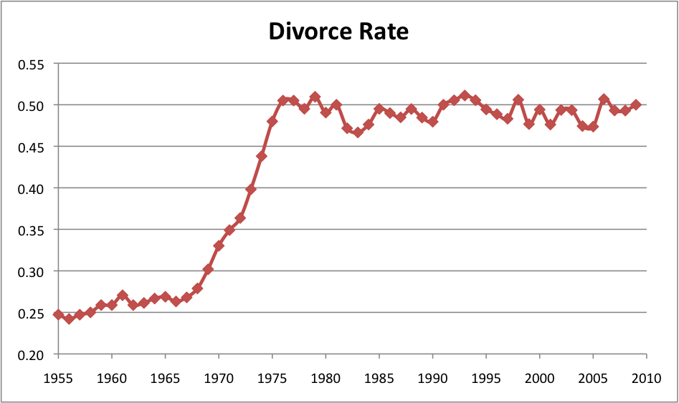
US Divorce Rate – 1955 through 2010

Slide 30
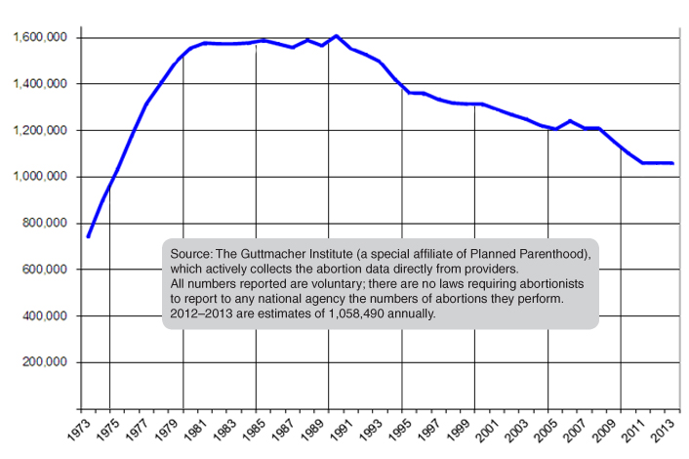
Abortions in the US per year – 1973 to present

Slide 31
Technological, Economic & Demographic changes
In the late 20th and early 21st century the US experienced significant technological, economic and demographic changes . . .
#1: Technological Changes
__________________________=> first modern computers were created during WWII as code breaking machines
After WWII US Govt funded reaserch at Universities into digital computer development (reducing size, increasing calcualtions, military applications)
By the 1980’s computers like Apple II and IBM had become usable by average user => 1990’s saw invention of email communication
“__________________” => started as a US Govt program (1960’s) to communicate via computer in case of a Soviet missile attack that disabled phones
By 1980’s programmers had invented languages and protocols that allowed international communication (TCP/IP)
-- _______________________browser made internet accessible to commoners & US Govt in 1991 promoted internet commerce
___________________________=> the first cell phones came out in the 1980’s but cost $1,000’s and had poor performance
1990’s = 1st commercially accessible cell phones (Nokia & Motorola)
2003 Apple Iphone gave consumers access to internet, email communication
By 2015 the access and scope of digital communications networks expanded => over ______% of Americans have cell phones, access to internet & personal computer

Slide 32
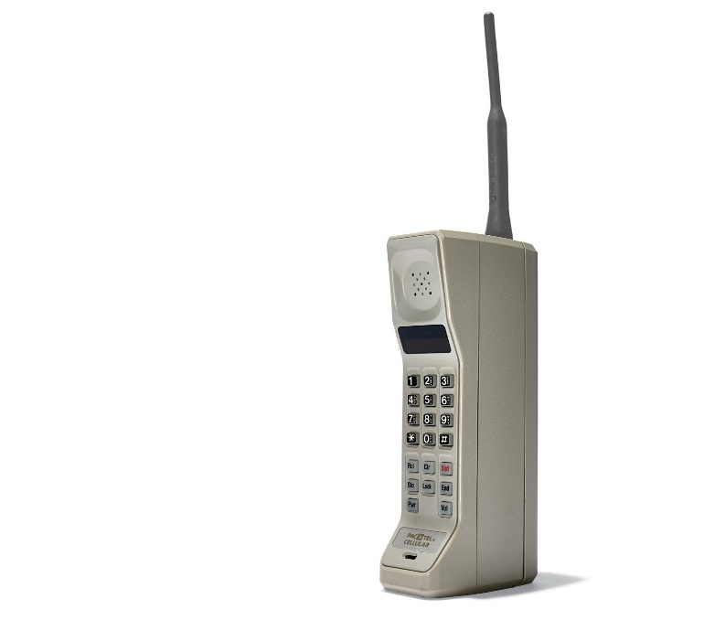
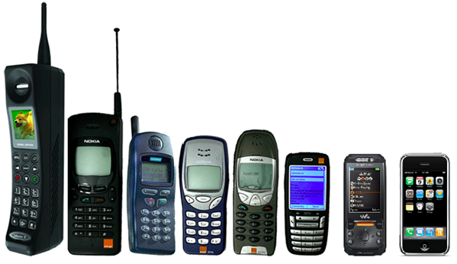
Mobile Phone history
The world’s 1st mobile phone was the Motorola DynaTEC 8000X => weighed about 3 pounds, required 6 hours to charge and had 30 minutes of talk time. It cost $6,000.

Slide 33
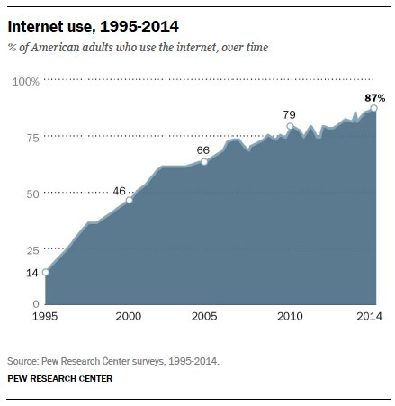
Internet Usage in the United States

Slide 34
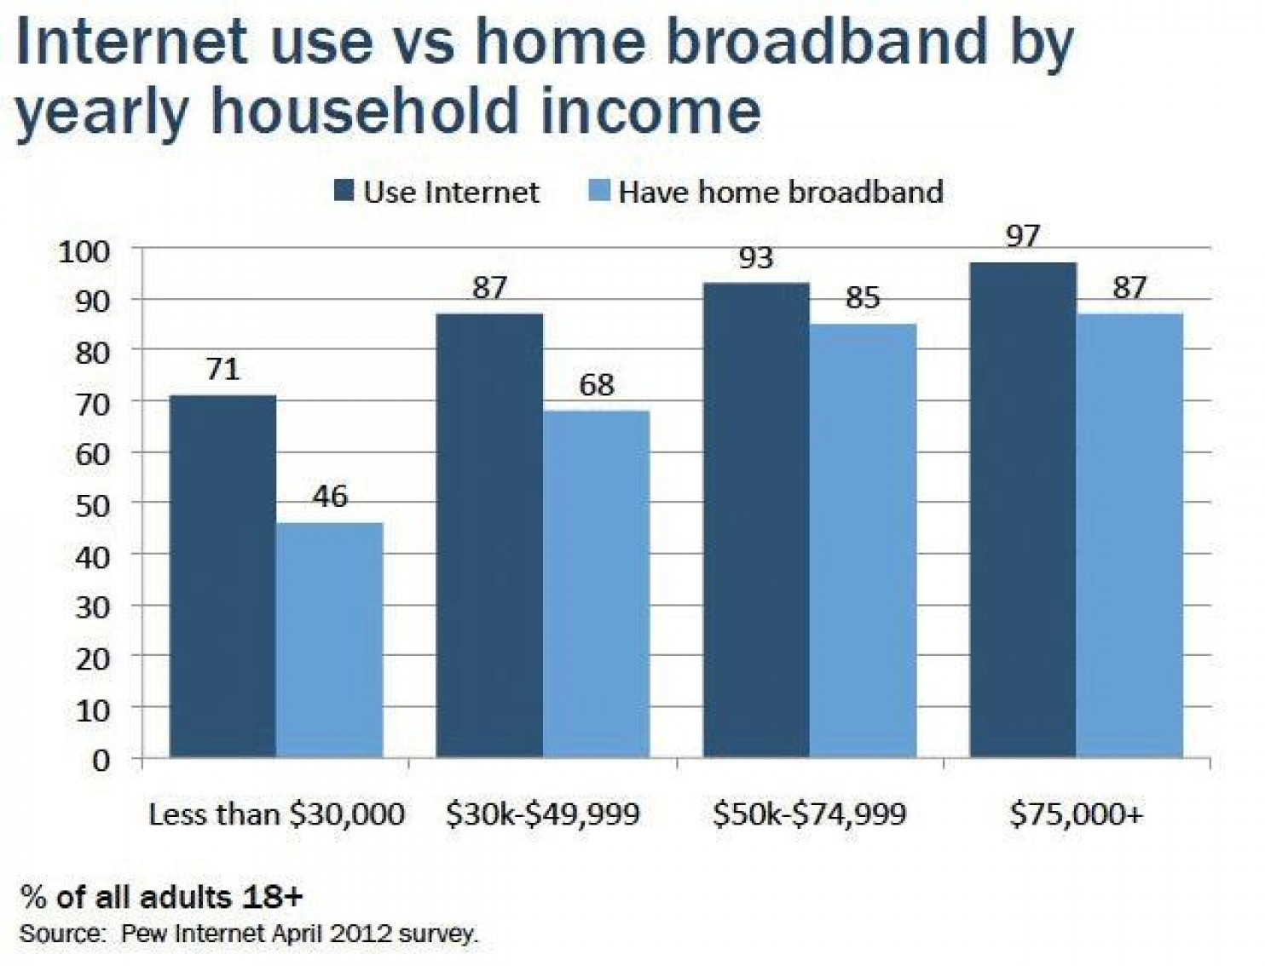
Internet Usage based on income level

Slide 35
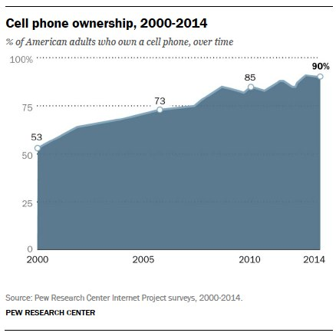
Cell Phone ownership in US

Slide 36
Technological, Economic & Demographic changes
In the period post 1980 technological changes continue to have significant impacts on the American economy, social behavior and cultural trends
Socially the ubiquity of cell phones and the internet have increased the forms & rapidity of communication => email, texts, facetime . . .
-- Internet has also given rise to social networks such as_________________, Twitter, Snapchat, Instagram => message and photo sharing
Economically, the Internet has led to mass commerce on a global scale
Sites like Amazon, Ebay & Paypal allow the instantaneous transfer of $$ around the globe between consumers
GDP share of US economy is ~ _____% and growing (3M jobs)=> size of global internet economy is over $5T
Internet services like _____________________have also changed US entertainment industry => digital & streaming content > TV content
#2: Economic Changes => Post 1970 the US economy has shifted from ___________ __________________________
Why? => Manufacturing jobs have declined due to a variety of factors and service employment has increased
Manufacturing decline => Outsourcing, technological losses (i.e. machines)
Service increase => growth of service sector industries (i.e. government, healthcare, retail stores, technology, education . . .)

Slide 37
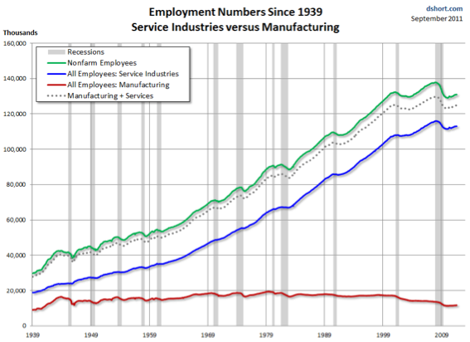
Service vs Manufacturing Jobs in US
In 1945 Manufacturing accounted for 4 times as many jobs as service sector jobs; by 2000 that ratio was reversed

Slide 38
Technological, Economic & Demographic changes
Exs of manufacturing decline can be seen in the US auto industry and US steel industry
Shift to service sector employment has required more education for average American worker
Due to the decline in manufacturing Union membership in the US has declined significantly and the power of Union labor has decreased
Most of the decline can be seen in manufacturing Unions (i.e. United Auto Workers) => public perception of Union leaders turned negative
-- Union leaders like Jimmy Hoffa were rumored to have ties to Mafia
-- Corporations developed anti-Union attitudes => i.e. Walmart
Due to the shift to service sector employment and decline of Unions, since 1980 the real wage of American workers has stagnated
Rising costs in education, healthcare & energy have further hurt workers
________________________is nearly at an all time American high => wealthiest 1% control over 50% of American wealth

Slide 39
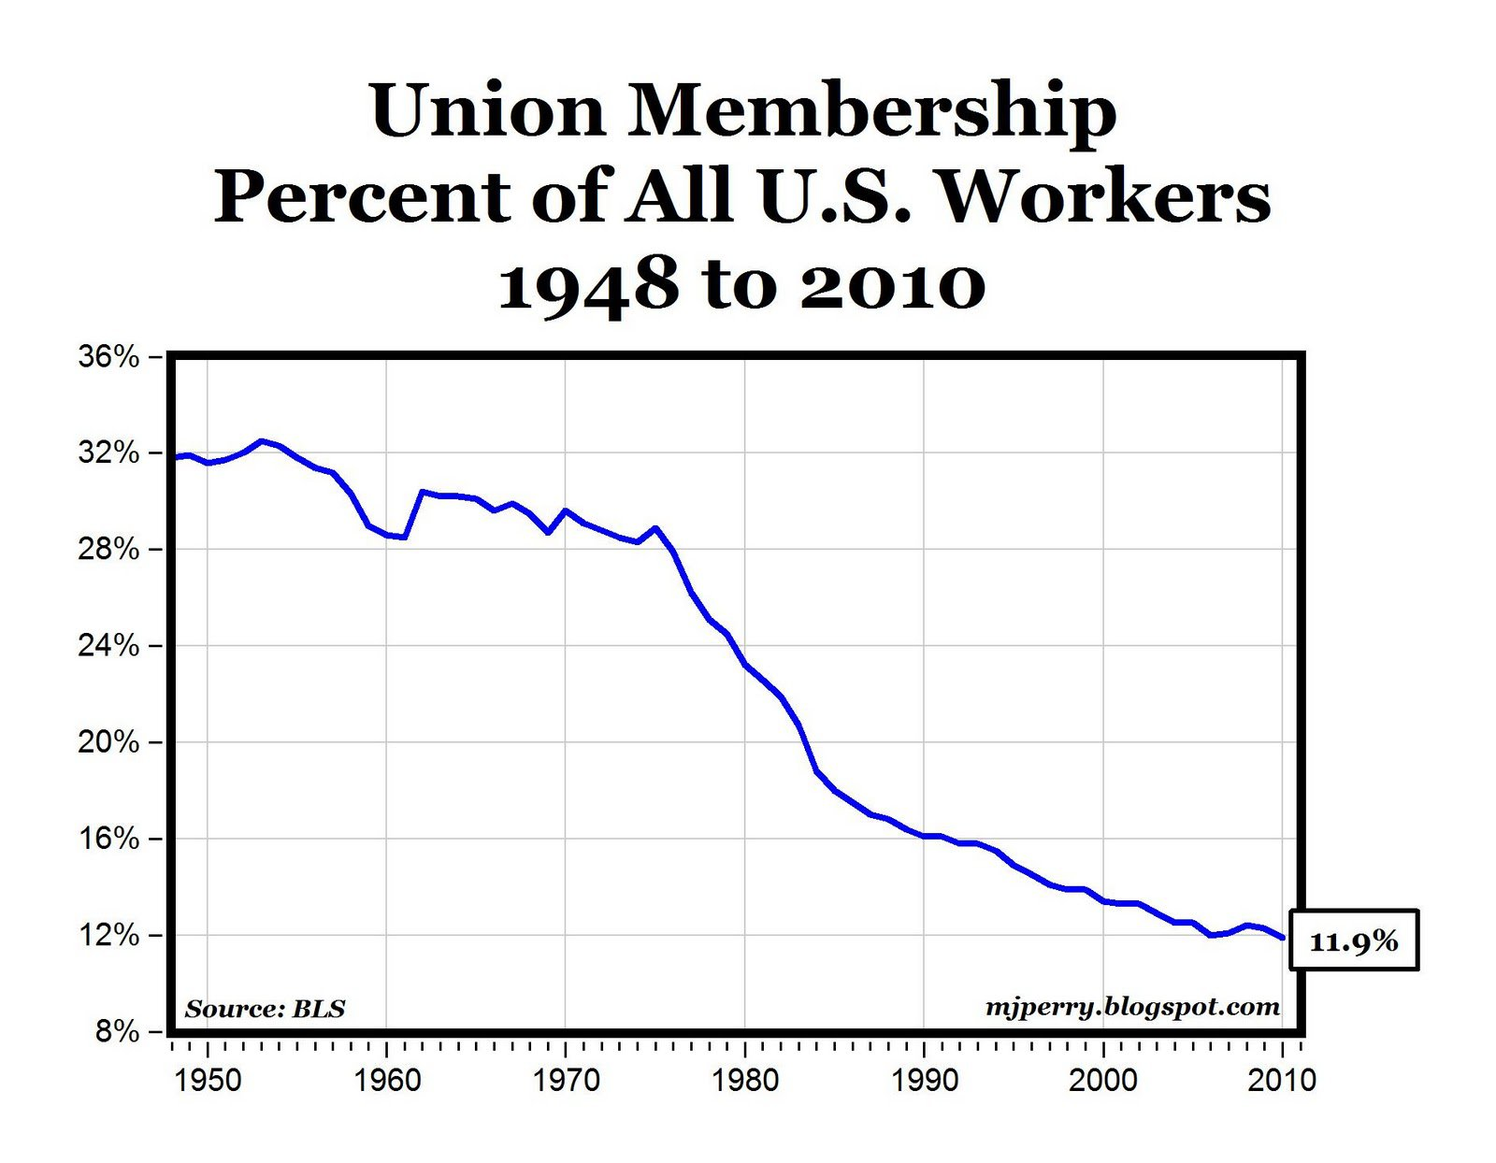

Slide 40
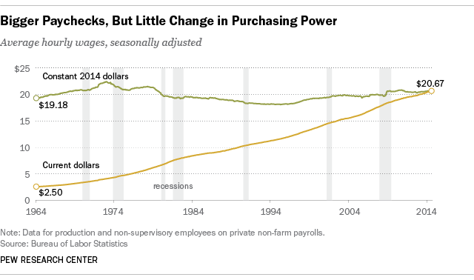
Real Wage of American Worker since 1964

Slide 41
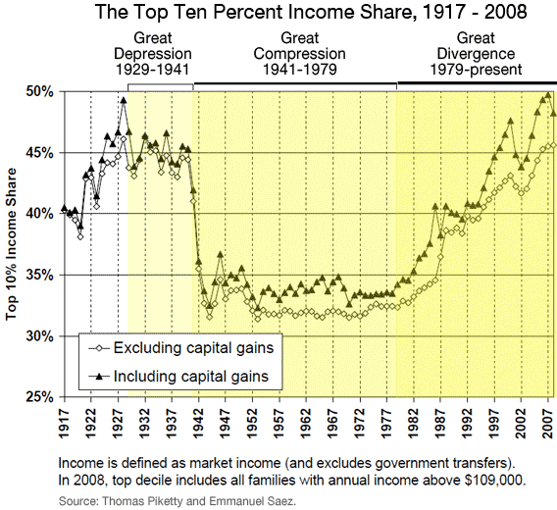

Slide 42
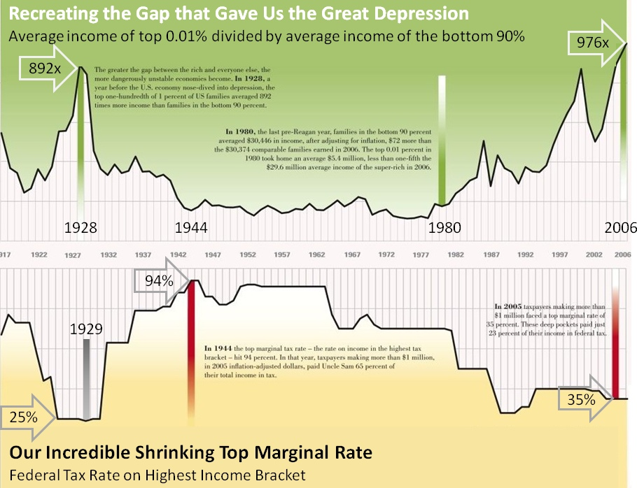

Slide 43
Technological, Economic & Demographic changes
#3: Demographic Changes => migration & Immigration continued to occur post 1980, but in somewhat different ways . . .
Internal migration to the ____________________________continued to occur => Q: Why??? (Graying of America, technology industry)
Political => all Presidents since 1964 have come from Sunbelt
Cultural => growth of population leads to SW cultural influence in America (i.e. food => Chipotle)
Economic => growth of technology sector centered in Silicon Valley
Post 1965 immigration from Latin America and Asia increased significantly
_____________________________________eliminates quota system & gives preference to reuniting families & educated professionals
-- Educated Chinese, Indians & Filipinos immigrate in high numbers
____________________________reformed immigration law in following ways
-- Required employers to attest to immigration status of employees
-- Made it illegal to recruit illegal immigrants
-- Legalized certain seasonal illegal immigrants
-- Legalized illegal immigrants who lived in the US prior to 1982 IF they paid back taxes, admitted guilt, paid a fine & proved they were not guilty of crimes (4M)

Slide 44
Technological, Economic & Demographic changes
New immigration policies led to the mass migration of many Latin American peoples to the US (esp. Mexican)
Q: Why? => job opportunities, drug related violence in Mexico and unstable Central American governments
Immigrants are a vital part of the US labor force (20% total) & are highly represented in______________________________________________
-- Many immigrants also work in the healthcare, technology and life sciences industries => advanced degrees
However, the state of US immigration policy and the high number of undocumented immigrants have created contentious policy debates
Some favor a guest worker program for immigrants workers & a path to legalization (fines, taxes, etc…) for ~ 15M illegals living in the US
Others want a far stricter immigration policy => aggressive border control (Wall???) & deportation for illegals in the US

Slide 45
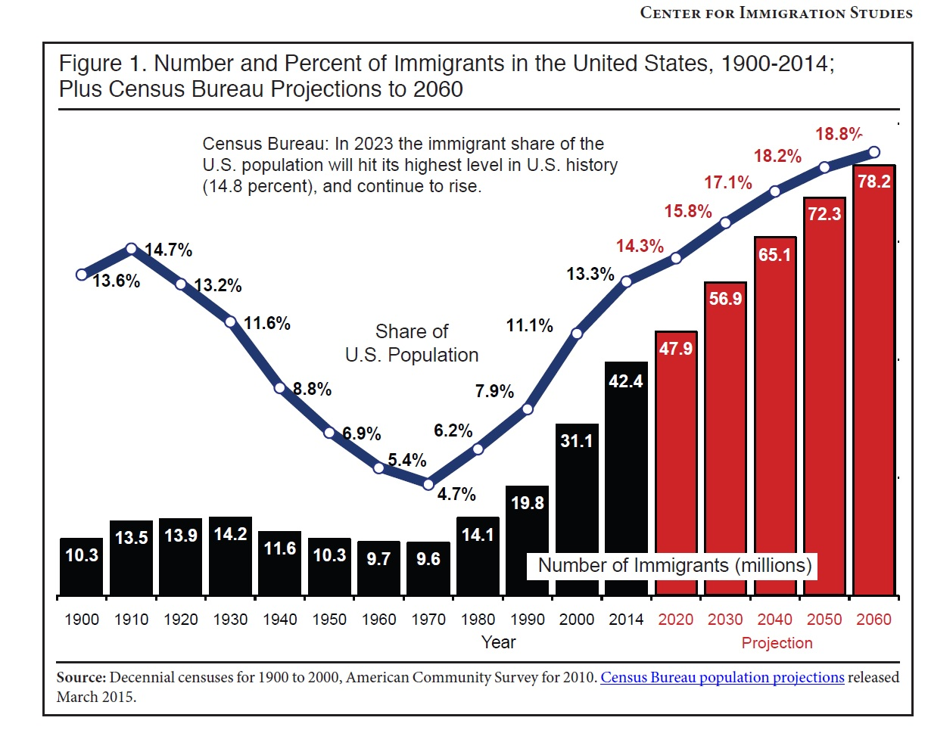
The US immigrant population has doubled since 1990 and tripled since 1980 => 2000-2010 is the highest decade of immigration in US history

Slide 46
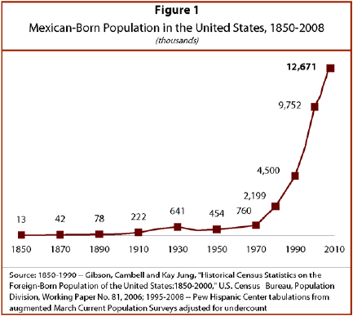
Mexican Born Population in the US

Slide 47
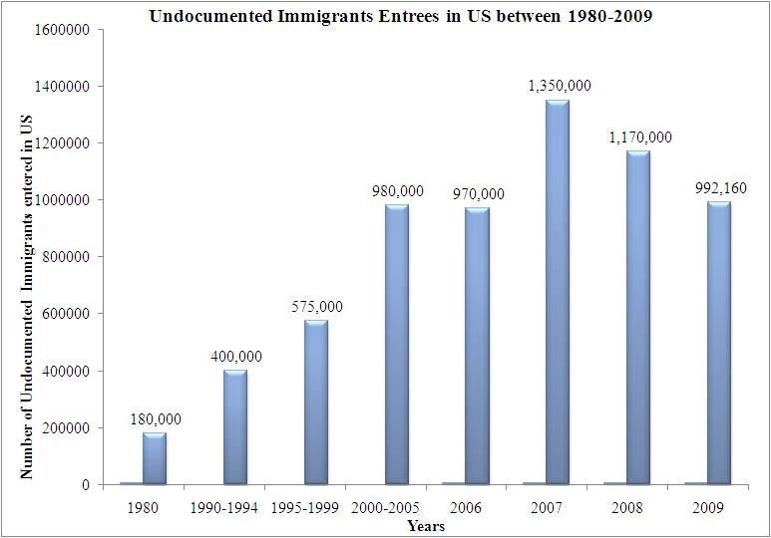
Estimated Undocumented Illegal Immigrants 1980-2010

Slide 48
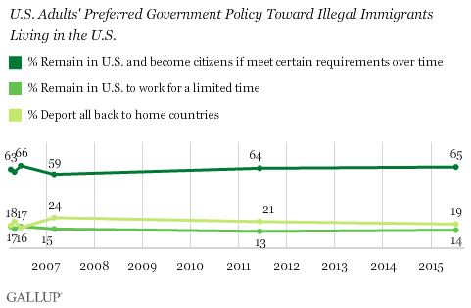
US Public Opinion on Immigration Policy

Slide 49
Foreign Policy of the 1980’s and 90’s
Reagan promoted an interventionist foreign policy => goal to end Cold War
#1: ____________________speech => ended years of Détente & negotiation w/ USSR in 1983 by referring to the USSR as “Evil Empire”
#2: Limited Military interventions => supported anticommunist groups in Latin America & Afghanistan
Supported right wing guerillas named ________________in Nicaragua in their attempt to overthrow Sandinista government
-- Ignored congressional acts to forbid it => led to Iran Contra scandal
CIA supported ($$, arms) the mujahideen in their war against the USSR in Afghanistan => became __________________________(Osama Bin Laden)
Sent troops into Lebanon to keep the peace
#3: Military Buildup => Reagan believed the USSR was economically weak, cheating on SALT & wanted to cause their collapse w/ a new arms buildup
Increased military budget by 40% & poured $$ into new research => initiated ____________________________________________________program
-- Laser anti-missile system that threatened MAD balance of power
#4: Diplomacy => initiated a new round of arms talks in 1982 called __________
Goal = reduce the size of nuclear stockpiles

Slide 50
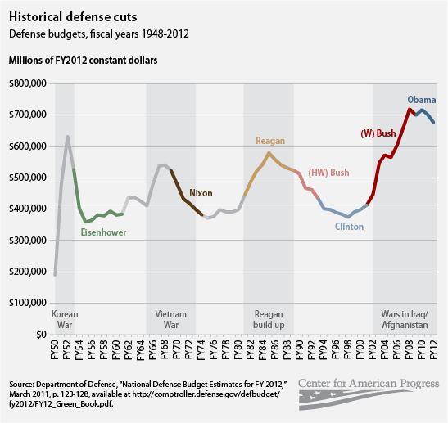
Defense Spending During the Cold War

Slide 51
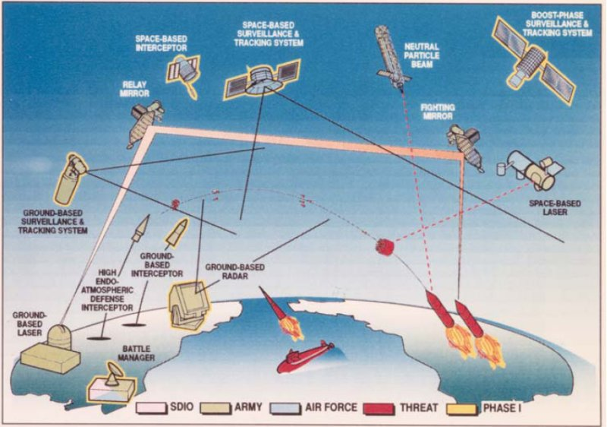
Strategic Defense Initiative – Star Wars

Slide 52
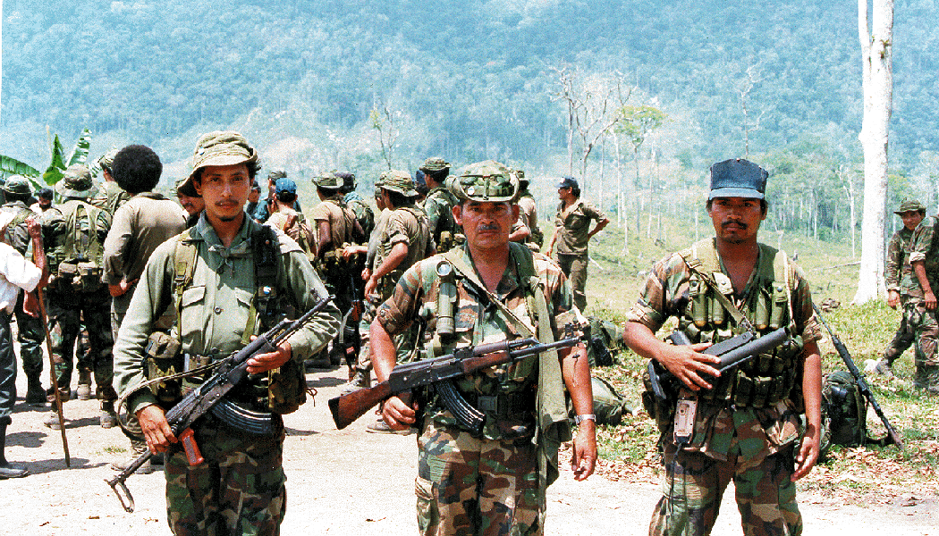
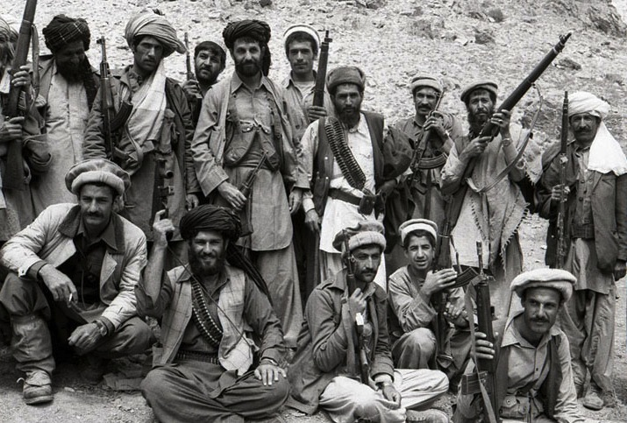
1980’s “Freedom Fighters”

Slide 53
Foreign Policy of the 1980’s and 90’s
Due to the cost of the new arms buildup, the war in Afghanistan & the military presence in E. Europe the USSR started to collapse in the mid 80’s
Mikhail Gorbachev becomes USSR leader in 1985 => institutes _________ __________________________(openess in economy and politics)
-- Soviet republics start to break away from USSR (Lithuania & Ukraine), others elect non-Communist leaders (Poland, Czechoslovakia)
_____________________torn down in 1989 as USSR abandons E Europe => USSR ceases to exist in 1989
Post Cold War the US grapples with new foreign policy paradigms => downsizing US military? Continued interventionism?
Some military downsizing occurs (_________________________=> base closures) but MIC is hard to eliminate entirely
During 1990’s US continues to intervene in peacekeeping missions to protect US interests & stop genocide
-- _____________________(1991) => evict Saddam Hussein from Kuwait and preserve access to oil (does not eliminate Saddam from power)
-- US commits troops to ________________________________=> stop genocide, civil wars and reduce casualties (some UN efforts)
-- US DID NOT intervene in Rwandan genocide prompting criticism

Slide 54
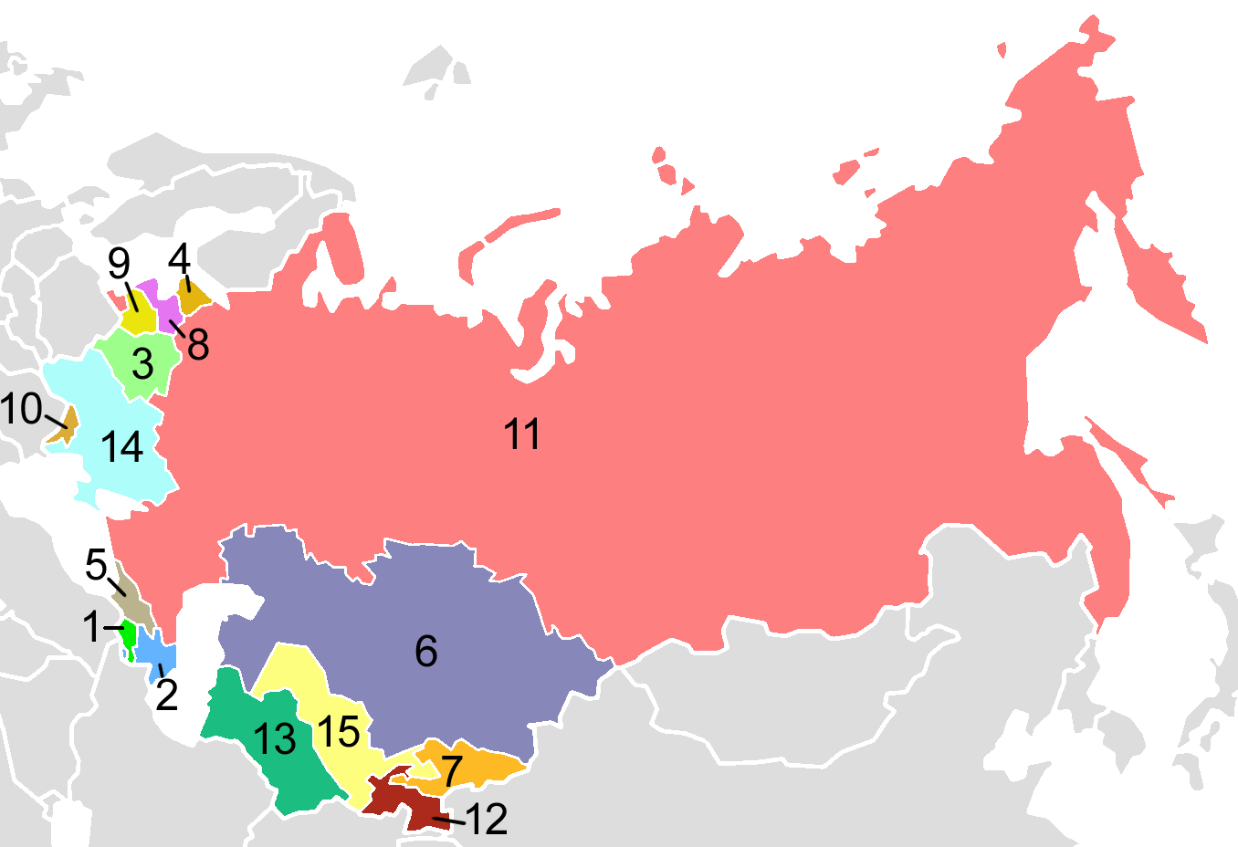
Dissolution of the USSR

Slide 55
US War on Terrorism
On Sept 11th 2001 (9/11) Islamic terrorists (Al Qaeda) under the leadership of Osama Bin Laden hijacked commercial airliners and flew them into the World Trade Center (NYC) and the Pentagon
After this the US declared war on terrorist networks and started a broad effort to weaken terrorist networks and sympathetic states
#1: _____________________=> GW Bush identified Iran, Iraq and N Korea as a new “Axis of Evil” and vowed to eliminate or weaken terror supporting states
Economic sanctions against Iran & N Korea => weaken oil exports
____________________________(2002-present) => US deposed Taliban and took away terrorist training grounds
Terrorists migrated to Pakistan and Afghan mountains => difficult to track down and eliminate
Afghan government remained unstable and weak
_________________ (2003-2011) => Bush argued that Iraq was developing ______
Invaded in 2003 and deposed Saddam Hussein (executed) => US attempted to install and develop democratic govt in Iraq
US got bogged down in Iraqi civil strife between Sunni and Shia groups => Al Qaeda, ISIS and other terrorist groups prevented stability
War efforts became lengthy, costly and unpopular on the homefront

Slide 56
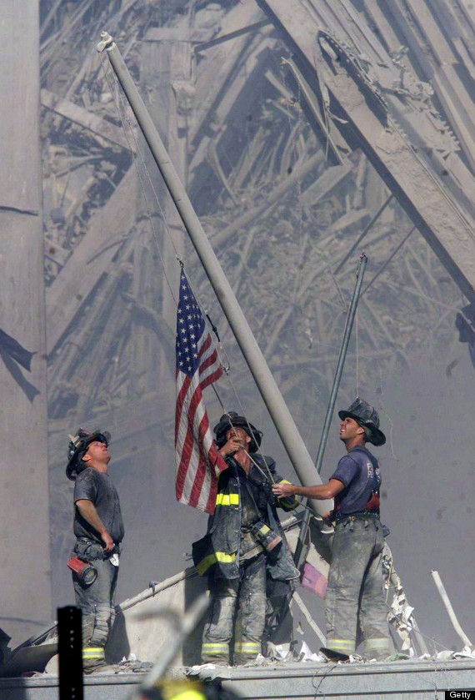
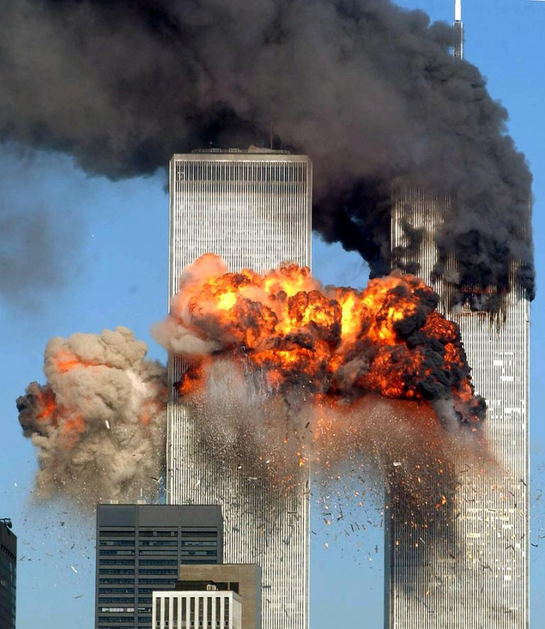
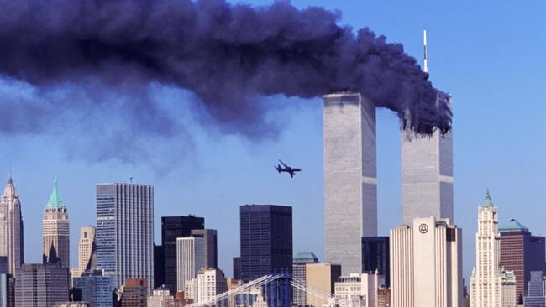
September 11th 2001

Slide 57
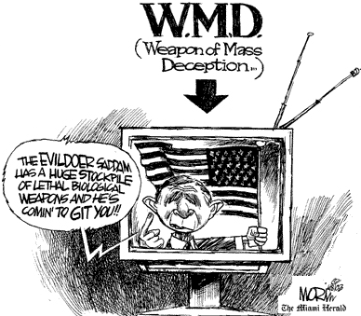
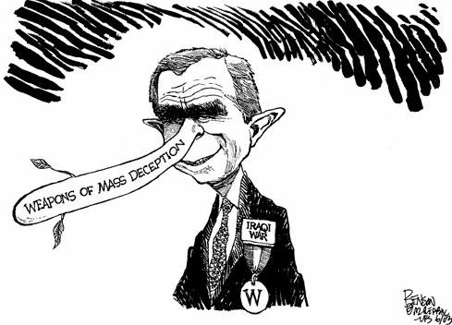
Weapons of Mass Destruction??

Slide 58
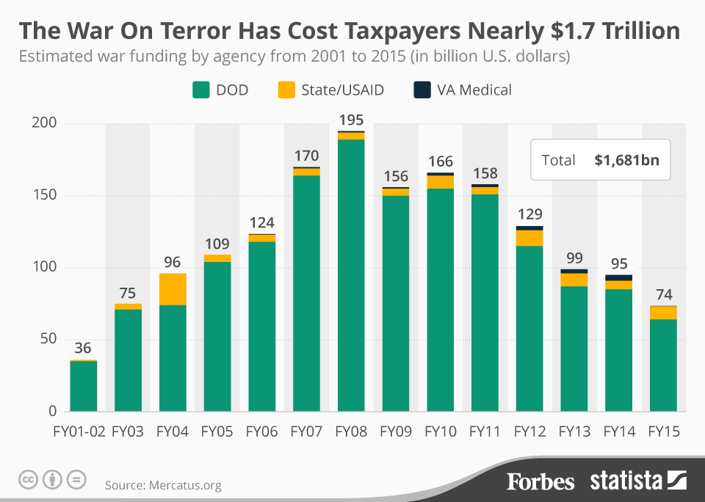

Slide 60
US War on Terrorism
#2: Domestic Efforts => US moved post 9/11 to shore up security and prevent another terrorist attack; ________________________established
Formation of _____(Transportation Safety Adm) => inspect passengers boarding planes (metal detectors, body scanners), Air Marshalls
Passage of ________________=> act which expands authority of NSA, FBI
Search and seizures of property w/o knowledge (delayed S&S)
Ability to freeze assets of terrorists or suspected terrorists
_________________=> allows NSA to listen to wide range of phone calls w/o warrants, collect records of individuals & create phone database
Detention and “enhanced interrogation” of suspected terrorists
Guantanamo Bay Cuba and “black sites” were used to ____________ suspected terrorists and obtain info to prevent attacks & find terrorists
-- Abu Ghirab prison scandal in Iraq exposed tortorous behavior of US prison personnel in Iraq
Many in the US questioned the legality of the Patriot Act provisions and various CIA & NSA statements were proven inaccurate
Waterboarding extent, domestic wiretapping => much exposed by rogue analysts like______________________

Slide 61
Waterboarding Some prisoners like Khalid Shiekh Mohammad (KSM) were waterboarded over 183 times

Slide 62
Homeland Security Terror Alert System

Slide 63
4th Amendment to US Constitution

Slide 64
Patriot Act Sneak Peek program

Slide 65
Abu Gharaib Prison Scandal

Slide 66
Edward Snowden – Patriot or Traitor?
In 2013 Snowden left his NSA contracting job in Hawaii and fled to China and Russia => he had copied 1000’s of pages of classified documents revealing the extent of the US’s counter-terrorism program & leaked the info to various news outlets over the next years
Implicated the US government in conducting undisclosed domestic wiretapping
Implicated telecomm cos in complying with govt programs

Slide 67
Fossil Fuel Debates
In the 21st century many in the US became concerned about Americans dependence on fossil fuels
The Iraq war and climate scientists warnings about global warming concerned many => 2014 & 15 warmest years ever recorded
The government and commercial response was significant and sometimes contentious . . .
#1: Involvement in International treaties
The US helped to negotiate _______________________in 1997 but Congress refused to ratify it (US one of 3 nations => Afghanistan, Sudan)
Many were concerned it would slow US economic growth & that developing nations would not be bound to the same provisions
US did sign the Paris climate change protocol in 2015
#2: Improved fuel standards for US automobiles
Obama adm passed emissions standards that set fleet averages to 54.5 mpg in 2025 => 12 B barrels of oil saved
#3: _____________________________=> vehicles capable of using electricity became popular and marketed by many auto companies
Exs: Toyota Prius, Chevy Volt, Tesla

Slide 68
Federal Fuel Standards – fleet averages

Slide 70
The US in the future????
In the 21st century the US has already faced very significant challenges, but remains the world’s leading superpower . . .

Slide 71
US Military Interventions since WWII

