Slide 1
AP World History Unit VI – the Modern World
1900 to Present Day

Slide 2
Unit Questions & Periodization
Why 1900? (1914??)
_____________________________________________________=> i.e. World Wars I & II
Some historians call 1789-1914 the “long century” => Why???
Major Unit Questions
#1: How did World Wars I & II represent a new kind of “total war”? How did industrialization impact modern warfare? Give examples from both events.
#2: Analyze continuities and changes in cultural beliefs and practices in ONE of the following regions from 1450 to the present. • Sub-Saharan Africa • Latin America/Caribbean
#3: Compare the emergence of nation-states in nineteenth-century Latin America with the emergence of nation-states in ONE of the following regions in the twentieth century. • Sub-Saharan Africa • The Middle East
#4: Analyze continuities and changes in nationalist ideology and practice in ONE of the following regions from the First World War to the present: • Middle East • Southeast Asia • Sub-Saharan Africa
#5: What impacts did the increasing globalization of societies post 1900 have on TWO of the following => The Environment; Culture; Economic Trade
#6: Compare the effects of the First World War in TWO of the following regions: • East Asia • Middle East• South Asia
#7: What impact did scientific advances have on worldwide demographics and economic connections post 1900?

Slide 3
The Modern Era – What is it?
What is the modern era? => utter revolution and change in what everyday life looks like for average human being from 1900 to 2000 (unrecognizable)
Demographic revolution also occurs => population growth accelerates to unseen levels; 6% of all humans ever to live were alive from 1950 to 2000
Life expectancy increases from 35 to 55 worldwide; 12% of all years lived by humans were lived from 1950 to 2000
Modern era developments have had huge impacts on many areas . . .
#1: Redefinition & Repositioning of “West”=> increasingly West = US; World Wars I & II lead to a relative decline of European power in world
#2: Increase in international conflicts & contacts => World Wars & Cold War led to development of world government (UN) & other agencies (World Bank, WTO)
#3: Democratic transition=> Few nations still had same form of government in 2000 as in 1914 => transition to more participatory democracy (Western style)
#4: Changes in belief systems => religion in most of world history has provided important moral, familial, governmental and cultural influences. However, in 20th century for many science, nationalism, liberalism have replaced those reliances.
#5: Challenging inequalities and colonialism => peoples around the globe threw off colonial ties using various methods including nationalism and also challenged systems of inequality based on gender, race and other statuses?
Major Unit Themes => 6.1: Advancements in Science &technology; 6.2: Rising levels of Global conflict & results; 6.3: Globalization of economy & society

Slide 4
World Population through History

Slide 5
Year | Est. World Population | Growth Rate
100,000 BCE | 10,000
30,000 BCE | 500,000 | 0.56%
8000 BCE | 6 Million | 1.25%
3000 BCE | 50 Million | 4.33%
1000 BCE | 120 Million | 4.47%
0 CE | 250 Million | 7.62%
1000 CE | 250 Million | 0%
1200 CE | 400 Million | 26.49%
1400 CE | 375 Million | -3.18%
1600 CE | 578 Million | 24.15%
1700 CE | 680 Million | 17.65%
1800 CE | 954 Million | 40.29%
1900 CE | 1.6 Billion | 71.28%
1950 CE | 2.5 Billion | 139.74%
2000 CE | 6 Billion | 462.42%

Slide 6
Urbanization from 1890 to 1950
Region | 1890 | 1950
USA | 35 | 64
Japan | 30 | 56
China | 5 | 11
Western Europe | 35 | 63
Latin America | 5 | 41
Africa | 5 | 15
World | 14 | 29
Percentage of population living in urban areas

Slide 7
Role of Science in society
Lord Kelvin (experienced British scientist) wrote in 1900 “There is nothing new to be discovered in Physics now. All that remains is more and more precise measurement” => scientists in other fields agreed
He could not have been more wrong => scientific and technological advances during the 20th century developed at breakneck pace
For most of world history religions played important influences in societies => culture, families, governments as well as explaining origin of universe
By 2000 many people looked to science and ideologies (liberalism, communism, nationalism) for these things
-- ________________________________explain universe & human behavior
Practice of science also changed => as technology advanced so did science
Scientific facilities expanded =>_______________________________________ __________________________________________________
-- Govts began to believe a country’s power depended at least partly on scientists and research universities (Manhattan Project)
-- Era of ____________________________(i.e. Goodyear , Fleming, Wright Brothers) over => collaboration & interdisciplinary studies abounded
Scientific advances were published about in press (Scientific American) & new technologies had immediate impacts on people’s lives (i.e. plastic, fertilizers)
New advances also brought new problems & dilemnas => who decides what research is appropriate (i.e. genetics); are scientists morally responsible for the applications of inventions? (i.e. atomic bomb, chemical weapons)

Slide 8
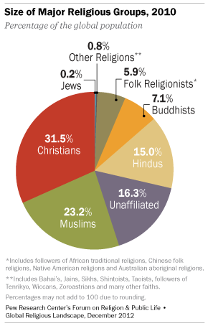
Worldwide Religious adherents -- 2010

Slide 9
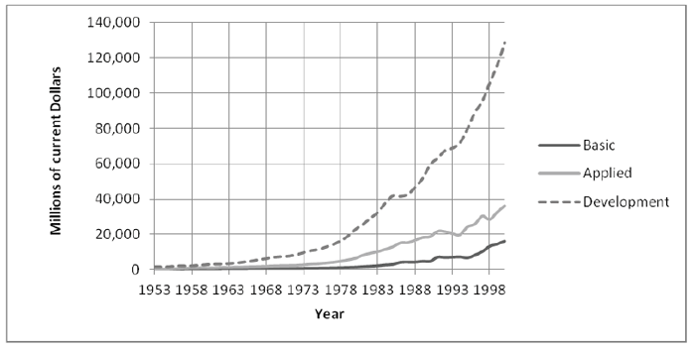
Spending on Scientific R&D

Slide 10
Scientific Advances & their Impact
Scientific advancements had far-reaching effects on many aspects of 20th century life . . .
#1: Understandings of the universe => theorists created new paradigms that explained the creation &organization of the universe; human behavior
________________(Edwin Hubble, Stephen Hawking) => universe created out of a “Big Bang” explosion some 15B years ago; expanding ever since
Einstein’s ____________________=> time, space, energy and mass are relative, not fixed . . . (explains large movement in universe)
Max Planck’s __________________=> atoms emit or absorb energy in discrete small particles (explains motion and behavior of small particles)
Psychology & Sociology => theorists like Sigmund Freud offered rational explanations for human behavior based on sexual desires & learning
Emile Durkheim argued “there are no religions that are false. All are true after their own fashion” => led to _________________(Europe not superior)

Slide 11
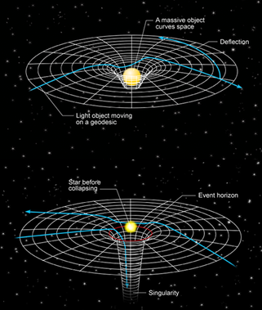
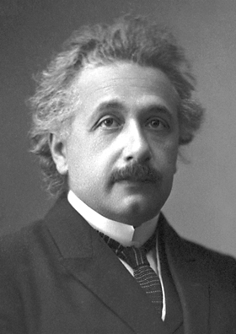
Theory of Relativity
Albert Einstein created his Theory of Relativity in his spare time while a patent clerk with the Swiss government => it explained the movement of large bodies and particles
He won the Nobel Prize for Physics in 1921

Slide 12
Scientific Advances & their Impact
#2: Communication and Transportation=> new modes of communication and transportation virtually eliminate the problem of distance
New communication technologies included radios, televisions, telephones, computers and the internet
By 2000 over _________________were in use => communication instantaneous
-- Now use of internet, email and video chats (Skype) make personal communication even more diverse
_________________________allow the proliferation of mass culture across space => leaders can use radios and TV’s to promote agendas (propaganda)
-- Hollywood becomes center of film industry => exports American culture & values around world (blurs line between popular and elite culture)
_____________________________also make vast amounts of information readily available to people => leads to democratization of information
New transportation technologies allowed more rapid migration between areas of world and for work like never before
Proliferation of cars led to growth of roads and highways => German autobahn; American Interstates (commute to work, vacation, travel)
-- Mass production of automobiles made them affordable to all (Model T)
_______________________led to increase in worldwide trade & travel
-- National airlines like KLM Royal Dutch Airlines (1920) linked areas of world

Slide 13
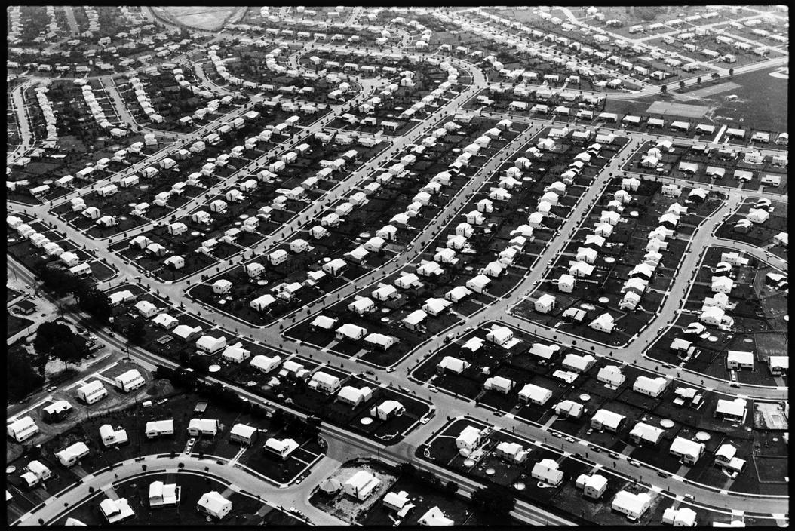
Levittown, New York 1954

Slide 14
Scientific Advances & their Impact
#3: _______________=> due to modern science & new technology worldwide food production increased 3X from 1950’s to the 1990’s (pop doubles)
In 1798 Thomas Malthus warned world that if unchecked population growth would outstrip food supply => he was wrong . . .
_________________, pesticide usage, gasoline tractors & hybrid seeds (eventually GMO’s) all increased agricultural output dramatically
Farms in developed world increase in size and complexity => by 2000 less than 1% of US population are farmers (agri-business)
Less farming pop. accelerates urban growth => reaches __% by 2010
#4: Medical advances => lead to increased lifespans for human beings (average life expectancy in world increases from 30 in 1900 to 55 by 2000)
New medicines like ___________(penicillin), ____________(polio vaccine) and medical procedures like organ transplantation aided human survival
Led to demographic transition in urbanized nations => Population explosion followed decline in death rates
-- Over time birth rate slows and population stabilizes (i.e. Europe, US)

Slide 15
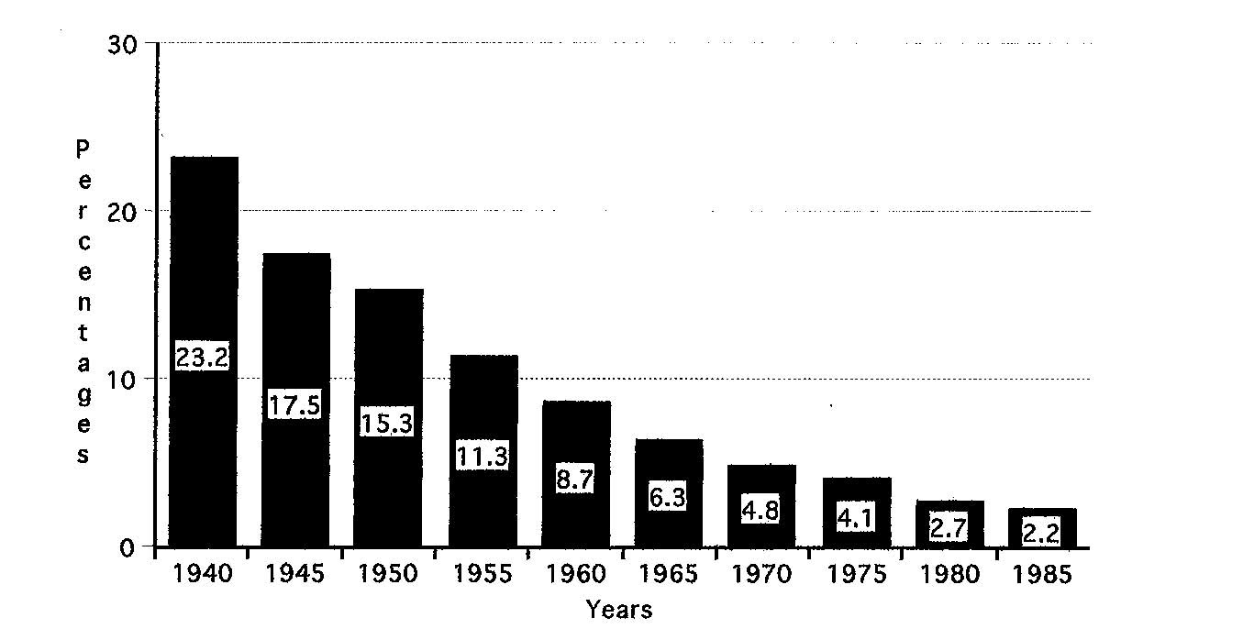
Percentage of US Population Farming

Slide 16
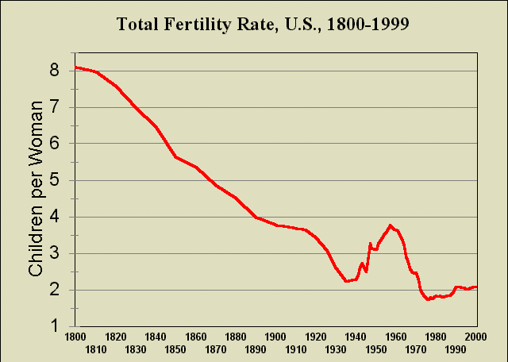
US Birth Rate over last 200 years
Replacement Rate = 2.1 kids

Slide 17
Energy Sources of 20th Century
In the 20th century new energy technologies greatly increased the productive capacity of humans
In the 20th century humans used more energy than the rest of world history combined (between 1950 & 2000 world consumption increased 400%)
______________________=> #1 energy source of 20th century; many applications such as cars, chainsaws, airplanes, ships & powerplants
-- Oil powered new internal combustion engines (cars, planes) => provided 30 times the power that a steam engine in 1850 had
-- Oil producing nations became wealthy & started cartels such as OPEC
__________________=> accounts for 5% of total world power (20% in US); by 1998 29 nations had 437 power plants (5%)
-- Nuclear plants are very costly to build ($2-5B) and maintain and produce radioactive waste (no known process for abatement)
-- High profile nuclear accidents => ________________(USSR 1986); Fukushima (Japan 2010) cause decline in nuclear usage
New energy technologies & the application of Ford’s electric powered assembly line combined with _______________________________ increased the productive capacity of workers 200 times (1750 vs 1990)
Worker in 1990 could produce in a week what a 1750 worker did in 4 years

Slide 18
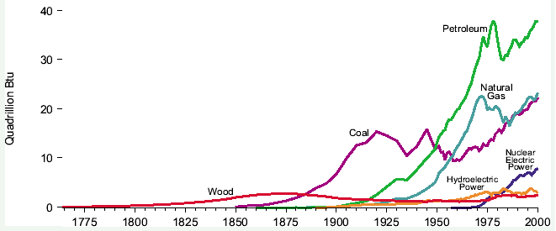
Worldwide Fossil Fuel Consumption
Q: What happens to fossil fuel consumption over 20th century?

Slide 19
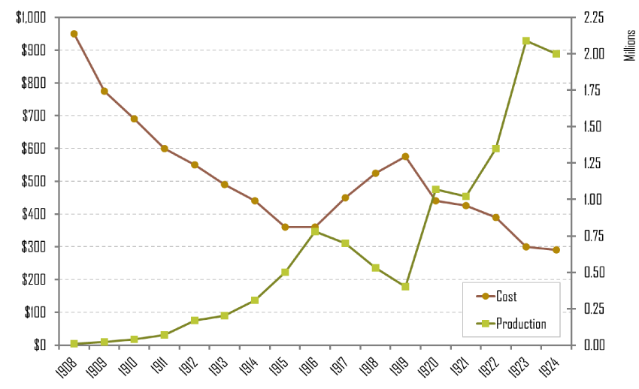
Ford’s Assembly Line Production
New energy sources and technology greatly increased production of consumer products => lowered prices and improved wages, thus stimulating modern consumerism in industrialized nations

Slide 20
Environmental Effects of 20th Century
Such rapid increases in energy usage have had severe environmental costs
#1: Global Warming => 11 of last 12 years have been the warmest recorded in the last 150 years; increasing strength & frequency of storms & hurricanes
_____________________is suspected to be a major cause of warming temperatures => carbon emissions trap heat into atmosphere
Results are particularly catastrophic in low lying areas => coastal flooding has increased as sea levels continue to rise
Carbon emissions are focused on actions of developed nations, however increasing emissions by large developing nations are increasing
#2: Conflicts over resources
Nations have become so dependent on oil that conflicts have erupted to preserve access to the resource => i.e. 1990 ______________
Nigerian Civil war is also largely due to quarrels over oil resources
Conflicts over access to clean water supplies have also erupted => chemical fertilizers, damming of rivers has led to water depletion in many areas
20% of world’s population experiences shortages => danger zones are concentrated in Middle East (rationing) and N. Africa

Slide 21
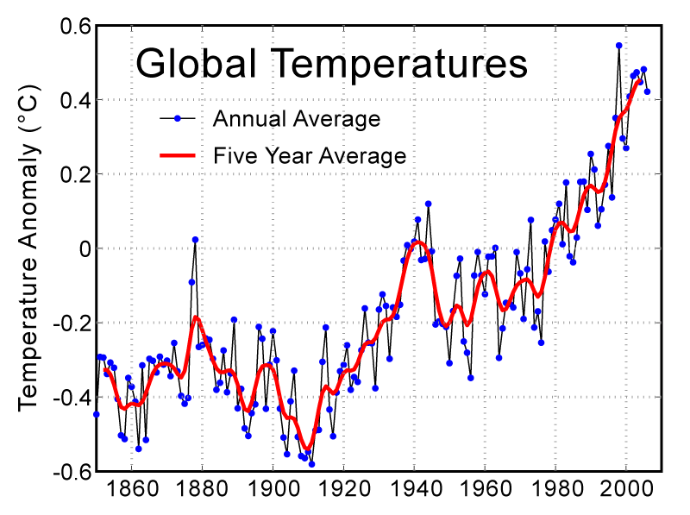
Average Temperatures over past 150 years

Slide 22
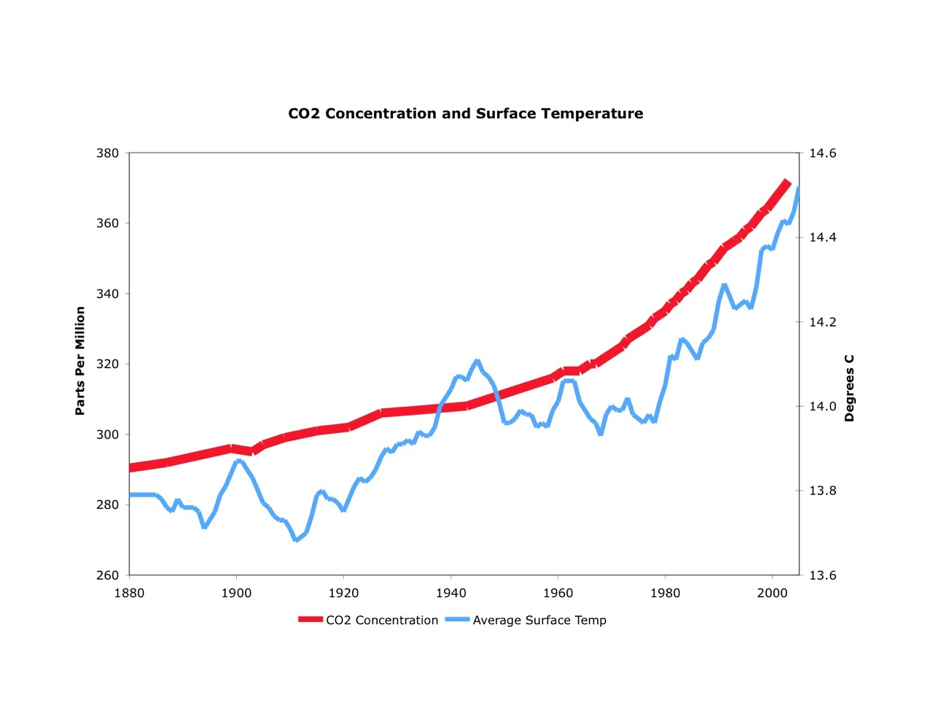
Average Temperature vs CO2 emissions

Slide 23
Environmental Effects of 20th Century
#3: ____________=> spurred by development of the chainsaw in 20th century
Chainsaws and machinery allowed cutting of forests 1000 times faster => remove forests to increase grazing land (esp in Amazon)
Modern society increased need and uses for wood => power lines, houses, railroads and paper
Forests were also removed so as to facilitate the building of massive highway systems => today highways cover 1-2% of earth’s surface
#4: Desertification => due to global warming the Sahara increases it reach by 100’s of feet every year
Part of reason behind 2008 conflict in the Sudan as herders were forced to migrate into Darfur region => Darfurian genocide resulted
#5: ________________________=> scientists estimate that by 2100 up to 1/3 of world’s entire catalog of species may be extinct
20% of worldwide species today are threatened
Global fisheries are becoming depleted due to overfishing => by 1990 2/3 of global fisheries were overfished and in danger of collapse
Many species already lost => Cape Lion, Caspian Tiger, Ibex, Eastern Cougar, Black Rhino, etc……

Slide 24
Global Fish Catch
Years | Marine Catch (in millions metric tons)
1950 | 15
1958 | 29
1963 | 33
1972 | 51
1987 | 68
1990 | 71
1993 | 74
1996 | 80

Slide 25
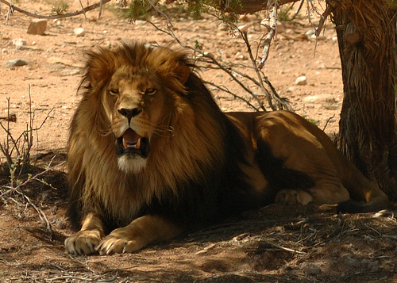
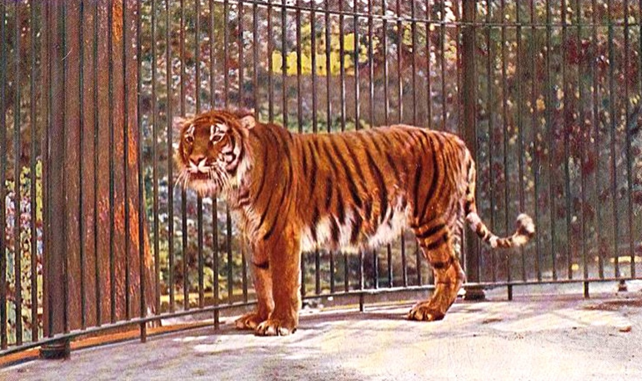
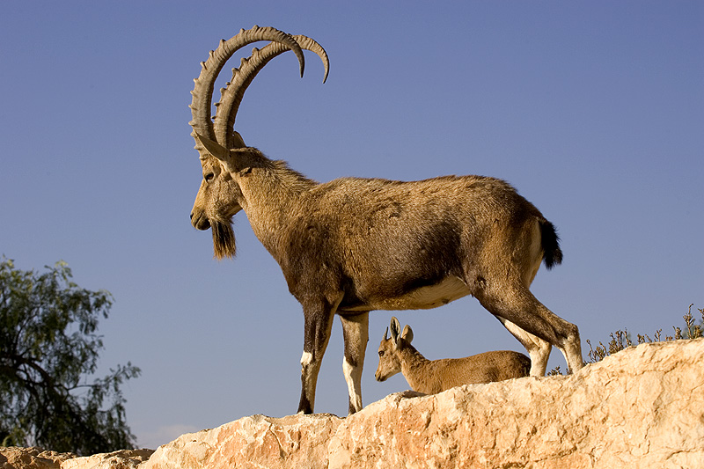
Extinct Species
Cape Lion (1963)
Ibex (2000)
Black rhino (2011)
Caspian Tiger (1970)

Slide 26
Environmental Effects of 20th Century
#6: Pollution of air and water
Water pollution has intensified largely due to agricultural growth => fertilizers & pesticides produce chemical runoff, fracking for oil & gas
Ocean life has also been damaged by large oil spills (i.e. Gulf Oil spill => 210M gallons) and cleaning of oil tankers at sea pollutes waters & fisheries
Smog pollution has become a big problem in urban areas => China and India are especially bad
Worldwide Responses
Post 1960 Green movement leads to increased awareness of environmental damage => start of Green political parties in many European nations
US passes __________________________Acts, as well as Endangered Species Acts => many other nations pass similar laws
1970 ______________started => over 500M celebrated in 2010
UN climate agency negotiates series of Protocols designed to curb release of harmful materials
-- Montreal Protocol (1987) led to 60% drop in cholorofluorocarbons (refrigeration)
-- ____________________(1997) attempted to limit carbon emissions

Slide 27
Demographic Shifts of 20th Century
During the 20th century population growth exploded across the globe as modern medicine lowered death rates and birth rates remained high
Birth rates in many developing nations accelerated as more reliable supplies of food increased fertility => nationalist policies also promoted large families
-- From 1950 to 2005 the population of developed nations increased by 50%; developing nations’ population increased by over 200%
Global population increased from 1.6B to 6B (400%) from 1900 to 2000 => by 2100 population would be 24B if trends continued
By 2000 Developed nations in Europe, US & Japan had experienced a demographic shift in population => declining birthrates to stabilize population
Factors lowering birth rate => less children die young, urbanization (less farm work); expanding female employment has led to lower birth rates
Declining birth rates have also been made possible by access to birth control technologies =>__________________________________________
-- Birth control pill (estrogen and progestrin) invented in 1960’s
-- Access to safe abortion practices has also reduced birth rates
-- More reliable birth control methods have changed sexual behavior in many nations => increased incidence of pre-marital sex
Developing poor nations & Muslim nations will contribute to most population growth in 21st century => birth rates triple that of developed nations

Slide 28
Population for World Regions (millions)
Major Area | 1750 | 1800 | 1850 | 1900 | 1950 | 1995 | 2050?
Africa | 106 | 107 | 111 | 133 | 221 | 697 | 1,766
Asia | 502 | 635 | 809 | 947 | 1,402 | 3,437 | 5,268
Europe | 163 | 203 | 276 | 408 | 547 | 728 | 628
Latin America | 16 | 24 | 38 | 74 | 167 | 480 | 809
North America | 2 | 7 | 26 | 82 | 172 | 297 | 398
Oceania | 2 | 2 | 2 | 6 | 13 | 28 | 46
World | 791 | 978 | 1,262 | 1,650 | 2,521 | 5,666 | 8,909

Slide 29
Percentage Distribution for World Regions
Major Area | 1750 | 1800 | 1850 | 1900 | 1950 | 1995 | 2050?
Africa | 13.4 | 10.9 | 8.8 | 8.1 | 8.8 | 12 | 23.7
Asia | 63.5 | 64.9 | 64.1 | 57.4 | 55.6 | 61 | 57.1
Europe | 20.6 | 20.8 | 21.9 | 24.7 | 21.7 | 13 | 5.3
Latin America | 2 | 2.5 | 3 | 4.5 | 6.6 | 8 | 9.4
North America | .3 | .7 | 2.1 | 5 | 6.8 | 5 | 4.1
Oceania | .3 | .2 | .2 | .4 | .5 | 1 | .5
World | 100 | 100 | 100 | 100 | 100 | 100 | 100

Slide 30
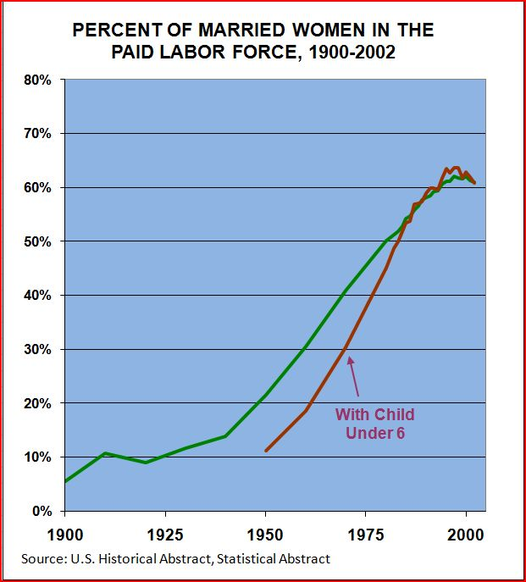
Percentage of Married Women in the Labor Market

Slide 31
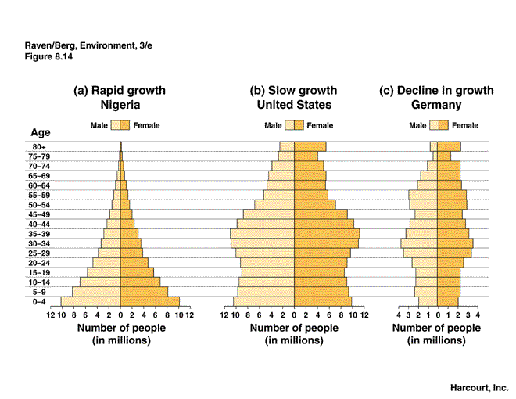
Age structure comparisons

Slide 32
Demographic Shifts of 20th Century
Demographic shifts, longer lifespan and increased travel and contact have given rise to new modern disease framework
#1: New emergent epidemic diseases
_______________=> severe hemorogetic fever spread between humans by bodily fluids
Recent outbreak in W. Africa has reached epidemic levels due to poor healthcare systems, conflicts, distrust of health workers & burial practices
____________________=> more virulent strains (H1N1) have appeared throughout 20th century; worst was 1918 Spanish flu (50-100M dead)
____________________=> HIV is an auto-immune disorder that incapacitates the ability to fight off disease; spread through bodily fluids
Of the 50 nations with highest HIV rates, 37 are in Africa => 25M have died of disease and an additional 35 M are infected
Improved sexual practices have slowed spread of disease
#2: Diseases associated with poverty => poor sanitation systems, lack of medical care systems and poor access to clean water lead to persistence of some diseases
Diseases like ________________________________have been a persistent problem in developing nations in Africa, Latin America and SE Asia
Diseases increase death rates, but also lead to fatigue and lower productivity
Average life expectancy in Africa is 50 compared to 78 in Europe

Slide 33
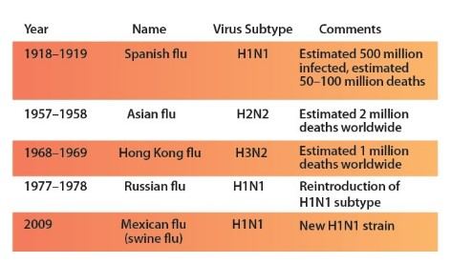
20th Century Flu Pandemics

Slide 34
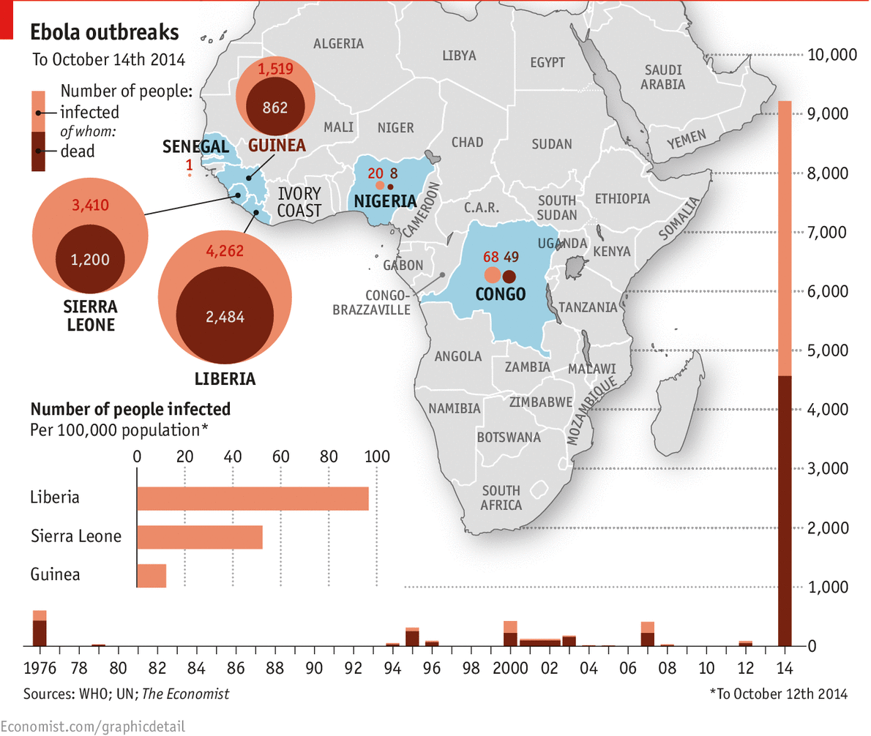
Ebola Outbreaks of 20th Century

Slide 35
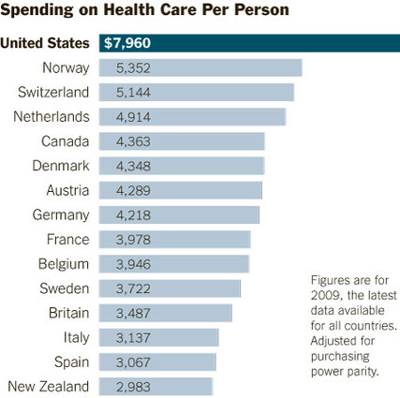
Demographic Shifts of 20th Century
#3: Diseases associated with changing lifestyles => mainly effect developed nations where a longer lifespan & diet contribute to maladies
______________________=> high incidence of smoking, red meat consumption and obesity (sugary foods) have led to higher rates of diseases
_________________=> degenerative dementia associated with loss of memory and intellectual functioning
Causes are poorly understood & there is no known treatment => life expectancy is 3-9 years
Developed nations with these chronic health issues have had to invest larger shares of GDP into treating lifestyles diseases

Slide 36
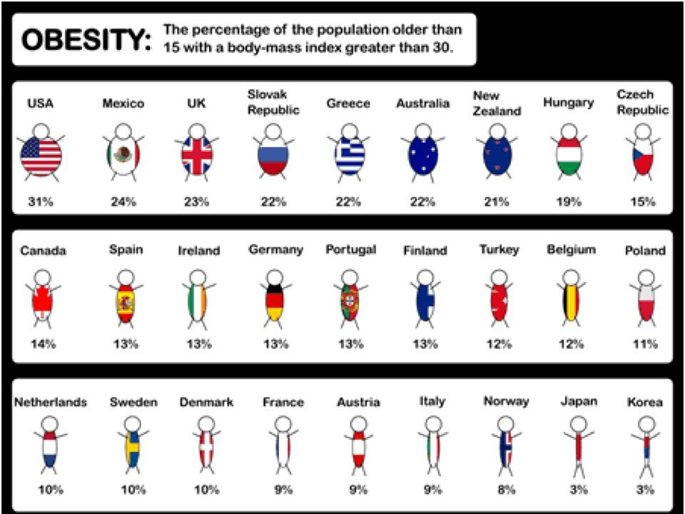
Obesity Rates by Country

Slide 37
Increased Wartime Technology in 20th century
During the World Wars of the 20th century new industrial technologies and modern techniques (i.e. Total warfare, trenches) were applied to warfare
Result = increasing numbers of civilian and battlefield casualties
New Modern Techniques & weapons
___________________(WWI) => by November 1914 Allies & Central powers had created a line of opposing trenches over 400 miles long
Barb wire, mines and machine guns protected “NO MANS LAND” => made assaults difficult (ceaseless shelling)
-- Exs: _____________(1916) => British/French assault gains 1200 yards but results in over 1million deaths
War turns into a bloody stalemate on Western and Eastern front
Due to Stalemate new weapons are invented by both sides to try and “win” the war and push the enemy back
#1:_________________________– Gas Q: How used???
Many type of Gas were launched at the enemy => tear gas, breathing gas, “mustard gas” (modern day = sarin, anthrax, etc…)
Soldiers must wear protective gear to avoid exposure

Slide 38
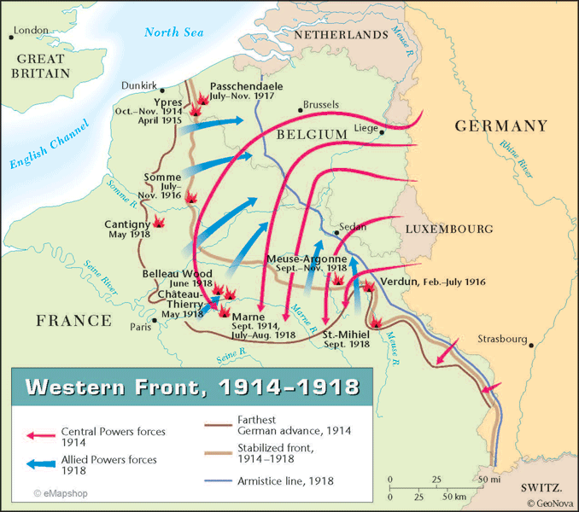

Slide 39
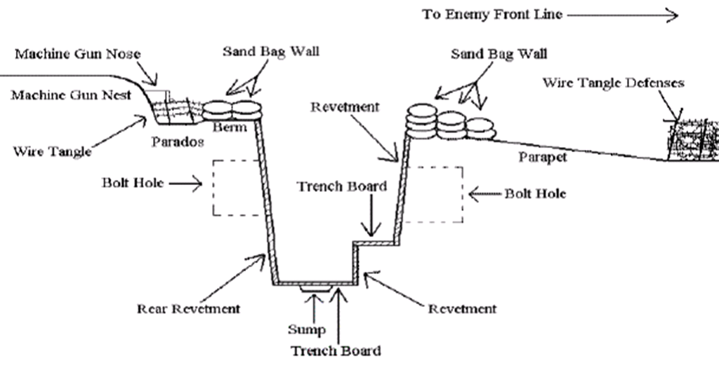
World War I Trench

Slide 40
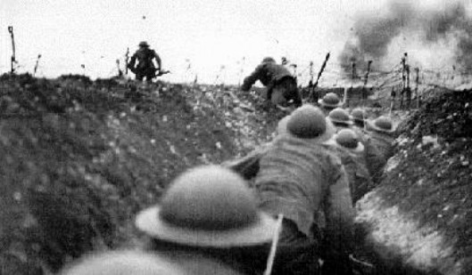
“We see men living with their skulls blown open; we see soldiers run with their two feet cut off . . . Still the little piece of convulsed earth in which we lie is held. We have yielded no more than a few hundred yards of it as a prize to the enemy. But on every yard there lies a dead man.”
-- All Quiet on the Western Front

Slide 41
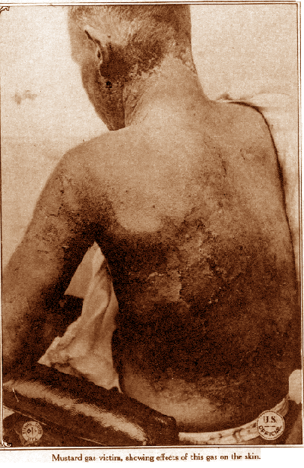
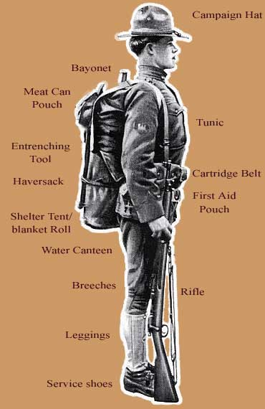

Slide 42
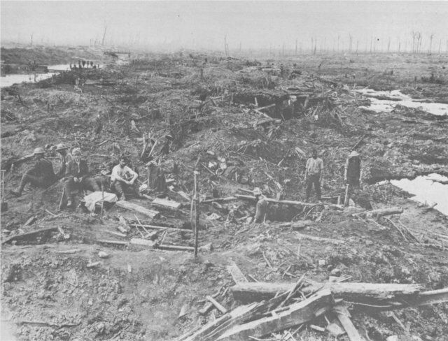
WWI Pictures – Trench warfare, Chemical Warfare

Slide 43
Death Tolls of Top 10 Wars in World History
1. 78,000,000 – World War II (1939–1945)
2. 40,000,000 – Mongol conquests (1206-1324)
3. 25,000,000 – Qing conquest of Ming dynasty (1616–1662)
4. 22,000,000 – Taiping Rebellion (China, 1850–1864)
5. 20,000,000 – World War I (1914–1918)
6. 16,000,000 – White Lotus Rebellion (China, 1794-1804)
7. 13,000,000 - An Lushan Rebellion (China, 755–763)
8. 10,000,000 – Era of Warring States (China, 475 BCE–221 BCE)
9. 8,000,000 - Red Eyebrows Rebellion ( China, 9-24)
10. 7,000,000 – Conquests of Tamerlane (1370–1405)

Slide 44
Increased Wartime Technology in 20th century
#2: _____________ Q: How used?
Developed by British to cross No Man’s Land
#3: _____________ Q: How used?
1st used to scout positions; then used for dogfights and bombings
“Red Baron” and other pilots became heroes
Total War => entire resources of economy directed at war effort; target enemies productive capacity win war
Nations further developed old weapons & created new more deadly ones
Panzer Tanks capable of moving at 20mph => leads to ________________ -- Lightning war => fast moving & destructive; overwhelm opponent
US B-29 bombers are capable of flying at high altitudes and targeting civilian populations and factories
-- ______________________of cities like Dresden => used napalm and other high incendiary materials (killed over 25,000)
_________________________in the US involved over 40,000 employees and the expenditure of over $2B => resulted in creation of atomic bomb
-- Used against military targets in Hiroshima and Nagasaki => resulted in over 250,000 casualties and radiation related deaths in millions

Slide 45
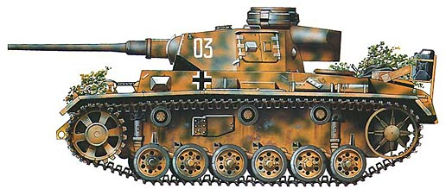
German Panzer tank

Slide 46
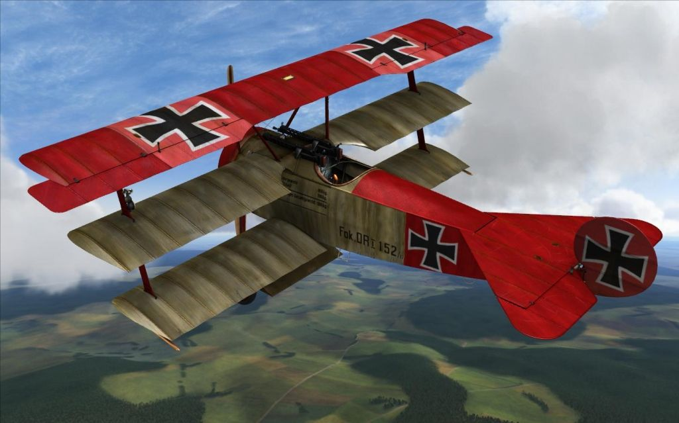
German Fokker DR-1

Slide 47
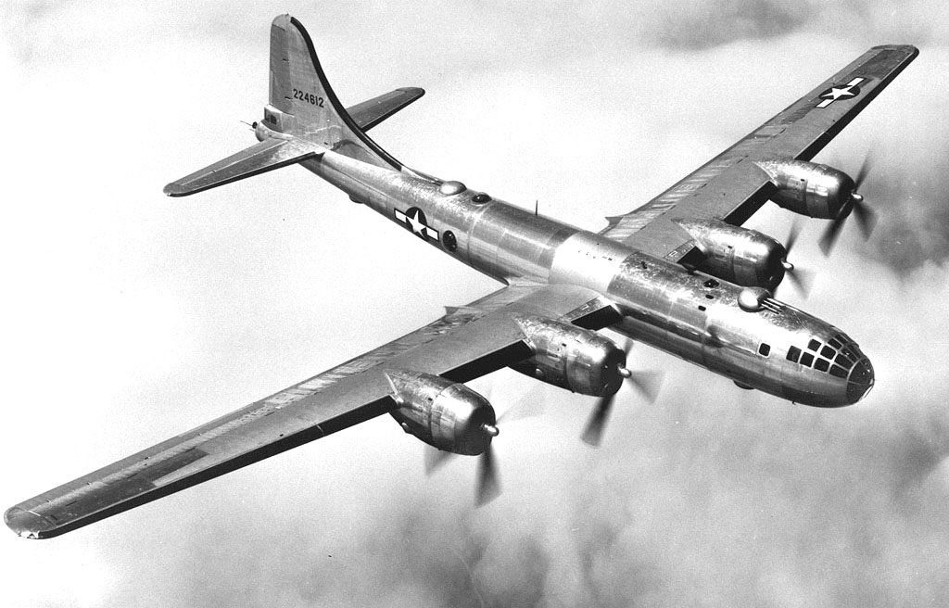
B-29 Bombers -- WWII

Slide 48
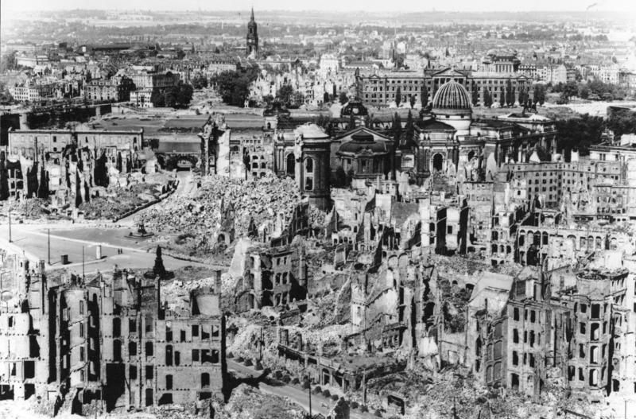
Firebombing of Dresden
In 1945 the British and US firebombed the city of Dresden prior to invasion with over 1200 aircraft in 3 separate raids using napalm and other incendiary devices => the resulting fire destroyed over 75% of the city and killed an estimated 25,000

Slide 49
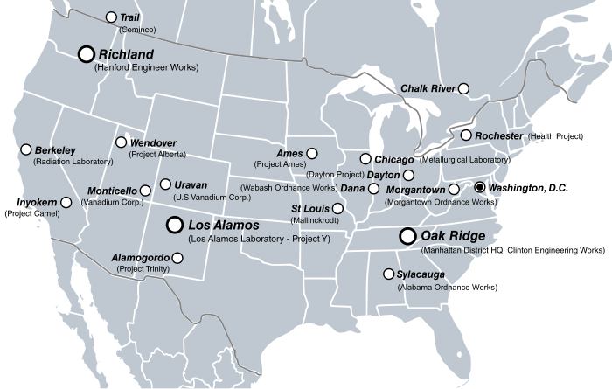
The Manhattan Project Sites
The Manhattan Project was coordinated between over 30 different sites across America and Canada => all were top secret
Albert Einstein was a key proponent & lead scientist was R. Oppenheimer
At its height the project employed more than 130,000

Slide 50
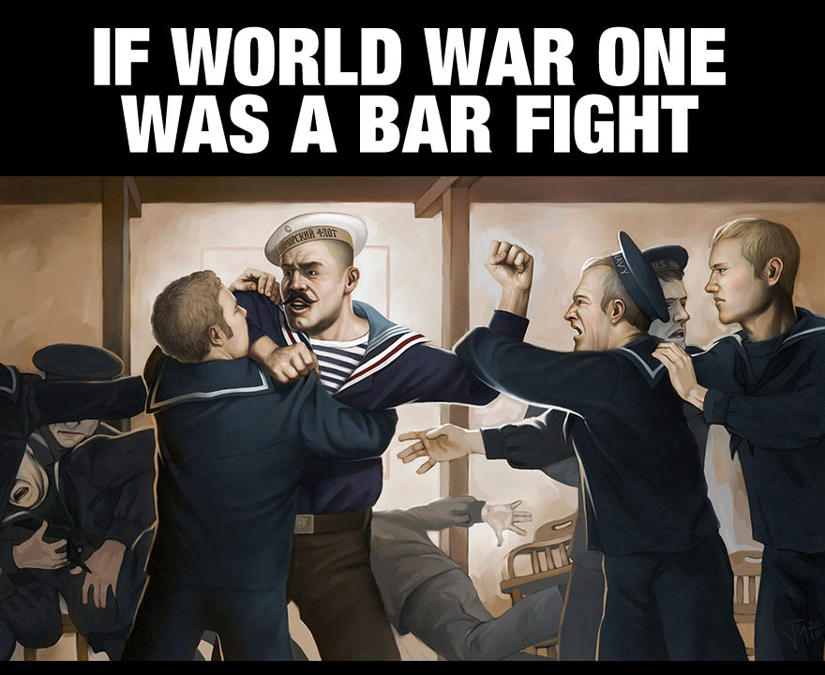
If World War I were a Bar Fight . . .
http://themetapicture.com/if-wwi-was-a-bar-fight/

Slide 51
Causes of World War I
By 1900 Europe was at its peak => in industrial development, technology, science, wealth and knowledge it exceeded all civilizations before it
Europe is a continent of only 3-4 M square miles (Asia is 17M) yet it controlled over 85% of the globe’s land and population
-- 3 largest powers (Britain, Germany and France) also controlled ½ of the world’s industrial output and ½ of international trade
-- However, unequal power relationships in Europe led to rivalries and an unstable situation that eventually led to a war of unseen proportions . . .
The Causes of World War I were varied but can be simplified into _______
#1: _______________=> nation states in the late 1800’s and early 1900’s regarded military prowess as a supreme value (Social Darwinism => survival of fittest)
States started ____________________________=> greatly increased size of national armies (Russia = 1.3M; Germany = 1M; France = 1M)
Huge industrial economies built up massive stores of new weapons => machine guns, battleships and howitzers
Militarism also involved the extreme influence of military leaders within governments => drew up rigid mobilization plans (complex RR schedules)

Slide 52
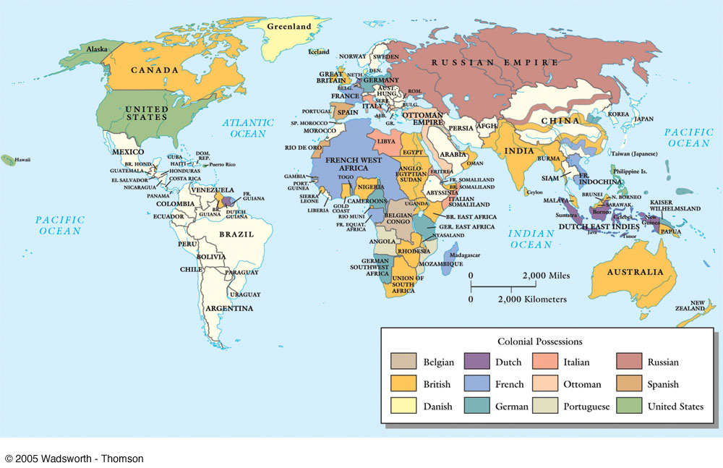

Slide 53
Percentage of Land Areas controlled by 5 Major European Powers & US in 1900
Region | Percentage Controlled
Africa | 97.4
Polynesia | 98.9
Asia | 56.5
Americas | 27.2
Source: Alexander Supan, Die Territoriale Entwicklung (1906)

Slide 54
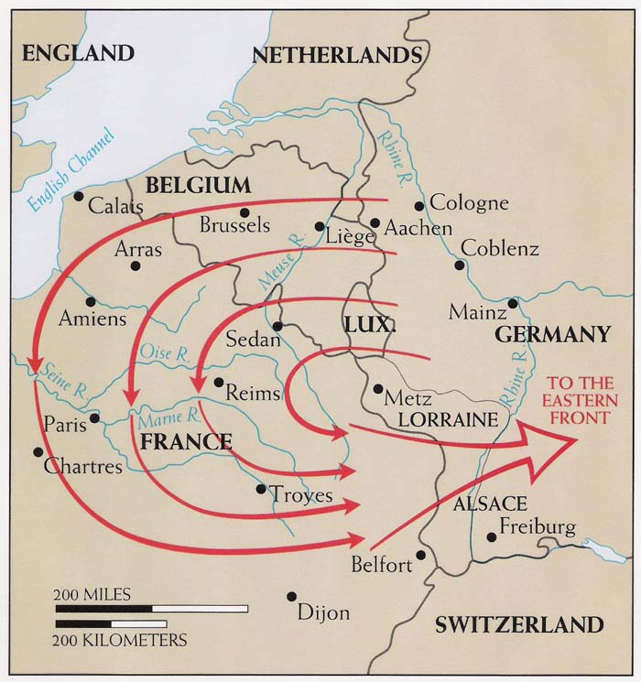
The German Schlieffen Plan

Slide 55
Causes of World War I
#2: ____________________ => commonly held belief in 1900 as that the road to power, wealth and greatness for European states was acquisition of colonies
European nations had unequal colonial empires => Britain had largest; Germany the smallest (late unification, anti-colonial policies of Bismarck)
Problem by 1900 was that very little of world remained to colonize
Germany believed it could seize colonial possessions of rivals with a short decisive war (i.e. Franco-Prussian War of 1870’s)
#3: ________________=> doubled edged sword in terms of contribution to WWI
Nationalism promoted pride of nation states and many times fueled by mass media (newspapers) inspire hatred and fear of other nation states
I.E. ________________rivalry over colonial network and industrial power; French & German rivalry over continental European military dominance
Nationalism also promoted desire of peoples within large multiethnic empires (i.e. Russian, Austria-Hungary) to desire independence & ethnic nations
Russian Empire in 1914 was only 50% Russian; Austria-Hungary was made of 11 different nations & was only 20% German speaking (Slavs, Magyars)
I.E. Polish Nationalism, Serbian Nationalism . . .

Slide 56
Causes of World War I
#4: ________________________=> fearful European nations had formed into broad alliances to preserve the balance of power in Europe (defensive alliances)
Allied Powers (i.e._______________________________________)
Central Powers (i.e._____________________________________________)
Alliances virtually guaranteed that a local conflict would morph into a European war & Europe’s colonial network made a European war into a WORLD WAR
During the War European nations mobilized large amounts of colonial soldiers from their colonies for both WWI and WWII
-- Africa => British, French & German regiments supplied over 165,000 soldiers in WWI and 500,000 in WWII
-- British _____________________(India and Nepal) formed elite sharpshooter units & supplied over 250,000 soldiers in each WWI and WWII => served in WWI assaults in Turkey & Middle East
-- _______________ (Australia and New Zealand) troops fought in Middle East at Battle of Gallipoli and in the expeditions of 1916
Colonial units served with European officers mostly => some colonials promoted to ranks of officers to secure loyalty and recruitment

Slide 57
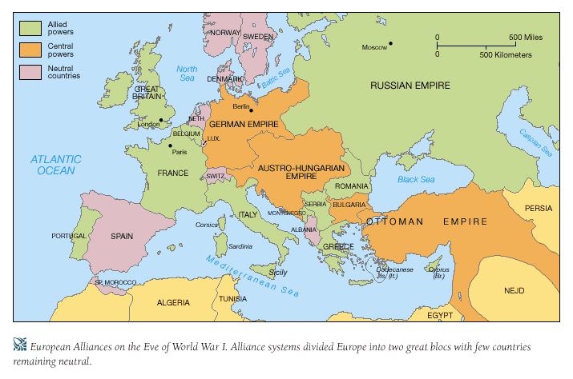
Europe in 1914

Slide 58
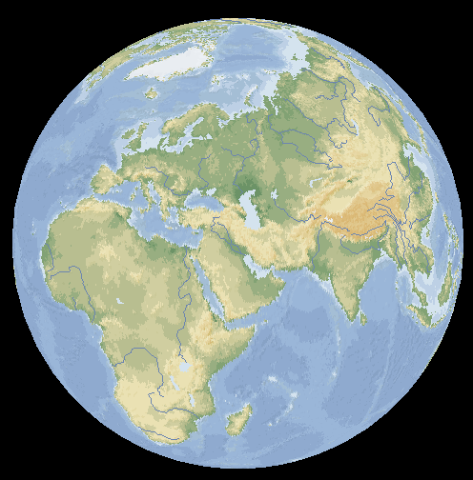
World War I – Regions of Fighting
Regions where fighting took place in World War I
Western European Front
Eastern European Front
Italian Front
Balkan Front
Palestine/Syria
Iraq
Arabia
German Togoland
German Cameroon
10 German East Africa
11 German Southwest Africa
12 German Pacific Islands
1 2
3
4
12
5 6
7
8
9
10
11

Slide 59
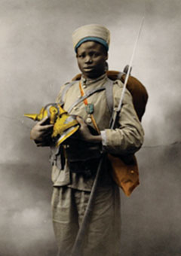
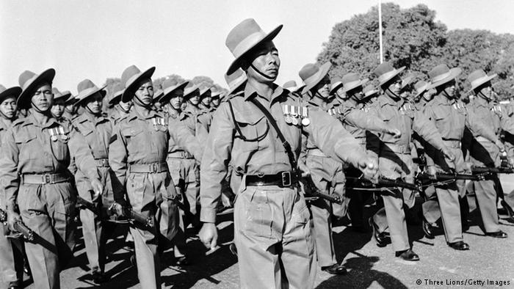
French Senegalese Soldier
British Gurkha Soldiers

Slide 60
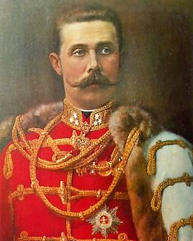
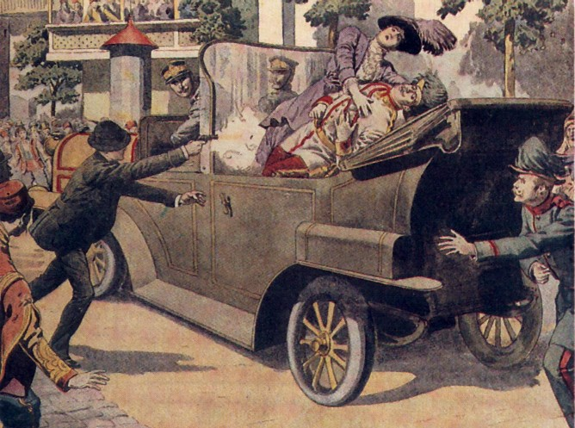
Outbreak of World War I
Q: What finally started all out fighting?
Assassination of Archduke Franz Ferdinand, prince of Austria-Hungary, by Serbian nationalists
Death led to a series of events that no one was able to control or diffuse => largely due to influence of military leaders and mobilization schedules that necessitated early deployment
By August of 1914 all of Europe was involved in a war that would last over 5 years
By the end China, Japan, Italy, US all joined in => over 30 countries & 1.4 B people involved

Slide 61
World War I Fighting Style & Total War
At the war’s outset, initial plans for a quick victory faded as both sides resorted to Trench warfare to stem the other sides’ advances
By November 1914 there was a line of opposing trenches over 400 miles long on the Western front=> ceaseless shelling and assaults took a heavy toll
Barb wire entanglements 3-5 feet high and 90 feet thick, mines and concrete machine gun nests protected “NO MANS LAND”
-- Ex: Battle of Somme (1916) => British/French assault gains 1200 yards but results in over 1million deaths
War turns into a bloody stalemate on Western and Eastern front => nations use new weapons (i.e. gas, tanks, airplanes, howitzers to attempt & win)
All nations employed a new style of TOTAL WARFARE as the needs of a large industrial war that lasted years were made apparent (both WWI and WWII)
________________________=> mobilization of a nation’s economic resources, centralization of public powers & manipulation of public opinion to keep war going
War’s effects were felt on homefront in a variety of ways . . .
#1: Bomb raids during WWII vs. industrial cities like Dresden & Hiroshima => “Blitz” bombing of Britain by Hitler & Nazi’s in WWII from 1940 to 1941
#2: Mobilization of ________________________(i.e. minorities & women) to fill industrial jobs while men fought => nations mobilized millions of men
1.4 British women worked in munitions plants during WWI; 38% of German Krupp arms workers were women
-- Workers were paid less than men, but this initiated a changing conception of gender roles as women took on “male” occupations

Slide 62
World War I Fighting Style & Total War
#3: Centralization of governmental power over economy => citizens were subjected to rationing of supplies (i.e. sugar, meat, rubber, gas), price controls & conservation efforts (i.e. Victory Gardens)
Governments also forced industrial production to convert to wartime production (i.e. War Production Board in US => limits consumer production)
Governments also sold War Bonds to fund war effort & promoted purchase as “patriotic duty” of citizens
#4: Manipulation of Public Opinion => governments stifled public opinion and freedoms in favor of war time nationalism and propaganda
Governments formed agencies like the ___________________(US in WWI) to promote wartime patriotism and nationalism among diverse populations
Hired “4 minute men” to speak in public places, created wartime propaganda posters, cartoons & ads (many times very racist)
Governments also passed laws to limit free speech and wartime dissension
British passed ________________________________=> allows government to imprison dissenters as traitors and censor newspapers

Slide 63
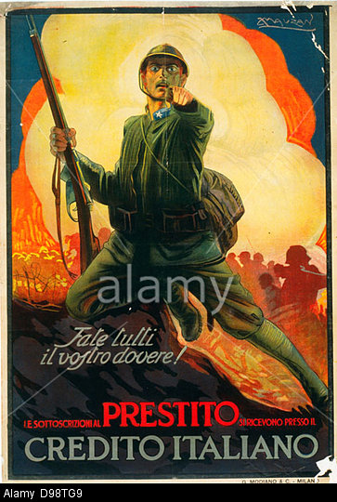
World War I & II Propaganda Posters

Slide 64
Conclusion of WWI & Treaty of Versailles
By 1918, despite the eruption of civil war and revolution in Russia and their withdrawal from the WWI, the war was grinding to a close w/ Allied victory . . .
#1: Superior British & French population, agricultural output & colonial resources
#2: Entry of the US into the war on the Allied side => US entered was to “______ _________________________” & due to German submarine attacks vs. shipping
#3: Collapse of Ottoman Empire and weakening of Austria-Hungarian state => both propped up by German military and economic resources by 1918
On November 11th 1918 the Germans signed an unconditional armistice and ended WWI => 15M soldiers were dead, 20M wounded
Trench warfare and employment of total war and ruined European infastructure, industries & farmland => remade political map of Europe
WWI also led to widespread disillusionment in Europe & around the world => Capitalism, Liberalism and Democratic system questioned
WWI also led many colonial peoples to question European cultural and racial superiority => millions had fought in war and wanted greater rights
-- European greed & conflict had led to the most barbaric and destructive war in the history of the world => was this “morally superior?”

Slide 65
The Treaty of Versailles
Wilson was approached by Germany and Central Powers in 1918 to make peace based on the _______________________=> set of idealistic principles
5 separate treaties ended WWI (Germany, Austria, Hungary, Turkey & Bulgaria) => German ____________________________most important
Conference was supposed to be founded on Wilson’s ideals of 14 Points but quickly degenerated into orgy of German revenge by France & Britain
Blamed war on Germany; took possession of German colonies & land in Europe; enforced brutal reparations on them ($269 Billion Marks)
-- Gave Germany a 100 year payment plan => 1920 to 2020
-- Restricted German army to 100,000 men and put limits on ships
Est. new Alliance system between France, Britain & US => French security
Only 4 of Wilson’s 23 “ideals” were followed in the peace but he got the _____ ____________________________and felt it could solve all the problems
League of Nations was an international organization designed to promote cooperation and negotiation between world powers
-- League failed to do so for two reasons => Lack of US entrance (Article X and isolationism) and lack of enforcement mechanism
Other treaties remade the map of Europe along more nationalist lines
Treaty dissapointed Nationalist hopes of Africans, Arabs and Asians => did not free any colonies or grant Arab independence via the _________________
-- France was given rule of Syria under League of Nations supervision; Britain was given rule of Iraq/Palestine

Slide 66
Europe in 1914

Slide 67
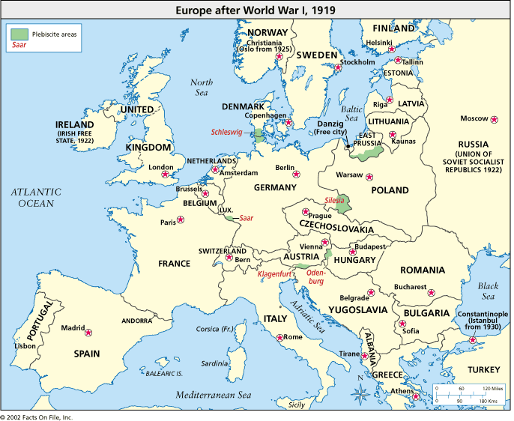
Europe in 1919

Slide 68
The Interwar period & Great Depression
After World War I there was a period of economic prosperity and political cooperation during the 1920’s
Dawes Plan loaned $$ to Germany for debt repayment & international conferences like the _________________________limited armaments
However, by 1929 a Great Depression engulfed the world in economic crisis
The Great Depression was caused by a downturn in domestic economies, high trade barriers & the collapse of the US stock market
-- Liberal economic policies of balanced budgets and tight $$ policy made depression worse => discredited capitalism & liberalism
The depression caused huge financial hardships in W. Europe and the US
-- Industrial production was down 50% in Germany and US
Economic strain of the Depression created serious problems
-- Young men out of work looking for answers in places like Germany and Italy => willing to accept extremism if it offered a job

Slide 69
Unemployment in the 1930’s

Slide 70
Causes of World War II
The Causes of World War II were very similar to those that started WWI
#1: Militarism
Fascist states of Italy, Germany and Japan were attracted to militaristic pursuits as means to achieve dominance of their respective races
Democratic states (France, Britain and US) engaged in heavy military spending in the late 1930’s to promote economic recovery from Great Depression
USSR under Stalin increased military spending due to the perceived threat from Nazi Germany & Western Europe (fear & paranoia towards democracies)
#2: Imperialism
After WWI Britain and France were not divested of colonial empires => by absorbing German colonies their empires became larger (i.e. ME mandates)
Germany, Italy and Japan all engaged in Imperialist expansion during the 1930’s
Italy
Mussolini promised Italians a return to “Mediterranean greatness” => invaded ______________________to establish beginning of new “Italian Empire”
League of Nations condemned invasion but did nothing to stop it

Slide 71
Military Spending in 1939
 | National Income | % spent on defense
United States | 68 | 10
Great Britain | 22 | 15
France | 10 | 18
Germany | 17 | 28
Italy | 6 | 20
USSR | 19 | 27
Japan | 4 | 35

Slide 72
Causes of World War II
Japan
Japan invaded Manchuria in 1931 & seized industrial factories => installed a puppet Manchuko govt under leadership of former Chinese emperor Puyi
Japan followed this up in 1937 by invading China and seizing the capital city of Nanjing => engaged in ethnic violence vs. __________________________
-- Both actions condemned by League of Nations => Japan withdraws
Japan sought to engage in imperial expansion in SE Asia to acquire further resources needed for industrialization (i.e. oil, rubber)
Germany
Hitler desires to dominate Europe w/ a Germanic state & secure “Lebensraum” for Germans => also desires to throw off shackles of Versailles Treaty (unpopular)
1935 Hitler __________=> creates German airforce & conscripts 500,000 men
1936-38 Hitler sends troops into Rhineland, Austria, Sudetenland
-- No response from League of Nations
September 1938 _________________=> Britain and France, eager to avoid war, agree to let Hitler have past conquests if he stops now; Hitler agrees
-- Western nations pursue policy of “________________________”
-- Chamberlain (British PM) “We have won peace for our time”
August 1939 => Germany and USSR sign_____________________; both agree to divide Poland and not attack each other (negates 2 front war for Hitler!!)
September 1939 Hitler invades Poland w/ “Blitzkrieg” (lightening War) style and conquers country in 6 weeks!! => Britain and France declare war!!

Slide 73
Causes of World War II
#3: _______________________________
Promotion of Fascism by Italy, German and Japan led to increased nationalism and desire to expand size and reach of nations
Fascism also created vehicle for employment of massive state resources and control for war aims => i.e. Nazi Party, Japanese imperial expansion
#4: _________________________________
The defensive alliance system perpetuated by Western democracies after WWI (France & Poland guaranteed aid if invaded by Germany from US & Britain) engendered fear and reprisal by Germany, Japan & Italy
Form the Axis alliance in late 1930’s to pursue their nationalist aims
Two Major WWII Alliances => Allies =_________________________________ Axis = _____________________________________
Character and Style of World War II
World War II was a war fought in very similar ways to WWI
Countries employed similar levels of ______________=> mobilization of economic resources, control of economies, promotion via propaganda and nationalism
-- Civilian populations were targeted and bombings intensified
Colonial populations were conscripted and used in non-European theaters => fighting consumed sections of Pacific, N Africa, ME, Europe and Asia
Increasing levels of technology made casualties higher than WWI => tanks, planes (bombers and fighters), machine guns, aircraft carriers

Slide 74
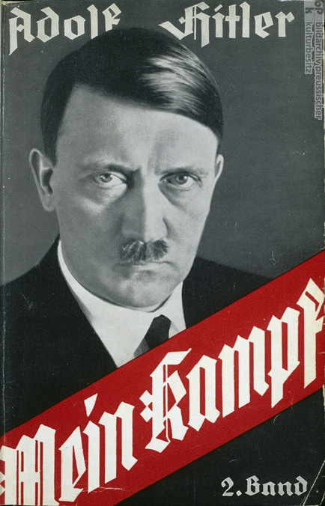
Adolf Hitler – Mein Kampf
Mein Kampf was Hitler’s biography titled “My Struggle” => in the book he rails against the Treaty of Versailles and outlines his major plans for German greatness. He alludes to his strategy to eliminate the Jewish people and invade the Western world to solve the problems created for Germany by WWI.

Slide 75
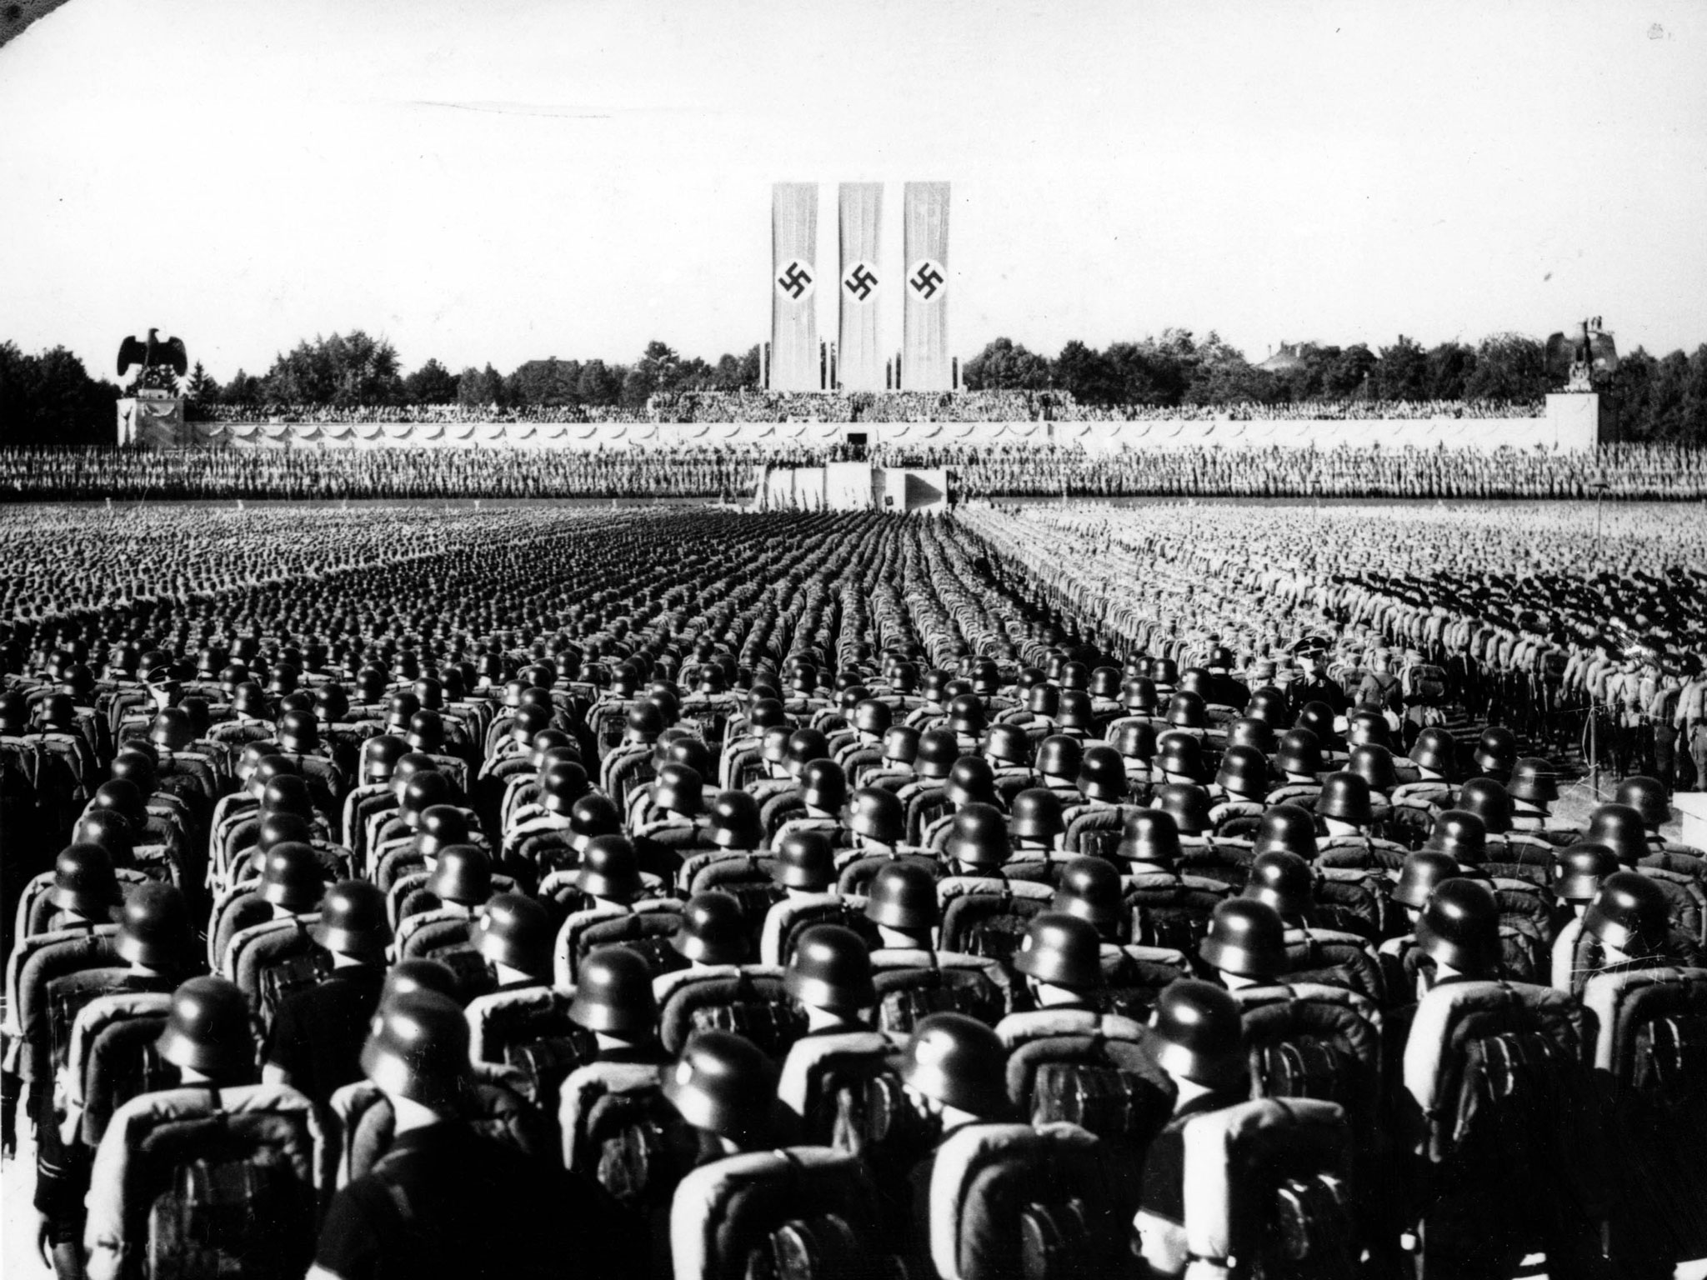
Nuremberg Mass Rally -- 1938

Slide 76
Allied Victory in WWII
By 1942 the Axis had expanded dramatically due to a series of victories =>
Germany controlled most of Europe, N Africa & were advancing into Asia
Japan controlled large sections of China and SE Asia & were advancing across the Pacific => US enters War after Pearl Harbor attack in 1941
However, the Allies ultimately won the war . . . HOW????
#1: Military and Political Cooperation
America and the Allied powers, most notably Britain cooperated militarily and politically from the war’s outset
_______________program gave American weapons to Allies => $50B +
Allies also cooperated on military strategy and aims => i.e. D-Day invasion
-- Coordinated assaults in Africa and Italy
-- D-Day was largest land sea assault in world history in 1944 => involved US, British & Canadian troops, paratroopers, ships, planes
Allies also agreed at the Pottsdam Conference to only accept unconditional surrender from Axis Powers => avoid Treaty of Versailles situation
#2: Industrial Production => US became the “_________________________”
US produced 40B bullets; 300,000 aircraft; 76,000 ships; 86,000 tanks & 2.6 M machine guns => overwhelmed the Axis powers

Slide 77
Allied Victory in WWII
#3: Technological and Scientific Advances
Threat of Nazi advances spurred Allies to invest mightily in R&D
US developed a plethora of scientific advances during the war including code-breaking technology (German enigma machine) & SONAR
-- SONAR counteracted German U-boats
Largest scientific advance though was the ________________=> $2B in funding
Joint US/British effort to develop atomic technology and weapons
In 1945 1st successful detonation occurred in N Mexican desert (Trinity Test)
2 Atomic bombs detonated against Japan => August 7th Hiroshima (an industrial city) w/180,000 casualties; Nagasaki on August 11th w/ 80,000 casualties
-- Japanese finally surrender after 2nd blast (VJ Day on August 14th)
#4: Commitment to advancing Democratic ideals
Early in the war, Churchill and FDR met aboard a ship in the Atlantic and agreed to the ____________________________=> plan for the postwar world
No Allied power would gain territory, self govt for colonies, economic barriers would be reduced, freedom of seas, disarmament after war
-- Blueprint for the UN and many events of postwar world

Slide 78
The Manhattan Project Sites
The Manhattan Project was coordinated between over 30 different sites across America and Canada => all were top secret
Albert Einstein was a key proponent & lead scientist was R. Oppenheimer
At its height the project employed more than 130,000

Slide 79
The Cold War Begins - 1945
WWII totally changed political structure of the world => NWO established w/ new “superpowers”; decline of Europe and decolonization
Nationalist movements in Africa, India, Middle East and SE Asia lead to loss of European colonies and decline of power
New world superpowers = United States and Soviet Union
Both nations pursue an interventionist foreign policy after the war to ensure peace, security and economic growth
Each country also had a different vision of Europe Post-WWII =>
-- USSR & Stalin had suffered massive casualties and wanted weak Germany & E. Europe to serve as a buffer against Invasion (“__________”)
-- US wanted a strong Europe and Germany to help rebuild and ensure prosperity (“Manifest Destiny” = create a free democratic world!!)
“Cold War” thus begins as soon as “Hot WWII” ended
Who?? => ___________________
What?? => ___________________________fought via indirect confrontations, proxy fights and increasing levels of diplomacy and tensions
Why?? =>______________________________; presence of nuclear weapons

Slide 80
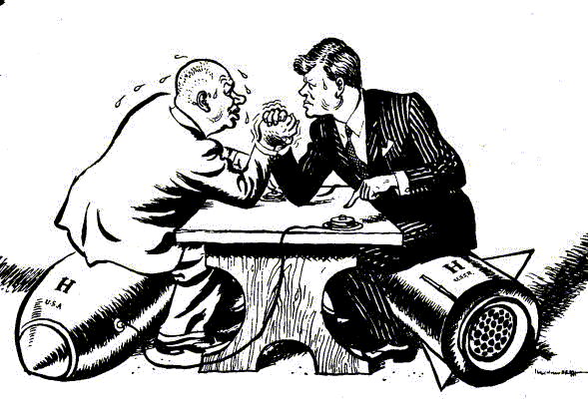
Cold War as an Arm Wrestling Match
Nikita Krushchev arm wrestling JFK during the Cuban Missile Crisis => How is an arm wrestling match a good analogy for the Cold War?

Slide 81
Cold War Strategies
Early in the Cold War President Truman & foreign policy leaders like Kennan & Marshall set general US policies & strategies to “win” the Cold War
Cold War Strategies
Main Strategy = _________________: idea proposed by George Kennan => to defeat Communism one must not let it expand . . . Communism is like a disease Q: HOW??
#1: ___________________=> world agency designed to promote peace and cooperation between world nations (prevent World War III)
Comprised of a Security Council dominated by China, USSR, France, Britain & US as well as a General Assembly of 140+ nations
#2: International Monetary Fund (IMF) & World Bank => attempts to promote economic growth & stability by regulating currency exchange rates & securing loans to aid developing countries (USSR refuses to participate)
#3: ______________________=> economic aid to Europe and Greece/Turkey to rebuild the countries after WWII and prevent Communist takeovers
Total post war aid ~ $17 Billion!! (Creates a Democratic W. Europe for decades)
#4: _______(North Atlantic Treaty Organization) => defense pact between US and W. European countries that promised assistance if any country was attacked
Soviets respond w/ WARSAW Pact (same thing w/ USSR and E. Europe)
#5: Indirect & Direct Confrontations eventually develop and are necessary to defeat the USSR

Slide 82
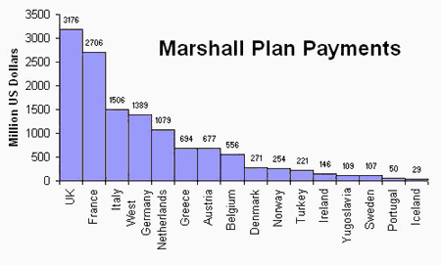
Marshall Plan Payments
George Marshall believed, as many foreign policy leaders did, that the rise of Fascism and political radicalism mirrored economic difficulties . . . Therefore if nations had healthy, stable economies they would reject Communism

Slide 83
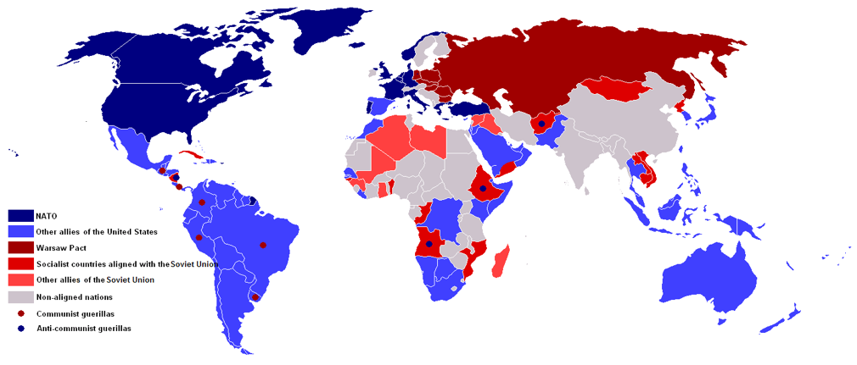
NATO vs WARSAW Nations

Slide 84
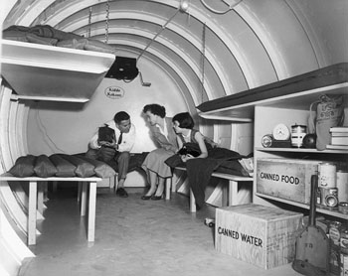
Life Magazine May 1955

Slide 85
Cold War Fighting
During the Cold War the US and USSR engaged in a variety of indirect competitions & direct military confrontations or Proxy Wars . . .
Indirect Confrontations
#1: _______________________=> the US and USSR both sought to maintain strategic military supremacy by devoting large sums to weapons spending and development
USSR develops 1st nuclear weapons in 1949; US develops hydrogen bomb in 1952 => (“Mike”) 1000X more powerful than Hiroshima bombs
Both nations develop ICBM missiles to deliver bombs across continents in minutes and bomber fleets to drop bombs on civilian targets
High levels of domestic spending goes to defense => growth of ____________ _______________________(defense industries) leads to economic dependence
#2: __________________________=> both nations come to view space as strategic and propaganda piece; focus on satellites and space exploration
USSR sends 1st satellite into outerspace in 1957 => ____________________
Post Sputnik US public and leaders fear that there is a “missile gap” w/ Soviets => more weapons & missile programs funded
USSR also beats US into outerspace => Yuri Gagarin in 1959
US commits to “put a man on moon” before USSR => Mercury, Gemini and Apollo missions launched and NASA created
Neil Armstrong walks on moon in 1969

Slide 86
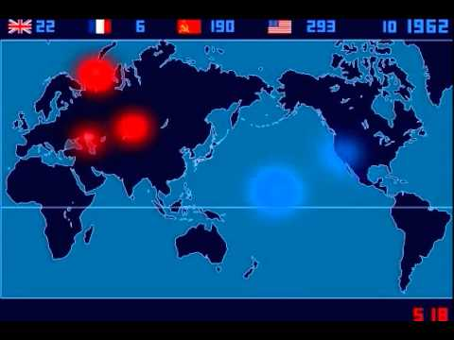
Timelapse video of Nuclear Testing
https://www.youtube.com/watch?v=LLCF7vPanrY

Slide 87
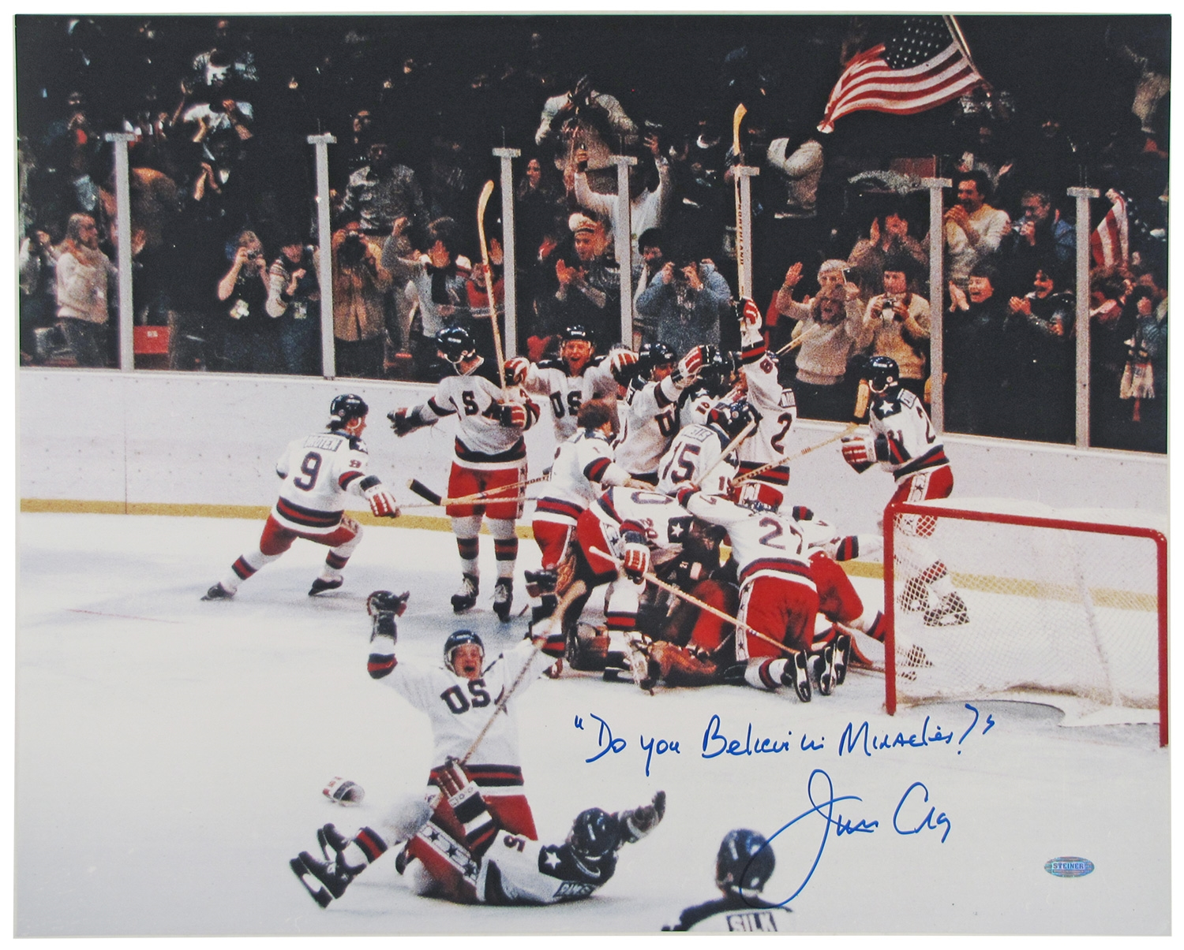
Cold War Fighting
#3: Social competitions
From 1950’s to 1980’s the Olympics took on Cold War implications as to nations competed for athletic and social superiority
Hockey, gymnastics, figure skating, etc…. => 1980 “Miracle on Ice”
“War of Kitchens” pitted American consumer products against Soviet technology during Krushchev’s 1957 US visit => higher standard of living?

Slide 88
“War of the Kitchens” -- 1957

Slide 89
Cold War Fighting
The US and USSR never engaged in a direct military confrontation during the Cold War (Q: WHY???) but did engage in a number of Proxy Wars
Proxy War => conflict between nations via the use of other actors (proxies)
Proxy Wars in Africa
_____________=> the MPLA (People’s Movement for Liberation of Angola) faced UNITA in a struggle to liberate Angola from Portuguese colonial control
MPLA was a Marxist organization and sought to bring Communism to Angola => supported by USSR and Cuba with arms and troops
UNITA was an anti-communist group supported by the US and South Africa with arms and troops
Civil War lasted from 1975 to 2002 and resulted in the deaths of 1-2M
Proxy Wars in Latin America
____________________________=> result of the Cuban Revolution in 1959 in which Fidel Castro became the Communist dictator of Cuba
US wished to re-install a anti-Communist regime and tried to overthrow Castro in 1962 Bay of Pig invasion (failed)
USSR allied with Castro and attempted to install nuclear missiles at Cuban sites => US noticed using U2 spy planes and blockaded Cuba
-- Period of tension almost leads to nuclear war

Slide 90
Soviet Missile Range – October 1962 -- 1st circle = Short range ICBM’s -- 2nd circle = Interm -ediate range ICBM -- 3rd circle = Long range ICBM’s

Slide 91
Cold War Fighting
__________________=> the socialist Sandinistas overthrew the government in 1979 which led to fears that the nation would become Communist
US backed a group called the Contras with arms and $$ => led to Civil War
Proxy Wars in Asia
_____=> Communist North Korea under Kim Jong tried to conquer Democratic South in 1950; led to UN involvement under leadership of US (88% of forces)
North supported by Soviet arms and $$ and Chinese communist forces intervene in 1951 in support of Communist North
After 3 years of warfare & 750,000 deaths the South remained Democratic and North remained Communist => DMZ established and still exists today
__________________=> in 1950’s N. Korean Nationalist leader ________ _________(Communist) fought a successful war against French colonial forces
Divided Vietnam w/ Communist North & Democratic South => 1964 North tries to reunify country militarily (elections in 1962 cancelled by US)
US supports South with Military forces, advisors and weaponry; China and USSR support Northern Vietcong guerillas with weapons, $$ and advisors
After almost a decade of war and 3M+ casualties (60,000 US) Vietnam becomes Communist in 1975

Slide 94
Fall of USSR and End of Cold War
In 1970’s the Cold War entered a period of relaxed tension called détente
______________=> relaxation of tension and conflict between nations
-- Resulted in a series of treaties reducing arms systems between two nations => __________________(Strategic Arms Limitation Treaty)
In the 1980’s the US introduced new weapons systems in response to Soviet involvement in Afghanistan (proxy war => US aids Taliban and Al Qaeda)
US builds new fleet of ________________(fly low under radar) and institutes ______________________=> anti nuclear missile satellite system
Cost = $1-2 Trillion (never functional)
USSR cannot keep up with increased arms spending and collapses economically in 1989 => anti-Communist Revolutions across E. Europe
Soviet Premier Gorbachev initiates economic and political reforms called ________________________________=> freedoms and capitalist ideas
-- USSR large multiethnic empire (92 nationalities and 112 languages) => disintegrates into ethnic turmoil and nationalism w/o strong Communist party
USSR divided into ______________________and Soviet Communist satellites in E. Europe declare independence and reject Communism

Slide 95
Disintegration of USSR

Slide 96
US SDI Program (Star Wars)

Slide 97
Challenges to Global Conflict
Although global conflict, often violent, dominated twentieth century interactions many groups and individuals worked to protest war
#1: _____________________and ______________artistic movement
In 1937 Picasso painted a 11x25 ft mural titled _______to protest the bombing of a Spanish village by Nazi & Italian Fascists during the Spanish Civil War
__________ toured internationally and brought widespread attention to the Spanish Civil War and the brutal tactics of fascist leader Francisco Franco
_______was an nihilist artistic and literary movement that began in 1916 in Switzerland to protest the violence of WWI
Dada attempted to react against the insanity of life and war by creating anti-art => using recycled objects or “_______________” industrial items as art
-- Dada encouraged political commentary and criticized nationalism, imperialism and rationality (all ideas that produced WWI)
-- Dada output included poems, art pieces, sculpture
Famous artists include Marchel Duchamp, Hannah Hoch

Slide 98
Pablo Picasso, Guernica
Guernica was created by Picasso in 1937 in reaction to the Nazi bombing of the Spanish city of Guernica, it is probably the most famous anti-war painting ever

Slide 99
Dada Art Quotes
"Dada does not mean anything.. We read in the papers that the Negroes of the Kroo race call the tail of the sacred cow: dada. A cube, and a mother, in certain regions of Italy, are called: Dada. The word for a hobby-horse, a children's nurse, a double affirmative in Russian and Rumanian, is also: Dada." - Tristan Tzara, Dada Manifesto
"Words emerge, shoulders of words, legs, arms, hands of words. Au, oi, uh. One shouldn't let too many words out. A line of poetry is a chance to get rid of all the filth that clings to this accursed language, as if put there by stockbrokers' hands, hands worn smooth by coins. I want the word where it ends and begins. Dada is the heart of words." - Hugo Ball's manifesto, read at Zunfthaus zur Waag on July 14th, 1916
"We attempted perfection; we wanted an object to be without flaw, so we cut the papers with a razor, pasted them down meticulously, but it buckled and was ruined... that is why we decided to tear prewrinkled paper, so that in the finished work of art imperfection would be an integral part, as if at birth death were built in." - Hans Arp from The Artist in his Studio by Alexander Liberman

Slide 100
Hannah Hoch, Cut with a Kitchen Knife Dada through the last Weimer Beer Belly Cultural Epoch of Germany
Hoch collage is a critique of modern culture created by slicing apart pieces of modern magazines and reassembling it into vivid, disjointed, emotional depictions of modern life. In this collage Hoch pits man against machine. The title refers to the decadence of pre WWI German culture

Slide 101
Challenges to Global Conflict
#2: Self Immolation of ______________=> Vietnamese Buddhist monk protested the anti-communist regime of Diem & Vietnam conflict by self-immolation
Monk was protesting lack of religious freedom and increasing levels of violence and US escalation of conflict in Cold War proxy fight
Duc following ex of Gandhi in satyagraha => self sacrifice & civil disobedience
#3: _____________Movement => the escalation of nuclear arms in 50’s, the Cuban Missile crisis & nuclear power produced a growing anti-nuclear movement
By 1960’s international nuclear non-proliferation movement began
_______________________=> banned nuclear tests in atmosphere, space and underwater (reduce danger of radioactive fallout)
Founding of direct action groups, social advocacy groups and scientific groups to limit the proliferation of nuclear arms and use of nuclear power
-- Exs: Campaign for Nuclear Disarmament, Greenpeace, Intl Physicians for Prevention of Nuclear War
-- Advocate the use of windmills, solar power and other energy sources rather than nuclear due to accidents (TMI, Fukushima)
** Since 1979 more nuclear plants have closed than opened**

Slide 102
Buddhist Protests against Diem

Slide 103
Challenges to Global Conflict
#4: Use of _______________________=> pioneered by Mohandas Gandhi in India’s nationalist campaign for independence from Britain
Denounced the use of violence as a western response, instead advocating the virtues of ahimsa (non-violence) and Hindu aestheticism
As head of Hindu Indian National Congress (an elite Nationalist org) he advocated non-violent protests in response to British policies
-- _______________and Indian homespun (Swadeshi) => Gandhi advocated re- industrialization of India’s textile industry & boycott of British textiles
-- _________________=> in protest of Britain’s ban on salt production, Gandhi & followers produced salt from seawater at Indian Ocean (60,000 arrested)
-- Fasting => Gandhi organized mass large fasts to protest violence between Indians and British; Hindus & Muslims (almost starved to death)
Although Gandhi was repeatedly jailed (6 yrs in jail) his style of protest was successful in recruiting massive numbers of followers from lower classes
-- Gandhi ___________________________________________(patriarchy), instead focusing on anti-colonialism and nationalism
-- Indian Nationalism became a movement of popular participation => wore traditional peasant garb, spoke to outcasts
-- Turned cause of Indian Nationalism into “morally superior cause”
Non –violence became a cause used by many popular protest movements
Used by __________________in 1950’s & 60’s in Af. American fight for Civil Rights
-- Exs: Montgomery Bus Boycott, March on Washington, Greensboro Sit-ins, Freedom Rides through south
-- Resulted in political laws like Civil Rights Act of 1964 (banned racial discrimination) and Voting Rights Act of 1965 (banned voting discrimination)

Slide 104
Gandhi’s changing clothing styles
Gandhi in South Africa as a British trained lawyer vs Gandhi in the 1930’s as an Indian Nationalist leader

Slide 105
Freedom Rides -- 1963

Slide 106
Promotion of Alternate World Visions
Post World War II many groups also promoted alternate visions to the existing social, political and economic order
** Q: What was the dominant social, political & economic order after WWII? **
#1: Communist leaders like _______________________________________in USSR => both offered alternatives to capitalism and consumerism
Appealed to many Nationalist leaders in developing nations like Cuba (Fidel Castro), Vietnam (Ho Chi Minh) and Chile (Salvador Allende)
Communists tried to make their appeal more universal by promoting ideas of economic equality among classes and _________________________________
#2: The __________________________(NAM) => movement of new emergent developing nations during the Cold War that refused to take formal sides
Movement called for abstention from the use of “collective defense arrangements that serve the needs of world powers”
Nations instead focused on promoting colonial independence and economic development => exs: Indonesia, Egypt, India, Ghana
Founded at the 1955 Bandung Conference in Indonesia => currently movement has over 100 member nations
Leaders like Egypt’s Gamal al-Nassir and Anwar Sadat often used status as non-aligned to court support from different world powers
Nasser’s use of USSR support in 50’s to nationalize Suez canal & secure $$ to build Aswan Dam; later in 1970’s he courted US support to secure peace treaty with Israel

Slide 107
Non-Aligned Movement

Slide 108
Promotion of Alternate World Visions
#3: __________________________Movement in South Africa
Q: What was apartheid? => system of racial segregation and discrimination against black settlers in South African government after independence
In reaction to forced resettlement on barren Bantustans black South Africans formed the _____________________(ANC) to protest white rule in S Africa
Engaged in peaceful protests against government passes, organized mine-workers strikes to protest unequal pay
-- During the 1950’s the groups developed ties to South African Communist parties => leaders arrested for being members of party
After the Sharpsville Massacre in 1961, where S. African troops fired on peaceful protestors, peaceful protest was outlawed
-- The ANC formed MK (Spear of the Nation) movement, led by _______ ____________________engaged in terroristic acts of violence in retaliation
-- Mandela was sentenced to prison for over 25 years
By 1990’s Intl pressure mounted on the white ruled govt of South Africa to end apartheid => Mandela released from prison & became President
-- Ne Constitution granted equal rights and political participation => black elites now ¼ of households (9% in 1991)

Slide 109
Nelson Mandela & ANC

Slide 110
Promotion of Increased Violence
Militarized states, for their own purposes, responded to many conflicts by the promotion of military dictatorships in various nations . . .
#1: ______________________=> CIA ousted the leftist government of Jacobo Arbenz in Guatemala in 1954 and installed military dictator Carlos Armas
Arbenz was 1st democratic leader after overthrow of repressive regime of Jorge Ubico => wanted to redistribute land of United Fruit Co
US feared Communist takeover of American state and also wanted to promote US business interests in Guatemala
#2: ____________=> CIA also spent millions behind the scenes to prevent ____________ __________________from coming to power in Chile => eventually won election in 1970
CIA orchestrated the 1973 coup that resulted in Allende’s assassination and installation of Augusto Pinochet => strict anti-communist; tortured opponents & executed 80,000
** Pattern repeated throughout Latin America => Cuba, Argentina, Mexico all ruled by repressive military dictatorships (massacre civilians, control economy)**
#3: ________________=> brutal military coup and dictatorship of _____________ (1971-1979) was supported by Britain and Israel initially with arms, advisors and aid
Both states wanted to prolong ethnic violence in Sudan which destabilized ME states like Egypt and also halt nationalization programs of Obote
Once in power Amin repressed ethnic minorities, & executed over 100,000 political opponents using “killer squads”=> also invaded Tanzania in 1979
Later in his regime Libya and the USSR aided Amin with arms and $$

Slide 111
1973 Chilean Coup
Salvador Allende
Augusto Pinochet

Slide 112
Cuban Revolution
Fulgencio Batista
Fidel Castro

Slide 113
Ugandan Military Dictatorship
Milton Obote vs Idi Amin

Slide 114
Promotion of Increased Violence
#4: ______________ => regime of ultranationalist dictator ______________was supported by Adolf Hitler & Nazi’s in 1930’s during the Spanish Civil War
During WWII Spain remained neutral but after the war the US and European nations supported regime of Franco
Franco was a staunch anti-communist => signed trade agreements with US and provided US military bases in Spain
Sold him arms, gave financial aid and offered him protection of NATO and admittance into UN in 1955
Franco was also a brutally oppressive dictator => utilized concentration camps against political opponents (killed in excess of 250,000)
Francisco Franco

Slide 115
Promotion of Increased Violence
Proliferation of Global violence to achieve political goals indirectly encouraged growth of terrorist groups and use of violence against civilians
#1: ________________________(IRA) => Irish nationalist group that sought to force British withdrawal from N. Ireland (Catholics vs Protestants)
Active from 1969 to 2005 => engaged in bombings against government buildings, British troops (usually sent warnings via telephone calls)
-- Total of 3,500 killed in terroristic violence
Supplied with arms from Libya and sympathetic supporters in US
Eventually did get British to allow greater home rule and provisions for re-unification referendums => 1998 Belfast Agreement
#2: _____(Basque Country and Freedom) => Basque nationalists who use violence against Spanish and French governments to gain independence for Basque region
Over 1000 killed in terroristic attacks against civilian targets and govt buildings => 400+ imprisoned for ETA activities in France and Spain
#3: _________=> Islamic terrorist organization that opposes US intervention in the Middle East aiding Israel, US wars in Iraq and trade agreements w/ Saudi Arabia
Part of history of Arab terrorism => Palestinian groups opposing Israeli state have been active since the 1970’s

Slide 116
Irish Republican Army

Slide 117
Promotion of Increased Violence
Hijacked flights (Pan Am flight 103 in 1988 killed 259) and killed 11 Israeli Olympic athletes at 1972 Munich games
Palestinian and other terrorist groups have traditionally been aided by militant and allied states => i.e. Syria, Iraq and Libya
Al Qaeda, led by Osama Bin Laden has expanded terrorist activities
Bin Laden used personal fortune to set up terrorist training grounds in Afghanistan during the early 2000’s
Upset by Iraq War in 1991, US military presence in ME and aid to Israel => bombed US embassies and attacked military bases
-- Declaration of Jihad against US and allies
Conducted ______________________________against US => killed 3000 and destroyed sections of US Pentagon and Twin Towers

Slide 118
Al Qaeda Terrorism – 9/11

Slide 119
Impact of Violence on Pop Culture
Proliferation of global violence and conflict has had significant impacts on popular culture in many nations . . .
#1: Dada Art => conceived of as a reaction against violence and disorder of WWI
#2: ______________________and other popular movies => movie plots center around spy organizations (Mission Impossible, James Bond), World wars (Saving Private Ryan) or martial arts violence (Matrix)
#3: _______________=> form of art that depicts socialist struggles of proletairet in idealized forms; use of bright colors and idealistic portrayal of communism
Popular in USSR from 1920’s until 1960’s; promoted in other Communist states as well (Eastern Europe, China)
#4: Video Games => Popular video game franchises also use backdrop of global conflicts for storylines and feature graphic violence
Examples => Call of Duty, Fallout (post apocalypse; nuclear weapons??), Elder Scrolls (medieval violence), Assassins Creed (Am Revolution)

Slide 120
Socialist Realism
The Struggle for Freedom and Liberty

Slide 121
Socialist Realism in China

Slide 122
Violence in video games

Slide 123
Call of Duty Series

Slide 124
Fall of Multiethnic Empires and Rise of Nationalism
By 1900 Europe was at its peak => in industrial development, technology, science, wealth and knowledge it exceeded all civilizations before it
Europe is a continent of only 3-4 M square miles (Asia is 17M) yet it controlled over 85% of the globe’s land and population
-- 3 largest powers (Britain, Germany and France) also controlled ½ of the world’s industrial output and ½ of international trade
-- Europe’s colonies reached across the globe and through rails, steamships, telegraph lines and radios linked the world in new ways . . .
By 1960, though the forces of WWI, WWII, Communism and Nationalism had destroyed Europe’s economic and political grip on the world
Destroyed the multi-ethnic colonial empires of great European powers Britain, France, Portugal and Dutch
Also destroyed the large land based multi-ethnic empires => Russian Empire, Ottoman Empire and Qing China
-- All collapsed due to a variety of internal and external factors

Slide 125
Fall of Large Multi-Ethnic land empires
#1: Russian Empire => large multiethnic Russian empire had been suffering from a series of problems for decades
Internal
Political discontent among middle class and educated => Russian Revolution of 1905 had produced few serious reforms despite Constitution of 1906
Introduced ½ elected Duma, but still gave Tsar autocratic authority over Executive branch foreign policy, church and army
Worker discontent => Russian workers were forced to work 12 hour days 6 days week in poor conditions for low pay; unions outlawed
Russian industry concentrated in a few large cities (Petrograd) and therefore workers can mobilize easily
External
World War I => Tsar Nicholas II felt need to personally lead army from front
Nicholas was a poor leader; Russian industry did not produce enough weapons and from 1914-16 2M soldiers were killed and 6M wounded
Nicholas suspended Constitution & Duma during the war => political unrest
Nicholas was insulated from social unrest by wife Alexandria who under advice of Siberian peasant healer Rasputin downplayed turmoil
-- Nicholas orders soldiers to fire on strikers in women strikers in Petrograd => army revolted and Duma stripped Tsar of power (Tsar abdicates the throne)

Slide 126
Russian Revolution 1917
Tsar Nicholas II
Tsarina Alexandria
Rasputin

Slide 127
Fall of Large Multi-Ethnic land empires
After the fall of the Tsar, a provisional government headed by the Duma took charge => continued fighting in WWI for “Russian honor”
Germans secretly shipped Russian revolutionary Vladimir Lenin back to Russia from exile in Switzerland
In Russian cities groups of workers and soldiers formed Soviets to advocate for additional rights and freedoms
Lenin became leader of the Bolsheviks, a political party dedicated to violent communist revolution => believed the time was ripe for Communist Revolution
Promoted three prong plan for Russia through propaganda => “Peace, land and Bread”; Worker Control of Production; “All Power to the Soviets”
In December 1917 the Bolsheviks seized control of government => renamed Communists w/ Lenin as supreme leader
Over the next three years Lenin consolidated control in Russia through a variety of measures . .
-- Agreement of peace with Germany => USSR lost significant lands
-- Victory in Russian Civil War => Communists defeated “Whites” who wanted to restore tsar & western armies in Russia
-- Establishment of secret police (Cheka) => instituted Red Terror (execution of anti-revolutionaries) and executed Tsar & family
By 1921 Russia was a Communist state with Lenin at its head

Slide 128
Treaty of Brest-Litovsk
Negotiated from a position of weakness, the treaty that ended Russian participation in WWI was very damaging to Russia

Slide 129
The Bolshevik Revolution
Vladimir Lenin
Leon Trotsky
Joseph Stalin

Slide 130
Fall of Large Multi-Ethnic land empires
#2: Ottoman Empire => after defeat in WWI the Allies dismantled the Ottoman Empire into separate provinces administered by the mandate system
Ottoman Empire already weak and on brink of collapse => Nationalism, political turmoil among janissaries and House of Saud (anti-Tanzimat)
Mandates = allocation of former German colonies and Ottoman territories to the French and British under League of Nations “supervision”
Mandates basically treated as colonies => resources (oil) exploited by British companies (Govt owned Iraq Petroleum Co & Anglo Persian Oil Co)
-- ME princes were promised independent states if they rebelled against Ottomans during WWI by British officer Lawrence of Arabia
Arabs in Middle East were upset => Wilson’s 14 Points called for Nationalism and self determination for all but only Europeans received this
Turkey did not fall under the mandate system due to the efforts of Mustafa Kemal or Ataturk (“father of the Turks”)
In 1921 he formed a Nationalist govt & expelled Greeks who had been trying to settle and take over parts of Anatolia => created a Turkish Republic
Ataturk embarked on a radical modernization program => abolished sultanate, secularized laws (no sha’ria) & introduced Latin Alphabet
-- Women also received full political and social equality => polygamy forbidden and civil divorce allowed; all families ordered to take a name
-- Modernized dress => eliminated Fez hats & encouraged dress in suits

Slide 131
Nationalism in Europe after WWI

Slide 132
Middle East Mandate System

Slide 133
Ataturk – Mustafa Kemal

Slide 134
Fall of Large Multi-Ethnic land empires
#3: Qing China => Qing China had been limping along for decades ever since the 19th centuries crisises (Opium War and Taiping Rebellion) and by 1911 collapsed
Internal
Population growth => By 1900 China had 400M people and peasant land plots averaged between 1-4 acres (1/2 of what they were in 1850)
Farming methods had stagnated, ½ of harvest taken by taxes
Chinese officials and foreign quarter grew rich off of trade and government monopolies of salt, iron etc… => became attracted to new western ideas
Chinese military was controlled by regional warlords instead of central govt
External
Boxer Rebellion => Cixi & other Confucian officials encouraged Righteous Fists to expel all foreigners from country (failed & China forced to pay indemnity)
Sino-Japanese War (1905) => began over intervention of Japanese in Korea
Industrial Japan crushed China & acquired Asian possessions (Korea & Taiwan) => China now not even most powerful Asian nation
Revolution
Sun Yat-Sen, head of the revolutionary alliance, and Yuan Shikai, the top military commander orchestrated an overthrow of the Manchus in 1911
Started out as a local military rebellion

Slide 135
Fall of Large Multi-Ethnic land empires
Sun organized Guomindang and attempted to westernize China => establish a republic
Yuan Shikai opposed westernization and desired to set up a military dictatorship
Leadership of China passed to Chiang Kai-shek (director of military academy) in 1925 when Sun died
Used position to train loyal commanders
Consolidated power by persecuting Chinese communists and establishing a strong military dictatorship
Chiang tried to modernize and westernize China => develop RR, industry and agriculture
Government officials very incompetent and lazy => motivation is to become “government officials and get rich”
After WWI Japan granted control of German colonial possessions on Chinese mainland

Slide 136
Chinese Revolutionary Leaders
Sun Yat-sen
Yuan Shikai

Slide 137
Post WWII Nationalist Independence Movements
In 1900 European trans-oceanic empires dominated the world politically => European powers controlled 85% of world’s land & majority of population
WWI and WWII weakened Europe’s hold on the colonial empires
-- Total War devastated Europe politically and economically => 50M + dead and economic production and agricultural capacity severely reduced
-- New ideas like Wilson’s 14 Points encouraged nationalist leaders to fight for self determination => Greece, Turkey, Egypt, Balkans successful
European colonial system educated a generation of Nationalist leaders => Kwame Nkurmah, Jomo Kenyatta, Ho Chi Minh and Gandhi
Some leaders and nations negotiated independence => India, Ghana
Some leaders and nations resorted to violent struggle => Angola, Algeria, Kenya and Vietnam
Colonial independence movements created all kinds of new problems => population resettlement, transnational identity, migration & ethnic violence

Slide 138
Consequences of Nationalist movements
Nationalistic movements in the 20th century and the resulting new nations had many demographic & ethnic consequences
#1: Challenges to National boundaries
Many new nations inherited boundaries from colonial settlements and some ethnic groups rebelled against the “artificial boundaries”
_____________________________________=> movement to establish an independent or specially sovereign state of Quebec in Canada
WHY? => Quebecois separatism began in 1960’s due to economic issues
-- Canadian industrialization led to many Quebec factories being owned by English speakers outside Quebec
-- Quebecois believed liberation = greater economic prosperity
=> Quebec is one of Canada’s 10 provinces but is the only one where Catholicism is the primarily religion & French is a widely spoken language
HOW? => ___________________(PQ) formed in 1970’s & advocated NV political separation via referendum (failed in 1980 60%-40% & 1995 51%-49%)
=> ____________________organization was active from 1963-1970 & bombed Montreal stock exchange and kidnapped governmental ministers
=> PQ today is a political party in Quebec that promotes ____________ ____________________(i.e. speaking French, Catholicism, etc…)

Slide 139
Quebecois Separatism

Slide 140
Consequences of Nationalist movements
________________________________________=> the Igbo, an African tribe located primarily in Southern Nigeria
________ were Christian, while N. Nigerians (_____________) were Muslim
-- Oil wealth of Nigeria is also in Southern Nigeria (Biafra)
Nigeria gained independence in 1960, but by 1966 ethnic tensions developed between the Igbo and Hausa clans (based on representation)
-- After coups and counter coups in 1966, Southern Igbos declared independence from Nigeria in 1967 and formed state of Biafra
-- Biafra secession set off _____________________from 1967 -70 => 2M+ Nigerians were killed and Biafra was reincorporated into Nigeria
Biafra movement set off decades of coups and counter-coups => i.e. Christian military general takes control . . . coup by Muslim general
-- State very de-stabilized until 1999 Olasanjo Obasango regime
** Secessionist Movements are a particular problem in Africa where multiple ethnic groups are incorporated into many African states => currently there are over _______________________________in Africa in over 25 countries **

Slide 141
Biafra Separatist Movement

Slide 142
Murdock Ethnic Groups in Africa

Slide 144
Present Day African map

Slide 145
Consequences of Nationalist movements
#2: Population Resettlements => due to national boundary changes and development of new states large scale resettlements sometimes ensued
______________________________=> after 1947 Indian independence the nation was divided into India and Pakistan
India was to become a _______________w/ govt set up by Indian National Congress and Jawaharal Nehru as President
Pakistan was to be a _______________________w/ govt set up by Muslim League and Muhammad Ali Jinnah as President
After plan was announced the public rioted in border areas w/ Muslims killing Hindus and Hindus killing Muslims in border regions
-- Widespread migrations ensued as Hindus and Muslims attempted to get on the “right” side of borders => ____________________________
-- Still animosity today between Pakistan and India over question of __________ => India annexed state but majority of residents were Muslim
Former colonial subjects to imperial metropoles => after independence, many former colonial subjects migrated for economic opportunities
Many studied at universities or resettled due to violence => brought cultures and religions with them
-- Exs: Indians to_____________, Filipinos to____, Algerians to _________
In 1980’s there were over 15M guest workers in European Union => many nations enact tougher immigration laws aimed at keeping ethnic minorities out
-- French law outlawing headscarves worn by women

Slide 146
Indian Partition

Slide 147
African independence Dates

Slide 148
Transnational Movements
To secure independence or to promote regional agendas and development after independence, many peoples sought to promote transnational movements . . .

Slide 149
Post-colonial Transnational Movements
#1: __________________=> Vladimir Lenin believed after WWI that Russian Communism and the anticolonial movements in Africa, Asia and the ME were natural allies
Lenin thought that imperialism was the only way capitalism remained viable => sever imperialism and capitalism (w/o M&M’s) would die
Huge part of USSR foreign policy
Lenin believed communism could be a force for change => promoted party formation through the 3rd Communist International (__________________) in 1919
Headquarters in Moscow trained agents from around the world in precepts of world communism & sent back to their countries to begin revolutions
Lenin believed Communist forces would have to ally with Nationalists (middle & upper classes) to gain independence & then turn after revolution
Appeal of communism was not high in Muslim, Buddhist and Hindu societies => religions united groups and promoted nationalist movements
Communism failed to be a factor in African, Indian & ME ind. Movements
Communism did have a much greater appeal in _____________________=> Confucianism had been discredited by failure to deal with westernization
Communist movements had success in ______________(combined w/ Nationalism)
-- Chinese communist party (CCP) founded in 1921; led by Mao Zedong
-- Vietnamese Communist Party (FCP) led by Ho Chi Minh

Slide 150
Communist International -- 1919

Slide 151
Post-colonial Transnational Movements
#2: ___________________________=> Pan African movement began during the 1920’s with the philosophy of ______________________
Garvey, as part of larger Harlem Renaissance, promoted African pride and __________________________through Black Star Line
Largely ineffective but leads to greater African consciousness
In 1940’s Pan Africanism incorporated African Nationalism & focused on independence => parties like __________________________(KANU) formed
Nationalist leaders used a combination of violent resistance and non-violent negotiation to achieve independence
-- Non-violent negotiation => ___________________in Ghana; Sekou Torre in Guinea; Julius Nyerere in Tanzania
-- Violent resistance => ___________________in Kenya; Ahmad Ben Bella in Algeria; _________________in Mozambique
After independence leaders attempted to promote greater African unity via transregional organizations like the __________________________(OAU)
African nations and Pan Africanism faced many tough challenges after independence due to legacy of colonialism

Slide 152
Marcus Garvey

Slide 153
Pan African Flag

Slide 154
Organization of African Unity (OAU)

Slide 155
Post-colonial Transnational Movements
A: ___________________________=> African boundaries established during European colonization remained after independence
Artificial boundaries combined many different ethnic and religious groups => i.e. Zaire or DRC has 200 ethnic groups speaking 75 different languages
Legacy of ethnic violence and civil wars ensues => 5-6M killed in decade long civil war from 1997 to 2006
B: Difficulty of ______________________=> due to little experience with self government many African nations deteriorated into military dictatorships
From 1957 to 1982 more than 70 African leaders were overthrown by violence
_________in Uganda; Mobutu Sese Seko in Congo; R. Mugabe in Zimbabwe
C: Economic difficulties => legacy of African banana republics led to weakness
Economies struggled to industrialize due to equipment cost & low commodity prices (i.e. gold, bananas, palm oil)
Many African nation’s resources controlled by foreign companies (i.e. DeBeers diamond company) => neo-colonialism
Governmental corruption also plagued many states

Slide 156
Ethnic Map of Congo

Slide 157
Idi Amin Dada -- Uganda
General Mobutu Sese Seko -- Congo

Slide 158
Robert Mugabe -- Zimbabwe

Slide 160
Child Soldiers in Sierra Leone

Slide 161
Post-colonial Transnational Movements
#3: Pan-Arabism => idea that all Arabs constituted a single nation; popular in Middle East and North Africa in 1950’s and 60’s
Promoted by _______________________(Egypt) & newly formed Ba’ath party => desired to unite all Arab states and promote development and prosperity
Nasser Nationalized ______________________in 1957 and evicted British and French => earned admiration of other Arab states in ME
Ba’ath party in Syria opened talks to create a new Arab state in ME => combination of Syria and Egypt called United Arab Republic (UAR)
-- Nasser promoted creation of an even larger Arab republic => kings of Saudi Arabia, Jordan & Iraq opposed due to sharing resource wealth (oil)
-- UAR fell apart in 1961 when Ba’ath party overthrown in Syria
Arab nationalism further discredited by loss of Arab coalition to Israel in 6 Day War in 1967 and loss of territories (Nasser tried to promote unity via Israeli opposition)
-- Libyan leader ___________________tried to revive Arab nationalism in 1970’s but was discredited by extreme policies (use of violence) and terroristic actions
Arab Nationalism has evolved from vision of a unified state to practical cooperation on economic matters, matters of political independence
____________________(founded 1945) has become main instrument of this vision
22 member states meet regularly to settle Arab disputes, promote economic growth, foster educational initiatives and deal with Arab migrant labor issues
-- League has been instrumental in preserving Arab cultural sites as well

Slide 162
Pan-Arabism

Slide 163
Pan Arabic Leaders
Libya’s Muammar Gaddafi
Egypt’s Gamul Abdul Nasser

Slide 164
Genocide in the 20th Century
Genocide => coined by Polish writer Ralph Lemkin in 1941 by combining the Greek word ‘genos’ (race) with the Latin word ‘cide’ (killing).
Genocide as defined by the United Nations in 1948 means any of the following acts committed with intent to destroy, in whole or in part, a national, ethnic, racial or religious group, including: (a) killing members of the group (b) causing serious bodily or mental harm to members of the group (c) deliberately inflicting on the group conditions of life calculated to bring about its physical destruction in whole or in part (d) imposing measures intended to prevent births within the group (e) forcibly transferring children of the group to another group.
"Thus for the time being I have sent to the East only my 'Death's Head Units' with the orders to kill without pity or mercy all men, women, and children of Polish race or language. Only in such a way will we win the vital space that we need. Who still talks nowadays about the Armenians?"

Slide 165
German Concentration Camps

Slide 166
Nazi Concentration Camp

Slide 167
“Educating” the new prisoners

Slide 168
Mass Grave at Nazi Death Camp

Slide 169
Nazi Holocaust Figures

Slide 170
Jewish Holocaust Deaths

Slide 171
20^{th &} 21st Century Genocides
Genocide | Years and Location | Estimated Deaths
Holocaust | 1933-1945 in Nazi occupied Europe | 6-10 million
Armenian Genocide | 1915-1923 in Ottoman Empire | 1-2 million
Cambodian Genocide | 1975-1979 | 2-3 million intellectuals, city dwellers, wealthy, foreigners & Buddhists
Rwandan Genocide | 1994 | 800,000 Tutsi
Darfurian Genocide | 2003-2010 | 500,000

Slide 172
Armenian Genocide -- 1915

Slide 173
Pol Pot & Killing Fields

Slide 174
Rwandan Genocide

Slide 175
Rwandan Genocide -- 1994

Slide 176
Refugees in the 20th Century
Refugee (refyoo’je) => a person who has been forced to leave their home in order to escape war, persecution or natural disaster
The situations and conditions prevelent in the 20th century create massive refugee populations for various reasons . . .
#1: Total War => the targeting of civilian populations destroys homes and forces many to leave their countries, most who never return
During and after WWII large numbers of refugees roamed Asia and Europe
90 M Chinese fled the Japanese advance into parts of SE & Central Asia
Millions fled the advance of the Russian Red Army in 1944
#2: Genocides => targeting of ethnic populations in many areas during the 20th century also caused large numbers of refugees
Millions of Jewish people fled the Nazi regime to W. Europe & the US
Genocides in Armenia, Rwanda, Cambodia and Darfur also caused peoples to flee to neighboring countries
#3: Terrorism and continued wars => terrorist acts in Israel, prolonged wars in many areas of Africa due to political instability after decolonization

Slide 177
Refugee Populations
Refugee commonalities . . .
Most come from poorer nations and settle in other poorer nations => most common areas today are the ME and Africa
Great majority never return to their homelands

Slide 178
Refugee Case Study -- Palestinians
Zionist Jewish settlement in Palestine
After WWI the British agreed to create a Jewish state in ME=> Balfour Declaration
Between WWI and WWII many Jews migrated to Palestine => favored setting up an independent Jewish state
In 1947, due to pressure to resettle European Jews after the Holocaust, the UN voted to divide Palestine into two states => Israel and Palestine
In 1948 Israel declared independence and Palestinians, aided by neighboring Arab states immediately attacked Israel => Israel prevailed due to US support
From 1948 to 1974 Israel & its neighbors fought 1967 Six Day War and 1973 Yom Kippur War => both won by Israel who increased land holdings
Over 1.5M Palestinian refugees fled the violence and lost their native homelands => settled in Jordan, Lebanon and Syria
-- 1M Palestinian refugees overwhelmed the 500,000 Jordanians; 500,000 Palestinians disrupted ethnic balance in Christian Lebanon
-- Refugee Palestinians demanded the return of their native homelands & sought Arab support for their plight (Arab states support due to Arab Nationalism)
Refugee Palestinians, w/ Egyptian support, started Palestinian Liberation Organization (PLO) in 1970’s to secure the elimination of Israel
-- Under Yasser Arafat in 1980’s the PLO executed the intifada => used terroristic bombings, rocket attacks and suicide bombings against Israel
-- PLO & Israel are still at odds today and violence regularly erupts

Slide 179
Palestinian Land and UN Partition

Slide 180
Six Day War -- 1967

Slide 181
Leads to Pan Arabism => ideology that sought to unite all Arab states in ME and North Africa into one political entity
-- Pan Arabism stressed the cultural unity of Arab states and the Islamic religion and sought to create a new Islamic Caliphate
-- Although unification has been attempted by many

Slide 182
Pan Arabism

Slide 184
During the early 20th century Indian nationalists increasingly demanded independence from Britain => demands increased after WWI
Educated Hindu leaders form the Indian National Congress
In 1919 British Gen Dyer ordered his troops to fire on Indian nationalist protests in Amristar => 400 killed; 1200 wounded
Gandhi responded

Slide 185
Impact of Increased Global conflict & violence
During the Cold War, huge arms buildup led to the growth of the Military Industrial Complex => Q: What is the Military Industrial Complex?
MIC = defense companies and industries who supply advanced weapons to the US (i.e. ICBM, fighter planes, bombers, guns. . . )
During Cold War industry greatly expanded as US & USSR budgets became dominated by defense (25% of US; up to 50-60% of USSR)
By 1965 the US and USSR each had enough nuclear bombs to destroy the world 10x => kept expanding stores
Both nations also sold arms to nations allied with them to fight proxy fights that promoted either Democracy or Communism . . .
-- US supplied weapons to Contra rebels in Nicaragua during the 1980’s; Iraq in the 1980’s, Israel up to the present day; Taliban rebels and Al Qaeda during the Afghanistan-USSR war in the 1980’s
-- USSR supplied weapons to Idi Amin in Uganda during the 1970’s; Vietnam during the 1960’s
** US and USSR supplied weapons led conflicts to become more deadly and also encouraged and prolonged many conflicts**

Slide 187
US vs USSR military arsenal

Slide 188
Contras in Nicaragua; NVA in Vietnam

