Slide 1
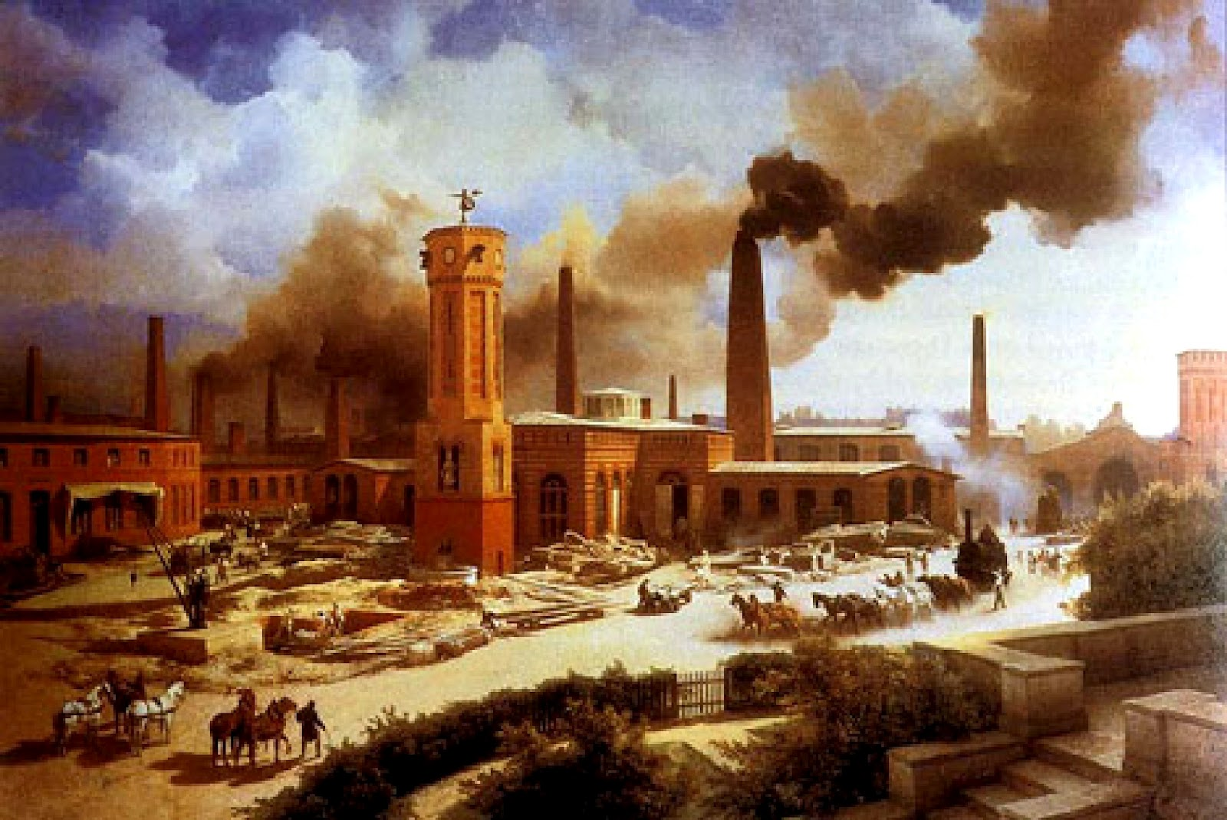
AP World History Unit V – The Age of Revolutions 1750-1900

Slide 2
Unit Questions & Periodization
Why 1750?
Start of various different “________________” => i.e. The ___________(1776); ______________________(1789) & _______________________(~1750)
Why 1900?
Beginning of a new “modern” age =>_________________; new technologies developed and world converges
Major Unit Questions
#1: How did the Industrial revolution change production, effect social and demographic trends & lead to inequalities between nations and social classes?
#2: Why did Europe lead Industrialization? What role did state governments outside of Europe play in attempting to repeat industrialization?
#3: Analyze changes and continuities in long-distance migrations in the period from 1700 to 1900. Be sure to include specific examples from at least TWO different world regions.
#4: Analyze changes & continuities in labor systems between 1750-1900 in ONE of the following areas: L. America & Caribbean, Russia, Sub Saharan Africa.
#5: Compare and Contrast the roles of women in TWO of the following areas during the period 1750 to 1900 => W. Europe, Sub Saharan Africa, East Asia or Latin America
#6: Contrast and compare the responses of Japan and China to western penetration in the 19th century.
#7: Compare and contrast the effects of political revolutions from 1750 to 1900 in TWO of the following areas => North America, Western Europe, Latin America

Slide 3
The Age of Revolution – What was it?
What was the “Age of Revolutions”? => massive and important economic and political revolutions took place in many areas of the globe
Revolutions had large &long lasting social & demographic consequences
New revolutions and their consequences/reactions created specific characteristics to this time period
#1: European dominance of global trade => Europeans used industrial power, unequal treaties, colonization & military power to control all major trade routes
#2: Rise of “have” and “have not” countries=> Industrial revolution gave huge economic and political advantages to participating countries
#3: Inequalities among regions due to Imperialism => Industrial nations formed overseas empires either through colonization, economic or political domination
#4: Large numbers of political revolutions inspired by desire for democracy or independence=> these type of revolutions continue to the present, but the “seed” revolutions during this period created the ideology and democratic forms needed
#5: Increasing amounts of overseas migration => peoples from around the globe migrated in increasing amounts, primarily for economic opportunities
#6: Rise of the “isms” => Capitalism, socialism, communism, liberalism, anarchism, nationalism all presented divergent views of the world and its future

Slide 4
Major Events of the Age of Revolutions
The Age of Revolutions (1750-1900) contains many major and significant world developments . . .
#1: Industrial Revolution => application of machine power to production; led to huge transportation changes (steamships, trains, canals)
Also led to huge demographic and social changes
#2: Political Revolutions => i.e. American Revolution (1776); French Revolution (1789); Haitian Revolution (1791); Latin American Revs (1820’s)
#3: Creation of new economic models/visions => Capitalism (A. Smith), socialism (H. Saint-Simon), communism (Marx), anarchism . . .
#4: Rise of Nationalism => national pride and unity that led to unification of states like German & Italy; emergence of others (Egypt)
#5: End of serf and slave systems => Russia and US were last stalwarts
#6: Extension & Rise of European Imperialism => Europeans set up system of economic dependence in many areas (i.e. Asia, Africa, L. America)

Slide 5
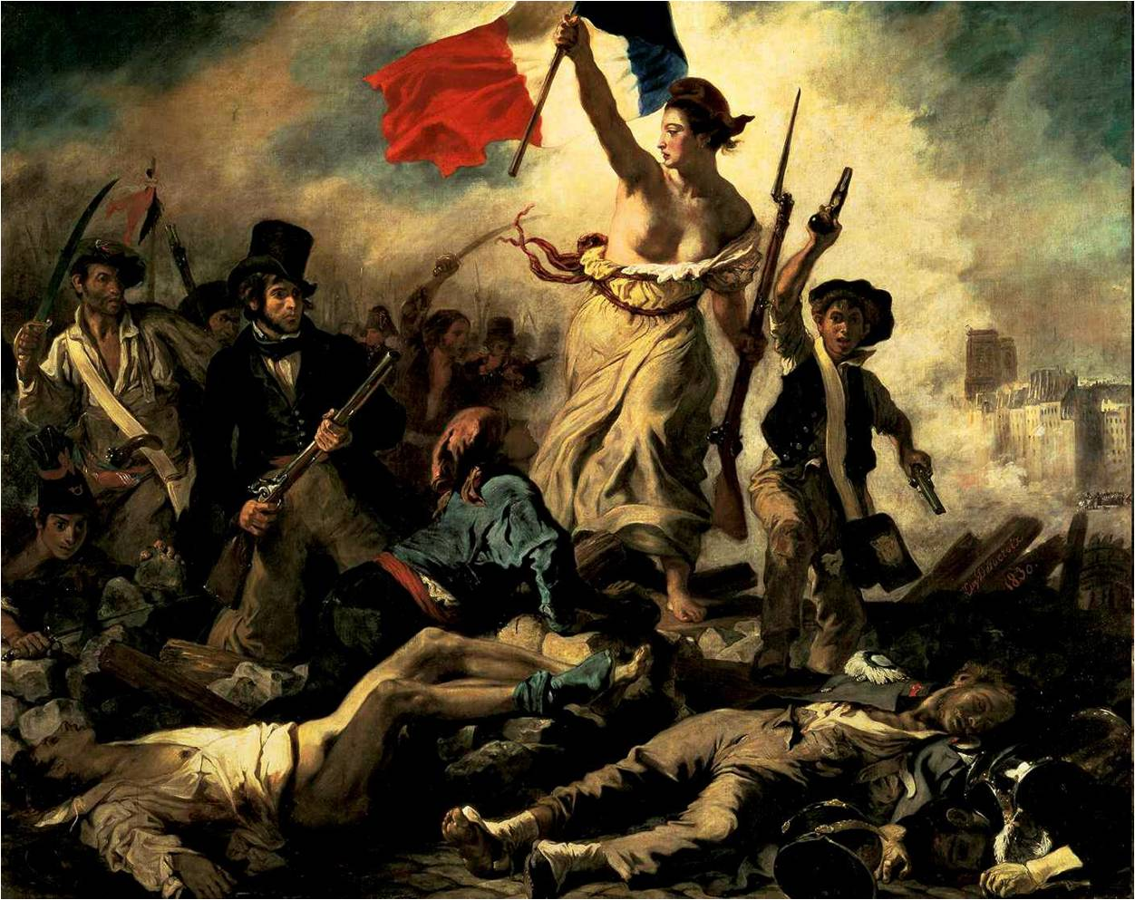
What is a Revolution?????
Rev·o·lu·tion (revəˈlo͞oSH(ə)n/) =>
1. a dramatic and wide-reaching change in the way something works or is organized or in people's ideas about it.
2. a forcible overthrow of a government or social order in favor of a new system (i.e. the American Revolution)

Slide 6
World Demography (by region) 1750 to 1900
 | 1700 | 1870 | 1913
Western Europe | 81.4 | 187.5 | 261
Asia | 374.8 | 730.6 | 925.9
Africa | 61 | 90.4 | 124.7
Latin America | 12 | 40 | 80.5
United States | 1 | 40.2 | 97.6
World | 603.4 | 1,270 | 1,791
Figures based on David Christian, Maps of Time: An Introduction to Big History

Slide 7
The Industrial Revolution -- Intro
Q: What was the state of industrial production in 1750?
Power? => wind, water, animal and human
Workplace? => home and workshop
Basis of economy? => agriculture (____% farmers)
Demography? => rural society (____% rural in 1750)
Basis of wealth? => land (aristocracy & nobles hold)
Impact on environment? => minimal
The Industrial “Revolution” was actually a more gradual process of innovation that made use of new sources of power and inventions to fundamentally change modes of production GLOBALLY
Ind. Revolution altered conception of a “good” & their consumption
Earlier, cruder forms of industrialization existed => “_________________ processes => i.e. “_________________”, sugar plantations, silver mining
The process of industrialization began in __________around 1750 & spread to parts of___________________________________________________
Q: Why Europe? Why Britan? => Some argue for “Eurocentric theories” (i.e. Europe is “superior”) . . . However, there were a confluence of factors

Slide 8
Industrial Revolution – BIG 9 Causes
#1: Europe’s/Britain location on ________=> access to trade routes (cheap)
#2: Europe’s/Britain’s abundant supply of ________________=> huge deposits of timber, coal and iron ore (needed for industrialization)
#3: Improved ________________________=> enclosure movement = large scale farming & lower costs (seed drill, metal ploughs, new fertilizers)
#4: _______________________=> displaced farmers moved to cities and started an urban revolution in Britain before other places
#5: European __________________=> Europe in 1700 (100M); Europe in 1900 (400M) . . . Improved diet (potatoes) leads to surplus labor supply
#6: Access to ________________=> Britain was a small island nation w/ many rivers and canals connecting them (whole nation within 50 miles of water)
#7: Private ____________________=> Enlightenment ideals passed into law by Parliament gave incentive to accumulation of wealth
#8: Access to ______________________=> Europe controlled over 40% of globe via colonial possessions and trading posts
#9: Accumulation of __________________=> stable political structure, few wars, central bank & 200 years of colonialism gave Britain flexible finance mkts & led to entrepreneurship

Slide 9
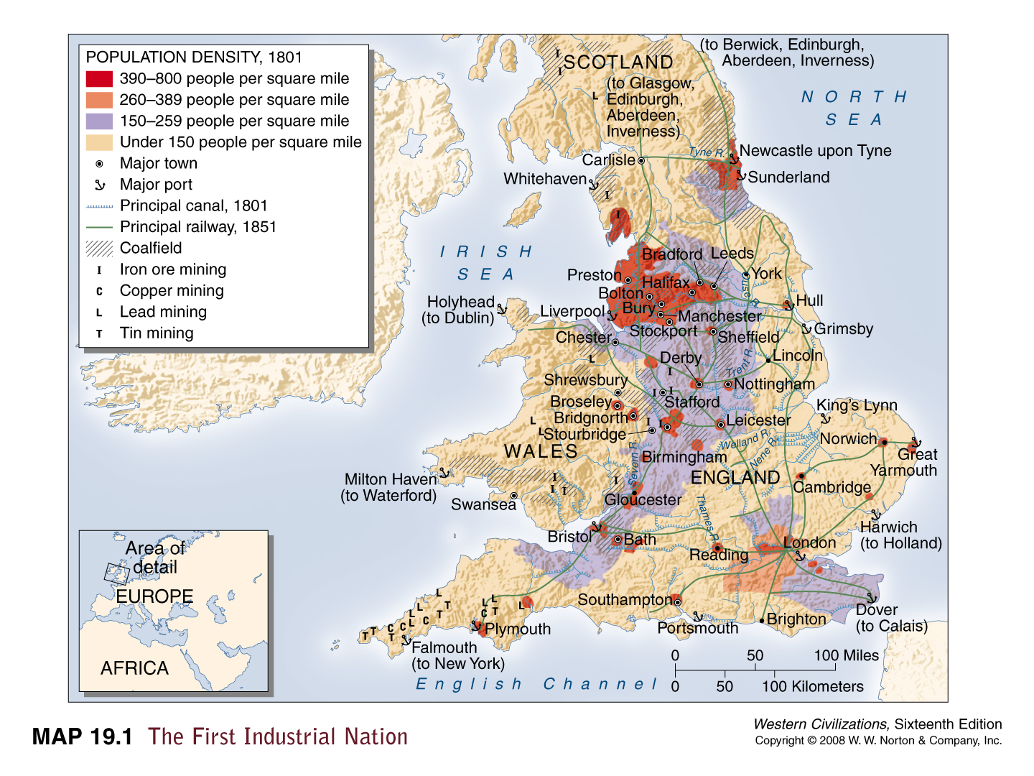

Slide 10
Industrial Revolution -- Production
The main effect of the Industrial Revolution was on the production of goods
By 1851 Britain produced 2/3 of the world’s coal and ½ of its iron
-- Created 20% of the world’s output of manufactured goods (2% in 1750)
Q: How?????
#1: Application of _______________________(i.e. coal, oil after 1900) => releases large amount of energy that can be harnessed by machines
Coal production in 1750 = 10M tons; 1860= 130 M tons; 1900 = 1B tons
#2: New inventions =>__________________________________________
Steam engine allows creation of machines to do work at an ever faster pace => i.e. Spinning Jenny, locomotive (___________________)
___________________(Eli Whitney) allows production of cotton to increase
-- America exports 1.5 M lbs of cotton in 1790 vs 85 M lbs in 1810
#3: Introduction of ______________________=> workers come to factories to which employ large expensive machinery
Utilize a ____________________=> speeds up production (reduces skill)
#4: 2nd Industrial Revolution (late 1800’s) => industrial advancements in _______________ _______________________(engines and cars), ____________________
Leads to development of rubber, mass produced guns, lightbulb, steel
New products such as steel buildings (skyscrapers, department stores), electric machines (i.e. sewing machine), cars (i.e. Ford), radios and telephones

Slide 11
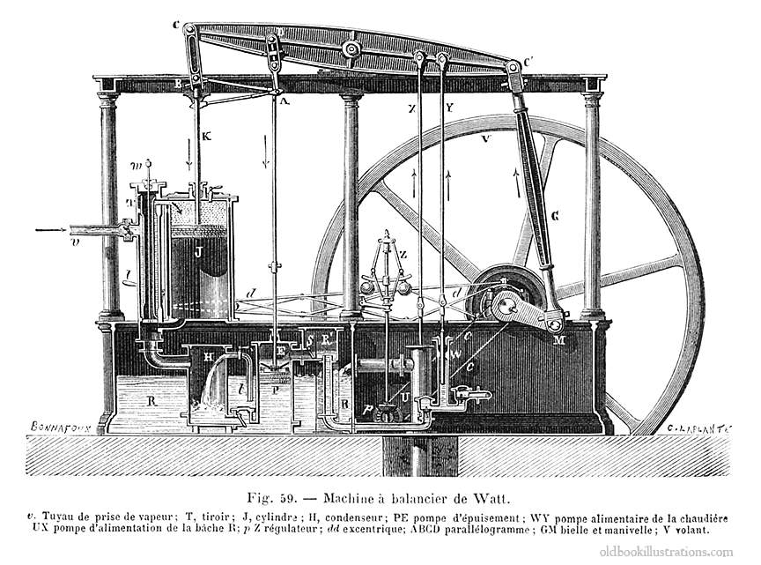
Watt Steam Engine => originally used to pump water out of mines (increase coal production)

Slide 12
US Steel Production & General Industrial Production

Slide 13
Industrial Revolution Case Study -- Textiles
The first British Industry to industrialize was the textile Industry => case study for other industries . . .
Step #1: British textile merchants export cotton in 1750, want to speed up production and therefore make more $$$$
Utilize “Putting Out System”
Step #2: Inventions like Flying Shuttle and Spinning Jenny make weaving and production of yarn faster => inventions expensive
Step #3: Inventions are moved to factories near water where workers specialize in each step of process (i.e. weaving, loading yarn, clearing jams)
Step #4: Invention of Watt Steam engine allows factories to be located anywhere and produce cotton faster
Step #5: Steam engine leads to invention of locomotive => cotton textiles can be shipped around country and world much quicker & coal moved to factories

Slide 14
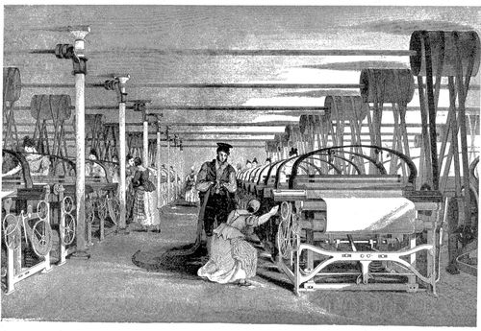
British Textile Factory ca 1800

Slide 15
Specialization of Labor – The Pin Factory
In Wealth of Nations, Adam Smith gives a classic example of specialization of labor in a pin factory . . .
Some workers pull wire of a spindle
Others straighten wire on series of posts
Others cut wire into shorter lengths
Others Sharper wires into needles
Lastly, others coat w/ tine and finish needle

Slide 16
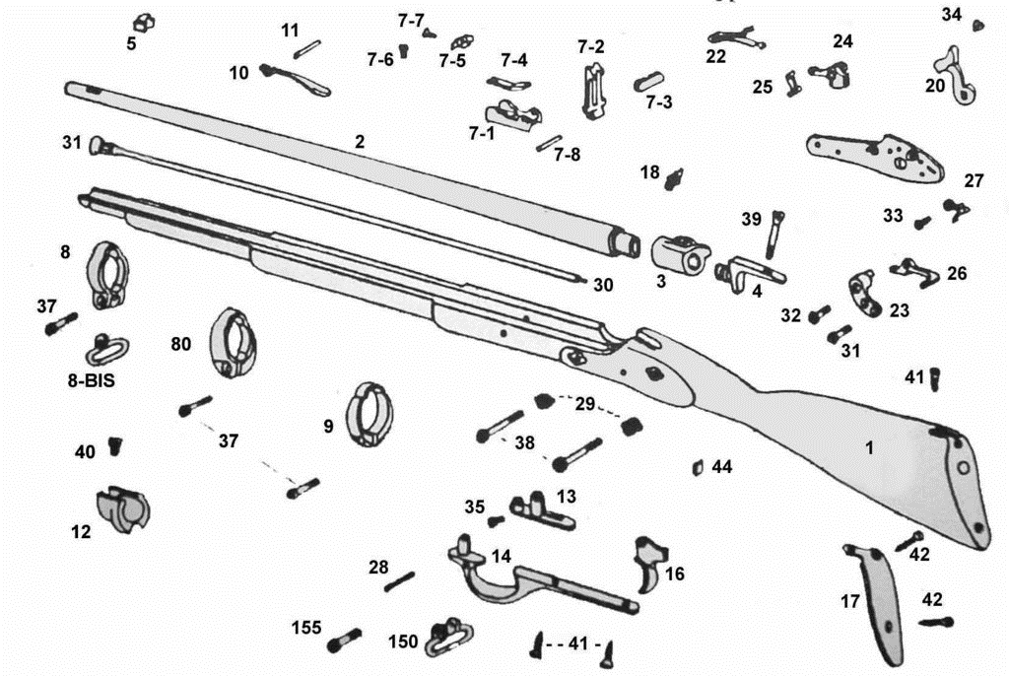
Eli Whitney’s Interchangable Part Gun

Slide 17
Industrial Revolution – Global Trade
Ind. Revolution greatly increased the military, economic & political strength of countries who participated => further integrated global economy
By 1900 Europe controlled over ______% of the globe (40% in 1750) => why??? . . . Industrial Revolution need for resources and markets
What developed was an international division of labor
Industrialized nations specialized in _______________________(i.e. textiles)
Non-Industrialized nations specialized in mass producing ______________ _____________________________(“Banana republics”)
-- Exs: _______(India); ____________(Congo & SE Asia); ________(W. Africa); __________(Argentina); ____________(Peru and S America)
-- Problems????
Industrialization also led to the decline of agriculturally based economic models of production => i.e. textile production in India
British textiles undersold Indian textiles on world market
“_______________” economies owned & controlled by industrial investors => i.e. American investors buy sugar plantations in Cuba (lack of $$ for industrialization)
Q: Economic effect??? ________________________________________
_____________________________________________________________

Slide 18
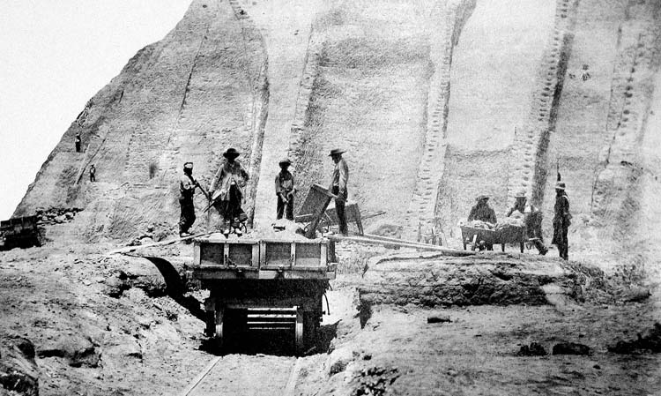
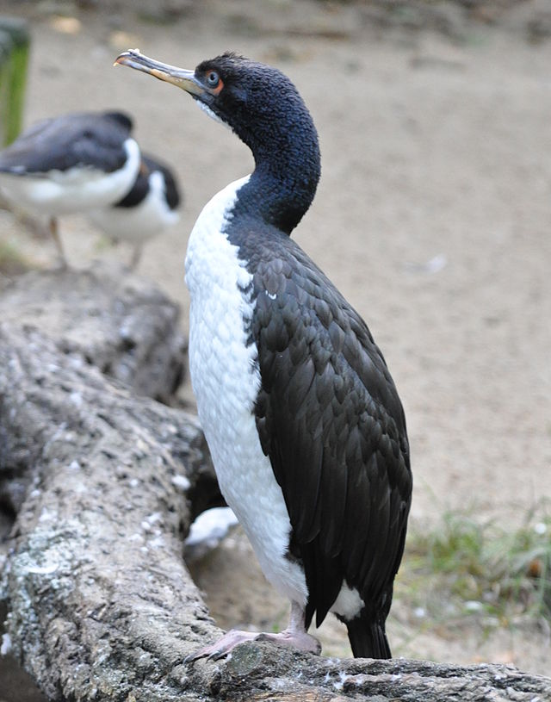
Single resource Export Economies – Guano Case Study
After the end of Spanish colonization and drying up of the silver mines, Peru needed a new export commodity => Guano (bat and bird dung)
High in nitrogen, phosphate and potassium
Above: Guanay Cormorant (#1 Guano producer)

Slide 19
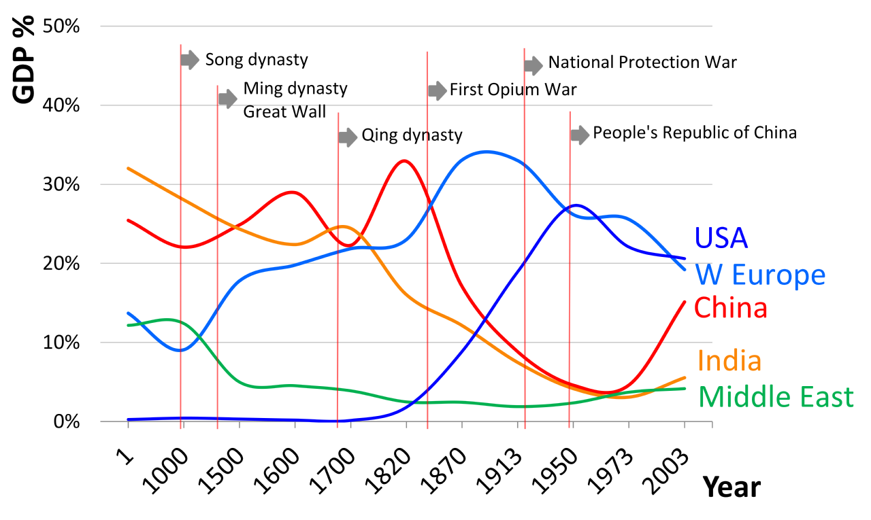
Share of World GDP by region

Slide 20
Industrial Revolution – Global Trade
Many non-industrial nations also ended up being colonies of Ind. nations => served resource needs & also provided market for finished goods
___________________expands greatly => acquire wool and beef from Australia; sugar from Java; cotton from India
US & Japan expand in Pacific => Hawaii, Philippines, Manchuria, SE Asia
Need for specialized minerals (industrial production )& use of gold, silver & diamonds as forms of wealth led to acquisition of mining centers
-- i.e. ______________in Mexico; ______________________in S Africa
Need for new markets also induced European nations to try and open new markets for their manufactured products
Repeated attempts by the British and French to “open” Chinese market during the 19th century => 1800 Europeans can only trade in _________ -- British sent ______________(1793) to open Chinese trade (failure)
-- Efforts ultimately culminate in _____________(1842) and British acquisition of Hong Kong as a port & opening of 5 additional ports
-- US opens Japan via _______________mission in 1852
Trade balance reversed => Europe exports more than imports by 1850

Slide 21
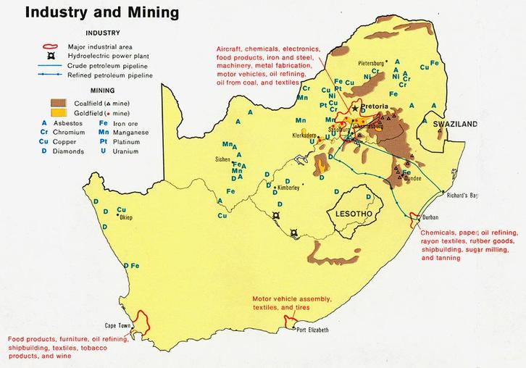
South African Gold & Diamond mines
For over 100 years the DeBeers Company had a worldwide monopoly on diamond production due to their S African mines
2005 US geological survey attributed 50% of gold reserves to S Africa

Slide 22
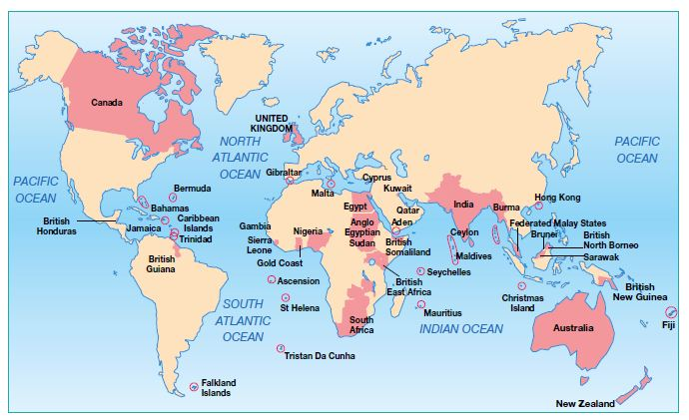
British Empire in 1900
Commentators at the time called the British Empire “the empire on which the sun never sets”

Slide 23
Industrial Revolution -- Economics
Industrialization was NOT free and thus financiers and industrialists developed methods to facilitate industrial growth . . .
Ideology of Industrial Revolution
Capitalism => ideas formulated by ______________________________(1776)
_____________________advocated lack of government intervention in economy => allow the “__________________” to control economy
Capitalism also included the control of resources of production by private individuals with secure private property rights & guarantees of freedom
Adoption of capitalist philosophy by European nations was a major boon to industrialization => promoted risk and reward of industrial production

Slide 24
Industrial Revolution -- Economics
________________=> founded by JS Mill
Based on ideas of ______________ ____________________________
Believed in ideas of free speech, free trade, free press and civil rights
Economic liberalism or ______________was idea that govt should act to promote greatest public good
Used to promote such ideas as . . .
-- Low govt taxation (business)
-- Laissez Faire policies
-- Free trade (i.e. repeal of Corn Laws in Britain in 1846)
-- Social welfare acts => i.e. British Factory Acts, prison reforms, Metro Police

Slide 25
Industrial Revolution -- Economics
New financial instruments were also employed to finance industrial growth
#1: __________________________=> growth of stock exchanges in London, Amsterdam, New York & Tokyo mirrored industrial growth
Stock Exchange => place where brokers and investors can trade the issues of company stocks (most common = London; LSE & New York; NYSE)
Stock exchanges led to greater flow of capital and investment $$ => growth of companies easier and capital allocated efficiently
#2: _____________________=> _____________________starts in 1700’s (starts at Lloyd’s Coffeehouse); become Society of London Exchange in 1774
Provides business insurance policies to ensure against risks of shipping
Fire Insurance Cos also begun after Great London Fire of 1666 => minimizes and spreads risk of industrial fire
#3: _____________=> due to discoveries of gold in S. Africa & Alaska/California an international gold standard was set up (all currencies backed by gold)
Led to a more stable international currency market => ease of exchange
Also led to expansion of $$ supply => currency fixed at exchange rate
Q: Who do hard $$ policies promoted by gold standard favor???

Slide 26
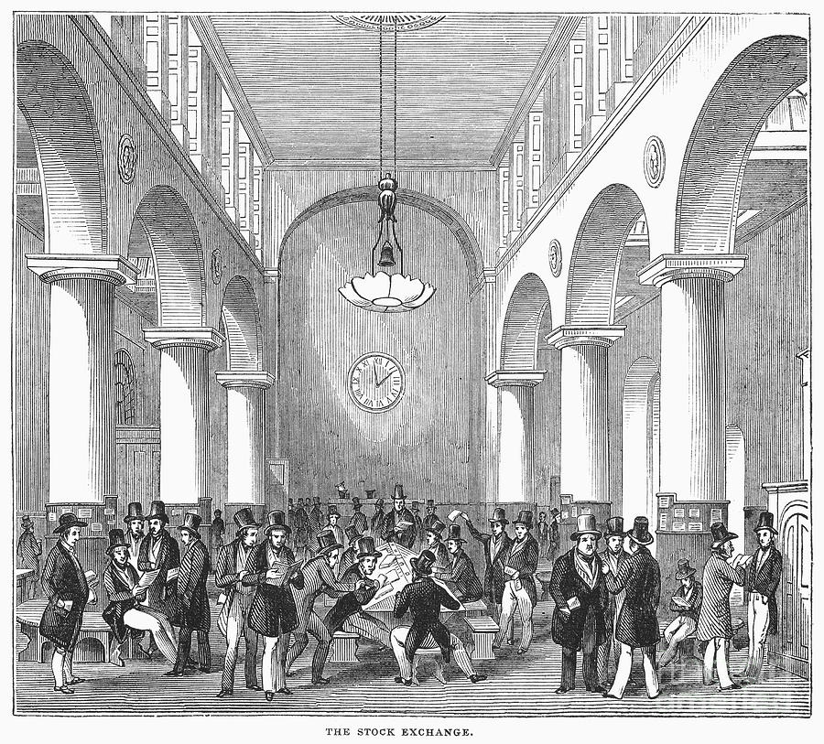
World Stock exchanges in 19th Century
Q: How would stock exchanges and stock aid industrial growth in Britain, US, Japan & other nations?

Slide 27
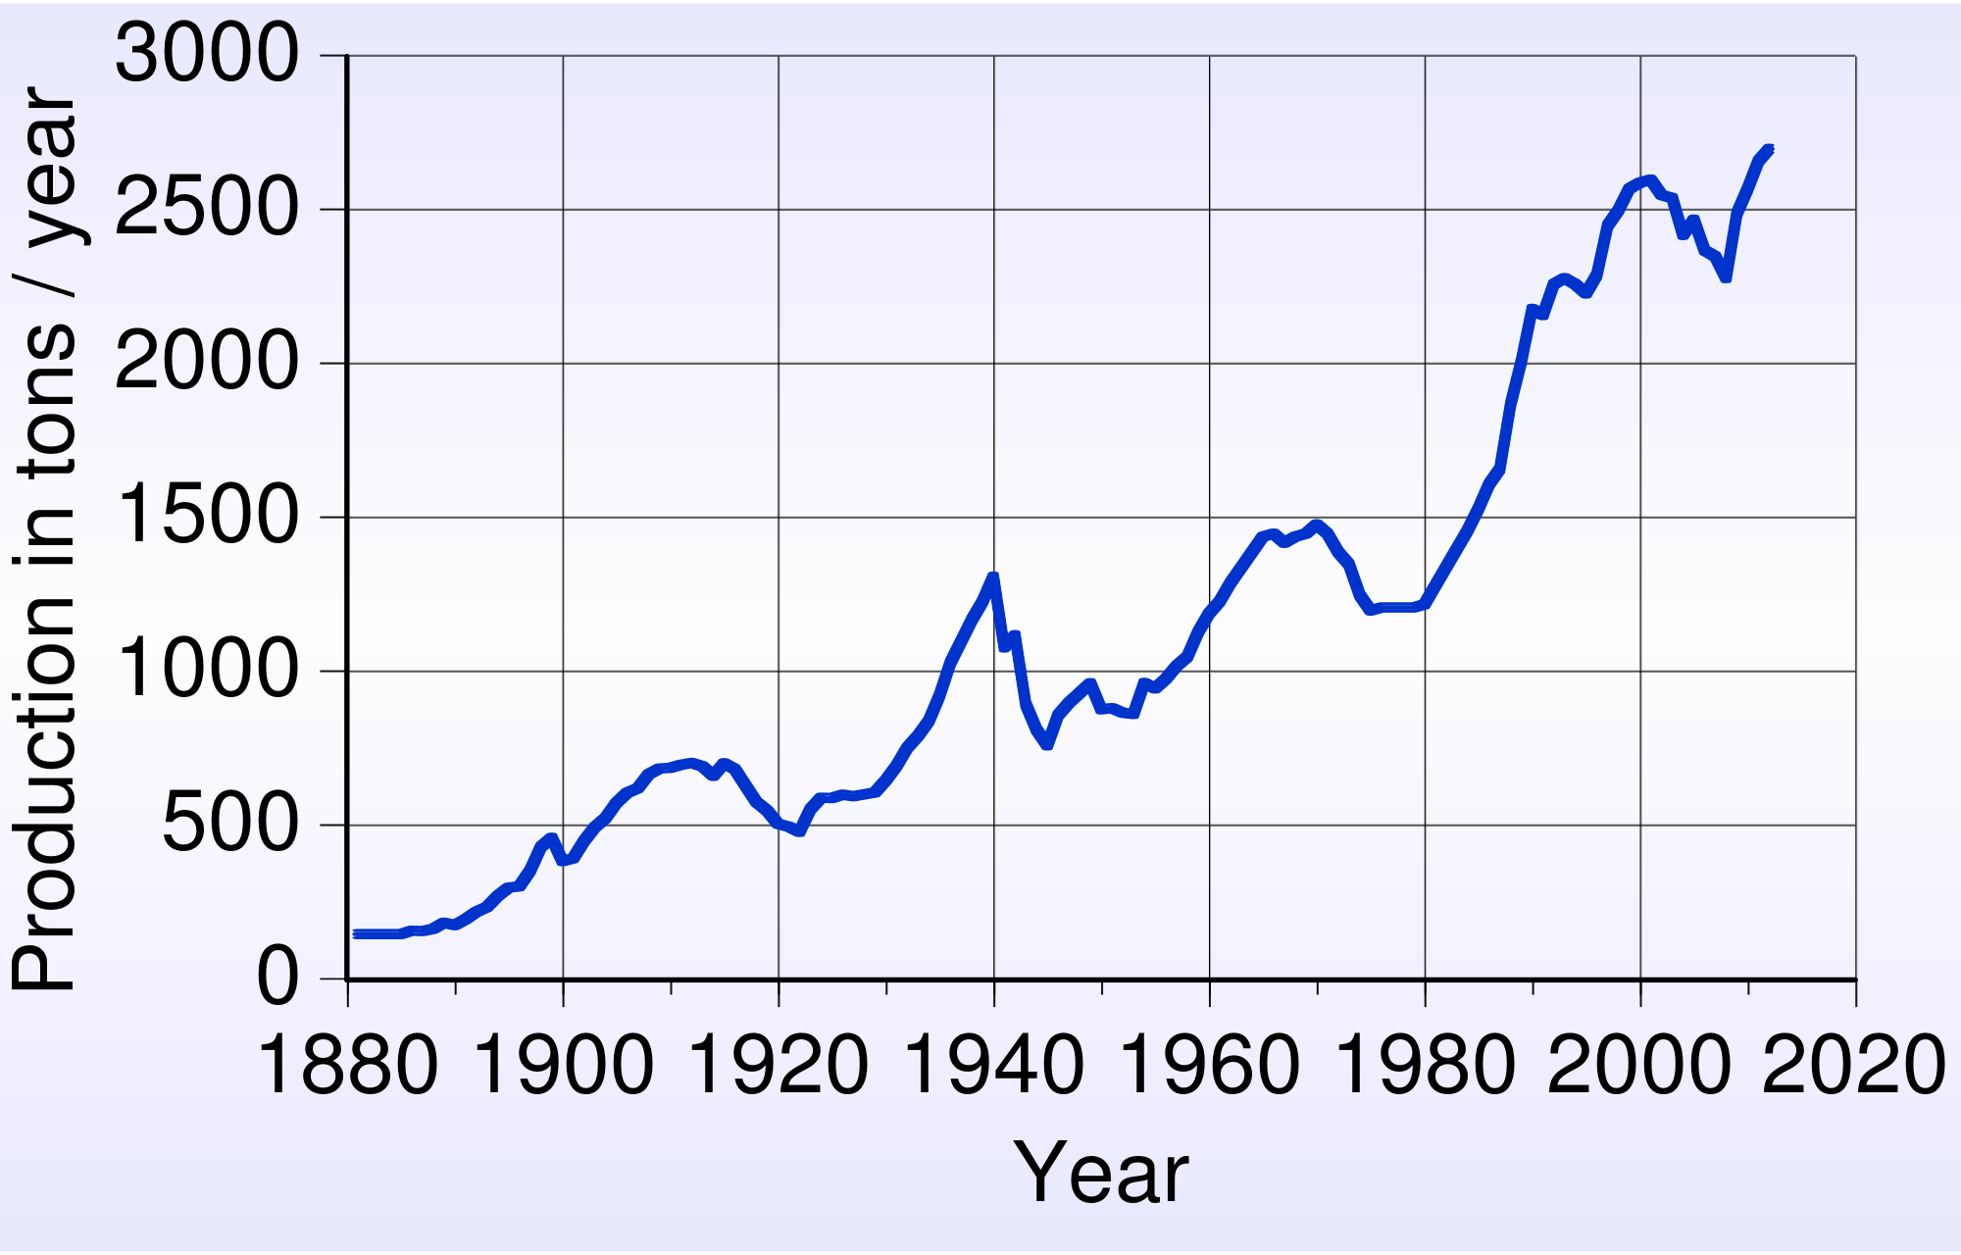
Gold Production – Gold standard

Slide 28
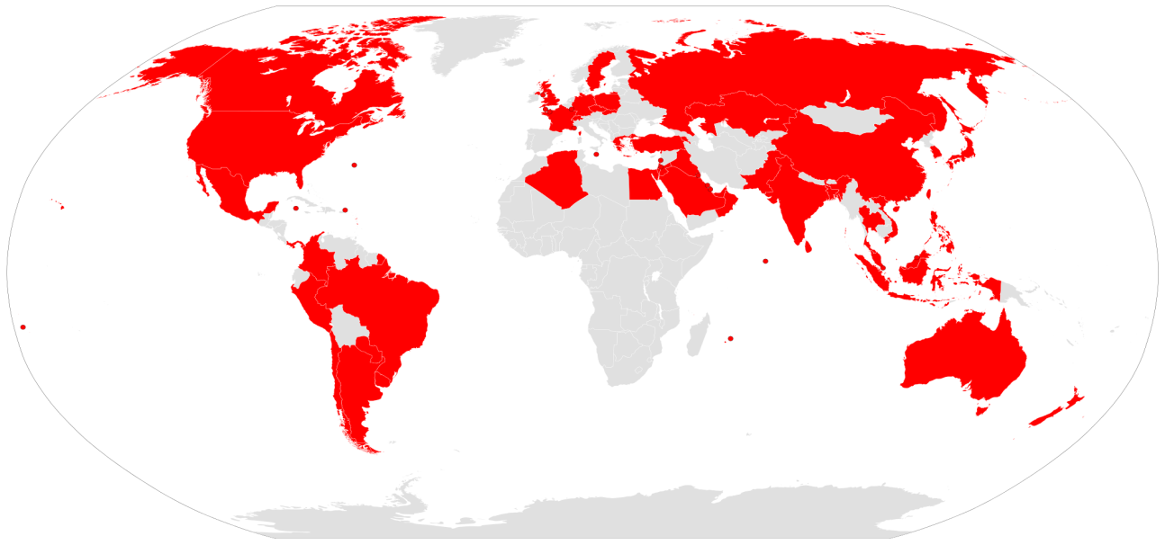
Industrial Revolution -- Economics
Global nature & scale of trade promoted the growth of ____________ ______________________(modern day multinational corporations)
Exs: HSBC (Hong Kong Shanghai Banking Co)______________________

Slide 29
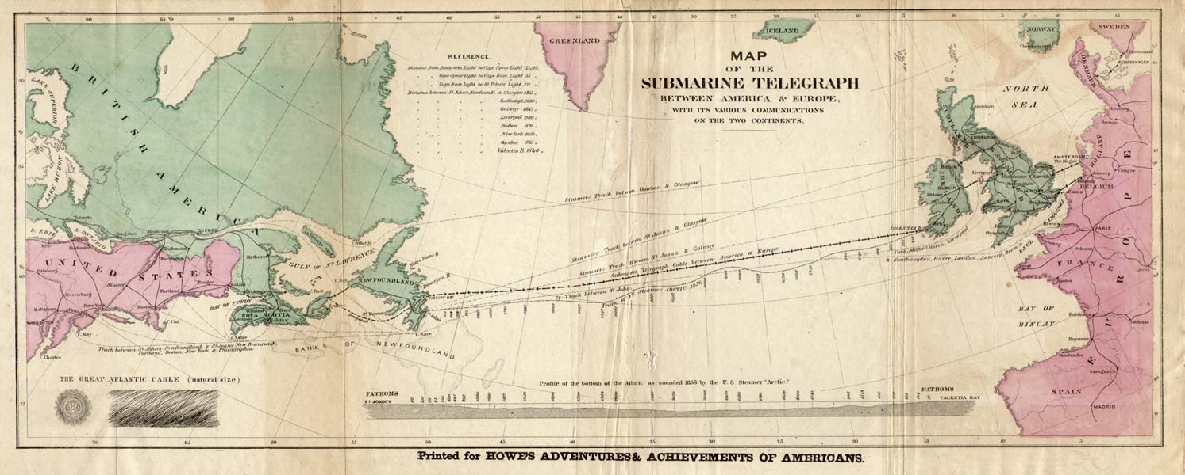
TransAtlantic Telegraph Wires
Transatlantic telegraph wire networks between Canada and Europe sunk in the 1850’s cut down communication time from 10 days to a matter of minutes

Slide 30
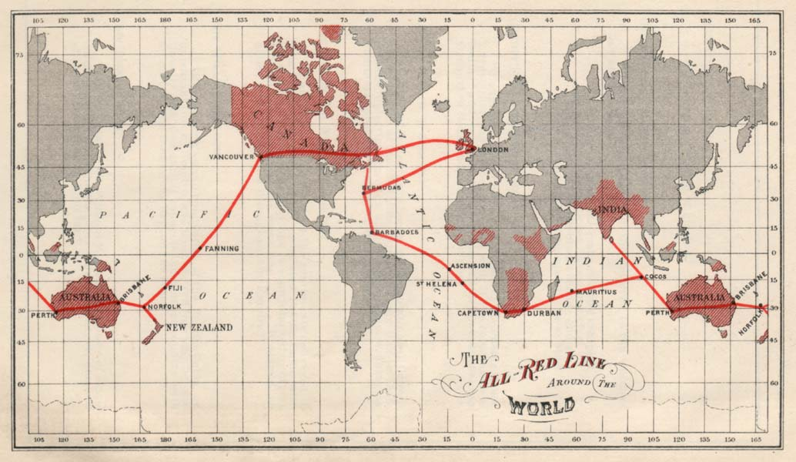
Worldwide Telegraph Communication
In 1911 the All Red Line was complete. The network had so many redundancies that 49 cuts would be needed to isolate the United Kingdom; 15 for Canada; and 5 for South Africa. Many colonies such as South Africa and India also had many land lines. Britain also possessed the majority of the world's underwater-telegraph deployment and repair equipment and expertise, and a monopoly of the insulation for underwater lines.

Slide 31
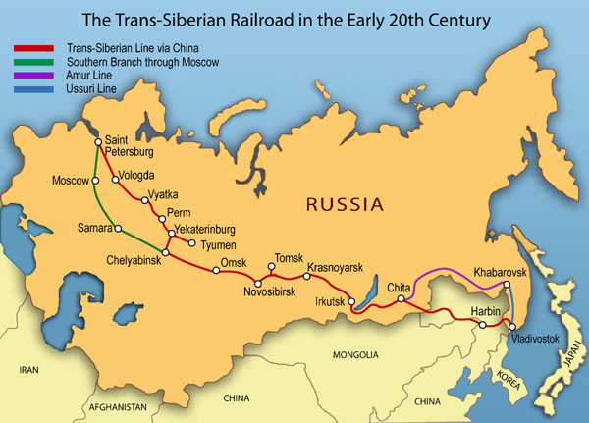
Trans-Siberian Railroad
At approximately 6000 miles the Trans-Siberian Railway is the longest RR in the world. It was completed with the sponsorship of Russian Czar Nicholas III in the 1890’s and served to vastly increase the Eat Asian land trade in grain. It also led to the internal migration of over 5 M peasants to Russian cities.

Slide 32
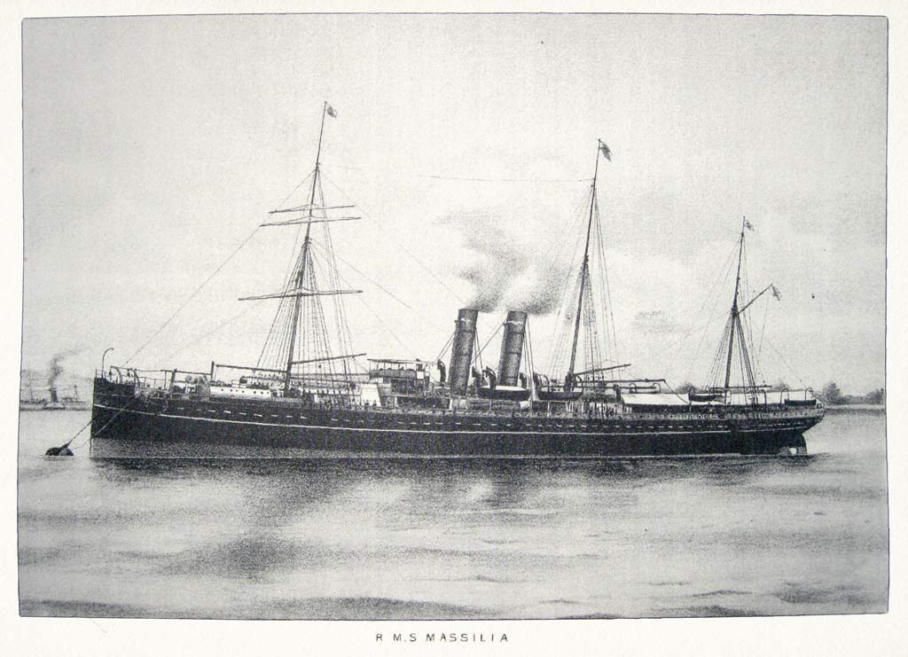
19th Century Steamships
Some examples of early steamships were hybrid designs => sails and steam engines

Slide 33
Impact of Industrial Revolution on Britain
In 1851 Britain hosted the world’s first “Industrial Fair” at the Crystal Palace, a building made of glass and iron
By 1851 Britain . . .
Produced 2/3 of the world’s coal and ½ of its iron
Created 50% of the world’s output of manufactured goods (2% in 1750)
GNP (size of their economy) grew 400% from 1780 to 1850
Industrialization had made Britain the wealthiest nation in the world and other countries wanted to do the same
Britain tried to stop this => Laws made it illegal to leave Britain if you were a skilled artisan or to export industrial machinery
However, after 1815 __________________________had made significant progress in Industrialization=> largely due to___________________________
States established technical schools and provided large stipends and bounties to British professionals to teach there & discuss machinery
States also invested in constructing national RR networks, roads & canals
Governments also provided grants to inventors and helped to establish _______ _____________________(pooled funds to est. industrial ventures)
Europe became divided into two economic zones => Western Europe (Britain, Germany, Belgium, N. Italy, France, Netherlands) & Eastern Europe
Industrial vs Non-Industrial => rest of world divided in same way by response to Industrialization

Slide 34
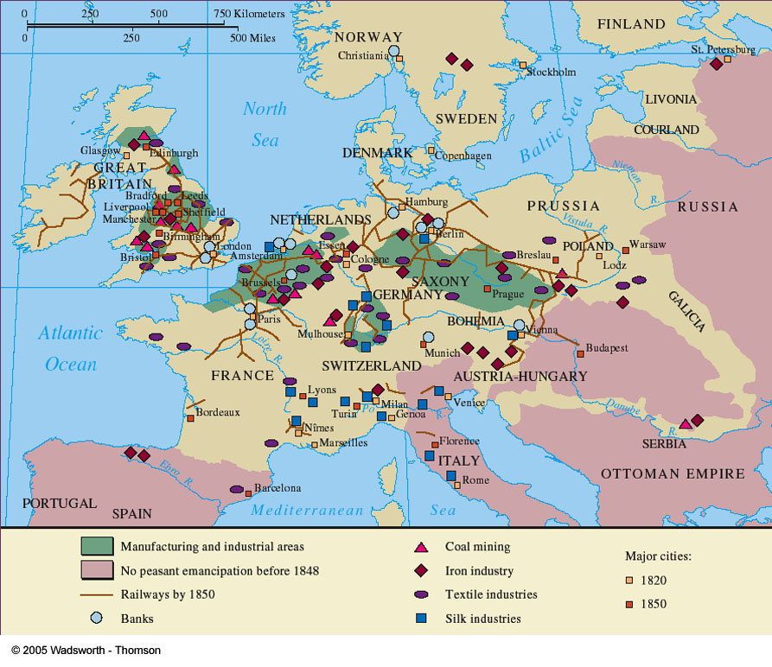
European Industrialization by 1850

Slide 35
Industrial Revolution – Qing China & Ottoman Empire
Ottoman Empire
By the 19th century the Ottoman Empire was known as “the___________ ___________” => in a long decline since its height during the 16th & 17th centuries
Ottoman Sultans resisted economic reform largely due to their lack of revenue => had trouble raising sufficient funds to pay janissaries
Lost territories in the _____________________________due to rising nationalism and military weakness => became focus of government
-- Only won Crimean War (1854) against Russia due to European aid
Qing China
By the 19th century the _____________________continued to grow => reached 400M by 1800 & placed huge strains on Chinese agriculture
Chinese persisted in using traditional methods but adapted new crops
Even after embarrassing losses in the Opium War in the 1850’s Chinese court officials _________________________________________________
Banking system was still primitive, no uniform set of weights and measures existed and use of paper money was very limited
Chinese ______________________________also neglected=> Grand Canal was silted, few roads had been built & RR travel was non-existent by 1900
Government intervention in manufacturing was mismanaged

Slide 36
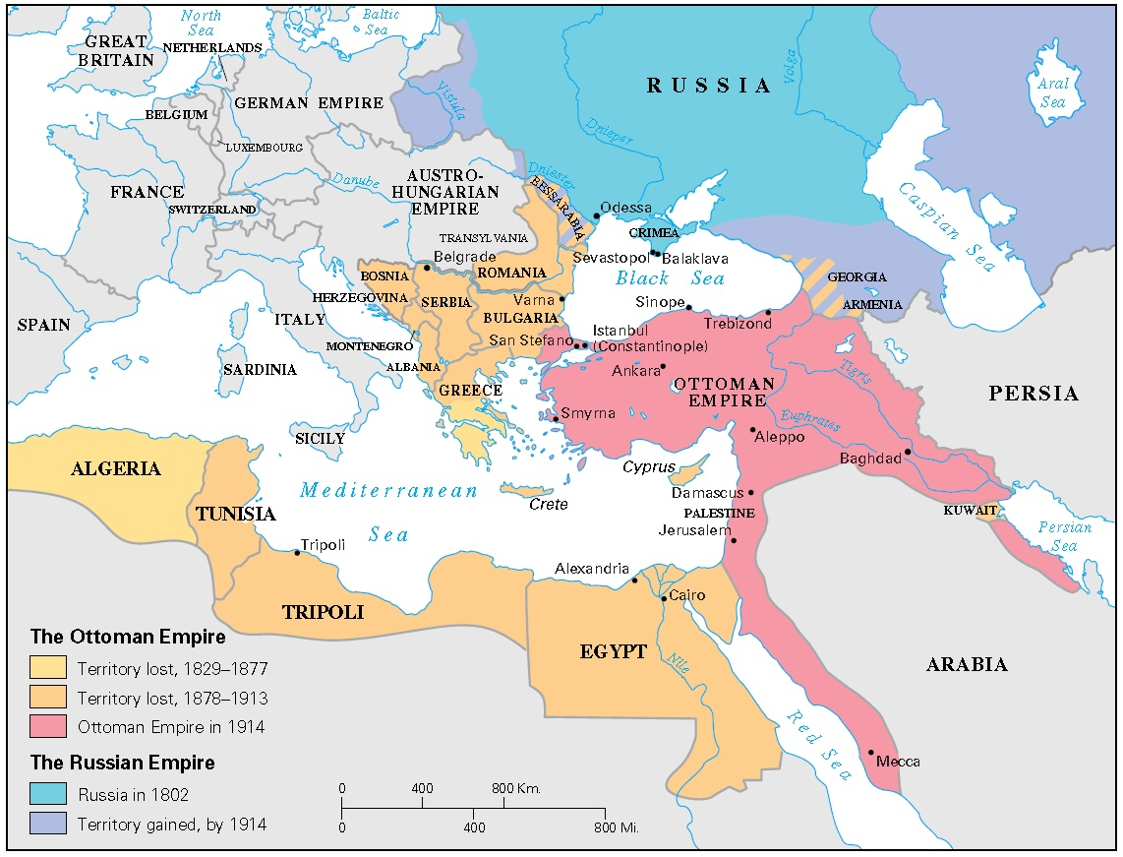
Decline of Ottoman Empire

Slide 37
Industrial Revolution – Russian Empire & Meiji Japan
Russian Empire => industrialization accomplished via government intervention
Russia had the resources for industrial development as well as a positive attitude towards Westernization established by Peter the Great
Tsars like ________________used tax revenue to pay bounties to American & European RR experts and machinists => by 1900 = 35,000 miles of track
Construction of ______________________linking Russia to Far East
Sergei Witte (finance minister to Nicholas II) also pushed industrial development in Russia’s oil & steel industry
By 1900 Russia was #4 in steel & #1 in oil (1/2 of worlds supply)
Tsar Alexander II _______________________in 1861 after loss in Crimean War
However, by 1900 Russia had not industrialized => lack of manufacturing tradition and artisans, focus on traditional timber & grain industry
Meiji Japan => rapid industrialization accomplished via______________________
After the opening of Japan to foreign trade after the Adm Perry mission in 1851 many Japanese leaders and business men realized the need for modernization
Installed young _________________as symbol of new Japan => co-opted traditional source of power to give “permission” to industrialize

Slide 38
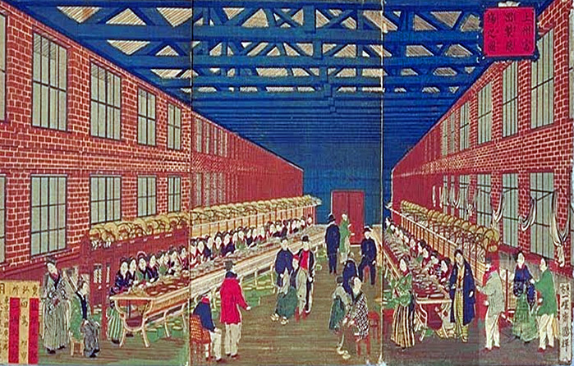
Tomioka Silk Factory – Japan 1889
Post 1880 the Japanese embarked on a remarkable flurry of industrialization, essentially completing 100 years of British industrialization in 10 years
Q: Why did the Japanese and Chinese governments and societies respond differently to western economic penetration?

Slide 39
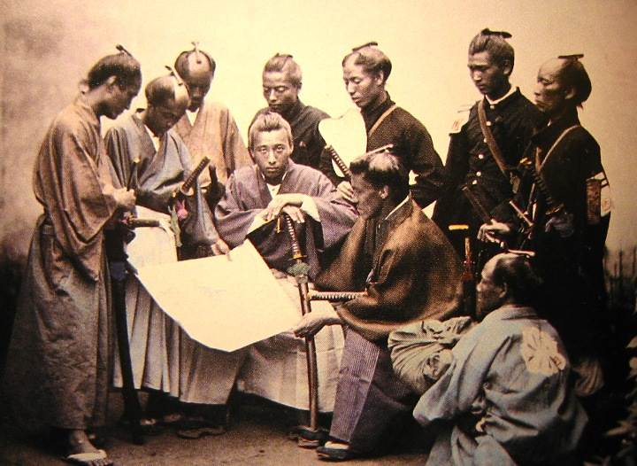
Meiji Oligarchs – one oligarch went so far as to say “Japan must be reborn with America as its mother and France as its father”
Q: What does this mean????

Slide 40
Industrial Revolution – Russian Empire & Meiji Japan
Meiji reformers provided _____________________________(steel, chemicals, machinery) and imported western experts to train Japanese
Created a universal education system emphasizing applied science
All industrial ventures were partnership w/ government => govt helped organize capital and start industry . . . handed over to private enterprise
By 1910 Japan had a successful ______________________________textile industries => 60% + of textile workforce were young women
Economic modernization was followed by political & social modernization
Constitution of 1890 created a ______(Congress) with a very limited electorate => really a disguise for despotism at rule of emperor
New military _______________________created a powerful Japanese military => oligarchs outlawed swords to strip samurai of power
Social customs were increasingly “____________________” => encouraged eating of more meat, lack of kimonos and ban on teeth blackening
Japanese did preserve Shintoism as state religion & Confucian family values

Slide 41
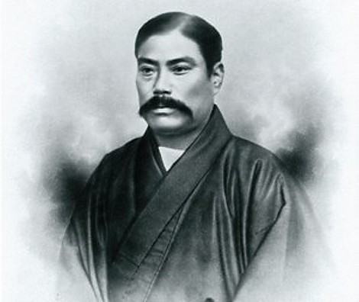
Q: Why did the Japanese and Chinese governments and societies respond differently to western economic penetration?
The____________________– founded in 1870
Originally a shipping company they have since become involved in:
-- Coal, Steel, Chemicals, Insurance, Planes, Banking, Cameras (Nikon), Atomic Energy
Iwasaki Yaturo

Slide 42
Industrial Revolution’s Effect on British Population
Q: What demographic effect did Industrialization have on Britain from 1750 to 1900?
 | 1750 | 1900
Population | 7 Million | 37 million
Urban Population | 13% | 87%
Life Expectancy | Men: 31 Women: 33 | Men: 45 Women 48
Deaths at Birth | 65% | 15%
Q: Did Industrialization represent a an increased standard of living?

Slide 43
World Demography (by region) 1750 to 1900
 | 1700 | 1870 | 1913
Western Europe | 81.4 | 187.5 | 261
Asia | 374.8 | 730.6 | 925.9
Africa | 61 | 90.4 | 124.7
Latin America | 12 | 40 | 80.5
United States | 1 | 40.2 | 97.6
World | 603.4 | 1,270 | 1,791
Figures based on David Christian, Maps of Time: An Introduction to Big History

Slide 44
Industrial Revolution – Social Effects
The Industrial Revolution had far reaching social effects on populations
#1: Urbanization => in 1800 9 cities had populations of over 1M; by 1900 27 cities exceeded 1M (total % of urban population went from 2% to 10%)
Britain had ____% urban population in 1851 & London had ____M by 1900
New industrial cities had poor unsanitary conditions and workers lived in crowded row houses called ________________________
1838 British Govt report cited “There were families where there were at least 5 persons to one bed . . . Lying at the top & bottom, children & adults”
Sewers and open drains were common on the streets => disease spread rapidly and deaths outweighed births until 1900
#2: Working Conditions => new industrial factories were shaped to “make man into machine” and represented significant change from agricultural work
Early textile factories were places of long hours (__________________a week), low pay and harsh discipline => workers broke into industrial lifestyle
___________________also common => Q: Why children desired???
Women workers used in _________________also => sexual abuse common
Work was dull and monotonous => little sense of accomplishment
Mills and mines were dirty, hot dusty and unhealthy => mines had especially dangerous conditions due to cave-ins, explosions and fumes

Slide 45
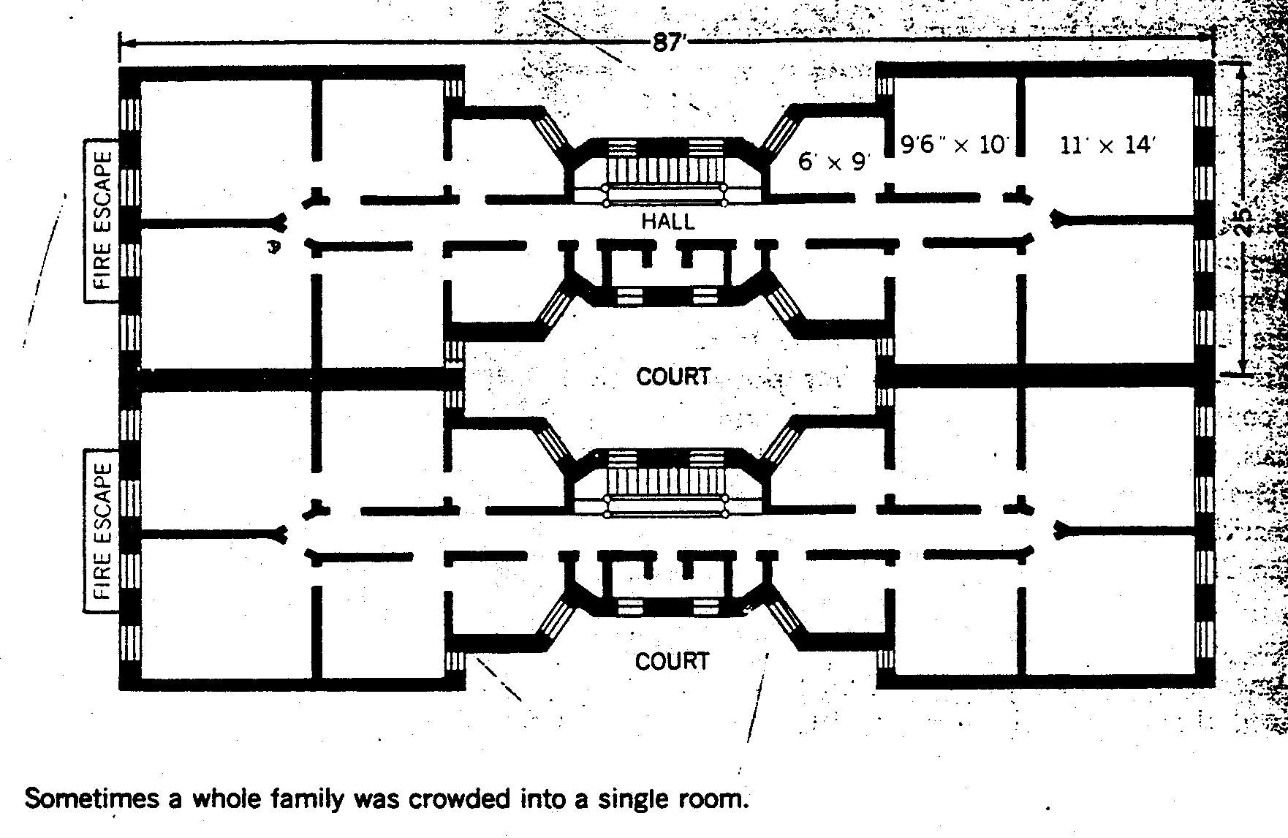
Dumbbell Tenement Plan in NYC after Tenement Housing Act of 1879

Slide 46
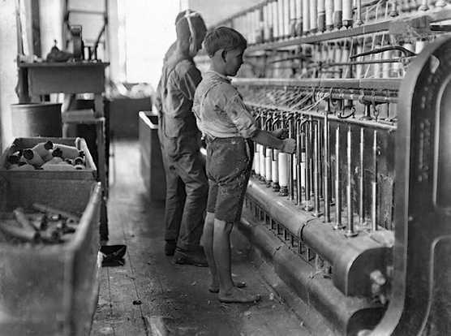
Child Textile worker in Britain (1867)

Slide 47
Q: What does this tell you about working conditions in Industrial age factories? How do they compare to present day working conditions?
In 1844, a factory in Germany posted the following guidelines for its workers:
“The normal working day begins at 6am precisely during all seasons and ends, after the usual break of ½ hour for breakfast, and hour for dinner and ½ hour for tea, at 7pm . . . Workers arriving 2 minutes late shall lose half and hour’s wage; whoever is more than 2 minutes late may not start work until after the next break, or shall lose his wages until the next break . . . No worker may leave his place of work for any reason unless it is connected to his work . . . All conversations with fellow workers is prohibited.”

Slide 48
Industrial Revolution – Social Effects
#3: Environmental Effects => shift to an industrial economy had disastrous environmental effects in short and long term
___________________increased globally, as did______________________, runoff from plants and the burning of huge amounts of coal and oil
#4: New Social classes
Most major change of industrial revolution was development of a larger industrial middle class => industrial factory owners & merchants
Also included new professional class of “____________________” => teachers, civil servants, doctors, lawyers, engineers
Known as ______________=> sought to separate themselves from working class (valued hard work and ambition; believed working class lazy & stupid)
Rest of society was the industrial working class or __________________
Due to industrialization, gap between the wealthy and working class widened
#5: Gender Roles => Gender roles became divided based on social class
Upper and middle classes adhered to _____________________=> Separate spheres for men (public) and women (domestic)
Working class women needed to work to support families => could aspire to work in retail shops, as telephone operators, teachers, or clerks (white collar)

Slide 49
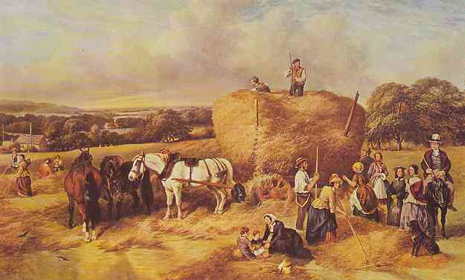
Manchester in 1750

Slide 50
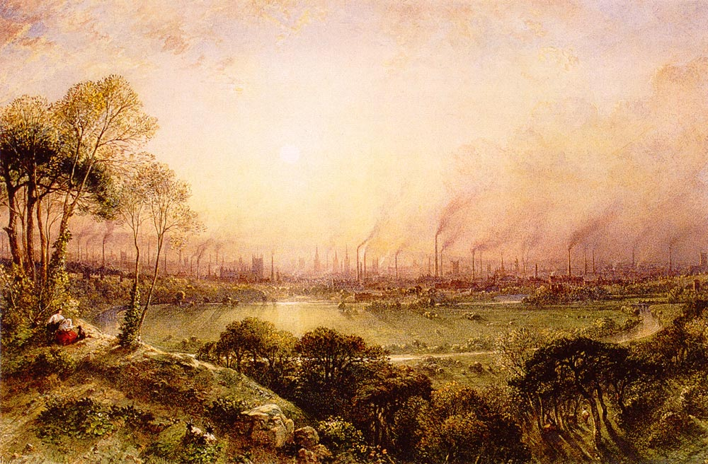
Manchester in 1850

Slide 51
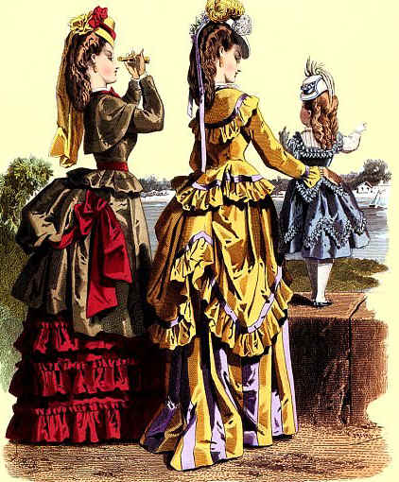
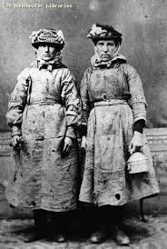
Victorian Age Women

Slide 52
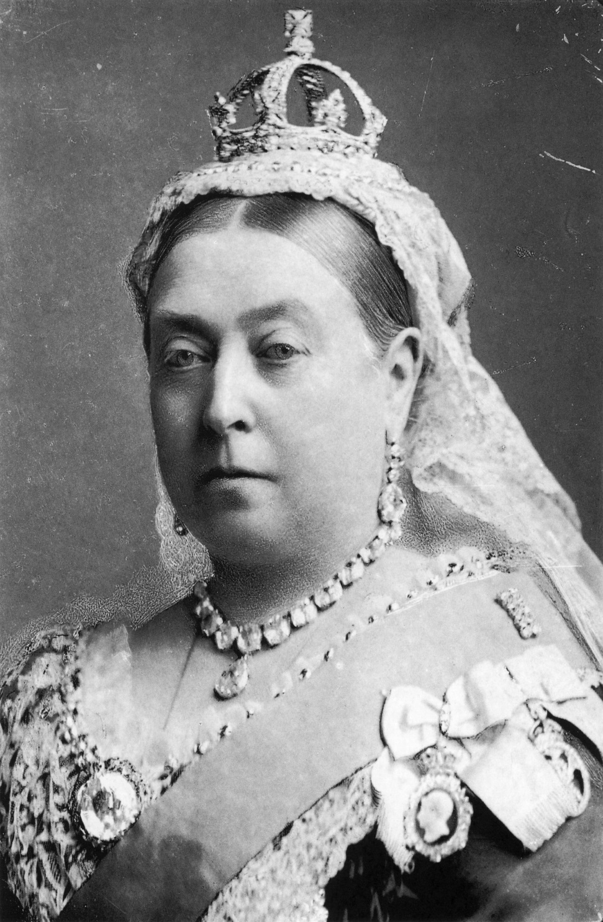
Queen Victoria
Exs of Victorian manners and sexual repression
#1: Do not refer to a woman’s leg as a “leg” but instead as a “limb”
#2: A gentleman always opens a door for a lady and carries heavy items for her
#3: A gentleman always walks on the outside when walking down the street
#4: When courting the only acceptable gifts for a man to give a women were flowers, candy or a book
#5: A gentleman may kiss a lady’s hand or forehead at the most in public

Slide 53
Wealth Concentration in US

Slide 54
Industrial Revolution – Social Effects
#6: Industrial benefits => after 1870 Industrialization did provide real benefits for those in Britain and other industrial countries
Real wages increased by over __________% for workers & unions, as well as legislation improved conditions
________________improved dramatically and migration was now possible => lower transportation costs also allowed consumers to buy goods
New products of industrial economy became very popular => i.e. Sewing machines, clocks, bicycles, ___________________________and telephones
Contributed to rise of modern ________________________(Le Bon Marche) ad modern consumerism
____________________run by coal burning electrified entire cities => reduced crime, provided heat and allowed for the use of new electrical machines
Allowed individual communication to became rapid as well (telephones)
Rise of _________________and scientific techniques also gave rise to huge increase in __________________=> hospitals, govt health care systems etc….

Slide 55
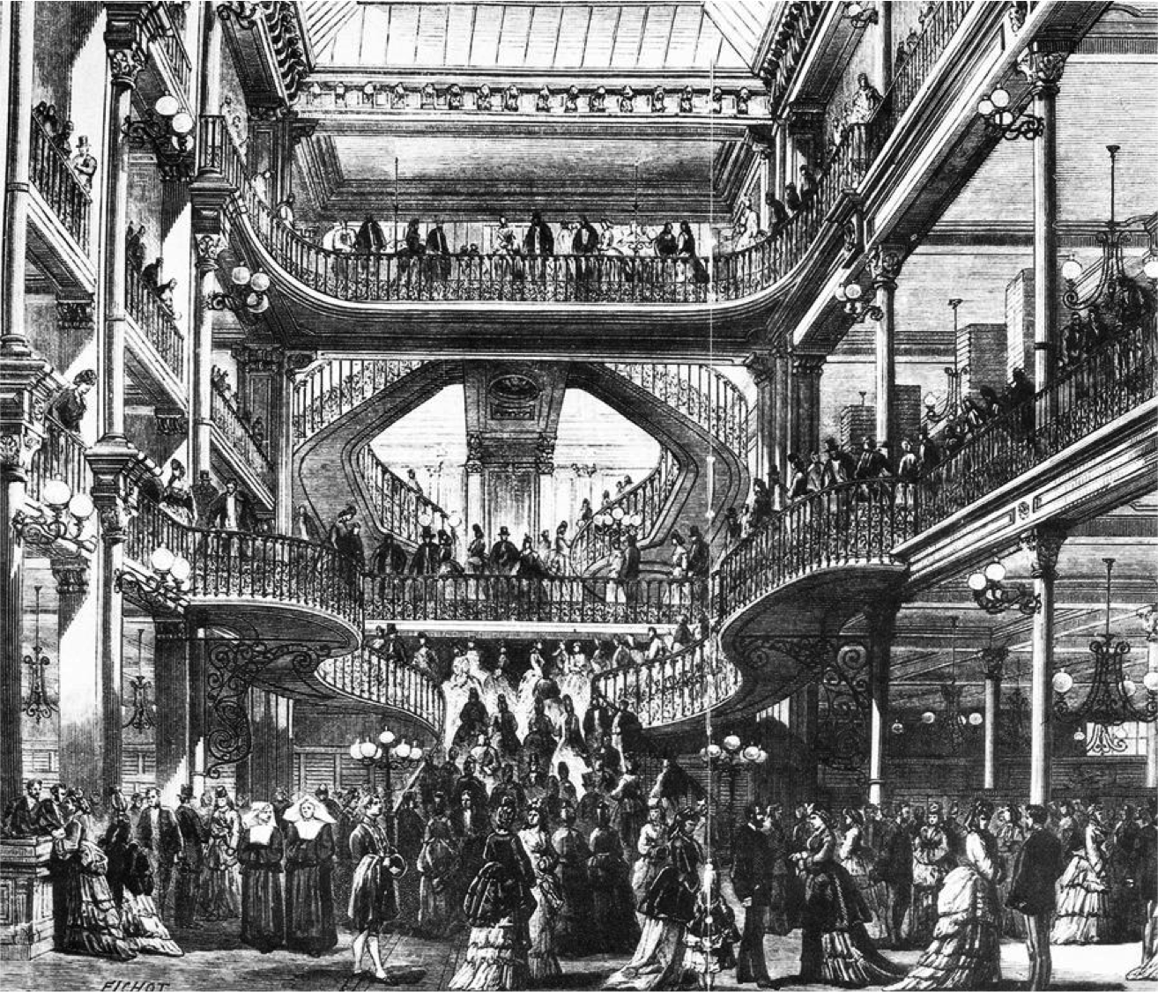
Shopping at Le Bon Marche – Paris 1870
Early department stores benefitted from steel beams which allowed creation of large open spaces => Le Bon Marche used steel beams, balconies and bridges to allow consumers to view products from above and below (15,000 to 18,000 people shopped there daily)

Slide 56
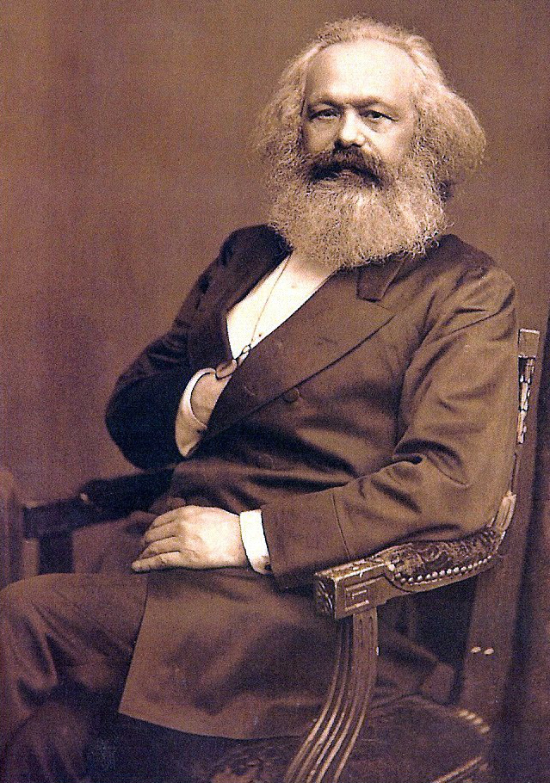
The Revolt of the Working Class (1848-1900)
The latter half of the nineteenth century was a very volatile time for working class
Class conflict was erupting all over Europe
As a result of the Industrial Revolution a poor working class (proletariat) developed and many blamed their struggles on capitalism itself =>
__________________gained popularity => promised more equal distribution of wealth
In the __________________Marx predicted that a Capitalist economy, even a democracy, would look after the interests of the wealthy at the expense of the poor
** Had Industrialized societies up until 1848 followed this pattern of behavior??? **
Reformers, theorists & workers attempted to promote alternative visions of the future to secure their interests in the industrial economy

Slide 57
Industrial Revolution -- Reactions
#1: ________________________=> supported by reformers who believed that equality between all human beings was the goal
Wanted to replace competition of industry with cooperation in utopian communities => exs: Robert Owen’s ________________Community
Owen was a wealthy Welsh industrialist who transformed a squalid factory town in Scotland into a flourishing utopian community
Attempts to do same in New Harmony IN were a financial failure => did lead to advances in science, education and social equality
-- Infighting and lack of motivation undermined Owen’s vision
Other utopian experiments like the Oneida community were financially successful but ideologically failures (i.e. complex marriage)
#2: ________=> vision based on writings of Karl Marx about a forceful takeover of the government by socialists who would promote equality via govt policies
Envisioned the eventual rise of a society based on equality and lack of classes, $$, private property etc…. => total communal bliss
**“Revolutionary Socialism” **
Some examples of “communist revolutions” => ___________________ ___________________________(none played out as Marx had envisoned)

Slide 58
Industrial Revolution -- Reactions
#3: Evolutionary Socialism => use democratic processes to improve conditions for working classes
Socialist Parties => German Social Democratic Party (SPD) was organized in 1875 and ran in the Reichstag elections
By 1912 it was the most populous party in Reichstag => other socialist parties not as successful (Britain, France)
In 1889 the Second International (gathering of Socialist leaders was called to promote socialism in Europe => due to division they were unsuccessful
-- Did institute May Day or Labor Day holidays in many nations
#4: Trade Unions => workers organized themselves into associations to fight collectively for better pay, working conditions and limit hours
_________________________________(Britain), ________________ ___________________(US) became very popular
Used tactics like ______________________________to fight for better wages and improved conditions
British membership soared in late 19th century => 1900 = 2M; 1914 = 4M

Slide 59
Industrial Revolution -- Reactions
By 1900 Unions and socialist parties had successfully brought about improved conditions in many countries
Germany => state programs for health &accident insurance and pensions
Health Insurance Bill provided basic health insurance for German workers => 1/3 cost paid by employers, rest by employees
__________________=> Paid for disability benefits (2/3 of wages) for workers disabled on industrial jobs (agriculture later) paid by employers
________________________________=> workers over 70 get a pension
Britain => laws restricting child and women’s labor
____________________=> min age for mills at 9, children 9-13 can only work 8 hrs a day and must receive 2 hrs of education
______________________=> prohibits all boys and girls age 10 and under from working underground in coal mines
Britain expanded male suffrage in a series of ________________=> by 1867 working class men in urban areas can vote in elections (1884 = countryside)
Japan => public education system established
Meiji reformers established 3 tiered American system culminating in a series of universities and technical schools

Slide 60
Intro to Imperialism
The industrial Revolution also had impacts on European empires and imperial practices => leads to a European desire to acquire M &M’s
M&M => ____________________________(expand industrialization)
Economic relationship of Europe to Asia/Africa changed . . .
Old = exchange gold/silver to China/India for tea, silk, spices, porcelain, pepper
New = exchange manufactured products for raw materials (oil, tin, rubber)
Europeans did this through the application of many types of Imperialism
Imperialism =_____________________________________________________ ________________________________________________________________

Slide 61
Type of Imperialism
In the late 19th century European nations (i.e. Britain, France, Germany, Belgium, Dutch) were very active in Imperial acquisitions all over world
Acquired huge transoceanic empires in Asia, Pacific, Africa => “_______ ___________________________”
United States & Japan also joined in and acquired large Pacific empires
#1: __________________Imperialism => complete political takeover of an area and subsequent domination politically, socially & economically
Use of subjugated area to benefit mother country (ex: Africa, SE Asia)
#2: ___________Imperialism => nations retains independence, but its trade & economy controlled by imperialist (i.e. natural resources, trade restrictions)
Exs: China (British & others) and Latin America (US)
#3: _____________Imperialism => dominating nation attempts to change the customs, religion & languages in country (usually for some economic purpose)
India under British rule => English schools, British style dress, Christian religion, promotion of British games such as cricket
Dominating culture supposed to be superior

Slide 62
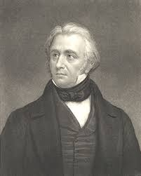
Thomas Macauley, Minute on Education (1834)
“I have no knowledge of either Sanskrit or Arabic – but I have done what I can to form a correct estimate of their value. . . I believe that it is no exaggeration to say, that a single shelf of a good European library was worth more than the whole native literature of India and Arabia . . . In every branch of physical or moral philosophy the relative positions of the two nations is the same.”

Slide 63
Rationale for Imperialist Practices
Although differences existed between nations as far as their motivations for Imperialist practices, most shared similar reasoning . . .
#1: Economic => M&M’s or markets and materials for Industrial production
Europe needed resources like palm oil, rubber, tin, oil for industrial machines and needed markets to sell their mass produced products
#2: Military => ________________________often (14 days max) and thus coaling stations or supply depots needed; naval bases & outposts also desired
Europeans, US & Japan feared competition form each other => “If we weren’t here some other white guys would be here”
#3: _______________________=> philosophy that sought to justify differences in wealth between people or nations using Darwin’s Theory of evolution
Human society was also subject to evolution => some people more adapted (i.e. work harder, more intelligent) . . . thus rich
Argued rich deserved wealth and poor deserved to be poor
#4: Scientific Racism => some Europeans used ‘science’ to prove the superiority of whites physiologically and morally
Used to support concepts like _____________________=> “burden” of the whites to “civilize” and “christianize” inferior societies (“Dark Continent”)

Slide 64
Scope of European Imperialism by 1900
By 1800 Europeans had established colonial control in many areas of the globe, but still only controlled about 35% of the world’s land area
By 1800 it was over 80% of the world’s land area => some continents like Africa the increase was even more dramatic (3% in 1880 to 98% in 1900)
European nations scrambled in Africa and Asia, especially to expand Imperial control
________________=> Canada, Australia, New Zealand, Hong Kong, BR. Guiana, West Indies (Jamaica & Bahamas), Nigeria, Egypt, India, S Africa, Rhodesia
_______________=> Fr. Indochina, Fr Guiana, Fr West Africa
______________=> Congo
______________=> East Indies, D Guiana
______________=> G West Africa, G East Africa, Cameroon
United States and Japan also established Empires in the Pacific => compete w/ Europeans and acquire resources of their own
_____=> Philippines, Hawaii, Puerto Rico
-- Mainly acquired in Spanish-American war (1898) => easily defeated the Spanish and took their colonial possessions
_____________ => Korea, Taiwan
-- Mainly acquired in Sino-Japanese and Russo-Japanese Wars => easily defeated Russia and China (emergence of Japan as Pacific power)

Slide 65
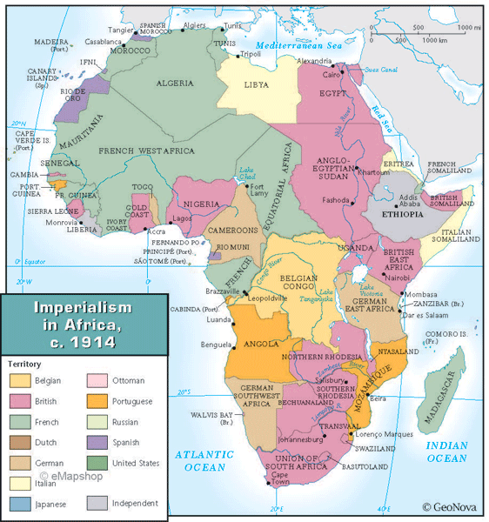
African Imperialism ca 1914

Slide 66
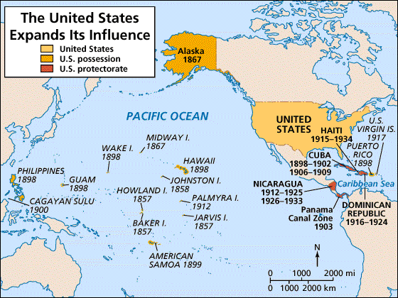
US Imperialist Actions (1890-1920)

Slide 67
Percentage of Land Areas controlled by 5 Major European Powers & US in 1900
Region | Percentage Controlled
Africa | 97.4
Polynesia | 98.9
Asia | 56.5
Americas | 27.2
Source: Alexander Supan, Die Territoriale Entwicklung (1906)

Slide 68
Population of Colonies Controlled by European Powers in 1939
Country | Population in Colonies (in millions)
Great Britain | 470
France | 65
Belgium | 13
Netherlands | 66
Germany (1914) | 13
Total | 627
Source: Mary Evelyn Townsend, European Colonial Expansion since 1871 (1914)

Slide 69
“Doubling Down” on existing Colonies
During the 19th century many colonial powers also doubled down and expanded their presence in valuable colonies
British Rule in India
Starting in 1619 Mughal emperors allowed British to set up trading posts called ____________________in coastal cities
These were controlled by the ________________________=> controlled the Indian trade in silks, spices, cotton cloth and Chinese goods
British East India Co had its own army made up of Indian Sepoys
-- British greased gunpowder cartridges w/ beef and pork fat => sepoys bite them off to fill guns w/ powder (Q: Why big deal??)
__________________ (1857) => sepoys rebel against British East India Co
British Govt crushed rebellion and takes India as colony
British occupation of India is known as the Raj (1858-1947)
India became the British “______________” => supplied cotton, coffee, tea, and opium (China) & 300 million population = great market
Britain modernized India => built hospitals, roads, RR track, telegraph lines, Universities & expanded British educational system, outlawed Sati
Effects?? => taxes increased by ____________(local officials loyal to British), Indian textile industry destroyed, Indian culture devalued

Slide 70
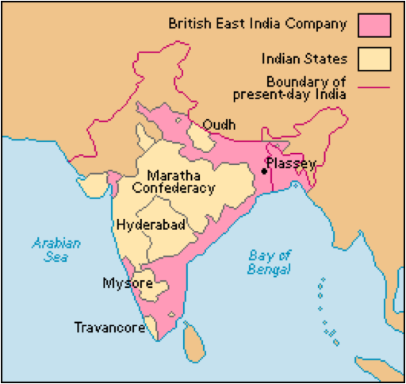
British East India Company (1850)

Slide 71
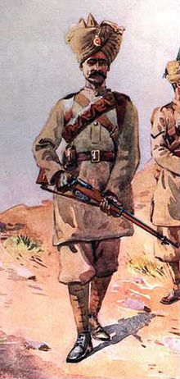
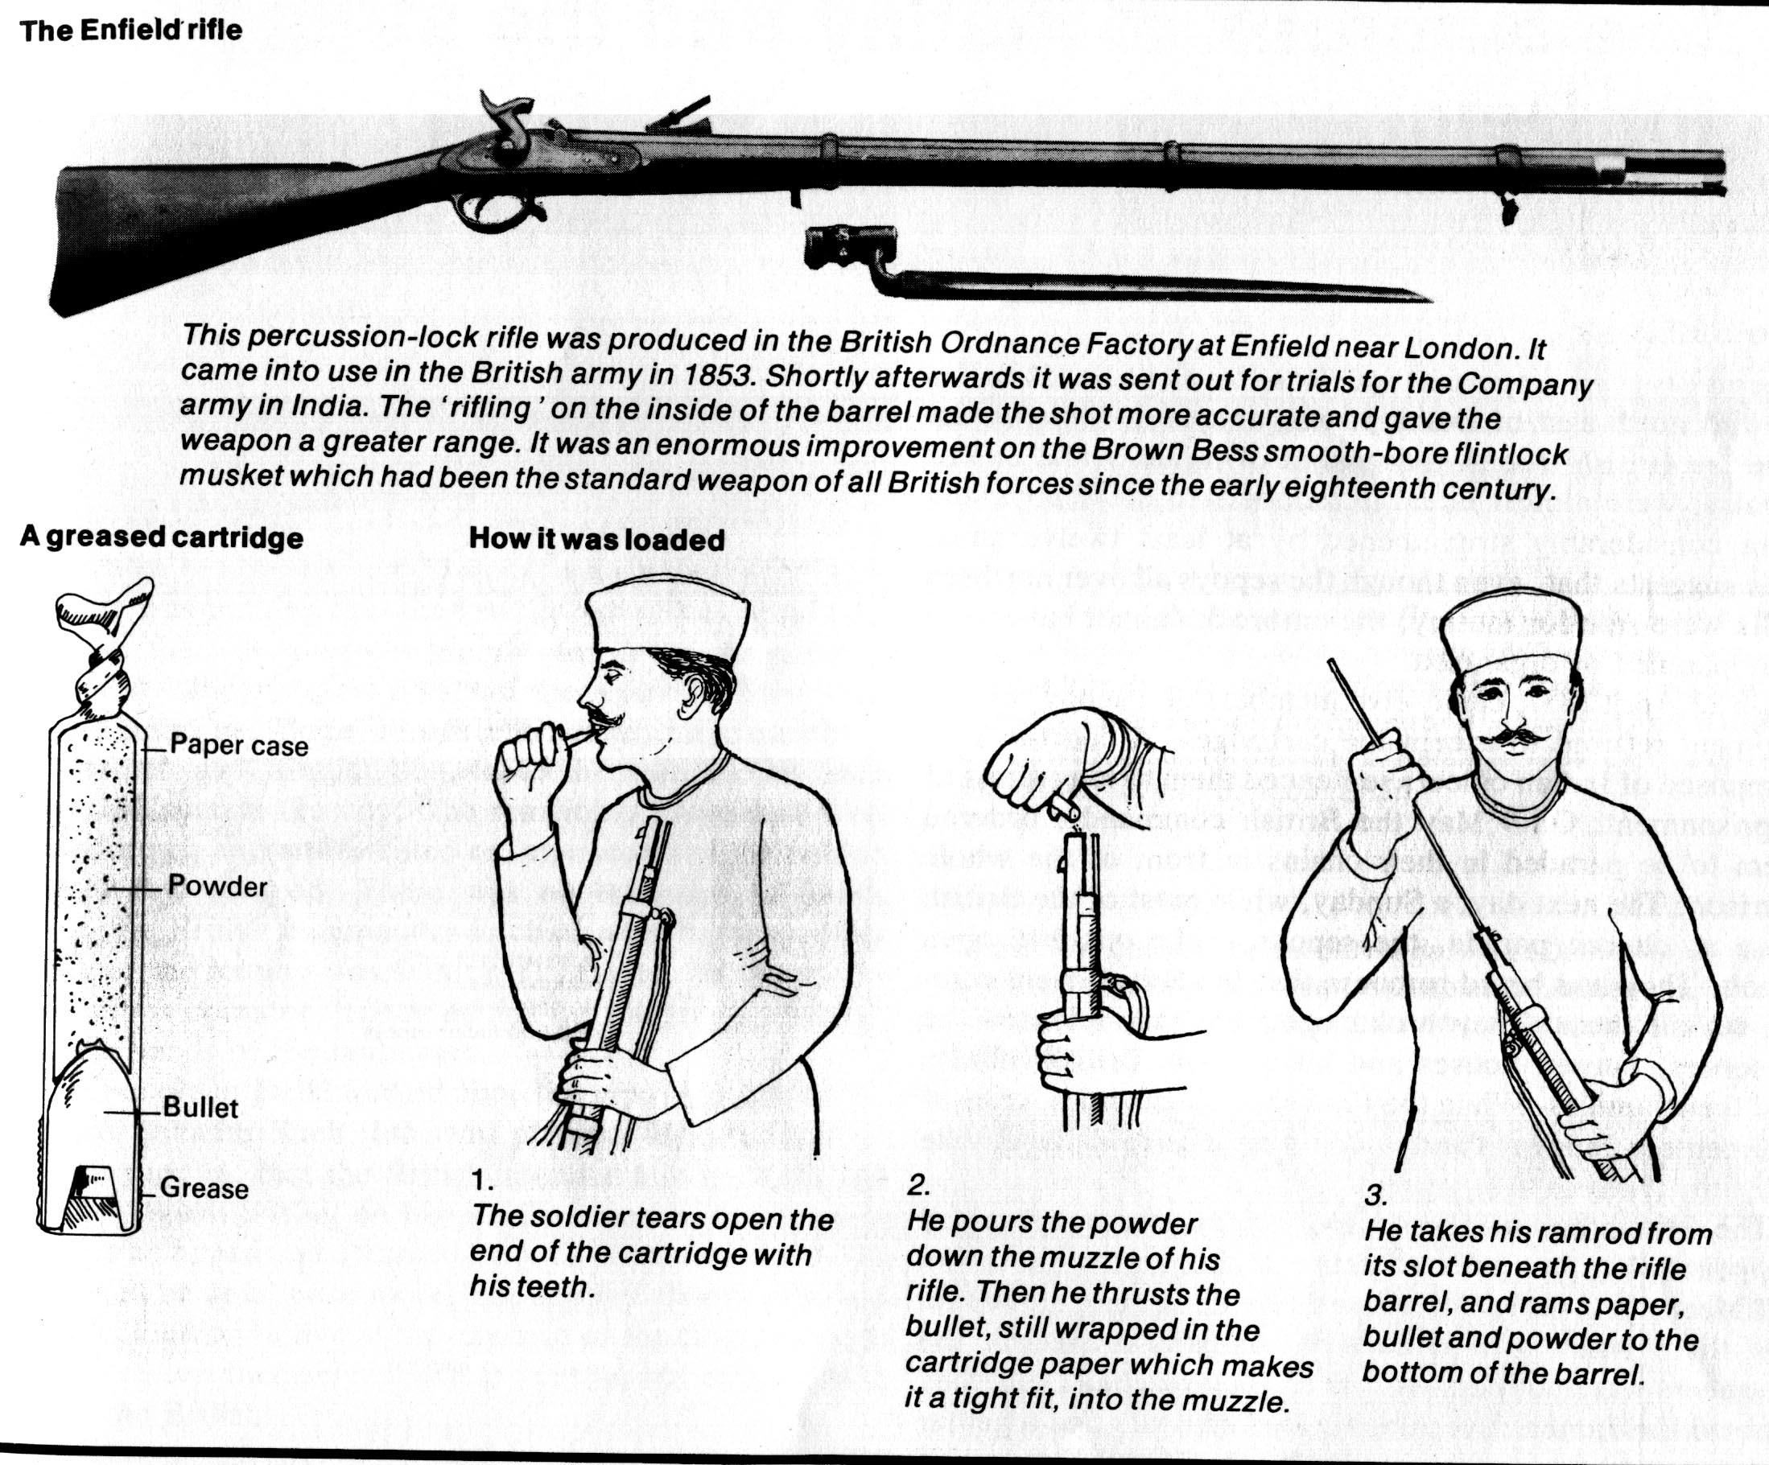

Slide 72
“Doubling Down” on existing Colonies
Dutch in East Indies
In the 1600’s the Dutch government gave a charter to the ____________to control the spice trade with the East Indies
Est. capital at Batavia => traded spices with Europe & Asia . . . Dutch introduced cash crops to expand profits (coffee, tea, rubber, sugar)
Indirect control via use of local elites and some company officials and military forces
By 1800 DEI Co was bankrupt and territories were nationalized under Dutch govt => expansion of authority in 1840’s
Done for nationalistic reasons and to prevent foreign competition
Move to more direct rule => _______________(1870’s) and putting down of many rebellions on Java and Sumatra

Slide 73
Colonization of Africa
In 1880 European colonial presence in Africa was confined to a few coastal areas (30%) but by 1900 over 97% of the continent under European control
Q: How? => “Scramble for Africa”
_____________________in 1884 tried to avoid warfare between the European nations by dividing African lands up among European powers
British = Egypt, Sudan, Nigeria, S. Africa and Rhodesia
Germans = G. East Africa, G. West Africa
French = Fr. West Africa, Madagascar
Portuguese = Angola & Mozambique
Belgians = Congo
Europeans used a mixture of warfare and diplomacy to establish dominion over their African imperial possessions
Warfare => Europeans made use of superior weaponry and at times brutality to subdue resistance of native African tribes (i.e. Zulus)
Diplomacy => Europeans applied one of two systems to African possessions (Direct or Indirect Rule)

Slide 74
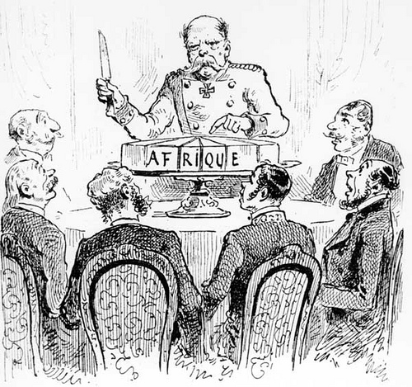
African Political Cartoon activity
African Cake

Slide 75
African Imperialism ca 1914

Slide 76
Colonization of Africa
Warfare & Violence
Many African tribes and peoples attempted to resist European imperialism => most were not successful due to lack of technology, ethnic conflicts
Ex: ______________________=> Egyptians w/ spears charge British machine guns (11,000 Egyptians dead; 28 British dead)
** Exception = _______________. . . Defeated Italians at the Battle of Adowa & remained independent (modern army w/ modern weapons) **
Europeans also used violence and threat of violence to control vast colonies with minimal presence (administrators and soldiers)
Ex: ___________________under ______________________
-- Gained control of Congo under guise of missionary activity
-- Set up massive rubber, palm oil and mining activities
-- Exploited population for labor through imposition of “hut tax” => forced labor to pay tax on each hut occupied
-- Leopold used _______________to force compliance => beat workers w/ chilcote whip and cut off hands as punishment for not meeting quotas
-- Over ________Congolese died in 10 years under Leopold’s regime => led to formation of Congo Reform Association to stop abuses

Slide 77
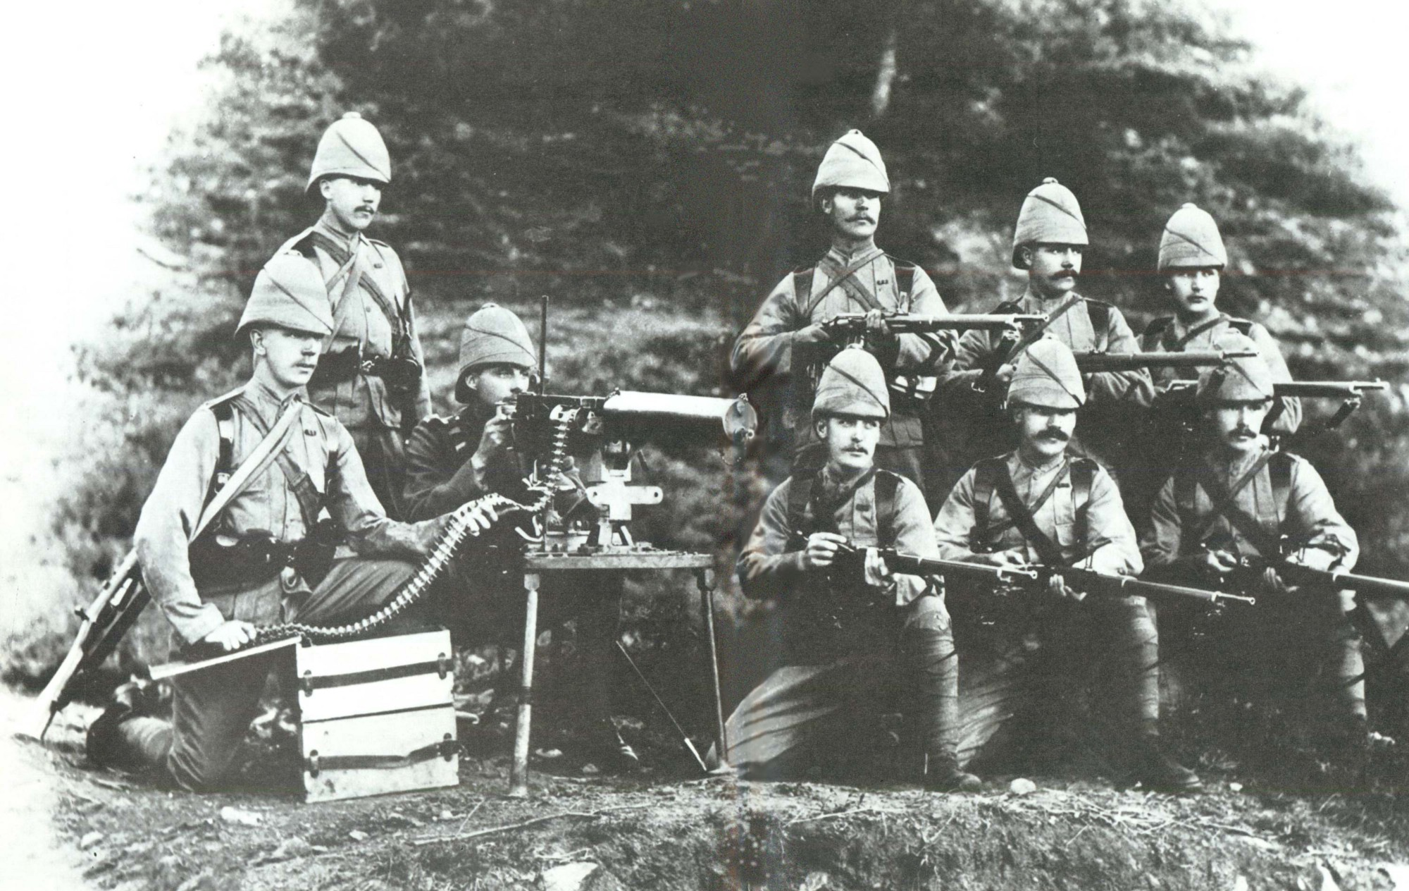
British Maxim Gun
According to Hilaire Belloc, the British would always beat African forces, for “Whatever happens, we have the maxim gun and they have not.”

Slide 78
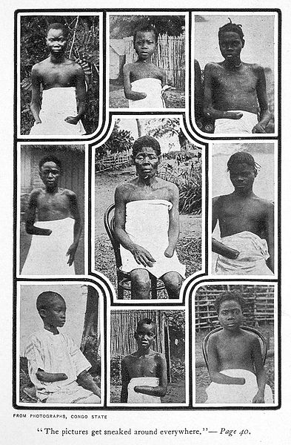
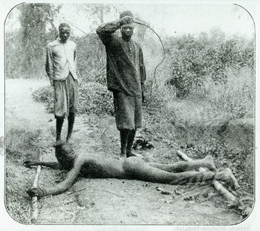
Abuses in the Congo Free Colony => Force Publique and King Leopold II used many brutal techniques to force colonials to work and punished them if they didn’t meet their Quotas

Slide 79
Indirect Rule – ________________
What was it?
One White Governor–General for the colony (F.D. Lugard) => controlled the British Military, set colonial policies and communicated British desires to natives
Small legislative council headed by whites w/ native participation (Nigerian Council) => helped to set policies & lent legitimacy
African colonial officials (traditional tribal chiefs) who implemented and enforced policies of the British
Why?
#1: Made use of government structure already there => saves $$
#2: Successful in other colonies => i.e. India
#3: Adaptive => allows certain areas to be governed differently
Successes => policy led to econ. development (i.e. roads, railroads) & export industries (minerals, oil), as well as an educated elite
Failures => colonial rule tended to be weaker outside of the capitol; lack of education and civil services

Slide 80
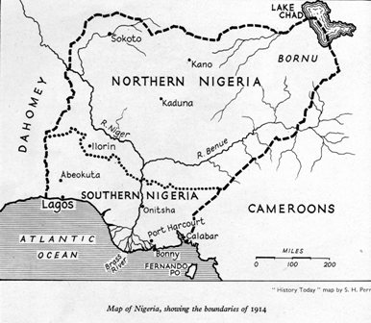
British Colonial Nigeria

Slide 81
Direct Rule – ________________
What was it? => Based on the idea of ____________*What is that?*
Assimilation = ____________________________________
_____________________________________________________
-- Goal = make Africans into French citizens
One Supreme Governor-General (Louis Faidherbe) in charge who takes orders from France and enforces them in all regions
-- Used military and French officials to create a highly centralized “chain of command” that controlled life rigidly
-- Little or no input from natives (could not own property, vote)
Why? => create a mirror image of France around the world
Successes => controlled all regions effectively
Failures => by 1945, only 100,000 of 30 million citizens had achieved citizenship; very costly to administer, lack of education & civil services

Slide 82
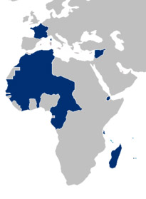
French West Africa & French Colonial Possessions

Slide 83
Settler Colonies
In some areas, Europeans and Americans set up settler colonies
Settler Colony => _________________________________________ ________________________________________________________
Settler colonies are more permanent settlements and establish governmental structures that replace indigenous ones
-- Prior to WWII White Africans numbered over 6M
Focus =_____________. . . settlers take over land and can use natives for labor, but tray to become self sufficient
Q: How are settler colonies different from traditional imperial colonies?
Exs: British in Australia, Kenya, South Africa, Zimbabwe; French in Algeria; Americans in the Western US
After de-colonization of Africa in the post WWII years most settlers in the colonies fled due to violent African regimes and reprisals
Exs: Robert Mugabe’s dispossessing of white land in Zimbabwe

Slide 84
British Settler Colonies in S. Africa & Australia
British established large settler colonies in Southern Africa and Australia
South Africa
British annexed S. Africa from Dutch in 1806 & started settlements to consolidate borders and eliminate the _______________natives
Settlements increased in late 1800’s after discovery of gold & diamonds
Cecil Rhodes (founder of DeBeers) encouraged expansion into __________ (Kenya, Tanzania) to explore for further minerals (“White Highlands”)
British settlers established permanent settlements => coffee, etc
After subduing a Zulu rebellion in the 1870’s British instituted a series of acts to control the settlement of native peoples & favor whites
___________________________________________=> controlled settlement & migration of natives and gave best land to whites
-- Set up a system of passes to restrict Native movement
Government restricted blacks voting and set up white rule (_______________)

Slide 85
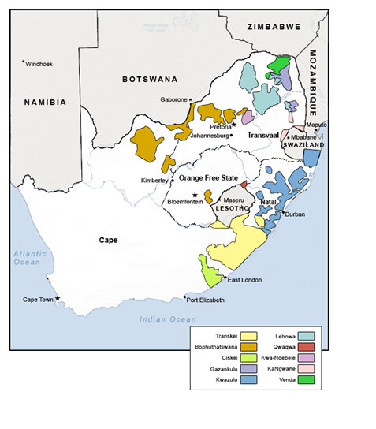
Native Land Act of 1913 -- Set up racially segregated reservations for all of South Africa’s non-white population (total reservation space = 12% of the country for 85% of the population

Slide 86
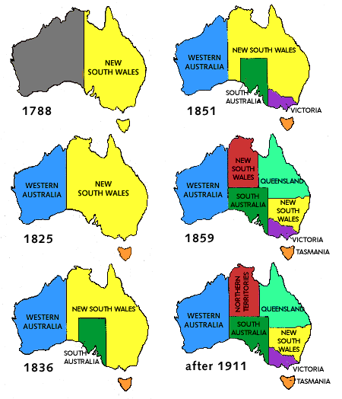
British Settler Colonies in S. Africa & Australia
Australia
When Europeans arrived the native population was ~ 1M (aborigines) => declined steadily due to disease and settlement of Europeans
Australia est. as a free colony in early 1800’s => immigration greatly increased after 1850’s gold rush
-- _______________________ _______led to resettlement of aborigines and forced assimilation into British schools & communities (pop decline)
_______________________of the early 20th century allowed only European immigrants into the country
Australia gained independence in 1930’s and remains a country dominated by Europeans with close cultural ties to Britain

Slide 87
Economic Imperialism
Not all acts of imperialism required a total takeover of an area politically => economic imperialism was also highly effective in some cases
British in China
By 1800 the British had been trading in China for over 200 years, but were confined to ONE port (Canton)
British taste for tea created a large trade imbalance => solution = Opium
British began to import opium in large quantities from India => up to 15% of population and 1/3 of court officials addicted by 1830’s
Manchu Govt tried to ban trade & arrest smugglers => led to __________(1839-42)
Humiliating defeat for Chinese => cede 5 ports to Britain (_____________), lower tariffs on British manufactured goods
US & British in Latin America
Ever since the issuance of the _________________________________in 1822/1906 the US had maintained extensive influence in Latin America
Monroe Doctrine & Corollary established L. America as a US zone of influence => US claimed “police power to intervene” in area
Many L. American nations also turned to ____________________________=> allowed British firms to build s & agricultural regions to coast
By 1914 85% of RR owned by British; 40% of employees were British & language of RR was English => same true of mining, public utilities in most nations

Slide 88
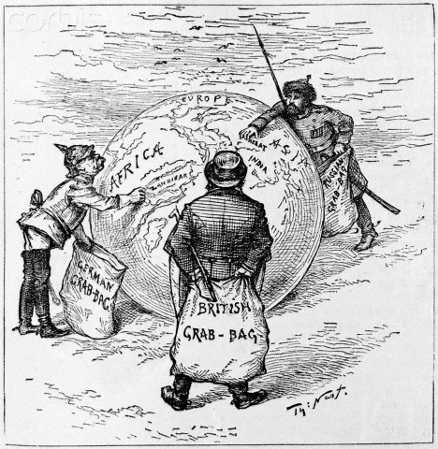
Cartoon #1: The World’s Plunderers

Slide 89
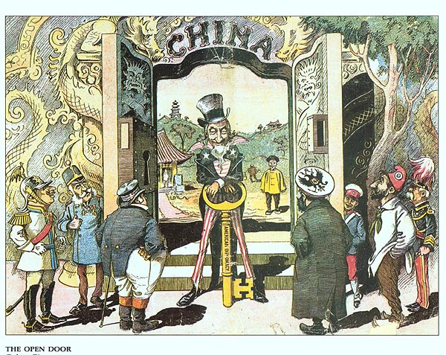
Cartoon #2: The Open Door

Slide 90
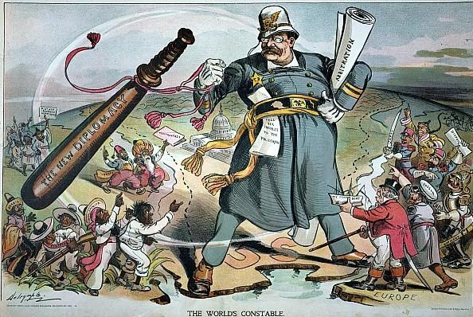
Economic Imperialism
In the early 1900’s Taft encouraged US investments in Latin America to control nations and create economic opportunities for Americans
“______________” => US cos (i.e. United Fruit Co) control land in Cuba, Honduras, Guatemala . . . to produce export crops (sugar, bananas)
US government used military interventions in early 1900’s to secure and maintain US investments and presence there

Slide 91
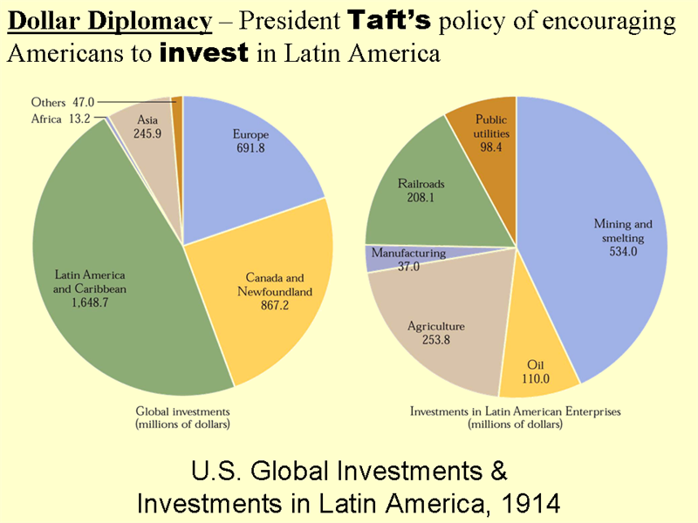

Slide 92
US Manifest Destiny
Q: Is the US the most successful settler colony in world history? Why or why not?

Slide 93
Impact of Imperialism -- Formation of New States
The influence of European Imperialism prompted other states to expand their borders and acquire new territories . . .
United States => The US was greatly enriched by Industrialization in the late 1800’s and began to experiment with imperialism in the Pacific
#1: Purchased Alaska from Russia for $7.2 M in 1867 => huge reserves of gold and oil found in late 1800’s/early 1900’s
#2: _____________annexation in 1898 => Queen Lili’oukalani was overthrown by American sugar planters in 1893 in a coup; annexation followed in 1898
#3: ______________________(1898) => Spain easily defeated by American forces after a questionable explosion in Havana harbor involving the USS Maine
US acquired Islands of_______________________________________
Despite promising the Filipinos independence if they aided the US, the US annexed the islands & promised to “civilize and christianize” the people
Philippine nationalism was aroused, however, and Emilio Aquinaldo led an insurgent force that fought for independence from 1899 – 1913
-- Over 20,000 Filipinos died & 200,000 civilian casualties resulted => Americans used Reconcentration camps to imprison 600,000 Filipinos
#4: Great White Fleet => to secure their new possessions Teddy Roosevelt built Panama Canal and commissioned a Great White Fleet to sail around the world

Slide 94
US Imperialist Actions (1890-1920)

Slide 95
Impact of Imperialism -- Formation of New States
Meiji Japan => after rapidly industrializing & forming a new state with power in the hands of industrial oligarchs, Japan moved to build a Pacific Empire
Japanese islands lacked important resources and Japanese wanted to acquire these elsewhere
#1: _______________________(1895)=> started over Korean intervention but ended with Japanese victory (crushed Chinese fleet) and acquisition of Taiwan
#2: _______________________(1905) => ended with sinking of entire Russian fleet in Korea and Japanese acquisition of Kurile islands, Karafuto and Korea
By 1915 Japan had also established economic dominance within China in the Manchurian peninsula as well
Russian Empire => after the modernization and industrialization efforts of Peter the Great Russians embarked on a 19th century program of expansion
Some 19th century Czars embraced modernization (Alexander II) & used Russian army to extract territorial gains from weakened Ottomans & Chinese
Series of Russo-Turkish Wars led to Russian annexation of Georgia, Kazakhstan and other Central Asian territories
Russia also acquired territory from Qing in unequal treaties signed under threat of war
By 1900 Russian Empire was 1/6 of Asian landmass and contained over 100 ethnic groups => Problems????

Slide 96
Russian Expansion – 1500-1900

Slide 97
Opposition to Imperialism – Formation of New States
On the edges of existing empires some native peoples attempted to form new states to resist expansion => Siam, Cherokees, Zulus & Hawaiins
#1: The ____________________=> in response to US expansionism the Cherokees formed a very advanced Native civilization modeled after US
By 1830’s they had written language, a system of agriculture w/ slaves, public schooling system, a written constitution w/ 3 branches
Developed communal identity within Georgia => unfortunately when Gold was discovered they were forced by US Govt to migrate to OK
-- Trail of Tears led to death of over 7,000 Cherokees
#2: _________________=> only SE Asian nation to remain independent during SE Asian colonization by European powers
19th century Siamese Kings (Rama III & IV) consolidated state power &used trade agreements w/ western powers to remain independent
-- Played British against French in a series of negotiations
Rama V westernized nation by abolishing slavery, est. RR and telegraph lines and an education system

Slide 98
Nation of Siam (18th and 19th centuries)
Siam (modern day Thailand) was the only SE Asian nation to remain independent during the period of European colonialization

Slide 99
Opposition to Imperialism – Formation of New States
#3:_________________________
Zulus were a Bantu group that united under the leadership of ____________in the early 1800’s to resist western incursions
Shaka created powerful sense of Zulu nationalism => focused on common culture, language & heritage
Shaka also used new military tactics like age grade conscription and encirclement
British provoked the Anglo-Zulu War (1877) which ended with British victory, despite Zulu success at Battle of Isandlwana

