Slide 1
Interregional Trade during the Postclassical Era
EQ: How did interregional trade change during the time period 600 CE to 1450 CE? What continuities existed? Why did these changes and continuities occur?
Trade during the Middle Ages involved the expansion & intensification of existing trade routes and the development of new ones
Intensification of old routes => Silk Road, Indian Ocean network, Trans-Saharan routes and the Mediterranean sea lanes
New Routes => Hanseatic League & Mesoamerican networks
Q: Why Trade? => regional variations in resources and skills due to climate zones and technological development
i.e. varying distribution of gold in Africa, silk industry in China
Q: Why expansion and Intensification? . . . Many factors
#1: States and Empires
#2: Rise of Islam
#3: Desire for luxury goods

Slide 2
Interregional Trade during the Postclassical Era
#4: New forms of credit & money
#5: State sponsored infastructure and trading organizations
#6: Increase in technology
Trade networks of time period also led to cultural and technological diffusion, migrations, as well as the spread of disease (i.e. Black Plague)
New and expanded networks also led to the rise of new cities (i.e. Venice, Timbuktu) and the decline of others (i.e. Rome, Alexandria)
Also for the first time, individuals were able to travel from one end of the networks to the other => i.e. ____________________________

Slide 3
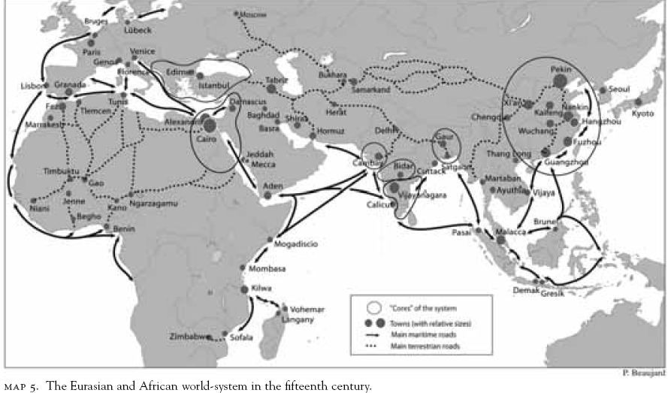
Eurasian Trade networks ca 1450 CE

Slide 4
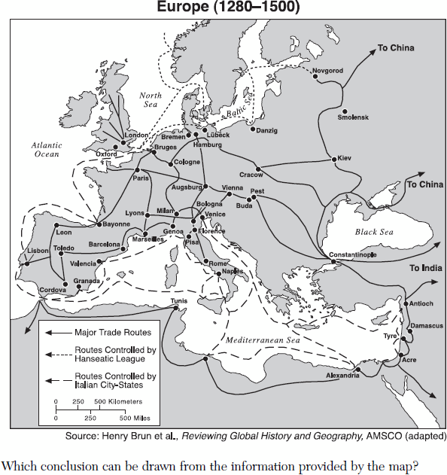
European Trade and Hanseatic League
European Trade during the Middle Ages was dominated by the Northern European Hanseatic League and the Southern European Venetian/Genoese trading cities

Slide 5
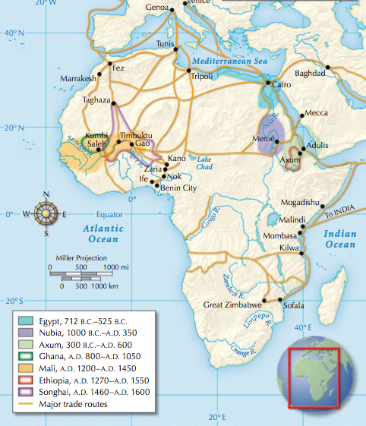
Trans Saharan Trade Routes (ca 1200 CE)
Islamic Traders and the emergence of larger African states changed the style and function of Trans Saharan trade in the post-classical period

Slide 6
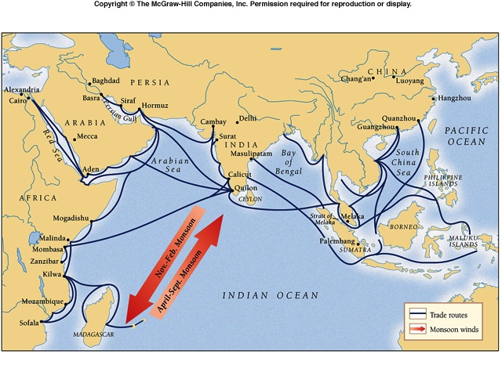
Indian Ocean Trade Network (ca 1000 CE)

Slide 7
Reasons for Intensification of Trade during Postclassical Era
#1: Growth of _______________________
The growth of several multinational empires during the Postclassical Era greatly aided trade among civilizations
Empires included Tang China, Abbasid Caliphate (and others), Byzantine Empire and the Mongol Empire
-- All empires drew many peoples into their trade networks and facilitated long distance communication through various methods
Tang China’s brief foray into Vietnam led to SE Asia becoming integrated into Indian Ocean & Silk Road networks
Mongols established courier system to link empire and used military force to reduce raiding along Silk Road
-- ______________and the security and stability provided by large empires greatly increased the volume of trade
#2: Rise of ___________
Islam was a religion, more than any other centered on trade and commerce => Mohammad was a merchant before a prophet
Muslim merchants establish ______________________in Malacca, East Africa, etc… that became very involved in Indian Ocean trade

Slide 8
Reasons for Intensification of Trade during Middle Ages
Islamic states stood at the center of networks => they were the hub of transregional trade in Sahara, Indian Ocean & Mediterranean
-- Islamic culture & language became the standard for commerce => civilization spanned many cultures (ME, African, Indian, SE Asian)
Muslim merchants also many times formed joint ventures with Christian and Jewish merchants => 1st ________________________
#3: Desire for ___________________
The rise of merchant communities, the urbanization associated w/ trade & the wealth of empires all led to a greater desire for luxury goods
Luxury goods were the #1 item traded in the Postclassical Era
_________ textiles => perceived as a status symbol in Europe and the ME; only the wealthy & the church could afford silk
-- China had a monopoly on silk production during Classical Era, but by 1200 production had expanded to India, ME & Byzantines
_____________ textiles => cotton was major export of India; also introduced in China; prized for its lightweight and breathable nature
-- Production limited by India’s lack of commercial development => lack of status for merchants, state control of trade and lack of unifying empire

Slide 9
Reasons for Intensification of Trade during the Postclassical Era
___________ => invented by Ming Dynasty in 1400; highly prized in Europe, ME & South Asia due to its ability to not spoil taste of drinks
______________ => “spice islands” of Malay Peninsula and Indian pepper were also highly prized goods
-- Salt traded from West Africa by Taureg nomads => salt traded in Timbuktu for gold in equal amounts (Q: Why valuable??)
-- Pepper traded from India => used to season food
-- Cloves, nutmeg, mace, cinnamon traded from “Spice Islands” => flavored food and used as medicines
_________ => 80% of gold mined was mined in Africa (Mansa Musa)
-- Gold trade helped to expand minting of coins (florins, etc…)
____________ => Eastern Europe & Africa were main slaving centers
Exotic ___________ => Chinese and ME traders received rhinocerus horns (medicinal uses) and giraffes for zoos and displays

Slide 10
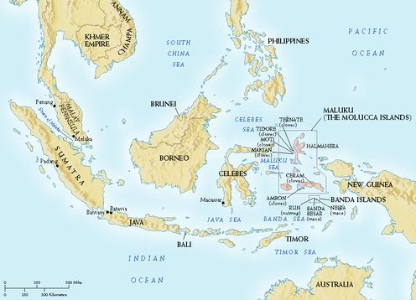
“Spice Islands” of Malaysia
Spices such as cinnamon, nutmeg, cloves, etc.. From the Spice Islands were literally worth their weight in gold during the Middle Ages

Slide 11
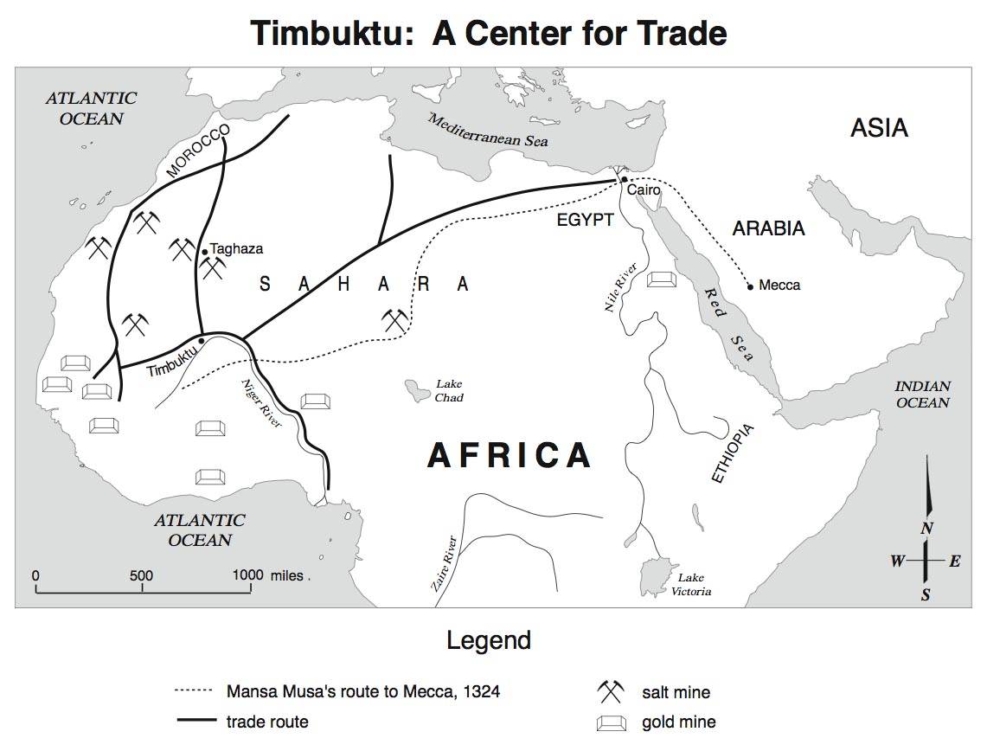
African Salt & Gold Trade

Slide 12
Reasons for Intensification of Trade during Postclassical Era
#4: New forms of _______________=> due to the volume of trade and long distances, new methods of payment were devised
Venetians and other minted new coin $$ => gold florins
Some states also printed paper $$ => Tang China printed notes in 9th century, but they inflated to 1% of value(not backed by gold)
Credit was also used for the first time, called “_____________” in China => paper certificate that was used by govt (promised to be redeemed for coinage at capital)
-- Used as currency by merchants (vs using large # of copper coins)
______________________ were also used by Italian bankers (i.e. Medici family) and at European fairs => promised holder that they could be redeemed at bank or another fair for amount of coinage
-- These bills were often discounted (i.e. => gave $10 to get a $9 bill) => way around Christian ban on usury (interest)
-- Italians and Jews dominated banking in Europe => Jews were not bound by usury laws and Italians invented ways around them

Slide 13
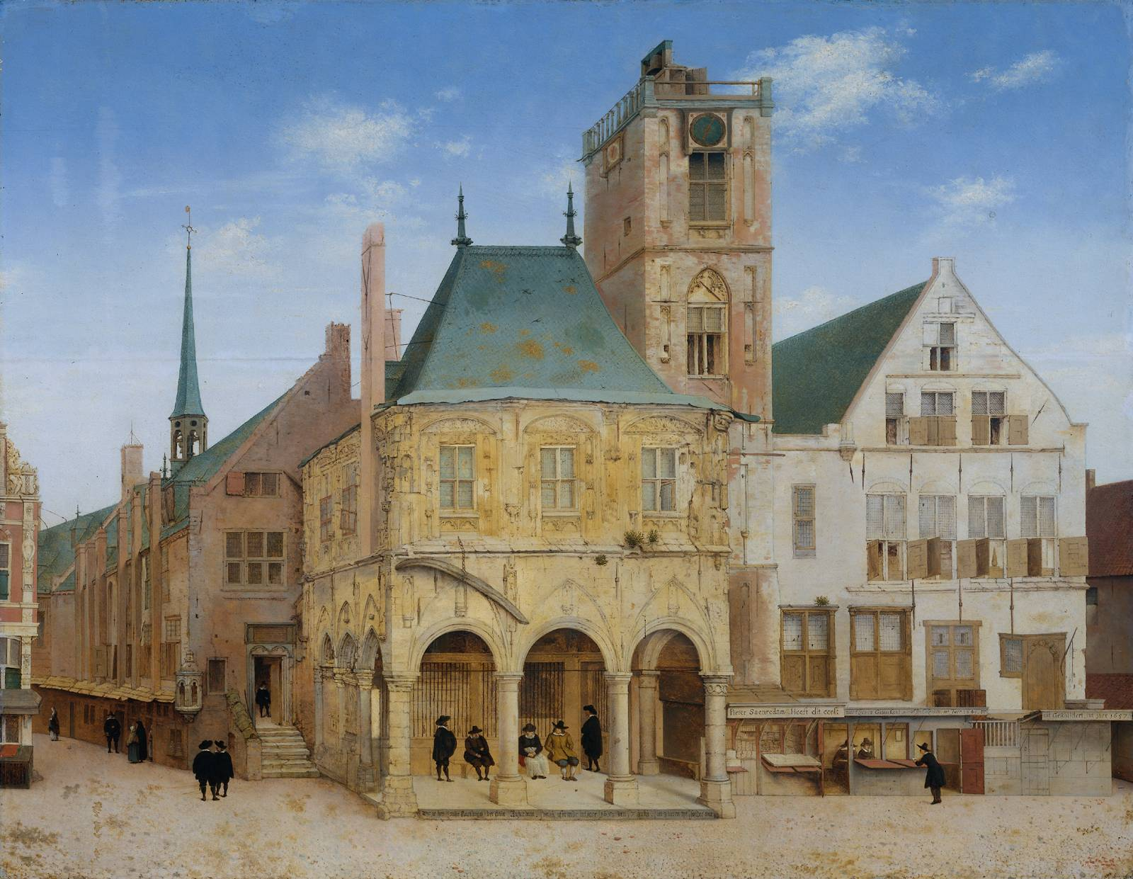
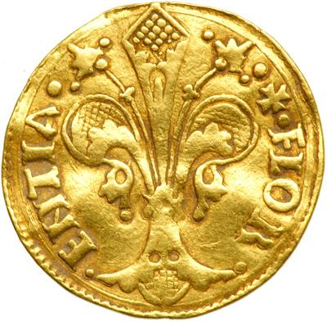
Venetian Banking House
Florin dated 1253
Italian Banking houses were the forerunner of modern day banks and helped to create commercial capitalism of 16th and 17th centuries => they would have branches in ME Crusader states and other areas

Slide 14
Reasons for Intensification of Trade during Postclassical Era
#5: State Practices and Trading Organizations
Many states and empires contributed to the encouragement of trade
_____________________ => built by the Sui and Tang dynasties to link Northern and Southern chinese rivers
_____________________ was also an organization created by Northern European cities to foster regional trade
#6: Growth of Technology
Camel saddles and increasing levels of organization of caravans routes led to increased caravan trade across the ME and Africa
__________________ grew up in ME along Great Persian road => roadside inns where travelers could sleep and gain supplies
Indian _____________and _______________also improved water travel => dhows incorporated lateen sails to better sail with wind
Boats also incorporated stern mounted rudders (better steering)
Size of dhows in Indian Ocean increased from 100 tons in 1200 to 400 ton by 1500
Improved astrolabe (ME) and magnetic compass (China) also led to greater accuracy in sailing

Slide 15
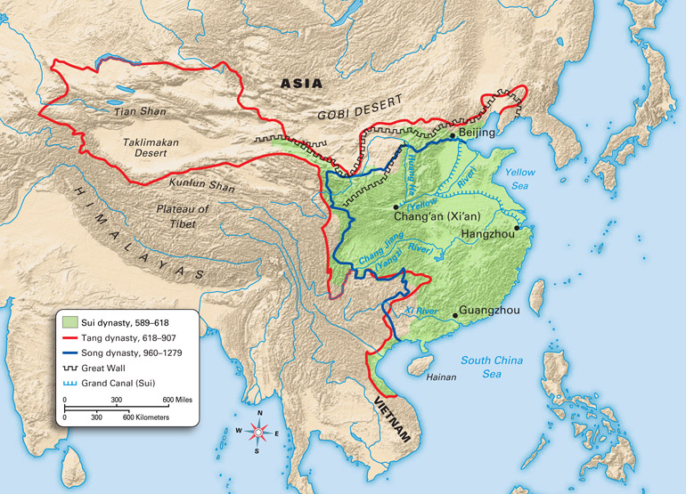
Sui and Tang Grand Canal
Grand Canal was used for regional trade (i.e. shipping rice to Northern China) as well as intl trade => silk and other goods shipped from Hangzhou

Slide 16
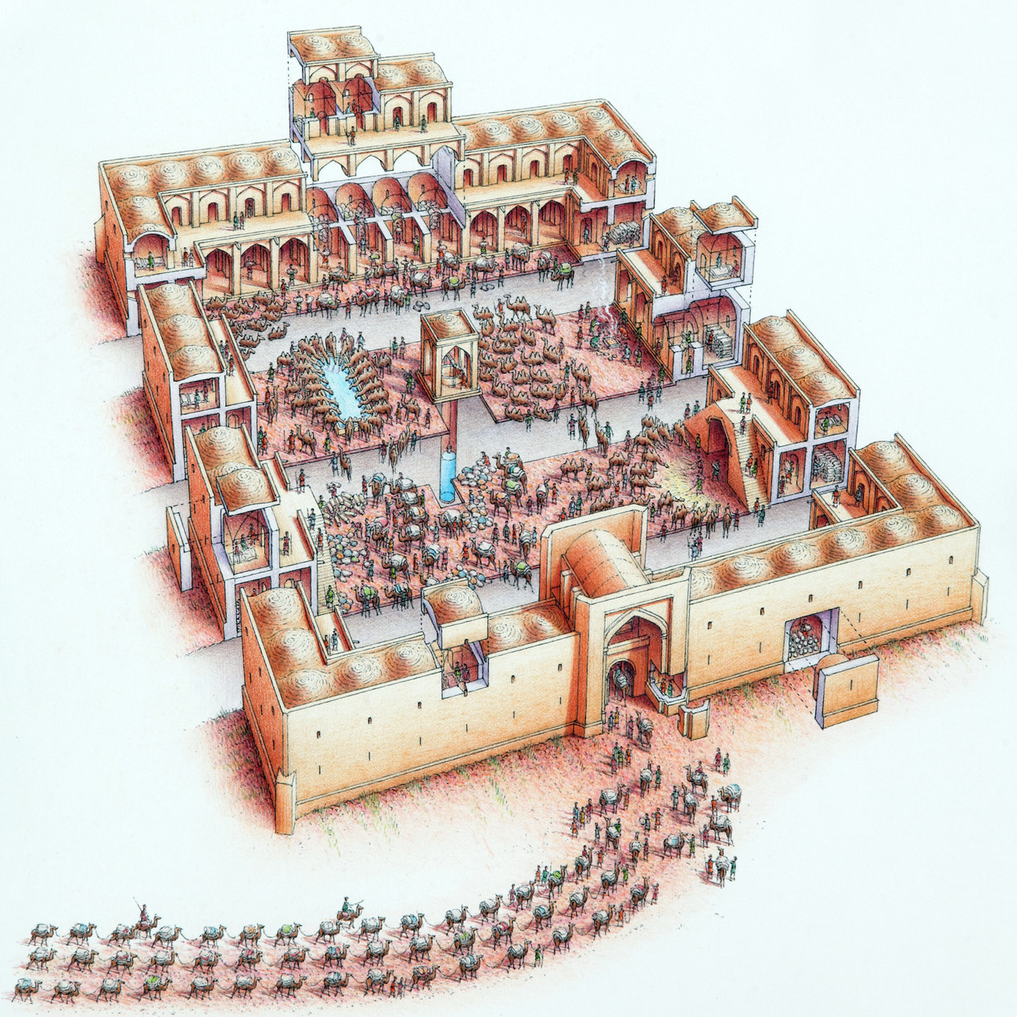
Caravanserais
Caravanserais were usually located along travel routes and organized in a square => they had water and food for animals, a bazaar for merchants and sleeping quarters

Slide 17
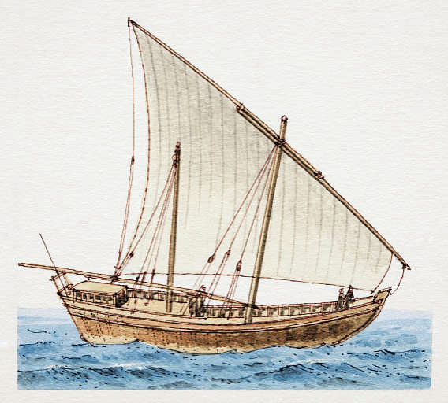
Indian Ocean Dhow
Dhows were very popular ships in the Indian Ocean trade networks due to their low cost, maneuverability. Often made of teak wood and sewn together (less likely to be damaged on reefs), they were sturdy and reliable

Slide 18
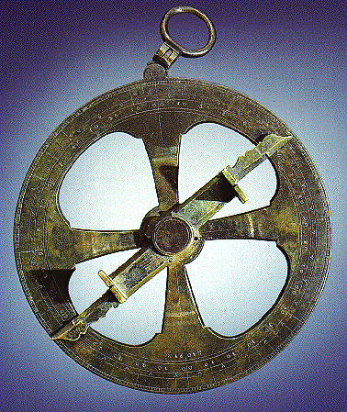
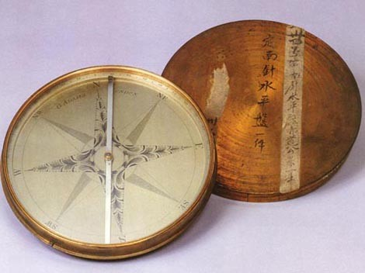
Astrolabe and Magnetic Compass
A mariner’s astrolabe is used to measure the latitude of a ship using the sun’s position at noon or a star of known declination

Slide 19
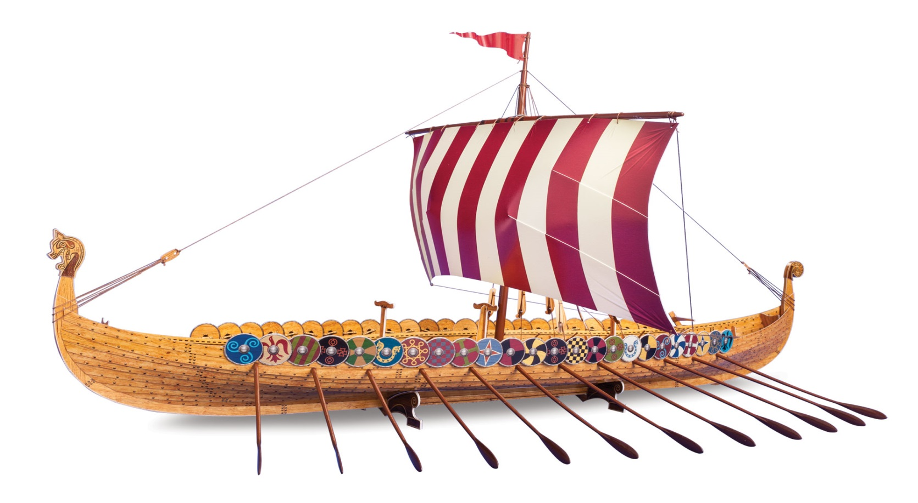
Reasons for Intensification of Trade during Postclassical Era
________________also represent a technological development, based on environmental knowledge (i.e. like Indian dhows)
Longships were adapted to sail both on open water and in small rivers and estuaries (raiding and trading in Europe)
Leads Vikings to establish trade and settlements on coasts of northern Europe as well as inland Russia
Q: What technological innovations do Viking longships have that can lend them to open water and river travel?

Slide 20
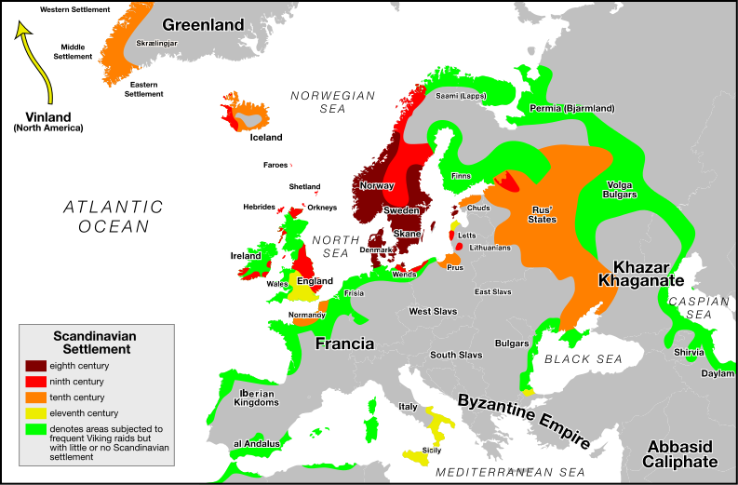
Viking Raids & settlements
A combination of motives, capturing of slaves and booty mixed with a desire to secure permanent settlements, motivated Viking expeditions across the ocean and up various rivers in Eastern Europe

Slide 21
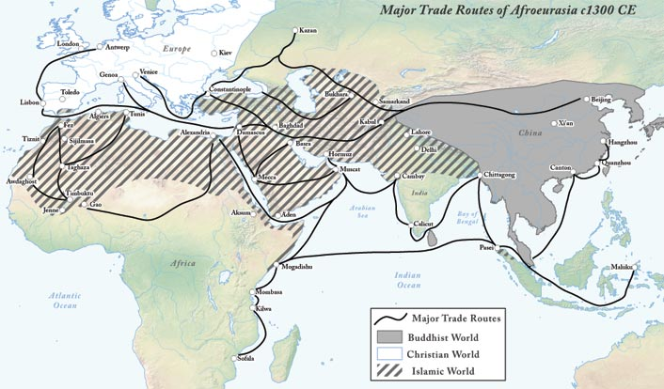
New Cities as commercial centers
Many cities during the Postclassical Era became hubs of trade and civilization => facilitated the exchange of goods, ideas and technology
European => Venice, Cordoba, Novgorod, Kiev, Flanders
African => Timbuktu, Kilwa
ME => Baghdad, Damascus, Aden
Mesoamerican => Tenochtitlan, Cahokia (N. American along the Mississippi river)
Asian => Hangzhou, Calicut, Melaka (Malacca)

Slide 22
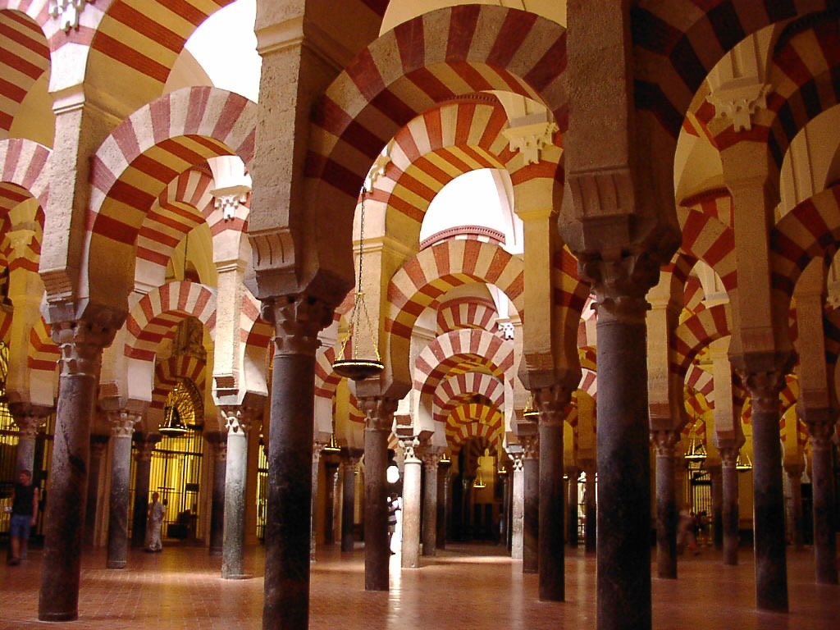
Cordoba in 1000 CE
“At the close of the 1st millennium CE the greatest and most cultured city in Western Europe was not Rome, Paris or London. It was Cordoba, the capital of Arab Andalusia . . . There were parks, palaces, paved roads, oil lamps lighting the streets, seven hundred mosques, three hundred public baths and extensive drainage and sewer systems. Perhaps most impressive of all was the public library, completed around 970 CE and containing nearly 500,000 books – more books than any European country contained. And it was merely the largest of seventy libraries in the city . . . No wonder that Hroswitha, a German chronicler called it “the jewel of the world.”
-- A History of the World in 6 Glasses (pg 93)
The Mezquita at Cordoba

Slide 23
New Trading Routes
During the Middle Ages, commercial growth led to the creation of new trade routes also . . .
#1: _______________(1241) => N. European trade partnership (Baltic Sea)
Main cities = Novgorod, Ypres, Flanders, Antwerp, Hamburg
Hanseatic League = confederation of cities that had formed ________ __________________(i.e. trading orgs that specialized in 1 commodity)
Each city wanted to foster trade with others and thus taxes were raised by taxing each guild and providing for a common army
-- Armies protected trade routes after Mongol fall
Hanseatic League traded furs, wool, amber, timber to other European cities and Hanseatic League linked its routes to Mediterranean
Hanseatic League’s growth was aided by _______________________
Centered in Champagne area of France => series of 6 fairs were held annually in 6 large towns in France (i.e. Flanders, Bruges, Hamburg)
-- Fairs were centers of exchange between Northern and Southern Europe => N goods (i.e. furs, wool, cloth, tin) were traded for Venetian goods (i.e. silks, sugar, spices, gold)

Slide 24
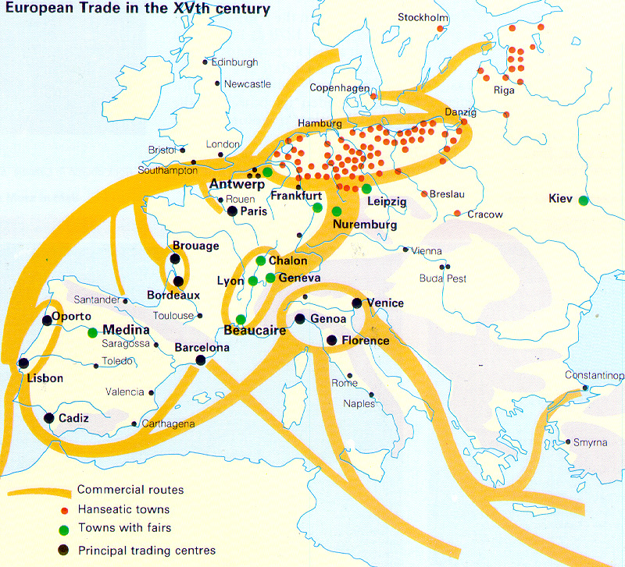
Hanseatic League

Slide 25
New Trading Routes
#2: Mesoamerican Routes => after 500 CE trade routes began linking the Andes region, as well as Mesoamerica
Overland Trade => carried via Alpacas over Incan roads
Trade centered on luxury goods and metals (i.e. pottery, copper, gold/silver jewelry, textiles)
Linked Andean cities and civilizations like Moche, Wari, Inca
Pacific Ocean => trade carried on large balsa wood rafts between Mesoamerica and Andean S. America
Trade contacts led to spread of metallurgy to Mesoamerica (via S. America) and spread of Maize to S. America (via Mesoamerica)
Maritime exploration also led to the settlement of Carribbean islands by Arawaks (S. American tribe)

Slide 26
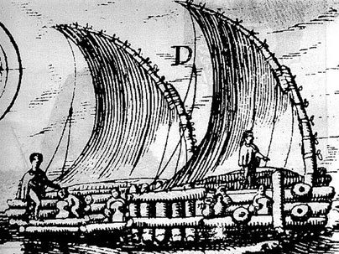
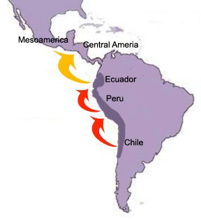
Mesoamerican TradeRoutes
Balsa wood rafts that measured up to 36 feet in length were used to carry trade between S. America and Mesoamerica after 100 CE => each raft could carry up to 20 tons of cargo

Slide 27
New Trading Routes
#3: Indian Ocean => all sea route from China to India/ME opened in 400CE due to efforts of Malay sailors and SE Asian traders (piracy always problem)
With collapse of Mongol Empire in 14th century, overland trade was severely disrupted => volume of trade in Indian Ocean increased
Indian Ocean route was also dependent on cooperation of ___________ _________________ rather than large commercial states (i.e. Silk Road)
-- Diasporic cities => Muslim, Jewish, Chinese merchants
Major States
Swahili city states (______________________) & Great Zimbabwe => traded gold, ivory, slaves and animal skins
_______ (ME city of Red Sea) => traded grain, opium, coffee & dyes
Indian Gujarat cities under Delhi Sultanate (i.e._______________) => traded cotton, indigo, cowrie shells, leather goods, gems & pepper
SE Asian empires like Sirijava & Majapahit vied for control of Strait of Malacca => by 1350 city of _____________controlled trade
-- Aided by ruler’s conversion to Islam
-- Traded rubies & gems, spices (cloves, nutmeg), gold, tin
Trade in Indian Ocean controlled mainly by _____________=> key to spread of Islam in region (i.e. Malacca, India, Swahili city states)
Piracy in Indian Ocean a constant problem => states try to control

Slide 28
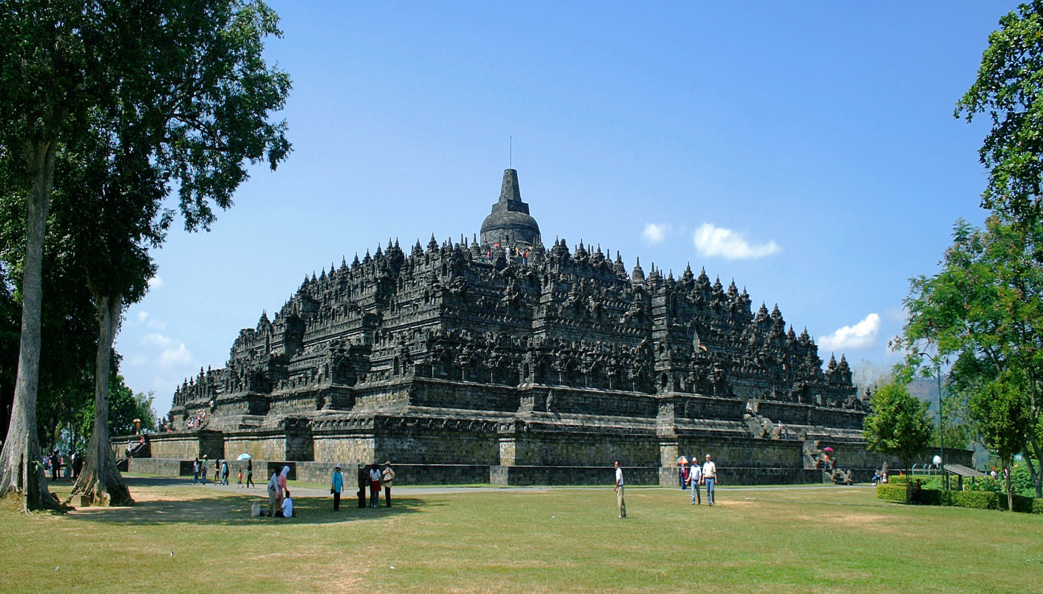
The Temple at Borodobur
Mountain shaped people of Malaysia initially worshipped mountains) structure w/ 10 levels => full of elaborate carvings and illustrations

Slide 29
Eurasian Trade networks ca 1450 CE

Slide 30
Results of Interregional Trade
Due to increased volume of trade & new trade routes, there were many important impacts of interregional trade during the Postclassical Era
#1: Concentration of wealth => merchants during the time period became a new economic elites as trade enriched many areas
____________were well respected in ME and occupied a favored status => established many diasporic communities and spread Islam
Malacca in SE Asia, Mali in Africa, Andalusia in Spain, Samarkand in C. Asia (Silk Road), Egypt
Jewish merchants and the merchant communities in Italian city states (i.e. Genoa, Pisa, Venice) also concentrated wealth due to trade
_________________________and letter of credit were precursors to the commercial capitalism that emerged in later centuries
Wealth concentration in Italy also led to the climate necessary for the Renaissance in the 15th/16th centuries
Kings in places like Malacca and Mali also showed vast levels of personal wealth based on trade (controlled key items)
** Hajj of Mansa Musa reading**

Slide 31
Results of Interregional Trade
#2: Cultural Exchange
Religious exchange occurred most often on trade routes
Islam spread to _________(Mali Empire & Swahili city states), ________(Malacca), ___________(Delhi Sultanate) & Central Asia (Silk Road trading cities like Samarkand)
Mahayana Buddhism was spread to _________________like Srivijava (India) and Vietnam (China), as well as __________(Zen Buddhism)
Hinduism was spread by Indian traders to interior SE Asian kingdoms like ____________=> developed castes system based on occupation
Crops and agricultural techniques
_____________was spread from SE Asia to China (matures faster and increased yields) => leads to pop growth
___________________________were spread from India to ME and throughout Mediterranean
-- Led to textile industry in Europe and ME
-- Europeans also desire to acquire land to cultivate sugar
-- Citrus improves diet and reduces diseases like scurvy

Slide 32
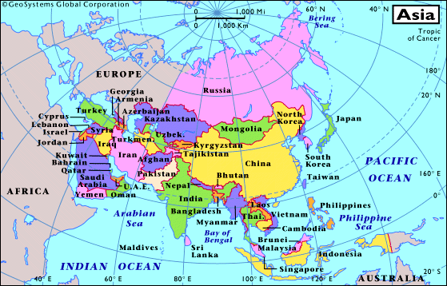
Diffusion of Crops during postclassical era
Citrus, Cotton & sugar do not grow well above the 40th parralel
Q: What areas are open to their cultivation outside of India?

Slide 33
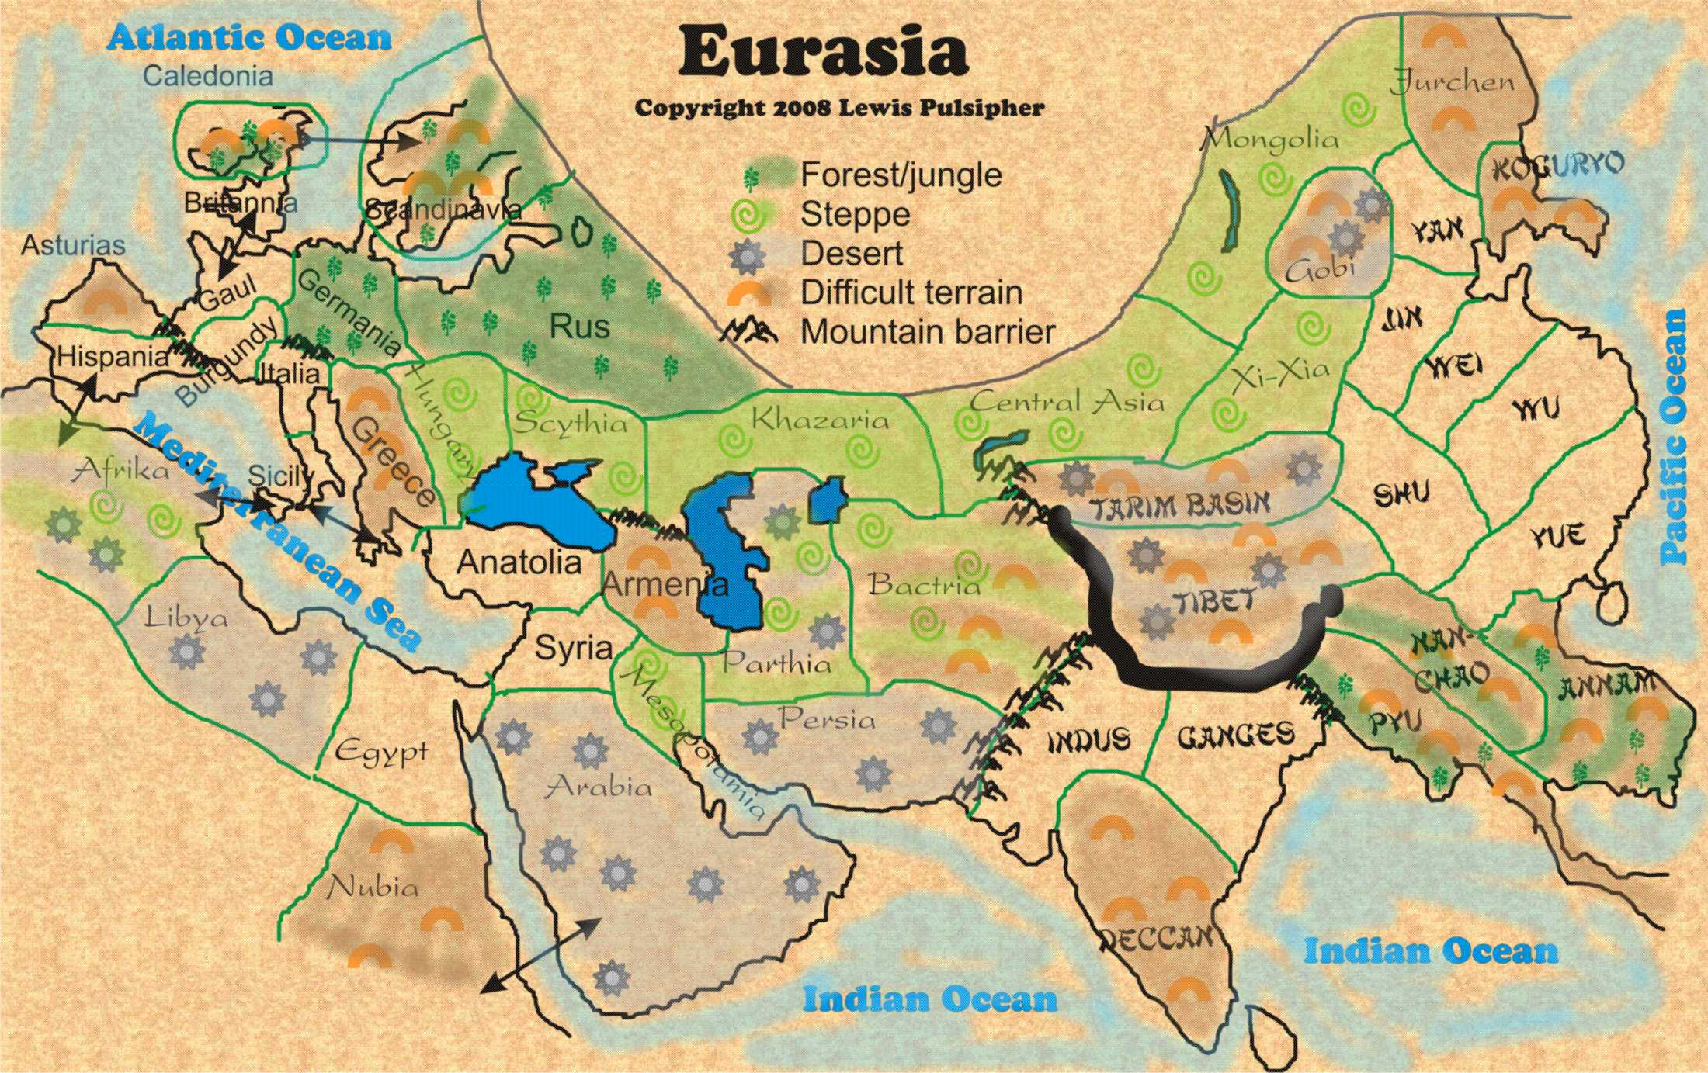
Eurasian Terrain

Slide 34
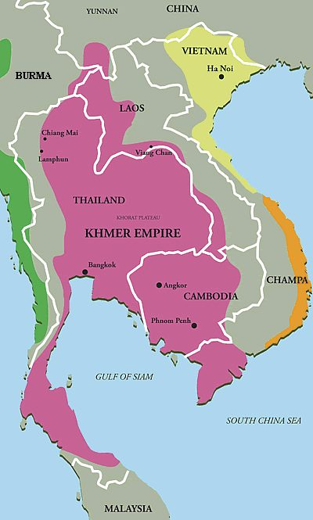
SE Asia in 1200 CE
The Kingdom of Angkor was based on the cultivation of champas rice => traded other items such as salt, honey and textiles
The empire declined by 1430 due to incessant wars with neighbors and silting of its irrigation canals

Slide 35
New Agricultural Techniques of Middle Ages

Slide 36
Results of Interregional Trade
Bananas were introduced by Malay traders and become important in Africa => high yields and ability to grow in jungled areas
-- Preferred crop of Bantus (spread via migration)
Farming techniques like 3 field system, use of improved iron plows & horse collars were imported to Europe via Central Asian trade
#3: Spread of ____________________=> diseases like Bubonic Plague, pnuemonic plague and measles/mumps spread during time period
Spread easily along trade routes and by large empires like Mongols due to ease of travel and contact

Slide 37
The Black Plague (14th Century)
One of the most detrimental effects of Interregional trade during the Middle Ages was the outbreak and spread of infectious disease
During the Classical Era outbreaks of disease occurred => Measles and mumps outbreaks in Roman and Han empires; Black Plague outbreak in Mediterranean during the 6th and 7th centuries
Plague started in SE Asia or Central Asia and was spread by _________ along ___________________________=> linked most of Eurasian world
Plague particularly effected more urban settlements and areas => spread easily in dirty environments (i.e. Europe)
-- Particularly hard hit were Egypt, Italy and China
Mortality is estimated to have been from_________________
-- China: pop decline from 120M (1340) to 80M (1400)
-- Europe: pop decline from 75M (1348) to 37M (1351)
-- Egypt: pop did not reach pre-plague levels until 1800’s

Slide 38
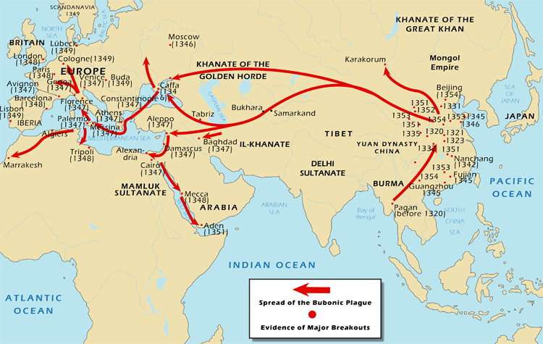
Spread of Black Death (14th century)
Q: What was the pattern of spread of the Black Death? Why did this pattern emerge?

Slide 39
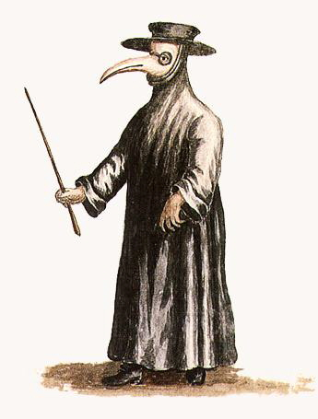
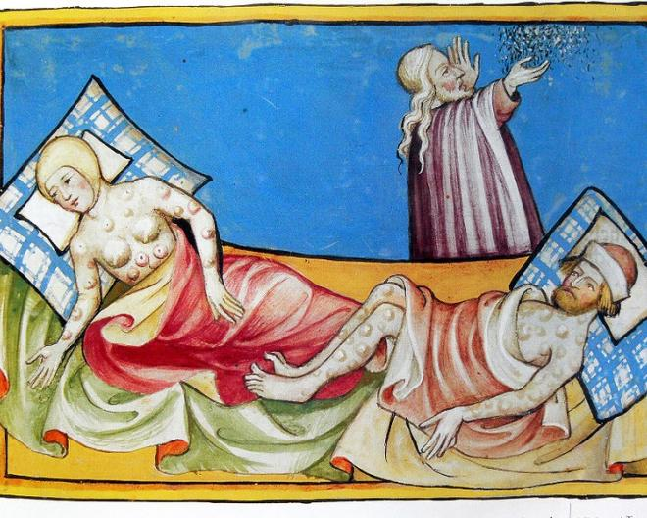
Medieval depictions of the Black Death
Plague doctors – wore mask to cover up the stench (herbs placed in beak) . . . Used medical techniques like bloodletting, use of urine as a disinfectant

Slide 40
Impact of the Black Plague in 14th century
#1: Religious effect => plague weakened the Catholic church due to inability to “stop” plague
Many looked for a scapegoat and in Europe that was the Jews => worst pogroms (massacres) were in Germany
Led to Jewish migration to Russia & Poland => offered protection
Other looked to “earn” god’s forgiveness by whipping themselves => _______________________(popular in 1350’s until they targeted Jews)
#2: Political Effect
Due to deaths ______________________=> within 80 years their empire collapsed in China, Russia and Persia
Plague also weakened ______________due to manpower shortages => led to growth in wages and more serf autonomy
Cities also declined in population as well as importance for over a century as food shortages followed
#3: Economic Effect
Volume of _________________dramatically
Fall of Mongol empire contributed, as well as deaths of many merchants and decline of cities and wealth (less desire for luxury goods)

Slide 41
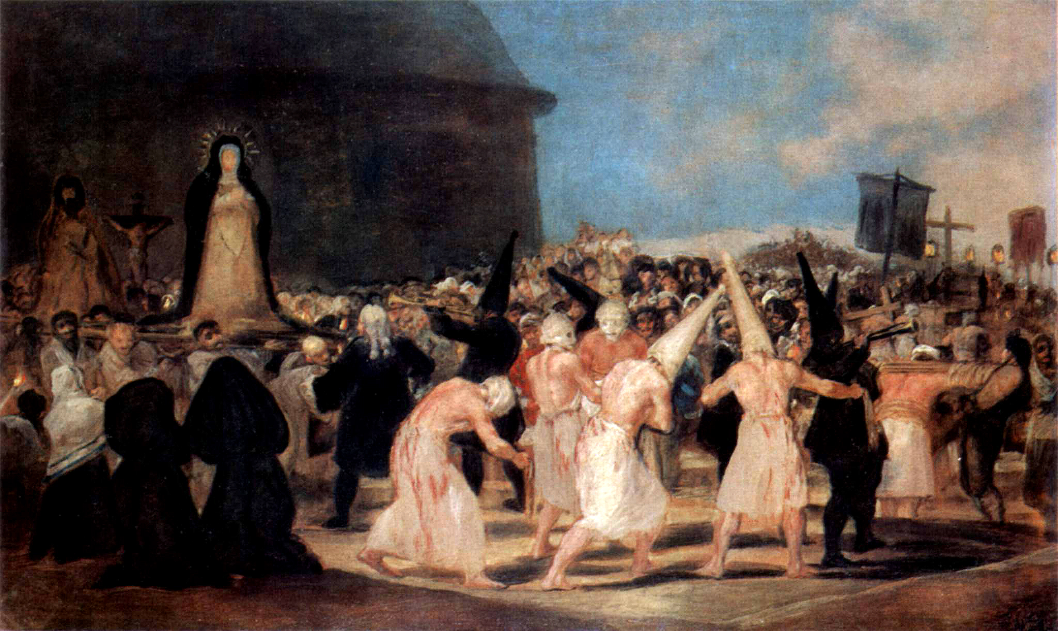
A Procession of Flagellants
A procession of Flagellants => during the Plague outbreak, flagellants would march through the countryside recruiting and offering penance to God through beatings

Slide 42
Migrations & their impact during the Postclassical Era
Throughout World history groups have migrated for various reasons => climate change, trade, conquest, living conditions
During the Middle Ages two significant migrations occurred that had significant effects on settlements, peoples and the environment . . .
#1: __________________Migration
Bantu language family originated in the Nigerian area => linguistic evidence shows that 300+ African languages are related to Bantu
Around 1st century BCE Bantu people started migrating south and west
As they spread they brought __________________ and agricultural crops (i.e. yams, millet) to other areas of Africa
-- Led to rise of Great Zimbabwe & population growth
Migration also led to a degree of African cultural unity => similar traditions (i.e. music, kinship, social categories)
Bantu languages intemixed with other languages in areas of Africa to create unique new languages => i.e. Swahili
_________________is a mixture of Bantu, Arabic & colonial languages
Swahili became a language popular in eastern Africa => Spoken by 140 M

Slide 43
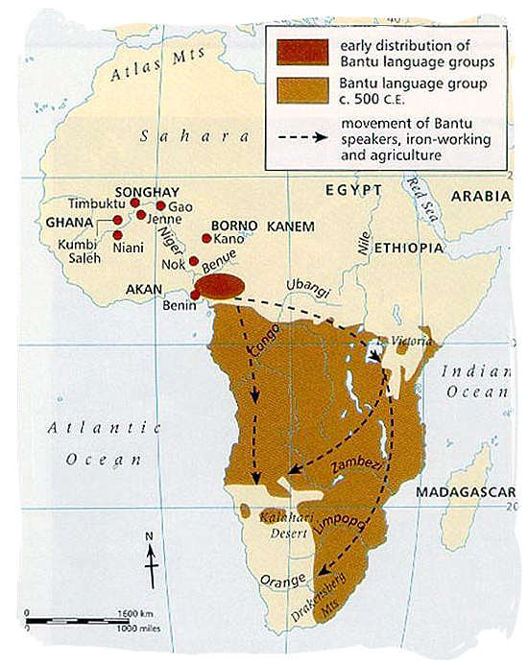
Bantu Migrations (ca 300 BCE to 1000 CE)
As the Bantu people migrated they brought knowledge of ironworking and agriculture (i.e. yams & sorghum)
Intermixing on the East coast of Africa between Bantu and Arabic language led to the development of Swahili

Slide 44
Migrations & their impact during the Postclassical Era
#2: _______________________Migration
Polynesian peoples originated in East Asia (i.e. Taiwan) around 8000 BCE and had sailed to New Guinea by 3000 BCE
Introduction of yam agriculture and animal domestication led to a population explosion => settlement of nearby islands
Established their own Polynesian culture based on farming, fishing on islands of the Pacific (i.e. Tonga, Fiji, Samoa) by 1000 BCE
Between 1000 BCE and 1000 CE Polynesians mastery of open ocean travel over long distances (using stars and currents) led to the colonization of far away Pacific islands (i.e. Hawaii, Easter Island)
Utilized fleets of large double hulled canoes => made carrying of animals (pigs, dogs) and plants (bananas, yams) to islands possible
Polynesians also made contact with the coast of South America => introduced chicken to S America and sweet potato to islands
Some settlements had disasterous ecological consequences
Easter Island settlements depleted natural resources (i.e. timber) due to population growth & religious practices (Maori heads)
Led to ____________________________=> decline of civilization

Slide 45
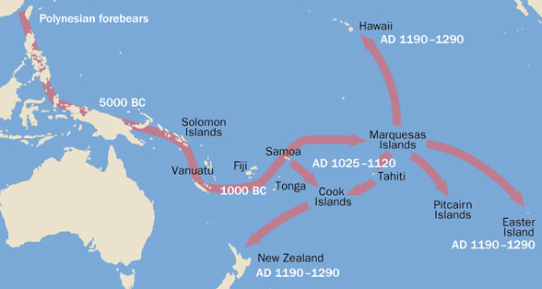
Polynesian Migrations
Polynesian people navigated the Pacific Ocean using no advanced scientific instruments – instead they used techniques passed down by oral tradition that included identifying star patterns, cloud shapes and patterns and the colors of the ocean and sky at various locations. Easter island and Hawaii are over 2300 miles from Samoa and Tonga.

Slide 46
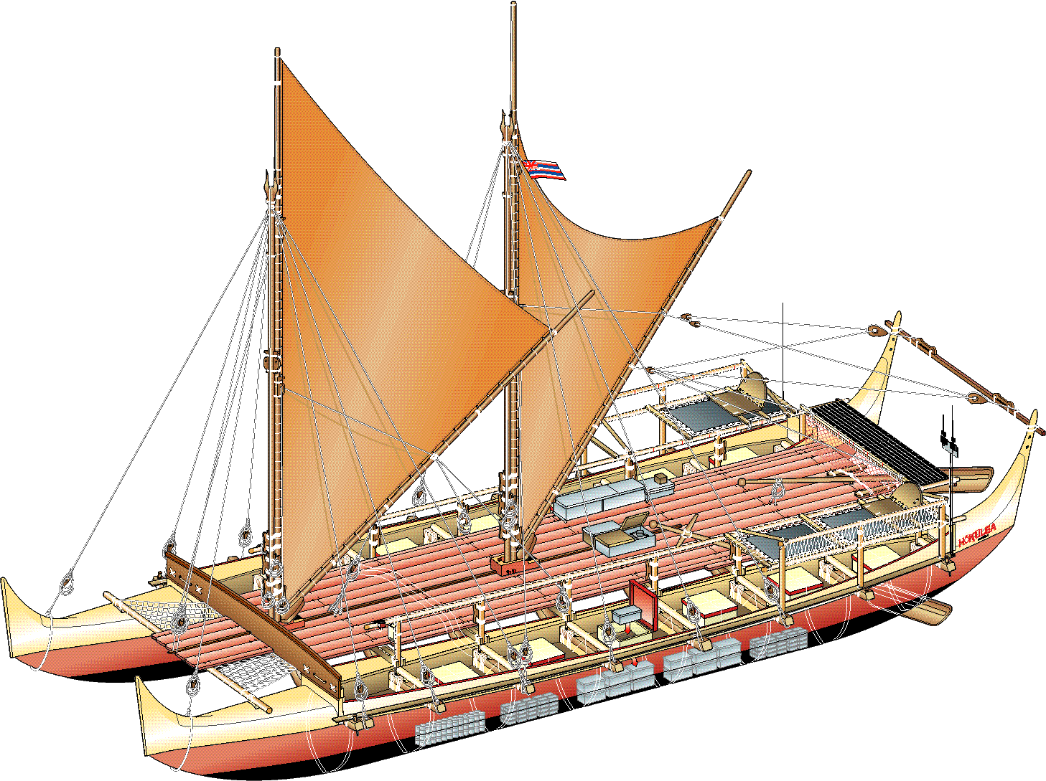
Polynesian longboats
Polynesian longboats could carry up to 100 people and various items for settlement or trade (i.e. chickens, grains, etc…)

Slide 47
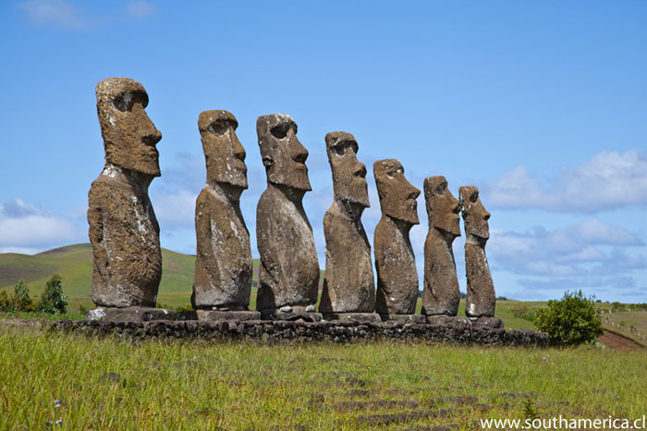
Maori heads on Easter Island
Large statues were part of the Maori religion (means to contact ancestors) but their creation consumed a large amount of resources (i.e. trees) which contributed to the ecological collapse of the island by 1700 due to deforestation and rat predation

Slide 48
Diffusion of Cultural, Literary & Artistic Traditions
Increasing contact and trade between regions and civilizations led to increasing amounts of cultural diffusion (Q: What is cultural diffusion?)
China & East Asia
The Tang and Song periods are seen as the height of Chinese artistic expression => great deal to do with influence of___________________
Buddhism & Daoism influenced the development of Chinese artistic styles in poetry/painting => focus on tranquility of nature
-- Buddhist & Daoist painters believed that depicting nature could lead to realization of Dao/enlightenment
-- Buddhist & Daoist painters also focused on portraying “idea” of mountain and depicted humans as small
Buddhism & Daoism also influenced Chinese poetry which often had nature, isolation and the shortness of life as themes
These ideas and themes were _______________through trade contacts
Buddhism spread to Japan from 6th to 8th centuries & melded w/ Shinto beliefs => focus on nature & meditation (Zen Buddhism)

Slide 49
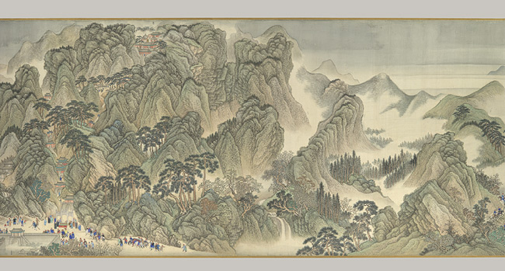
Tang China landscape painting (Daoist influenced)

Slide 50
Diffusion of Cultural, Literary & Artistic Traditions -- Japan
Buddhism and Chinese Confucianism influenced Japanese poetry, painting & architecture => focus on natural themes and mood
-- Poetry => simplicity and often focused on nature (Buddhism) but also very structured (_______form; linked verses of 17 syllables)
-- Painting => landscapes (i.e. rolling hills w/ rice field)
-- Architecture => buildings designed to imitate Tang court; Japanese wood structures outlast Chinese
_______________________ also played a key role in Japanese society
Neo Confucianism was brought to Japan via trade contacts in the Kamakura period (i.e. 14th century) and was used for monk education
Tokugawa shogunate (16th century) adopted it as the official state religion as a means of control => Focus on_____________________
-- Created a more rigid social hierarchy => samurai, farmers, artisans and merchants
-- Also introduced more ethnocentrism into Japan => Japanese came to believe their rational culture was center of world

Slide 51
Diffusion of Cultural, Literary & Artistic Traditions -- Korea
Neo-Confucianism and Buddhism also played important roles in ______
Korea was controlled by the Han dynasty for centuries and thus Koreans were exposed to Chinese civilization
Used Chinese institutions and ideology to create a Korean state by time of Tang dynasty
-- __________________ became state religion; Chinese art forms and architecture dominated capital city (Kyongju)
-- Koryo dynasty (935-1392) adopted a version of _____________ ___________examination => limit power of Korean nobles
-- Art focused on _________________adopted from China and landscape painting
Koryo dynasty maintained a tributary relationship w/ China

Slide 52
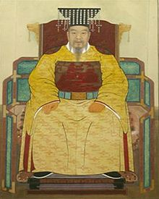
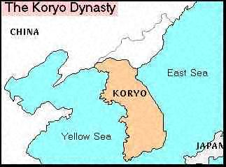
Koryo Dynasty
The Korean Koryo Dynasty was established by General Wang Kon in 935 => deeply influenced by the Chinese model

Slide 53
Diffusion of Cultural, Literary & Artistic Traditions -- Vietnam
Vietnam was ruled as part of China during the Qin, Han & Tang empires
After 1000 years of foreign rule, though, Great Viet gained their independence in 939 CE from the Tang Dynasty
Chinese rule left behind a powerful cultural and political legacy
1. Viet rulers used same political traditions to rule => styled as emperors, used civil service exams, 6 ministries and local/provincial governments
2. Vietnamese adopted __________________________beliefs
Elite adopted Confucian practices while commoners practiced Buddhism & Daoism in concert w/ animistic practices
Confucian concepts like filial piety and role of family were also adopted => women maintained more rights than Chinese though
-- Vietnamese women allowed to own property & initiate divorce => these were codified into Vietnamese legal code in 1460
3. Vietnamese also adopted Chinese artistic & literary styles => dynastic histories, poetry, porcelain and architecture
4. Chinese characters also from the basis for Vietnamese chu nom characters (Vietnamese written language)

Slide 54
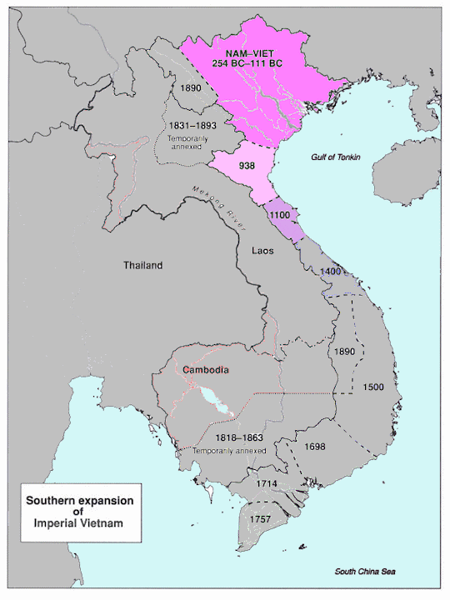
Dai Viet during the Tang Dynasty
After hundreds of year of foreign rule, Great Viet arose as an independent state => Vietnamese people have been fighting for 1000’s of years to be independent

Slide 55
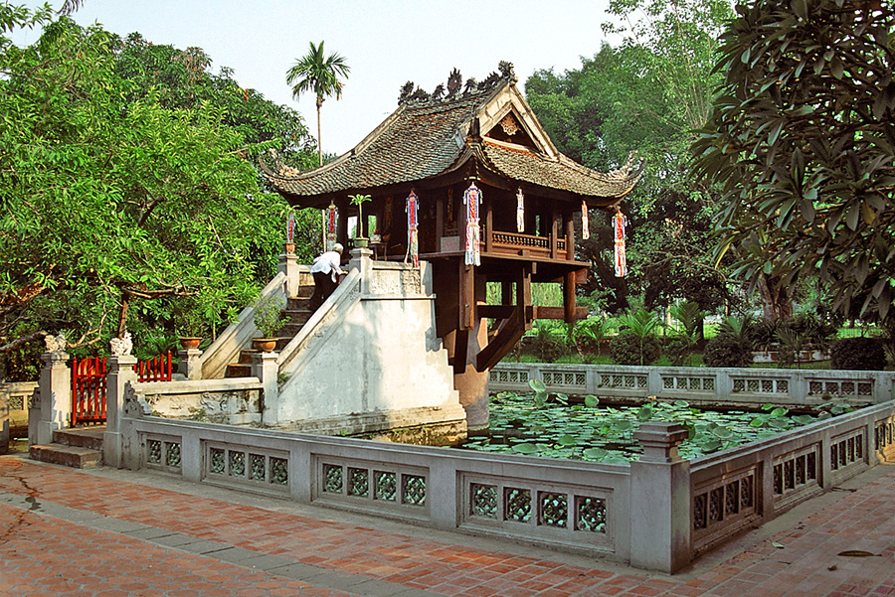
One Pillar Pagoda in Hanoi
The One Pillar Pagoda in Hanoi is done in the classic Chinese architectural style => it is a Buddhist temple and shaped like a lotus flower

Slide 56
Other Examples of Cultural Diffusion
In addition to Chinese influence in East Asia, there are many others examples of cultural diffusion and influence during the Postclassical Era
Indian Hinduism and Buddhism in SE Asia => Thai, Pagan & Angkor kingdoms adopt Buddhist religion (Theravada) & caste based societies
Kingdom of Angkor had a state Hindu cult w/ 1000’s of local deities, 100’s of temples and over 300,000 priests
SE Asians also adopted Indian writing script and used it to create their own epics (i.e. Ramayana)
Buddhist architecture also dominated (i.e. stupa) in temples like Borobudur in Java & Shwedagon pagoda in Yangon (Myanmar)
2. Islam’s influence in Sub Saharan Africa & Malacca
3. Toltec/Mexica & Inca traditions in MesoAmerica

Slide 57
Borobodur in Java
Borodobur is one of the greatest Buddhist shrines. It was organized into three levels of the stupa which represent the sphere of desire, the sphere of rom and the sphere of formlessness. It borrows significantly from Indian stupas in its shape, as well as the spire on the top.

Slide 58
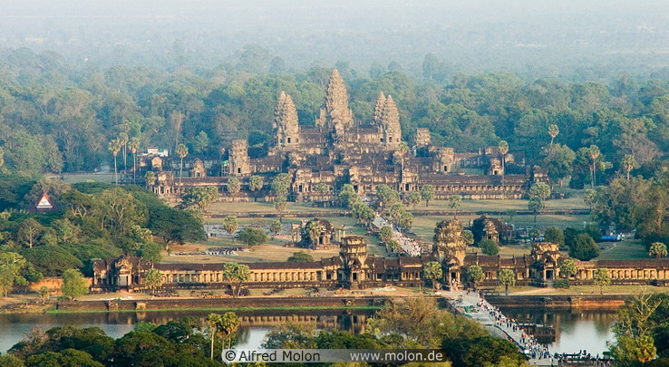
Temple of Angkor Wat
The temple of Angkor Wat uses Indian architectural techniques (domes, mound shaped) w/ Buddhist influences (delicate, ephemeral)

Slide 59
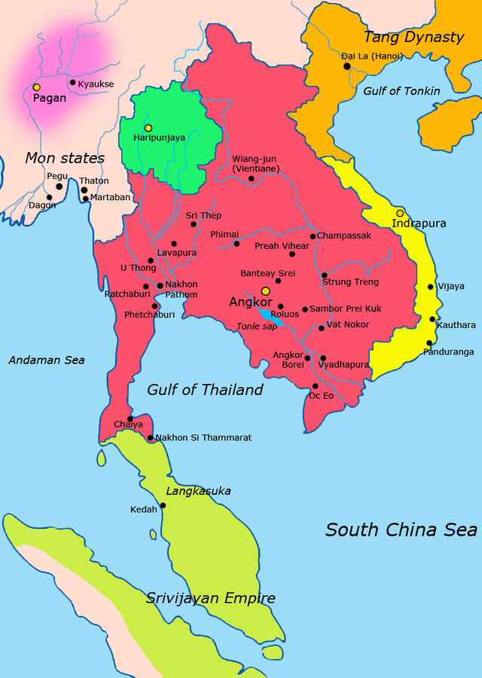
Kingdom of Angkor (or Khmer Empire)
Angkor existed as a regional power from 802-1432 => SE had little connection to trade routes and did not specialize in any export commodity

Slide 60
World Population through History

Slide 61
Year | Est. World Population | Growth Rate
100,000 BCE | 10,000
30,000 BCE | 500,000 | 0.56%
8000 BCE | 6 Million | 1.25%
3000 BCE | 50 Million | 4.33%
1000 BCE | 120 Million | 4.47%
0 CE | 250 Million | 7.62%
1000 CE | 250 Million | 0%
1200 CE | 400 Million | 26.49%
1400 CE | 375 Million | -3.18%
1600 CE | 578 Million | 24.15%
1700 CE | 680 Million | 17.65%
1800 CE | 954 Million | 40.29%
1900 CE | 1.6 Billion | 71.28%
1950 CE | 2.5 Billion | 139.74%
2000 CE | 6 Billion | 462.42%

Slide 62
Agricultural Production in the Postclassical Era
Agricultural Production increased dramatically during the Middle Ages due to many new inventions and technological innovations
#1: The ________________=> adopted from central Asian nomads, the horse collar was used extensively in Europe and led to incr in yields
Horses plow faster and more efficiently than oxen
#2: _________________field system => used in Mesoamerica by the Aztecs, this system increased yields & allowed year round farming
#3: ______________ field system => used in Andes by the Incas, system greatly increased yields and allowed farming in colder climates
#4: __________________=> used in China, Andes and SE Asia, terracing allows more land to be cultivated in mountainous regions
#5: __________________ rice => adopted from SE Asia, the Chinese used this fast maturing rice to double their rice yields
#6: _________________ system => used in Europe, farmers rotated crops and left 1/3 of land fallow to return nutrients to field

Slide 63
New Agricultural Techniques of Middle Ages

Slide 64
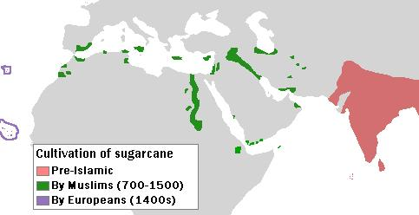
Luxury Goods & Industry during the Postclassical Era
Due to increasing demand for luxury goods in Europe and the Middle East, some crops were transported and cultivated in equivalent climates
________________=> originated in India (still #1 producer) but also transferred to Egypt, Spain & Iran and grown for European & ME markets
_____________ => originated in SE Asia, but imported to Middle East, Spain and Southern China
_______________=> originated in SE Asia but imported to India, Spain and ME where cultivation expanded onto irrigated plantations
** Cultivation of water intensive crops and irrigation systems necessary to support citrus, sugar & cotton contributed to desiccation in ME**
_____________ => originated in China but worms smuggled into Byzantine Empire where it became a major industry

Slide 65
Manufacturing during the Middle Ages
Manufacturing endeavors intensified in many regions of the world during the Middle Ages as well . . .
#1: India => most trade was controlled by state monopolies and artisans/merchants occupied low position in society
Still India was _______________________during Middle Ages => production increased due to local government sponsorship
#2: Middle East => textile production increased due to cultivation of elaborate state sponsored irrigation canals
Iran had a burgeoning cotton textile industry
#3: China => China expanded production of many items due to technological innovations and advances (i.e. gunpowder, compass, movable type printing)
______________=> Chinese perfected techniques for creating steel and produced 35,00 tons in 11th century (same as 18th century British #’s)
-- Produced arms, armor and agricultural implements
__________________=> cotton was grown to produce textiles
______________________=> manufactured in larger quantities under the Song & Ming dynasties in distinctive blue/white and yellow combinations
-- Extremely popular in Europe (Netherlands)

Slide 66
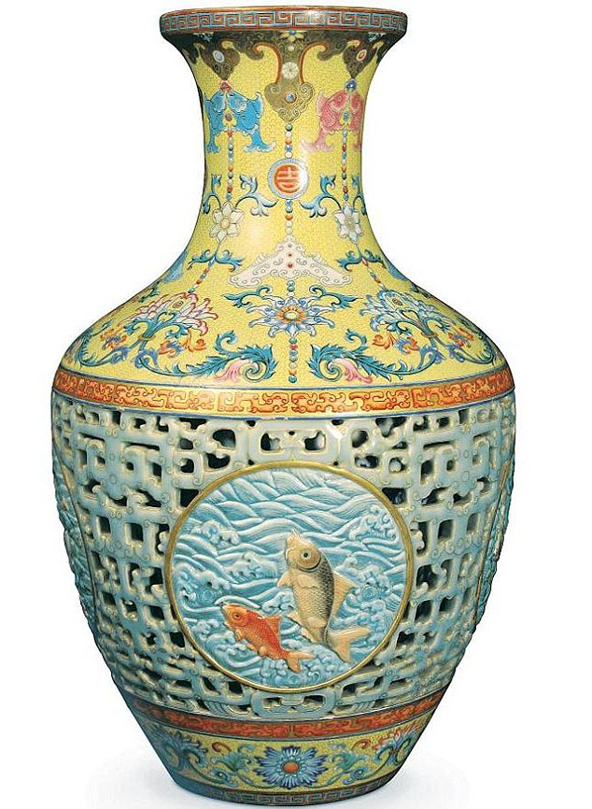
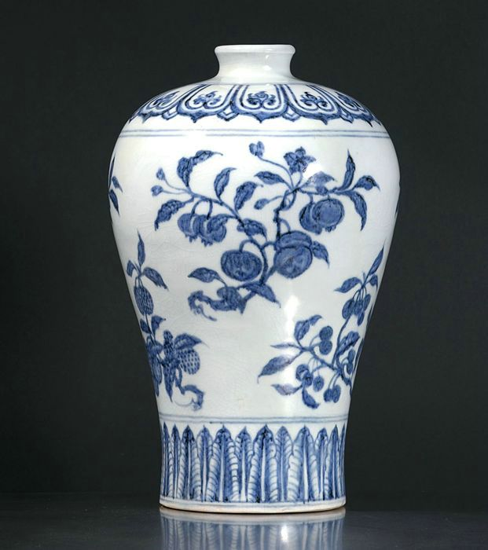
Ming Porcelain Vases
This Ming Vase sold at auction in 2010 for a record $53 million

Slide 67
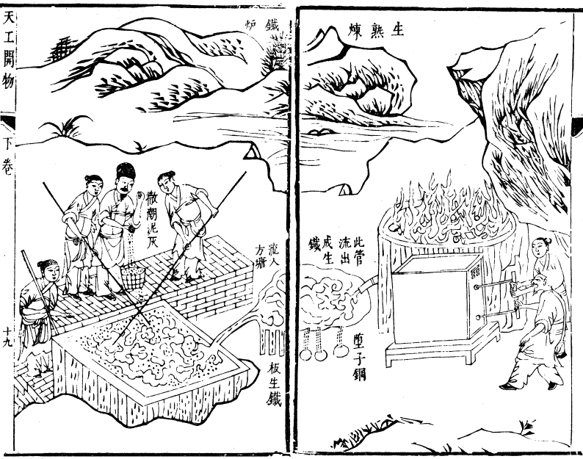
Chinese Blast Furnaces
The Chinese were the 1st to make steel in reliable quantities using refined processes => the Song were producing 35,000 tons/yr in the 11th century

Slide 68
Cycles of Decline & Recovery during the Postclassical Era
During the Postclassical Era factors contributed to a series of urban & demographic declines & revivals (world population growth charts)
Factors contributing to Urban & populational Decline => exs: Athens, Rome, Pataliputra, Chang’an, Alexandria
#1: _______________=> invasions in various areas of the world contributed to urban decline as people fled cities (target of invasions)
Europe => Vikings decimated Northern European cities (100’s of raids) and Mongols destroyed Russian cities like Kiev
Fall of Roman Empire led to decline of_________________________
China => ____________________________contributed to urban decline
Mongols razed many cities => ___________& 92 other cities destroyed
Chinese populational census reported 120 M in 1200; 60 M in 1300
India => conquests of ___________were responsible for the destruction of many cities (Timur’s invasions killed up to 5% of world population)
Timur razed _____________________& destroyed the Delhi sultanate
Middle East => the Mongol & Tamerlane invasions, combined with the Crusades dealt Middle East a triple blow
Mongols razed Baghdad and killed the Caliph in 1258 CE

Slide 69
Death Tolls of Top 10 Wars in World History
1. 78,000,000 – World War II (1939–1945)
2. 40,000,000 – Mongol conquests (1206-1324)
3. 25,000,000 – Qing conquest of Ming dynasty (1616–1662)
4. 22,000,000 – Taiping Rebellion (China, 1850–1864)
5. 20,000,000 – World War I (1914–1918)
6. 16,000,000 – White Lotus Rebellion (China, 1794-1804)
7. 13,000,000 - An Lushan Rebellion (China, 755–763)
8. 10,000,000 – Era of Warring States (China, 475 BCE–221 BCE)
9. 8,000,000 - Red Eyebrows Rebellion ( China, 9-24)
10. 7,000,000 – Conquests of Tamerlane (1370–1405)

Slide 70
Cycles of Decline & Recovery during the Postclassical Era
#2: ___________________ => spread of infectious diseases like the Black Plague along trade routes from China to the ME and Europe also decimated populations
Urban areas hardest hit due to disease spreading more rapidly in crowded environments => many European cities abandoned
Black Plague estimated to have killed as many as 200 M people, including 30-60% of European population
#3: Decline of ____________Although overall agricultural productivity expanded during the Postclassical Era some areas experienced problems
China => systems of extreme taxation including the Well field system and tax farming squeezed producers and reduced yields
SE Asia and India => large scale irrigation systems in area were created and sustained by large states (i.e. Delhi Sultanate)
-- Timur invasions and warfare after 1250 CE caused decline in these systems and thus lack of food (therefore urban decline)
Middle East => climate changes after 1100 CE caused a severe decline in agricultural productivity (region never recovered)
-- Lack of upkeep on irrigation systems led to crop failures
-- Too much irrigation led to desiccation in many areas

Slide 71
Spread of Black Death (14th century)
Q: What was the pattern of spread of the Black Death? Why did this pattern emerge?

Slide 72
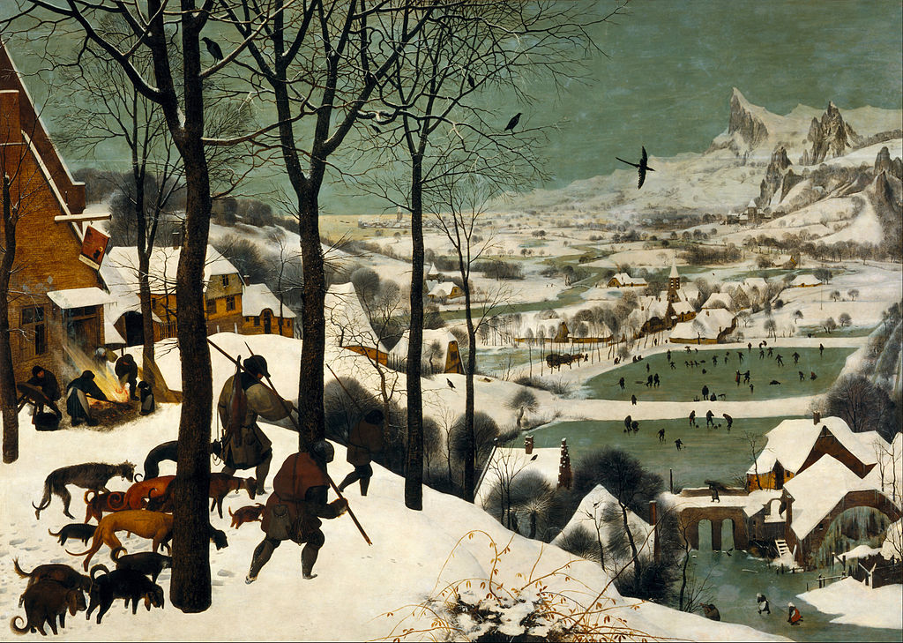
Cycles of Decline & Recovery during the Postclassical Era
#4: The _____________________ (see reading)
Starting in 1300 CE the earth went through a period of cooling for ~400 yrs
Why? => decline in sun spots, eruptions of large volcanoes (i.e. Mt Huanyaputina in Peru) and decline in human population
Effects => caused events like the Great European famine of 1315-17 CE
Harvests decimated by early and late frosts, cool temps
Led to starvation, infanticide and cannabalism
Decline in trade due to frozen rivers
Led to increased rainfall in Sahara & retreat of desert (i.e. Timbuktu)

Slide 73
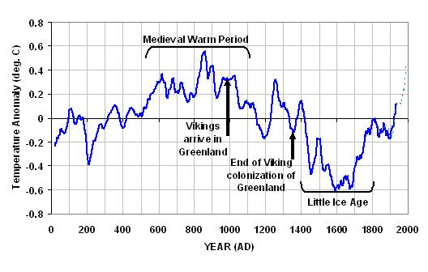
Worldwide temperature by Century

Slide 74
Cycles of Decline & Recovery during the Postclassical Era
Factors Contributing to Urban and Populational Increase => key cities like Novgorod, Timbuktu, Venice, Huangzhou, Calicut, Baghdad, Malacca
#1: End of Invasions
Rise of Feudal systems in Europe brunted Viking invasions and various interludes such as __________________________led to an increase in urban population
After the fall of the Yuan empire in the 14th century invasions declined due to introduction of ___________________(Chinese, Ottomans, Europeans)
#2: Rise in Agricultural productivity => great rise in agricultural productivity was the #1 factor in increasing populations (Q: Methods?)
2nd Great trip point in human populational increase => Q: 1st??
#3: Reliability of safe and reliable transport
Large empires of time period (i.e. Mongol, Abbasid, Tang, etc…) led to revitalization of ___________________________________network and thus trading cities
Mongols fought to keep Silk Road free of bandits
Islamic empires thrived on trade and improved camel transport networks => _________________________and camel saddles
Ocean travel facilitated by advances in dhow and junk ships (larger, stern rudders) and use of _____________________(post 1200 CE)

Slide 75
Caravanserais
Caravanserais were usually located along travel routes and organized in a square => they had water and food for animals, a bazaar for merchants and sleeping quarters

Slide 76
Cycles of Decline & Recovery during the Postclassical Era
#4: Rise of _____________________
Islam greatly encouraged commerce and from 800 CE -1300 CE commercial networks greatly expanded => profit & other motives
Islamic trading cities (_________________) linked ME to both China (____________), Africa, India (____________) & Europe (________)
Islamic culture also greatly encouraged urbanization => means of religious conversion and cultural activity
-- i.e. madrasas & libraries in Cordoba; House of Wisdom in Baghdad
New innovations (i.e.___________________) fostered development of trade cities, especially European centers such as Venice & Genoa
Venice developed large mercantile fleet and conducted trade w/ ME
________________encouraged N. European cities and trade growth
MA Trade fairs also encouraged European trade
#5: Warm & stable temps from _____________________
Europe, ME, India and China experienced stable, warm temperatures from over 500 yrs during Middle Ages
Led to reliable harvests and populational growth (cities prospered)

Slide 77
Hanseatic League

Slide 78
Eurasian Trade networks ca 1450 CE

Slide 79
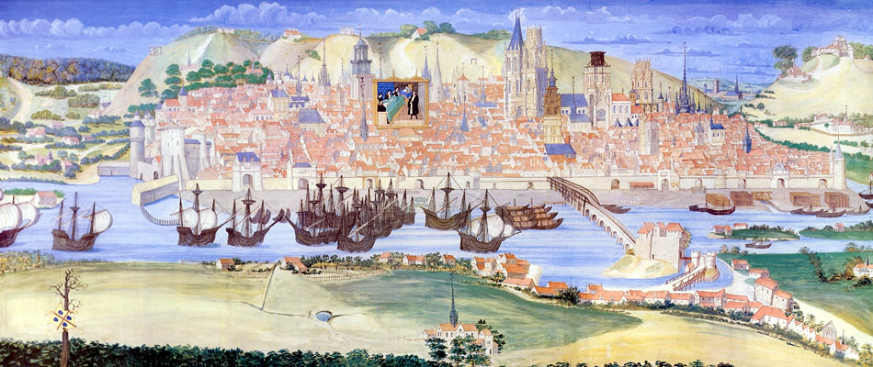
Cycles of Decline & Recovery during the Postclassical Era
#6: Availability of ___________________
Population growth after 1000 CE led to a surplus of labor => thus spurring growth of artisans and cities
Artisans in many regions est. trade guilds => orgs of craftspeople (i.e. candlemakers, butchers, weavers) who traded on a common street
Organization of many labor systems also helped to increase productivity of labor => i.e. mi’ta, coervee, guilds, tax farming, feudalism, slavery

Slide 80
Cities During the Postclassical Era
Cities in the postclassical era served many of the same purposes as before => trade, religious & cultural activity, interaction & govt. power
Venice => center of Mediterranean trade (established ports on the Black Sea and Middle East Crusader states)
-- During the later Middle Ages many cities were also the site of the first _________________________
-- First Universities were in Bologna and focused on liberal arts, law, theology and medicine
-- Universities trained Middle Ages doctors, lawyers & govt officials
Baghdad, Timbuktu, Cordoba, Cairo => centers of ME universities (House of Wisdom), libraries and Islamic thought (also trade)
-- Baghdad & Cairo also seat of Islamic caliphate (Abbasids)
Constantinople => center of east/West cultural exchange; silk industry, cotton textiles, citrus farms, Orthodox church
** Many of major cities of the Classical era had declined and were replaced by other cities => why decline and replacement?? **

Slide 81
World’s Largest and most Central Cities
Classical Era Middle Ages
1. Rome 1. Baghdad
2. Pataliputra 2. Calicut
3. Carthage 3. Timbuktu
4. Alexandria 4. Cairo
5. Constantinople 5. Constantinople
6. Chang’an 6. Chang’an
7. Teotihuacan 7. Tenochtitlan
8. Athens 8. Malacca
9. Persepolis 9. Cordoba
10. Babylon 10. Sana
11. Damascus 11. Huangzhou
12. 12. Venice
13. 13. Cusco
14. 14. Samarkand
15. 15. Delhi
16. 16. Kiev
17. 17. Kilwa

Slide 82
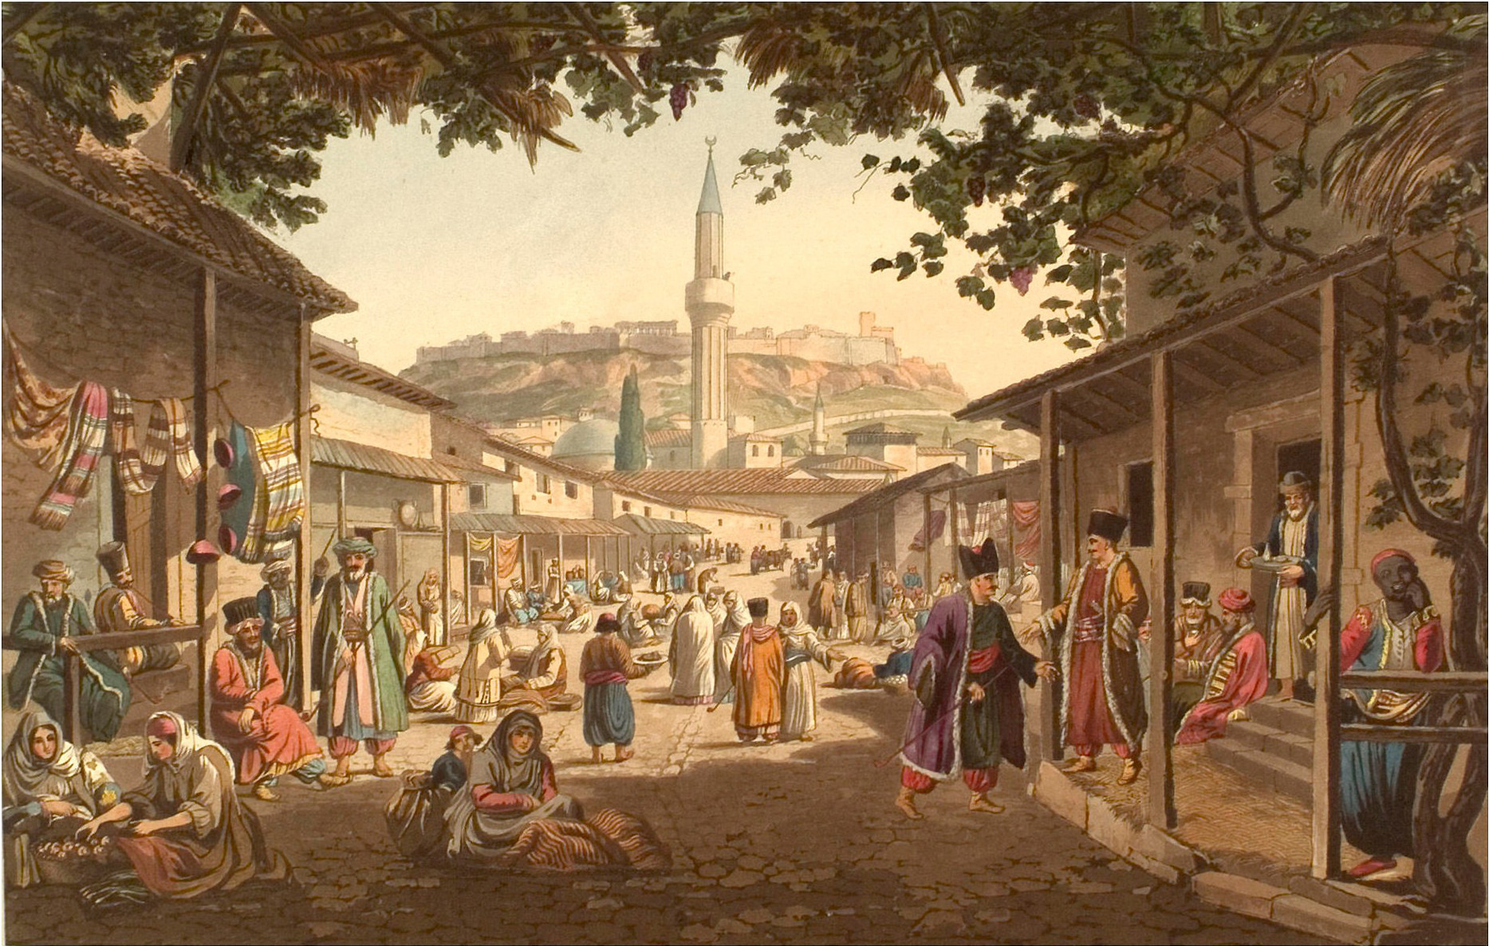
Islamic Trade Bazaars
Trade bazaars were often the center of Islamic cities => contained goods from both East and West, as well as strictly controlled food

Slide 83
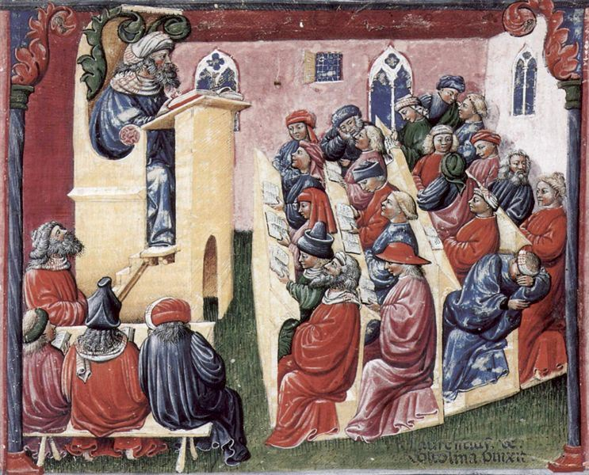
European Medieval Universities
During the Middle Ages there were over 80 Universities in Europe => most pursued a liberal arts focus and focused on lecture
-- No exams but to gain a degree you had to pass an oral exam by a committee

Slide 84
Cities During the Postclassical Era
However, cities also served new functions and were organized differently in different areas of the world . . .
Islamic cities (i.e. Baghdad, Cairo)=> organized around trade
-- Largest buildings = palace of caliph, mosques and other public buildings (fountains, courtyards, public baths)
-- Trade bazaar located at center of city
Chinese cities => Chang’an, Huangzhou
-- Some were more trade oriented (Huangzhou), others were adm centers (Chang’an or Khanbaliq) for Confucian officials
-- Became centers of industrial production also => steel, textiles, silk
-- Chinese cities were also organized to provide many forms of entertainment => i.e. boxing, plays, musicians, festivals
European cities => Flanders, Venice
-- Centers of trade and freedom
-- Organized by trade guilds => each had a street
-- Smaller in size than other M.A. cities => Venice in 1450 (100,000) vs Baghdad at its height (700,000) vs Chang’an (1 million)

Slide 85
European Cities as Centers of Freedom
European Cities as centers of freedom and innovation
European cities of the Middle Ages were different than any other area
New European cities (and old Roman ones) were centers of trade and thus needed mobility more so than feudal serf farmers
-- Paid kings and lords to have their own city “charters” => thus governed independently with different rules and restrictions
Examples of burgher “freedoms” . . .
-- Right to inherit property
-- Freedom from military obligations
-- Right to choose own officials and church leaders
-- Written laws that guaranteed independence from state
New city residents were called _________________________➔ mostly artisans, merchants and industrialists
Cities of this sort very popular in Italy & Germany
-- Some areas tried to forcibly gain independence via commune movement => most failed in areas with stronger monarchs
Medieval European towns took on their own character => walled cities for protection w/ narrow streets dominated by merchants and guilds
Crowded due to expensive cost of being inside walls => centers for disease, rodents and sewage (wells for drinking)

Slide 86
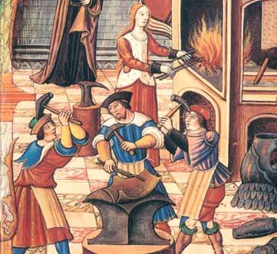
Middle Age European guilds
Craftsmen of any sort (i.e. weavers, blacksmiths, candlemakers, etc…) formed guilds in European cities to collectively sell items and gain concessions from government => each guild had its own street in the city

Slide 87
Rise of European Kingdoms
During the late Postclassical Era (i.e. 1300 CE onwards) Europe became a pluralistic state with many competing monarchies and city states
Italian & German City States
German & Italian princes and Pope control dozens of small principalities => leads to greater local freedom and autonomy but lack of unity
England
After 1066 Norman invasion William I created a strong centralized monarchy in England (still a vassal to king of France though)
Over the years, though many events caused England to become more of a ____________________________
-- __________________(1215) => limited power of king
-- Parliament (1300) => Two knights from every county, 2 reps from every town and feudal lords meet to discuss taxation, laws etc…
** Discuss influence of Robin Hood mythology**
French Kingdom
Originally broken up into three sections at the end of the Carolingian Empire (850CE) => King Phillip II consolidated power in 13th century

Slide 88
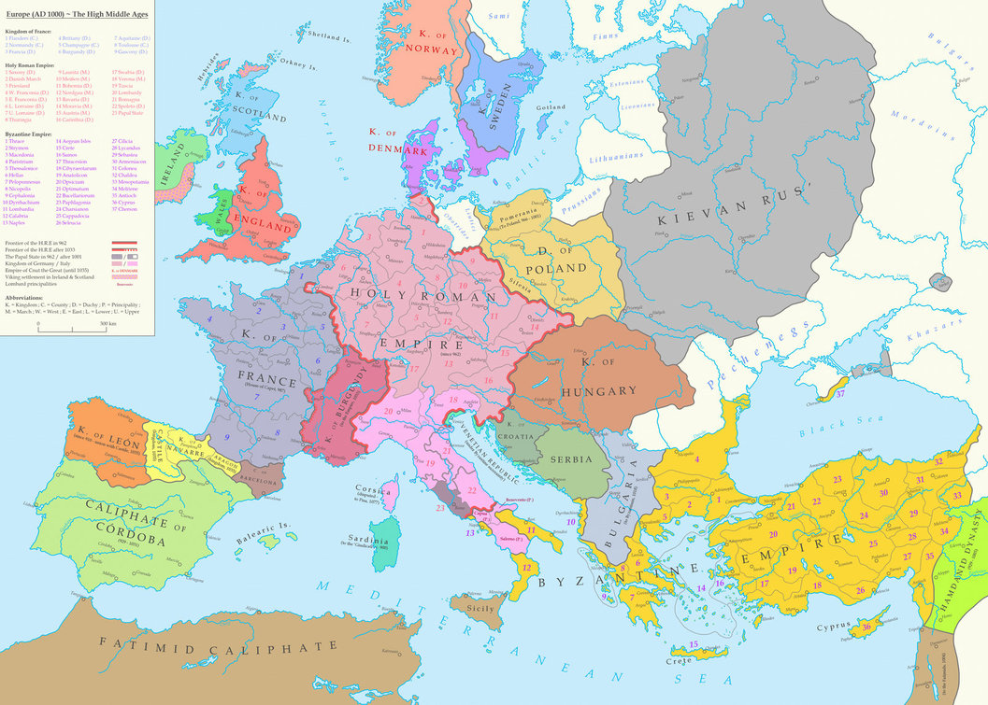
Europe in the High Middle Ages

Slide 89
Rise of European Kingdoms
French power became very centralized => officials appointed by King
Establishment of Estates General in 1300 => made up of reps of 3 groups in French society (nobles, clergy, commoners)
Iberian Kingdoms
Christian knights established kingdoms of ____________________________ _____________________ to remove Muslims from Europe (did by 1500)
Holy Roman Empire
Otto I was crowned Holy Roman Emperor by Pope in 962 => empire was a loose confederation of German & Italian city states
Tried to control Church by selecting Bishops & Pope (lay investiture controversy) => lost power after ________________________(1122)
Tried to control Italy by taking resources => lost many wars and thus weakened Empire
Kievan Rus
Viking leader Oleg settled in modern day Ukraine and established 1st Russian kingdom => Vikings became Rus ruling class (intermarried w/ Slavs)
Vladimir I married Byzantine princess & converted Russians to Orthodox Christianity

Slide 90
Labor Management Techniques in Postclassical Era
Overall, there were many continuities in the types and uses of labor systems between Middle Age and Classical societies . . .
Food production depended on a combination of free peasant agriculture and slavery or forced labor systems
-- Great majority of workers also continued to be employed in food production of cereal grains (i.e. corn, rice, wheat, barley)
Social Hierarchies in most societies placed farmers at or near the bottom of social hierarchies (exception = Chinese)
Most societies also used a mixture of forced labor, labor obligation and free labor systems
However, there were also important changes in labor management during the Middle Ages . . .
#1: Free Peasant Agriculture => important especially in Europe
#2: Nomadic Pastoralism => migrate ~ 150 miles/yr (herds);militaristic
#3: Guilds => craft & ind. production (master/journeyman/apprentice)
#4: Coerced Labor => i.e. Serfs and mi’ta labor systems
#5: Labor Taxes (govt) => i.e. Geld, (tax to pay for mercenaries) & coervee
#6: Military Obligations => Incan & European Feudalism

Slide 91
Peasant Revolts in the Middle Ages
There were literally hundreds of peasant revolts in different areas of the world during the Middle Ages => harsh working conditions, high taxation and church issues caused most of these revolts. Although popular, the pitchforks and crude weapons of the peasants were usually no match for trained armies and most failed.

Slide 92
Social Structures during the Postclassical Era
As in previous periods, social hierarchies were mainly shaped by class and caste hierarchies (continuity)
Europe => social position was organized by class hierarchies => class and social position in feudalism was based on land and occupation
Hereditary monarchies and status (i.e. France, England) present during the time also made social mobility difficult to achieve
The social position of _______________________improved during the later Postclassical Era => Italian merchants respected & usury laws relaxed
Involvement in church building, financing of the Crusades & Renaissance increased their prestige & acceptance by Catholicism
________________also existed outside of class hierarchies and formed their own enclaves of special privilege => opportunity for social mobility
**Aztec & Japanese societies also based on strict social hierarchies**
China => social position continued to be determined by land, wealth and position, often determined by success on Civil Service Exams
Landed aristocracy continued to have most candidates w/ success on Civil Service examination => path to success and social mobility
Dominated by scholar gentry & males but more egalitarian than others => enforced a sort of cultural uniformity on China

Slide 93
Feudalism Hierarchy

Slide 94
Aztec Hierarchy

Slide 95
Social Structures during the Postclassical Era
Land consolidation also occurred during the Song => led to aristocratic dominance in rural areas and of government by wealthy families
________________________in China still not regarded with much respect => seen as a symbol of decadence and foreign influence
Japan & Vietnamese adopted the Chinese Civil Service examinations, but they did not impact social hierarchies (did reinforce idea of cultural pride)
India
Despite the introduction of Islam to India during the Delhi Sultanate (10th and 11th centuries) India’s caste & class system was unchanged
Castes system did become ______________=> Muslims incorporated into Indian castes (i.e. Indian rulers joined Brahmin or kshatriyas)
-- Castes formed for different occupations => fishing, pottery, weaving
Restrictions of caste system may have been partially responsible for lack of commercial activity in India during Middle Ages
-- Castes could not overlap duties and also could not trade outside geographic area => limited trade opportunities
-- Govt monopolies existed on trade & merchants accorded a low status
Indian hierarchical caste system imported into areas of SE Asia => Angkor and Pagan organized society into varna castes based on occupation

Slide 96
Indian Caste System
Indian Caste system provided social organization, economic justifications and political framework to India => formed a sort of identity far different from territorial sovereignty in Europe

Slide 97
Family & Gender during the Postclassical Era
Patriarchy persisted in almost all societies during the Postclassical Era as represented by the following developments and practices . . .
Hindu India => practice of _________(widow sacrifice) often as a means of the family of dead male acquiring property from sacrificed widow
-- Widows who did not participate were expected to live ascetic life
Neo-Confucian China => practice of _____________________
-- Practiced by all classes, a means of emphasizing female virtues of submissiveness and self discipline
-- Limited opportunities and mobility of females
Islamic society => introduction of _________________(separate female living quarters for an Islamic household)
-- Started by Abbasids under Harun al Rashid => tradition of polygyny allowed for Muslim males (women maintain fidelity)
-- Islamic practice of head & body covering also begun
-- Islamic society strictly restricted activities of females => cloistered in home & not allowed public contact w/ males
Feudal Japan and Europe => women (especially aristocratic) were managers of household finances and supplies (domestic sphere)
** Harem culture spread to India where it evolved into the purdah => seclusion of wives and women from public life (also covering of head) **

Slide 98
Islamic Harem
Islamic Harems were basically the living quarters for all female members of a household => harem of Harun al Rashid included his wife, sisters, mother, concubines, etc….

Slide 99
Family during the Postclassical Era
Family relations also differed dramatically based on culture => majority of familial organization was a continuity from previous time periods
European society had developed a tradition of ______________ _____________=> husband/wife and children
Chinese society was organized into ___________________=> at least three generations in one household Q: Why???
-- Chinese tradition of clan organization an ancestor veneration => ancestors were important in familial shrines
-- Prevalence of rice farming (labor intensive) & lack of arable land
-- Due to influence of Neo Confucianism Chinese family culture became obsessed with filial piety (#1 goal of family life)
Arraigned marriages common, parents selected careers, familial shrines contain accounts of filial piety
Indian society organized in__________ units => 100’s of nuclear families that would be bound to a single occupation or caste group
-- Served as a social safety net

Slide 100
Family during the Postclassical Era
African society organized into nuclear families tied to lineage groups (similar to clan or jati) => villages organized into lineage groups
-- Islamic African kingdoms like Mali did not develop harem cultures and seclude women like Indian cultures did
SE Asian society was organized into nuclear family units => more available land and higher status for women in many cultures
-- SE Asian culture did import the idea of filial piety from China => respect for elders was valued and held as an ideal
Overall, some cultures and areas did develop significantly more social opportunity and power for women during this time
SE Asia
Mongol China
West Africa
Japan => Introduction of Buddhism initially limited women’s participation (i.e. monasticism only) by forbidding them from visiting shrines and denying them enlightenment, but eventually women became full participants

