Slide 1
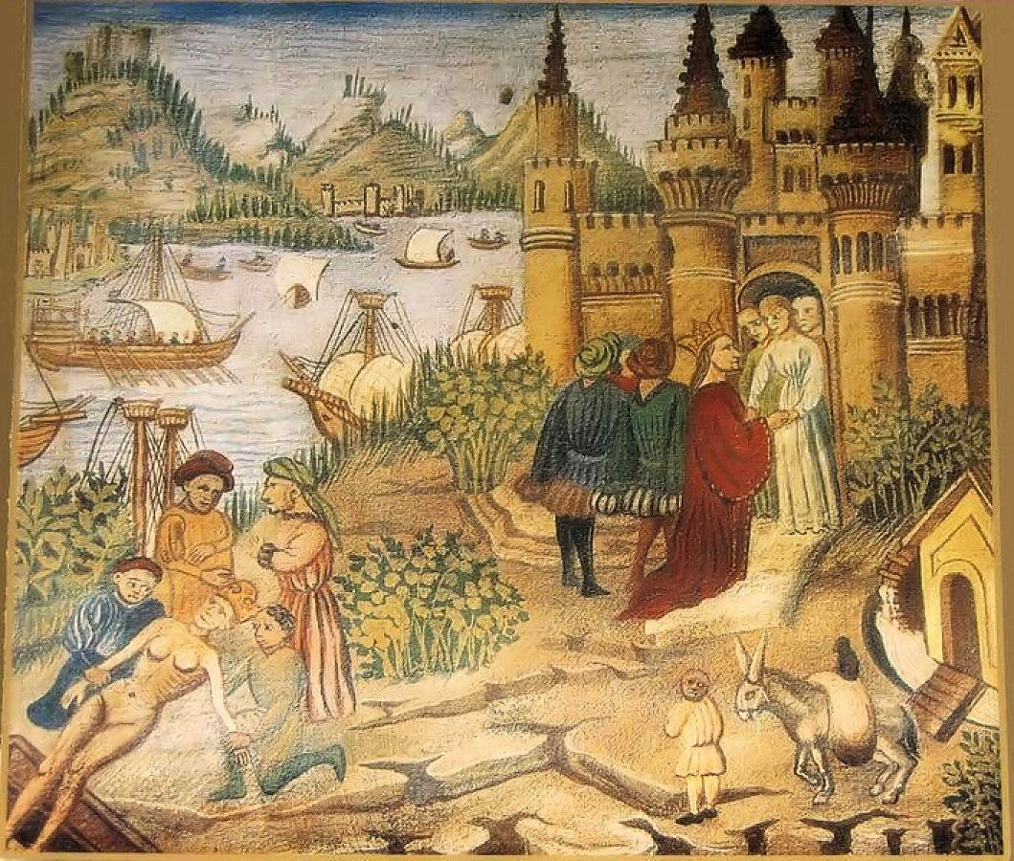
The Postclassical Era – Regional & Transregional Interactions
600 CE to 1450 CE

Slide 2
What were the Postclassical Era (Middle Ages)?
** Periodization Activity **
Periodization => Q: Why 600 CE? Why 1450 CE?
In general, it is a time period (~600 CE to 1450 CE) between the Classical and Modern ages (European)
Historian Leonardo Bruni 1st developed the idea of dividing history into Classical, Medieval and modern periods
-- Based on the writings of Petrarch that European culture had stagnated & drifted into a “Dark” time after the fall of Rome
-- Enlightenment and Reformation scholars agreed and idealized the classical period as the time when Christianity 1st developed
Its name (Medieval) denotes some type of deficiency or primitive quality to it, yet there were many positive developments
-- European Universities (Oxford, Cambridge) were begun
-- Gunpowder, the magnetic compass, moveable type printing and the Dhow ship were all popularized
-- In Africa, Mesoamerica cultural expression reached its zenith in the civilizations of Mali, Ghana, Zimbabwe and the Aztecs & Incas
-- In the Middle East Islam developed and led to a cultural flowering and rapid political & economic expansion
-- Pastoral peoples (i.e. Mongols, Turls) reached the height of power also

Slide 3
Postclassical Era States and Empires
Politically, Middle Age states & empires can be divided into a few categories . . .
#1: Reconstituted States => states that had existed before, but were now reinvented with new ideas and/or strategies
Byzantine Empire, Sui/Tang/Song China, Holy Roman Empire
#2: Islamic states & Empires => Islam became a unifying force in the ME; empires expanded & traders/missionaries spread the faith to other areas
Abbasid Empire, Ghana, Mali, Delhi Sultanate, Andalusia
#3: Feudal States => feudalism predominated in Europe and Japan
Kingdom of Charlemagne and Japanese shogunates
#4: Mesoamerican Empires => civilization reached a zenith w/ the rise of empires
Aztec and Incan empires
#5: City States => city states were used for religious and trade purposes
Italian city states (i.e. Venice), Mayan city states (i.e. Tikal) and Swahili city states (i.e. Kilwa)
#6: Pastoral Empires => pastoral peoples reached height of power
Mongol Empire, Viking raiders, Seljuk Turks
** All states and empires combined traditional sources of power (i.e. elites, patriarchy, religion) w/ new innovations (i.e. tributary systems)**

Slide 4
The Rise of Islam
The Arabian peninsula prior to Islam was a divided place inhabited by Bedouin tribes => each ruled by a ____________ & tribal council
Religion was polytheistic w/ a supreme God Allah presiding over a pantheon of spirits that inhabited natural objects (trees, rivers)
-- Allah was said to inhabit a sacred stone (each town had one)
-- No priests; religion a communal experience
Economy was based on trade caravans using camels => due to Byzantines & Sassanid Empire wars trade came through Yemen
-- Growing tension between Bedouin traders and merchant elites
___________________believed that while meditating in the desert he was given the final revelation of GOD (Allah) like Abraham and Jesus before him
Muhammad never claimed divinity (_____________)
Islam has no central religious authority or leader; ________ = scholars
Revelations were written down in the __________________=> 114 suras that were organized by committee after Muhammad’s death
-- Quran is a sacred book, contains guidelines for living and also discusses governmental organization
-- ____________is also a holy book, collection of Muhammad’s sayings => used to interpret Quran and supplement its teachings

Slide 5
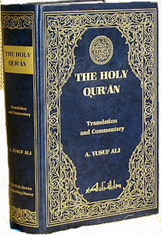
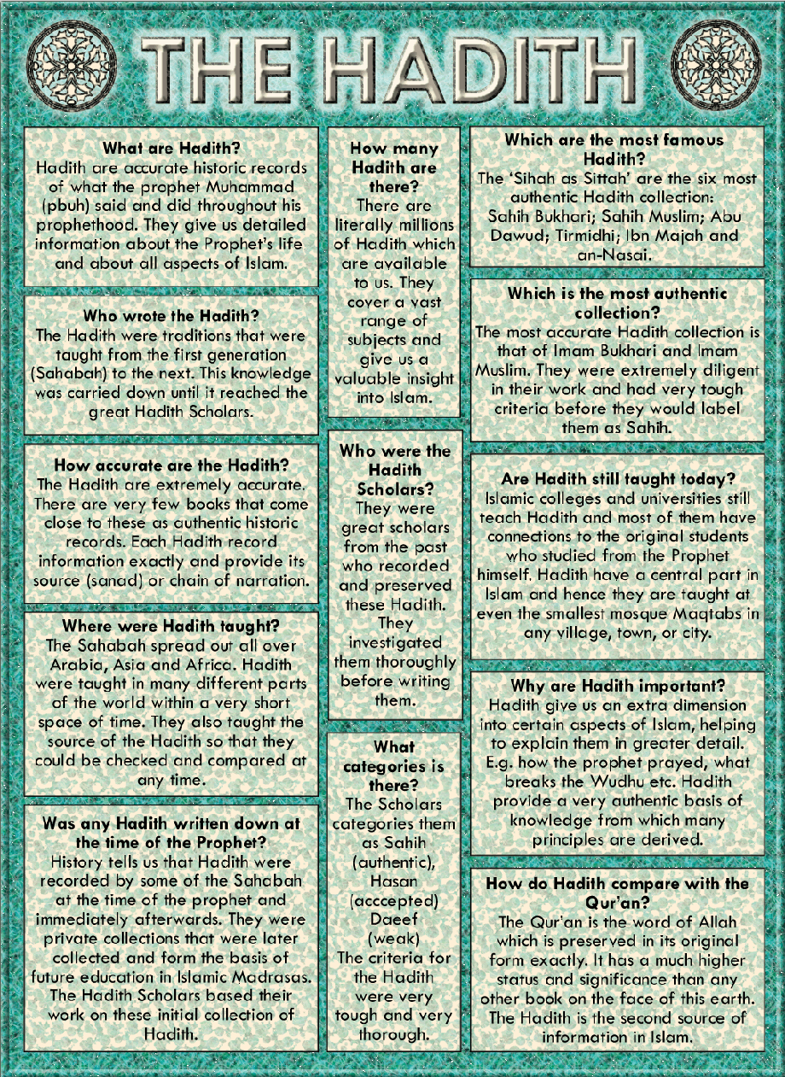
The Koran and Hadith
The earliest versions of the Quran do not contain marks used in Arabic to denote meaning, thus the true meaning of certain sections is constantly debated => some Hadith sayings were not written down for centuries after Muhammad’s death

Slide 6
Main Tenets of Islam
The goal of a Muslim is to reach paradise (luxurious garden) through submission to the will of Allah => i.e. follow___________________
#1: Believe that there is one God (Allah) & Muhammad is his prophet (___________________________)
#2: __________________________towards Mecca
#3: Fasting during month of ______________(sunrise to sunset)
#4: __________=> pilgrimage to Mecca (walk around Ka’aba) once during life
#5: _____________=> giving alms to the poor (2.5% per year)
Islamic belief is also seen as a way of life => _____________law code drawn up to regulate behavior
Muslims forbidden to gamble, drink alcohol or lie
Sexuality is strictly restricted => contact between unmarried frowned upon, marriages are to be arraigned by parents
-- Women should cover themselves to avoid “tempting” men
-- Polygyny is permitted but Muhammad limited wives to four
Islam is clearly part of the ME religious tradition that includes Christianity, Judaism and Zoroastrianism
Bible is a holy book in Islam and Jews and Christians are called “people of the book” => God spoke to them 1st & made final revelation to Muhammad
Muslims tolerate other “people of the book” in most early civilizations
Like Zoroaster, Muhammad wandered in the desert & received revelations

Slide 7
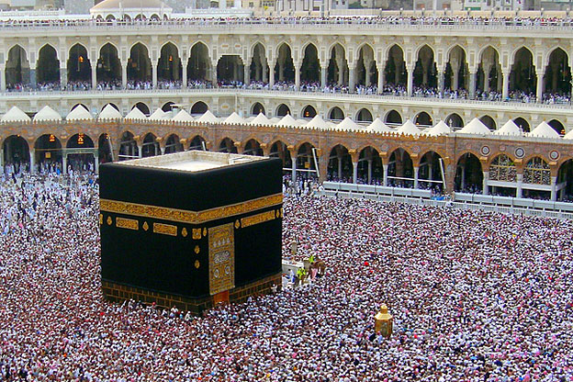
The Ka’aba in Mecca
Inside the Ka’aba container is a black meteorite that fell to earth and is seen as a divine object => 6 million Muslims make the Hajj each year

Slide 8
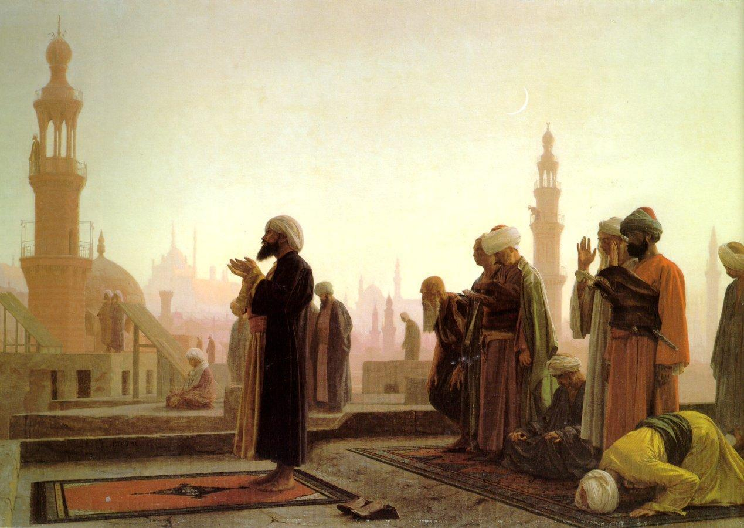
Muslim prayer -- Salah
The Salah has certain steps and characteristics => removing shoes, bowing down and prostrating, chants are common; Muslims are called to prayer 5 times a day in many countries from minarets

Slide 9
The Spread of Islam
After Muhammad’s death in 632 his closest followers elected Abu Bakr (Muhammad’s father in law) to succeed him as caliph (ruler)
Caliph was considered a political as well as religious office (imam)
Many followers believed that Ali, Muhammad’s 1st cousin and husband to his 1st daughter was the rightful heir
Led to the birth of ___________(“Party of Ali) & ___________ (“people of tradition & community) split in Islam
-- __________believe that only family of Ali should rule as caliphs
-- ______________believe the community elects own leadership
Despite the controversy Islam spread very quickly throughout Arabia and the Eurasian world in variety of ways (see graph) . . .
#1: ____________________________
Muslim armies defeated the weakened Sassanid & Byzantium forces in Persia, Syria and Egypt => expanded to nomadic tribes of C. Asia (Turks
Formed the _________________=> expanded into Persia further, conquered Berbers in N. Africa and the Visigoths in Spain
How? => use of mobile cavalry, devotion to cause & belief that those who die in battle ascend to glories of heaven
In 750 the Umayyads were overthrown due to decadence => caliph swimming in a pool of wine and becoming drunk; dozens of wives, etc..

Slide 10
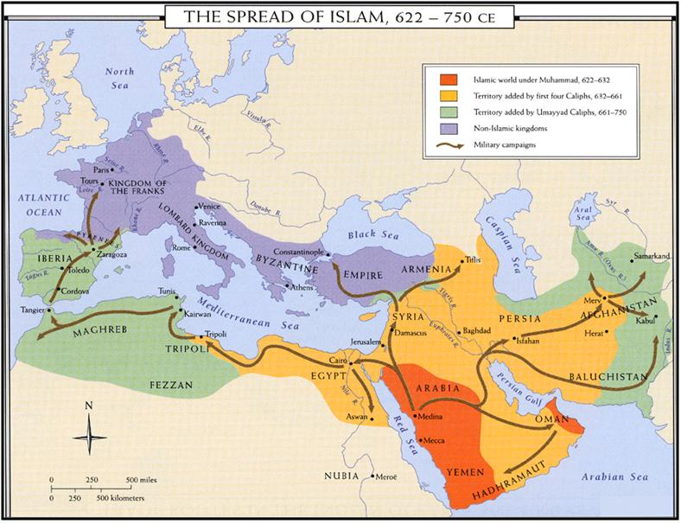
The Expansion of Islamic Rule

Slide 11
Abbasid Caliphate
The ________________________took its place (new style)
________ (religious & political leader) was the ruler who administered the autocratic govt system & was seen as Muhammad’s heir
-- The Caliph relied on a vizier (PM) to lead the council of bureaucrats who collected taxes and administered the army
Abbasids established their capital at ____________=> became a cosmopolitan cultural center (Greeks, Persians, Arabs, Jews)
-- Compiled religious tracts (Hadith), translated Greek learning & wrote Arabic poetry, songs and texts (1001 Nights)
-- Led to ______________________________from China to Europe => paper (China), zero (India); Indian dhow ship & lateen sail
Abbasid rulers were very influenced by _________customs and rituals
-- Persians occupied many high level admin positions
-- Abbasid rulers sat on golden thrones encrusted w/ jewels in large audience halls of petitioners (executioner next to throne)
-- Adopt and administer a tribute system where outlying areas pay taxes to Baghdad (head tax on all non-Muslims; taxes on trade)

Slide 12
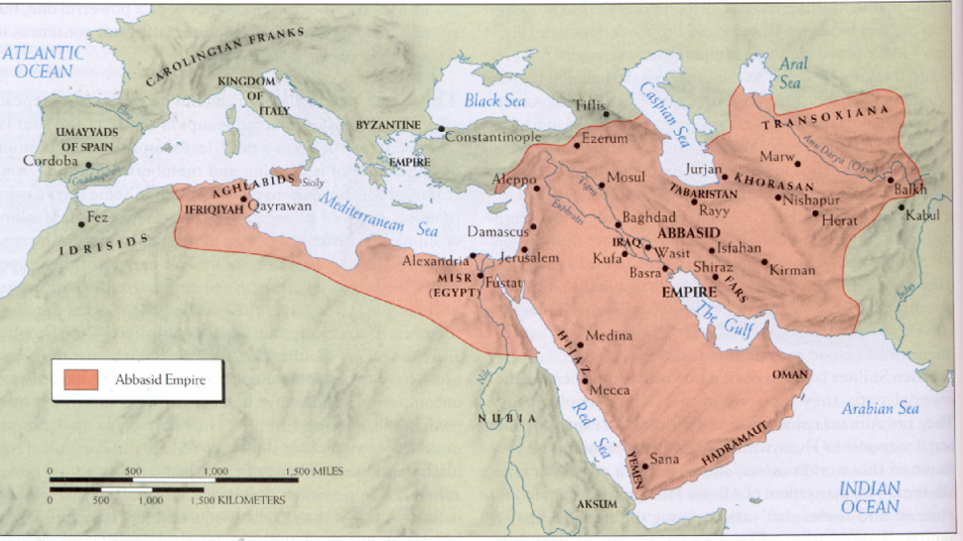
The Abbasid Caliphate

Slide 13
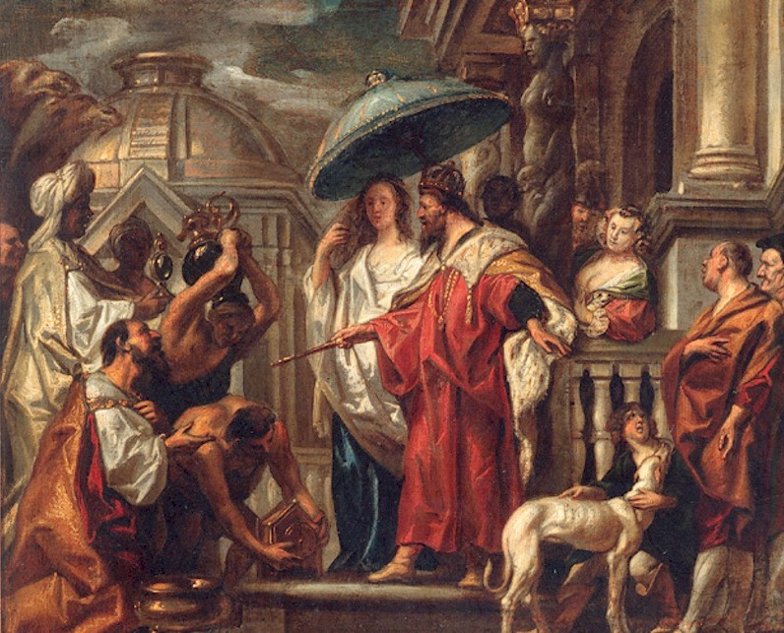
Harun al Rashid & Caliphate
Chinese travelers described the court of Harun-al-Rashid, “The king wears a turban of silk brocade and foreign cotton stuff. On each new and full moon he puts on an eight-sided flat-topped headdress of pure gold, set with the most precious jewels in the world. His robe is of silk brocade and is bound around him with a jade girdle . . . The king’s throne is set with pearls and precious stones, and the steps of the throne are covered with pure gold.”
As the capital moved East to Baghdad, the Caliphate came under extensive Persian influence => decadent palaces, jeweled thrones, harems, etc….

Slide 14
Fracturing of the Caliphate
After 850 or 900 CE, the Abbasid caliphate weakened and the Islamic concept of “caliph” was fractured between many rival states . . .
Why fall of Abbasids?
-- __________________=> caravans traveled 20 miles/day, couriers 100 miles/day (hard to communicate and respond to crises)
-- ___________________________=> snowfall in Baghdad killed date trees, rivers & canals became silted due to overpopulation
-- Decadence and decline => Abbasid rulers became focused on wealth and extravagance (wine, harems, homosexuality)
-- ________________________=> Mamluks (Turkish slaves/soldiers) were widely used and revolted to form the Seljuk dynasty by 1060
By 1100 the Caliphate had fractured into many parts
Shi’ite Fatimid Dynasty in Egypt (Cairo); Seljuk Turkish dynasty in Mesopotamia & Andalusian Muslim kingdoms in Spain (Cordoba)
Madrasas (Islamic religious universities) and Imams preserve Muslim cultural unity

Slide 15
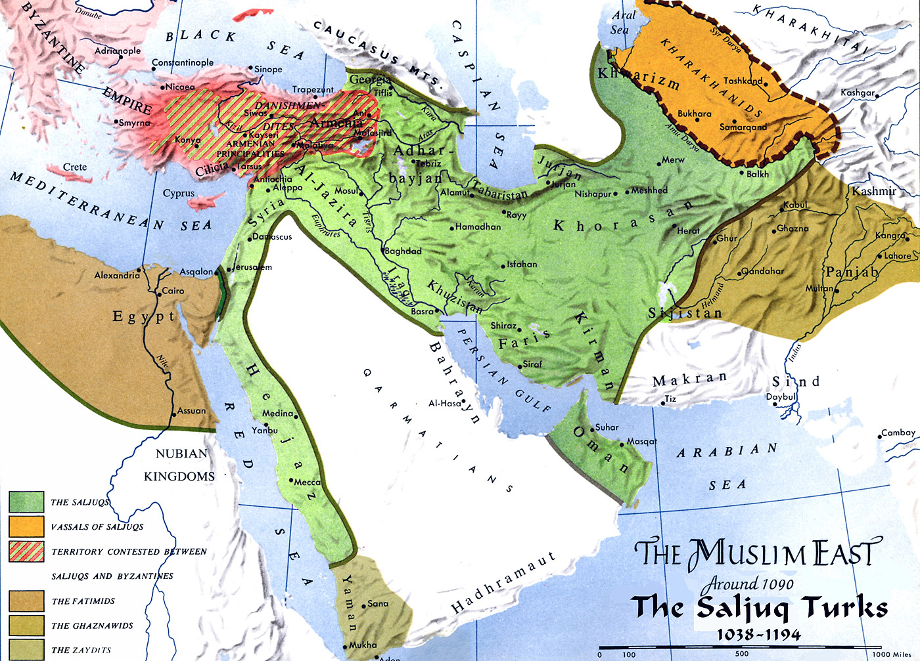
The Fracturing of the Muslim Caliphate

Slide 16
Spread of Islam
#2: _________________________________
Tradition of raiding and trading led many leaders to pledge support to Muhammad & caliphs (protection from raids & freedom to trade)
In Abbasid caliphate (and other Muslim countries) highest classes were judges, officials and merchants => Muhammad started as a merchant
Baghdad capital located at the intersection of trade routes => overland Silk Road from East and Indian Ocean trade up Tigris
___________________were used by Muslims in ME to trade w/ Chinese, African, Indian and European merchants
-- Muslims traded carpets, spices, glass, textiles for silk & porcelain (China), jewels and spices (India) & ivory, slaves, salt and gold (Africa)
During Abbasid rule, non-Arab & Arab Muslims were treated as equals => gave rise to greater conversion rates among conquered populations
Benefits of conversion = freedom from head tax (___________) , greater opportunity for education, access to govt positions, adv. in trade
Merchants who converted to Islam were favored over non-Muslims
___________________________________were key to the intl. spread of Islam
Diasporic merchant communities established along the Indian Ocean & Saharan trade routes => Swahili City states, Malacca, Ghana & Mali
-- Islam represented commercial success and high social status => many elites converted (filtered down in many cases)

Slide 17
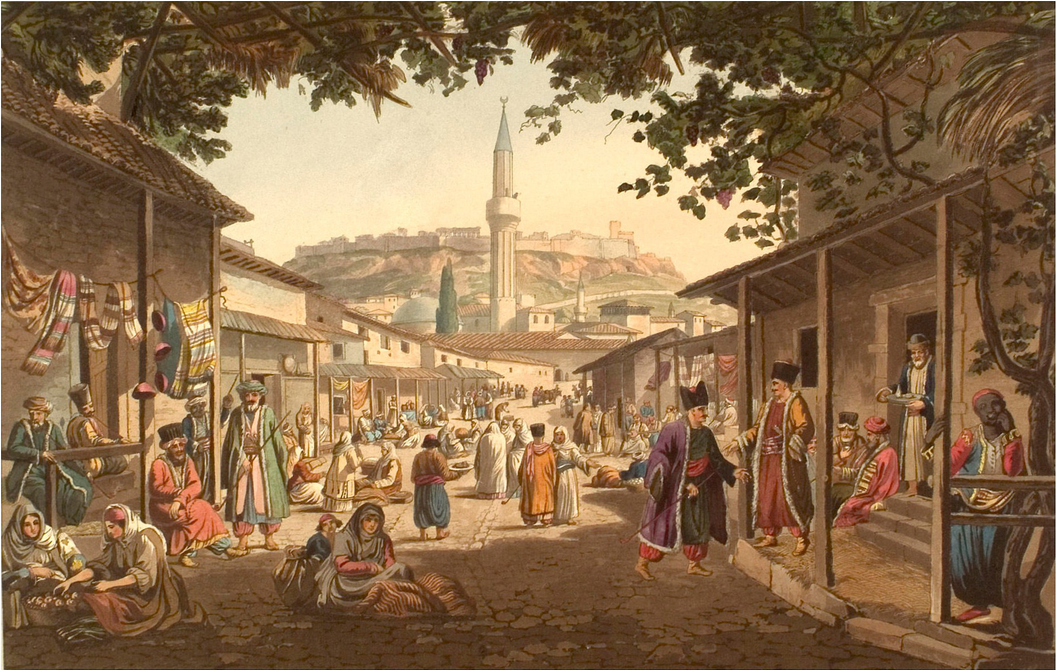
Middle Eastern trade bazaar
A bazaar is basically what we would call a marketplace => goods are exchanged and merchants of many different nationalities are gathered

Slide 18
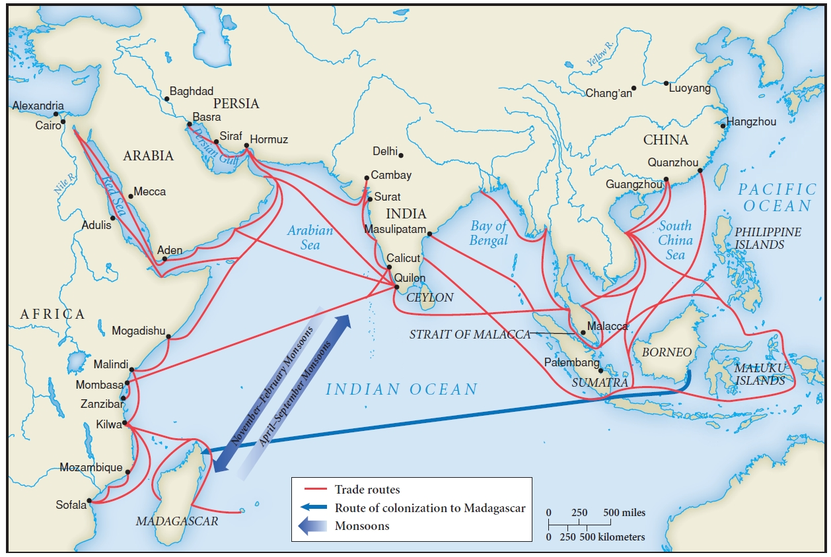
Muslim Diasporic Communities in the Indian Ocean
Muslim merchants on the Indian Ocean and Saharan trade routes established Muslim communities that gradually became vehicles for conversion => locals were attracted to religions, focus on equality, connection w/ trade, etc….

Slide 19
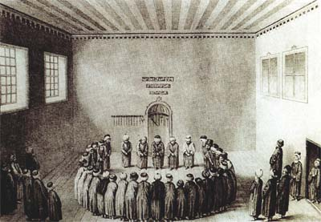
Spread of Islam
#3: __________________________________
Sufism was an Islamic movement that started in the 750 as a reaction against the excesses of elites in the Umayyad & Abbasid dynasties
Sufis attempt to get closer to Allah in this life by living lives of ___________ and following Islamic law perfectly
-- Sufi followers must learn under a teacher (mystic) who gains authority in an unbroken line back to Mohammad (via Ali)
Although their intent was not missionary per se, Sufi’s attracted followers and converts throughout Eurasia
Many were attracted by purity of worship (i.e. Buddhism)
Sufi missionaries spread out across Eurasia => West Africa, India, Malacca, Central Asia & won converts via example

Slide 20
Religious Conversion in Different Locations
#1: ________________=> Islam spread by Muslin traders across the Sahara
Peaceful and voluntary acceptance of Islam => mainly occurred in Urban centers among the elite or merchants (i.e. Mansa Musa)
Many W. African cities became centers of Islamic religious and intellectual study (adopted Arabic language) => i.e. Timbuktu
-- 150 Qur'anic schools, several madrasas, huge mosques
#2: ________________=> conquered by Arabic Berbers in 700 and became a vibrant Islamic civilization (capital = Cordoba; #1 city in world by 1000 CE)
Religious toleration led to harmony & cooperation between Muslim, Jewish and Christian scholars & artisans (mixed civilization)
Astronomy, medicine, arts and architecture all flourished
Declined in 11th century when toleration ended and constant warfare ensued between Christian and Islamic kingdoms
#3: _______________=> Islam imported through Turkish tribes from C. Asia
Initially very violent => destruction of Hindu and Buddhist temples (led to series of Muslim led governments; Delhi Sultanate, etc…)
Islam never became dominant due to cultural boundaries (i.e. monotheistic, lack of icons and statues, focus on equality of all believers, sexual modesty)

Slide 21
Postclassical Era States and Empires
During the postclassical era there was considerable continuity in statecraft, but also great changes and diversity in how societies organized civilization
#1: Reconstituted States => some societies like the Chinese and Byzantines reorganized old models and applied new techniques to meet needs
____________________________=> began as the Eastern Roman Empire
Emperor Justinian attempted to revive the Roman Empire in scope (by conquest) & ideology (by compiling its law in the_____________________)
Failed & empire reborn as the Byzantine Empire (600 - 1453)
Byzantine Empire combined traditional power w/ new innovations
Traditional sources of power
1. Roman authority => style themselves as heir of Rome
-- Use Roman legal code (_________________)
2. Ritual & Ceremony => elaborate religious centered ceremonies (i.e. procession of all govt officials opening palace each day)
3. Military power => Byzantines were basically a military state for centuries(threats from Islamic Turks, Germanic kingdoms)
-- __________________________were highest in world; use of “Greek Fire”

Slide 22
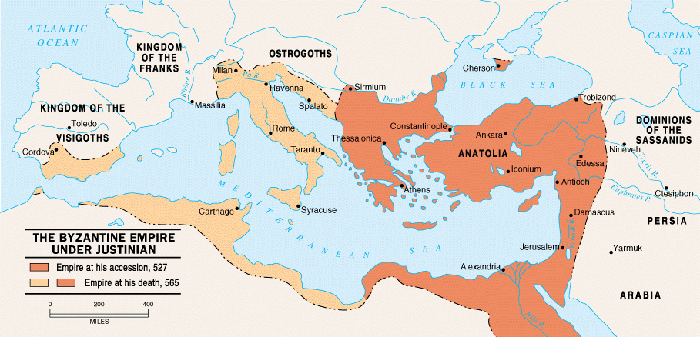
Map of Byzantine Empire
The Emperor Justinian brought back the glory of the old Roman Empire for a short time via administrative reforms and conquest => these conquests drained the empire of resources and were short lived (by 605 Italy was lost)

Slide 23
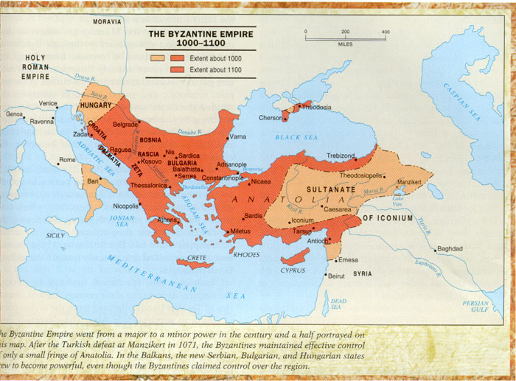
Byzantine Empire (ca 1000 CE)

Slide 24
Postclassical Era States & Empires – Byzantine Empire
New Innovations
Byzantines smuggled silkworms from China and started a silk industry (state monopoly which raised huge revenues)
Byzantines also sought to separate themselves from Latin Christianity by promoting ____________________(Greek language)
-- Used ____________faith as a method of political control => reason for expansion into Eastern Europe & beyond
-- Use of Christianity as a unifying force => emperors put $$ into church construction & iconography (i.e. Haga Sophia)
-- Greek Orthodox ________________= leader of Orthodox church
-- Series of schisms (icons, Nicene Creed wording) resulted in excommunication of Pope Leo IX by Patriarch Michael in 1054
-- Byzantines desired to spread Orthodox Christianity => led to conversion of Kievian Russia to Orthodox Christianity in 988

Slide 25
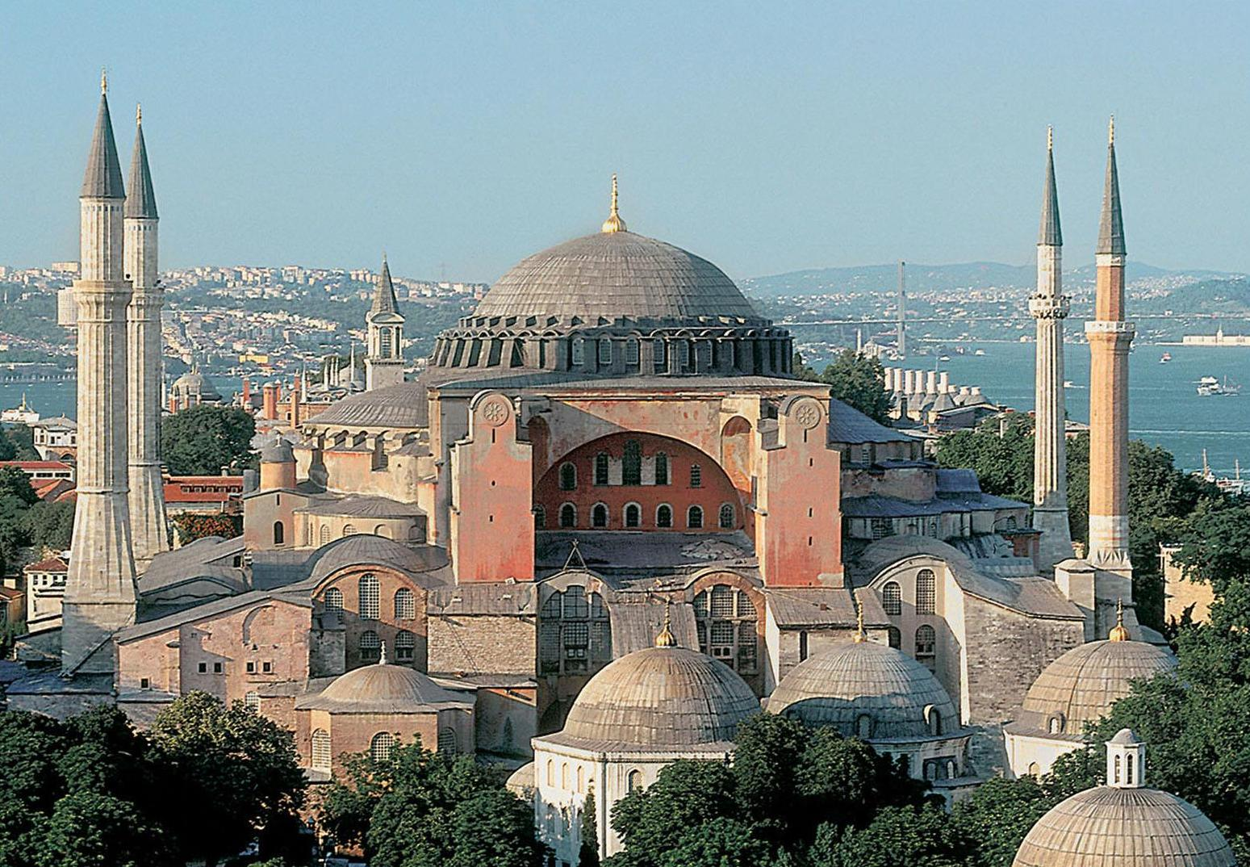
Hagia Sophia – Byzantine Architecture
The Hagia Sophia was the most impressive cathedral in the world until the Vatican constructed the Sistine Chapel during the Renaissance => it was the site of many ceremonies meant to increase the prestige of Orthodox Christianity

Slide 26
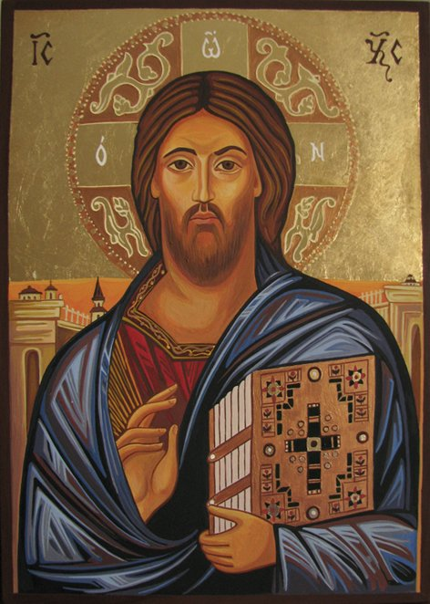
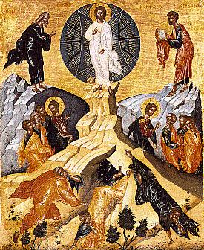
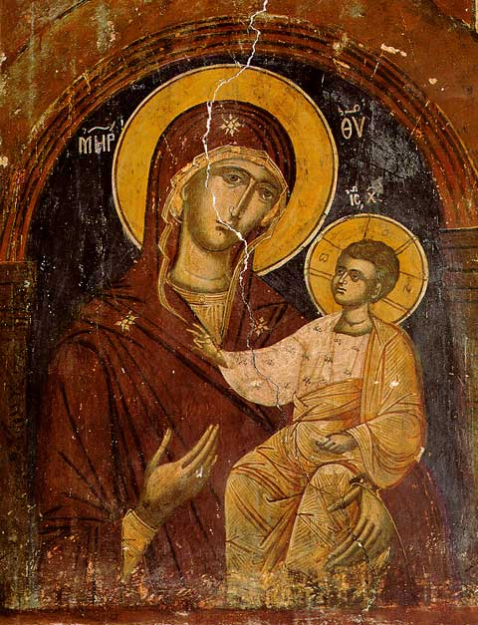
The Iconoclasm debate in Byzantium
Icon = image of Jesus, saint or religious image
Icon were popular and worn by many Christians due primarily to illiteracy; Byzantines banned icon production during the 9th century as a means of separating themselves from Roman Christianity (pagan & worshipping images)

Slide 27
Postclassical Era States and Empires
Sui/Tang/Song China => after the fall of the Han dynasty China entered a period of 4 centuries of disunity
In 581, the Sui Dynasty reunified China under one Emperor at Chang’an
The Sui, Tang & Song dynasties combined traditional power w/ new innovations
Traditional Power
1. Religion/ideology => by the Song Dynasty _________________re-emerged after Sui & Tang emperors endorsed Buddhism
_________________________was an attempt to combine traditional Confucian principles w/ metaphysical ideas of Daoism and Buddhism
-- World is real => fulfillment comes from embracing world
-- World exists as two separate spheres => material world and spiritual world (_______________________, like the Dao)
-- Supreme Ultimate governed by a set of conflicting principles (__ ________) and goal was to transcend material world via self cultivation
-- Average Chinese not really effected by new changes (still worshipped household deities) but Buddhism did bring a belief in reincarnation

Slide 28
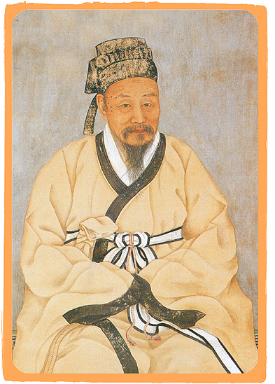
Neo Confucian Scholars
Zhu Xi was the founder of Neo-Confucianism and holds a reverence close to Confucius himself => believed the central focus of life should be the investigation of things and improvement of self (path to Supreme Ultimate)

Slide 29
Postclassical Era States and Empires
2. Landed elites => during the Song dynasty the landed gentry emerged as the pre-eminent class in Chinese society
-- Controlled most land in rural areas & received education in Confucian classics
-- Due to superior knowledge, 50% of bureaucrats were elites
3. __________________=> continued during Tang & Song dynasties
-- Only males allowed to take Civil Service Exam
-- Practice of _________________is cultivated to attract wealthy husbands => sign of submissiveness and self discipline
New innovations
1. During the Sui and Tang dynasties _____________was established as state religion due to popularity among people
-- Monasteries built, __________________used in Civil service exam, Buddhist art created and patronized
-- Later Tang dynasty persecuted Buddhists and destroyed temples as fear of foreigners increased due to border problems

Slide 30
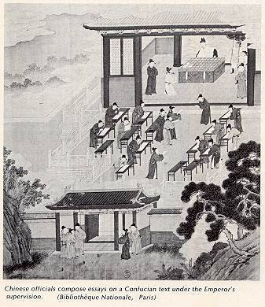
Song Civil Service Examinations
Held every year at 3 levels => provincial, district & imperial
-- Farther you went higher your govt. position
Chinese academy at Chang’an had 30,000 students by 1st century BCE
Young boys would study Confucian classics, which were the subject of the exam, for years
-- Emphasized obeying parents, respecting elders, good morals, respect for tradition, respect for others and peace
Q: How would China benefit from basing government position and leadership on examinations? List three benefits.

Slide 31
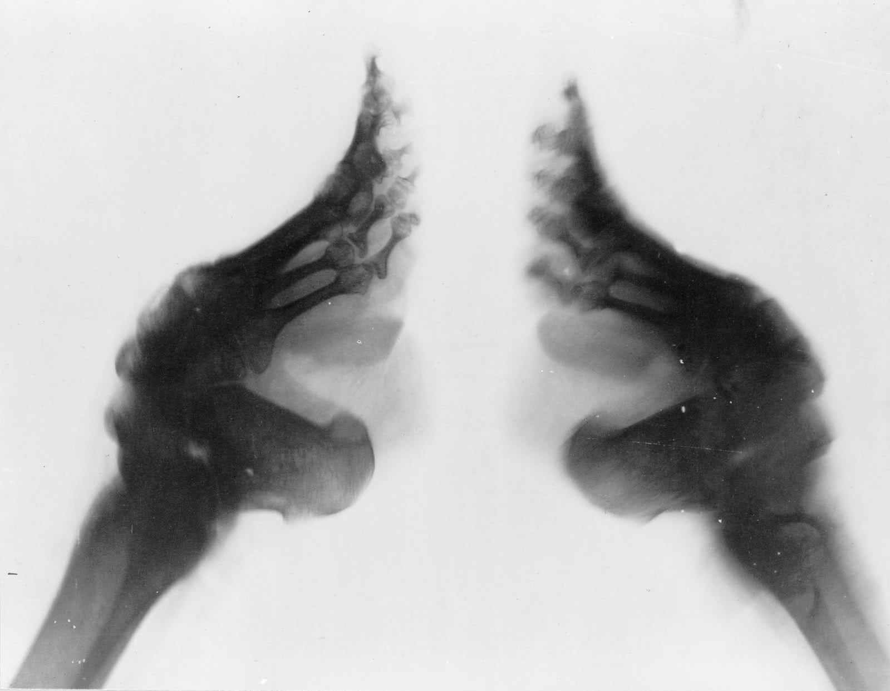
Chinese Footbinding

Slide 32
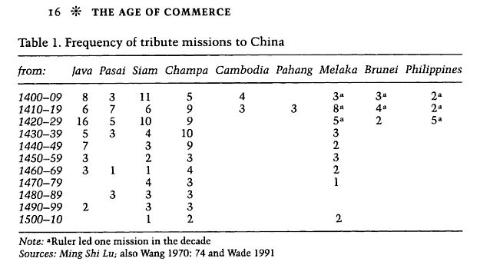
Postclassical Era States and Empires
2. _________taxation system used to raise revenues under the Tang
-- Attempted to reduce power of wealthy landowners by granting land for life to farmers in return for a tax payment & 3 weeks labor
-- Song also tried to do the same by taxing land progressively
3. _________________=> Tang and Song instituted tributary relationships with Korean peninsula as well as states in SE Asia
-- _______________________________all paid tribute at one time
-- Tribute states benefitted by gaining recognition from China and access to trade with Chinese markets

Slide 33
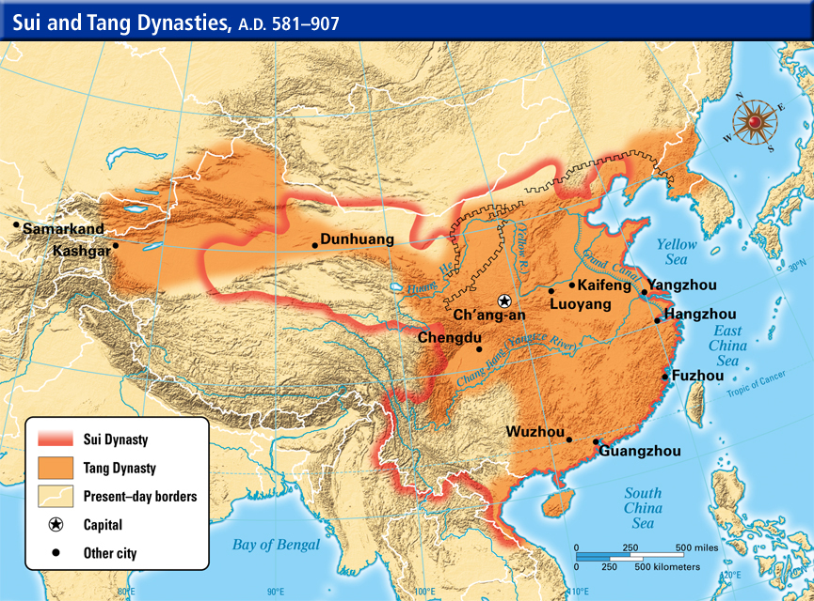
Sui (581-618) & Tang (618-907) Dynasties

Slide 34
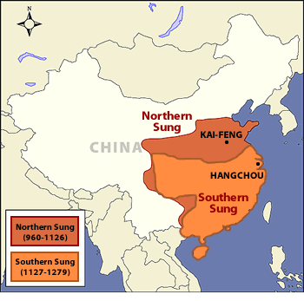
Song Dynasty (960-1279)
The Song Dynasty was constantly threatened by nomadic groups => the Jin conquered the Northern section in 1126 and the Mongols conquered the Southern Song in 1279

Slide 35
Feudalism in Europe & Japan
#2: Feudal States in Europe and Japan
______________= decentralized political organization where local lords control land & military power & give them out in exchange for service
European Feudalism
After the fall of the Rome in 476 Europe was a cluster of small Germanic kingdoms for 400 years
All Christian kingdoms & melded German traditions with Christianity => use of _________(payment to family for wrongdoing) & ordeals
There were attempts at unity in Europe during the Middle Ages
#1: ______________________(ca 800 CE)=> broken up after death
#2: ________________(ca 1000 CE) => Otto I of Saxony and others tried to institute an Empire encompassing Germany and Italy
-- Failed due to internal conflicts & church squabbles and led to both areas being ruled by small independent city states
Feudalism developed as a social, political & economic system to fill the void and offer protection from various raids (Vikings, Muslims, etc..)
** GW: Feudalism in Europe and Japan **

Slide 36
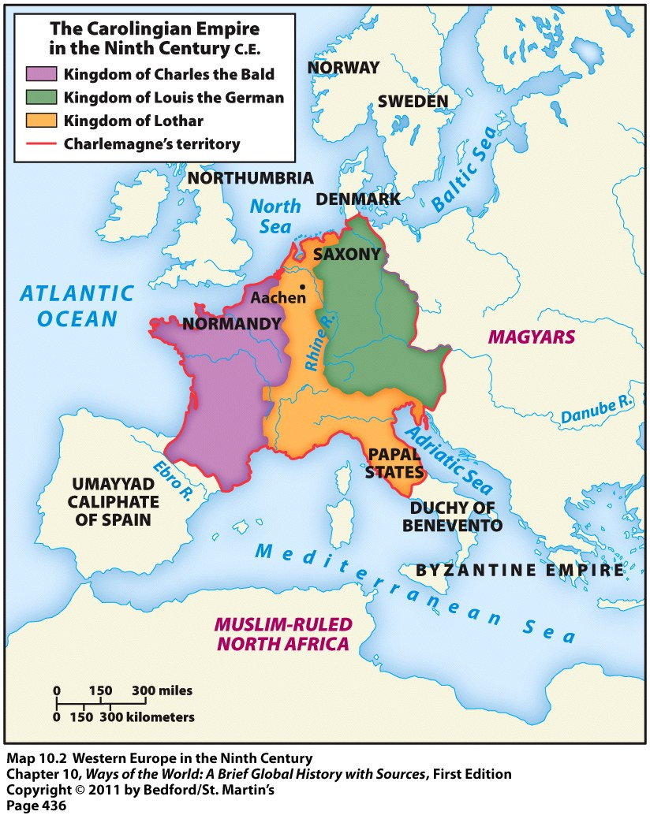
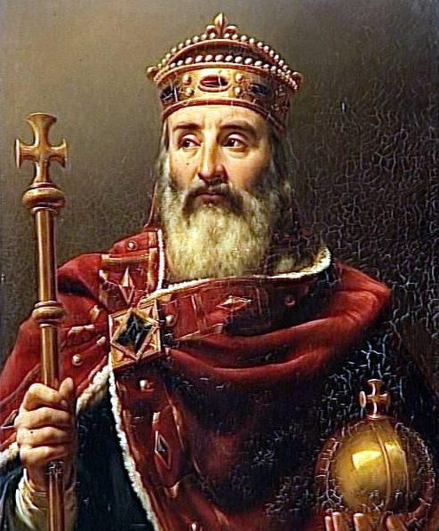
Charlemagne or Charles the great
It was a Germanic practice to divide territory between sons at the time of the fathers death – reason Germanic kingdoms couldn’t maintain stability

Slide 37
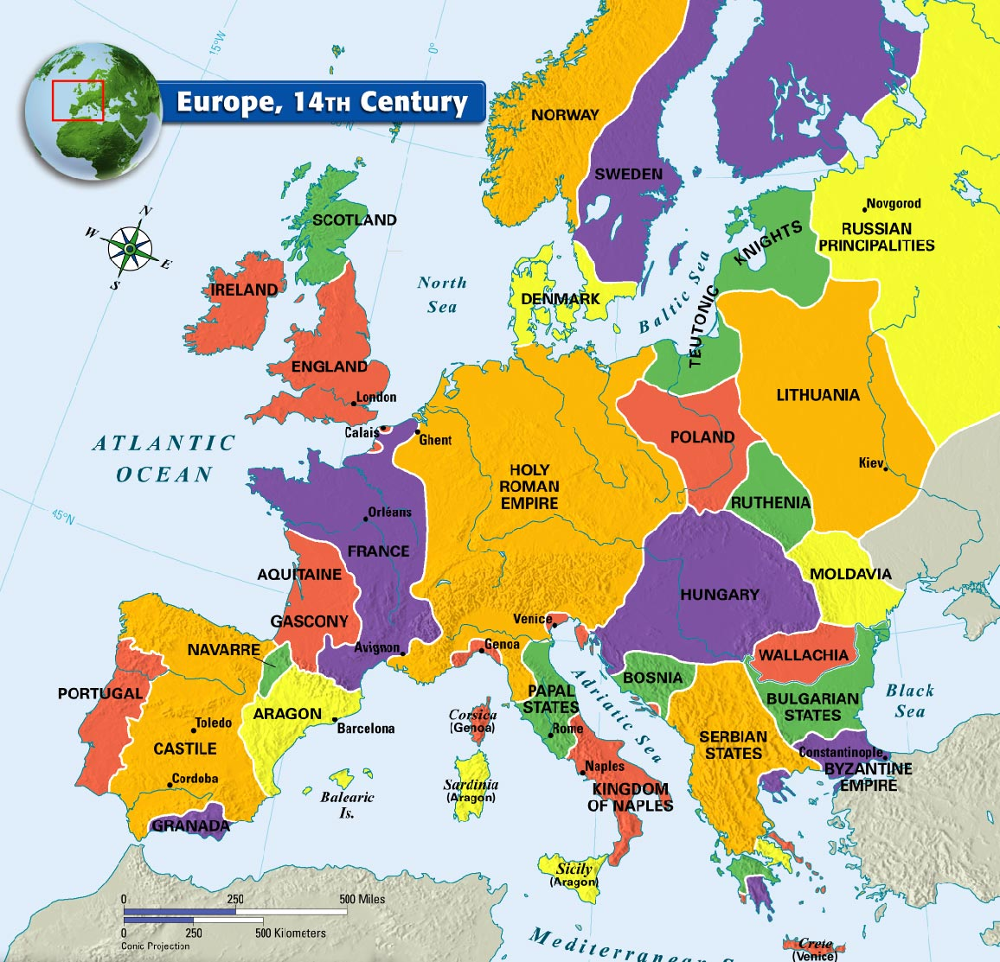
Holy Roman Empire
Holy Roman Empire was actually more a collection of independent city states and principalities => no direct central authority

Slide 38
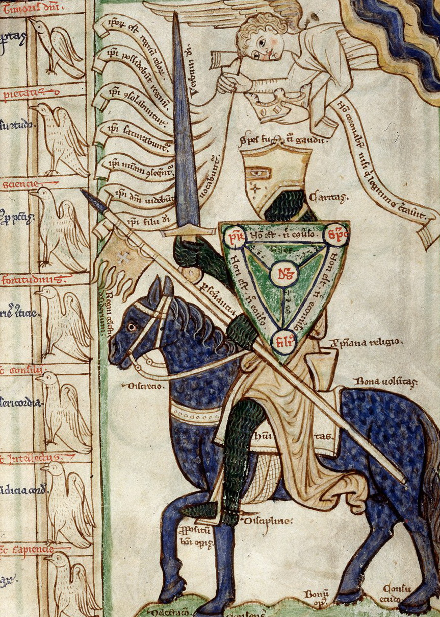
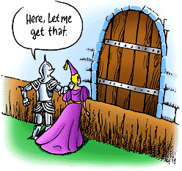
European Knights of Middle Ages
Middle Age Knights were expected to follow the Code of Chivalry => bravery in battle, dedication in training, service to all (lord, less fortunate)
Knight warfare dominated Europe for over 500 years (800-1300 CE) => knights were responsible for training and outfitting themselves (expensive and time consuming) => expected to have a sword, lance, horse (rode w/ stirrups borrowed from Central Asian nomadic groups)

Slide 39
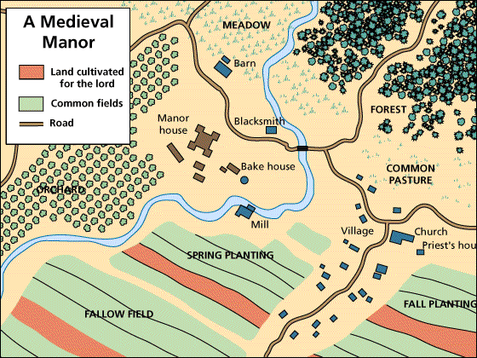
Manorialism diagram
Manoralism and fief holding dominated Europe for 500 years (800-1300 CE) and became increasingly complex => larger fiefs were subdivided and a series of requirements was made for all classes

Slide 40
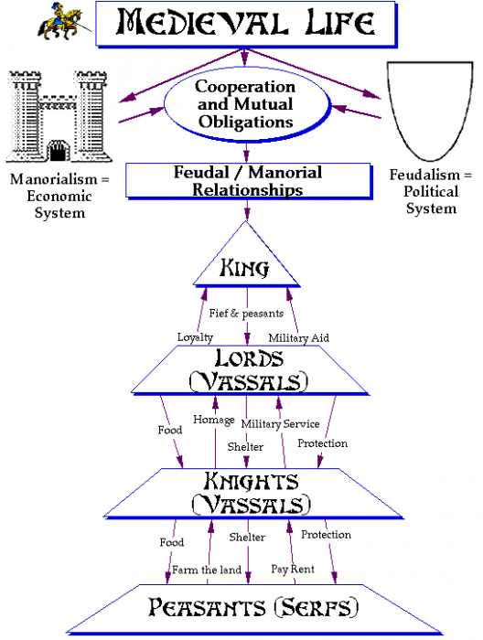
Feudalism & Manoralism
Major duties of each class:
Lords => provide fiefs for vassals and protection/support in court
Vassals => provide military service or knights for lord (~ 40 days/year)
-- Provide land & protection to serfs
Knights => give military service to Lord/vassal; train and outfit themselves
-- Large horse (carry man & armor); sword, lance
Serfs (60% of population) => give service to lord (3 days/week); pay rents in form of % of crops

Slide 41
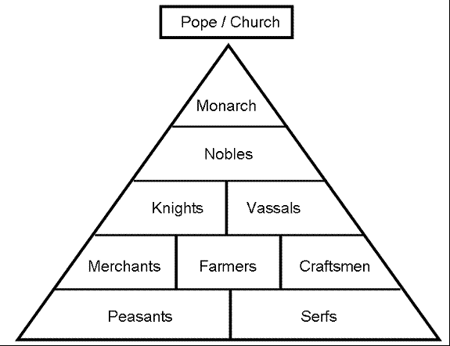
Feudalism Hierarchy

Slide 42
Feudalism in Europe & Japan
Traditional sources of power (continuity)
1. Patriarchy => feudal society remained very patriarchal
-- Division of labor w/ men in public sphere (farm land, tradesmen) & women in domestic (kids, food, etc…)
2. Military power => lords used ____________to maintain military control
3. Use of religion => MA kings like Charlemagne & Otto I were crowned by the ________and sought to convey__________________________
4. Land owning elites => vassals who owned fiefs and managed land
New Innovations
1. __________=> serfs forced to work for lords 3 days/week (bound to land) and pay % of crops to lord in exchange for land
2. Support of monasteries & growing power of Catholic church =>
____________________________(nuns) granted land & exemptions from obligations => Served as the social agencies of MA (provided hospitals, schooling & copied texts)
1/3 of land owned by church & they collected 10% of revenues
-- Became a powerful economic, social & cultural institution => focus of architectural developments, literature
* Overall, Feudalism in Europe led a greater degree of political, economic (3 field agriculture, wheeled plow) and cultural stability (church & monastaries) *

Slide 43
Feudalism in Europe & Japan
Japanese Feudalism
Due to threat of Tang expansion in the 7th century, Japan reorganized its govt & society on the Chinese model => ________________(620 CE)
Centralized bureaucracy (Grand Council of State) was created w/ 8 ministries => each run by officials chosen by an examination system
Japanese leader took title: _________________
Rural districts were designed & organized (based on Chinese model)
Taxes collected from rural peasants & a Chinese law code instituted
Elites and some poets even wrote in Chinese
__________also borrowed from China & developed into the most popular religion due to endowed monasteries & Pure Land sect
-- Did not totally replace Shinto religion => adapted Buddhism into ______________(focused on becoming one w/ nature via meditation)
By 9th century this system had broken down and decentralization of authority led to a feudal system in Japan => Kamakura Shogunate
Lasted well into the 19th century due to lack of foreign threat and isolated nature of Japanese society

Slide 44
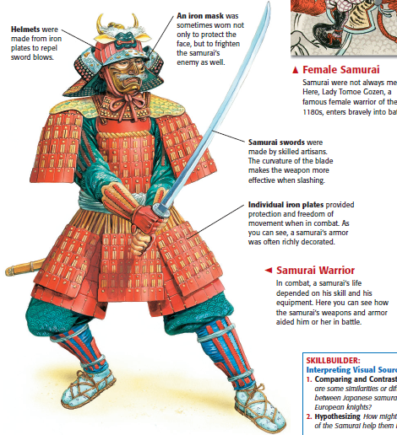
Samurai Culture reading
Samurai followed the Bushido Code => strict code of conduct
Emphasizes honor and bravery in battle
-- Surrender not option => commit sepuku
Unquestioned loyalty to daimyo & emperor
Service to community and those less powerful

Slide 45
Most valuable samurai swords are known as Masamune swords after their creator
Masamune Katana in Tokyo museum – similar sword sold for over $8 million

Slide 46
Feudalism in Europe & Japan
Traditional sources of power
1. Military power => daimyo & shoguns were military leaders with ______________________to protect from invasion and rival clans
2. Land owning elites => ________were noble elites (vast estates) and gave it to samurai and peasants in return for obligations & rent
In general, Feudalism also provided Japanese society with a degree of stability and prosperity
Feudal daimyo and shogun able to repel Mongol invasions during 13th century => aided by rough waters and hurricane force storms
Economic trade prospered after 1200 (controlled by daimyo)
Society flowered culturally
-- Development of Japanese Zen Buddhism
-- Development of Japanese art forms (bansai, haiku poetry, literature w/______________________)
** Q: Was Japanese society feudal? How would you compare Japanese and European feudalism? **

Slide 47
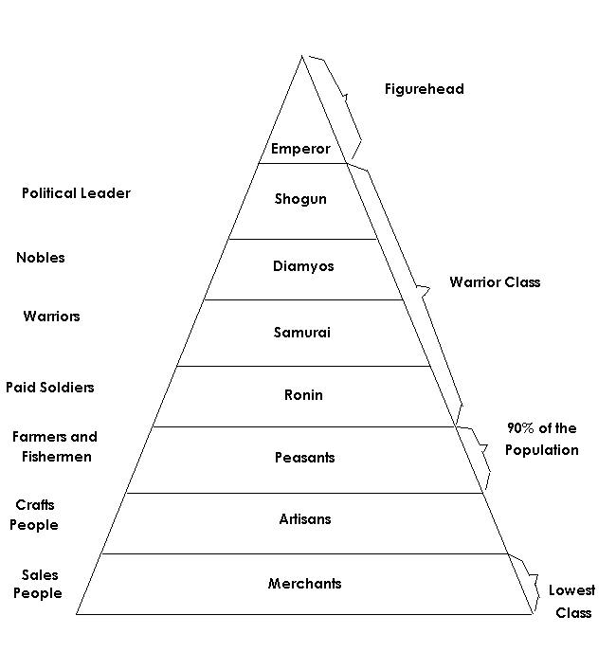
Japanese Feudal Hierarchy
Merchants and tradespeople were NOT respected in Japanese culture

Slide 48
New State Systems in other areas
#3: City States => prominent in many geographic areas
_______________________
Cities like________________________, as well as the Papal states
Venetians and Genoese developed vast sea based trading network that dominated the Mediterranean
-- Largest cities in Europe by 1300’s (i.e. Venice pop = 100,000)
Government was dominated by wealthy elites who controlled trade
-- i.e. Medici family in Venice (used patronage and support of arts)
Papal states were controlled by Pope & Catholic church hierarchy
_________________________
By 9th & 10th centuries a series of trading ports, partially founded by Arabian Islamic diasporic traders was founded on East Coast of Africa
Exs:______________________________
Traded goods like gold, ivory, & exotic animals => acquired from interior (gave them textiles, silk, paper)
States were autonomous and taxes were levied on trade
Ruling classes were often Arabic and Islamic => Arabic culture huge influence on culture of state (_______________language, Arabic architecture)

Slide 49
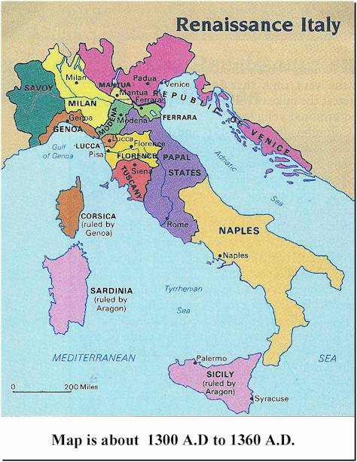
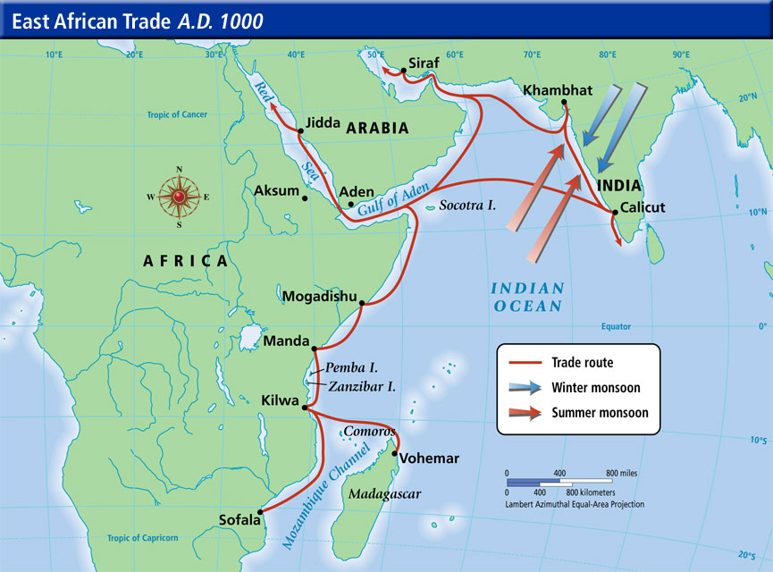
City States
The Italian and Swahili city states were heavily involved in trade in the Mediterranean and Indian Oceans

Slide 50
New State Systems in other areas
____________________
During the post-classical period the Maya civilization reached its peak
Leading cities like Tikal ~ 100,000 residents
Each city state was autonomous and likely traded with others
Government => organized around a king (religious and political leader) and religious practices (______________________)
-- City states warred constantly for sacrifice captives and dominance
-- Ruling elite were powerful landowners, who may also have become administrators or artisans (valued in Mayan culture)
Society => organized around farming using__________________________
-- Religion played a key role => city organized around a series of massive temples at the center
-- Mayans were advanced technologically => developed accurate calendar and writing system (hieroglyphs)
** City State problems => city states in these areas exhibited two problems . . .
#1: ____________=> evident in Mayan example, but also among Italian city states
#2: Lack of power => when confronted w/ attack from empires both Swahili city states and Italians were unable to maintain independence (i.e. Portuguese colonization in 15th century for Swahili city states)

Slide 51
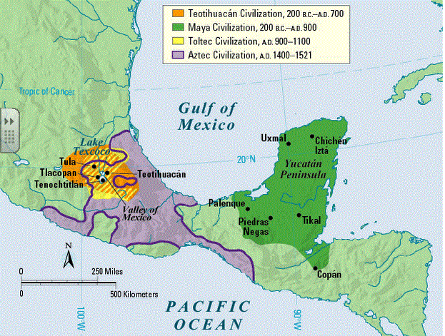
Mayan City States

Slide 52
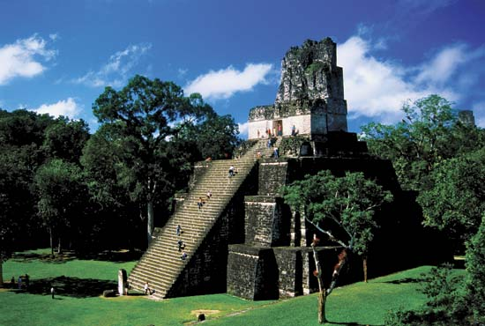
Mayan Temple at Tikal
Religious temples formed the basis of Mayan cities => many are estimated to have taken over 40,000 man hours to complete
-- They were sites of human sacrifice (often by decapitation)

Slide 53
New State Systems in other areas
#4: Mesoamerican Empires
Partly due to isolation, both empires lacked wheeled vehicles, metals and draft animals but were able to develop large empires
________________
Capital city = Tenochtitlan (~100,000 residents) => Aztec Empire operated as a ______________________
Aztecs were powerful warriors (i.e. Spartans) who conquered others => forced to pay tribute (crops, sacrifices, $$) to Tenochtitlan
Emperor was head of state (religious and political figure) => promoted worship of ________________ to provide unity to empire
Aztec society
Strict hierarchy => Nobility controlled majority of land; priests and merchants/artisans were middle class and below were serfs & slaves
-- Very patriarchal => men trained for war; women stay in home
Agriculture based on ______________________
Society organized by familial kinship groups called calpullis (~1000) => like local government (settled disputes, collected taxes)

Slide 54
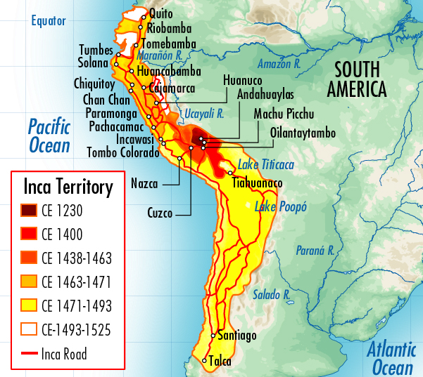
Aztec and Incan Empires

Slide 55
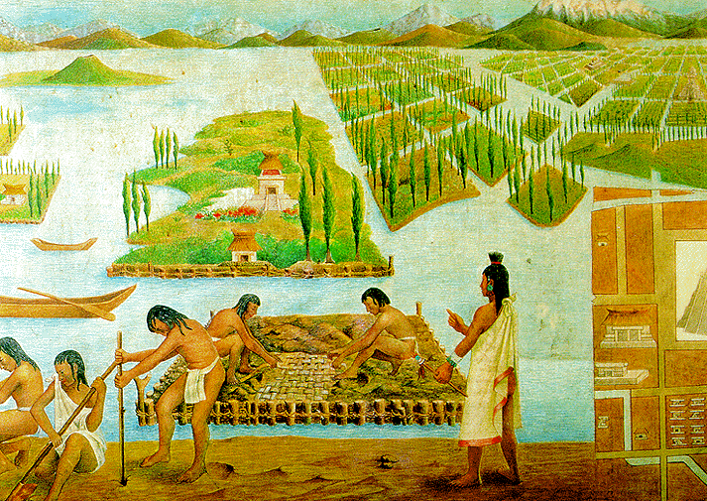
Aztec Chinampas
Teotihuacan chinampas were made of reeds and anchored to the shore => underground irrigation and resistance to frost made them productive year round

Slide 56
New State Systems in other areas
____________________
Built a huge empire which stretched over 2500 miles by 1300
Capital at Cuzco (Machu Pichu) where emperor used vast bureaucratic administration to rule over empire
-- Writing system consisted of tying rope knots
Civilization was based on conscripted labor (_______)=> conquered districts were forced to serve in military, construct roads (25,000 miles), make crafts, farm, etc… (mi’ta service was periodic)
Incas were a warrior society => 200,000 man standing army
Agriculture was based on ___________________
** Overall, the Mesoamerican empires were technologically underdeveloped and not acclimated to Eurasian diseases => fell to Spanish when they were invaded in the 16th century**

Slide 57
New State Systems in other areas
#5: Islamic States => due to conquest and trade contacts areas other than Arabia developed Islamic states
Mali Empire
Prior to the arrival of Islamic traders and missionaries W. Africans had no written language (oral tradition) and a pantheistic religion
-- Griots = professional oral historians
Arabic traders introduced ________________in Gao 1st and it spread through the region due to the Ghanian Empire (600 – 1200 CE)
Gave people a common language, culture and helped to unify area
Islam also gave local rulers ___________________________& administrative practices to increase authority
Also integrated area into larger worldwide network of trade (caravans)
Mali Empire rose from the ashes of Ghana
Government => based on small village leaders (___________) => served as religious and political leader
-- ____________________(1330’s)=> converted to Islam and encouraged conversion & study by citizens and scholars
-- Led to major cities like ____________________becoming centers of Muslim learning => dozens of universities and scholars migrated there
Economy was based around _____________________& used cowrie shells for $$ => taxed trade and had self sufficient agriculture

Slide 58
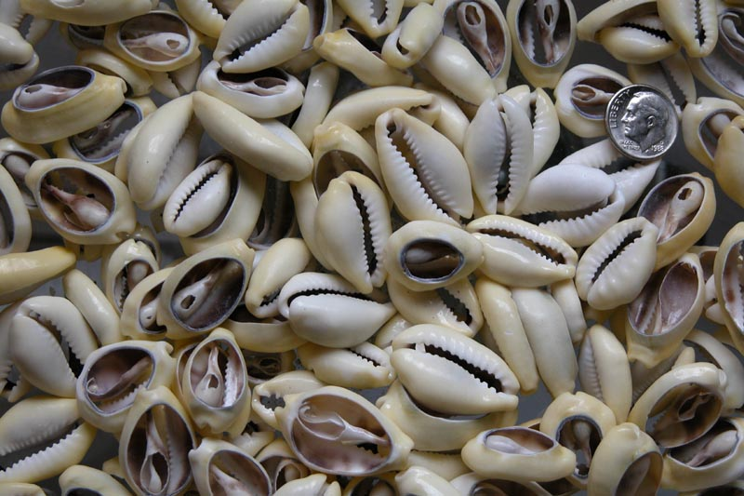
African Cowrie shells

Slide 59
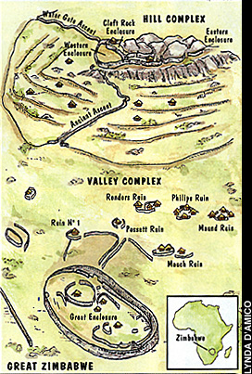
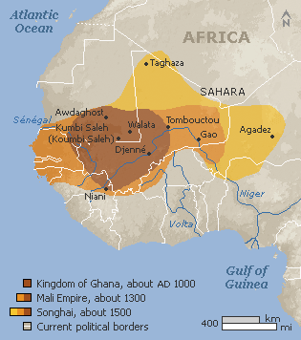
Ghana, Mali and Great Zimbabwe

Slide 60
New State Systems in other areas
Delhi Sultanate
Arose in the 10th century out of the Ghazni empire in northern India => Turkish Muslims who raided over centuries into Hindu territory
Advanced military technologies of Turks (i.e. steppe horses w/ stirrups) easily defeated divided Hindu princes & infantry/elephant armies
Government => ruler was called a ___________(religious and political figure)
Sultans est. a bureaucracy and local governors => ruled via brutal force and heavy taxation of ________________________(jizhah)
Gradually expanded state after threat of Mongol invasion ended
Economy and society => based on Indian Ocean trade and frontier raids
________________________=> India is one area where significant Islamic conversion did not occur
Muslims were viewed as_______________________________ => forced to live in separate areas of town
Muslims in India adopted caste system in Muslim society => little benefit for lower caste conversion
Sultanate came to an end when _______________________invaded in 1398 and sacked the city of Delhi (killed 100,000 Hindus at its gate)
Did provide a centralizing influence in India after 100’s of years of disunity

Slide 61
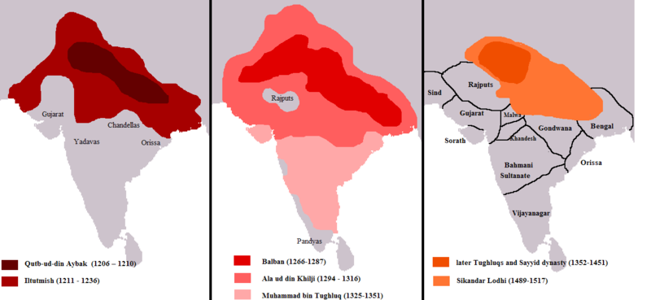
Delhi Sultanate (1206-1526)
The Delhi sultanate originates from Turkish invasions of disunified India after the fall of the Guptas (700-800 years of disunity) => Delhi sultans were very violent in their attempts to suppress Hindu and Buddhist beliefs and desecrated 1000’s of shrines and temples

Slide 62
Pastoralism and the Mongols
Pastoralist vs Agriculturalists
Pastoralists relied on raising of___________________________
Used every part of animal => milk, meat, blood, wool, hide
Animals also used for transportation, trade and military
Overall a less productive economy and thus smaller populations
Pastoralists did ___________________________=> lived in small encampments with kinship groups
Organized politically into families, clans and tribes
Pastoralists, especially the Mongols, also offered women a higher status than every agricultural society of its time
There was a _____________=> women were expected to tend house, but also worked w/ animals (esp. when men were at war)
Few restrictions on activities for women => greater role in public life
-- Some women served as political advisors, some in military
Mongol women could initiate divorce and remarry if widowed

Slide 63
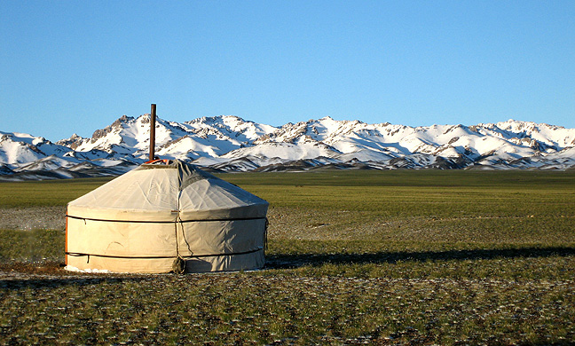
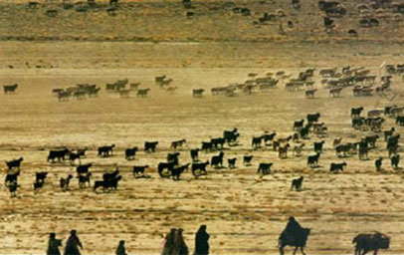
Mongolian Yurt
The Mongols were a pastoral nomadic people => NOT homeless, they lived in mobile Yurts and focused on raising livestock

Slide 64
Pastoralism and the Mongols
Pastoral Economic Interactions
Pastoralists like the Mongols traveled in systematic patterns to graze cattle, horses, etc based on seasonal changes and environment
Pastoralists traded with agricultural neighbors => traded horses, inventions like stirrup for food, manufactured products & luxury items
Used their military power to raid civilized areas or extracted tribute in exchange for peaceful relations
-- Romans, Chinese, Persians, Guptas, Byzantines all paid tribute at one time
At times, desire for goods or conquest led to the formation of tribal confederations for various purposes
The __________________________________________all formed confederations for these purposes
-- Some confederations (i.e. Xiongnu) harassed agriculturalists, others conquered them and set up civilizations (i.e. Mongols)

Slide 65
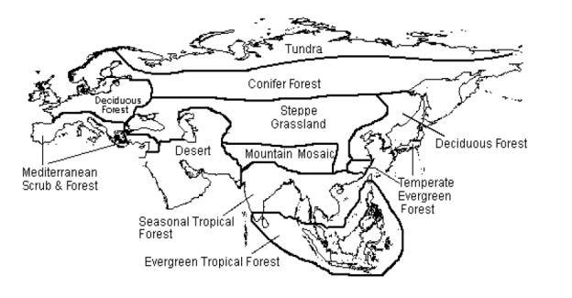
Pastoralists and the Environment
Pastoralism was best adapted and flourished on the Steppe grasslands of Eurasia => the Huns, Goths, Xiongnu, Magyars and Mongols all originated from this area

Slide 66
The Mongol Expansion (1206-1368)
The Mongols in 1160 were an obscure tribe in C. Asia (1-2 M people) => constant disunity w/in tribe, raiding/disputes led to internal wars
Temujin (Genghis Khan) united tribe by utilizing shifting alliances, deception and military prowess
After being elected “____________________” (supreme leader) in 1206 he embarked on a campaign of conquest that lasted over 50 years
Q: Why? => shifting climate patterns created drought in steppe lands, need for common goal to unite tribes, $$$$
Q: How?
Use of __________________________________(could ride for days straight, shoot bow while riding)
-- Organized into units of 10, 100, 1000, 10,000 warriors (ordos; based on social structure); leaders fought w/ men => total size of army 130,000
-- ALL warriors benefitted from booty equally
Genghis Khan also used superior military tactics => hit and fade, flanking, siege warfare
-- Conquered people used for abilities => engineers, blacksmiths, etc..
-- Adopted Chinese__________________________
Genghis Khan also used _____________________=> threat of annihilation
-- Regularly massacred conquered cities who resisted (i.e. Urgench => all 50,000 soldiers ordered to kill 24 residents each); caused easy surrender

Slide 67
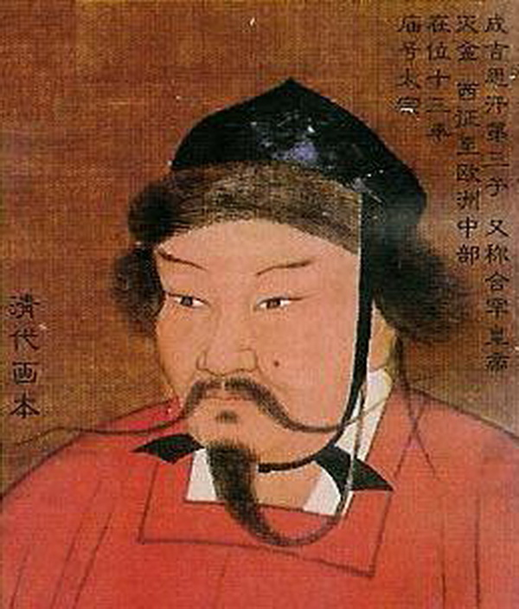
Genghis Khan => 1162 – 1227
Genghis Khan did not have an easy upbringing
-- Father murdered when he was 6 & he grew up in wild
Once said, “Man’s highest joy, is in victory: to conquer one’s enemies, to pursue them, to deprive them of their possessions, to make their beloved weep, to ride their horses and embrace their women and daughters.”

Slide 68
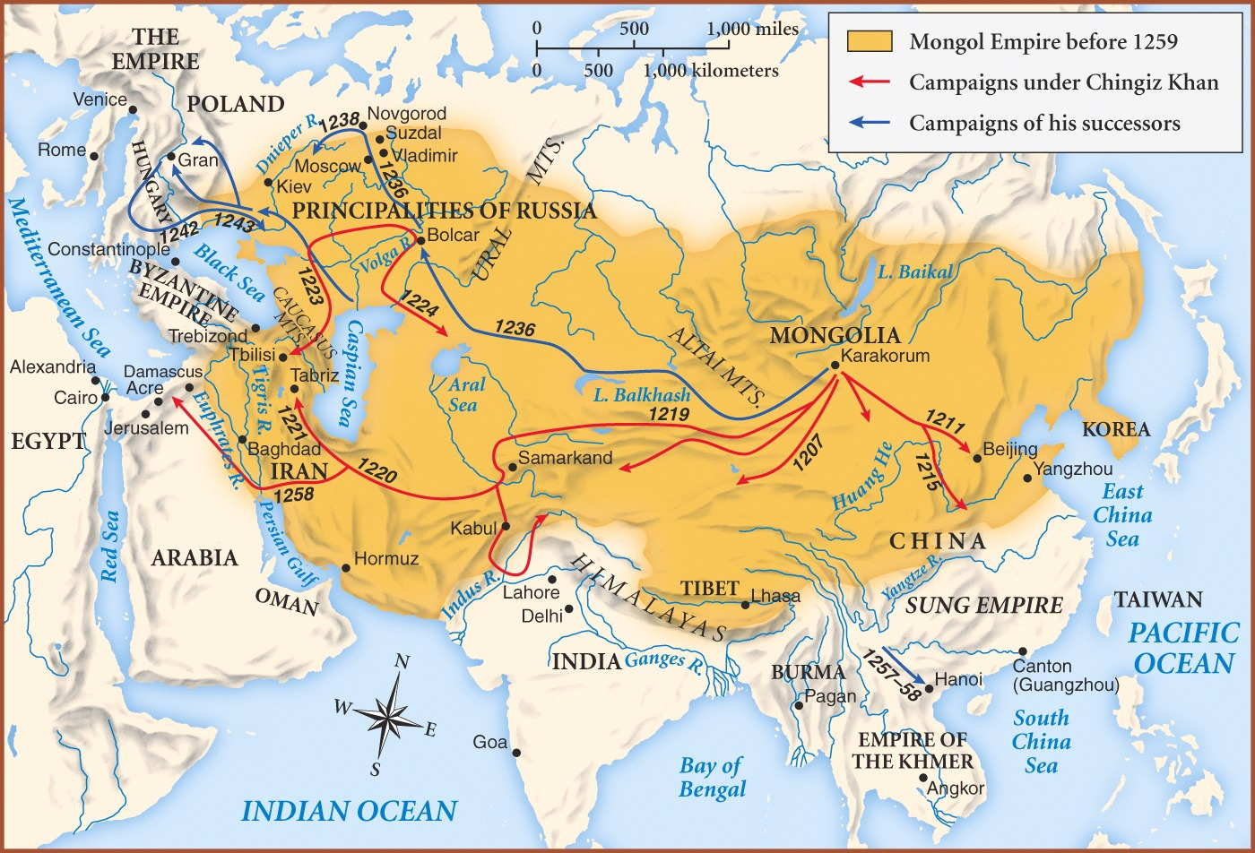
The Mongol Empire at its Height (1260)
The Mongol Empire represents the largest contigious land empire in world history => it was over 12 million square miles and was composed of 32 different countries today

Slide 69
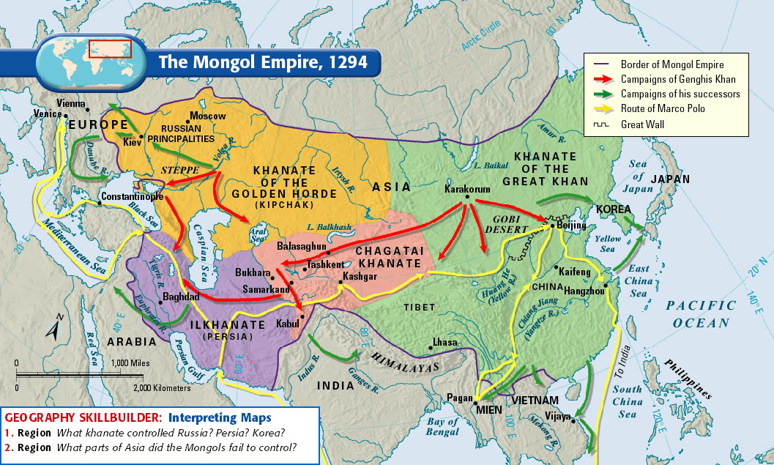
The Mongol Empire after Fragmentation
After the death of Kublai Khan in 1294, the empire was split into different sections and each pursued its own agendas from there on

Slide 70
Mongol Defeats
Mongols were very successful, but were turned back at the limits of their empire on a few occasions
#1: Invasion of Japan => failed due to a storm that sank Mongol fleet numbering 50,000 (Japanese naval forces more experienced)
#2: SE Asia/Vietnam => jungle environment impeded movement and supply lines stretched too thin
#3: Egypt => Mamluks defeated Mongols (exhaustion)
#4: Western Europe => Genghis Khan died & troops returned to funeral

Slide 71
Mongol Empire -- Administration
Due to the size and cultural diversity Mongol administrative system adapted to diverse elements and varied across the empire
“Although empire created on horseback, it cannot be ruled from it”
-- Many Mongols maintained nomadic lifestyle => laws passed in China that forbid Chinese learning Mongol, forbid intermarriage
-- Mongols served as highest level administrators => adopted a Chinese style legal code that brought order and peace
-- Many locals used to administer empire => lack of Mongol pop.
__________________________staffed w/ horses => allowed communication across vast empire; encouraged trade
Established capital at Khanbaliq (along trade routes; later Beijing) => separate sections of city for Mongol & Chinese (prevent intermixing)
Revenue system combined Mongol and Turkish practices => taxed agricultural land via a contract system (highest bidder raised taxes)
Instituted a __________________=> used for taxation & conscription
Genghis Khan also instituted a policy of religious toleration

Slide 72
Mongol Empire -- Administration
Mongol did apply many of their own practices to the governmental system => most significant was rise of ______________________
_________________=> autonomous principalities ruled by a Khan; created after the death of Genghis Khan (Mongol traditional practice)
-- Khanates were required to submit to the “Grand Khan” elected in a meeting after the previous Khan’s death
-- Khanates were often _______________________________when he died or as rewards for service => used to administer empire locally
Mongol administration was effective in ruling, generating revenue and encouraging trade => created a period called “__________________”
Mongol invasions & empire brought many of world areas into close contact during the 1300’s

Slide 73
Mongol Impacts on Conquered peoples
In general, the Mongols domination of most lands was brief (100-200 years) and thus did not impart a huge cultural legacy on the people
Mongols did not transmit any new religion to conquered people either => adopted a policy of religious toleration & assimilation
However, this is not to say that their cultural, economic and political impact on conquered peoples was not significant . . .
Mongol China
In China the Mongols conquest was long and hard (70 yrs) => #1 goal in China was to extract wealth & thus they adopted Chinese practices
Adopted Chinese dynastic rule => ________________
Many upper class Mongols adopted Buddhism as well => liked idea of one idea/groups ruling over entire world
Used Chinese style postal system, taxation policies & administration system (Mongols filled highest positions)
Transferred capital to Khanbaliq => fostered a growing respect for merchants in opposition of Confucian values
-- _______________declined in importance during Mongol rule => Mongols refused to utilize examination system (used hereditary rule)

Slide 74
Mongol Impacts on Conquered peoples
Mongols, though, did not fully integrate into Chinese society . . .
Many refused to adopt civilized living arrangements => still lived in yurts and established grazing areas within cities
Language sharing not allowed (i.e. between Mongols & Chinese)
Did not adopt Chinese footbinding & forbid intermarriage
Mongol rule in China had four main effects . . .
#1: Encouragement of _________________________=> higher status of merchants and Pax Mongolica led to growth of Silk Road trade
#2: Agricultural/Rural devastation => rural pop. declined by 40% during Mongol rule & oppressive taxation of farmers led to abandonment of land
#3: Unification of _____________________=> Japanese society unified and national trade networks increased due to Mongol threat
Korea => Chinese printing practices (i.e. educated elites), cotton agriculture (export industry) & military knowledge (i.e. gunpowder)
#4: __________________________=> Muslim doctors shared medical knowledge & astronomers improved Chinese calendar; Persian diplomats refined Chinese adm. practices

Slide 75
Yuan Dynasty

Slide 76
Mongol Impacts on Conquered peoples
Russian Impact (the Golden Horde)
The Mongol conquest of Russia was ______________=> destroyed prominent Russian cities (i.e. Kiev) and reoriented Russian power bases
Political & economic power in Russia shifted north towards ________ ____________=> negotiated w/ Mongols rather than fight (i.e. Kiev)
Thousands of Russian sold into slavery
Mongol armies did not directly _________________=> had little to offer economically or culturally
Drained Russia of silver through taxation and led to collapse of currency => tax collection handled by local princes
Due to Mongol control___________________________________
Detrimental effect on trade and cultural exchange
Positive effect on development of Russian language => Orthodox Church rejects Greek and use Russian instead
Russia did absorb some Mongol practices => i.e. weaponry (horses & cavalry), diplomatic rituals, taxation systems& use of military conscription

Slide 77
Khanate of Golden Horde

Slide 78
Mongol Impacts on Conquered peoples
Conquest of Islamic ME was also more violent than China => sacked and destroyed__________, killed _____________& massacred 200,000 citizens
Adoption of ___________(i.e. selling of tax contracts on land to highest bidder => then collected taxes & kept extra) decimated agriculture
-- Mongols neglected canals => led to over-silting
__________________________were heavily influenced by Persians though
Many adopted Islam and married local women
Left governmental operation in hands of Persian diplomats
Learned Persian and used in record keeping and discourse
Most importantly, Mongols encouraged & ___________________________ in science and technology
Established astrological observatories in cities like Samarkand & Tabriz
Spread medicinal advances to China and Europe
Spread astronomical advances to China and Europe also
-- Improved accuracy of calendar & prediction of astrological events (i.e. eclipses, etc) => some ideas influenced Europeans like Copernicus
-- Improved accuracy of scientific instruments like astrolabe
-- Invented decimal notation which reached Europe

Slide 79
Mongol Impact on Trade & Cultural Interaction
Mongols did not make or create or make anything new themselves => spread the inventions & cultural innovations of conquered peoples
Via the _____________and protection of trade routes they created the first real Eurasian economy (linked ME, Asia, Europe and Africa)
Mongol Empire also led to substantial exchange of peoples and cultures
Missionaries and traders traveled peacefully through empire => Mongols encouraged trade (taxation) and tolerated religion
Mongols transferred skilled artisans & scientists across empire => led to Chinese artistic techniques reaching Europe & ME doctors & scientists interacting in China
________________also originated in Mongolia and was spread through China, ME and Europe via Mongol trade networks in the 14th century
Overall the #1 beneficiary of this network of exchange was Europe
Avoided the devastation of the Mongol armies but reaped large benefits in trade and innovations (i.e. paper, compass, astrolabe, astrological studies, gunpowder, etc….)

Slide 80
Cultural Exchange in Mongol Realm
Region | Major Contributions
China | Daoism, acupuncture, painting, printing, gunpowder weapons, compass navigation, medical techniques
Persia / the Middle East | Islam, astronomy, lemons, carrots
Byzantium | Christianity

Slide 82
Technological & Cultural Transfers between states
The Mongol Empire is one significant element during the Postclassical Era providing for cultural transfer between areas, but there were others
The __________________=> a series of 6 “holy wars” fought by European Christians to recapture holy lands in ME & spread Christianity
Q: Who? => knights, peasants, middle class, nobles, kings, priests ,etc…
Q: Why? => multiple reasons
Attempt by Pope Urban & other popes to increase power & authority
Conflict between __________________________over appointment & discipline of bishops => Popes want to reassert power & autonomy
In 1200 4th Crusade crusaders sacked Constantinople as a means of reducing power of_________________________
2. Desire by ______________________sons to acquire own territories & kingdoms
3. Desire by Italian merchants to acquire ports in ME
4. Christian religious benefits => cancellation of sins by Pope; cancellation of debts, glory and honor
5. Conquering of Anatolia by Seljuk Turks who closed down pilgrimage routes
Q: Where => in addition to the Crusade to Jerusalem & the Holy Land, there were also “Crusades” to Muslim Iberia; Baltic Sea; Russia; Byzantine Empire

Slide 83
The Crusades

Slide 84
The Taking of Jerusalem: 1st Crusade
Crusaders were often brutal => after taking Jerusalem in 1099 they massacred 1000’ of the city’s inhabitants (Jews and Muslims)

Slide 85
Q: How does Pope Urban attempt to get young European knights and vassals to support his Crusade?
Pope Urban from a Speech on his Crusade tour: “Enter upon the road to the Holy Sepulcher…and wrest that land from a wicked race, and subject itself to yourselves. Jerusalem is a land fruitful above all others, a paradise of delights. That royal city situated at the center of the earth, implores you to her aid. . . I offer forgiveness of all sins to all who endeavor on this Holiest of Crusades”

Slide 86
Impact of the Crusades
The Crusades were only moderately successful militarily
_______________recaptured Jerusalem and established ___________ ______________and held them for ~ 100 years => i.e. Jerusalem, Acre
-- Kingdoms were centers of trade between Italian city states and ME
Little to no conversion of Muslims => reinforced cultural traditions and animosity between the groups
Real importance of Crusades was cultural and technological => Crusaders transferred much_______________________________________
Abbasid Caliph al-Mamum had founded the “________________” => research center in Baghdad
-- Translated texts from Greek, Persian & Indian => these texts (many of them lost in Europe) were transferred back to Europe
** Led to rebirth in Greek/Roman culture (Renaissance)**
-- Invented algebra, equations for curves and lines and started study of optics => stimulus for scientific revolution in Europe
Muslims also improved the ____________and had borrowed _____ __________from China=> made long distance sea travel more reliable
Muslim scholars and scientist developed chemistry (distillation of spirits) as a byproduct of alchemy (attempt to turn lead to gold)

Slide 87
Impact of Crusades
Muslim doctors like Al Razi & Ibn Sina revolutionized ___________ _________=> diagnosed diseases like hay fever, measles, smallpox
-- Started medical practices like hernia & cataract operations; filling teeth w/ gold; wrote concerning spread of disease via water
-- Also wrote on philosophy => emphasized reason (like Aristotle)
ME Muslims also had adopted many Tang Chinese technologies => movable type printing, paper and gunpowder
** These inventions & cultural ideas were spread from ME to Tang China & ME to Europe via the Crusades, Mongol Empire & trade networks**

