Slide 1
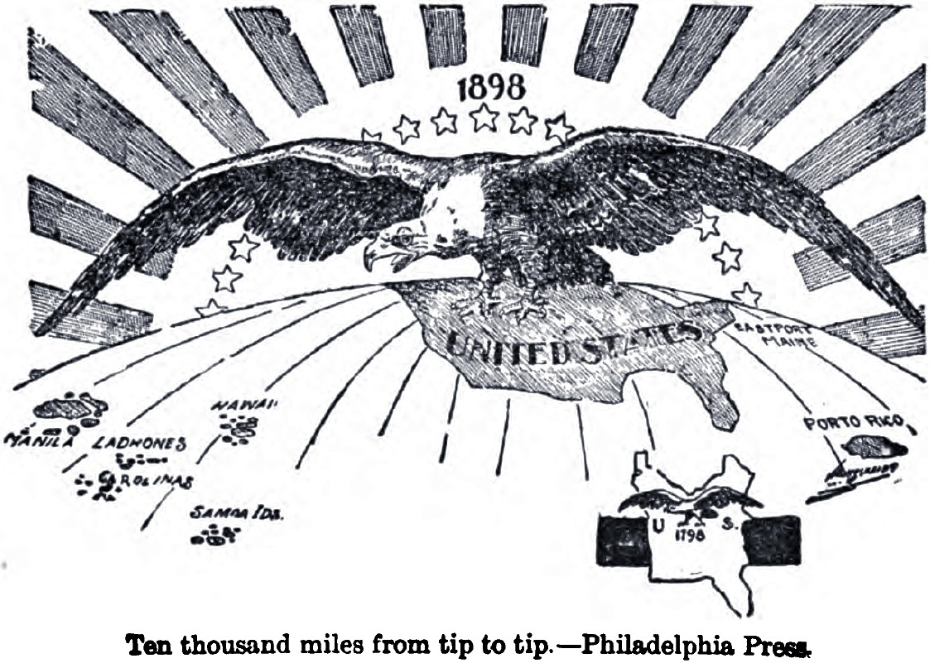
AP US History Unit VII – The US in the Early 20th Century
1898 to 1945

Slide 2
Unit Big Questions and Periodization
Periodization => Why 1898? Why 1945?
In 1898 __________________________________ => Imperialism
-- Opens era of more active US engagement in world affairs
In 1945 _________=> US the unquestioned #1 world superpower
-- After 1945 US engages in Cold War and interventionist policies
Unit Essential Questions . . .
How was US expansionism of the late 1800’s & early 1900’s a continuation & departure from previous patterns of expansionism?
What reforms did Progressive reformers and Presidential leaders institute to help manage the new industrial economy?
How did US foreign policy change and modify from 1898 to 1945? What factors led to those changes?
What new social and economic tensions appeared in US society by the 1920’s and how did those tensions manifest themselves in US social, political and cultural developments?
How did the Great Depression change US economic philosophy & the role of the government in the US economy?

Slide 3
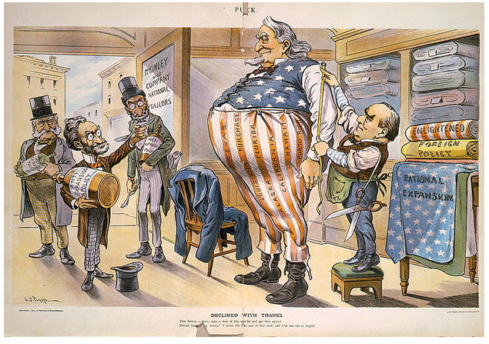
Key Changes of the Period 1898 to 1945
During the early 20th century the US changed dramatically in social, political and economic ways (largely due to industrial economy) . . .
Social => US becomes a more _________________that is increasingly driven by_____________________________; urban pop> rural pop
Economic => economic uncertainty brought by industrialization and the Great Depression transforms US into a___________________________
Political => increasing international conflicts and growing US power leads the US into a role of____________________________________

Slide 4
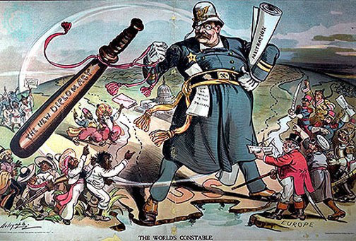
Unit VII Main Eras
Unit comprises many different broad eras & developments in US History
___________________________(1890-1914) => reformers institute improvements aimed at new industrial society
________________________(1920-1929) => US society undergoes a social and cultural transformation which unleashes a variety of tensions
_____________________(1929-1939) => Stock Market collapse & laissez faire policies unleash a decade of collapse that remakes the US economy
______________________=> increasingly violent & large international conflicts presses US into a more interventionist foreign policy

Slide 5
Problems of Industrialization & Early 1900’s
The transformation of the US from an agricultural to industrially based economy in the late 1800’s and early 1900’s produced a variety of issues
Economic
Industrial economy produced a deep divide between the uber wealthy and the poor working classes => no regulation of wages, Plutocracy
One factor in an economy that was very unstable => periods of prosperity followed by deeper recessions
Large Trusts and corporations came to dominate many industries (i.e. RR, Oil, finance) & engaged in abusive practices &monopolistic behavior
Social
Increasing need for labor led to high immigration & rapid urban growth => Cities became centers for poor, unsanitary and dangerous (i.e. tenements)
Large corporations were also increasingly engaging in environmental degradation => western mining, logging, Hetch Hetchy damming
Political
Trusts & machines, as well as the power of industrialists, led to a political system that was dominated by corruption and scandal
I.e. Tammany Hall, Boss Tweed, Whiskey Ring Scandal, Credit Mobilier

Slide 6
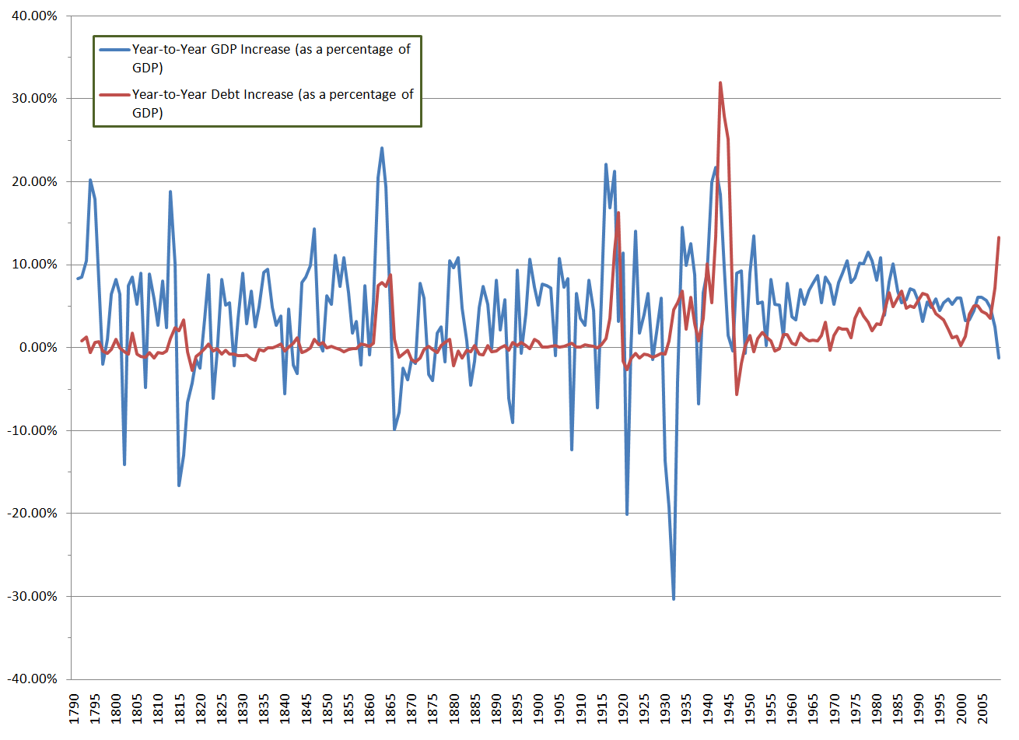
Economic Activity of the Late 19th Century
Despite the success of the uber-wealthy during the period economic prosperity overall was not quite as consistent
Period from 1865 to 1917 was characterized by periods of great prosperity followed by deep depressions

Slide 7
Wealth Concentration in US History

Slide 8
The Progressive Movement (1900-1915)
What was Progressivism?
One reformer said, “the real heart of the movement is to use government as an agency of human welfare” => How is this a departure from the Gilded Age?
Attempt to improve ills of the new industrial society of late 1800’s
Who were the Progressives??
Many different groups of reformers made up movement => _____________ ______________________________
Many different groups contributed to the Movement
#1: __________________– writers & journalists like ________________ (the Jungle @ Chicago Meatpacking), _______________(History of the Standard Oil Co), Jacob Riis (How the Other Half Lives @ NYC Tenements)
Sensational accounts of horrors of industrial life and industry => brought attention to causes and many times led to laws and improvements
#2: _______________________________=> tried to improve life in urban slums via settlement houses and improved legislation at local level
Led by figures like __________________________and Jane Addams
#3: Women Reformers => mainly urban middle class white women
Reformers like Carrie Nation, Francis Willard and the _________(Women’s Christian Temperance Union) fought against the saloon culture
-- Worked w/ Anti-Saloon League to gain “dry territory” in 50% of US by 1914 => passage of ___________________in 1919

Slide 9
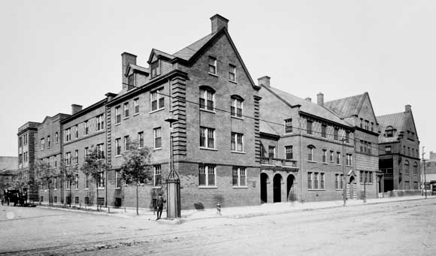
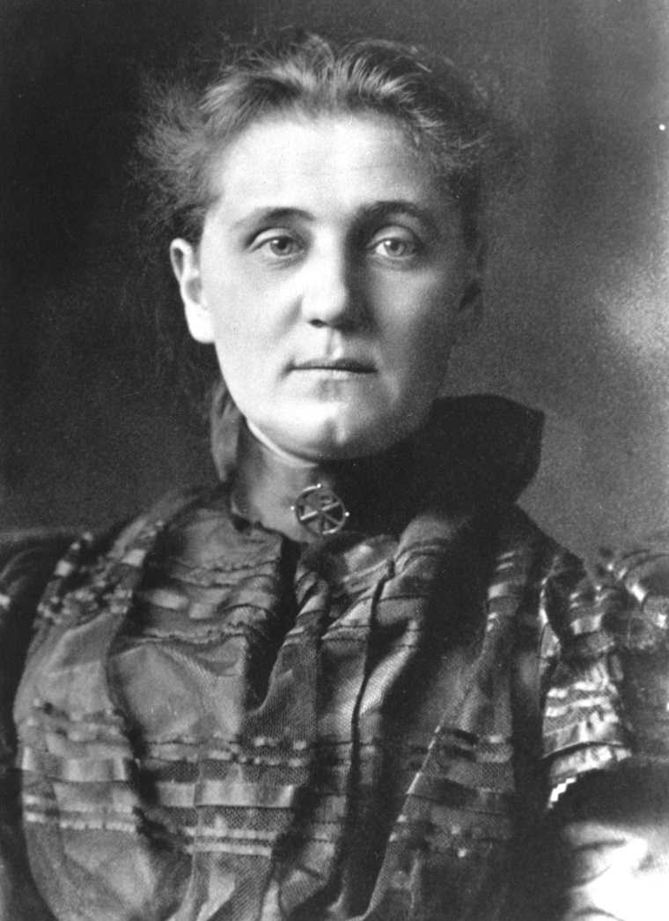
Jane Addams – Hull House
Hull House was one the first prominent settlement houses in American cities => it once covered a city block on Chicago’s South side and provided services for the city’s poor
Addams was a wealthy women who pioneered the US social services and social work movement of the late 1800’s

Slide 10
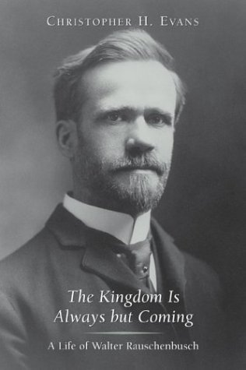
Walter Rauschenbausch – Hell’s Kitchen

Slide 11
The Progressive Movement (1900-1915) (Cont)
_______________also advocated for child labor laws & women’s labor laws through organizations like the National Consumer League (NCL)
-- Organized boycotts of business that used child labor, etc….
#1 Problem = Largest source of Federal Revenue in 1900 is alcohol taxes => passage of federal income tax (16th amendment)
Leaders like Susan B. Anthony and others helped to fight for the right to vote which was passed in the __________________in 1919
#4: Political Reformers => attempted to refom local and national corruption
“____________________” of Governor Robert LaFollette was effective in removing power from machines => Adopted by many states
-- Initiative (i.e. voters directly propose laws)
-- Recall (i.e. voters can remove a politician from office)
-- Referendum (i.e. voters vote on proposed laws)
-- Direct Election of US Senators (17th Amendment in 1913)
Many states also passed laws to limit workday hours and local codes to establish better tenements and workplace safety (in response to incidents such a Triangle Shirt Factory and Muller v. Oregon)

Slide 12
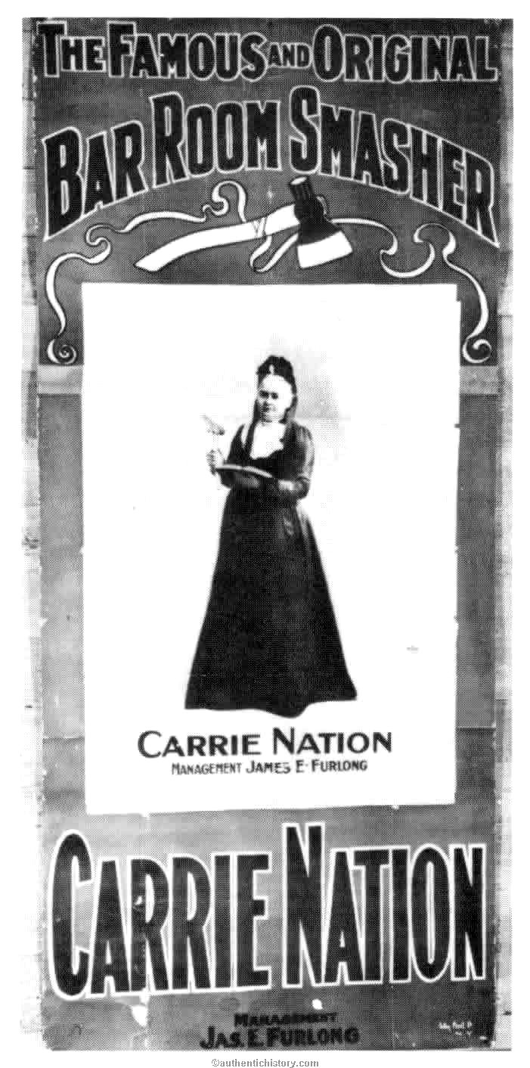
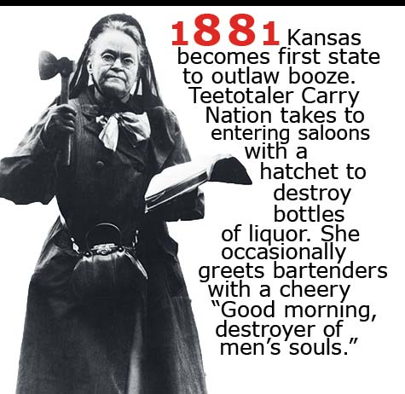
Carrie Nation & WCTU

Slide 13
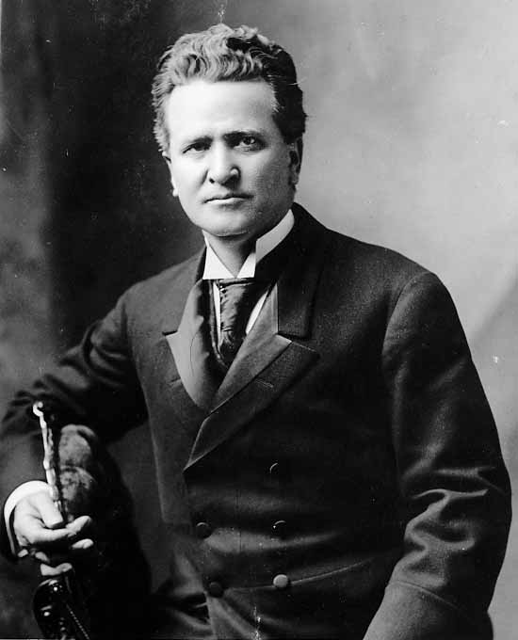
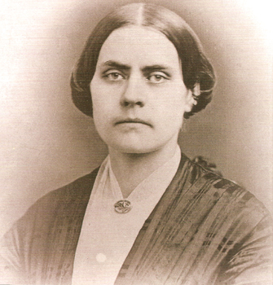
Progressive Reformers
Susan B Anthony
Robert LaFollette

Slide 14
Progressivism Divided
Although the Progressive Movement provided a unified vision for using government & private institutions to address the problems of an industrial society, at times Progressives were divided . . .
#1: _____________________=>reformers like WEB DuBois and Booker T Washington were divided as to the response to Southern segregation
Washington = accomodation; Du Bois = change and challenge now
#2: ______________________=> some called for greater participation (i.e. women voting); others called for increased reliance on educated experts
#3: _______________________ => some called for immigration restrictions so that problems could be addressed, others advocated open immigration
#4: _________________________________=> some called for managed resource usage (Pinochet & TR), others advocated preservation of natural state (Muir)

Slide 15
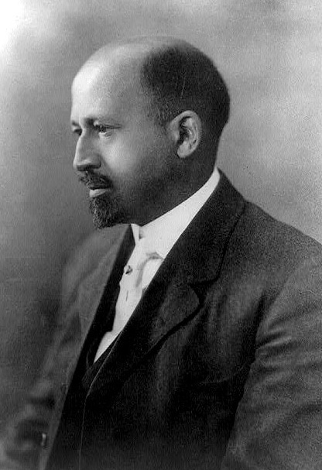
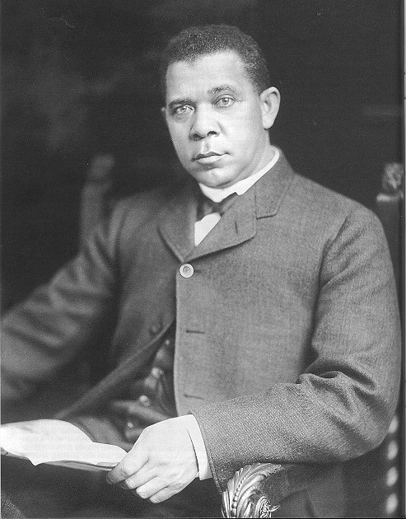
African American Reformers
WEB DuBois Booker T. Washington

Slide 16
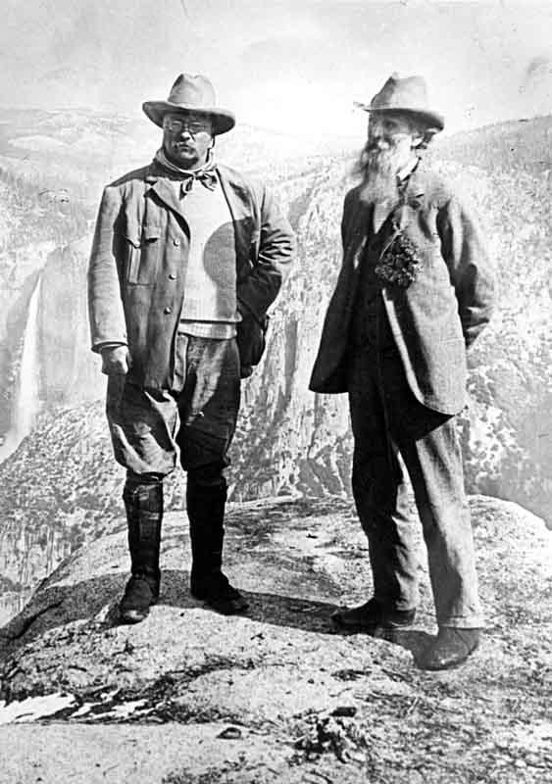
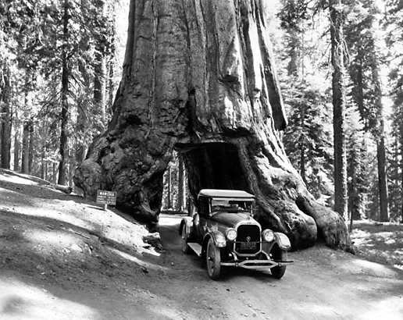
Environmentalism => Muir vs Roosevelt

Slide 17
Progressive Presidents => legislation & Action
Progressive Reformers were successful in also gaining governmental support for their efforts at reform => TR, Taft & Wilson all “progressive”
Teddy Roosevelt
TR was a new kind of President in 1901 => active, engaged and wanted to use the power of Presidency to bring change . . . “Bully Pulpit”
Inaugurated the “_________________________” => made up of the 3 C’s
#1: Control of the Corporations
TR supported Unions in their right to exist and bargain w/ management in the Coal Strike of 1902 (1st time US govt. intervenes on behalf of workers)
TR gains a reputation as a “TrustBuster” => i.e. uses the Sherman Anti-trust Act to “regulate” and threaten trusts to get them to behave appropriately
Creates the _____________________(1903) to regulate businesses; gains passage of the Elkins Act & Hepburn Act which regulated RR behavior
#2: Consumer Protection
After reading the Jungle backed the ___________________________which required inspection of meat and proper labeling of packages
#3: Conservation of Natural Resources
TR had lived in the West as a cattle rancher for years and loved the outdoors => 1st public figure who sought to preserve them
Passed the Newlands Act of 1902, which started irrigation projects in SW; Added over 125 M acres to newly established_____________________

Slide 18
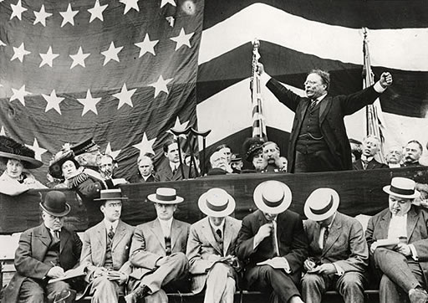
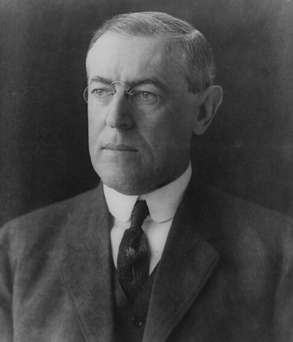
3 Progressive Presidents
Friend said of him, “If TR is at a wedding he wants to be the bride and if he is at a funeral he wants to be the corpse”
Loved to coin “phrases” and give very animated speeches => enjoyed being the center of attention!!

Slide 19
Progressive Presidents => legislation & Action
Although less Progressive, Taft and Wilson also added significant achievements to progressivism . . .
Taft
Most famous for getting stuck in the WH bathtub, Taft regulated trusts more aggressively than TR (broke up Standard Oil CO)
Wilson
Enacted sweeping social and economic reforms
_____________________=> created system of Federal Reserve Banks (12) and regions to handle country’s money supply and economics
Created the ____________________________& Clayton Antitrust Act to further regulate behavior of trusts and big business
-- Trys to ensure “competitive environment” in business
Gained passage of ________________________(1916), Child Labor Laws and the Adamson Act (enacted an 8 hr workday for RR workers)
Through the Underwood Tariff he also reduced rates dramatically
Local governments had also enacted building codes, fire codes and other measures designed to improve life in urban areas by 1916

Slide 20
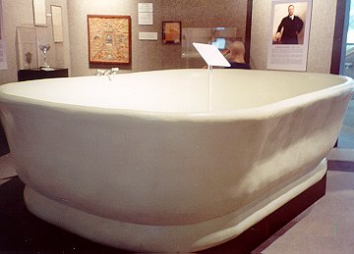
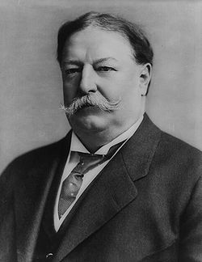
William Howard Taft & the “bathtub”

Slide 21
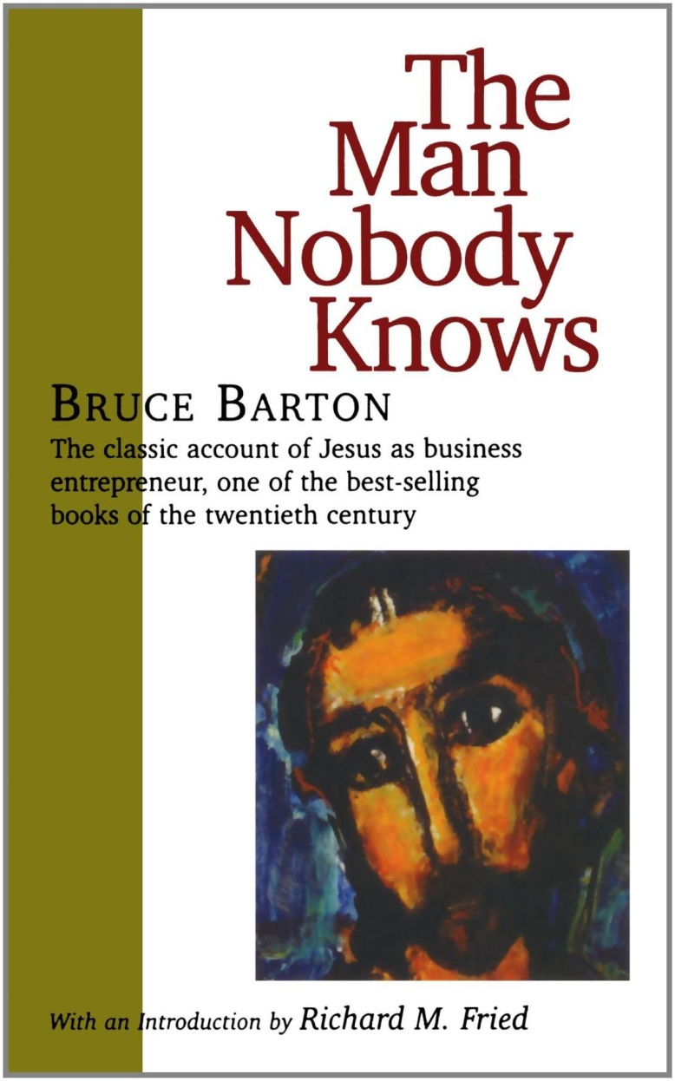
The “Roaring” Business Climate of the 20’s
WWI led to much disillusionment among many in the US and Europe => “Lost Generation” and loss of desire by many to reform society
Discuss Remarque passage => All Quiet on the Western Front
The ideology of the decade best portrayed in Bruce Barton’s The Man Nobody Knows => Jesus as world’s 1st “business” leader
“He picked 12 men from the bottom of society and forged them into a successful organization that conquered the world”
Preaching, healing, etc… are “departments in his organization”
Barton changed the way Americans looked at businessmen => business is seen as “noble” and businessmen as the “knights of America”
1928 list of most powerful Americans did not include the President!!

Slide 22
The “Roaring” Business Climate of the 20’s (Cont)
US had a booming economy during the period => WHY??
#1: US was a Creditor Nation – European nations owed US vast sums of $$$
US desired repayment of $16 Billion it had loaned => Euro nations refused to pay b/c they said they had fought the war while US watched
French/British sought to get their war debts paid by Germany via reparations ($32 billion) => Germany inflates currency (1924 loaf of bread costs $120 million!!)
US sought to solve problem via __________________(1924) => US backed system of loans
* Only Finland repaid US debt => contributed to US isolationism in 1930’s *
#2: US had no war destruction to deal with
In addition, US Congress passed Fordney-McCumber Tariff of 1922 which boosted tariffs to high ~38% rates => US prosperity kept in US
#3: US industrial Productivity increased 70% from 1922-1928 w/ new machines and productive processes
New economy was created by advent of the electric and gasoline age => largest new invention was automobile

Slide 24
The “Roaring” Business Climate of the 20’s (Cont)
#4: Rise of corporations => 1920’s was the age of large corporations and the creation of the US oligopoly
US Govt. reverted back to Laissez-Faire philosophy & Coolidge summed it all up w/ his famous saying “_________________________” => Anti-trust laws were often ignored and Presidents nominated businessmen like Andrew Mellon (3rd richest man in US) to run regulatory agencies
US Supreme Court killed child labor legislation and reversed Muller v. Oregon in Adkins v. Children’s Hospital
US Govt. very hostile towards Unions and ends 1922 Railway strike w/ Federal Troop injunction
Industries set up “Trade Associations” w/ the go-ahead from Federal Government that set prices, decreased competition and standardization
#5: Rise of American Advertising => National economy and entertainment industry allowed first real mass consumer culture in US history
“_________________________” became the new philosophy of the age => buying makes one happy, fulfilled and successful
Cos. made products quickly & sought markets fro them => persuasion, sexual appeal, guilt, etc…. used throughout the decade to sell
_______expanded rapidly as well => majority of Americans bought cars, electric appliances on credit (70% of these purchases made “on time”)

Slide 25
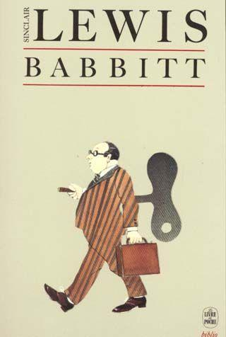
Sinclair Lewis, Babbitt (1922)
“Just as he was an Elk, a Booster, and a member of the Chamber of Commerce, just as the Priests of the Catholic Church determined his every religious belief and the senators who controlled the Republican Party decided in little smoky rooms in Washington what he should think about disarmament, the tariff and Germany, so did the large national advertisers fix the surface of his life, fix what he believed to be his individuality. These standard advertised wares – toothpastes, socks, tires, cameras, instantaneous water heaters – were his symbols and proofs of excellence; at first the signs, then the substitutes, for joy and passion and wisdom.”

Slide 26
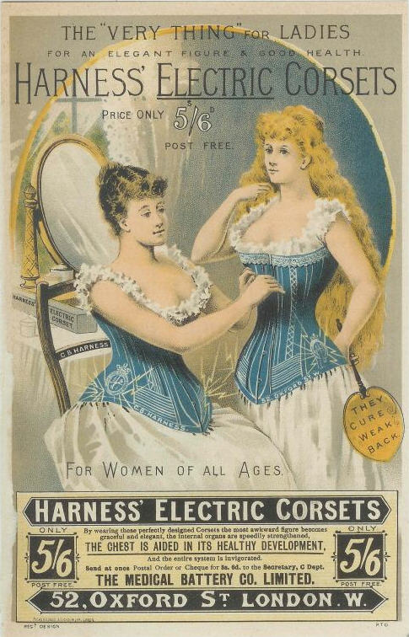
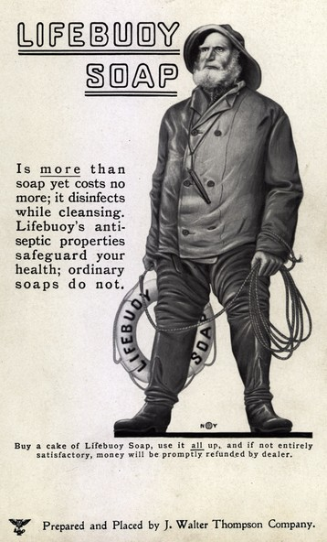
1920’s Advertisements

Slide 27
Henry Ford -- #1 Businessman of Era
Automobile was the #1 invention & product of the 1920’s => drove prosperity & a remaking of American landscape (roads vs RR; also drove aeroplane industry)
Personally Ford did not graduate high school and his 1st 2 companies failed => he was also an Anti-Semite
_______________________. revolutionized production methods in the 1920’s by utilizing the scientific management theories of Frederick Taylor (copied by others
#1: Interchangeable Parts => 1st introduced by Eli Whitney, Ford used this to make & repair cars efficiently w/ little waste
#2: Division of Labor => divides labor into pieces to improve efficiency (reduces skill)
#3: ___________________=> worker wastes no time and production never stops
1914 Ford introduces 1st modern assembly line that is motor powered
** Due his innovations, by 1930 ______% of US autos were Fords!!**
Ford also instituted what he called “Welfare Capitalism” at his factories
Believed that a well-paid worker was the best worker so he:
Prohibited Unions but paid workers ~$5/day
Employed ex-cons and mentally handicapped
Instituted 40 hr. workweek and better conditions
Union membership in 1920’s dec. by 30% due to this & Government measures

Slide 28
Model T Sales (by year)

Slide 29
1912 Ford Model T – Car came “in any color as long as it was black” – Henry Ford

Slide 30
Early 20th Century Economic Theory
By the early 20th century economics had emerged as a field of study and industrial economies sought to use ideas to promote growth
Dominant school of thought was the Classical (Conservative) => based on theories of Adam Smith in Wealth of Nations
Smith advocated Free Market Capitalism w/ little government intervention => ____________________
-- Believed that the “Invisible Hand” of market (people acting in self interests) worked best to regulate economy
Argued that economic flucuations were natural in economy
Other theorists (Karl Marx or Herbert Spencer) believed that govt. needed to be involved to regulate the abuses of unrestrained capitalists
Government would control or regulate certain essential industries (i.e. RR, water, sewer, automobile, telephone, etc..)
Socialist ideas and programs were popular in Europe by 1914 =>
-- Germany = social security
-- Britain = national healthcare & unemployment insurance
US feared socialist revolution and believed ideas to be counter to American identity => Hoover’s “______________________________”

Slide 31
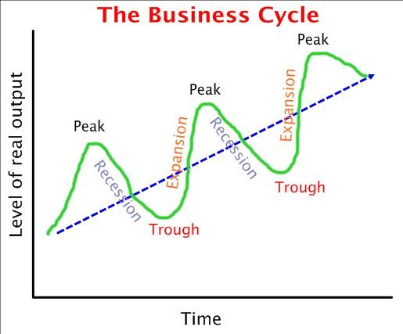
Business Cycles & Economic Flucuation

Slide 32
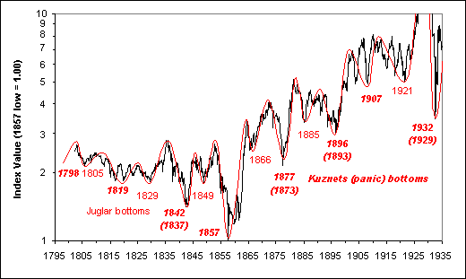
US Business Cycles of 19th and Early 20th century
In the late 1800’s and early 1900’s business cycle flucuations became increasingly severe and jagged => Farmers experienced a severe recession after WWI and the credit boom of the 1920’s led to a huge bubble

Slide 33
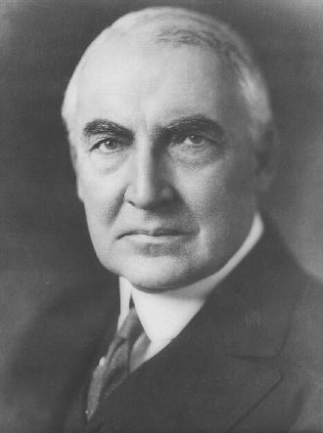
Republican Presidents of the 1920’s
The election of 1920 was a referendum on Progressivism & WWI
Democrats – James Cox
Republicans – Warren Harding
Slogan was “___________________”=> US tired of seeing what needed “fixed” in their society (i.e. Progressivism) & wanted to pivot from focus on WWI
Warren Harding was considered attractive and helped to attract the female vote (first election for women) => history of affairs
Had a decade long affair w/ Nan Britton => fathered a child

Slide 34
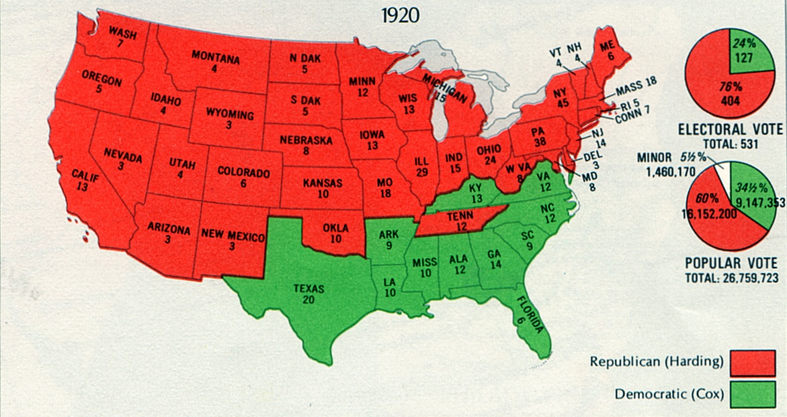
Election of 1920

Slide 35
Republican Presidents of the 1920’s
The Republican Presidents of the 1920’s endorsed and practiced a laissez faire focus on business => actions and policies
#1: Appointment of conservatives to Cabinet posts => Herbert Hoover as Secretary of Commerce (new position) & Andrew Mellon as Secretary of Treasury
-- Sided with business in labor disputes and ceased to enforce regulations
-- Coolidge said, “The Business of America is Business”
#2: Cut income taxes on wealthiest Americans from 73% to 25% => led to a concentration of wealth in top 1% (owned 43% of wealth)
#3: Harding’s Sup Court nominees overturned laws designed to regulate business and allowed application of anti-trust laws to unions
#4: Ford McCumber Tariff of 1922 set rates very high and protected American industries from foreign competition
However, Harding is most well known for scandal
Appointed some old poker buddies from Ohio like Albert Fall Sec. of Interior and Harry Daugherty as Att. General => Friends known as “_________________” b/c Harding would spend days in WH playing poker and drinking
Although short lived, Harding’s administration fell apart due to a series of Scandals:
#1: ____________________________=> Charles Forbes (Harding appointee) found guilty of selling govt. supplies for profit of over $200 Million!!
#2: ________________________________=> Sec. of Interior Fall leases govt. oil fields to private contractors for “bribes” of ~ $500,000!!
As scandals were coming to light Harding died of pnuemonia during a trip to tour West
Given a large and well attended funeral

Slide 36
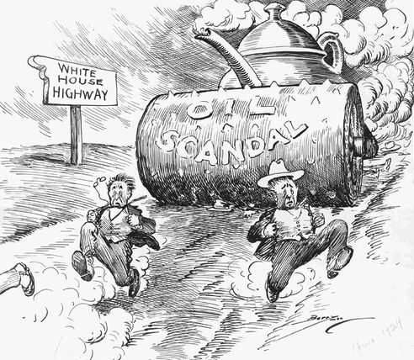
Teapot Dome Scandal

Slide 37
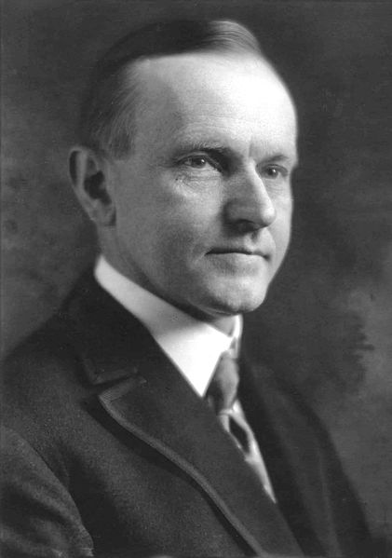
Calvin Coolidge (1923-1929)
After Harding’s many scandals US was looking for honesty in Presidency
Coolidge was the son of a Presbyterian Minister and was extremely honest, quiet, dry, shy and boring
Observers remarked that Coolidge looked as if he had been “weaned on a pickle” (Nickname was “__________”)
Coolidge was a very strict “__________” apostle and believed that, “the man who builds a factory builds a temple, the man who works there worships there”
Continued and amplified laissez faire policies => deregulated industries and encouraged credit purchases

Slide 38
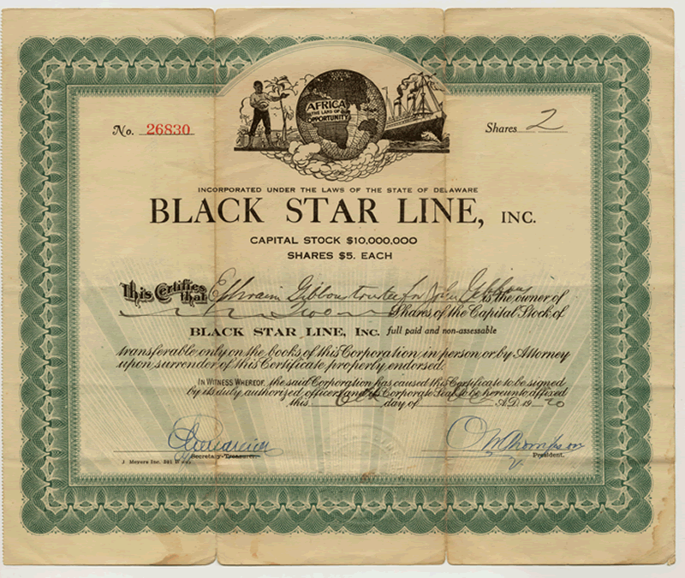
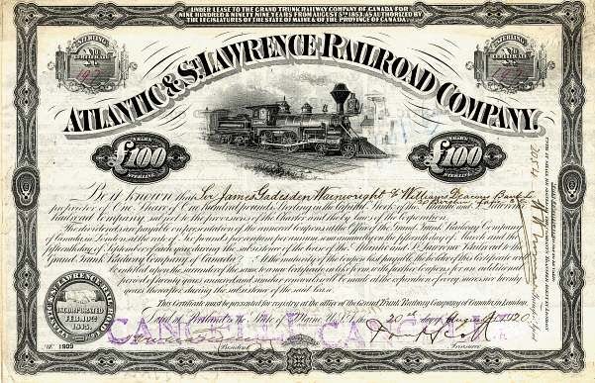
Stock Market Crash of 1929 – Black Tuesday
Much of the great boom of the 1920’s was due to the Stock Market => Q: What is a Stock?? Why buy stock??
1920’s credit policies extended to stocks (i.e.“________________”) => buying stocks on “loan” w/ ~5-10% deposit
By the summer of 1929 ~ $6 Billion in stocks bought on margin => creates huge “bubble” of inflated stock prices
Market crashes in October of 1929 & culminates in “_________________” => stocks lose 75% of values within 3 weeks!! ($40 B lost and panic ensues)
Due to margin loans, many banks go bankrupt and millions lose savings and faith in economy => restrict spending & cause further pain

Slide 39
Stock Market Crash of 1929

Slide 40
Causes of the Great Depression
What is a Depression?? =>
Why is the Depression of the 1930’s called the “Great” Depression??
-- 1929 = 23,000 businesses fail; Avg incomes falls from $2,300/yr. In 1929 to $1,600 in 1932; Unemployment rises from 5% in 1929 to 25% in 1932!!!
What made the depression of 1929 the Great Depression??
#1: Stock Market Crash => US lost confidence, destroyed savings & banking
#2: Depressed Farms and Industries => 1920’s hadn’t been good for farmers; dust storms and natural disasters destroyed Midwest
#3: Overproduction and Overconsumption => US industries produced too much in 1920’s w/ new machinery and too many credit purchases were made
Warehouses full of merchandise ready for consumption at time of crash
#4: Monetary Policy => Federal reserve new & did not understand $$ policy (expand in time of crisis); 1930’s => $$ too tightly controlled
#5: Decreased Foreign Trade => High ____________________________made things worse as US shut out Europe for no paying WWI debts

Slide 41
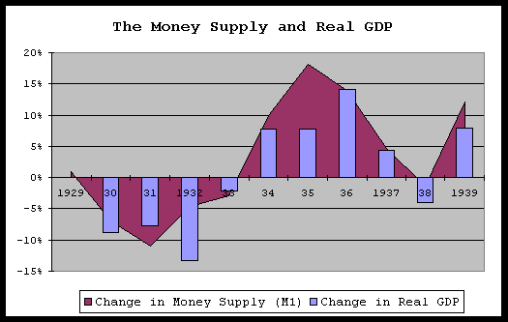
1930’s US $$ Supply

Slide 42
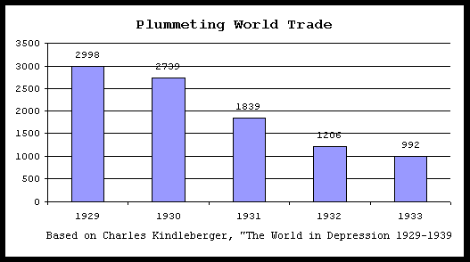
1930’s World Trade
Ironically, even though tariff rates rose by up to 50%, imports declined so sharply that tariff revenues fell 46% from $602 million in 1929 to $328 million in 1932. This not to mention the loss of tax revenue from the domestic unemployment the tariffs caused indirectly.

Slide 43
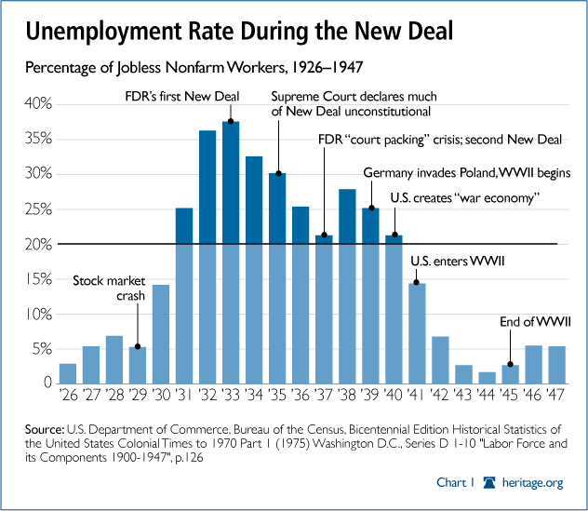
Unemployment During the Great Depression

Slide 44
Life During the Depression
Life during the Great Depression was very hard and crushing . . .
Rural Farmers
Farmers during the 1930’s were faced w/ a wide variety of problems
#1: Chronically low prices => 2nd decade; prices were so low many farmers let crops rot in field or dumped milk b/c it would cost more to sell it
#2: Dust Storms (“_______________________”) => 1000 + feet high => blocked RR lines, buries farm equipment/houses; kills animals, destroys soil
Caused by over-farming , de-forestation & drought in MW (“__________”)
#3: Bank Foreclosures => many farmers had borrowed against farm in tough years or to buy modern equipment and now 1000’s go bankrupt
Some retaliate w/ “Penny Auctions” where property is sold for a low price and then given back to families
Leads many to abandon Midwest => migrate to California (“_________”)
Urban Poor
1933 was the peak of unemployment => over _____% nationwide w/ reduced wages for others
“_________” hardest hit => Chicago = 50%; Cleveland =50%; Toledo = 80%
Former rich and middle class on streets selling apples, begging, homeless

Slide 45
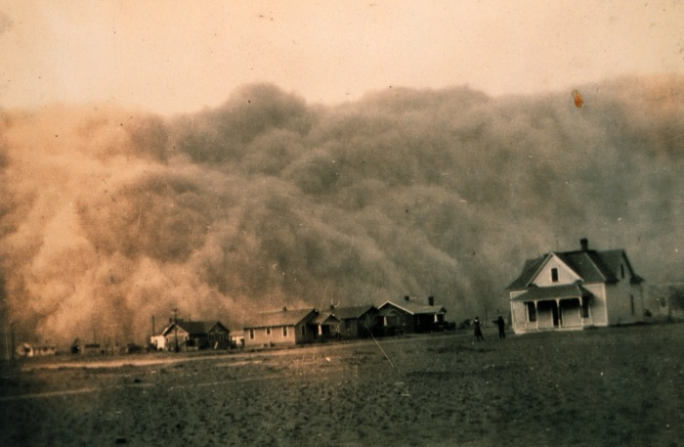
Black Blizzard in Kansas

Slide 46
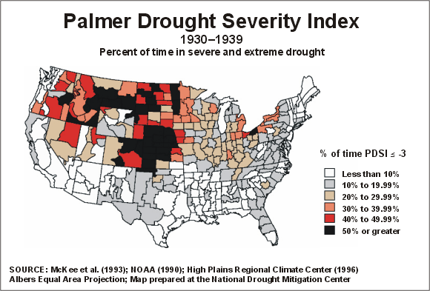
Dust Bowl in 1930’s

Slide 47
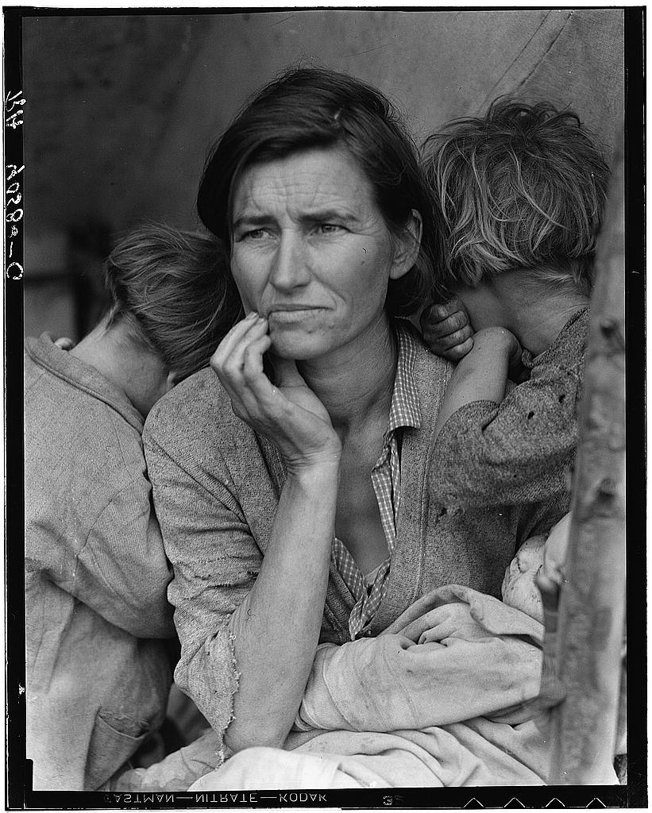
Migrant Mother by Dorothea Lange

Slide 48
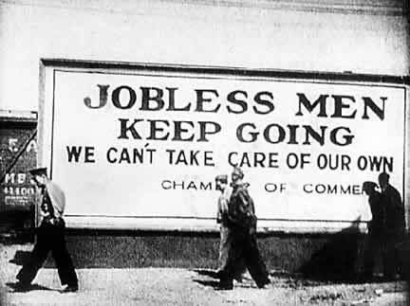
Life During the Depression (Cont)
“_____________________________” – home for those w/o a home
1932 2 M on road looking for work & 2 M living in “Hoovervilles”
People live in crates & boxes => settlements in cities 10 sq miles
People eat “turtle soup”; scraps; dog food; etc….
Family Life
Family roles change during the 1930’s as male employment decreases and women find it easier to get a job (i.e. telephone operator; laundry; etc…)
Overcrowding a major issue as families share apartments to pay rent
Victorian family model is stressed and men lose respect for themselves => many turn to odd jobs and wait for work each day or become___________

Slide 49
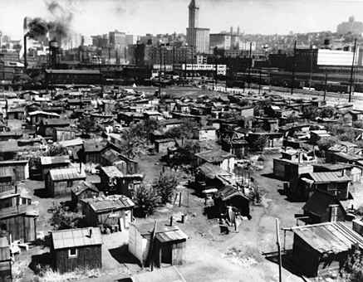
“Hooverville” in Seattle (1933)

Slide 50
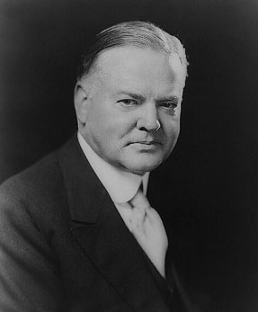
Herbert Hoover and the Great Depression
Hoover famous in 20’s for his humanitarian efforts during WWI in Belgium to feed starving millions
Hoover was an individualist who believed in the spirit of hard work and sacrifice
-- “____________________” => self made millionaire who believed in laissez faire ideas
Reactions to the Depression:
#1:______________ => “We have passed the worst & shall rapidly recover” (May 1930)
Hoover was very rich and seemed disconnected to suffering of avg. American
Believed in the capacity of US economy to recover & return to prosperity (laissez faire)
Thought “doles” and handouts would ruin the national spirit and prolong depression

Slide 51
Herbert Hoover (Cont)
#2: Voluntary and Local Action => Hoover called on firms to not fire workers & expand; encouraged local action to provide food & emergency housing
Hoover eventually did break down and established the Reconstruction Finance Corporation and secured ~$500 Million in funding
-- RFC, though, only loans $$ to banks, RR’s, Insurance Cos., etc…. to fix depression from top down (“Trickle Down Economics”)
* Signals the economic philosophy of Republican Party in the 20th century and beyond!!! *
#3: Lower Income Taxes => most Americans don’t pay them (mostly only rich do!!)
#4: “______________________________” => 20,000 WWI veterans marched on Washington in 1932 to secure early payment of their 1945 war bonus
Set up a camp outside of DC, which was very unsanitary and tried to intimidate Congress w/ presence => Congress votes bill down and they refuse to leave
Hoover orders federal troops to disperse them and they burn down shacks and employ tear gas => 11 month old baby killed due to tear gas exposure
Hoover becomes reviled in country and blamed for the Depression!!!
-- Ghettos and box cities called “Hoovervilles”; newspapers called “Hoover Blankets”; Pockets turned inside out called “Hoover Flags”

Slide 52
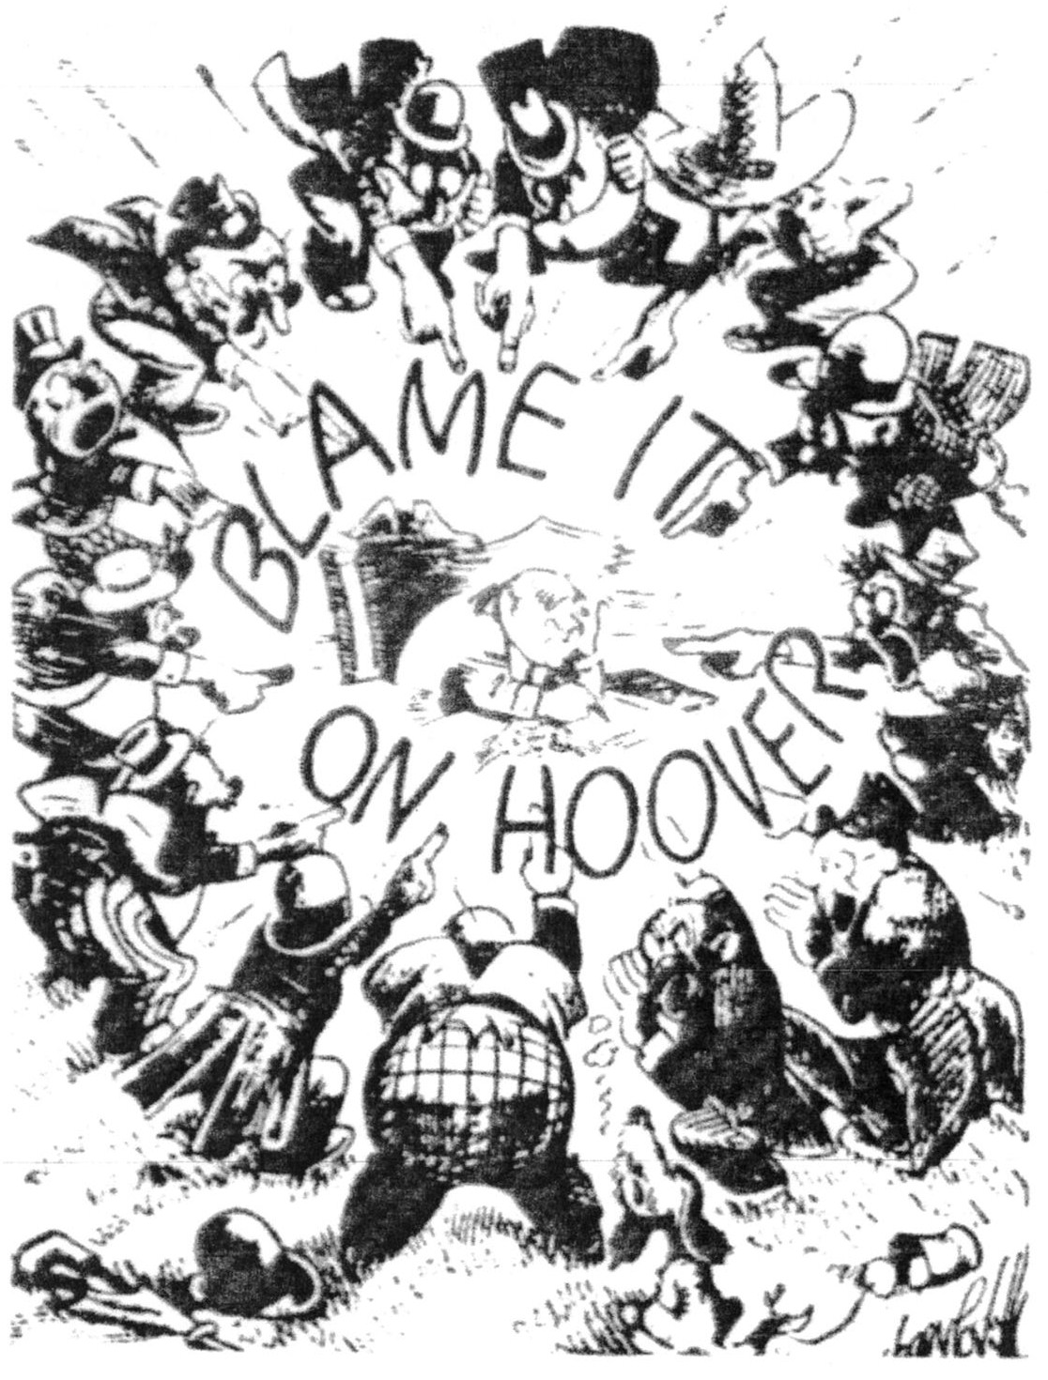
“Hooverisms”
-- "Hoover Blankets" were a blanket made from a newspaper
-- "Hoover Flags" were empty inside-out pants pockets
-- "Hoover Hogs" were jackrabbits fried over a fire
-- "Hoover wagons" were broke down automobiles pulled by mules

Slide 53
“Bonus Army” of 1932 Before Hoover After Hoover

Slide 54
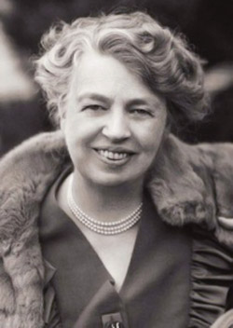
Franklin Delano Roosevelt (FDR) & the New Deal
FDR was born into a wealthy & aristocratic family
Married his distant cousin _______at age 23 –
FDR very politically experienced => 1913 – Asst. Secretary of Navy; 1920 – VP nomination; 1928 NY Governor
1920 FDR contracted Polio and was partially paralyzed from waist down => used a wheelchair & braces for rest of life (Never let photographers document this)
FDR’s wife Eleanor was an important political asset => kept Roosevelt’s name active
Took up # of causes => precedent for modern 1st ladies
Answered personal letters from public => result is that people feel connected to Roosevelt and that he cares for their suffering

Slide 55
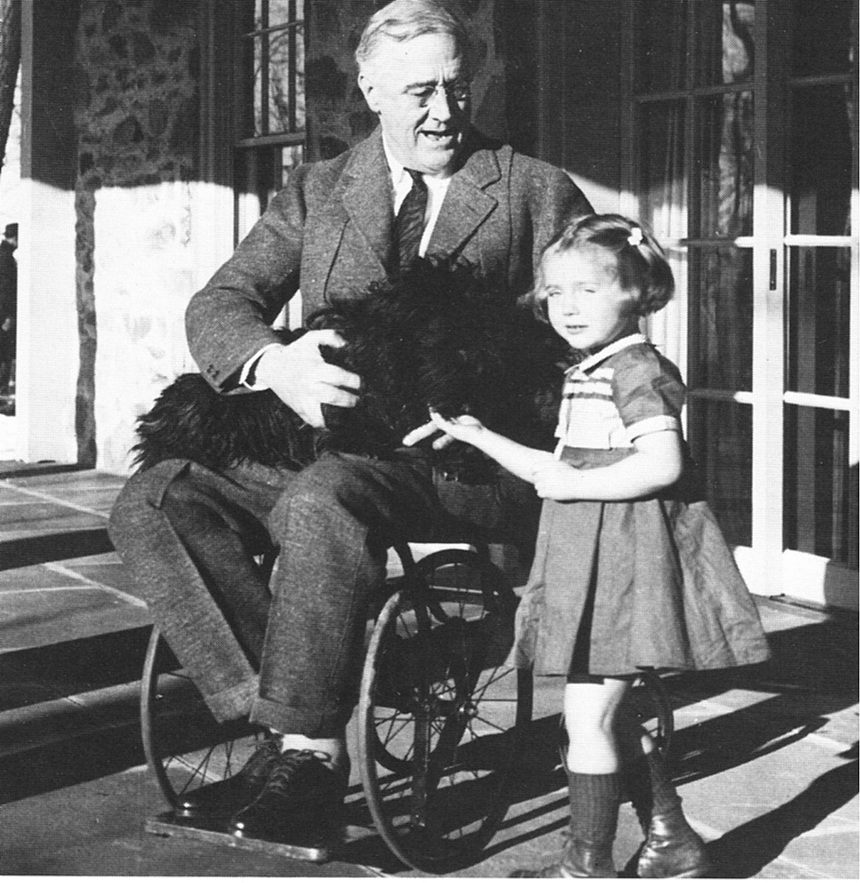
FDR in a Wheelchair on Campaign Trail

Slide 56
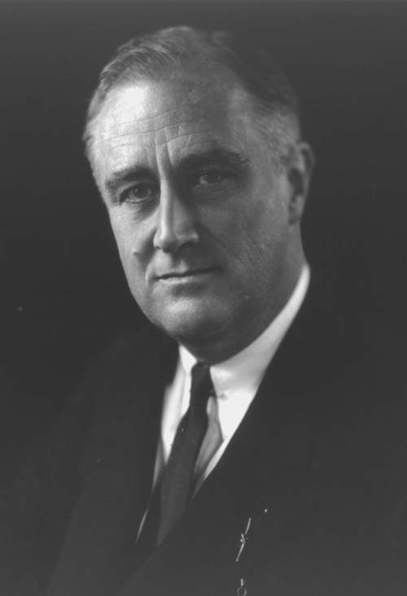
FDR and Election of 1932
FDR campaigned on a liberal platform to extend government assistance to the needy => New Deal
Represents a new __________________ that stresses government intervention during recession & depression
FDR election was a blowout! => Hoover won only 6 states (huge mandate for programs)
Roosevelt uses “_____________________” to improve communication & trust
Use radio to give addresses in a casual atmosphere to help calm public’s fears
-- “_________________________________”
Roosevelt embarks on his “__________” => passes New Deal to fix problems of Great Depression
More laws than any other 100 day period before => sets precedent

Slide 57
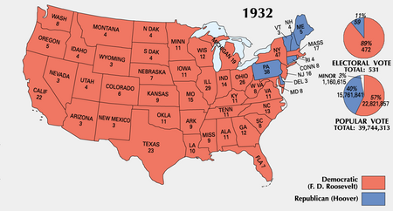
Election of 1932

Slide 58
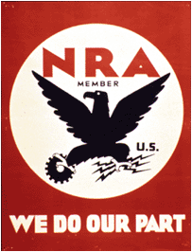
FDR and the “New Deal”
Roosevelt immediately implemented his New Deal => series of laws whose philosophy dated back to pre WWI Progressivism
New Deal was the laws but also the spirit of reform and social welfare behind them => passed by a large Democratic majority
New Deal was organized into Roosevelt’s “________”
#1: _____________=> Provide immediate aid to unemployed and suffering
#2: _____________ => stimulate economy and bring back prosperity
#3: _____________=> prevent future depressions and “fix” US economy
Often the laws passed ostensibly for one purpose actually fulfilled others (i.e. TVA)
Most laws necessitated the creation of government agencies “__________ ____________________” to administer their provisions

Slide 59
Relief, Recovery and Reform
FDR’s top priority was to alleviate suffering of millions of Americans
New Relief Agencies/Laws:
_______________________________(FERA) => over $3 billion for direct dole payments or work wages on government projects
Civilian Conservation Corps (CCC) => federal agency that employed 3M young men in outdoors work in reforestation, fire-fighting, swamp drainage, etc…
Agricultural Adjustment Act (AAA) and Homeowner Loan Corporation (HOLC) => made available millions of dollars to help farmers (and HOLC for non-farmers) pay mortgages and produce/buy food
=> Subsidizes production (fallow land to increase prices)
________________________(WPA) => $11B for jobs to build bridges, roads and also fund the Federal Writers Project (cultural studies and artistic funding)
New Recovery Agencies/Laws:
Elimination of gold standard (1933) => FDR eliminates payments in gold and orders all gold surrendered to govt. (inflate currency)
National Recovery Administration (NRA) => wages floors established and max hours were also established; child labor forbidden and labor allowed to organize into Unions (opposed by corporations)

Slide 60
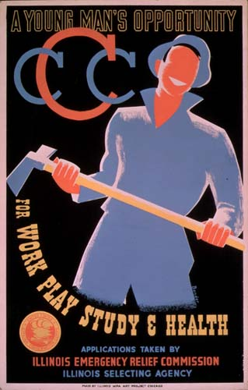
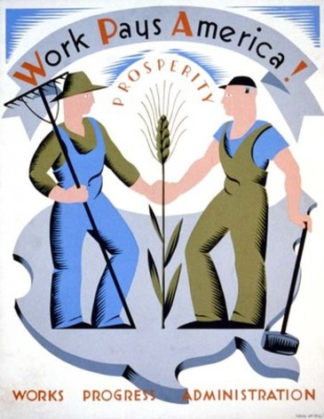
New Deal Advertisements

Slide 61
Relief, Recovery and Reform (Cont.)
Wagner Act (1935) => allowed workers to unionize (after repeal of NRA in 1935 by Supreme Court) and was very important milestone for Unions (led to creation of CIO Unions for unskilled auto and other workers)
New Reform Agencies/Laws:
__________________________(TVA) => dam construction and electrification in TV for poor and low income families/businesses (jobs and electricity)
Glass-Steagall Banking Reform Act => creates ________to insure bank deposits to up to $5,000 (end of lost bank deposits and bank failures)
______________________________(SEC) => federal agency that regulates stock trading to insure safe market conditions and prevent another “crash”
Indian Reorganization Act => allowed federal govt. to protect Indian lands from seizure and allowed Indian tribes self-government on their land
___________________=> provided for federal/state unemployment insurance, retired workers would receive payments from government also to aid elderly in times of need (one of most sweeping pieces of legislation ever passed!!)
Fair Labor Standards Act => established _________________________at $.25/hr and set a maximum work week of 44 hours

Slide 62
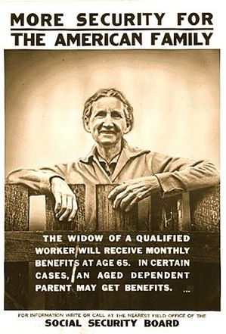
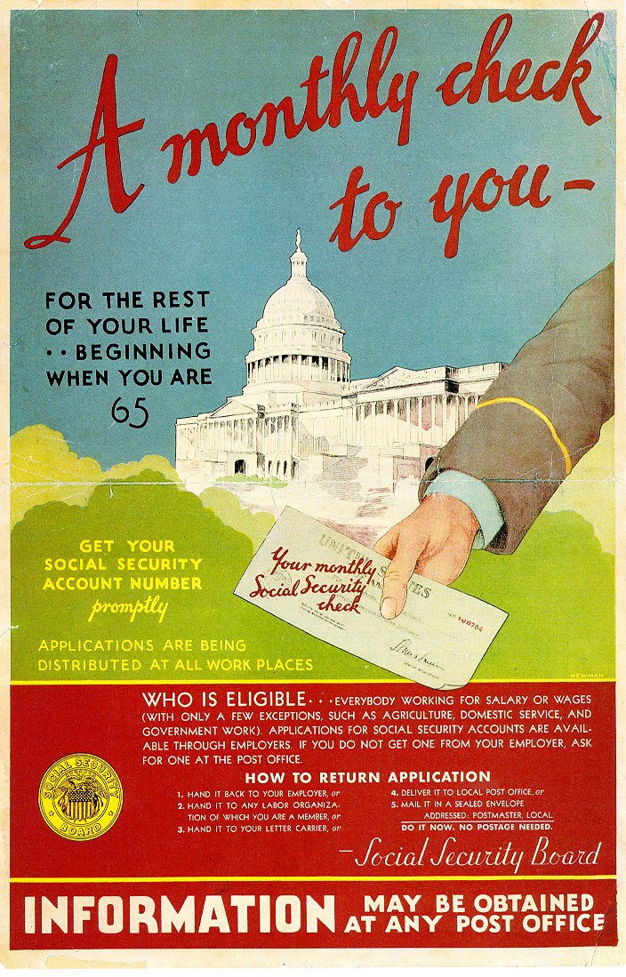
Social Security Act

Slide 63
New Deal Criticisms
Most in US supported the New Deal in principle => Democrats control Congress & Presidency in 1930’s, but some criticisms did arise
Some believed that the New Deal was not doing enough to solve Depression => unemployment still at ~15% in 1934
Others were fearful that the US was becoming a socialist or Fascist republic w/ Roosevelt in control
#1: Labor and Unions => NRA and Wagner Act allowed Unions to bargain collectively (over 1.5 M workers stage 1800 strikes in 1934!!)
Fear that US will be taken over by Union violence and competition
#2: Demagogues and Radicals => some believe New Deal not going far enough
LA senator _______________preaches “Wealth distribution” (all $$ over $5,000 made each year turned over to government and redistributed to public) and becomes immensely popular
Minister Father Coughlin blames depression on American Jews and says “social justice must prevail in US”
________________calls for $$ payments to elderly in the country who are suffering under the depression

Slide 64
1930’s “Demagogues” Father Coughlin Huey Long

Slide 65
New Deal Criticisms
#3: _____________________=> $$ conservatives form a group against the New Deal which they consider “Socialism”
Concerned the US is overspending and creating huge bureaucracy => Social Security Act, etc…..
Many wealthy consider FDR a “traitor” to his class => Was the New deal “socialist”??????
#4: Supreme Court => Ultraconservative court nominated in 1920’s shot down 7 New Deal agencies including NRA and AAA
Roosevelt attempts to “pack” the court w/ a new justice for each over 70 who wouldn’t retire => Q: Why do this???
Country reacts w/ alarm at Roosevelt trying to take away the “checks and balances” of Constitution
-- However, Supreme Court gets message and justices retire or start voting Roosevelt’s way (Roosevelt eventually appoints 9 justices!!)

Slide 66
King Franklin the First???

Slide 67
New Deal Evaluation
Was the New Deal positive for America in the Long Term?
Negatives:
Federal Govt. spending balloons under the New Deal => Keynesian Economics leads to large government debt and balanced budget not a priority
National Debt doubled to $40 billion by 1939!!
Creates many long term mandates that prove very expensive (i.e. Social Security)
Natl Government becomes single largest employer in country => huge govt bureaucracy
Many still unemployed & WWII buildup needed to solve all of Great Depression ills
Roosevelt tried to destroy (unwittingly) the checks/balances in Constitution => Court Packing Scandal of 1937
Positives:
Many national laws created to benefit Americans by providing a higher level of security=> i.e. Wagner Act; Minimum Wage; Social Security; FDIC
Govt. philosophy changed forever into a more activist Govt. that is responsible for each citizen’s well-being (i.e. managing economy w/ laws & reforms)
Indians, women, blacks given further rights and voice in New Deal Govt. (i.e. “Black Cabinet”; Women’s new posts and Indian Reorganization Act)
Leads to LT political reorganization => Democratic Party appeals to working class, immigrants & African Americans

Slide 68
Federal Government Spending as a percentage of GDP

Slide 69
Federal Government Debt in US History

Slide 70
Social Security – Ratio of Workers to benficiaries

Slide 71
Election of 1928
Q: Where is the Democratic Party strongest?

Slide 72
Election of 1936

Slide 73
Election of 1948

Slide 74
Election of 1964

Slide 75
1920’s Cultural Developments => Roaring 20’s
1920’s cultural developments led to changes=> shift to a modern society dominated by a national culture, but tension developed between modern & traditional values
New 1920’s Society
#1: Rise of Middle Class
New economy led to incr. standards of living and more “______________________”
Products cost less & new “_____________” allowed nationalization & inc.competition
#2: “Consumerism” and Credit
Old Puritanical values of thrift and moderation were shunned as “old fashioned”
New society encouraged consumerism and pushed credit buying => 70% of new “modern” (i.e. toasters, vacuums, refrigerators, radios, etc..) were bought on credit!
New items begin to be seen as “necessities” => i.e. cars = freedom/independence
#3: Rise of Youth Culture
1920’s saw the development of a large “Generation Gap” => related some say to school attendance (1890 = 6% of US youth in HS; 1930 = 51%)
** States required school attendance until a certain age & passed child labor laws **
Youth Fashion also developed => “____________” (flat chested, loose blouse, low waist, short hair w/make-up) and “_____________” (baggy pants) were symbols of rebellion
-- Young girls also began smoking, marrying older and engaging in sexual activity
-- Sigmund Freud contributed to this w/ publication of his work that suggested sexual repression led to many nervous and societal ills

Slide 76
1920’s Chain Stores

Slide 77
1920’s Youth

Slide 78
New 1920’s Appliances

Slide 79
US Divorce Rate in 20th Century

Slide 80
1920’s Popular Culture
Rise of Youth and Consumer culture also led to the rise of US entertainment industry => by 1930’s entertainment is #3 industry in US !!
Music
Marconi’s wireless telegraphy (_________) was used in WWI to send messages on battlefield and in 1920’s first long range communications were possible
Radios made a ___________________possible w/ programs, news, familial gatherings, advertising all centered around it
-- Main stream US culture created (vs regional ethnic cultures)
Changed entertainment, corporate sponsorship, politics (Fireside Chats)
New music of the age was __________(supported by Al Capone) and Blues => sounds which were modeled after cities & other aspects of culture
Famous singers were minorities like Bessie Smith & King Oliver => most famous dance was __________ (seemed very “sexual” to older generations)
Songs were also recorded and marketed to youth who played them on phonographs => new technologies were a shock to older generations
Film
1920’s Americans went to movies ~ once a week!! ($.10/show)
1st feature length films were called “_____________” => cost a nickel to watch
“Great Train Robbery” and others told simple stories

Slide 81
1st full length classic was “Birth of a Nation” (D.W. Griffith) which showed a sympathetic view of KKK and portrayed Reconstruction badly
Hollywood, w/ fantastic weather, became film capital and industry took off during WWI when it produced propaganda films for Govt.
“ The Jazz Singer” (Al Jolson) changed films by adding sound => movie stars such as ___________and _________________were idolized by teens

Slide 82
1920’s Popular Culture (Cont)
Architecture
Celebrated the newfound technology available (steel buildings) by creating masterpieces of moderninity => Frank Lloyd Wright utilized city planning and age of skyscraper was ushered in in American minds w/ Empire State Building

Slide 83
Sinclair Lewis, Babbitt (1922)
“Just as he was an Elk, a Booster, and a member of the Chamber of Commerce, just as the Priests of the Catholic Church determined his every religious belief and the senators who controlled the Republican Party decided in little smoky rooms in Washington what he should think about disarmament, the tariff and Germany, so did the large national advertisers fix the surface of his life, fix what he believed to be his individuality. These standard advertised wares – toothpastes, socks, tires, cameras, instantaneous water heaters – were his symbols and proofs of excellence; at first the signs, then the substitutes, for joy and passion and wisdom.”

Slide 84
1920’s Architecture

Slide 85
1920’s Society – Tension between Modern & Traditional Edward Hopper – Automat

Slide 86
1920’s Society – Tension between Modern & Traditional John Sloan – 6th Avenue Elevated

Slide 87
“Heroes” of the 1920’s
1920’s sought to glorify the “new society” by raising up “new” role models that utilized or exemplified new consumer culture and youthfulness
Sports increase in popularity due to 1) National culture created by radio & cars 2) Increased leisure time due to mechanization 3) Increased income
New Heroes were symbols of new societal attitudes and models of success => also National and thus contribute to nationalization trend
Clara Bow => “ultimate Flapper”; dressed provacatively, star of many films; smoked; successful modern women who was free of marriage
Babe Ruth => Yankees baseball star; raised as an orphan and rose to fame; successful & lived a wild life by utilizing modern technology (i.e. cars, etc..)
Jack Dempsey => professional boxer and heavyweight champion; defeated many foreign rivals and symbolized America’s fascination w/ violence
Charles Lindbergh => 1st to fly across the Atlantic; “American Idol” of 1920’s; loved by all b/c he used modern technology but adhered to traditional values
Sports stars were more well known than leaders and heralded the shift to a culture focused on entertainment (#3 industry in US during the 1920’s)

Slide 88
1920’s Heroes

Slide 89
1920’s Heroes

Slide 90
Cultural Conflict – clash of traditional & modern
Many Traditionalists were appalled at credit buying, young “flappers, jazz music
-- Attempted to institute measures to stem the advance of modernism
Prohibition
Prohibition had been enacted steadily for decades as more and more rural states and localities became “dry” => over 50% of population lived dry by 1920
The Progressive Era helped the crusade and women’s groups, now gaining the right to vote, were the true catalysts
In 1919 the __________________________was ratified and Congress later passed the Volstead Act to enforce the law => “no person shall manufacture, sell, barter, transport, import, export, deliver, furnish or possess any intoxicating liquor except as authorized by this act.”
Law popular among the traditional areas of US => Where????
What led to rampant disregard for the law???
#1: Disillusionment post WWI about Progressivism and self-denial
#2: Attitude among soldiers that this was not “their law”
#3: Poor enforcement of law by underpaid agents who were too few in #’s
#4: Hypocrisy among leaders and rich => i.e. Harding, Congressional leaders
#5: Lack of regard for law by youth & modern generation

Slide 91
Per Capita Consumption of Alcoholic Beverages (Gallons of Pure Alcohol) 1910-1929

Slide 92
Prohibition Era Lawlessness & Bootlegging
Organized criminal activity rose up to a monstrous scale in the 1920’s to supply the alcohol so many wanted
_______________________________________became methods of acquiring alcohol and these places, unlike the saloon, were open to women
Gang Wars in such locales as Chicago (rum-running capital of the US due to it’s proximity to Canada) resulted in hundreds of deaths
Gangsters often not convicted due to deaths, bribes, and lack of evidence
__________________emerged as the supreme mobster of the US => appeared in public as an upstanding citizen who “owned” Chicago w/ illicit payoffs
Brought in $$ Billions during his ~ 8 year reign; By 1930 the underworld “take” was ~ $15 B; many times the Government’s income
Capone expanded activities to include narcotics, prostitution & gambling
Repeal of Prohibition => WHY??
#1: By 1930 after the _______________many believed Prohibition was a failure
#2: Increased lawlessness instead of decreasing it (i.e. _________________ _____________in 1929 where Capone’s men killed 7 members of a gang)
#3: _________________could raise $$ for government and help pay for relief

Slide 93
St. Valentine’s Day Massacre -- 1929

Slide 94
“Scarface” Al Capone

Slide 95
Scopes Monkey Trial – Science vs Religion
1920’s High School education becoming more prevalent w/ ~30% of Americans graduating from HS
Many schools began teaching science and focused on Darwin’s Theory of Evolution => 3 Southern States passed laws prohibiting this teaching on the ground that it eroded moral values
John Scopes challenged the ________(TN Law) in his classroom & was aided in his defense by numerous NY attorneys, including well known Clarence Darrow
William Jennings Bryan testified as a “Bible Expert” for the defense and was made to look like a fool by Darrow
Scopes was found guilty (9 mins) and fined $100 => effect of the trial was to increase ___________________________appeal to it’s bedrock communities but also to cast some doubt on it’s relevance in scientific age
Butler Act remained a law in Tennessee until 1967

Slide 97
The Bible Belt
The Bible Belt contains the highest percentage of religious adherents per capita in the US => #1 religious denomination?

Slide 98
Variety in Cultural Expression in the Early 20th Century
Literature
New mass market magazines like Reader’s Digest, New Yorker, Time all began during this time period => reinforced national culture
Many major literature movements were a reaction against mainstream culture of the 1920’s (i.e. consumerism and materialism)
#1: _______________________featured writers like Langston Hughes who wrote about African pride and unique culture (precursor to rap music)
Music included Jazz and Blues (based on Christian spirituals and African musical patterns); also included poetry, literature and artwork
Spawned political movement of _____________which focused on black nationalism & pride => “Back to Africa” movement (Black Star Line)
** Coincides with the division of American cities on ethnic lines by 1930**
#2: “_______________” => writers such as F. Scott Fitzgerald (__________), Sinclair Lewis (Babbitt) &Ernest Hemingway (“A Farewell to Arms”)
Reaction against the materialistic and consumerist culture that they viewed as hollow and empty (Post WWI sacrifices)

Slide 99
The Cotton Club
The Cotton Club was a white only establishment operated by NYC gangsters in the 1920’s in Harlem => it featured many of the most prominent jazz & blues musicians (Duke Ellington, Louis Armstrong, Billie Holliday), as well as prominent poets like Langston Hughes

Slide 100
Major Figures of the Harlem Renaissance

Slide 101
Harlem Renaissance Art

Slide 102
Back to Africa Movement

Slide 103
Variety in Cultural Expression in the Early 20th Century
Theater => Yiddish theater
Imported from Eastern Europe during the late 1880’s (often due to persecution in Russian pogroms) Yiddish theatre was immensely popular
Featured plays performed in ________________(traditional Jewish language) in NYC (2nd Street) and other American cities
-- By 1940 there were over 200 companies in US (22 in NYC alone)
Height was in the 1920’s when immigration and cultural flowering provided large audiences that rivaled Broadway
Many plays were adaptations, but many were original & included theme of Jewish cultural experience => assimilation, immigration & poverty

Slide 104
Early 20th Century American Immigration
America emerged in the 1920’s, after WWI, as one of the world’s great powers => very disillusioned by WWI & Versailles Conference
Post WWI Americans retreated behind Atlantic & Pacific Oceans => engaged in isolationism, especially from Euro affairs (Q: Precedent for this???)
Isolationism had huge impact on immigration policies
-- Immigration to US from Europe had spiked in early 20th century => 15M new immigrants came from 1900 to 1920 (foreign born percentage ~15%)
-- Immigration increased due to US policies, job opportunities &WWI dislocations and disillusionment
HOW??
#1: Xenophobic reactions
_________________________________=> Americans fearful of Soviet Communism & the Bolshevik Revolution (1918)
Americans viewed immigrants from S & E Europe as communists, socialists & anarchists => revolutionaries who were violent & “Anti-american”
Small American Communist Party was blamed for labor unrest in 1919 & anarchists immigrants blamed for bombing of Att General Palmer’s house
Led to deportation of “Reds” in society and govt. positions in 1919-20 by Att. General Mitchell Palmer => illegally rounded up and deported
Businessmen used Scare to undermine Unions & it culminated in the Trial & execution of _______________________________________in 1921

Slide 105
US Immigration during late 19th & Early 20th centuries

Slide 106
Foreign Born Population in the US

Slide 107
Sacco & Vanzetti Trial -- 1921

Slide 108
Early 20th Century American Immigration
KKK resurgence (1920-1924)
____________cast a wider net than the 1st => anti-modern (i.e. bootlegger), anti-immigrant (esp. Catholics) and anti-minority (i.e. blacks, Jews)
-- Used ideas of Social Darwinism to assert Anglo-Saxon superiority
Spread rapidly in the Midwest and “Bible Belt” and had 5M + members in 1924 (very politically powerful!!) => seen as more socially acceptable
Movement fell apart in 1925 when prominent KKK leaders like David Stephenson were jailed for rape and murder
-- US Govt. also prosecuted KKK on income tax evasion

Slide 109
Early 20th Century American Immigration
#2: Restrictive Government Policies
Due to fears, US government enacted strict immigration quotas =>_____ _________________________________
Immigration Act of 1924 (National Origins Act) set up a _____________for immigration based on the % of a nationality’s population in the US in 1890 (outlawed Japanese immigration)
Favored immigrants from N. Europe and Latin America
-- Mexican and Latin American immigration was unrestricted at this time in order to guarantee a supply of cheap labor => utilized on farms in SW and industrial jobs
Extremely restrictive to ____________________________=> severely reduced numbers
Ended an era of open immigration in US history and led to a massive decline in immigration until in 1931 more foreigners left than arrived!!

Slide 111
Early 20th Century Migrations
From 1900 to 1945 the US experienced an unparraled amount of internal migration related to historical events (i.e. WWI & II; Great Depression)
Sheer amount of migration (ex: up to 25% of total population during WWII) and its character made it very consequential
#1: ___________________________
Migration of African Americans out of the South starting in WWI => extended from 1915 to 1960 due to various events
Involved over _______blacks during time period
Moved in two basic waves =>
-- 1st wave (1915 to 1940) was to N. cities (i.e. Chicago, NYC, Detroit)
-- 2nd wave was westward to Pacific cities (i.e. San Diego, LA, Seattle)
Reasons => racial discrimination in South (2nd KKK; segregation) and new job opportunities in North (escape sharecropping); lack of immigration
-- Mechanical cotton picker (1942) led to less need for labor in South
Results? => remade racial character of many Northern cities; made race relations more of a national issue
-- By 1970 half of all blacks lived outside the South => blacks population becomes increasingly urban

Slide 112
Great Migration – 1915 to 1960

Slide 113
Early 20th Century Migrations
#2: ________________and ____________Migration (1930’s)
Migration of mid-western farmers westward during the years of drought and depression in the Great Plains (i.e. KS, CO, OK, NB, TX)
Involved millions of farmers in multiple waves from 1932 to 1939
Reasons? => severe drought and Dust storms decimated land
-- Moved to ________________due to belief in economic opportunities => exploited by Cali landowners due to glut of labor
Results? => increasing corporate farming of Midwest after WWII, huge increase in population of California
-- Migrants met with xenophobia due to lack of jobs and land during Great Depression
#3: _______________Internal Migrations (1940’s)
Migration of up to _____% of US population around the country (westward, southward and urban areas) for job opportunities in defense industry
WWII mobilization of over 15M men left millions of jobs open in urban areas and defense industries => located primarily in South & West Coast

Slide 114
Migrant Mother by Dorothea Lange

Slide 115
Black Blizzard in Kansas

Slide 116
Dust Bowl in 1930’s

Slide 117
Okies and Dust Bowl Migrations

Slide 118
Okie xenophobia

Slide 119
Early 20th Century Migrations
Reasons? => new job opportunities in defense plants
-- FDR located these along West Coast (i.e. San Diego) and in the South (i.e. Houston, Dallas, Memphis) => Q: WHY????
Results?
“__________________” => cities where wartime factories led to large increases in population (i.e. San Diego; 400% growth)
-- Leads to racial tensions as new migrants (blacks and Mexicans) clashed w/ established residents =>__________________________
Boom in Southern industry => govt contracts ($6B +) jumpstarted Southern industrial pursuits
Increasing employment for women => “____________________”
-- Q: Result after wartime?
Movement of Natives away from reservations => in 1940 90% of natives lived on reservations & by 1980 only 50% did
** Effect of all Migrations is to accelerate urbanization in US => new job opportunities located in urban centers **

Slide 120
WWII Migrations

Slide 121
Zoot Suits of the 1940’s

Slide 122
Zoot Suit Riots – June 1943 (LA)
Riots started over a supposed fight between sailors and Hispanic youths – but escalated into days of violence involving thousands. Of the 9 servicemen arrested, only 1 was convicted and ordered to pay a $25 fine
An eyewitness to the attacks, journalist Carey McWilliams, described the scene as follows:
Marching through the streets of downtown Los Angeles, a mob of several thousand soldiers, sailors, and civilians, proceeded to beat up every zoot suiter they could find. Pushing its way into the important motion picture theaters, the mob ordered the management to turn on the house lights and then ran up and down the aisles dragging Mexicans out of their seats. Streetcars were halted while Mexicans, and some Filipinos and Negroes, were jerked out of their seats, pushed into the streets and beaten with a sadistic frenzy.

Slide 123
US Rural vs Urban Population

Slide 124
Early 20th Century Migrations
#4: Mexican Americans
During the 1930’s and 40’s Mexicans faced ambivalent US government policies concerning migration and immigration
During the late Great Depression (i.e. 1935-39) Mexican Americans in the SW were repatriated (i.e. forced or encouraged to leave)
-- Total of 2M were forced to leave (60% US citizens)
-- Repatriations were due to Great Depression joblessness
However, a few years later under the________________, Mexican farm workers were allowed to migrate temporarily to the SW & California
-- Led to over 4.5 M workers receiving bracero exemptions => Creation of a __________________________________but NO CITIZENSHIP
-- Harvest crops during WWII labor shortages => extended until 1964

Slide 125
Bracero Program – 1942 to 1962

Slide 126
Japanese American Internment camps
Interment Camps were located in the most hospitable land => extreme cold and warm temperatures (cheapest for government to purchase)

Slide 127
Early 20th Century Expansionism -- Reasons
What is Imperialism??
The economic, political and social domination of a weaker nation by a more powerful one (usually by means of military force)
Why did the United States become Imperialistic in the late 19th century?
#1: Commercial/Business Interests => US industry continued to boom & needed raw materials; periodically overproduction caused depressions
Many business leaders felt that expansion could solve problems
#2: Military/Strategic Interests => US desired to become a sea power by expanding naval presence and trade relationships
CPT Alfred Mahan’s study of world powers Influence of Sea Power upon World History, argued at the time that Naval Power = world power
-- US wanted coaling stations in Pacific & canal linking Oceans
#3: Religious/Missionary Interests => missionaries and many Europeans saw Imperialism as “_____________________________”
Bring civilization (i.e. White Anglo-Saxon Protestant culture) to the non white peoples of the world
Many Social Darwinists also believed that it was America’s “destiny” as a superior race to dominate the earth
#4: Closing of the American Frontier => Turner Thesis argued that the frontier was
“closed” by 1890 and Americans needed a “new frontier” for idealistic reasons
and also to serve as a “safety valve”
“March of the Flag” ideology => America’s next frontier

Slide 128
“White Man’s Burden” in advertising (ca 1900)

Slide 129
Early US Imperialism (1867-1895)
US desire for colonial possessions was also influenced by Europe’s desire and the “Grab” for empire among European Nations at the end of the 19th century
-- Europeans divided Africa among themselves, SE Asia and other areas
US Empire was “Informal” (i.e. did not require direct military control); the British Empire was “Direct” => required vast administrative costs & military
Hawaiian Islands => US orgs. established missions in 1820’s; Us expanded presence in 1887 w/ a US Naval station
1893 revolt by w sugar planters overthrows the native government in an effort to circumvent the McKinley tariff (US refuses to annex until 1898)
** American appetites are whetted for further expansion!! **
There was much opposition to the US quest for Imperialism that grew with each Imperialistic action that the US took though . . .
_________________________was created in 1899 to oppose Phillipine Annexation => included Mark Twain, Samuel Gompers & Andrew Carnegie -- Argue that Imperialist policy is geared toward special interest groups, is “Un-American” and will imperil American values by “diluting” citizenship

Slide 130
Spanish American War (1898)
Cuba had repeatedly attempted to gain independence from Spain
1895 they revolted against the Spanish again and US Newspapers wrote about the war in “_________________________” style
-- Hearst says to his staff photographers, ‘You furnish the pictures, I’ll furnish the war”
US has a lot of property & trade invested in Cuba, as well as citizens there
Sends Battleship ___________to Havanna to provide aid to Americans
Spanish foreign writes a very insulting letter about McKinley to friends and a few days later the USS Maine suddenly blows up, killing 260 US sailors!!
1976 commission concluded that explosion caused by boiler explosion, but Americans of the day blamed Spanish mines
-- “Remember the Maine, to hell w/ Spain”
McKinley, after much deliberation and division w/in the Republican party asks for a declaration of War and gets it
Congress also passes the Teller Amendment, which promises Cuba freedom after the war

Slide 131
Late 1800’s Yellow Journalism
Yellow Journalism, or sensationalism became very popular at the end of the 19th and early 20th century in newspapers published by Hearst and Pulitzer => contributed to outbreak of Spanish American War

Slide 132
Spanish-American War (Cont)
War lasted only 113 days and was a resounding American victory, although many Europeans felt that the US would lose (increases US prestige)
Caribbean Theater => Americans easily conquered Spanish naval and land forces;
Teddy Roosevelt and “Rough Riders” gain acclaim
American forces unprepared for a tropical war and many die of disease and heatstroke (400 battle deaths; 5,000 disease deaths!!)
Pacific Theater => Adm. Dewey destroys the entire Spanish fleet w/o loss of life &
captures Manila => restores revolutionary leader Emilio Aguinaldo to the island
Peace Treaty signed w/ Spain
#1: US annexes Philippines and pays Spain $20 Million for it
US occupation causes the _______________=> leads to atrocity & another broken US promise before Philippines is granted independence in 1946
-- US commits many atrocities and establishes “Reconcentration Camps” => 600,000 Filipinos die
#2: US annexes _____________& imposes the Platt Amendment on Cuba
Gives US a naval base, veto power over Cuban foreign policy and right to intervene in Cuban internal affairs
War signals America’s arrival as a “world power” in the eyes of Europeans

Slide 133
US Imperialist Actions (1890-1920)

Slide 134
America on the World Stage (1900-1910)
After their territorial acquisitions US begins to take a more aggressive stance in Foreign Affairs and interactions, especially in the Caribbean and Asia . . .
#1: “________________________” => Sec. of State John Hay responds to attempts of European powers to colonize China with Open Door Policy
China open to “fair competition” => i.e. no colonies
#2: ______________________=> US wanted canal for decades to negate “Two Ocean Navy” and after Spanish-American War wanted it even more!!
After Columbia negotiates, then demands more $$ for a canal zone, TR sends in US Naval forces to aid a Panamanian Revolution
-- Negotiate the canal from Panama instead!! (Total price of Canal was $400 Million and thousands of American lives!)
#3: Roosevelt Corollary and “______________________” => TR’s foreign policy mantra was “Speak Softly and Carry a Big Stick”
Roosevelt said that only the US could intervene in Latin American affairs (i.e. debt collection) => Started the 20th century “Bad Neighbor” Policy
-- US has sent troops and established military bases US in dozen + Latin American countries in the next 100 years!!
Ex: US intervention in _________________(1910-1918) => attempted to protect US business interests & promote US backed leaders (Diaz vs Huerta)
-- By 1900 US companies and individuals owned 27% of Mexican land
-- US sent troops into Mexico 3 times => hunt Pancho Villa for 11 months

Slide 135
US Open Door Policy in China

Slide 136
Panama Canal -- 1908

Slide 137
The Big Stick in the Carribean (1905)

Slide 138
America on the World Stage (1900-1910)
#4: Roosevelt brought in in 1906 to negotiate peace treaty between Russia and Japan => is successful and earns 1906 Nobel Peace Prize
#5: To project American Naval power in the Pacific after the Spanish American War Roosevelt also sends out the “_______________________”
Fleet of modern American ships that sail around the world, stopping at key countries

Slide 139
America on the World Stage (1900-1910)
#6: “________________________” – use American Government loans and investment to ‘control’ central American nations (prop up Govts)
US constantly intervened in domestic political affairs of nations “to protect American business interests” => Nicaragua in 1912 (10 year occupation)

Slide 140
Isolationism vs Interventionism??
What is Isolationism? Interventionism?
Isolationism => disconnection from world affairs by refusing to enter alliances, foreign economic commitments and international agreements, usually for the purpose of domestic focus
Interventionism => proactive use of military, economic or political involvement in world affairs to attempt and influence the outcome or course of events
Throughout US History from 1776 to 1900 what had been US foreign policy? Why? Examples?
Examples =? _____________________________________________
____________________________________________________________
____________________________________________________________

Slide 141
World War I
How did the War start?
#1: Alliance System – European nations involved in a
system of defensive “alliances”
Allied Powers (i.e._______________________ ________________________, etc..)
Central Powers (i.e.____________________ _________________________, etc..)
#2: Assasination of Archduke_______________– heir to
Austrian-Hungarian throne was killed in Serbia to
forward cause of Serbian Nationalism
Ignited powderkeg of alliance system
#3: Imperialism – European nations controlled large empires & believed they could gain more land and colonies w/ a short fight (i.e. Germany)
#4: Militarism – European nations had vast militaries and many countries believed themselves superior

Slide 142
World War I – Map of Countries

Slide 143
The German Schlieffen Plan

Slide 144
US Neutrality & Intervention
For the first 3 ½ years of war US remained neutral => Q: WHY???
#1: US citizens and leaders viewed WWI as a European affair => Precedent???
#2: US wanted to benefit from trade with both sides
#3: Progressive Movement created a strong non-violent sentiment in US => US idealism headed by Wilson
#4: US has large immigrant population from both sides in war => support for war???
Wilson issues _____________________________in 1916 “US citizens must remain neutral in thought as well as deed” (American Isolationism)** Problems??**
** Both sides “woo” Americans to join war on their side**
Problems w/ Neutrality
#1: Black Tom Island Incident – German operative leaves briefcase on train platform
detailing German industrial sabotage plans
#2: Balance of Trade – America uses “neutrality” to become supplier of war weapons &
provisions ($10 Billion to Allies by 1918) => British blockade prevents trade w/ Germany
Germans institute Submarine (U-boat) warfare against US shipping
-- Sink ___________(passenger ship carrying war supplies and 128 US passengers)
-- Germans agree in 1916 to ________________________that they will give warning before sinking any passenger vessel
#3:____________________________– offer to help Mexico fight war against US in North America to gain lost land back

Slide 146
The US in WWI – The War & Postwar Negotiations
US In WWI
Wilson’s war message makes US foray into WWI about humanitarian and democratic causes => “Make the world safe for democracy”
Hoover organizes Belgian food drive for refugees
____________________(1917) raised a seperate American Army (American Expeditionary Force or AEF) under John J. (“Blackjack”) Pershing
4 Million men raised; Blacks serve in separate units (usually in construction battalions that were not armed)
US troops arrived in time in 1918 to stop the German advance and “save the day” for the Allies => did not participate in much fighting
US troops ill prepared for horrors of ________________=> new weapons (chemical warfare, machine gun, howitzers), rats/lice, infection
In November of 1919 the Germans surrender
Postwar negotiations held at Versailles => Wilson actively involved
Total death toll = 8.5 million; 22 million wounded => led to disillusionment among Europeans in progress and industrialization

Slide 147
World War I Trench

Slide 148
WWI Pictures – Trench warfare, Chemical Warfare

Slide 149
Chemical Warfare

Slide 150
WWI – Peace and Aftermath
Wilson was approached by Germany and Central Powers in 1918 to make peace based on the ______________=> set of idealistic principles
National boundaries respect ethnic groups, freedom of seas, etc…
Wilson decided to break precedent and attend the negotiations himself
Wilson greeted as a “Saviour” Europe by the masses due to idealism
Conference was supposed to be founded on Wilson’s ideals of 14 Points but quickly degenerated into orgy of German revenge
European nations (i..e Britain and France) dominated conference and enforced brutal terms on Germany in particular
-- Blamed war on Germany; took possession of Germany’s colonies & land in Europe; enforced brutal reparations on them ($269 Billion Marks);
Only 4 of Wilson’s 23 “ideals” were followed in the peace but he got the _________________________and felt it could solve all the problems
League of Nations was an international organization designed to promote cooperation and negotiation between world powers

Slide 151
Europe in 1914

Slide 152
Europe in 1919

Slide 153
Wilson’s Failure & Decline of League
Wilson returned home to a nation divided against the Treaty => isolationists thought the League was an “entangling alliance”
US divided into 2 basic camps as to the Treaty of Versailles (1919)
#1: Irreconciliables – believed League was an entangling Alliance (LaFollette)
#2: Reservationists – believed that the League was good but were concerned
about _______of the League charter (said that members would be required to
support other members militarily if invaded); (Henry Cabot Lodge)
Wilson embarked on a 26 stop tour of the country to sell the Treaty to the public but due to poor health, collapsed and suffered a stroke
Treaty of Versailles came to a vote in the Senate 2 times w/ Lodge amendments and as a result Wilson forces the defeat of it
US never joins League and body does not function effectively
US tries to promote a unilateral vision of world order through international investments, peace treaties & select military interventions
Maintains isolationism from world events in 1920’s & 30’s
** Who’s Who in US Isolationism of 1920’s and 30’s **

Slide 154
Article X of League of Nations
“The Members of the League undertake to respect and preserve as against external aggression the territorial integrity and existing political independence of all Members of the League. In case of any such aggression or in case of any threat or danger of such aggression the Council shall advise upon the means by which this obligation shall be fulfilled.”

Slide 155
League of Nations (d. blue = member; l. blue = colony)

Slide 156
Fascism & the Rise of the 3 Dictators
WWI “Total War” and the Great Depression gave rise to a new form of government in the 1920’s and 30’s => _____________
Fascist states shared 4 common core beliefs/practices . . .
#1: Extreme Nationalism => pride in superiority of nation
#2: Totalitarian Govt. => dictator controls all aspects of life
#3: Glorification of war & military => militarism & conquest
#4: Racial superiority => idea of “master race”
Three nations embraced Fascism as a form of government
Italy => _________________created 1st Fascist dictatorship
Germany => ________________established a Nazi dictatorship
Japan => ______________________controlled an authoritarian militaristic state
Due to similar govts and goals they formed an alliance in 1940 called the Axis Powers

Slide 157
Benito Mussolini

Slide 158
Emperor Hirohito

Slide 159
Road to War (1929-1939)
Mussolini and Italy
Mussolini promises return to prosperity & new “Mediterranean empire” => invades Ethiopia
Ethiopians have no “army” and fight w/ muzzle-loading guns and horses !!
Intl. Community outraged and League of Nations “condemns” invasion => no action
Hitler and Germany
Hitler desires to dominate Europe w/ a Germanic state & secure “Lebensraum” for Germans => also desires to throw off shackles of Versailles Treaty (unpopular)
1936-38 Hitler sends troops into Rhineland, Austria, Sudetenland
September 1938 Munich Conference => Britain and France, eager to avoid war, agree to let Hitler have past conquests if he stops now; Hitler agrees
-- Chamberlain (British PM) “We have won peace for our time”
August 1939 => Germany and USSR sign “Non” Aggression Pact; both agree to divide Poland and not attack each other (negates 2 front war for Hitler!!)
September 1939 Hitler invades Poland w/ “Blitzkrieg” (lightening War) style and conquers country in 6 weeks!! => Britain and France declare war!!

Slide 160
Road to War (1929-1939)
Hirohito & Japan
1931 => Japan invades Chinese province of Manchuria
Defeat the Chinese (3 months) & install puppet regime => League of Nations condemns invasion (Japan withdraws from League)
Japan uses Manchurian base to launch invasion of China => Rape of Nanking occurs in late 1937
Genocide w/ 10,000’s killed and maimed

Slide 161
Japanese Expansion Pre-Pearl Harbor

Slide 162
Early WWII – (Sep. 1939-Dec. 1941)
After Poland Hitler took a few months to swallow up Denmark, Norway, Belgium and Luxembourg
Then in April 1940 Hitler invades France !!
French and British had 1 million + troops on _____________=> huge trench system on the entire border of France/Germany built after WWI
Hitler invades through Belgium and bypasses line to head for Paris => French suffer heavy losses and surrender to Hitler after only 3 months!!

Slide 163
Maginot Line

Slide 164
US – Isolationism or Intervention??
US public strongly anti-Hitler, but country very divided as to what to do???
___________________ => Formed the Committee to Defend America by Aiding the Allies; believed that America should aid Britain to stop Hitler
__________________ => formed the Committee to Defend America First; believed that America should prepare for war but not help anyone (supported by Charles Lindbergh, Herbert Hoover; Germans/Italians)

Slide 165
Committee to Defend America First – Charles Lindbergh
“It is not difficult to understand why Jewish people desire the overthrow of Nazi Germany. The persecution they suffered in Germany would be sufficient to make bitter enemies of any race. No person with a sense of the dignity of mankind can condone the persecution the Jewish race suffered in Germany. But no person of honesty and vision can look on their pro-war policy here today without seeing the dangers involved in such a policy, both for us and for them. Instead of agitating for war the Jewish groups in this country should be opposing it in every possible way, for they will be among the first to feel its consequences. Tolerance is a virtue that depends upon peace and strength. History shows that it cannot survive war and devastation. A few farsighted Jewish people realize this and stand opposed to intervention. But the majority still do not. Their greatest danger to this country lies in their large ownership and influence in our motion pictures, our press, our radio, and our government.”
– Charles Lindbergh (October 1941)

Slide 166
US Prepares for War – (1941)
After the defeat of France in 1940 many in US are very alarmed !!!
US, under guidance of Roosevelt, (having been elected to 3rd term!!! => Opinion on “breaking” the 2 term precedent??????) begins to “bulk up”
#1: US passes a $37 billion war spending bill designed to create a “two ocean navy”; modern air force; world-class army
#2: US passes ___________________=> peacetime conscription Act which “drafted” 1.2 million for service in “W. Hemisphere only”
#3: ___________________=> US gives Britain 50 older destroyers in exchange for US rights to 8 naval bases around the world for 99 years time; also allowed US to “lend” to Britain tanks, guns, etc… for use during the war and then receive them back at the end (by end of war US sent $50B + to Allied nations!!)

Slide 167
Pearl Harbor – December 7th 1941
“December 7th, 1941, a day that will live in infamy” – FDR speech to Congress

Slide 168
Pearl Harbor Attack -- Casualties

Slide 169
World War I & II Homefronts
WWII was not undertaken as ”idealistic crusade” as WWI was => 1944 poll showed that majority of Americans did not know the goal of the war effort
In 1941 only 15% of US economy was focused on war production and unemployment was still at ~15% => __________________________
Government used propaganda and took direct control of many aspects of wartime economy (WWI and WWII, but larger role in WWII)
_______________________(WPB) was created to orchestrate the US economy
Non-war production was severely limited => i.e. toys, cars, etc… and factories were converted to war time goods
US produced 40B bullets; 300,000 aircraft; 76,000 ships; 86,000 tanks & 2.6 M machine guns => US becomes the “_________________________”
Females & minorities step in to fill employment gaps due to male shortage
6 M women took jobs during the war; 50% who never worked before
“Rosie the Riveter” ideal thus took hold in American society and after the war many women continued to work outside the home
-- Most women though did not work outside the home and 66% of those who did lost their jobs at war’s end
Overall the war increased US productivity as farmers mechanized, factories focused on efficiency and the government directed production

Slide 170
World War I & II Homefronts
World Wars I & II were the first real examples of “Total War”
Total War = war where entire home front is mobilized and aids in the effort to win war and as a result is targeted by the enemy
Q: HOW????
War bonds => loans to govt used for war supplies
US Govt. spending on the war unprecedented ** Where do they get $$??
-- Total wartime bill was ~ $330 Billion => 2 X as much $$ as all previous federal spending since 1776!!!
Revenue Act of 1942 increased # of people paying income taxes from 20% of population to ~100%
War Bonds were also sold to subsidize cost of war (WWI = Liberty Bonds) => marketed by celebs and cartoon characters
2. “Victory Gardens” & scrap campaigns => conservation of resources
3. Rationing => US and other nations rationed key supplies like gas, rubber, meat, sugar, metal, cloth . . .
OPA (Office of Price Administration) administers rationing system => much fraud and abuse
War Labor Board (WLB) controlled wages and enforced Smith-Connally Act which declared strikes in wartime industries illegal

Slide 171
US Federal Spending as Percent of GDP

Slide 172
US National Debt during the Early 20th Century

Slide 173
WWII US War Bond Q: How does buying a war bond aid war effort?

Slide 175
WWII Rationing Coupons

Slide 176
World War I & II Homefronts
4. Wartime production => women and minorities fill in employment gaps left by mobilization of men (15M +)
US becomes “Arsenal of Democracy”
US produced 40B bullets; 300,000 aircraft; 76,000 ships; 86,000 tanks & 2.6 M machine guns

Slide 177
WWI & II and the Repression of Civil Liberties
Full mobilization on war effort in WWI & II led to extreme actions in some cases that violated civil liberties and challenged American values
World War I
Wilson also created _____________________________to mobilize support for the war at home => headed by George Creel
Employed 150,000 + workers to do things such as give “4 minute speeches”; create propaganda; anti-german movies and slogans/songs
Wilson also passed the __________________________=> made antiwar statements “treason” and punishable by prison terms
-- 1,300 arrested under the act, mostly socialist union leaders
World War II
Feb. 1942 Roosevelt signs _________________________ordering all civilian Japanese to be removed based on “eminent danger to the US war effort”
110,000 Japanese were removed to 10 centers on the US interior => forced to sell possessions at ~ $.5 on the dollar (allowed to take 1 suitcase)
-- Weather was extreme => 110 in the summer & -30 in winter
-- Most families lived in 1 small room and had no furniture
-- Communities adjusted to life by starting newspapers, schools, etc…
-- Supreme Court supported removal in _____________________case => in 1988 US government agreed to pay $20,000 reparations to families

Slide 178
WWI Propaganda

Slide 179
Japanese Internment Camps

Slide 180
Allied Victory in WWII
By 1942 the Axis had expanded dramatically due to a series of victories =>
Germany controlled most of Europe, N Africa & were advancing into Asia
Japan controlled large sections of China and SE Asia & were advancing across the Pacific
However, the Allies ultimately won the war . . . HOW????
#1: Military and Political Cooperation
America and the Allied powers, most notably Britain cooperated militarily and politically from the war’s outset
Lend-Lease program gave American weapons to Allies => $50B +
Allies also cooperated on military strategy and aims => i.e. ______________
-- Coordinated assaults in Africa and Italy
-- D-Day was largest land sea assault in world history in 1944 => involved US, British & Canadian troops, paratroopers, ships, planes
Allies also agreed at the _________________to only accept unconditional surrender from Axis Powers => avoid Treaty of Versailles situation
#2: Industrial Production => US became the “____________________”
US produced 40B bullets; 300,000 aircraft; 76,000 ships; 86,000 tanks & 2.6 M machine guns => overwhelmed the Axis powers

Slide 181
Nazi Empire at its Height (1942)

Slide 182
Japanese Empire at its Height (1942)

Slide 183
Allied Victory in WWII
#3: Technological and Scientific Advances
Threat of Nazi advances spurred Allies to invest mightily in R&D
US developed a plethora of scientific advances during the war including code-breaking technology (German enigma machine) & ___________
-- SONAR counteracted German U-boats
Largest scientific advance though was the _______________=> $2B in funding
Joint US/British effort to develop atomic technology and weapons
In 1945 1st successful detonation occurred in N Mexican desert (Trinity Test)
2 Atomic bombs detonated against Japan => August 7th Hiroshima (an industrial city) w/180,000 casualties; Nagasaki on August 11th w/ 80,000 casualties
-- Japanese finally surrender after 2nd blast (VJ Day on August 14th)
#4: Commitment to advancing Democratic ideals
Early in the war, Churchill and FDR met aboard a ship in the Atlantic and agreed to the ___________________=> plan for the postwar world
No Allied power would gain territory, self govt for colonies, economic barriers would be reduced, freedom of seas, disarmament after war
-- Blueprint for the UN and many events of postwar world

Slide 184
The Manhattan Project Sites
The Manhattan Project was coordinated between over 30 different sites across America and Canada => all were top secret
Albert Einstein was a key proponent & lead scientist was R. Oppenheimer
At its height the project employed more than 130,000

Slide 185
Atomic Bomb and Destruction

Slide 186
WWII Impact
At the conclusion of WWII the US stood atop the ashes of a world destroyed => Europe and established powers were in tatters
The US emerged as the most powerful nation militarily & economically
-- The War impacted the US deeply in a variety of ways . . .
#1: Establishment of US as pre-eminent military power
US had developed advanced technologies during the war => SONAR, code-breaking machines, and atomic weapons
US had also produced the world largest military machine during the war
Large military budgets stayed after war => ______________________(MIC)
Through various treaties the US had also gained access to dozens of military bases around the world => British colonies, etc….
US foreign policy evolves as military & economic power is used to ensure democratic principles => become _____________(i.e. Korean War, Vietnam)
#2: Establishment of US as pre-eminent economic power
Govt management of economy & focus on efficiency improved American production => i.e. battleship production goes from 4 months to 2 weeks
Economic destruction of Europe strengthened US competitive position

Slide 187
WWII Impact
#3: Social Impact in US => greater focus on equality for all
After winning the fight against Fascism and racism many in America came home to a patriarchal and segregated country
Military was segregated in WWII (i.e.___________________________)
60% of women lose jobs when “the boys came home”
** WWII experiences created a generation of blacks and women who wanted more from US => fought in Civil Rights & Feminist movement to get it **

Slide 188
US Federal Spending as Percent of GDP

