Slide 1
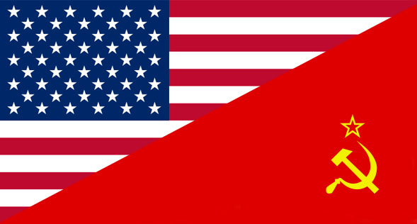
AP US History Unit VIII – The Cold War
1945 to 1980

Slide 2
Unit Big Questions and Periodization
Periodization => Why 1945? Why 1980?
In 1945 _________________________________=> US becomes #1 world leader and pursues interventionist foreign policy
In 1980 _______________________is elected President => US domestic policies change to more conservative stance & Cold War ends
Unit Essential Questions . . .
Analyze the changes that occurred during the 1960’s in the goals, strategies & support of the movement for Afr. American civil rights.
Analyze the ways in which the Vietnam War heightened social, political & economic tensions in the US from 1964 to 1975?
How did social, political and economic events from 1945 to 1980 contribute to a sense of malaise in US society?
What were the Cold War fears of the American people in the aftermath of the Second World War? How well did the US government address these fears during the period 1945 to 1960?
What effects did the liberal movement have on the United States socially & economically? Confine your answer to the period 1960-1980.
How did the Cold War foreign policies change and modify to the circumstances?
Analyze the causes and consequences of population movements in the US during the period 1945-1980 such as suburbanization, growth of the Sun Belt and immigration to the US.
Analyze the causes and consequences of protest movements in the US from 1945 to 1980 involving groups like African Americans, women, college students and Latinos.

Slide 3
The Cold War Begins - 1945
WWII totally changed political structure of the world => NWO established w/ new “superpowers”; decline of Europe and decolonization
Nationalist movements in Africa, India, Middle East and SE Asia lead to loss of European colonies and decline of power
New world superpowers = United States and Soviet Union
Both nations pursue an _____________________________after the war to ensure peace, security and economic growth
Each country also had a different vision of Europe Post-WWII =>
-- USSR had suffered massive casualties and wanted weak Germany & E. Europe to serve as a buffer against Invasion (“Iron Curtain”)
-- US wanted a strong Europe and Germany to help rebuild and ensure prosperity (“Manifest Destiny” = create a free democratic world!!)
“Cold War” thus begins as soon as “Hot WWII” ended
Who?? => ___________________
What?? => “war” between the US & USSR fought via ______________
______________________________________________________________
Why?? =>______________________________; presence of nuclear weapons

Slide 4
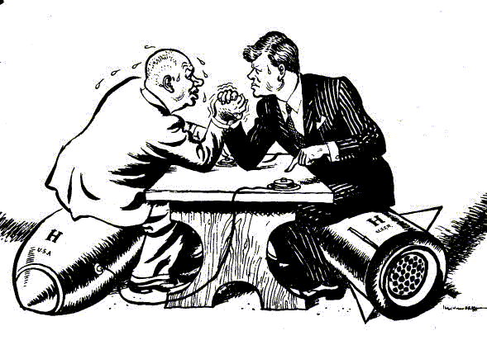
Cold War as an Arm Wrestling Match
Nikita Krushchev arm wrestling JFK during the Cuban Missile Crisis => How is an arm wrestling match a good analogy for the Cold War?

Slide 5
Cold War Strategies
Early in the Cold War Truman and foreign policy leaders like Kennan and Marshall set general US policies and strategies to “win” the Cold War against the USSR
Cold War Strategies
Main Strategy = Containment: idea proposed by George Kennan => to defeat Communism one must not let it expand . . . Communism is like a disease Q: HOW??
#1: ______________________=> world agency designed to promote peace and cooperation between world nations (prevent World War III)
Comprised of a Security Council dominated by China, USSR, France, Britain & US as well as a General Assembly of 140+ nations
#2: ________________________(IMF) & World Bank => attempts to promote economic growth & stability by regulating currency exchange rates & securing loans to aid developing countries (USSR refuses to participate)
#3: _________________=> economic aid to Europe and Greece/Turkey to rebuild the countries and prevent Communist takeovers
Total post war aid ~ $17 Billion!! (Creates a Democratic W. Europe for decades)
#4: _______(North Atlantic Treaty Organization) => defense pact between US and W. European countries that promised assistance if any country was attacked
Soviets respond w/ WARSAW Pact (same thing w/ USSR and E. Europe)
Many nations in Africa and ME responded to Cold War tensions with NAM => Non-Aligned Movement (not pick a side)
#5: Indirect & Direct Confrontations eventually develop and are necessary to defeat the USSR

Slide 6
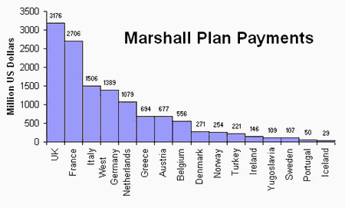
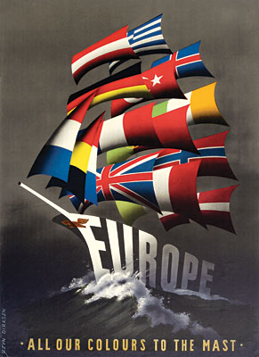
Marshall Plan Payments
George Marshall believed, as many foreign policy leaders did, that the rise of Fascism and political radicalism mirrored economic difficulties . . . Therefore if nations had healthy, stable economies they would reject Communism

Slide 7
Indirect Cold War Confrontations
There were numerous times when the USSR & US engaged in indirect confrontations through intermediaries or via various competitions . . .
#1: US aid and support of Anti-Communist leaders around the world
US supported non-Communist leaders in _______________________and ______ => used CIA to engineer coups and supported brutal dictators
CIA ousted the leftist government of Jacobo Arbenz in Guatemala in 1954 and installed military dictator Carlos Armas
-- Arbenz was 1st democratic leader after overthrow of repressive regime of Jorge Ubico (land to United Fruit Co & US military bases)
US supported the regime of Fulgencio Batista in Cuba for decades (encouraged American investment into Cuba)
-- When Fidel Castro overthrew Batista & installed a Communist govt US instituted a sugar embargo => Castro nationalizes Cuban land
-- CIA and JFK responded with __________invasion => funded a group of Cuban nationals to assassinate Castro and overthrow government
CIA also spent millions behind the scenes to prevent Salvador Allende from coming to power in Chile => eventually won election in 1970
-- CIA orchestrated the 1973 coup that resulted in Allende’s assassination and installation of Augusto Pinochet

Slide 8
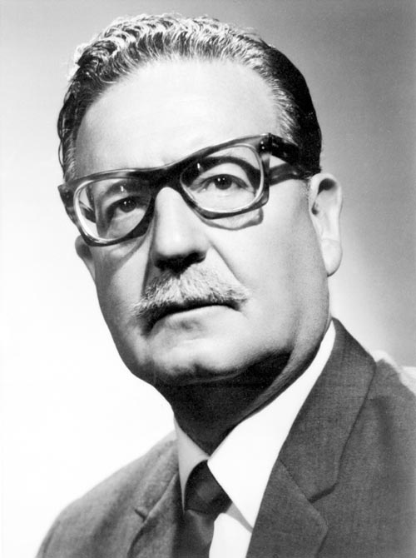
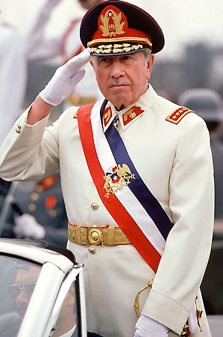
1973 Chilean Coup
Salvador Allende
Augusto Pinochet

Slide 9
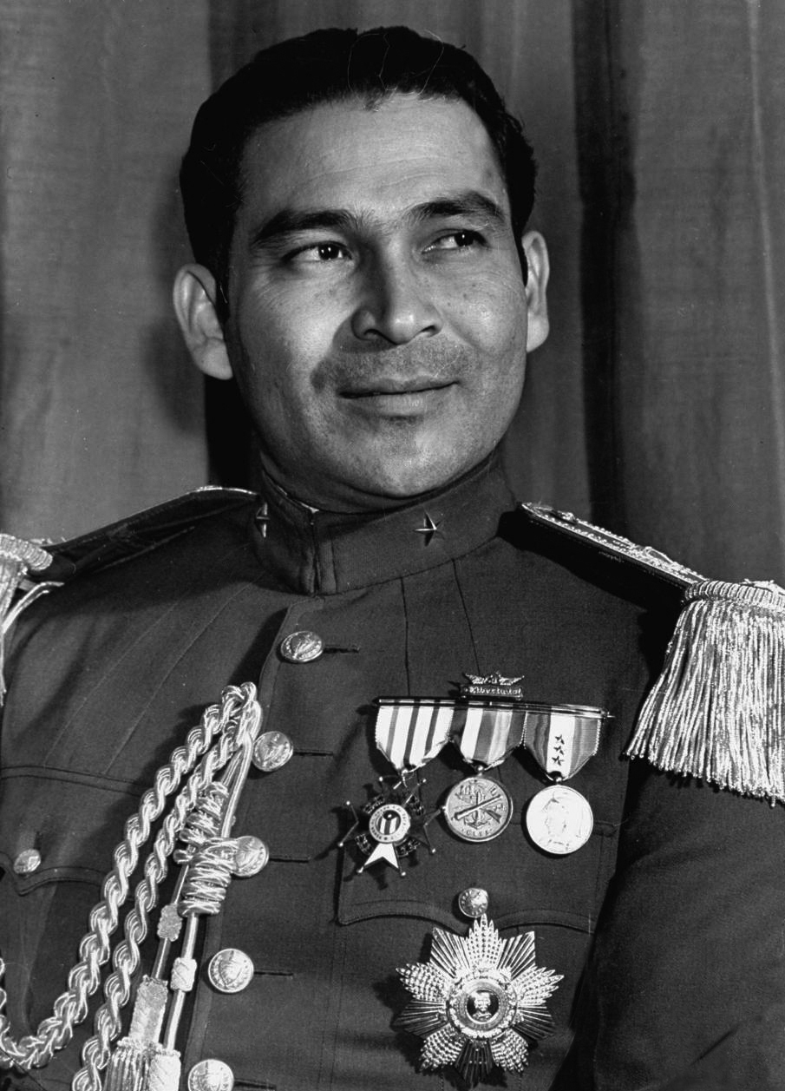
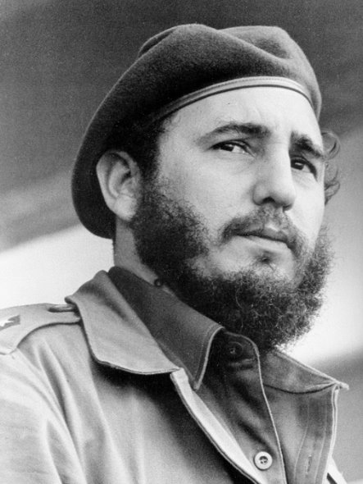
Cuban Revolution
Fulgencio Batista
Fidel Castro

Slide 10
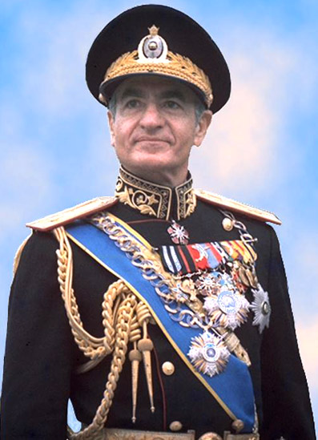
Indirect Cold War Confrontations
Due to fears of Soviet penetration into the Middle East & resistance of Iran to western oil companies CIA executed a coup in Iran in 1954
-- Installed Shah Pahlavi as military dictator => led to resentment of US in Middle East, especially Iran
In 1962 JFK announced the institution of Alliance for Progress => Marshall Plan for Latin America (led to little financial success)
In 1957 Eisenhower declared the ______________________=> financial assistance for any Middle Eastern nation fighting Communist takeover
Shah Pahlavi

Slide 11
Indirect Cold War Confrontations
#2: _____________=> in 1949 the USSR detonated its first atomic weapon
Ethel & Julius Rosenberg blamed for leak and executed after trial in 1951
*Rosenberg case helped convince US there was a internal Communist threat*
Many Americans became fearful of a Nuclear WWIII w/ the Soviets
Eisenhower creates ___________________________(FCDA) to ease fears by creating public service ads & increasing awareness
-- Duck and Cover Campaign advertisement**
Businesses in US encourage home bomb shelters, radiation proof clothing, etc..
Eisenhower Adm. used a document from Truman era (National Security Council Memo #68) NSC 68 to expand on an already growing US military
NSC 68 used during 1950’s to expand military 4x it’s size
Eisenhower sought a new strategy, shunning Containnment as “too passive” => introduces ___________________________or “Brinkmenship”
Threaten large response if USSR gets “out of line” => i.e. nuclear
Eisenhower felt this idea would save $$, threaten Soviets to retreat ** Q: Problems w/ new Cold War strategy?? **

Slide 12
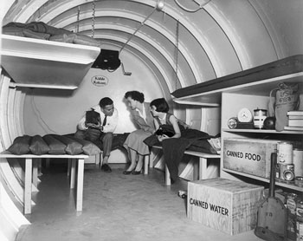
Life Magazine May 1955

Slide 13
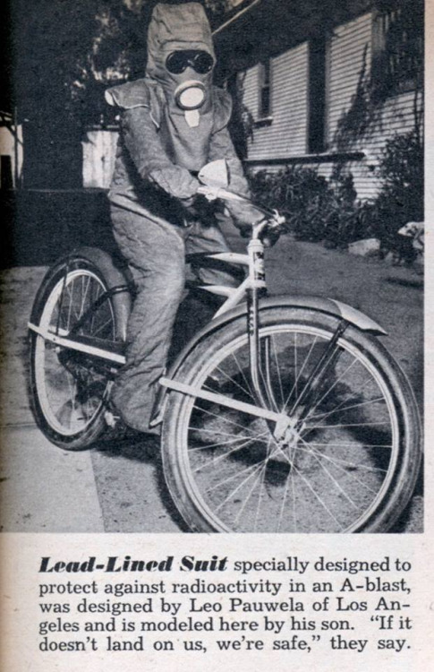
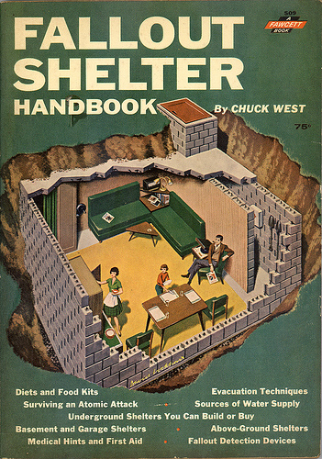
Nuclear Fears – Commercial Response

Slide 14
Indirect Cold War Confrontations
As a result of new Cold War paradigm defense spending increases as US nuclear arsenal & bomber fleet expand => (2 in 1945; 32,000+ in 1965)
US develops _________________________in 1952 to overpower USSR (codenamed “Mike”) => 1000X more powerful than Hiroshima bombs
US also tests new weapons in the open seas (i.e. Bikini Atoll test of 1954) and Nevada deserts => much radiation exposure in US and overseas
#3: ___________=> in 1957 the USSR sent ________(184 lb satellite) into orbit
Sputnik increases US tensions => USSR promotes Communism as way to scientific advancement and industrialization
Post Sputnik US public and leaders fear that there is a “missile gap” w/ Soviets => more weapons & missile programs funded
National Defense and Education Act places emphasis on math & science in public schools &provides grants for graduate education
USSR also beats US into outerspace => Yuri Gagarin in 1959
US commits to “put a man on moon” before USSR => Mercury, Gemini and Apollo missions launched and ___________________created
__________________________walks on moon in 1969

Slide 15
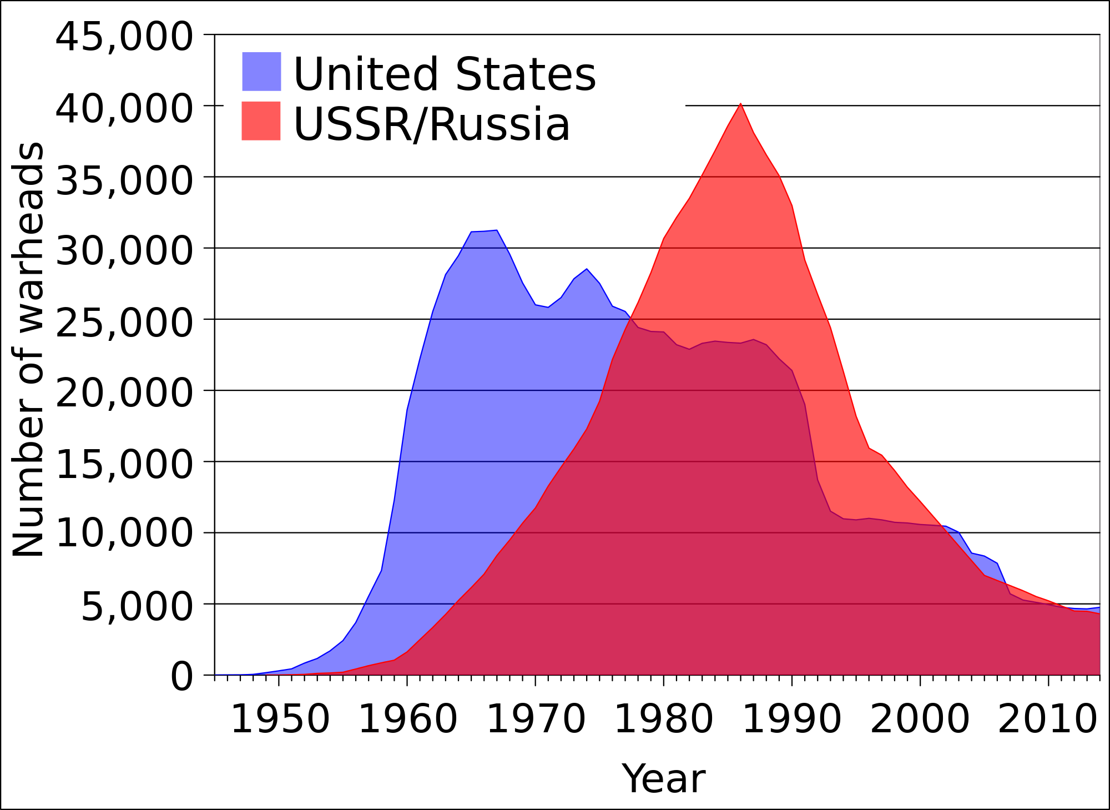
US vs USSR military arsenal

Slide 16
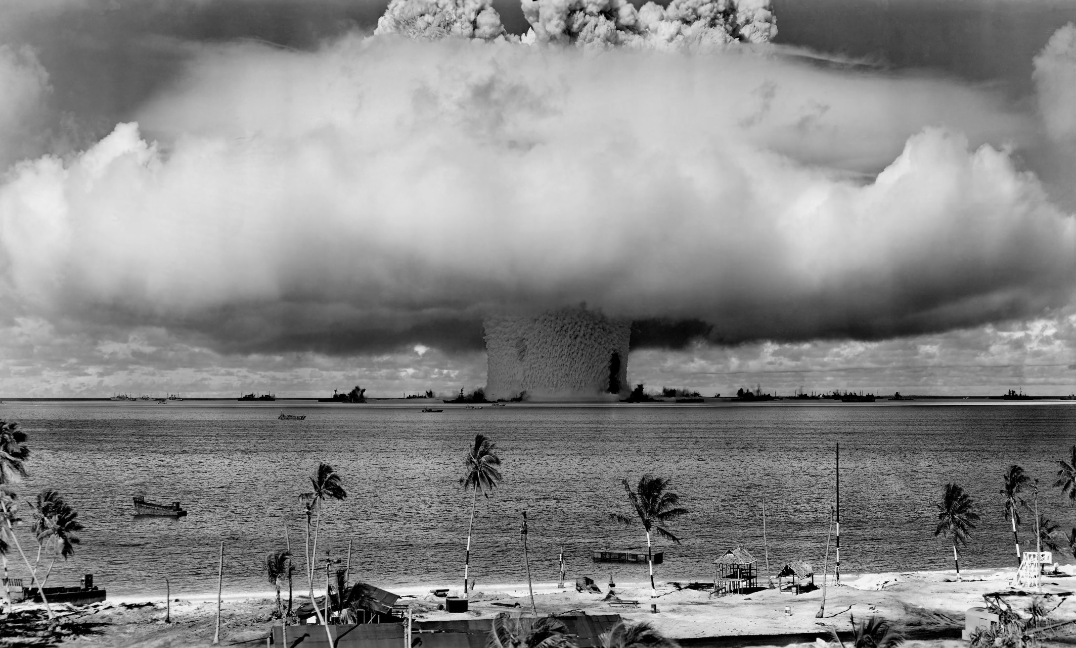
Bikini Atoll Nuclear Tests – 1946 to1956
Between 1946-1954 the US tested over 28 weapons at the Bikini Atoll island chain

Slide 17
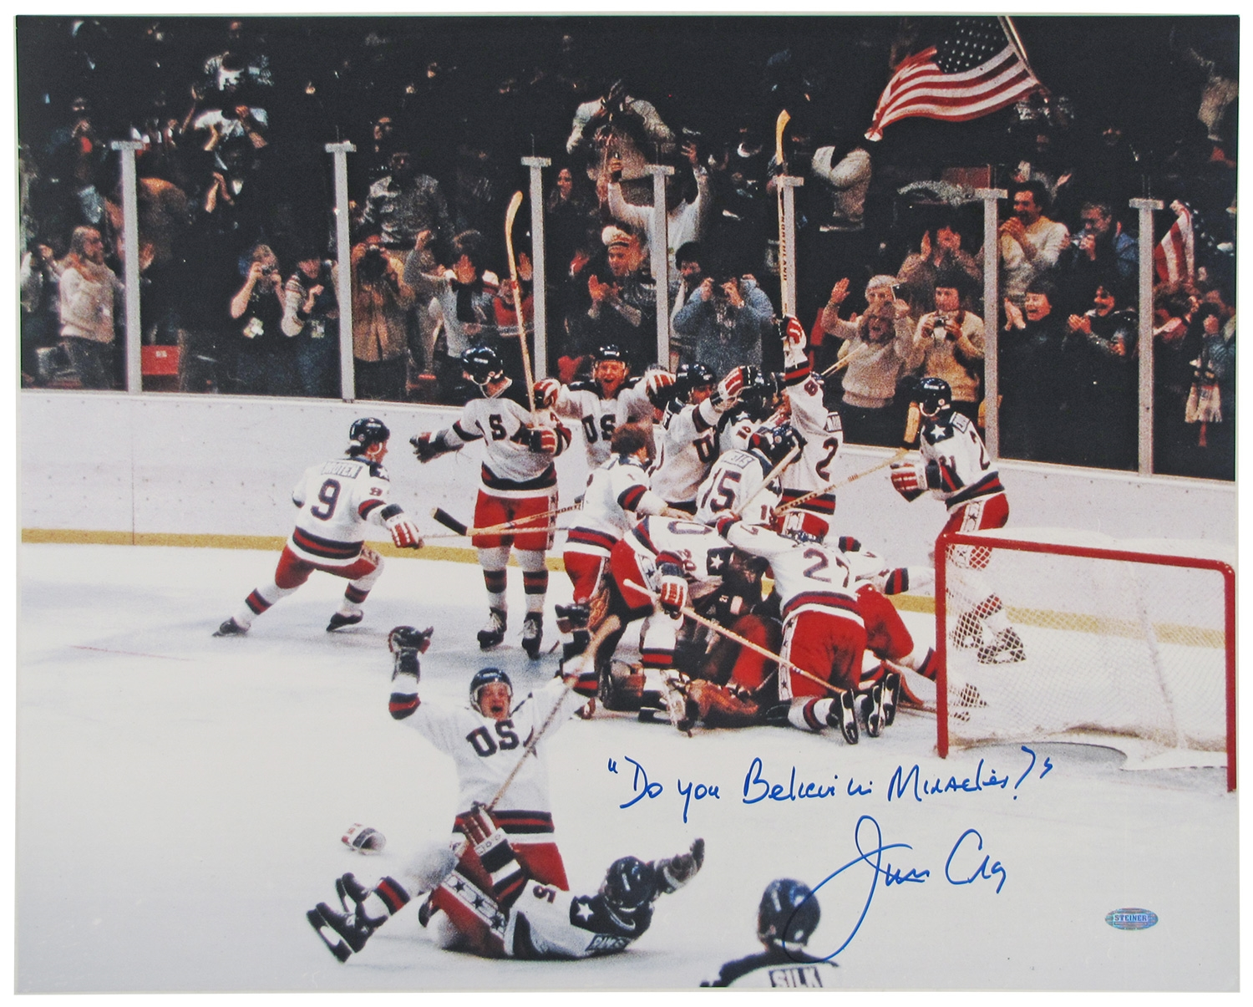
Indirect Cold War Confrontations
#4: Social competitions
From 1950’s to 1980’s the __________________took on Cold War implications as to nations competed for athletic and social superiority
Hockey, gymnastics, figure skating, etc…. => 1980 “Miracle on Ice”
“________________” pitted American consumer products against Soviet technology during Krushchev’s 1957 US visit => higher standard of living?

Slide 18
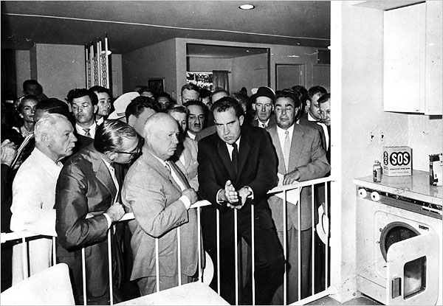
“War of the Kitchens” -- 1957

Slide 19
Direct Confrontation in Cold War
However, during the Cold War, there were also numerous instances of direct confrontation between the US and communists . . .
#1: ____________________________(1948-49)
Due to Yalta & “Race to Berlin” Germany was divided at the end of WWII
US also wishes to start rebuilding process economically but USSR stalls and controversy erupts over currency reform and 4-Power control
USSR feels threatened and in 1948 cuts off power, access to W. Berlin *WHY??*
US responds w/ Berlin Airlift => 11 month airlift campaign which gives Berliners needed supplies (277,000 flights & 2M tons of supplies)
By 1949 Stalin backs off and US “wins” a Cold War victory
#2: _______________________________(1963)
After Bay of Pigs many covert CIA operations to assassinate Castro failed
Castro pushed further towards Soviets
Krushchev, w/ Cuban cooperation, installs USSR nuclear missile sites in Cuba in Summer of 1962 => American U2 planes spot sites on October 16th
US has Jupiter Missiles in Turkey and other bases in Europe
What should the US do in response???? => Advisors call for nuclear strike, invasion, etc…………

Slide 20
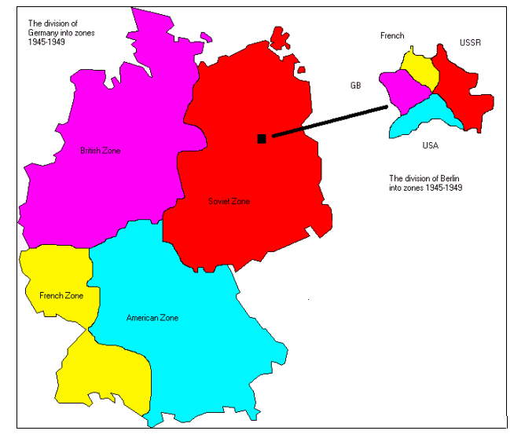
Germany Divided -- 1945

Slide 21
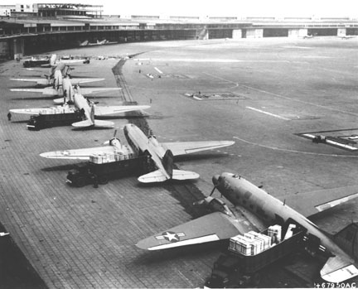
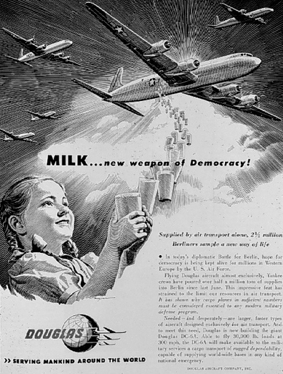
Berlin Airlift

Slide 22
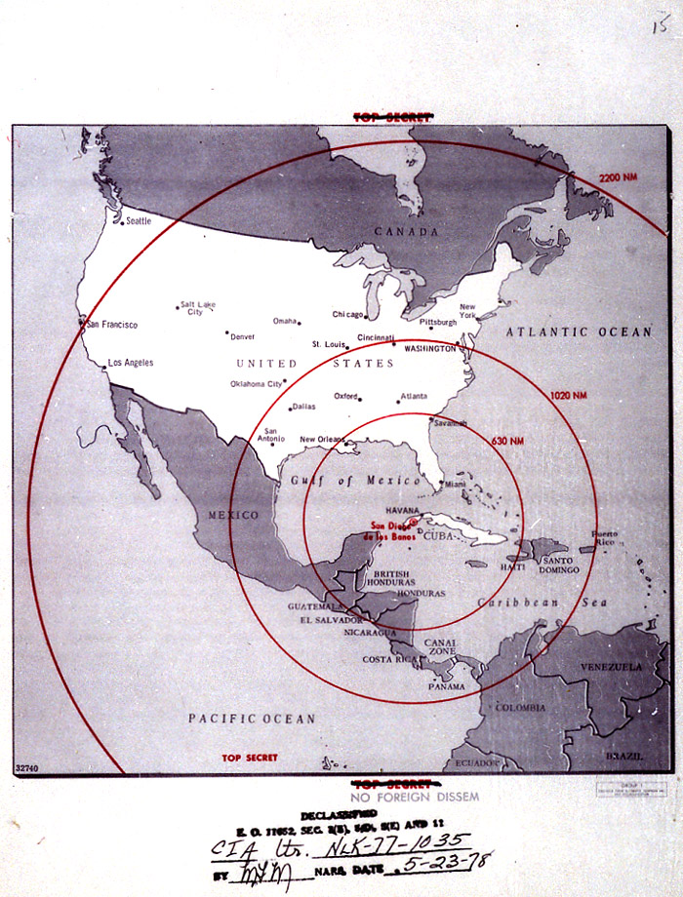
Soviet Missile Range – October 1962 -- 1st circle = Short range ICBM’s -- 2nd circle = Interm -ediate range ICBM -- 3rd circle = Long range ICBM’s

Slide 23
Direct Confrontation in Cold War
October 22nd -- JFK announces situation to US public & initiates a “quarantine” against Cuba => “quarantine” not an act of war like blockade
180 US warships sail to intercept any Soviet ships => tension increases
October 26th – Krushchev backs down => USSR removes missiles if US promises not to invade Cuba & remove Jupiter missiles in Turkey
-- Closest to nuclear war US/USSR ever came!!!
** Documents released in 1991 => Soviets had operational missiles and were cleared to launch if US invaded!!!! **
#3: _________________________________(1950-53)
WWII ended w/ Korea divided at the 38th parallel between Communism in the North & Democracy in the South => Each wanted to reunify the country
June 25th 1950 the N. Koreans attack w/ Stalin’s “blessing”
US leads UN effort to halt N. Korean advance => after initial success China intervenes & stalemate ensues
-- Relatively popular US action due to aggression & UN support
MacArthur Controversy erupts => Truman seeks to fight a “Limited War” w/o nuclear weapons and bringing USSR into fight
-- MacArthur wanted to drops 50 nukes on China and argued that “there is no substitute for victory!” (MacArthur removed from command)
Armistice concluded 2 years later => DMZ established & still exists today!!

Slide 25
Direct Confrontation in Cold War
#4: _______________________________(1954-1974)
France had a colonial presence in SE Asia since 1890’s (rubber, gems, minerals)
During WWII Ho Chi Minh founded Vietminh => Vietnamese Nationalism
After WWII Ho attacks the French & attempts to establish a communist regime
Sees himself as the “Vietnamese George Washington”
US sends $2.6 billion under Eisenhower to help the French fight => French stronghold of Dien Bien Phu falls in 1954 and French negotiate peace
Vietnam split at 17th parallel into 2 countries => North (Communist) and South (Democratic) Vietnam w/ elections in 2 years to unify country
US supports the regime of _________________in the South (Catholic dictator)
Due to Ho’s popularity Diem cancels elections in 1957!!
Eventually inept and corrupt regime is overthrown w/ US aide in 1963
US “Hawks” prescribe to ______________________in region and world under
If 1 country falls to Communism then all in region may => US is afraid at “dominoes” thus far?
US gradually becomes involved in Vietnam by sending military advisors (1960) and eventually troops to support the South (15,000 by 1964)

Slide 26
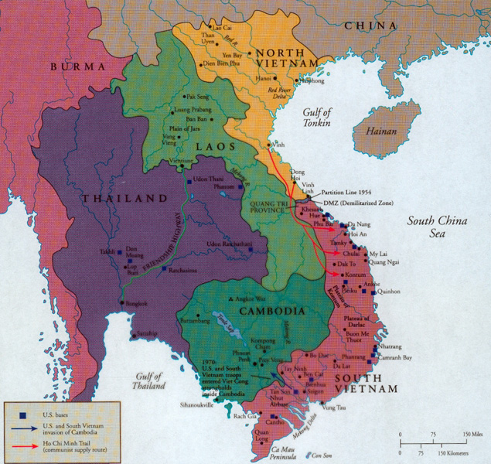

Slide 27
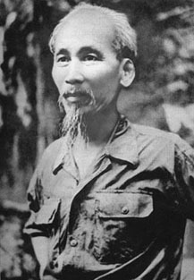
Ho Chi Minh and Diem

Slide 28
Buddhist Protests against Diem

Slide 29
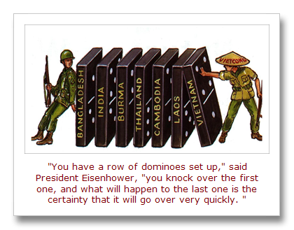
Domino Theory

Slide 30
Johnson Escalates the War
_________________(1964) => 2 US destroyers sunk while patroling Gulf of Tonkin (conducting commando operations)
Johnson uses the episode to get Congress to pass the Resolution allowing him to “use whatever force/means deemed appropriate” in Vietnam
US begins a draft & sends 100,000’s of soldiers to Vietnam => 500,000 by 1968
Average age = ______!!
US also begins __________________in to destroy Vietnamese military capacity=> US bombs North to win w/o death
Bombing campaign that lasts 3 years! (More bombs dropped in Vietnam than during all of WWII!!)
Mounting Intl. Opposition forms against the war => France condemns invasion and USSR uses opportunity to plot elsewhere

Slide 31
Vietnam Fighting and Tactics
The Vietnam War was a very difficult one for US troops => average age 19
Vietnamese had been fighting for over 20 years in WWII & vs French => great warriors, knew land, had defensive systems in place
Vietnam War Fighting
#1: Vietnamese use ______________=> undercover civilian groups in the South (_________________) wage terror campaign against the South and US soldiers
Bomb restaurants, attack US supply trains, kill soldiers
Vietcong/North Vietnamese also utilize extensive tunnel systems (i.e. Cu Chi tunnels) to hide and ambush US & then melt into jungle
Vietcong/North Vietnamese also utilize simplistic booby traps against the US => Q: Psychological impact????
#2: US responds by employing _______________against the Vietnamese => chemical which defoliates forests (5M acres) and kills North Vietnamese food
Later found to be full of carcinogens like DDT (birth defects and deaths)
#3: US also utilizes helicopters and advanced technology to try and outmanuever Vietnamese => travel in small Platoons to “search and destroy” Vietcong
-- Due to age and small numbers atrocities occur => ________________largest where US soldiers kill 400+ Vietnamese villagers they believed were Vietcong

Slide 32
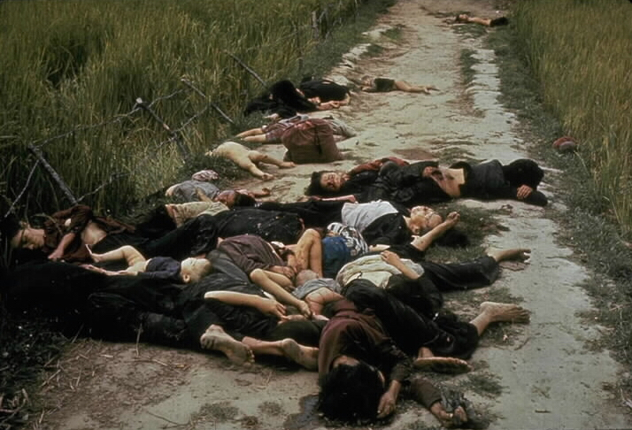
My Lai Massacre -- 1968

Slide 33
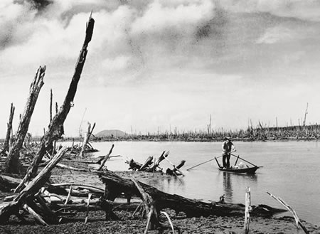
Agent Orange in Vietnam

Slide 34
TET and Vietnam Protests
By 1968 many in US are growing tired of war, but Johnson says, “I can see the light at the end of the tunnel” => assures public we are winning the war
January of 1968 North Vietnam launches __________________=> huge attack against South from tunnels, Cambodia, traditional forces, etc….
Vietnamese lose every battle and suffer 10X US casualties but people begin to see war as “unwinnable” and Johnson as a “liar”
Anti-war protests heat up!!
_________________________burn draft cards, stage protests (chants of “Hey, hey LBJ how many kids did you kill today”)
Many flee to Canada to avoid draft & verbally assault returning soldiers
College students stage protest on college campuses => i.e. “teach-ins” and rallies, some like _______________turn violent (4 students dead!!)
70% + of US public after TET don’t support war & don’t know purpose
Particular focus = student protest movements

Slide 35
Source: James Fallows, writing about his 1969 draft board experience
. . . Even as the last of the Cambridge contingent was throwing its urine and deliberately failing its color-blindness tests, buses from the next board began to arrive. These bore the boys from Chelsea, thick, dark-haired young men, the white proles [members of the working class] of Boston. Most of them were younger than us, since they had just left high school, and it had clearly never occurred to them that there might be a way around the draft. They walked through the examination lines like so many cattle off to slaughter. I tried to avoid noticing, but the results were inescapable. While perhaps four out of five of my friends from Harvard were being deferred, just the opposite was happening to the Chelsea boys.

Slide 36
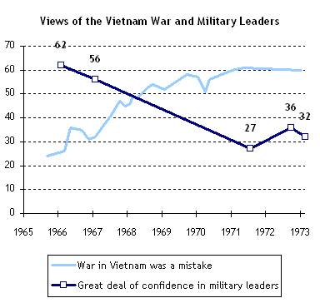
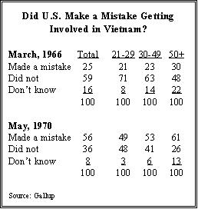
Vietnam Public Opinion Polls

Slide 37
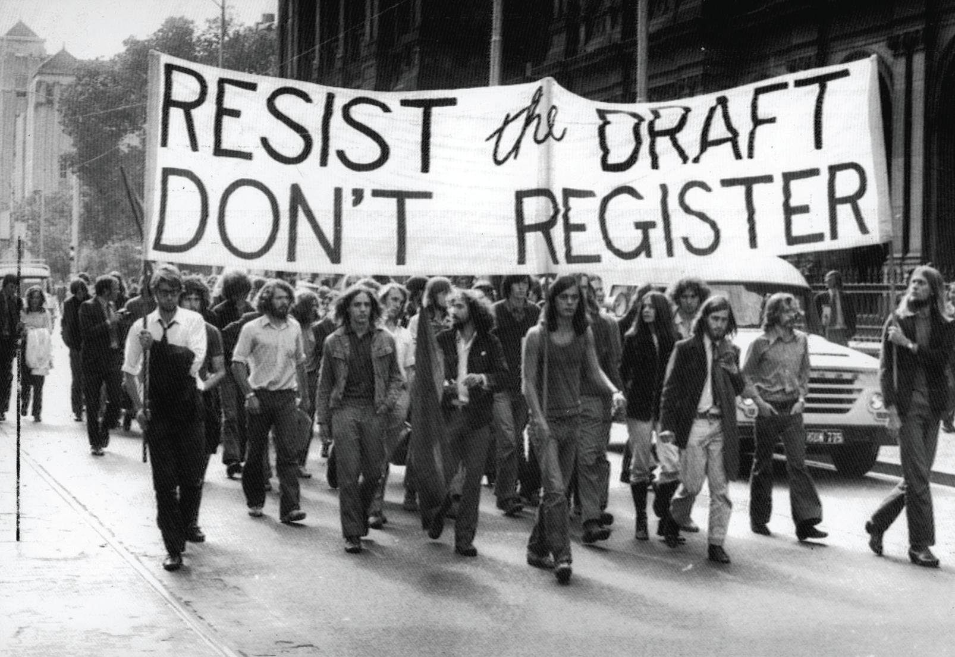
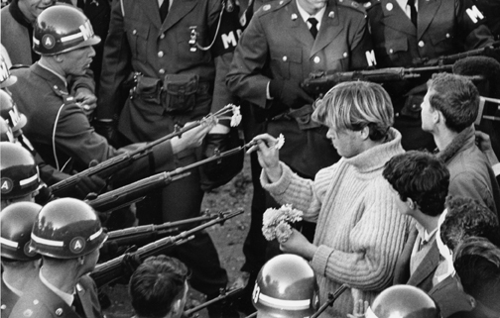
Vietnam Anti-War Protests

Slide 38
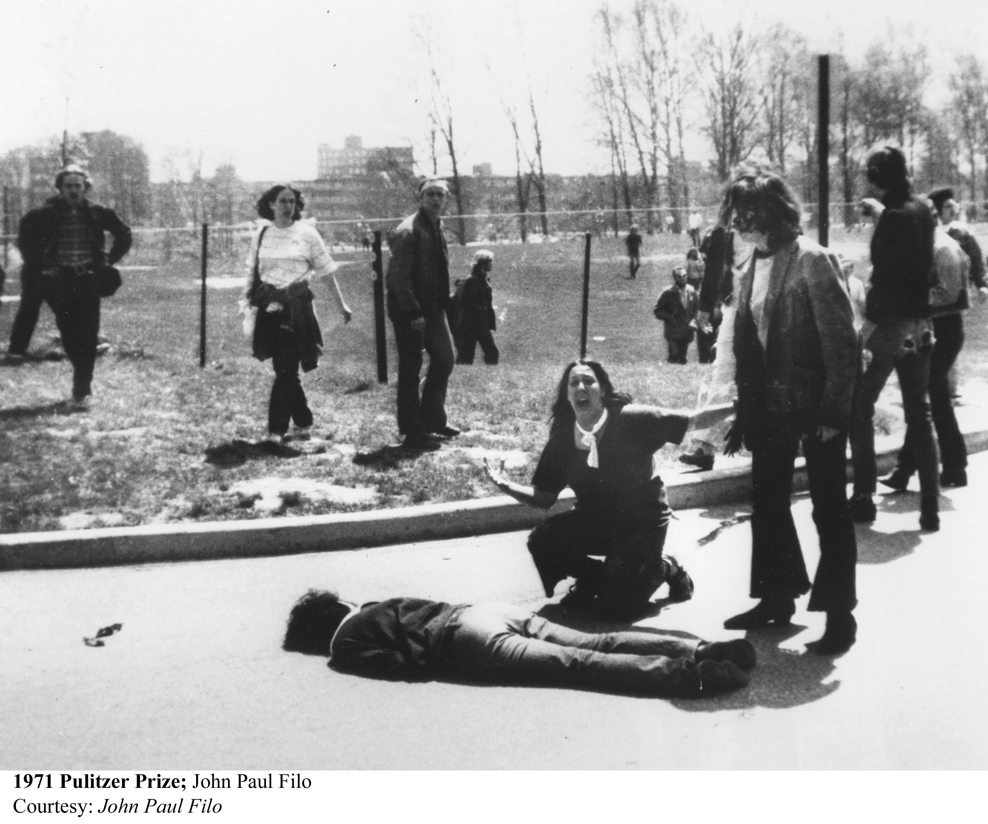
Vietnam Anti-War Protests

Slide 39
End to Vietnam – 1968 +
In the election of 1968 Johnson chooses not to run due to approval rating of 28% and calls for widening of war from Joint Chiefs
Robert Kennedy (Peace candidate) is assassinated as he seems assured of winning Democratic nomination
Democrats nominate Hubert Humphrey (VP) on Pro-war platform but convention in Chicago is the site on protest, tear gas and barb wire
Richard Nixon is nominated by the Republican Party and says he has a “Secret Plan” to end the War
3rd Party candidate George Wallace runs on a platform of “Segregation now. . Segregation tomorrow . . . Segregation forever”
Nixon wins election due to divided Democratic Party
Secret Plan “____________________________” => Train South Vietnamese soldiers to fight and take over US positions in the field
By 1972 only 25,000 US troops remain & Nixon concludes a Peace settlement by 1973 => Paris Peace Accord promises US aid if North attacks
North attacks in 1974 => Q: US response?????
Total Cost of War => ~ ___________________dead; many times more wounded; ____________________spent on war!!

Slide 40
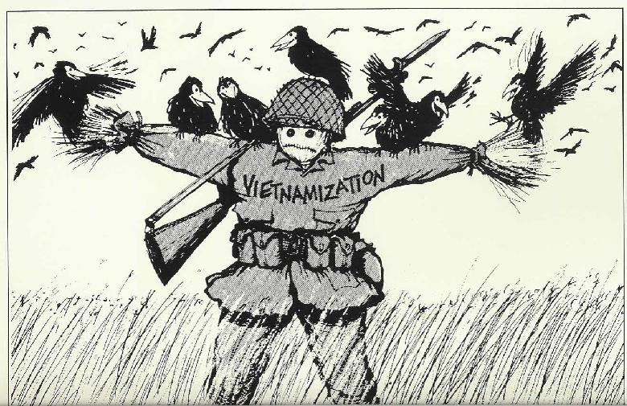
“Vietnaminization”

Slide 41
Election of 1968

Slide 42
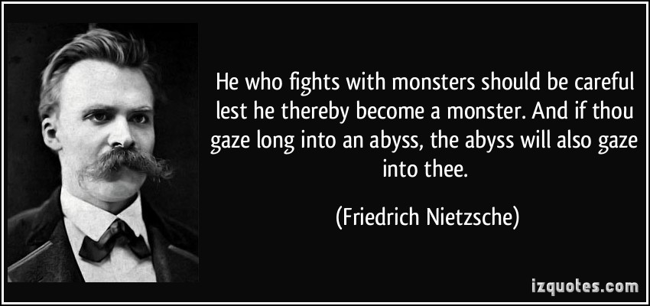
Vietnam War – Did US become a “Monster” by fighting too long with monsters?

Slide 43
Cold War Debates
Various episodes in Cold War brought up many important debates in US society about many of the issues involved w/ US new role in 20th century
#1: Use of Force => Vietnam started new debate about the use of force by US
Countercultural non-violent movement (students and youth promoted) promoted a greater desire for new Cold War strategies
Response? => Nixon’s ______________________program
What?? => limit Communist expansion and influence through __________ ___________________________________________
Why?? => What are the benefits of such a Plan??
#1:
#2:
#3:
Nixon had a reputation as hard on Communism
National Security advisor Henry Kissinger instrumental in facilitating Détente
Harvard educated in foreign diplomacy and very trusted by Nixon
Set up and ran many of the covert negotiations behind landmark meetings

Slide 44
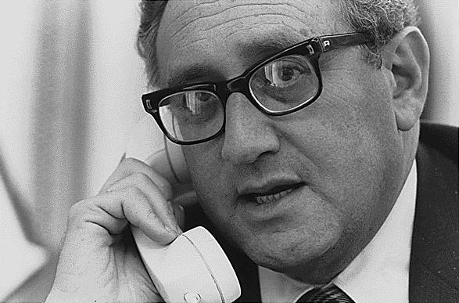
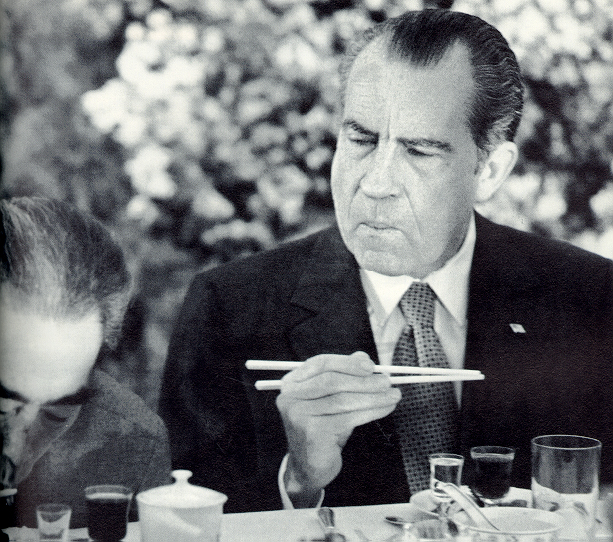
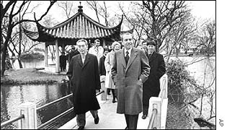
Henry Kissinger and China

Slide 45
Nixon’s Détente in Action
Nixon executed 2 landmark Détente achievements => part of larger Triangular Diplomacy (play USSR & China against one another)
Nixon’s Visit to _______________________
Before Nixon’s visit China was not recognized as a nation by the US and we had no relationship w/ them whatsoever
Ping-Pong match played before Nixon’s visit to “break the ice” between the nations => “_________________________________”
Nixon tours the country and visits the sites; drinks tea w/ Mao Zedong
Normalized relations; gained China’s admittance to the UN and fostered trade between the countries
-- China also helped US end Vietnam War
Nixon’s Visit to the ___________________
1st President to visit USSR => went to negotiate an proliferation Treaty
USSR and US signed the _________________________________(SALT)
Limits warheads, subs and other weapons systems
USSR wants to save $$ on weapons and also gain grain trade from US

Slide 46
Cold War Debates
#2: Growth of Nuclear Arsenal and___________________________________
During the 1950’s and 60’s the US military arsenal grew to enormous numbers => i.e. Massive Retaliation policy
Many Americans debated usefulness of such drastic numbers => by 1965 US could destroy entire world 10 times !!!
Nuclear testing was also highly debated => environmental impact of fallout and release of strontium into atmosphere
-- _______________________signed => nuclear weapons can only be tested underground or in outerspace
SALT treaty in 1970’s also places limits on the size of nuclear arsenal => promotes nuclear downsizing (SALT II and other agreements follow)
In his Farewell speech Eisenhower also warns of growth of US MIC
Q: What is the Military Industrial Complex???? => Defense industry, contractors & research firms (employ people & have powerful lobbies)
Eisenhower worried that this group would become too powerful and lead to a self-reinforcing war machine . . . Q: True???

Slide 47
US vs USSR military arsenal

Slide 48
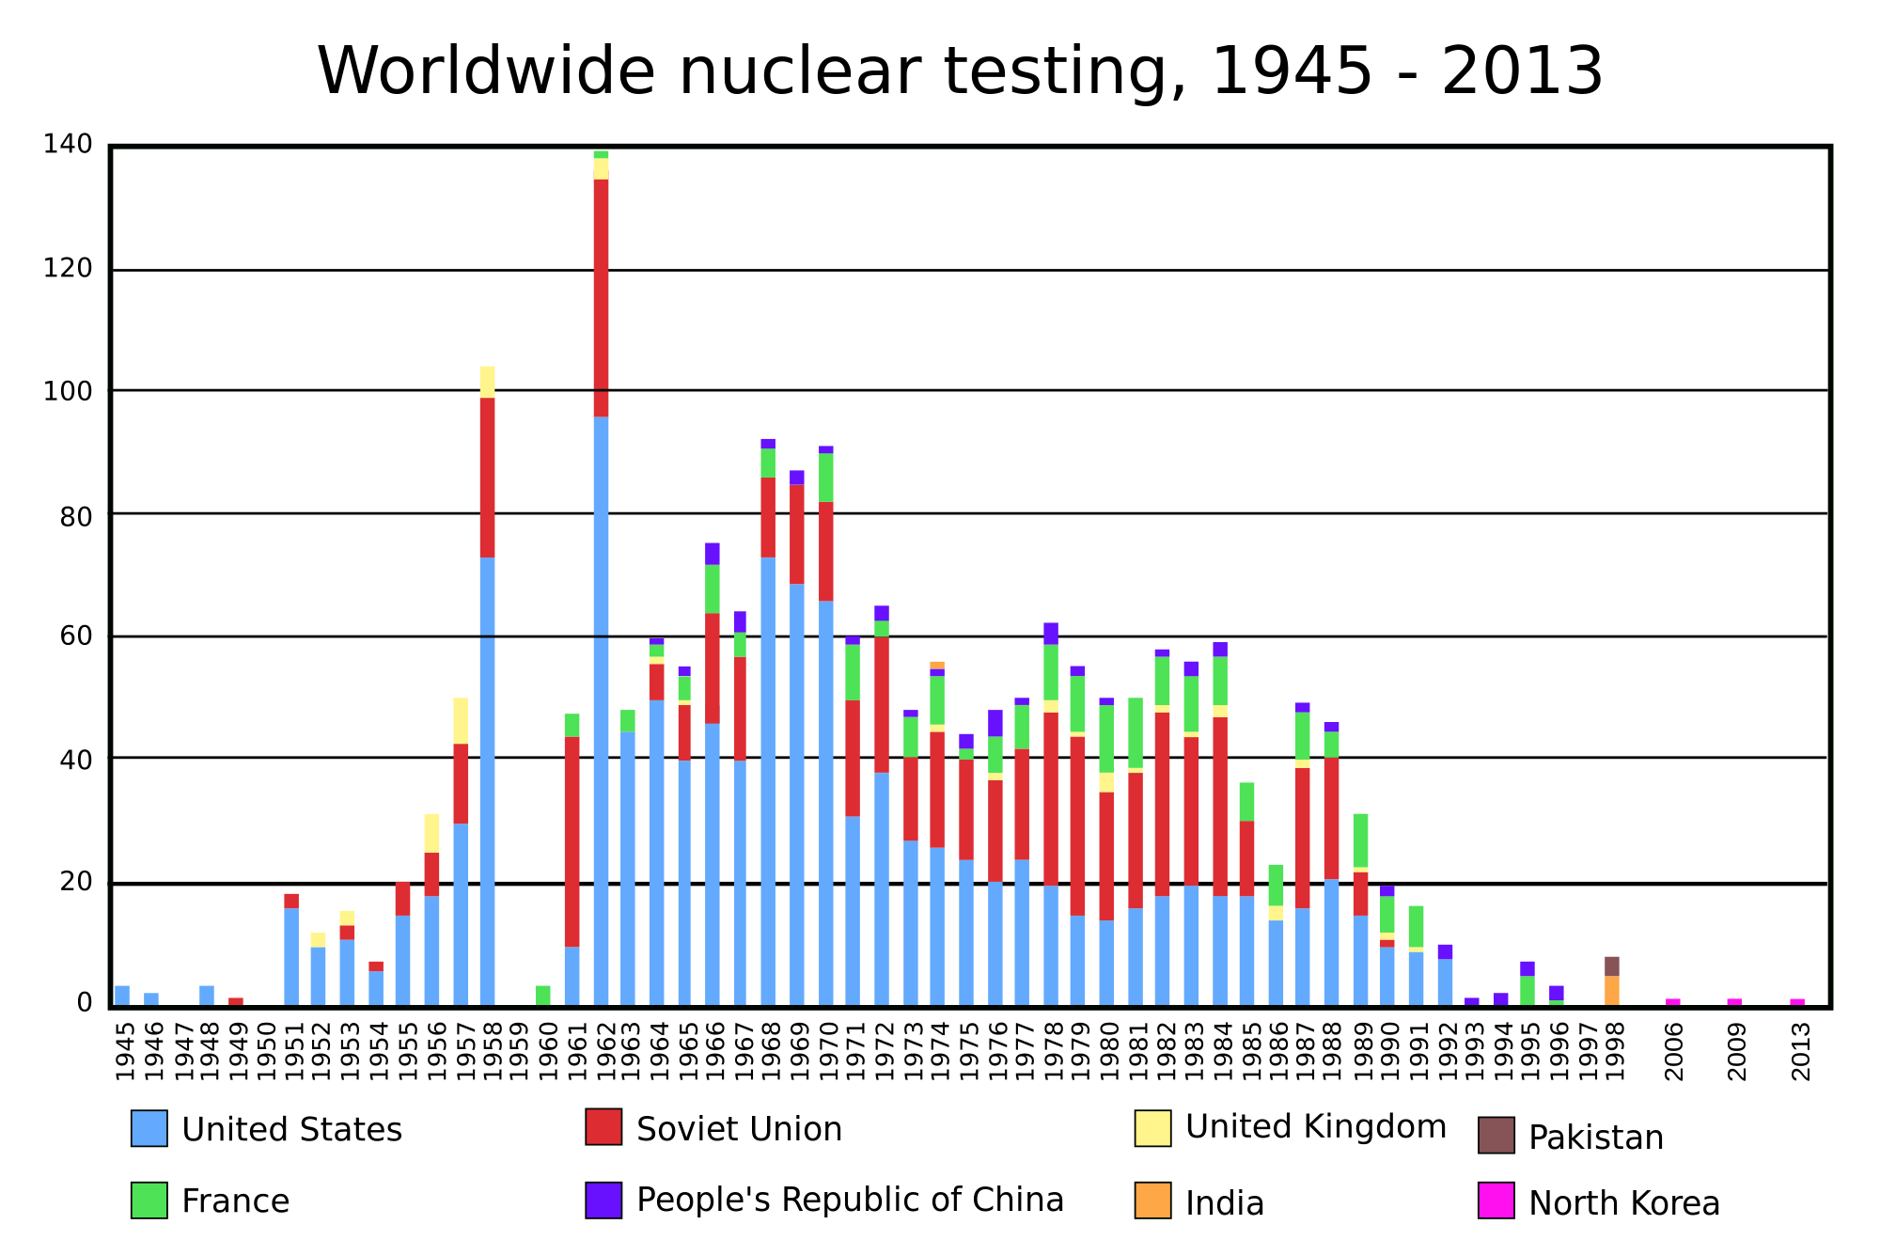
Nuclear Testing in 20th Century

Slide 49
Eisenhower Farewell Speech

Slide 50
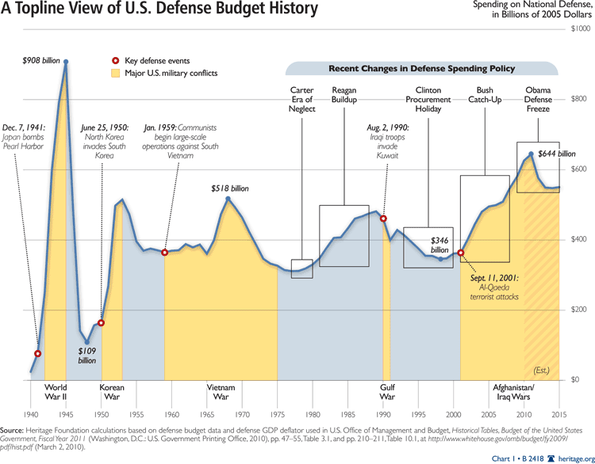
Defense Spending in 20th Century

Slide 51
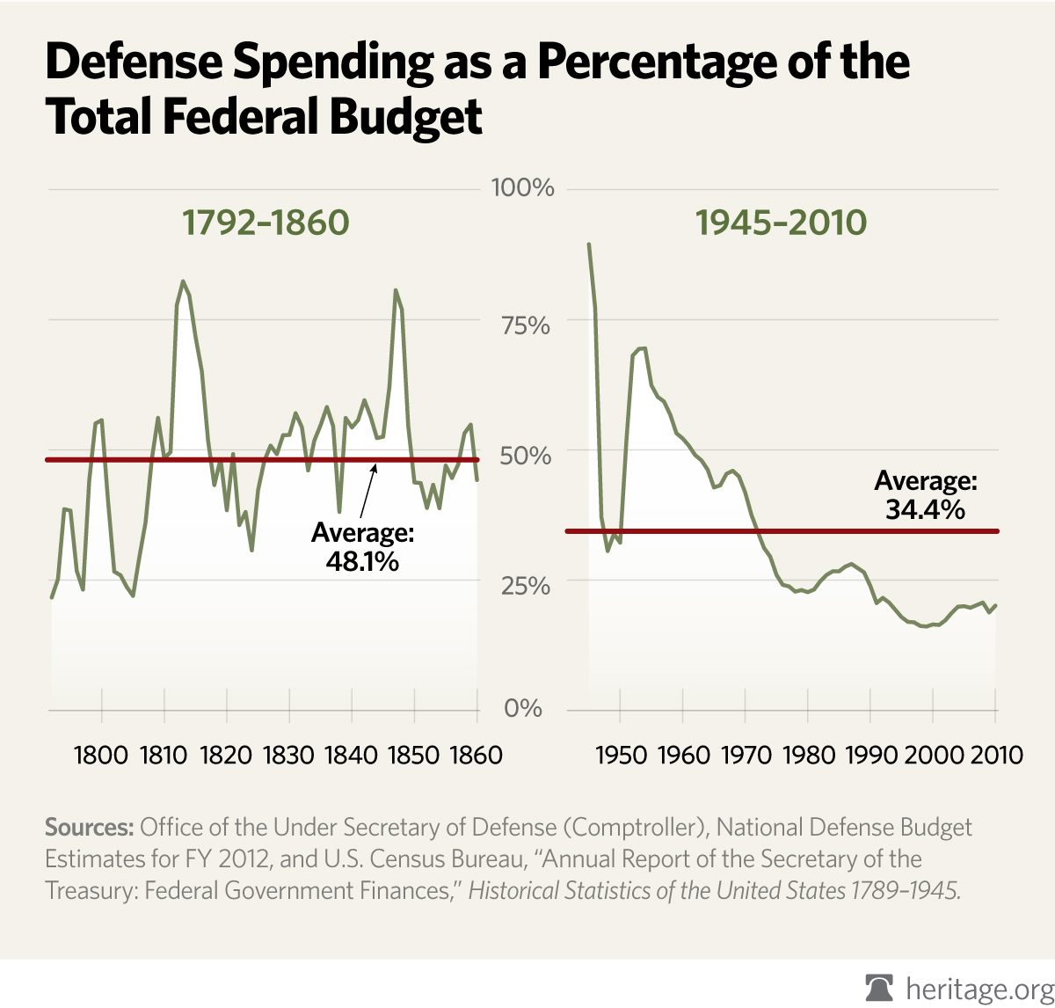
Historical US Defense Spending

Slide 52
Cold War Debates
#3: Executive Powers in Wartime
Since inception of Constitution there has been disagreement between President and Congress over war powers
Congress has power to declare war but President is Commander in Chief of military => Q: Who decides when to go to war?
US has engaged in 150-200 military actions yet has declared war only 5 times => War of 1812, Sp-American War, Mexican War, 2 WW’s
After Vietnam and _____________________(covered up but exposed by Pentagon Papers) by Nixon Congress passes War Powers Act
_________________________places limits on President’s deployment of troops => after 60 days President must seek Congress’s approval
-- Presidents have denied authority of law => little practical impact

Slide 53
Communist Fears of 1950’s
Postwar US was a time of much fear/hype concerning domestic Communism
Many fear Communist spies were operating in US => BOTH parties in US take action against “domestic” communism
-- Q: 1st time in US History???
#1: Truman’s “Loyalty Program” => fearing a “soft” image on Communism Truman launches federal loyalty program where employees must take oaths
Oaths also required of some occupations (i.e. teachers)
#2: ________________________________________=> formed in 1938 to investigate Communist subversion in the US government and society
Richard Nixon (key member of committee) brought Alger Hiss to trail for Communist subversion at Yalta
Nixon found secret “Pumpkin Papers” at Hiss’s house inside a pumpkin??
Hiss declared guilty of perjury & investigations increase
In 1947 “Hollywood 10” (10 directors, screenwriters) who refused to testify before HUAC were fired and “blacklisted” by movie industry
#3: McCarran Internal Security Bill (1950) allows President to arrest & detain suspicious persons in a “internal security emergency” (Truman veto overrode)
#4: Rosenberg Trail => Ethel and Julius Rosenberg arrested in 1950 for providing the USSR w/ nuclear secrets; electrocuted for their crimes in 1953
** Atmosphere of fear allows extreme actions to be taken **

Slide 54
Alger Hiss and the HUAC
"Are you now or have you ever been a member of the Communist Party?”

Slide 55
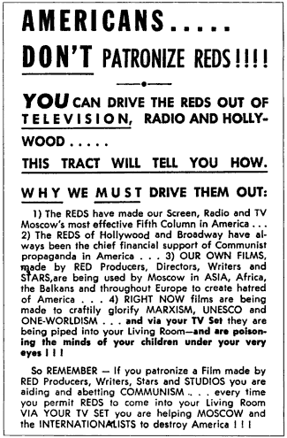
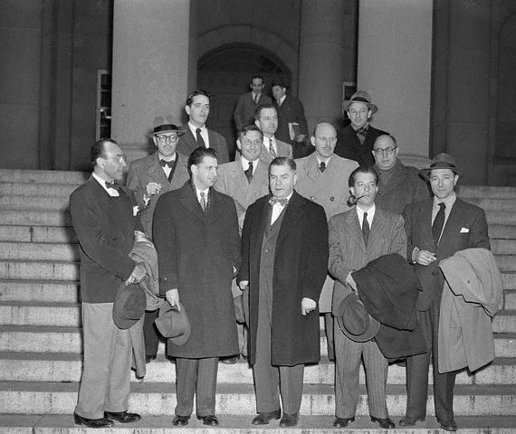
Hollywood 10

Slide 56
McCarthyism and Communist Hysteria
_________________________took Communist hysteria to new heights in Feb. 1950 when he accused 205 members of State Dept. of being Communists
McCarthy a Senator from Wisc. Speaking at W Virginia women’s club
McCarthy used tactics of a demagogue in almost 4 years hunting Communists in US => Intimidation, unfounded accusations, fake evidence, theatrical trails
Ruined lives of 1000’s; some commit suicide; held investigations for years
Truman, Eisenhower, etc… stay clear of him b/c they fear him
In 1954 McCarthy accuses Army of harboring Communists => Army stands up to him and exposes his tactics in televised hearings
Afterward McCarthy officially censored by US Senate => both parties back off communists hunts after 1955 McCarthy episode
**Q: Is this enough punishment???**
1957 – McCarthy found dead of alcohol poisoning
Communist hysteria pervades in US w/ startup of many Communist vigilante groups in neighborhoods around US

Slide 58
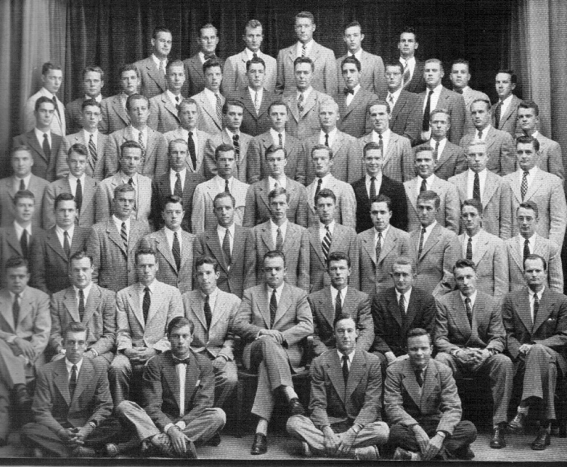
Social Conformity in Postwar America
Social Conformity => _______________________________________
_________________________________________________________
Exs:______________________________
The Organization Men of the 1950’s => social conformity at its height

Slide 59
American Postwar Prosperity
In 1945 US society was engulfed in uncertainty over economic future
Great Depression only ended by WWII buildup => Post WWII signs were not good (GNP slumps in 1946; Prices up 33% in 1947; Unions strikes sweep US)
However, despite fears US in 1947 embarked on nearly a 20 year economic boom => Natl. income doubled in 50’s; doubled again in 60’s !! (US envy of world!!)
Causes?
#1: _______________________(1944) => provided college education and tuition assistance for returning veterans and allowed VA to loan veterans over $16 B to buy homes
College education for 8M + vets!! Stimulated education & construction industry
#2: US escaped War destruction of other nations => private industry in 1950’s experienced boom as new technologies drove spending (i.e. cars, electronics, appliances)
#3: Growth of _______________________________=> defense budgets of the 1950’s took over 50% of total Govt. spending!!
$$ flowed into aerospace, electronics, weapons, scientific research & computers
#4: Cheap Energy => US companies controlled ME oil in the 50’s and 60’s (Iran, Iraq, etc…) and kept price cheap (promoted growth in cars & highways)
#5: Incr. in worker productivity => educational level of workforce incr. greatly w/ 90% of teens enrolled in high school by 1960
White Collar workers also outnumbered blue collar => US a “Post-Industrial society”
New technologies (i.e. 1st computers in 1950’s) allowed workers to work at quicker pace and have more leisure time
#6: _______________________=> farmers decrease as agriculture advances due to use of science and technology (i.e. use of pesticides, drought resistent seeds, new technology)
15% of US farmers post WWII; 2% by 1990 => By 1990 1 farmer can feed 50

Slide 60
Postwar Prosperity Effects => Consumerism
During the 1930’s and 40’s war years US had to “go without” => now in the Postwar world Americans have $$ and spend on products & leisure industries
Americans take up hobbies => powerboats, golfing, fishing, travel . . . .
#1: ________________=> By 1960 60% of Americans own a home (up from 40% in 1950)
83% of new homes located in Suburbia & 25% of all homes built in 1950’s
#2: _____________=> Majority of American families owned a car by end of 50’s
Cars produced new mobility w/ advent of Interstate Highway System =>________ _________________________ ($27B to build 42,000 miles of highways)
-- Franchises sprung up along the highways =>___________________________
#3: ____________=> 90% of US owned a set by end of 1960 (Q: #1 TV Show in 50’s???)
New TV culture pervaded American lifestyle => advertisers spent $10B/yr. on ads that encouraged consumption ** Gillette Ad**
Diner’s Club introduced 1st Plastic CC in 1950 => helped feed consumerist expansion
-- TV diners became popular also => busy, on the move lifestyle
Federal Communication Commission (FCC) started to regulate airwaves => FCC chairman in 1958 calls TV a “vast wasteland”
#4: _______________________=> frig; washer/dryer; stove; etc.. became “necessities”
“War of the Kitchens” between VP Nixon & USSR Premier Krushchev in 1956 highlights prosperity of US (US has 6% of world pop.; 50% of wealth!)

Slide 61
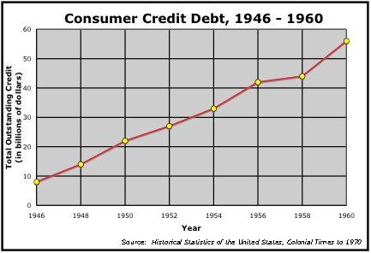
Consumer debt in Postwar America
Q: What happens to postwar debt in the US from 1946 to 1960? What does this show about the US economy? Mindset of US consumers?

Slide 62
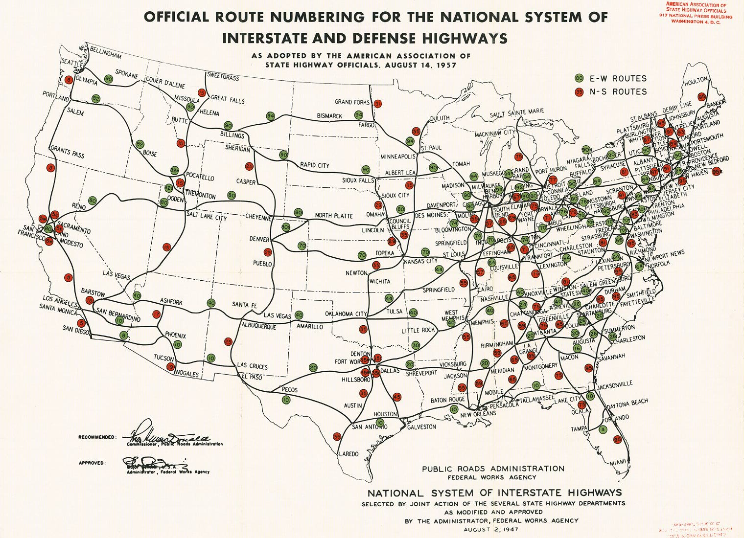

Slide 63
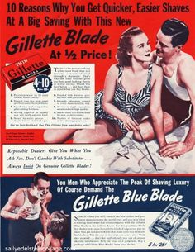
Postwar Consumerism Ads
Gillette Razor Ad from 1954
http://americanhistory.unomaha.edu/module_display.php?mod_id=46&review=yes
Postwar American companies began to use propaganda techniques employed by the government in WWII to market products to consumers
Companies also used techniques like Planned Obsolescence to ensure continued prosperity for their products and corporations

Slide 64
1950’s Culture Activity Sites
Elvis Video: https://www.youtube.com/watch?v=qka6JrKUM5U
Date with Your Family: https://www.youtube.com/watch?v=XEtaaW3UFZA

Slide 65
Postwar Prosperity Effects => Suburbanization & Baby Boom
During the 1950’s US population increased by 30M w/ little immigration
Americans wanted to “Return to Normalcy” => nuclear family promoted
From `946-1960 a baby was born every 7 seconds (61 M children born)=> BB helped to elongate & feed American economic Boom ** Q: HOW??**
Society in the 1950’s became very focused on children’s well being
“_________________” re-emerged in US society as women were expected to stay at home w/ kids => TV reinforces this w/ “Leave it to Beaver” etc.
-- No realistic expectation for most families as more married women worked to participate in consumer prosperity of decade (doubled in 1950’s)
Focus on nuclear family also helps to reinforce social conformity => attempts to tamp down teenage rebellion & juvenile delinquency
TV offers endless hours of children’s programs (i.e. Lone Ranger)
Benjamin Spock provide advice for children (focus = advoiding juvenile deliquency); ______________ creates _________________
Fleming’s antibiotics also become widely available
______________occurred at breakneck speed during the 1950’s as a way to escape crime, poverty of cities => own your own home and raise family
Suburbs like _______________grew up as the embodiment of “American Dream” but often discriminated against minority home ownership
“Cookie-Cutter” houses built within communities that encouraged conformity and “Keeping up w/ the Jones” mentality

Slide 66
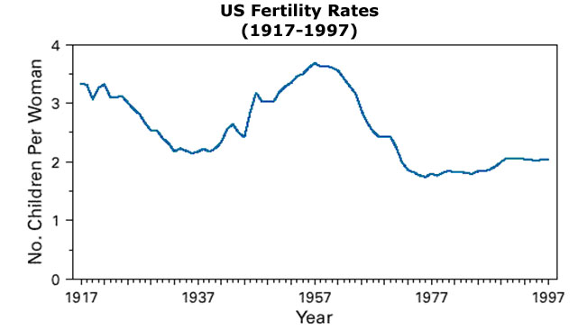
20th Century American Fertility Rates

Slide 67
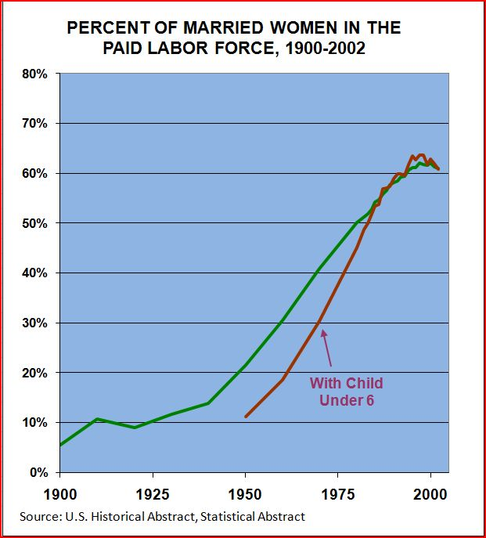
Percentage of Married Women in the Labor Market

Slide 68
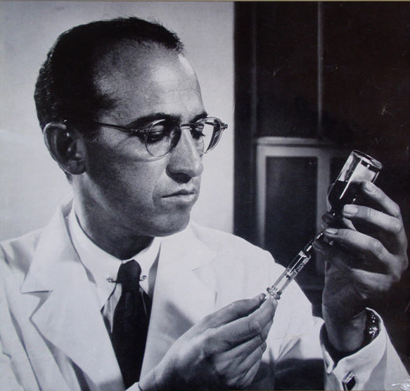
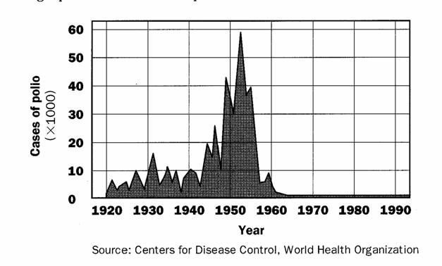
Jonas Salk and Polio

Slide 69
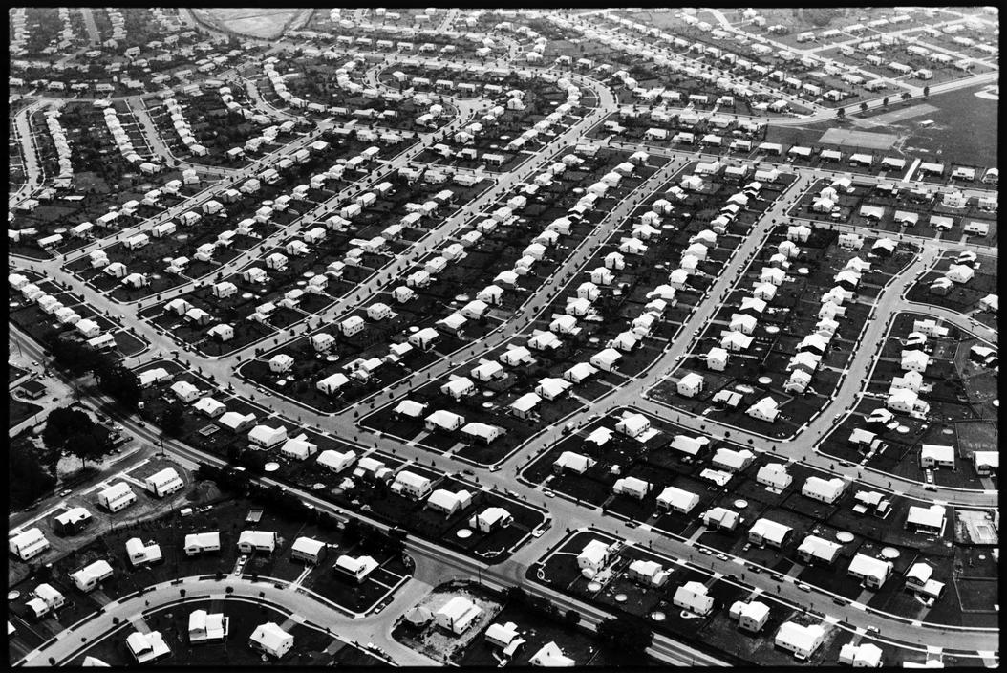
Levittown, New York 1954

Slide 70
Rise of the Sunbelt
In three decades after 1945 30M Americans moved each year => majority going to suburbs or Sunbelt . . . Q: Sunbelt?
Sunbelt = VA to Florida through Texas and Cali
-- Area increased in population at twice rate of “______________”
Q: Why?? Where??
Migrants were looking for better climates, jobs and lower taxes => migration focused on Texas, Florida and California
Migrants found jobs in Texas energy industry, California aerospace and technology cos and federal military installations in all three states
-- Ex: NASA facilities all located in Texas & Florida
By 1965 California passed NY as largest state (currently has 1/8 of total US population)
With growing population came growing political power => federal spending in sunbelt outpaces North
All Presidents elected since 1964 have come from Sunbelt states

Slide 71
1950’s Counter-Culture Reaction
Vast majority of Americans were happy w/ consumerist/conformist lifestyle of 1950’s . . . However, there were some critics and challenges to conformity
Counter-Culture Reaction
#1: Youth Culture => Popular music in the 1950’s was ___________________and others (mostly white singers playing music inspired by blues and jazz)
Focused on rebellion and sexually provocative lyrics and movements
Movie stars like Marilyn Monroe and Playboy magazine also introduced rebellious sexual ideas into culture of 1950’s
#2: Academic Critics => David Reisman & Kenneth Galbraith lamented the conformity/consumerism of society & wanted more public spending
#3: Literature => “Beat” writers like _______________________reacted against social conformity; while others like Joseph Heller & JD Salinger expressed disillusionment w/ modern society => Catcher in the Rye, Catch 22
#4: Women’s Movement => 1963 Novel The Feminine Mystique expressed female dissatisfaction w/ chains of hosewivery and galvanized women’s rights movement
Start ______________________________w/ Gloria Steinem to fight for full female equality
#5: Civil Rights => Blacks were regularly denied affluence, govt. support, freedoms and prosperity and reacted against this harshly (no longer willing to “wait”)
WWII experiences (i.e. fighting against Fascism and Racism in Nazi Germany) gave African Americans desire to fight for own rights

Slide 72
Postwar Academic Critics
“The US postwar economic boom is an entirely new phenomenon . . . Societies before have operated on an economy of scarcity . . . The US and other industrialized nations no operate on an economy of abundance.”
-- John Kenneth Galbraith, The Affluent Society
“The conformity expected in corporate America today is changing the dominant social dynamic in the US. Formerly, people were predominantly ‘inner directed’ when forming opinions of themselves, using their own values and the esteem of their families and friends to form self assessments. Now, though, people are becoming ‘other directed’, concerning themselves primarily at winning the approval of the corporation or community.”
-- David Riesman, The Lonely Crowd

Slide 73
Betty Friedan and NOW
Source: The Feminine Mystique by Betty Friedan (1963) "Housewives are mindless and thing-hungry... ; They are trapped in trivial domestic routine and meaningless busywork within a community that does not challenge their intelligence. Housework is peculiarly suited to the capabilities of feeble-minded girls; it can hardly use the abilities of a woman of average or normal human intelligence."

Slide 74
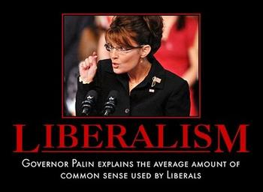
Liberalism
Liberalism => In the twentieth century, a viewpoint or ideology associated with free political institutions (i.e. anti-communism) & religious toleration, as well as support for a strong role of government in regulating capitalism & constructing the welfare state

Slide 75
Liberalism and the “Split Level society” of Postwar America

Slide 76
Civil Rights Movement
Post WWII both North and South had segregated societies
North = de facto segregation => suburbanization & housing discrimination
South = de jure segregation => laws and statutes (Jim Crow)
NAACP under leadership of ______________________(1st Black Supreme Court Justice) sought to end this discrimination by bringing legal challenges
________________________case (1954) declares segregation illegal 9-0 !!
Warren Court frustrated w/ lack of Congressional/Presidential Action
-- Truman did desegregate the military by Executive Order in 1948 and reflected the growing attitude that the federal govt should promote greater racial justice and equality
Eisenhower Adm. still refuses to act to support Brown decision & blacks seek to bring an end to discrimination via alternate means => Civil Rights movement
_______________________=> 9 students who integrated Little Rock Central High in Arkansas (severe discrimination and physical violence)
Civil Rights Movement has 2 Competing Ideologies
Non-Violent Resistance – adopted from Gandhi and Thoreau
A. Principles => suffering can educate and change; the Universe is essentially good and good will triumph (connected to Christian religion)

Slide 77
Little Rock Nine
Originally the 9 students who enrolled in Central High School in Little Rock were prohibited from entering by Gov Orville Faubus => after the intervention of President Eisenhower they attended classes in 1957
The Students encountered severe racial discrimination from students, administrators and teachers

Slide 78
Civil Rights Movement (Continued)
B. Methods
1. _________________________(i.e. _______________________1963)
2. _______________(i.e. Greensboro 1960-61; _________________1963)
3. ________________________(i.e. ________________________1956-57)
C. Leaders –_____________________________.; Rosa Parks; James Farmer
D. Organizations – Student Non-Violent Coordinating Committee (SNCC); Congress on Racial Equality (CORE); Southern Christian Leadership Conference (SCLC)
Black Power – adopted from black pride philosophy of Marcus Garvey et al.
A. Principles => Blacks should have pride in ancestory; blacks should separate themselves from white society
B. Methods =>
1. ___________(i.e. Watts Riot of 1965)
2. Migration to _________________
3. Adoption of _________________(i.e. Malcolm X; Mohammed Ali)
4. Armed black resistance fighters (i.e. Black Panthers)
C. Leaders => Stokely Carmichael;________________; Elijah Mohammed
D. Organizations =>___________________; Nation of Islam
** Which of the following ideologies do you believe would be most effective?? Why?? **

Slide 79
Greensboro Sit-Ins -- 1960

Slide 80
Civil Rights Gains and Appraisal
Pressure increases on JFK by 1963 => Civil Rights groups were well organized and would not accept compromise (want to force federal action in South)
#1: ____________=> forces JFK to uphold federal law requiring desegregated bus
facilities by chartering bus trip thru “Deep South”
Riders encountered KKK violence & destruction of property during ride
#2: Civil Disobedience in Birmingham (1963) => civil rights protestors use children in marches & Sheriff “Bull” Connor uses dogs/fire hoses against them
Kennedy endorses civil rights in the face of: Political pressure to keep black vote in S.; Intl. pressure to uphold US human rights image; Cold War pressure to court African states to democracy; Media pressure in US
Passage of Civil Rights Legislation (LBJ Influence & JFK martyrdom)
#1: ______________________=> bans discrimination in any facility open to the public; ends segregation in schools; created EEOC to monitor employment practices; ends sex based discrimination as well
#2: _____________________=> piggybacks w/ _________________(bans poll taxes) to outlaw literacy tests and ensure black voter registration
#3: Equal Housing Act of 1968 => housing discrimination illegal; extends civil rights protections to Natives on reservations

Slide 81
Birmingham -- 1963

Slide 82
Freedom Rides -- 1963

Slide 83
Civil Rights Gains
Blacks in political office incr. in south & Gary, Ind. & Cleveland elected black mayors
By 1972 nearly ½ of all black children in the south sat in desegregated classrooms => higher % than in the North!!
1/3 of all black families had risen economically into the “Middle class”
In the 1980’s ___________________was Passed => attempt to remedy racial disparity in college admissions by applying racial bias
Q: Is this enough??? => Black Militants take over movement after MLK Jr.’s assassination in 1967

Slide 84
Black Panther Party

Slide 85
The Great Society – LBJ and the 1960’s
LBJ assumed the presidency after Kennedy was killed in 1963
Johnson was described as “big, arrogant, charismatic, driven” Texan
Had risen from a member of the House in 1938 to Senate Maj. Leader in 1955
Johnson was a master at building coalitions and influencing politicians
“_____________________” described his method of bullying, flattering, etc… to influence others
Won a landslide victory in 1964 over Barry Goldwater due to use of media => Goldwater was a ultra conservative who advocated use of nuclear weapons in Vietnam, end to social security
Zenith of Liberalism

Slide 86
Johnson Treatment

Slide 87
Johnson’s Great Society
Johnson was from rural Texas and had seen the blight of poverty in the US
Read “The Other America” => exposed the dual nature of US prosperity
Johnson was inspired to begin his “Great Society” => legislative program to eliminate poverty and racial discrimination from US (“War on Poverty”)
Great Society Programs (already discussed Civil Rights measures)
1. Economic Opportunity Act– established ______________and VISTA to aid early education for the poor
2. _________________________– health care for the poor and elderly
3. Elementary/Secondary School Acts –federal funds for poor schools and to poor college bound students
4. Immigration and Nationality Act of 1965 – abolished national quota system and gave preferential status to relatives of US citizens
5. NEA (Natl. Endowment for the Arts) – provides funds for struggling artists; later law establishes PBS (public broadcasting station)
6.______________________– establishes Food Stamps, WIC, breakfast programs
7. _______________________________Acts => established federal standards for clean water & air at federal level
8. Fair Packaging & Labeling Act => requires all packaging to be fair & informative

Slide 88
The Great Society Impact
Overall reduced poverty from 24% to 13% of US population!!
African Americans below poverty line dropped from 55% in 1960 to 27 % in 1968
_________________tied up so much $$ that Great Society eventually declined from lack of $$ => Program also led to “Conservative Backlash”
Federal expenditures on health went from $4B in 1964 to $12B in 1968; Education rose from $5B to $16B

Slide 91
Q: What is the POV of the image concerning LBJ’s Great Society and his foreign policies?

Slide 92
Liberalism at Supreme Court in 1960’s
Earl Warren (CJ during the 1960’s) felt that many inequities existed in society => if Congress & President refused to address them – Court would
Major Cases
#1: Baker v. Carr => decided that Congressional representation must be apportioned based on census population data (“1 person = 1 vote”)
Lessened influence of Gerrymandering
#2: _____________________=> gave US citizens “Miranda Rights” to be read upon arrest to ensure knowledge about what is happening (5th amendment)
#3: ________________=> ensured right to free legal representation in felony cases (8th amendment)
#4: __________________=> illegally seized evidence cannot be used in trial (4th Amendment)
#5: ________________________=> banned laws preventing access to contraception arguing Constitution guaranteed a “right to privacy” (14th & 9th amends)
Many in society reacted against the “judicial activism” of Warren => conservatives sought to replace and reform Supreme Court during 1980’s

Slide 93
Expansion of Liberalism
In the 1960’s, the apex of liberalism, the movement expanded to include many minority groups fighting for rights and equality
#1: Latin American Rights => Cesar Chavez and UFW
______________organized Latino farm workers during the 1960’s into the UFW and struck against use of pesticides on grapes and poor working conditions
Use of nonviolent tactics prompted large public support for grape & lettuce boycotts => improved wages and conditions for migrant workers
Chavez also led fasts to unite Latino community in pursuit of greater equality & community (opposed Bracero program & illegal immigration)
#2: _____________________movement => begun in 1968 in Wisconsin the AIM movement was similar to Black Power movement (militant activism)
Spoke out against unemployment &alcoholism on Native reservations & fought for reform of Bureau of Indian Affairs (occupied it for days in protest)
Also protested against government’s history of broken and unequal treaties => occupied Wounded Knee in 1973 in protest (“right of conquest”)
Led to FBI standoff that lasted 73 days => 2 killed, 1200 arrested
-- FBI and CIA attempted to infiltrate and destroy AIM

Slide 94
Expansion of Liberalism
#3: Feminism => started under leadership of Betty Freidan & Gloria Steinem
________________________________formed to advocate for full female equality in workplace and societal laws and statutues
Major issues => equal pay for women, end of sexual discrimination, right to birth control and abortions for women
-- 1973 ______________________case secured equal abortion rights for women across the country
Gloria Steinem founded Ms Magazine to be the voice of the movement
NOW attempted to get passed the _____________________in the 1970’s => amendment banning sexual discrimination
-- Passed Congress but did not gain ratification at state level => advocacy of conservative women like Phyliss Schlafy
NOW remained active in 1980’s and 90’s => encouraged redefinition of gender roles in American society (“Stay at home dads”)
Many traditionally male occupations and careers now open to women => military academies, professional sports leagues for women, combat
However, even today there remains a gender pay gap and representation issue (majority of government positions, CEO’s)

Slide 95
Number of Abortions in America

Slide 96
Gender Pay Gap

Slide 97
Expansion of Liberalism
#4: Gay and Lesbian Rights
In the 1960’s ad 70’s gays and lesbians increasingly emerged and demanded more equal rights and recognition
____________________________dedicated to showing that homosexuality was NOT abhorrant behavior
-- ____________: spontaneous riots vs police raids against gays in NYC in 1969 => 1st Gay pride marches organized in 1970 to commemorate event
Harvey Milk was elected to San Francisco local govt as an openly gay politician in 1977 => passed an ordinance banning gay discrimination
-- Assassinated 1 year later by Dan White (Twinkie defense)
In the 1980’s gay rights and movement were slowed by worries that the gay lifestyle promoted the spread of AIDS

Slide 98
1960’s/70’s Counter-Cultural Revolution
Cultural developments during the 1960’s were seen as major turning point => massive Generation Gap developed among youth in the 1960’s
Youth blamed the older generations for US problems (i.e. Vietnam, CIA covert operations, Cold War, racism, sexism, poverty, Watergate)
Youth engaged in various types of rebellion vs. authority and organizations in US society => Counter Cultural movement or “Hippie” movement
#1: Sexual Revolution => advent of _________________(estrogen and progestrin) in 1960’s
Kinsey’s books on sexual behavior (90%+ have premarital sex & 10% of are homosexual) influenced many to become more free concerning sexuality
Pre-marital sex & multiple partners became more acceptable among youth
#2: Beat writers => Allen Ginsberg and Jack Kerouac (On the Road)
Centered in Greenwich Village (NYC) & San Francisco Beatniks focused on rejection of materialism, exploration of drugs, sexuality (gay & lesbian) & religion, new styles
Beatniks dressed modestly (dark colors), wore dark glasses, goatees and were usually apolitical
#3: Student protest movements => mostly in response to Vietnam
College students engaged in protests in high numbers during the 1960’s (10-20%)
Some protests were Free Speech & against attempted censorship of Beatniks (i.e. Berkeley 1964), most were anti- Vietnam & anti-poverty in nature => i.e. Kent State
Students formed an organization, _______________________________to coordinate and give voice to movement (protest = patriotic)
Published Port Huron Statement => statement of liberal principles that included a call for participatory democracy and civil disobedience
-- Viewed racism and the “bomb” as primary problems of modern society

Slide 99
Attitudes about Pre-marital sex

Slide 100
1960’s/70’s Counter-Cultural Revolution
-- SDS wanted to eliminate campus ROTC programs
By late 1960’s some students grew disillusioned w/ peaceful protest and formed the ______________________________
-- Weathermen sought to overthrow the US government => utilized bombing of federal buildings (Pentagon, Capitol) & banks
#4: Hippie Movement
Many youth decided to “drop out of mainstream culture” or adopt attitudes in opposition to mainstream culture
Hippies engaged in actions like living in communes, pre-marital sex, experimental drug use (LSD, marijuana), practice of Eastern faiths (i.e. Buddhism, Hare Krishnas), environmental concern, organic foods, wearing brightly colored clothing and long hair
Popular musicians like Bob Dylan, Jimmi Hendrix and CCR expressed themes of movement in music => festivals like _____________
Films like “Rebel With A Cause” and actors like James Dean and Marlon Brando expressed the sentiment of generation also
Artists like Andy Warhol created “Pop Art” to glorify the ordinary and rebel against traditional artistic expression
These ideas and attitudes became integrated into mainstream American culture via process of “Cultural Diffusion”

Slide 101
1970’s Counterculture

Slide 102
1970’s Environmentalism
In response to Oil crisis and long lines at gas pumps and purchase restrictions US institutes variety of measures
New lower 55 MPH national speed limit to conserve fuel; Alaskan pipeline funding; proposals for alternate energy sources (i.e. wind, nuclear, etc..)
___________________________expressed early concern for environmental effect of US policies & LBJ’s Great Society passed Clean Air & Water Acts
However, it was the environmental disasters of the 1970’s , TMI and Love Canal, that made environmental concern more mainstream
_______________________
Love Canal had been sold to Hooker Chemical in 1930’s after failed business plans & turned into a toxic waste dump site (21,000 tons dumped there by 1953)
Hooker covered the site w/ 8-10 feet of dirt & sold land to town of Love, NY for $1 in 1955 => Love erected 800 houses, 240 apartments & elementary school by 1978
1978 rainfall leaches chemicals to the surface and negative consequences follow
“Black” trees; radioactive puddles; birth defects
US Govt. steps in and evacuates 200+ families => Big Q: where else where chemicals buried??? What else????

Slide 103
1970’s Environmentalism (Cont)
______________________________(Harrisburg PA) March 28th-30th 1979
1st nuclear power plant was commissioned at Shippingsport PA in 1957
During OPEC embargo more were commissioned and by 1979 there are 99 total in US => Today = 110 (20% of energy supply comes from Nuclear power)
Mechanical failures cause overheated core which partially melts down!!
Public panics and many are evacuated from immediate area
Authorities get plant under control in the end w/ 0 casualties & little release of nuclear materials
** Both disasters make US more aware of environmental dangers and TMI causes virtual shutdown of future nuclear activity in US power industry**
-- NRC, EPA and Superfund all created/beefed up in reaction to crisises

Slide 104
Modern Conservatism in 1960’s and 70’s
In the 1950’s American conservatism experienced a postwar resurgence => Americans reacted against the big government policies of WWII
Eisenhower Republicanism (dynamic conservatism) was mixture of social liberalism (i.e. desegregation) & economic conservatism (small govt)
Eisenhower supported many New Deal programs (i.e. Social Security, TVA, farm subsidies) & expanded public works (Interstate Highway Act of 1957)
By 1960’s many conservatives wanted a “Choice not an echo” of liberalism
Reaction against Great Society, Civil Rights (blacks, women), countercultural movement and perceived youth delinquency
Young Americans for Freedom (YAF) drafted Sharon Statement => manifesto for modern conservatism
-- Called for small government devoted to Law and Order, national defense and protection of personal liberties and freedoms
-- Also opposed judicial activism of 1960’s Supreme Court => judges should not “legislate from bench”
Republicans nominated _____________________to be the modern conservative President in 1964 => radical conservative in contrast to liberal LBJ
LBJ successfully painted Goldwater as simply a radical => Goldwater often shot from the lip (use nuclear weapons in Vietnam?)

Slide 105
Election of 1964

Slide 106
Barry Goldwater & Election of 1964
http://www.livingroomcandidate.org/commercials/1964

Slide 107
Modern Conservatism in 1960’s and 70’s
Conservatives in the 1960’s and 70’s continued to fight for these goals with moderate success on some fronts
Richard Nixon was elected President in 1968 => New Federalism (return $$ to states . . i.e. kill Great Society)
-- Instituted some conservative policies => opposition to school busing (Southern strategy), “Law & Order” in cities (anti-protest & Black Power)
-- -- Tried to appeal to the “_______________________” => white middle class, suburban, midwestern, southern person who does not engage in protest
1978 Supreme Court Case ________________________________struck down racial quotas in college admissions (preserved affirmative action though)
Some conservatives also supported George Wallace => radical southern candidate that opposed integration & student protest
_________________________argued for “moral conservatism” in the 1970’s and also founded the anti-feminism movement
Argued for use of moral judgement in government and against anti-moral policies like abortion (Roe v Wade decision)
Founded the Eagle Forum in 1972 => promoted the traditional role of women & pro-family policies (raise moral children who are good citizens)
Opposed the ERA amendment => would led to females in military, unisex bathrooms and lose of female SS death benefits

Slide 108
George Wallace
Wallace on segregation => “Segregation now, segregation tomorrow, segregation forever.”
Wallace on Hippie protest => “If any demonstrator ever lays down in front of my car, it will be the last car he ever sees”
Wallace on Hippies => “ Here are two words that the hippie does not understand – SOAP & WORK”

Slide 109
Phyliss Schlafly & Moral Conservatism

Slide 110
1970’s Malaise
Q: What is Malaise? => a general feeling of discomfort, illness, or uneasiness whose exact cause is difficult to identify
The 1970’s in the United States were permeated by a feeling of malaise that was brought on by many complex factors . . .
#1: Political Assassinations => many popular figures in the 1960’s and 70’s were assassinated, some under mysterious circumstances
JFK was assassinated in Dallas Texas on November 22nd 1963 during a motorcade by Lee Harvey Oswald
Government investigation,_____________________, endorsed the lone assassin theory or Magic Bullet Theory
-- Very suspicious circumstances and 90% of Americans disbelieve report
Many Americans believed there was a conspiracy => LBJ, MIC, Southerners, Communists, Cubans, Jackie Kennedy, Mob bosses ?????????
_________________were both killed in the 1960s => MLK Jr’s was killed by White supremacist James Earl Ray, Malcolm X by Nation of Islam fanatic
James Earl Ray later claims he was set up by the CIA & did not shoot MLK Jr.
_____________________was shot while campaigning for President in 1968 on a strong anti-Vietnam war stance => many believe he was killed for views

Slide 111
1970’s Malaise
#2: Vietnam War => Vietnam lasted almost 10 years and in the end the US was unable to contain the spread of Communism (60,000 + dead)
Shattered many Americans belief in the “invincibility” of American military power => fear future problems . . .
War protests also divided the country and the tone was unpatriotic in the minds of many from the older generation => feared for the future of US
#3: _________________________=> worst presidential scandal in US History
Nixon Whitehouse was filled with “yes men” & Nixon friends=> i.e. Haldeman (Chief of Staff), Ehrlichman (Domestic advisor), Dean (lawyer)
Nixon was obsessed with winning re-election in 1972 => creates CREEP and engages in dirty tricks campaign (Canuck Letter; use of CIA and FBI)
CREEP authorizes and masterminds the break-in at the Watergate hotel (DNC headquarters) to steal Democratic strategies and plans
“Plumbers” are caught and expose Nixon’s involvement in the cover-up
Alexander Butterfield (Nixon aide) testifies about the existence of a ________ _____________=> Congress & Supreme Court order Nixon to hand over tapes
Nixon refuses and then hands over tapes with huge gaps
Nixon is forced to __________________in 1973 => 1st president in US History

Slide 112
Nixon and Watergate

Slide 113
1970’s Malaise
#4: Energy Crisis & Stagflation => OPEC and 1970’s oil embargoes
After Nixon resigns Gerald Ford takes over as President => 1st “unelected” leader of the United States
Most view him as a “caretaker President”
Most Americans are outraged and feel betrayed when _________________a few weeks later => feel that a “deal” was made!!!
Ford & Carter Presidencies were troubled by International Developments
“Stagflation” => US economy stagnate w/ industries and production that was falling behind Japan in cars/electronics and Third world in steel
1970’s also saw rampant inflation within US economy of 17%+ (average rate =2-3%); Causes much economic hardship!!!
Energy Crisis and ___________________=> due to US support for Israel in Yom Kippur War and meddling in Iran’s Govt. OPEC institutes oil embargo vs. US
33% of US oil bought from OPEC & lack of supply cause oil prices to increase by 400% !! (
-- Long lines and gas shortages throughout the late 1970’s
US responds by developing a national energy policy => tries to limit consumption (55mph speed limit, conservation, domestic drilling)
-- Forms alliances with Middle Eastern nations (i.e. Saudis, Kuwait) and vows to preserve access to Middle Eastern supplies
-- Tries to promote Peace in the Middle East => Jimmy Carter’s _____________ _____________________in 1979 (peace treaty between Egypt and Israel)

Slide 114
1970 Toyota Corolla

Slide 115
Energy Crisis of 1970’s

Slide 116
US Oil Production vs Consumption

Slide 117
Camp David Accords

Slide 118
1970’s Malaise
#5: ______________________(1979-1981)
US backed leader of Iran Shah Pahlavi leaves country for medical treatment in US (US installed via CIA coup in 1950’s)
While he is gone a coup occurs and state becomes Islamic Republic (Ayatollah Khoemeni) => hostile to US interests, especially oil
New Govt. holds US diplomatic prisoners hostage for 444 days and Carter seems weak and hopeless in his inability to secure release
-- Failed raid, weak negotiations => Carter a weak leader???

