Slide 1
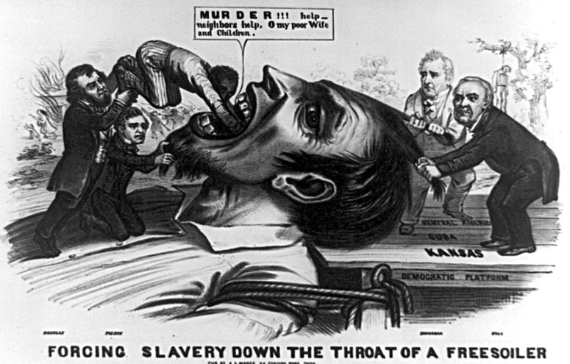
AP US History Unit V: Civil War & Reconstruction
1844 to 1877

Slide 2
Unit Big Questions and Periodization
Periodization => Why 1844? Why 1877?
In 1844 ___________________________________begins
-- Opens last era of United States territorial expansion & questions about slavery in territories
In 1877 _______________________ended w/ Compromise of 1876
-- Civil War had settled question of slavery and Union had been preserved; Southern society, though was left relatively unchanged
Unit Essential Questions . . .
What events, people and actions led to the outbreak of Civil War?
How did the North win the Civil War? What social, political and economic advantages did they have?
War Southern Reconstruction a “revolution” socially politically or economically in the South after the Civil War? How did southerners
How did the Civil War effect US industrial development and settlement in the West? What new laws or actions encouraged western migration and settlement?

Slide 3
US Expansionism up to 1848
During the early 19th century the US engaged in a series of actions (i.e. diplomatic & military) to acquire territory in N. American continent
WHY???
#1: ___________________=> territory in the West had needed resources (i.e. gold, silver, land, etc…) and also gave US access to new markets in Asia
US wanted a Pacific port fro Chinese and Asian trade
#2: ____________________=> US feared acquisition of N American territory by European powers (i.e. Russia, Britain, Spain, France)
Feared that European colonization would stunt American growth and present security threats (i.e. war, territorial claims)
#3: ______________________=> US believed that their civilization was “exceptional” and it was their god given right to expand from “sea to sea”
Idea based on an assumption of white cultural & racial superiority
Exs . . .
-- Whites use land more productively
-- Whites more intelligent than blacks or Natives (industrialization)
-- Christianity is superior to tribal religions

Slide 4
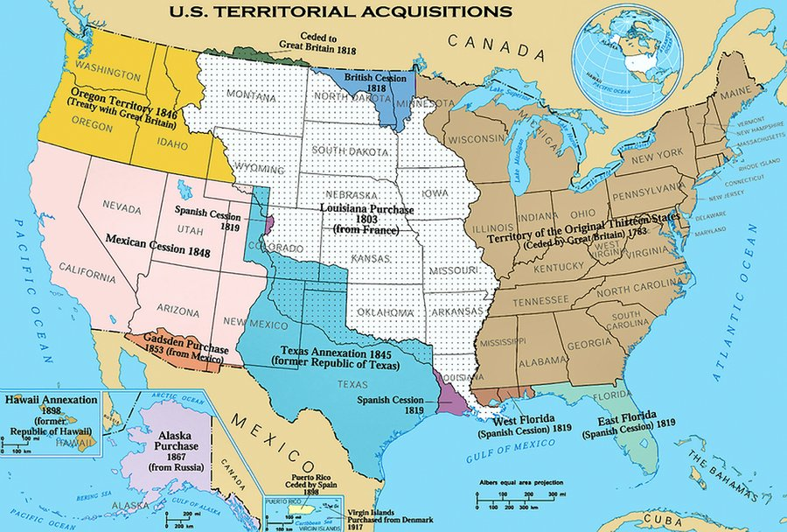
US Expansion – 1800 to 1848

Slide 5
US Expansionism up to 1848
As the US expanded two ideologies emerged as to how the nation should use the new land acquired . . .
Northern view => use land for industrial development and promote free labor in territories (abolitionist influenced)
Southern view => use land to expand cash crop agriculture and slavery (influenced by southern “fire eaters”)
-- Southerners also want to ensure survival of institution by expansion and also preserve political balance in Senate
Series of compromises crafted by gifted politicians (i.e. Henry Clay, Daniel Webster and JC Calhoun) preserved Union during 1800 – 1840
Missouri Compromise (1820) most significant => divided nation into Slave and Free territories after LA Purchase
Others concerning Tariff of Abominations, Natl Bank, etc….
__________________(1846-1848) brought the issue of slavery in the territories up again as large new sections of land were acquired
The war also created huge conflicts on the homefront between Whigs and Democrats due to the way in which it started
** Brief review of Mexican War **

Slide 6
Problems w/ Compromise??? Who “wins”?
-- See quotes

Slide 7
Mexican War (1846-48)
Polk sends John Slidell in 1845 w/ $25M to negotiate purchase of California => Mexicans refuse to even meet w/ him
Mexicans still upset by Texas annexation & other incidents
Polk orders Gen Zachary Taylor into disputed territory near the Rio Grande and tells him to “wait for an attack”
Two US soldiers are killed while getting water => Polk says “despite all of our efforts to avoid it, American blood has been shed on American soil . . . Such actions cannot be ignored.”
** Analysis? => who is at fault? ( see Grant quote)
Some Whigs protest outbreak of war => Abraham Lincoln introduces ____ ____________________ (identify the spot where American blood spilt)
US never loses a battle and captures huge swaths of Mexican territory
Negotiates the Treaty of Gaudalupe-Hidalgo => Mexico recognizes annexation of Texas, cedes to US a vast territory (1/2 of Mexico), pays Mexico $15M and assumes $3.5 M in Mexican claims
Outcome? => US fulfills Manifest destiny, gains international respect, acquires Pacific port and opens trade with China and Japan
Alienates Mexico & Central American countries (US = “collossus of north”)

Slide 8
The Battles of Monterrey and Mexico City
Ulysses S Grant said of the Mexican War => “This war was the most unjust war ever fought by a stronger nation against a weaker one.”

Slide 9
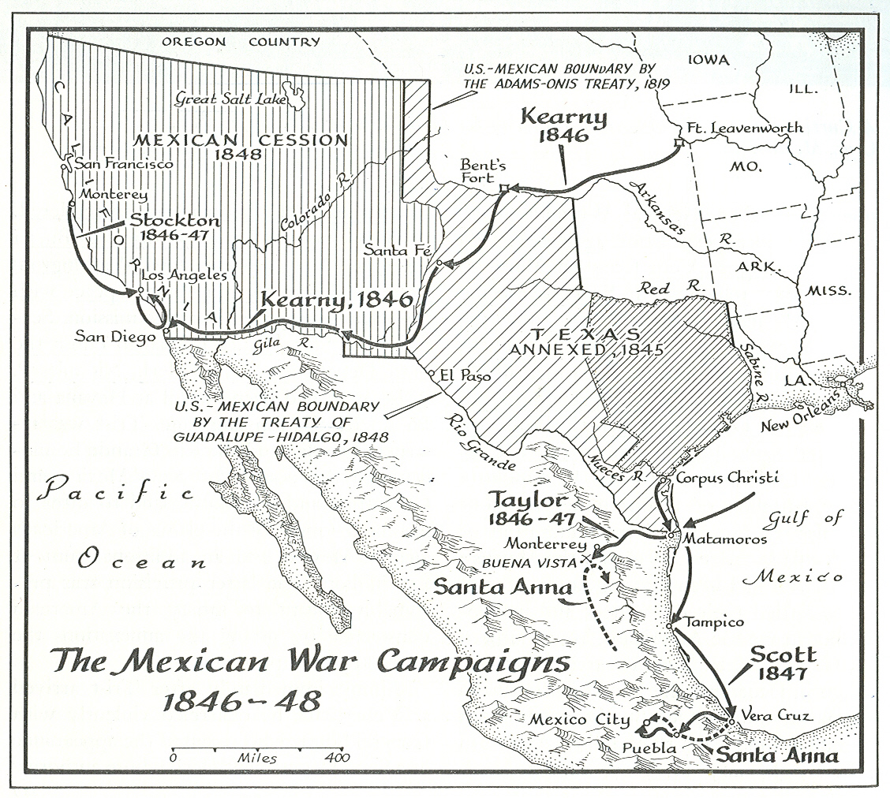
Mexican War Campaigns

Slide 10
Westward Migration
After the Mexican War the US had gained a vast section of territory that contained very few American settlers => the South was anxious that this territory become open to slavery, the North was insistent that it not
** Politics in the 1850’s becomes a constant struggle between the North and South => every issue seems somehow to devolve into slavery **
Settlement came to the new territories much more rapidly than before due to 2 elements:
#1: _______________________=> greatly increased ability of individuals to travel to new territories more easily (see Gadsden purchase)
#2: __________________________________attracted a large number of settlers in their early years as territories
Oregon’s status was up in the air during the 1830’s & 40’s => many settlers arrived(traveling the Oregon Trial) to preserve US claims
California experienced a massive _____________________and people flocked there in the thousands, both to mine and to “mine” the miners (population went from 14,000 to 100,000 in 1 year!!)
Western settlements led to an expansion of Pacific trade => Commodore ____________________________opening of Japan => Treaty of Kanagawa
Allowed US access to Japanese ports => led to modernization of Japan
Unequal treaties also signed with Chinese => gave US “most favored nation status” . . . Favorable conditions for trade (huge Asian markets)

Slide 11
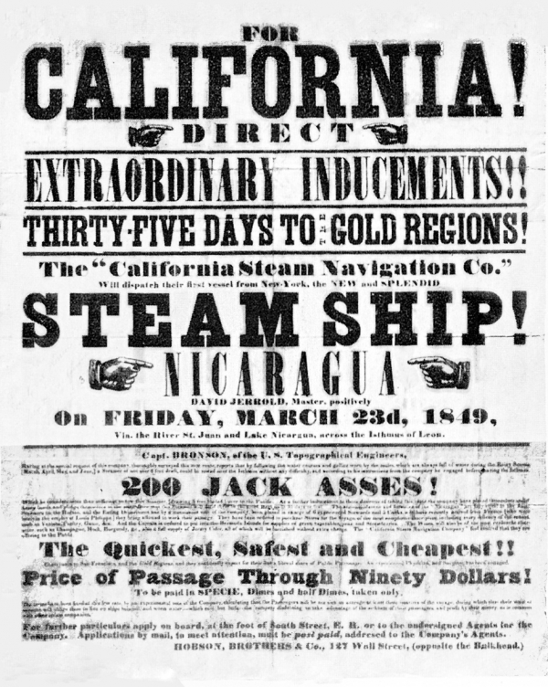
Advertisement for “Gold Fever” in CA

Slide 12
Western Resource Rush
The California Gold Rush was the beginning of the restructuring of the West economically and environmentally
Gold discovered near Pike’s Peak in 1858 => Native treaties re-negotiated to give access to whites (100,000 travel to CO territory)
Silver discovered in 1859 (Comstock NV) => 100,000 to Utah territory
** Mining becomes large industry in Western US => leads to adv. in mining technology (square set technology & Washoe process) **
Leads to degradation of environment in West
Ranching and farming also become major western industries

Slide 13
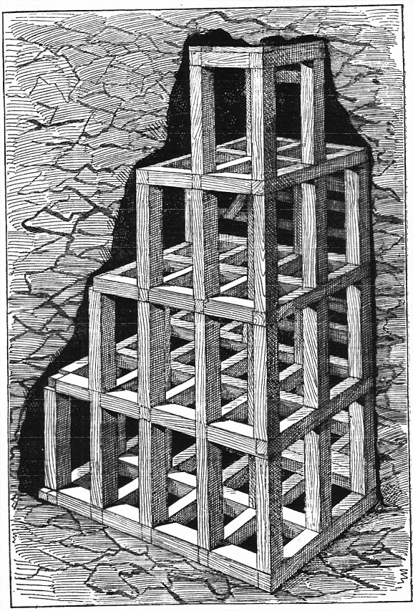
Square Set mining techniques
Square set mining allows miners to open up veins of ore in many directions simultaneously and greatly increases the productive capacity of mines

Slide 14
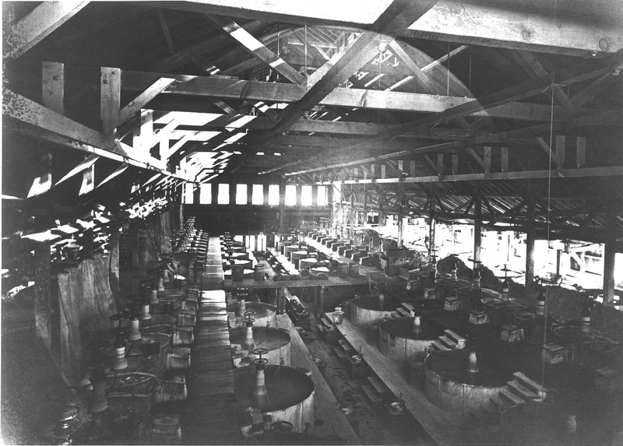
Washoe Process – silver refining
The Washoe process was a variant of pan amalgamation that used mercury and copper sulfate to extract silver from ore => involved the mass application of silver refining in large bins

Slide 15
Slavery in the Territories?
California gained a large # of settlers & reached the 60,000 required for statehood => Cali govt anxious to acquire it due to lawlessness
CA admission as Free Soil state would tip Senate balance to North
The Missouri Compromise (1820) was seen as “outdated” and ineffective => new methods were proposed for the new territories
#1: _______________________=> Suggested by David Wilmont (PA) days after the Mexican War started
Slavery would be outlawed in any territory acquired from Mexico => convinced Southerners that North want to outlaw slavery -- Passed the House but not the Senate
#2: John C. Calhoun’s “Southern position” => territories are not property of the Fed. Govt. but states, so Fed. govt. can’t outlaw slavery
State’s right position => based on Theory of Nullification, etc….

Slide 16
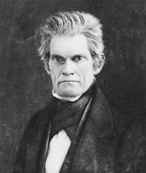
#3: “Polk Compromise” => extend MO Compromise line to the new territories all the way to the Pacific
-- Angered Northern abolitionists and Southerners felt the new territory wasn’t suitable for slave economies
#4: “________________________” => advocated by Lewis Cass and Stephen Douglas (Prominent Northern Senators)
-- Said that new territories would vote for their status

Slide 17
Compromise of 1850
California wrote a Constitution (Free-Soil) and applied for admission to the Union => would tip the balance to the North in the Senate
Southern “fire-eaters” threaten secession
Henry Clay and Stephen Douglas create a series of Compromises designed to satisfy both sections => called “______________________”
Daniel Webster advocates it in his famous “7th of May Speech”, which offends Northerners so much he has to resign as a member of Cabinet
John C. Calhoun argues against it and proposes a “dual presidency” with one executive from the N and one from the S (both w/ veto power)
Eventually after death of Taylor, who opposed Compromise, Millard Fillmore and Douglas were able to secure it’s passage
-- After it’s passage a “Second Era of Good Feelings” occurred where for 3-4 years sectionalism declined and secession talks quieted

Slide 18
Compromise of 1850 (Cont)
“Northern”Terms:
#1: California admitted to the Union as a Free State
#2: Territory in dispute between Texas and N. Mexico goes to N. Mexico
#3: Slave Trade abolished in District of Columbia
“Southern” Terms:
#1: A tougher Fugitive Slave Law allowing no trail for slaves, felony charges for aiding escaped slaves, etc… (~4000 slaves escaped every year)
#2: Federal assumption of Texas’s pre-annexation debt
#3: Congress declaration that it does not have jurisdiction over the interstate slave trade
#4: Allowance of “popular sovereignty” to determine slave status of the rest of Mexican Cession land’s slave status
** Who got the better end of the deal?? Was this a real “Compromise”? Why or why not?? **

Slide 19
US After Compromise of 1850

Slide 20
Leadup to the Civil War – Economic Differences
By the 1850’s the North and South were essentially diametrically opposed societies within the same nation
North = ________________based economy based on _______________
North produced 90% of US manufactured goods
North was also more urbanized (26% of population) and had far more immigrants (23M total population)
Northern industries included transportation (RR, steamships), textiles, leather, iron and firearms (32 times Southern output)
-- North also had mechanized agriculture in staple crops (produced ½ of corn; 4/5 of wheat and 7/8 of oats)
South = cash crop ___________________ economy based on ___________
Produced 2/3 of worlds cotton (cotton exports surpass all other US exports combined)
Had only 10% of manufacturing 25% of RR lines and 13% of banks
South also had few urban areas (10% of population) and little immigration (only 9M people total)
South depended on manual labor with little mechanization => value of slave capital in South exceeded all investments in Northern industries

Slide 21
Leadup to the Civil War – Northern Ideology
North & South also had ideological differences related to labor systems
Minority of Northern abolitionists became increasingly vocal during 1850’s => adopted a variety of visible tactics
#1: ______________________=> series of routes & safehouses used by over 100,000 slaves to escape to North and Canada
-- Fugitive Slave Law of 1793 = Southern officials collect runaways
-- Famous advocates = Harriet Tubman (13 trips & freed 70+ slaves)
#2: ____________________and other abolitionists tracts => the fierceness of advocacy of abolitionists increased in 1850’s
-- Depicted slavery as a moral evil => literature showed impact on families, Christian southerners & portrayed slaveowners as sadistic
#3: Use of violence => _____________became a martyr for abolitionism after his raid on Harper’s Ferry in 1859 (hung after its failure)
-- Attempted to start a slave rebellion in South by seizing Federal arsenal & supplying slaves with weapons (defeated by Robert E Lee)
-- Also used violence in KS to secure its status as a Free Soil State

Slide 22
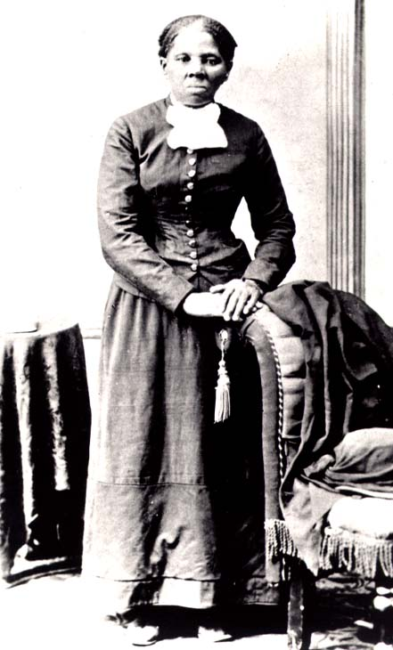
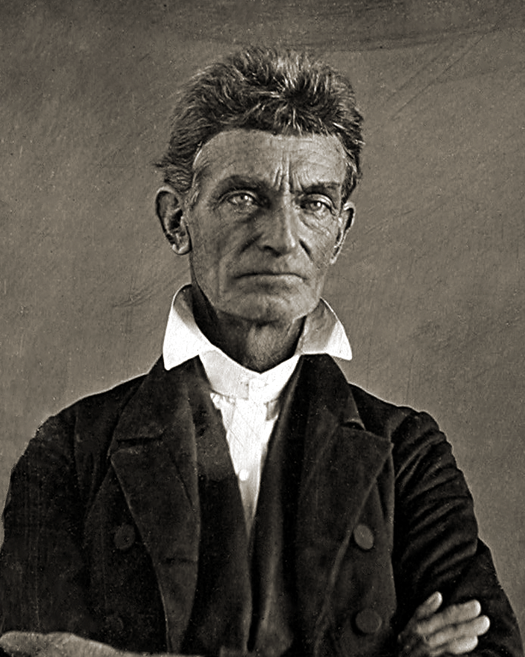
Northern Abolitionists
Harriet Tubman
John Brown

Slide 23
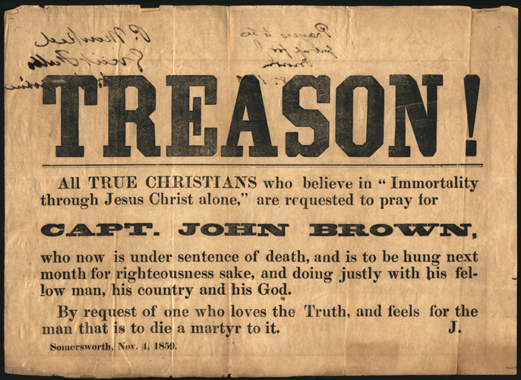
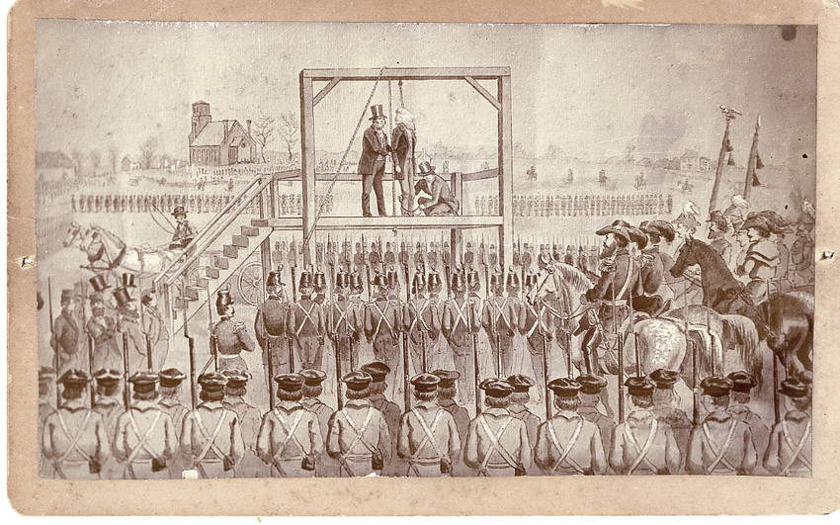
After his arrest and Execution Brown became a martyr for the cause of abolitionism

Slide 24
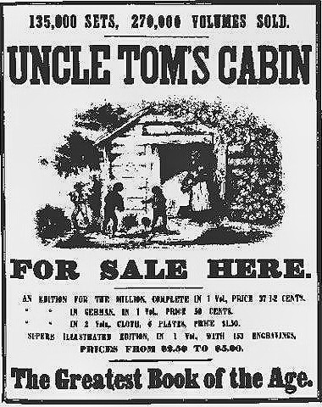
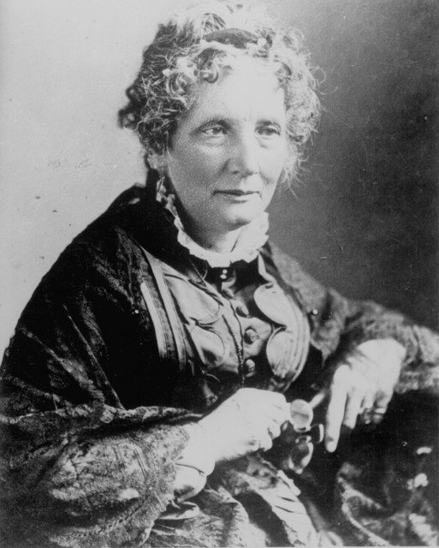
Harriet Beecher Stowe – Uncle Toms Cabin
According to legend, Abraham Lincoln greeted Harriet Beecher Stowe in 1862 by saying "So you're the little woman who wrote the book that started this great war." Whether the story is true or not, the sentiment underscores the public connection between Uncle Tom's Cabin and the Civil War.

Slide 25
Leadup to the Civil War – Southern Ideology
Southerners created an elaborate mythology to portray slavery as a positive good for American society
#1: State’s Right arguments => Calhoun’s Theory of Nullification used to argue that State’s Rights should be supreme
-- Argued this was in tradition of Jeffersonian Democracy
#2: Slavery = moral good (Christianizing and “civilizing” Africans)
-- Conditions were better for slaves than Northern “wage slaves”
-- Slaves were well treated, fed, housed, clothed => part of Southerners’ families (took care of children, etc…)
#3: Racial stereotyping used to portray Africans in negative light
-- ____________________________portray blacks as dim-witted, buffoonish, lazy, musical and happy
-- Shows were popular among all classes and gave many an unrealistic image of slave life, culture

Slide 26
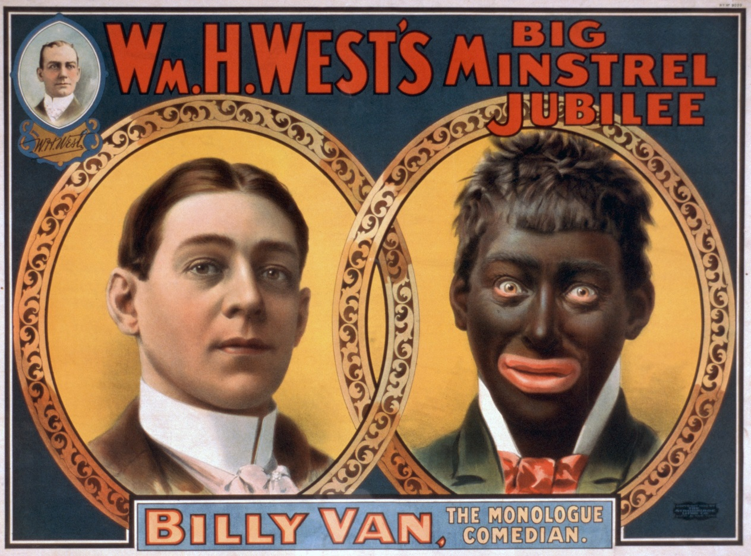
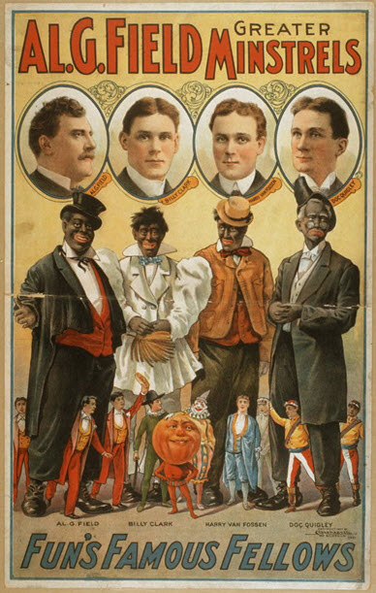
Black Faced Minstrel shows
Minstrel shows were very popular in South and beyond pre-CW => usually involved whites dressing up in blackface to imitate blacks
Stock characters were used => “mammy” black nursemaid; mullatto wench; Southern dandy
Racist depictions of blacks predominated

Slide 27
Kansas-Nebraska Act -- 1854

Slide 28
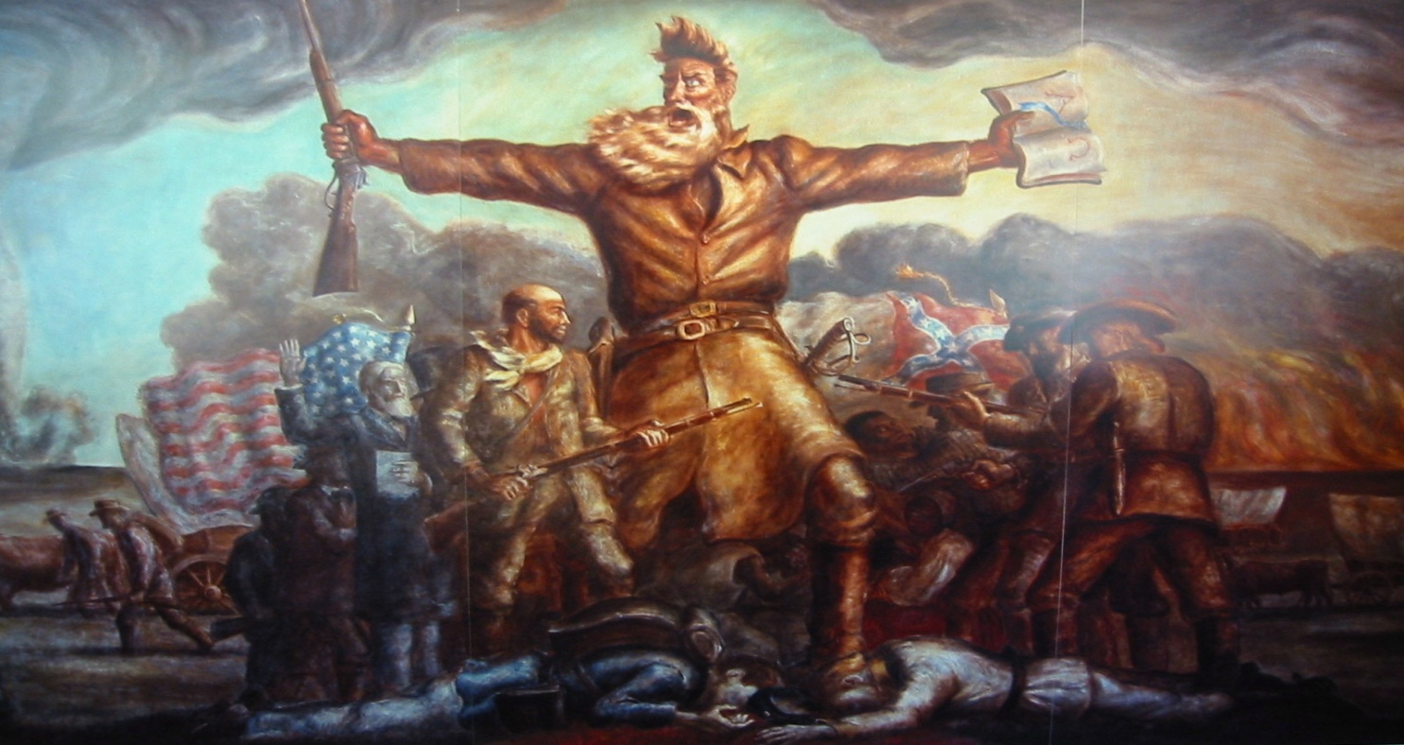
John Brown and Bloody Kansas
John Brown led a group of Free-Soil settlers to Kansas in the 1850’s along w/ the NE Emigrant Aid Society => led to violence against pro-slavery settlers at Pottawatomie Creek in 1854

Slide 29
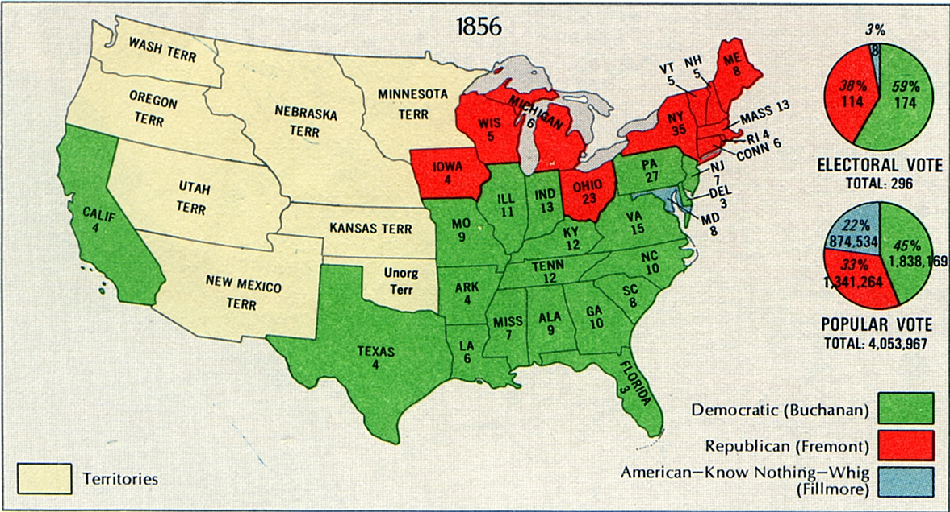
Election of 1856

Slide 30
Outbreak of Civil War
In addition to the many events and individuals that helped lead to the outbreak of war, 3 political factors contributed to its outbreak . . .
#1: Weak Presidential Leadership during the 1850’s
Presidents during the 1840’s and 50’s tended to be either southern or pro-southern northerners => WHY?
Series of weak and inefficient leaders dominated presidency in 1850’s
Zachary Taylor (Whig; 1848) => never held political office before
-- Died two years into office
Franklin Pierce (Democrat; 1852) => “hero of many a bottle”
-- Supported KS/NB Act; strictly enforced Fugitive Slave Act
-- Supported US acquisition of Cuba => failure
James Buchanan (Democrat; 1856) => never married
-- Supported Dred Scott decision; accepted Kansas LeCompton Constitution (slave state); did nothing in face of secession
** “Let spurned sisters go their seperate ways” **

Slide 31
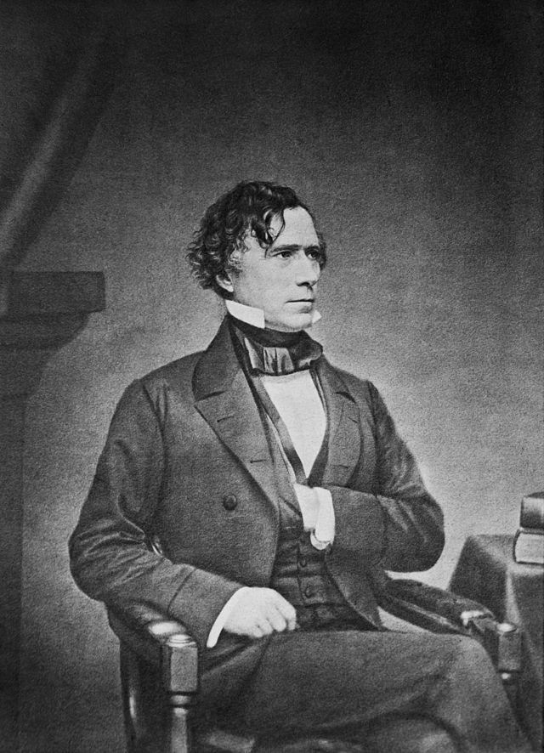
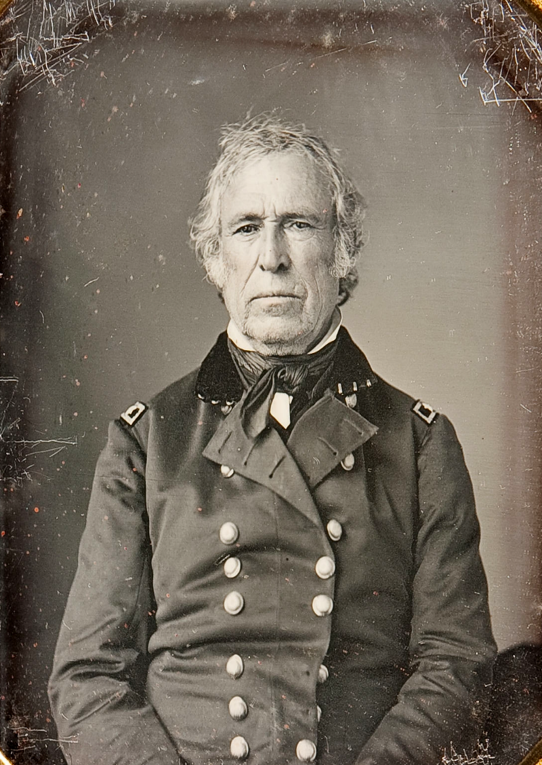
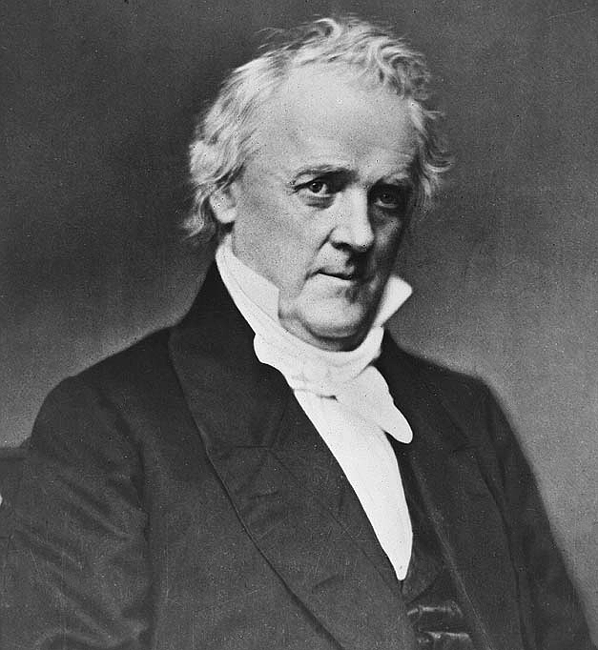
3 of Top Ten Worst Presidents

Slide 32
Outbreak of Civil War
#2: Breakdown of Political Compromise
After death of Triumverate => Webster, Clay and Calhoun leaders in Congress became more extreme sectional and refused to compromise
Compromises also became weaker due to increasing sectional divisions between North and South (1850 vs 1820)
Less concrete and lead to more divisions and conflict
Collapse of 2nd Party system (Whigs and Democrats) also brought slavery to forefront as a political issue
-- 2nd Party system attempted to downplay slavery as an issue
Many events (i.e. KS/NB Act; Dred Scott Decision also destroyed many of older stable compromises => i.e. MO Compromise
Stephen Douglas was not able to fill Henry Clay’s shoes

Slide 33
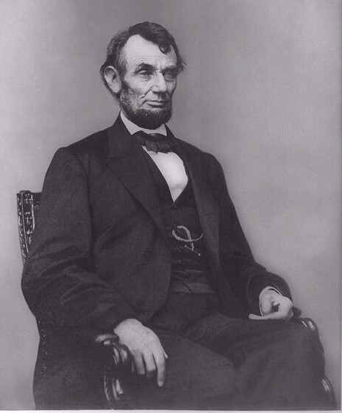
Outbreak of Civil War
#3: ________________________________=> Lincoln elected (Rep) on a Free Soil platform
South threatened to secede if Lincoln elected => feared slow demise of slavery
** Q: Was slavery in peril as an institution? => Democrats control both houses of Congress & Supreme Court (+ Dred Scott)
Weeks later SC, Alabama, Mississippi, Florida, Georgia, Louisiana & Texas secede
Elect Jefferson Davis as President
-- Weak leader, chose a poor cabinet
Form their own Confederate States of America (CSA) => Confederacy
Last ditch effort at compromise (Crittenden Compromise => extend MO Compromise line) failed

Slide 34
Election of 1860

Slide 35
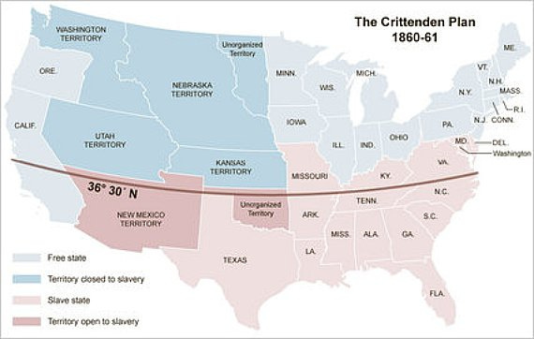
Crittenden Compromise
Crittenden Plan was last ditch attempt to avoid Civil War => Lincoln said he would veto it if it passed . . .Q: Why????

Slide 36
Secession and Civil War ??
When can a State “secede” according to the Constitution??
-- Secession not mentioned but some provisions are:
=> Article IV Section II and III – “Fugitives from Justice must be surrendered to which the state that they have fled.” . . . . “Slaves and apprentices must be returned”
=> Amendment 9 and 10 => “The people retain rights not here enumerated” . . . “Powers not delegated to the Federal Govt. are here reserved to the states and the people”
=> Article III Section III => “Treason shall consist only in levying war against them [US] . . .”
Why didn’t North let the South go??? => Is US really two separate “nations” at this point???
#1: Sets a dangerous precedent
#2: Weakens US in face of European nations
#3: Establishes principle that Democracy “doesn’t work”
#4: Sections “dependent” on each other
#5: What to do w/ Debt? Territories? Boundary? Etc….

Slide 37
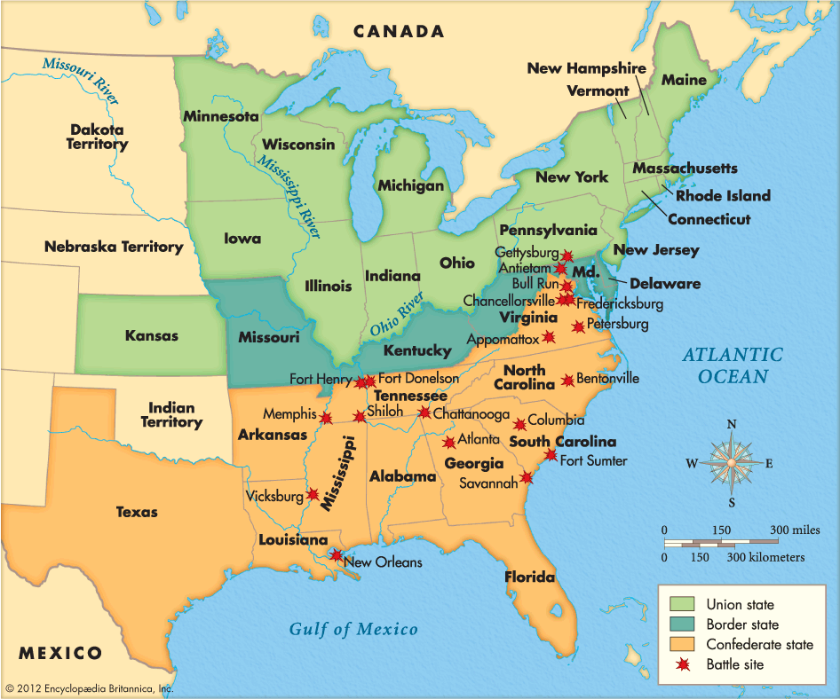
Major Civil War Battles

Slide 38
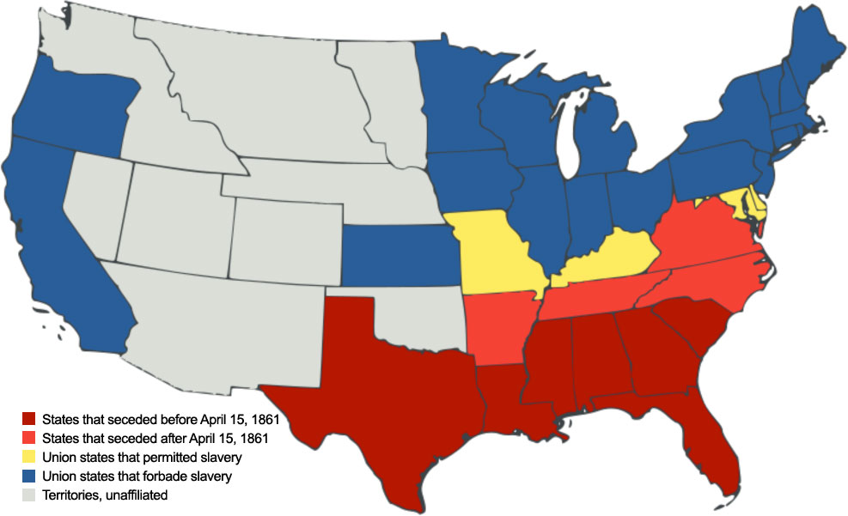
Civil War – Confederacy vs Union

Slide 39
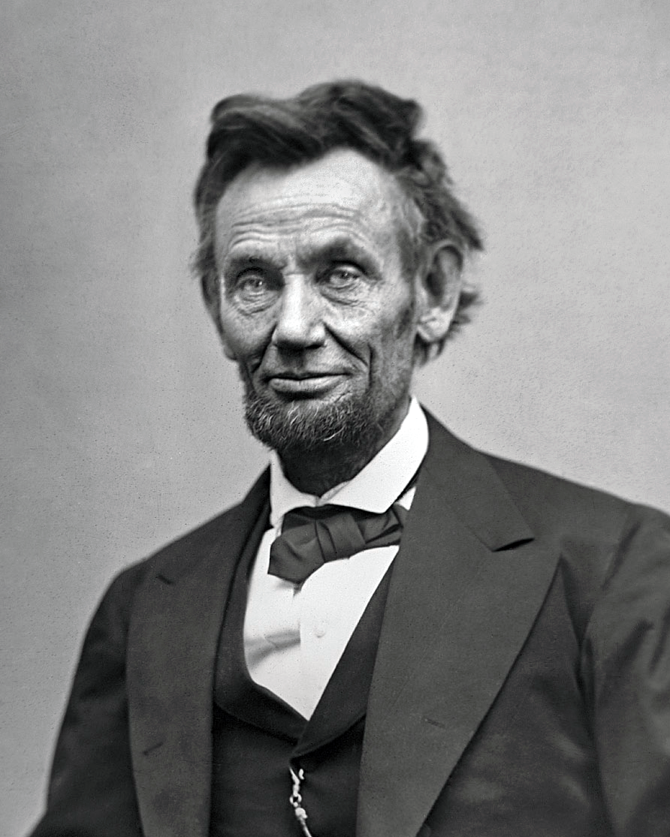
Lincoln’s Objective in CW
“MY Paramount objective in this struggle is to save the Union, and it is not either to save or destroy slavery. If I could save the Union without freeing any slaves, I would do it; and if I could save the Union by freeing all the slaves I would do it; and if I could save the Union by freeing some slaves and leaving others alone, I would do that also.”
-- Lincoln’s reply to Horace Greely on his request for emancipation

Slide 40
Advs/Disadvs in Civil War
Northern States -- Advantages
#1: Far more states (24 vs 11) and population (23 million vs 9 milion) than South => more immigration during war also
As a result only 50% of men served in Union army and 75% + served in Confederate army
#2: Greater manufacturing capacity => North had 90% of manufacturing capacity (textiles, shoes) and produced 32 X more firearms than South
#3: Greater Transportation network => North had 22,000 miles of RR track; 10X more than South (easier to supply and move troops)
#4: North had better political leadership => Lincoln vs Davis
Southern Confederate ideal held back national mobilization
#5: North had larger army and Navy => South had no Navy to speak of and Northern army already established
#6: Controlled Federal territories => resources and manpower
North in general had more wealth and capital than South

Slide 41
Advs/Disadvs in Civil War
Confederate States – Advantages
#1: Superior Military leaders => majority of West Point grads come from South (Robert E Lee, Stonewall Jackson, Longstreet)
#2: Home field advantage – most battle fought in South which gives South a tactical advantage (defensive war also)
#3: Southern military culture – southerners used to firearms and horses and therefore better soldiers
#4: “King Cotton” – South produced 66% of world cotton and believed that Britain and France would aid them due to economic ties
South was held back though by their insistence on state’s rights => difficulty raising revenue, draft, fielding a combined army and trading
Southern economic system (i.e. slave based) did not hold up to war as well => slaves liberated & manpower drain led to lower production

Slide 42
Outbreak of Civil War – April 12th
After states seceded sentiment in North divided => many believed that “Wayward sisters should depart in peace” (i.e. Buchanan)
Lincoln doesn’t “force” war but sends re-supply mission to Federal fort in SC => Fort Sumter (SC considers this an act of war!)
SC attacks fort and galvanizes North to fight => 4 states secede (VA, Arkansas, Tennessee and NC) but MD, KY and MO stay w/ North
Would have doubled manufacturing capacity => Lincoln said, “I would like to have GOD on my side but I must have Kentucky”
Lincoln states war is “preserving Union” to keep border states in and Forg. countries out

Slide 43
Civil War Brief Summary
Major Battles and War => See handout “Noteworthy Battles of the Civil War”, “Coastal Blockade” and “The US during the Civil War”
Lincoln’s War Strategy
After Bull Run and Penninsula Campaign disasters Lincoln resolved privately to end slavery in the South and to a “___________________”
#1: Suffocate South w/ a blockade
#2: Free slaves and undermine economic institution of South
#3: Capture Miss. River and cut Confederacy in half
#4: Send troops through GA and Carolinas to demoralize South
-- Destroy Southern environment and infastructure
#5: Capture Capital of Richmond
#6: Engage enemy wherever possible and kill Southerners
South and Robert E Lee resolved to fight a ___________________and wear down Northern opposition => secure ______________due to Cotton exports
Foreign Intervention during the Civil War
Originally British and French sided w/ Confederates => favored S. social system (aristocracy); relied on S. for raw cotton; wanted to see American democracy fail

Slide 44
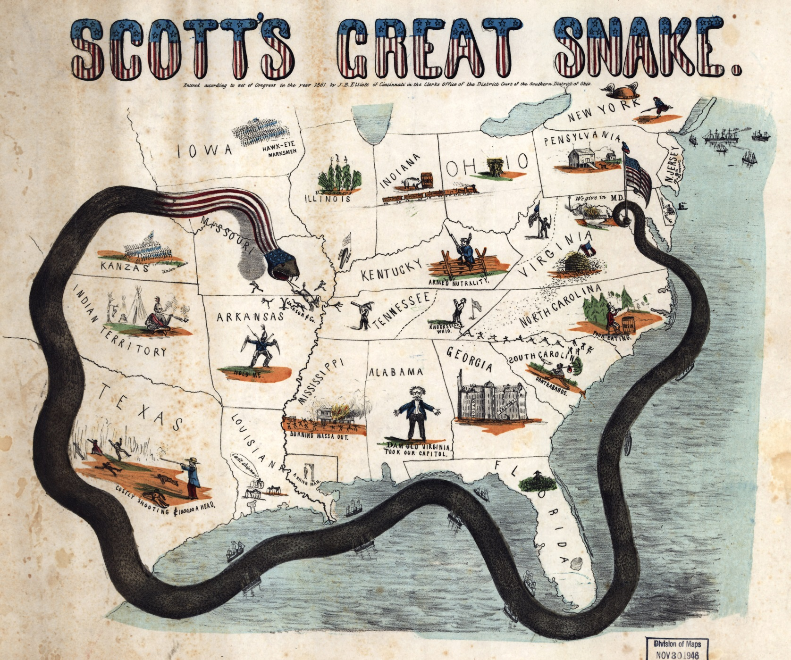
Winfield Scott’s “Anaconda” Plan

Slide 45
Civil War Brief Summary (Cont.)
After Antietam and the_______________________, though both declined to enter a war @ slavery (also working classes in both countries favored the North) => Britain also found other supplies of Cotton in India/Egypt, and refused to make weapons of war for Confederates after Alabama incident
_______________________________________________=> change the tone and ideology of the war => Q: How so?????
Despite “freeing slaves”, Emancipation Proclamation is really a conservative document => Q: What slaves does it actually free? Why???
Drafts and Military Service
Both North & South resorted to drafts in later years of war => Both had draft laws that favored wealthy (Union draft laws allowed “$300 Men” & South allowed slaveholders w/ 20 + slaves exemption)
_________________(1863) => immigrants and working classes revolt against what they consider unfair law (wealthy & blacks exempt)
-- Also feared labor competition from freed blacks

Slide 46
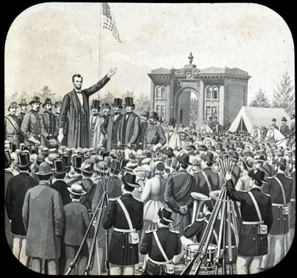
Abraham Lincoln’s Gettysburg Address
“Four score and seven years ago our fathers brought forth on this continent, a new nation, conceived in Liberty, and dedicated to the proposition that all men are created equal. Now we are engaged in a great civil war, testing whether that nation, or any nation so conceived and so dedicated, can long endure.”
-- Abraham Lincoln, Gettysburg Address (November 19th 1863)
Q: The language and ideas expressed by Lincoln in the passage most directly reflect the language and ideas of what other document in US History?
Q: In the passage, Lincoln is drawing upon which continuity and element of American identity to make his case for renewed support in the northern cause during the Civil War?

Slide 47
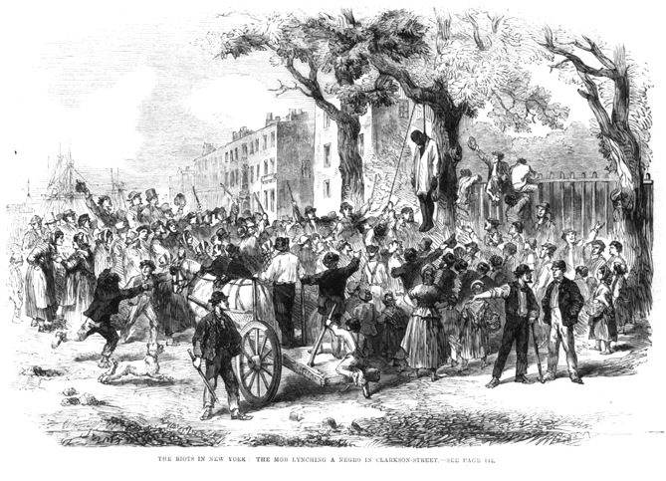
NYC Draft Riots -- 1863

Slide 48
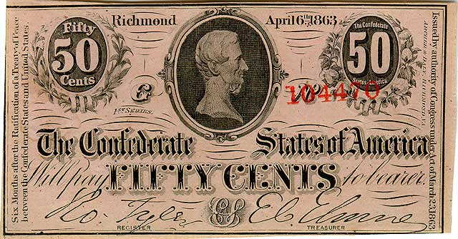
Civil War Brief Summary (Cont.)
Economics of War
Both sides tried to mobilize their economies for war (i.e. Total War)
-- North much more effective => converted factories to war production, gave bonuses for firearm manufacture, transportation aided production
-- South held back by insistence on state’s rights
Financing of war effort
Northern War paid for by Taxes (Income, “sin”, customs), borrowing via bonds, and issuing “______________________” (not backed by Gold)
Southern War paid for by bonds, but “State’s Rights” limited taxes; majority of war paid for by “_________________” which inflated 9000% by 1865
Blacks and War effort
Blacks were allowed to enlist in Northern Army after 1863 (10% of Northern Army!!) => huge manpower bonus at critical time

Slide 49
Lincoln’s Suspension of Civil Liberties
Lincoln has been much criticized for his suspension of Civil Liberties during time of war => Why necessary??? (Lincoln, Wilson, FDR, Bush)
Lincoln concluded that he needed to “tear a few holes in the Constitution . . . And patch them later” ** Opinions?? **
What did he do??
#1: Proclaimed a blockade w/o congressional authority (Supreme Court later ruled Constitutional b/c Congress wasn’t in session)
#2: Increased the size of Federal army w/o Congressional approval
#3: Spending of Federal (2M$$) w/o Congressional approval
#4: Suspended writ of habeas corpus so that anti-Union protestors could be arrested and keep in prison w/o a trial
Arrested anti-Union newspapers editors in North
#5: “Supervised” voting in Border States to ensure loyalty
ALL of the above are Unconstitutional => does this constitute “High crimes and misdemeanors”??

Slide 50
Election of 1864 – Politics during War
The Northern Democrats had divided in two after the outbreak of the war => Pro-War Democrats and Peace Democrats known as “_______________”
Copperheads like Clement Vallandingham spoke against war & committed Treason (attempt to negotiate secession of NW states)
B/c the Republicans feared defeat they combined with the Pro-War Democrats and nominated Dem. Andrew Johnson as VP to attract votes
Dems nominate General McClellan and run on a “Peace” platform
Election was very close and Union soldiers were allowed to vote at front and furloughed home to vote in some cases

Slide 51
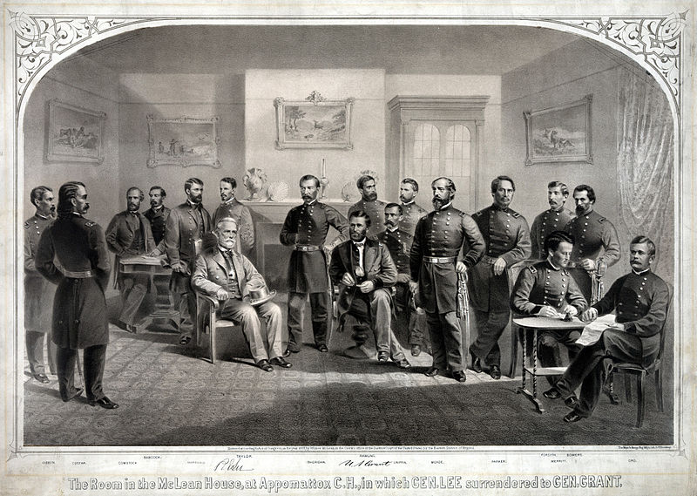
End of Civil War
After 4+ years of war Lee finally surrendered to Grant at Appomattox on April 9th 1865 => war claimed over 630,000 dead w/ over 1M causalties
Why Union victorious?
#1: Greater resources and manpower => economic manufacturing, population, naval ships and transportation infastructure (RR)
#2: Improved military leadership => Grant and Sherman tipped scales to Union near the end of war (South exhausted)
#3: Sherman’s March to Sea => destroyed Southern environment & infastructure; tapped will to fight
#4: Lack of foreign intervention => Lincoln’s diplomatic manuevers (i.e. Emancipation Proclamation) kept foreign nations out of war

Slide 52
Civil War – Results and Consequences
Northern Effects
#1: Huge industrial boom – wartime industries flourish and innovation rewarded greatly => grain exporting began, oil industry in PA
#2: Improved infrastructure and internal improvements => Focus on “transcontinental RR”; leads to large westward migration
#3: Increased expression of “Nationalism” – national government and philosophy dominant now (triumph of Federalism; death of state’s rights)
Southern Effects
#1: Economic Collapse and Ruin => South had 30% of nations wealth in 1860 and only 12% by 1870!!
-- $2B worth of slaves freed, huge war debts, currency worthless, blacks destitute and clueless initially
#2: Social Chaos => social order of “slavocracy” gone
-- “Closed” society shattered, freed blacks homeless and challenge poor whites
#3: Political Anarchy => What will be the status of Southern states that have seceded? Confederate generals and leaders?
-- Almost all Southern leaders are disenfranchised and blacks have no experience
#4: Any attempt to restore order breeds contempt for Union

Slide 53
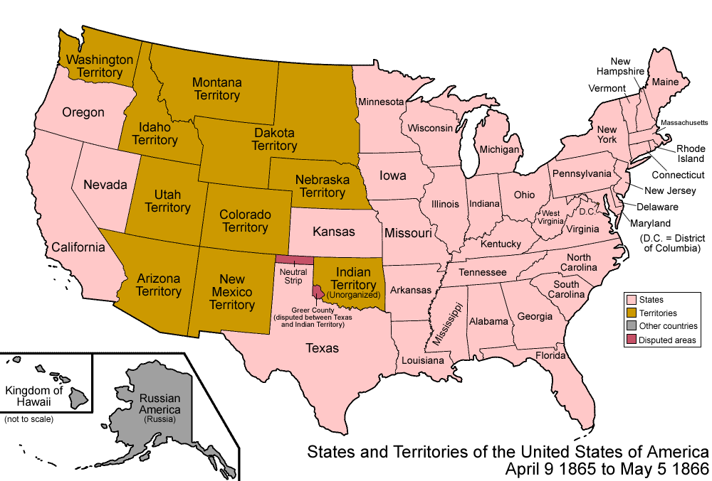
Civil War – Results and Consequences (Cont)
BOTH
Most costly War in national history w/ 600,000 + dead!!
War cost over $15 Billion dollars directly !!!
State’s Rights Constitutional position crushed
Democracy “works” => British Parliament passes English Reform Bill 2 years later

Slide 54
Lincoln’s Assasination -- 1865
On April 15th, 6 days after Confederate surrender, Lincoln was assassinated at Ford’s theater by John Wilkes Booth (later executed
The other two elements of the plot, to kill VP Johnson and Sec. of State Seward both failed => Booth hoped to throw Union govt. into chaos and give South another chance to declare independence
Lincoln was seen as a martyr for the cause of Union

Slide 55
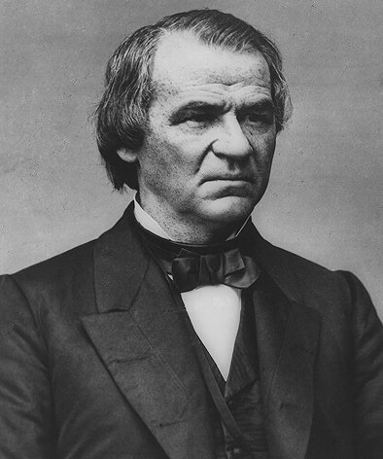
Andrew Johnson as President
Came from very humble beginnings => poor NC family, orphaned young and never attended school
Grew up a tailor’s apprentice
Advocate of poor white farmers and refused to secede w/ Tennessee in 1861
Governor of Tennessee after it was captured by the Union in 1863
Very stubborn man w/ little charm, hated by the South and distrusted by the North

Slide 56
Reconstruction Period – 1865-1877
South was in total ruins socially, politically, economically, – most white Southerners refused to admit “defeat” & scorned the North
See HW Assignment => “Letter to My Old Master”
Most blacks had no idea what to do and a lot of slaveowners refused emancipation initially
A good deal of blacks moved out of the South at this point (Exodusters moved to the West to escape discrimination and KKK) for various reasons and the South experienced great population shifts
Many also turned to religion to help the transition
Huge argument erupted among Republicans about how to “Reconstruct” the South => (i.e. had the South ever really “left” the Union??)
With Lincoln dead Radical Republicans clamored for vengence => Johnson agreed w/ ____________________of “Individual Rebellion”:
1) 10% of all voters must take oath of allegiance
2) Certain Confederates disenfranchised ($20,000 + of property)
3) State conventions to repeal secession and ratify_______________

Slide 57
Early Political/Social Reconstruction
_________________________(1865) was created to aid blacks in their new life
Goal = “provide food, clothing, medical care, education to freedmen and white refugees”
-- Real success = education => denied to blacks during slavery
“40 acres and a Mule” => each freedmen was to receive land confiscated from Confederates to begin their lives
-- Few actually did b/c of corruption and collaboration w/ white former slaveowners (only 20% gained any land)
Black Codes
-- First laws passed by new S. Govts. were Black Codes (i.e. old Slave Codes)
1) Forbade Black assembly w/o whites
2) No right to bear arms
3) Home b/f sunset
4) No black businesses
5) Forbade owning property 6) Can’ travel w/o permit
7) Strict labor contracts
8) Can’t sue whites
9) Can’t marry or date whites (miscegenation)

Slide 58
Early Political/Social Reconstruction (Cont)
_______________=>< most slaves were forced into the sharecropping system and were trapped in the cycle of debt for decades
Income rose by 46% until 1877 then fell dramatically => blacks buy supplies & food from “County Store” w/ interest of up to 50%!!
In 1865 when Congressional role call announced many “old Confederates” show up to represent their states
House and Senate refuse to seat many of them and embark on “Radical Reconstruction”!!

Slide 59
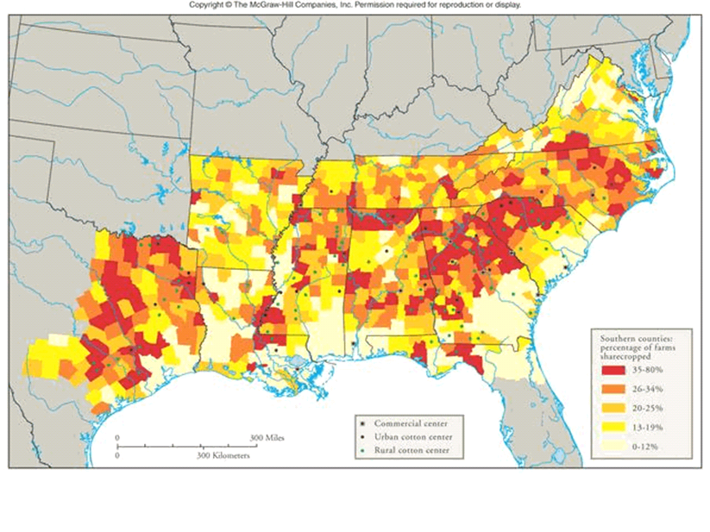
Sharecropping in the South (~1880)

Slide 60
Congressional or “Radical Reconstruction”
Republican Congressional Leaders like Thaddeus Stevens (“State Suicide”) and Charles Sumner took over Reconstruction after 1866
Believed South was a conquered Territory and Reconstruction, “must revolutionize Southern institutions, habits and manners . . . The foundations of their institutions must be broken up and relaid”
Radicals took full, veto proof control of Congress after 1866 and pushed through an entirely different program for Reconstruction
Passed the __________(equal protection amendment) and _________Amendments (blacks males gain voting rights)
-- Insisted that any reconstructed state accept them (even though many Northern states didn’t allow blacks to vote!)
Reconstruction Act => divided the South into 5 military districts to be administered by military generals and soldiers!
-- In order to be readmitted states had to ratify all amendments and establish free state governments w/ black representation
Radicals impeached Johnson when he tried to slow down programs

Slide 61
Johnson Impeachment
Power struggle between the Executive and Legislative branches
Why???
#1: Johnson was a Democrat and vetoed many of Radicals programs
-- I.E. Freedmen’s Bureau and Civil Rights Bill
#2: Johnson favored Lincoln’s “lenient” 10% program
#3: Tensions were rising in the nation over Reconstruction
How??
Republicans passed the Tenure of Office Act => Johnson can’t remove a Cabinet official w/o Senate approval
-- Supreme Court declares unconstitutional 26 years later
Johnson vetoes it and Congress overrides them; then Johnson removes his Secretary of War Edward Stanton (spy for Radicals)
Congress says Johnson violated a congressional law and Impeaches him
Senate keeps him in office by 1 vote!
-- Johnson promises to go along w/ Republicans if they let him stay
** Who “won” here?? Results?? (Decades of “Weak” Presidents and dominant Congresses!!) **

Slide 62
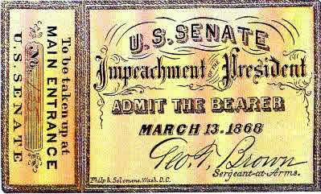
Andrew Johnson’s Impeachment

Slide 63
Southern Age of Reconstruction Governments
Governments dominated by Republicans due to voting restrictions
“Republicans” consist of Scalawags, Carpetbaggers, Freedmen
-- _________________= southerners who aided Reconstruction Govts
-- _______________________= northerners who worked w/ govts
Blacks formed the ________________to help them organize politically => Northern whites and church supported helped to elect black Republicans
-- Hiram Revels, Blanche Bruce
Accomplishments
A. Public Education established
-- By 1876 majority of whites and 40% of blacks in schools
B. Land Redistribution
-- Limited as a lot of whites lost land due to tax and war debts
-- 20% of blacks gained land ownership and rest sharecroppers
C. Income/Job growth
-- White income down 35%; black income up 46% => this reversed after northern military presence left in 1877
Evaluation => Governments never dominated by blacks and were subject to the same type of corruption that was rampant during the period

Slide 64
African Americans in Office 1870–1876
State | State Legislators | U.S. Senators | U.S. Congressmen
Alabama | 69 | 0 | 4
Arkansas | 8 | 0 | 0
Florida | 30 | 0 | 1
Georgia | 41 | 0 | 1
Louisiana | 87 | 0 | 1*
Mississippi | 112 | 2 | 1
North Carolina | 30 | 0 | 1
South Carolina | 190 | 0 | 6
Tennessee | 1 | 0 | 0
Texas | 19 | 0 | 0
Virginia | 46 | 0 | 0
Total | 633 | 2 | 15

Slide 65
End of Reconstruction -- 1876
After the Johnson incident and the backlash from the 15th amendment the Radical Republicans lose a lot of influence
Stevens and Sumner die in the early 1870’s
Women’s rights movement very divided over CW amendments
-- Stanton & Susan B Anthony advocated for 13th amendment
-- Both advocated against 14th and 15th amendments => inserted word “male” into Constitution (no voting or equality for women)
White leadership re-emerges in the South
#1: ________________restores all Confederates and Whites to power except 500 top Confederate officials
#2: _________formed by many former Confederates who could not stand the sight of former slaves as their “rulers” => i.e. Nathan Bedford Forest
Used fear, intimidation & violence to “keep blacks in their place” (i.e. not voting) => thousands of blacks lynched during Reconstruction
Congress passed the Force Acts in 1870/71 to deal with this, but they could not totally rid South of this

Slide 66
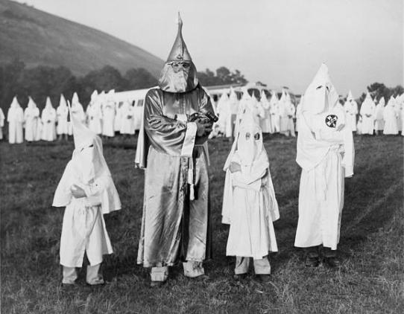
KKK – a Generational issue

Slide 67
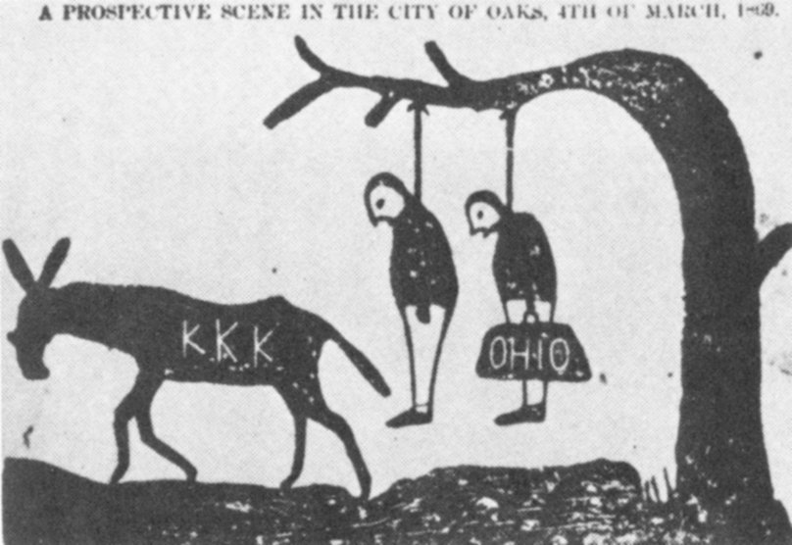
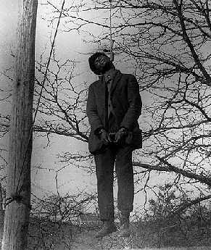
Lynching in the South Post CW
From 1870 to 1960 over 3500 blacks were lynched in the South

Slide 68
End of Reconstruction -- 1876
#3: Many counties formed “_____________” to organize whites to vote Democratic => “Solid South” votes democratic for 70 years!!
Institute “grandfather clauses” and “poll taxes” on voting
#4: Loans/Jobs only granted to blacks who “did as they were told”
#5: _________________were passed after Reconstruction ended
Legalized segregation => separate facilities for blacks (schools, restaurants, buses, cemeteries, asylums, pool halls, LL fields)
Judged constitutional in Plessy vs Ferguson (1896) case => “separate but equal”
** Although initially not used in the South to promote equality & freedom 14th amendment has been used in modern times to argue for . . .**
Equal rights for same women (voting, education), Hispanics and other minorities, Native Americans (AIM movement), Americans with Disabilities (ADA Act and education) and same sex marriage

Slide 69
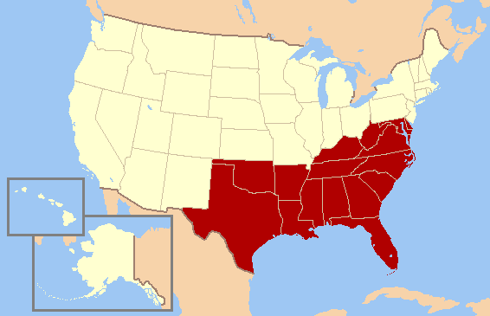
The Solid South
From 1880 to 1940 nearly every electoral vote cast fro President in the red area was cast for Democratic candidate => Q: WHY?

Slide 70
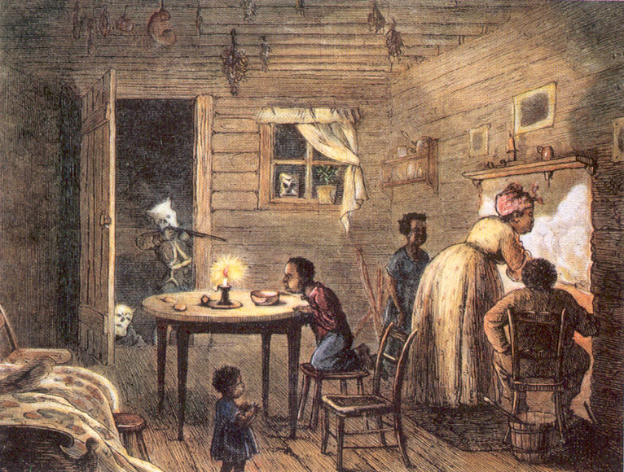
End of Reconstruction (Cont)
General Loss of commitment in the North after 10 + years
#1: Industrial Revolution booming and North wants to make some $$$$
#2: Northerners disillusioned with “incompetent” Southern govts =>
ex: LA governor “saves” $100,000 in 1871 on a salary of $8000
#3: Westward migration brings Native problems which distract focus
#4: Republicans lose power in Congress in 1874 due to Grant adm. scandals and economic Panic of 1873

Slide 71
Reconstruction Evaluated
Many Republicans lamented Reconstruction as a “Lost Cause” because still in the South as one black put it, “The blacks eat, sleep, move, live, only by the tolerance of whites, who hate them. The blacks own absolutely nothing except their bodies; their former masters own everything and will sell them nothing. If a black man draws even water from a well, he must first get permission of the white man, his enemy . . . And the whites are determined to only give him work on such terms as will make him a serf and impair his liberty”
Was Reconstruction a “Success” or a “Failure”? Was the South “reconstructed or resurrected”? Why?
Were the events of 1860-1876 a “Revolution”? Why or why not?
1996 DBQ

Slide 72
Thomas Nast’s View of Reconstruction

Slide 73
Election of 1876
Election signaled the end of the Reconstruction Era
Democrats (united) => Nominate Samuel Tilden; famous for arresting and prosecuting Boss Tweed in NYC
Ran on platform of Civil Service Reform and end to Reconstruction
Republicans (divided) => Nominate Rutherford B. Hayes; CW veteran
Election featured 20 “disputed” electoral votes in states of Florida, South Carolina, Louisiana, and Oregon
All states submitted two sets of returns but Constitution doesn’t specify who opens?? (Speaker = Democrat; Senate = Republican)
Three days before President takes office a deal is worked out:
#1: All federal troops removed from SC and LA (Reconstruction over)
#2: Democrats given place at “Spoils Table”
#3: Congress will give subsidy to Texas-Pacific RR
Republicans abandoned the Southern Blacks and white rule set in w/ blatant black disenfranchisement and discrimination

Slide 74
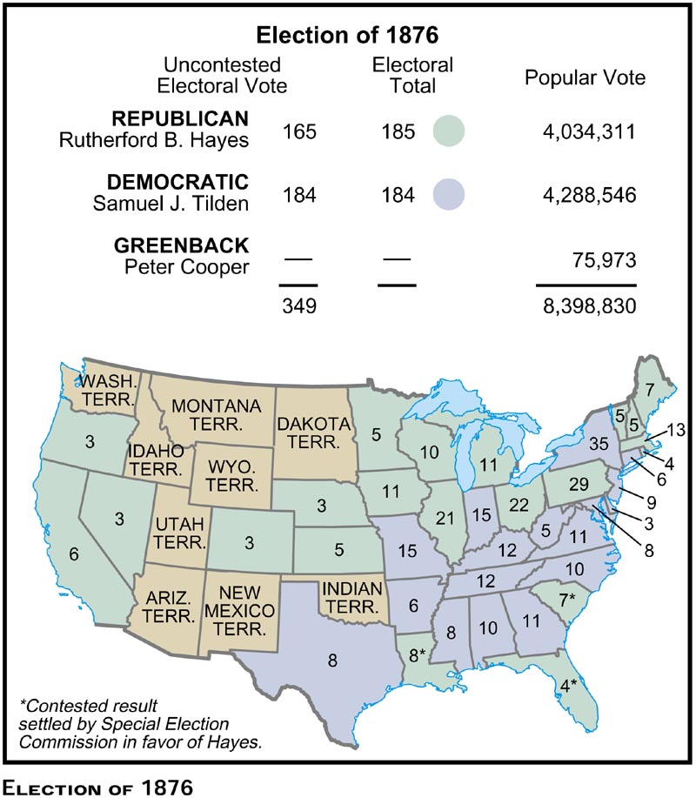
Election of 1876

Slide 75
Post Civil War National Economic Development
W/O S. Democrats in Congress Lincoln & Republicans were able to pursue policies encouraging greater National Economic development
#1: ______________(1862) – 160 acres given to farmers who farmed land for 5 yrs (led to massive Western movement after the war)
#2: Morrill Protective Tariff (1861) – Raised tariff 10% ($$ went to internal improvements) to offer further protection for industry
#3: ___________________(1862) – Gave federal land to states for engineering, agricultural & military colleges (i.e. Penn State, MIT)
#4: Annexation of Alaska ($7.2 million) and Wake Islands (1867)
Reviled at the time as “Seward’s Icebox”=> rich land in terms of resources (i.e. gold, oil, timber)
#5: ________________(1862) – Made Federal land grants & financing available to railroad companies; standardized RR gauges
Led to introduction of transcontinental RR in US (5 by 1900)
RR work was high paying (and dangerous) and offered opportunities for immigrants (Irish) to earn a living and travel west
-- Large percentage of RR workers building transcontinental RR were Asian (Chinese) due to difficult economic times in Asia

Slide 76
Pacific Railway Act and Federal Land Grants

Slide 77
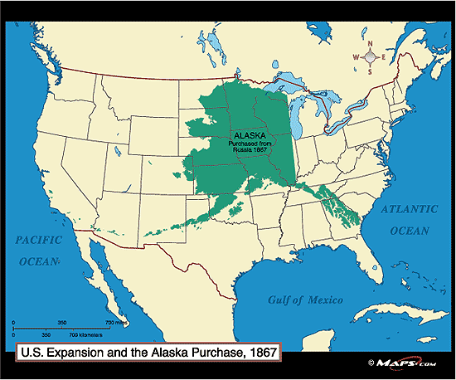
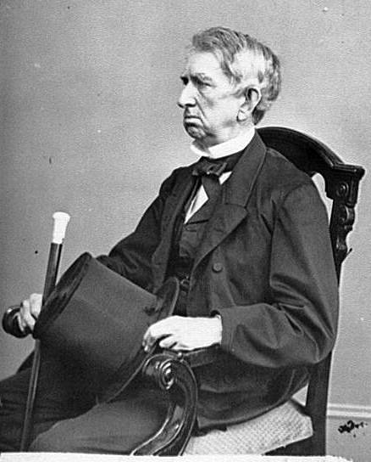
Alaskan Purchase Treaty -- 1867
US purchased Alaska from Russia in 1867 for $7.2 M => reviled at the time as “Seward’s Icebox”

Slide 78
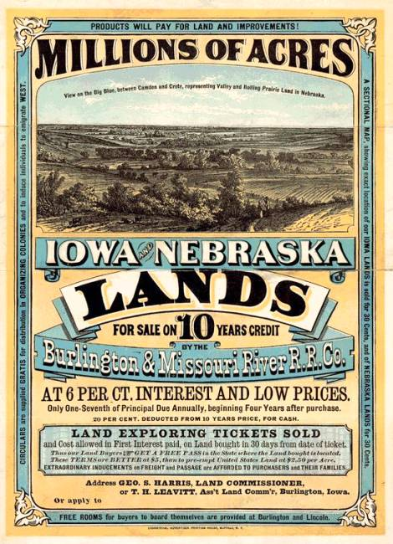
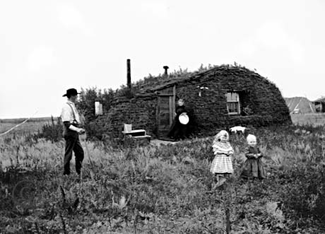
Homestead Act -- 1862

Slide 79
Impact on Natives and Hispanics
Due to generous and effective government policies Western migration accelerated after the Civil War => induced by National Economic policies
In 1827, the US govt speculated to displaced Natives that it would take “500 years for Americans to fully settle the vast American West”
Settlers came into conflict with peoples already living in areas of the West => Natives and Hispanics
Natives
Great Plains tribes like the Cheyenne, Apache & Sioux had lived nomadic lives for centuries hunting buffalo & gathering food
US government attempted to gain cooperation from tribes in the 1850’s by granting tribes their own plots of land (reservations); loss of culture
-- Sioux = Dakotas; Apache = New Mexico
Whites often broke promises when resources were found on Indian land (i.e. Dakota gold rush of 1890’s) & resigned treaties many times
-- White settlers also participated in massacres of peaceful Natives => ____________________________ (1864)
-- Some Natives became very militaristic and refused to cooperate => i.e. ________________________led rebellions against US Government
-- Plains Indian wars begun to remove Natives from West by force

Slide 80
The “Closing” of the West

Slide 81
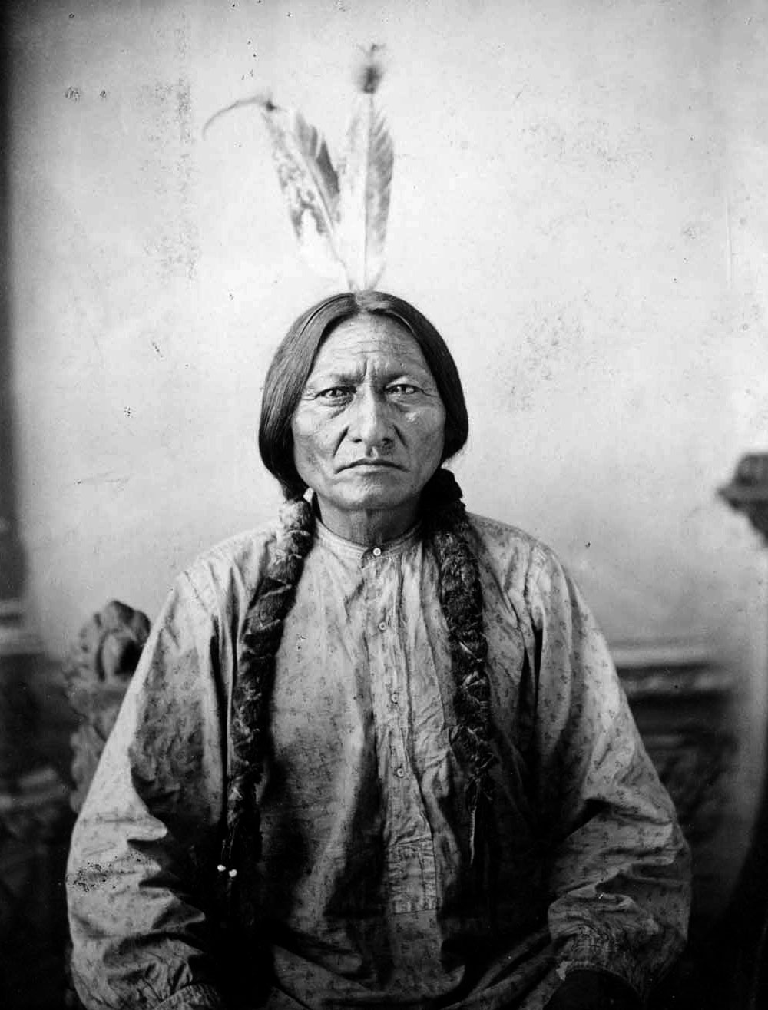
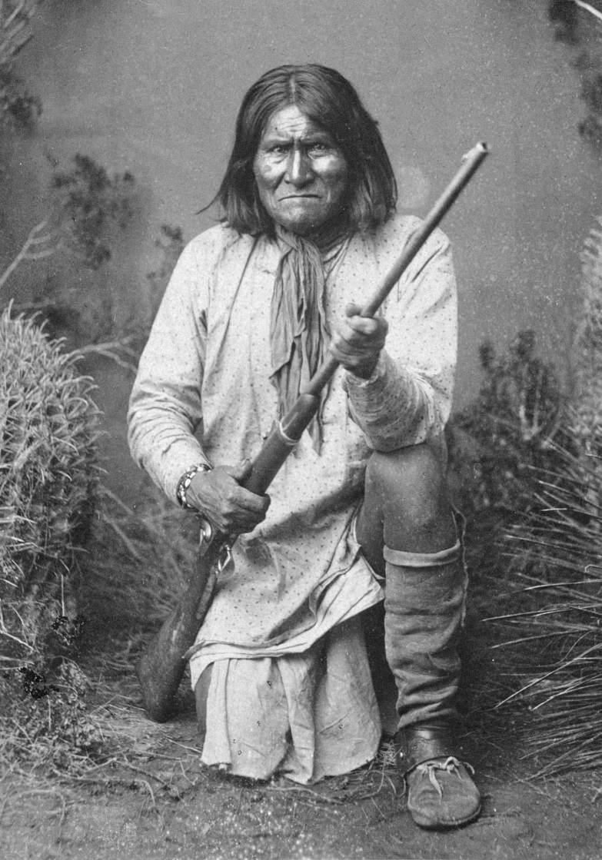
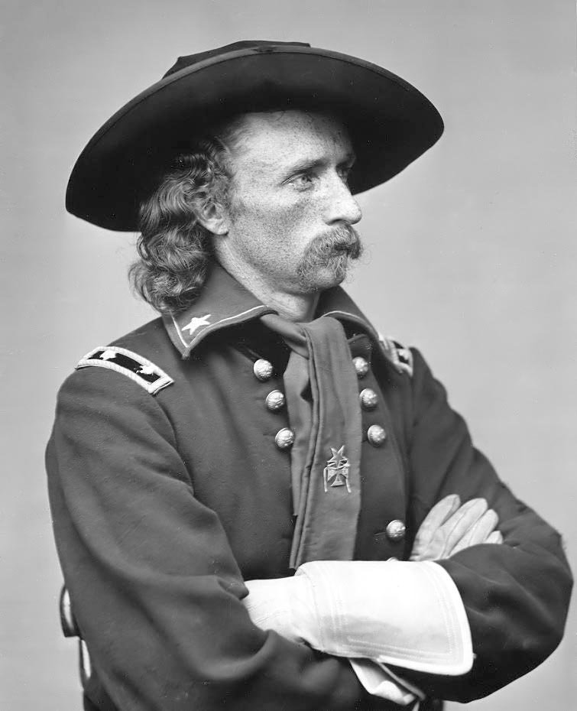
Sitting Bull & Geronimo
Sitting Bull Geronimo General Custer

Slide 82
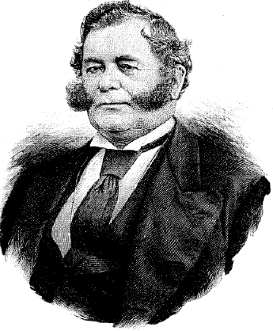
Impact on Natives and Hispanics
During the mid 1800’s, Spanish power declined in the American West
Spanish missions were replaced by the ___________________as the ruling entity
-- Californios like Mariano Vallejo occupied positions of power in California
Californios amassed huge estates => ranchos & controlled key govt positions
-- Ranchos were large farms (livestock) run by Native slaves
After US victory in MX War the Californios were replaced by white settlers
-- Economy moved away from pastoralism => Mining, agriculture, trade
-- Despite support of US philosophies, Californios lands were confiscated and turned over to whites (Mariano Vallejo owned 50,000 acres but died w/ 200)
Mariano Vallejo

